Slide 1
Resequencing and Variant Calling
Joshua Randall
Human Genetics Informatics
Wellcome Trust Sanger Institute
Thanks to Thomas Keane (WTSI Vertebrate Resequencing) for the use of his slides
Many more slides from Thomas can be found at: http://www.slideshare.net/thomaskeane

Slide 2
Resequencing and Variant Calling
Sequence Alignment
Lab Exercises: Mapping
Alignment Post-processing
SNP/indel Calling
Lab Exercises: Calling

Slide 3
Sequence Alignment
Sequence alignment in NGS is
Process of determining the most likely source within the reference genome sequence from which the observed DNA sequencing read is derived
Principles and approaches to sequence alignment have not changed
Basic Local Alignment Search Tool (BLAST)
‘Seed and extend’ approach
Query sequences vs. larger database of sequences
Split query sequences into short sequences (~10bp) and search for locations where these cluster in the larger database of sequences
Nucleotide blast, protein blast, blastx, tblastn, tblastx….
NGS: Nucleotide based alignment
Very small evolutionary distances (human-human, strains of the reference genome)
Allows for assumptions about the number of expected mismatches to speedup alignment programs
NGS has just massively scaled up a challenge that has existed since the inception of bioinformatics

Slide 4
Hash Table Based Alignment
All hash table based algorithms essentially follow the same seed-and-extend paradigm
K-mer is a short fixed sequence of nucleotides
Typical algorithm
Build a profile (index) of all possible k-mers of length n and the locations in the reference genome they occur
Several Gbytes in size for human genome
Foreach sequence read
Split into k-mers of length n
Lookup the locations in the reference via the index (seed phase)
Pick location on the genome with most k-mer hits
Perform Smith-Waterman alignment to fully align the read to the region
Output the alignment of each read onto the reference in BAM (or equivalent) format
Hash of the reads: MAQ, ELAND, ZOOM and SHRiMP
Smaller but more variable memory requirements
Hash the reference: SOAP, BFAST, Mosaik, SMALT, SNAP, Stampy, NovoAlign
Advantage: constant memory cost

Slide 5



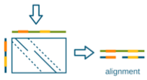
Hash Table Based Alignment
Sequencing reads
Kmer hash
Reference Genome

Slide 6
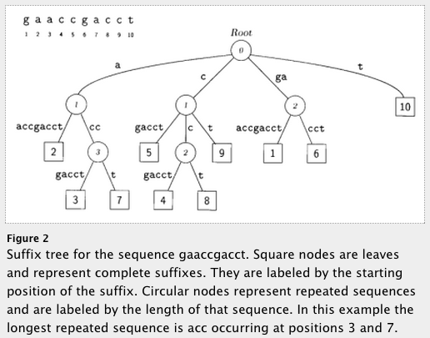
Suffix Trie/Array Based Aligners
Data structures to enable fast string matching
A suffix trie (or simply trie), is a data structure that stores all the suffixes of a string, enabling fast string matching (at the expense of space). A similar data structure is the FM-index, a suffix-array-like data structure based on a Burrows-Wheeler Transform (BWT) which is much more space efficient.
FM-Index based
Small memory footprint
Examples
MUMmer, BWA, SOAP2, Bowtie
Still require a final step to generate local alignment
Delcher et al (1999) NAR
Notes:
needs work

Slide 7
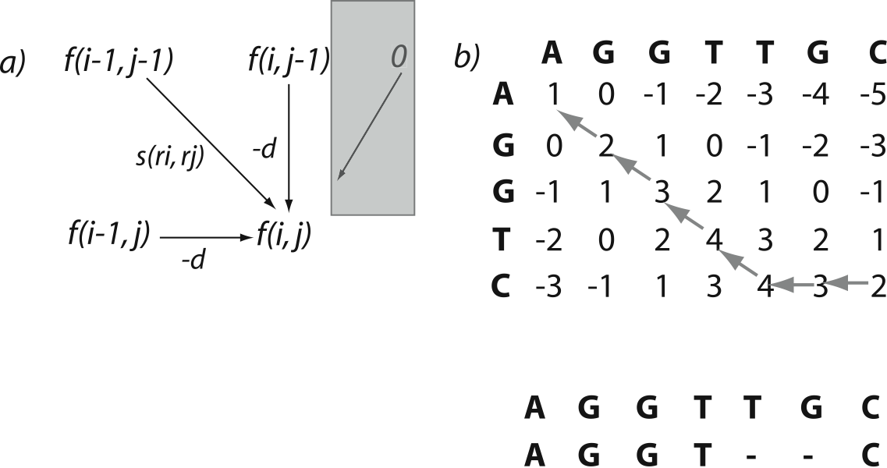
Smith-Waterman Alignment Algorithm
Two similar dynamic programming algorithms for generating the optimal pairwise alignment between two sequences
Time consuming to carry out for every read
In NGS, only applied to a small subset of the reads that don’t have an exact match
Important for correctly aligning reads with insertions/deletions
 | A | G | G | T | T | G | C | A
A | 1
G
G
T
C
A
Max:
Match score (s): +1
Mismatch score (s): 0
InDel penalty (-d): -1
A | G | G | T | T | G | C | A
A | G | G | T | C | - | - | A
Notes:
Match/mismatch = +1
Indel = -1

Slide 8
Smith-Waterman Alignment Algorithm
Two similar dynamic programming algorithms for generating the optimal pairwise alignment between two sequences
Time consuming to carry out for every read
In NGS, only applied to a small subset of the reads that don’t have an exact match
Important for correctly aligning reads with insertions/deletions
 | A | G | G | T | T | G | C | A
A | 1 | 0
G | 0 | 2
G
T
C
A
Max:
Match score (s): +1
Mismatch score (s): 0
InDel penalty (-d): -1
A | G | G | T | T | G | C | A
A | G | G | T | C | - | - | A
Notes:
Match/mismatch = +1
Indel = -1

Slide 9
Smith-Waterman Alignment Algorithm
Two similar dynamic programming algorithms for generating the optimal pairwise alignment between two sequences
Time consuming to carry out for every read
In NGS, only applied to a small subset of the reads that don’t have an exact match
Important for correctly aligning reads with insertions/deletions
 | A | G | G | T | T | G | C | A
A | 1 | 0 | 0 | 0 | 0 | 0 | 0 | 0
G | 0 | 2 | 1 | 0 | 0 | 1 | 0 | 0
G | 0 | 1 | 3 | 2 | 1 | 1 | 1 | 0
T | 0 | 0 | 2 | 4 | 3 | 2 | 1 | 1
C | 0 | 0 | 1 | 3 | 4 | 3 | 3 | 2
A | 1 | 0 | 0 | 2 | 3 | 4 | 3 | 4
Max:
Match score (s): +1
Mismatch score (s): 0
InDel penalty (-d): -1
A | G | G | T | T | G | C | A
A | G | G | T | C | - | - | A
Notes:
Match/mismatch = +1
Indel = -1

Slide 10
Smith-Waterman Alignment Algorithm
Two similar dynamic programming algorithms for generating the optimal pairwise alignment between two sequences
Time consuming to carry out for every read
In NGS, only applied to a small subset of the reads that don’t have an exact match
Important for correctly aligning reads with insertions/deletions
 | A | G | G | T | T | G | C | A
A | 1 | 0 | 0 | 0 | 0 | 0 | 0 | 0
G | 0 | 2 | 1 | 0 | 0 | 1 | 0 | 0
G | 0 | 1 | 3 | 2 | 1 | 1 | 1 | 0
T | 0 | 0 | 2 | 4 | 3 | 2 | 1 | 1
C | 0 | 0 | 1 | 3 | 4 | 3 | 3 | 2
A | 1 | 0 | 0 | 2 | 3 | 4 | 3 | 4
Max:




⬅
⬅

Match score (s): +1
Mismatch score (s): 0
InDel penalty (-d): -1
A | G | G | T | T | G | C | A
A | G | G | T | C | - | - | A
Notes:
Match/mismatch = +1
Indel = -1
smith-waterman-demo.html
Then use example with CAMBRIDGE / CAGE
Then change match score to 3
Then change mismatch score to -2

Slide 11
Mapping Qualities
What if there are several possible places in the genome to align your sequencing read?
Genomes contain many different types of repeated sequences
Transposable elements (40-50% of vertebrate genomes)
Low complexity sequence
Reference errors and gaps
Mapping quality is a measure of how confident the aligner is that the read is corresponds to this location in the reference genome
Typically represented as a phred score (log scale: -10 log₁₀ P)
Q10 = 1 in 10 incorrect
Q20 = 1 in 100 incorrect
Paired-end sequencing is useful
One end maps inside a repetitive elements and one outside in unique sequence
Then the combined mapping quality can still be high
Hence always do paired-end sequencing!

Slide 12
Alignment Limitations
Read Length and complexity of the genome
Very short reads difficult to align confidently to the genome
Low complexity genomes present difficulties
Malaria is 80% AT – lots of low complexity AT stretches
Alignment around indels
Next-gen alignments tend to accumulate false SNPs near true indel positions due to misalignment
Smith-Waterman scoring schemes typically penalise a SNP less than a gap open
New tools developed to do a second pass on a BAM and locally realign the reads around known indels and ‘correct’ the read alignments
High density SNP regions
Seed and extend based aligners can have an upper limit on the number of consecutive SNPs in seed region of read (e.g. Maq – max of 2 mismatches in first 28bp of read)
BWT based aligners work best at low divergence

Slide 13
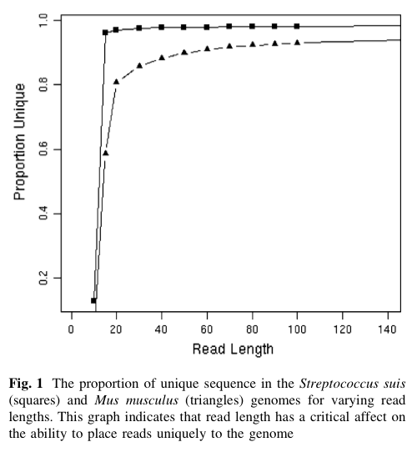
Read Length vs. uniqueness

Slide 14
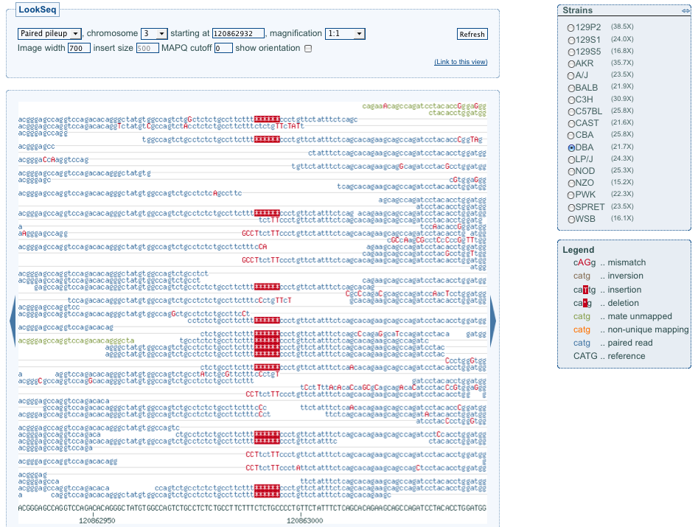
Example Indel

Slide 15
Using BWA
bwa index [options] <in.fasta>
-a STR BWT construction algorithm: bwtsw or is
bwtsw for human size genome, is for smaller genomes (div deprecated)
bwa aln [options] <prefix> <in.fq>
Align each single end fastq file individually
Various options to change the alignment parameters/scoring matrix/seed length
bwa sampe [options] <prefix> <in1.sai> <in2.sai> <in1.fq> <in2.fq>
sai files produced by aln step
Produces SAM output for paired-end reads
bwa samse [options] <prefix> <in.sai> <in.fq>
Unpaired reads – produces SAM output
Use samtools to manipulate SAM file or convert to BAM
samtools view –bS in.sam > out.bam

Slide 16
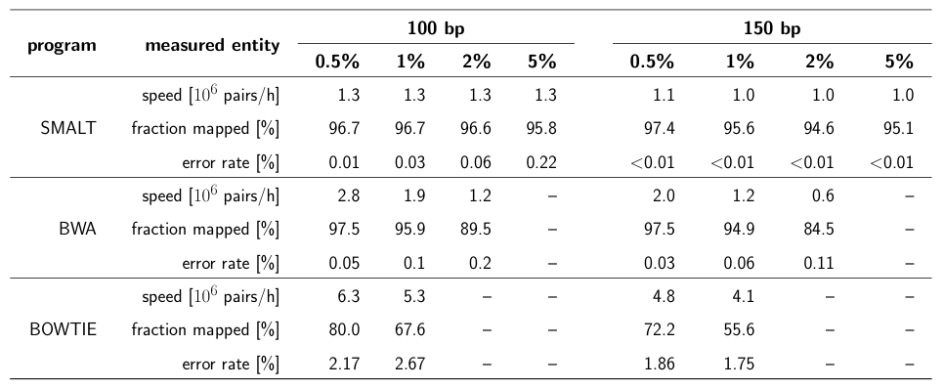
Using Smalt
Index the genome
smalt index -k 13 -s 6 hs37k13s6 NCBI37.fasta
Produces an kmer index of the genome
-k 13 speciﬁes the length, -s 6 the spacing of the hashed words
Align the reads
smalt map -i 800 hs37k13s6 mate_1.fastq mate_2.fastq

Slide 17
Parallelising Short Read Alignment
Aligning a single lane of reads can take a long time on a single computer
Simple parallelism by splitting the data
Split lane into 1Gbp chunks and align on different processors
BWA ~8 hours per 1Gbp chunk
Merge chunk BAM files back into single lane BAM
‘samtools merge’ command
Always check for truncated BAM files
Running ‘samtools quickcheck -vv’ on your file is one way to check
`samtools index` should also give an error if input is truncated

Slide 18
QC Metrics from Alignments
Several useful metrics to check to assess the quality of your data and alignments produced
Number of reads mapped, bases mapped, duplicate fragments, reads w/adaptor, error rate, fragment size distribution, genotype check
Genotype check – is this the correct sample?
Use an external set of genotypes for the sample to assess the likelihood that the sample is the expected sample e.g. genotyping chip
Biases in sequencing
GC vs. depth
Indel ratio
Read cycle vs. base content

Slide 19
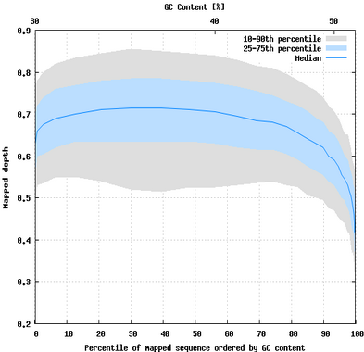
GC vs. Depth
Notes:
Premise for this plot: all positions of the genome should be sequenced equally regardless of sequence context e.g. GC %

Slide 20
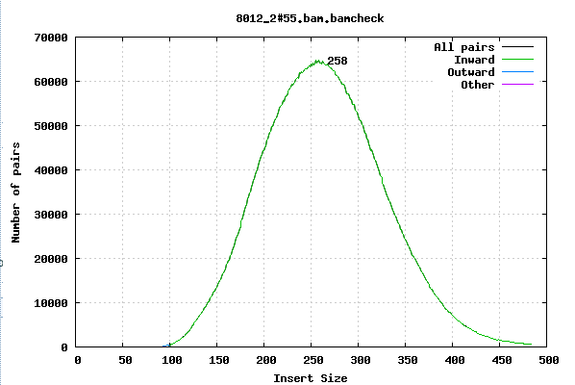
Fragment size
Notes:
Premise: in the library creation, a certain DNA fragment size was desired. What is the actual fragment size observed in the data?

Slide 21
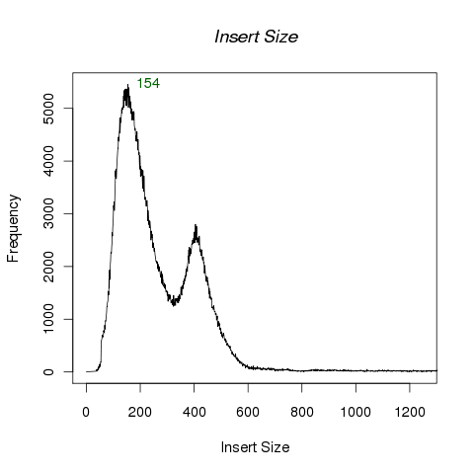
Fragment size

Slide 22
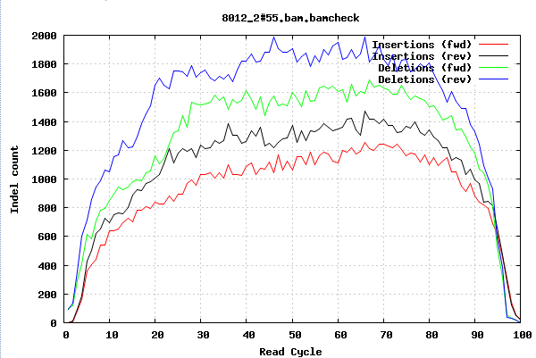
Indels per cycle
Notes:
Premise: Insertions and deletions should occur equally at any position in the reads.
Take all of the reads and just count at what position the indels are occurring in the reads

Slide 23
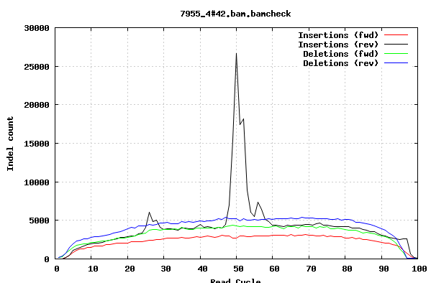
Indels per cycle

Slide 24
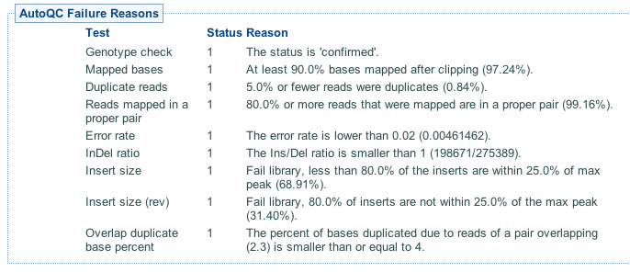
QC Metrics from Alignments

Slide 25
Reading and Links
Flicek and Birney (2009) Sense from sequence reads: methods for alignment and assembly, Nature Methods, 6, S6 - S12
Samtools: http://samtools.sourceforge.net/
BWA: http://bio-bwa.sourceforge.net/bwa.shtml
Smalt: http://www.sanger.ac.uk/resources/software/smalt/
Local realignment
http://www.broadinstitute.org/gsa/wiki/index.php/Local_realignment_around_indels

Slide 26
Resequencing and Variant Calling
Sequence Alignment
Lab Exercises: Mapping
Alignment Post-processing
SNP/indel Calling
Lab Exercises: Calling

Slide 27
Resequencing and Variant Calling
Sequence Alignment
Lab Exercises: Mapping
Alignment Post-processing
SNP/indel Calling
Lab Exercises: Calling

Slide 28
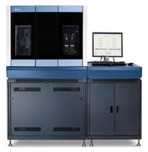
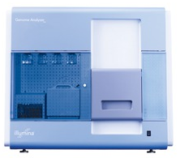
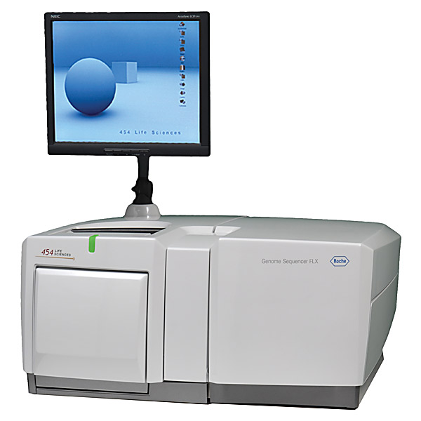
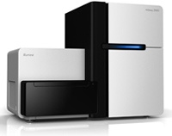
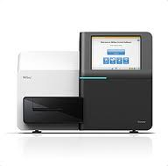
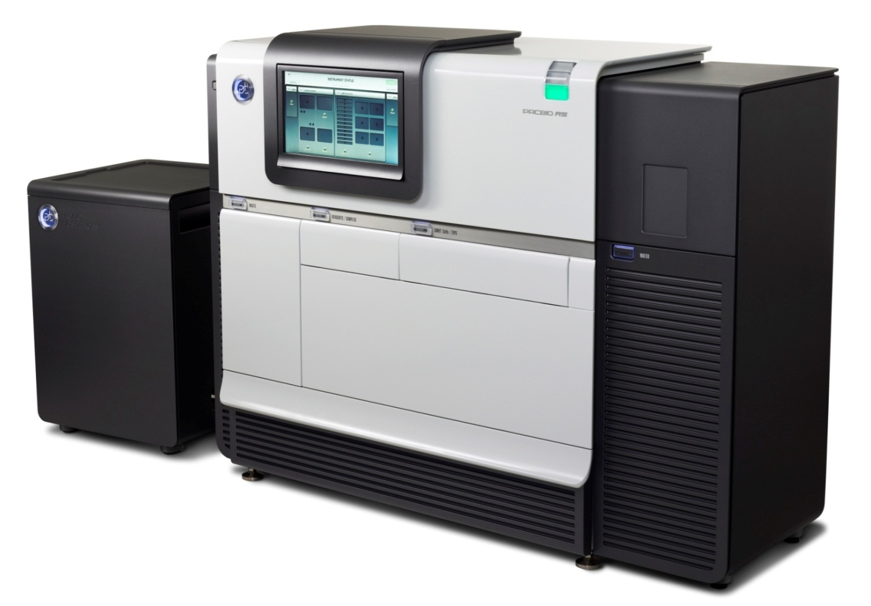
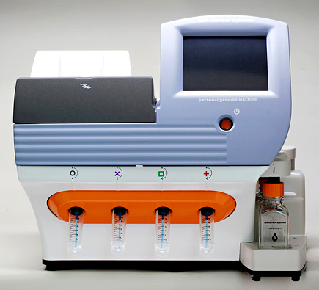
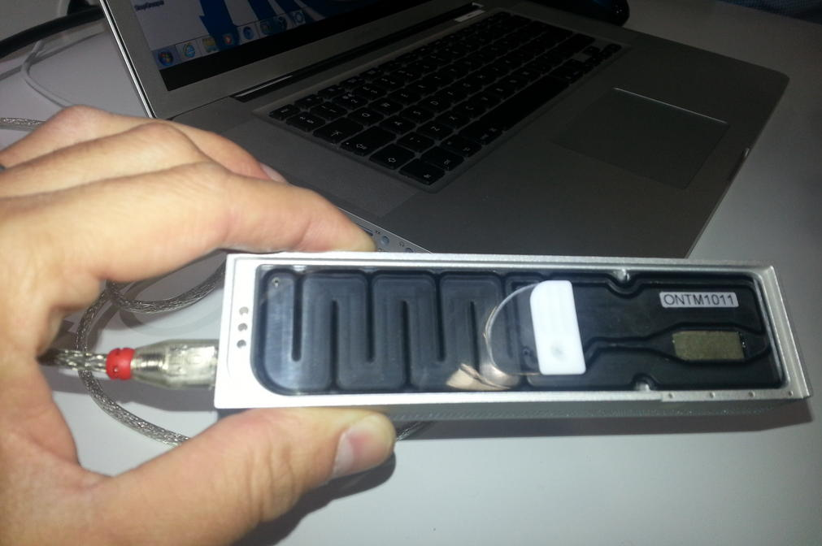
Data Production Workflow
Sample
merge
BAM
BAM
Sample/Platform
Library
merge
BAM
BAM
BAM
Library
BAM
BAM
BAM
BAM
BAM
BAM
Improvement
BAM
BAM
BAM
BAM
BAM
Lane/Plex
Alignment
(bwa, smalt etc)
Fastq
Fastq
Fastq
……
Fastq
Fastq

Slide 29
Data Production Workflow
Sample
merge
BAM
BAM
Sample/Platform
Library
merge
BAM
BAM
BAM
Library
BAM
BAM
BAM
BAM
BAM
BAM
Improvement
BAM
BAM
BAM
BAM
BAM
Lane/Plex
Alignment
(bwa, smalt etc)
Fastq
Fastq
Fastq
……
Fastq
Fastq

Slide 30
BAM Improvement
Lanelet-level operation carried out after alignment
Input: BAM
Process 1: Local realignment around InDels
Process 2: Base quality recalibration
Output: (improved) BAM

Slide 31
Realignment
Short InDels in the sample relative to the reference can pose difficulties for alignment programs
InDels occurring near the ends of the reads are often not aligned correctly
Excess of SNPs rather than introduce InDel into alignment
Realignment algorithm
Input set of known InDel sites and a BAM file
At each site, model the InDel haplotype and the reference haplotype
Given the information on a known InDel
Which scenario are the reads more likely to be derived from?
New BAM file produced with read cigar lines modified where InDels have been introduced by the realignment process
Software
Implemented in GATK from Broad (IndelRealigner function)
What sites?
Previously published InDel sites, dbSNP, 1000 genomes, generate a rough/high confidence InDel set

Slide 32
Realignment

Slide 33
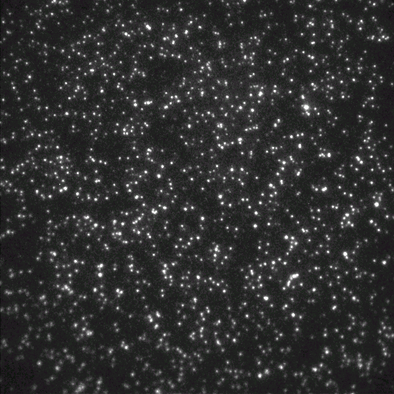
Base Quality Recalibration
Each base call has an associated base call quality
What is the chance that the base call is incorrect?
Illumina evidence: intensity values + cycle
Phred values (log scale)
Q10 = 1 in 10 chance of base call incorrect
Q20 = 1 in 100 chance of base call incorrect
Accurate base qualities essential measure in variant calling
Rule of thumb: Anything less than Q20 is not useful data
Illumina sequencing
Control lane or spiked control used to generate a quality calibration table
If no control – then use pre-computed calibration tables
Quality recalibration
1000 genomes project sequencing carried out on multiple platforms at multiple different sequencing centres
Are the quality values comparable across centres/platforms given they have all been calibrated using different methods?

Slide 34
Base Quality Recalibration
Original recalibration algorithm
Align subsample of reads from a lane to human reference
Exclude all known dbSNP+1000G pilot SNP sites
Assume all other mismatches are sequencing errors
Compute a new calibration table bases on mismatch rates per position on the read
Pre-calibration sequence reports Q25 base calls
After alignment - it may be that these bases actually mismatch the reference at a 1 in 100 rate, so are actually Q20
Recent improvements – GATK package
Reported/original quality score
The position within the read
The preceding and current nucleotide (sequencing chemistry effect) observed by the sequencing machine
Probability of mismatching the reference genome
NOTE: requires a reference genome and a catalog of variable sites

Slide 35
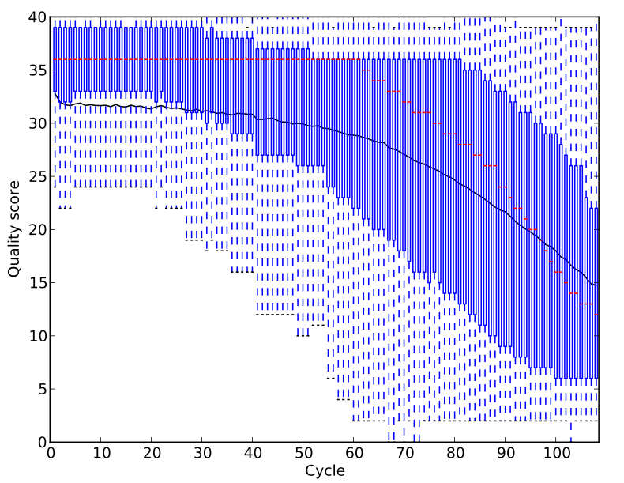
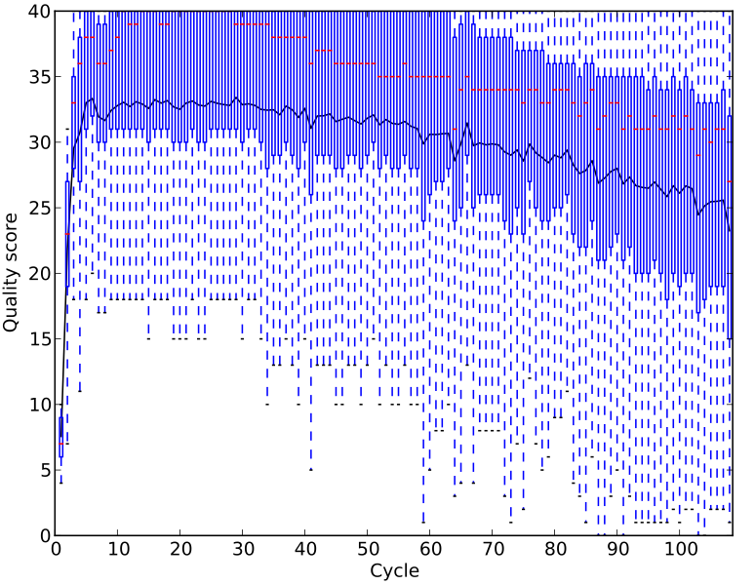
Base Quality Recalibration Effects
Before Recalibration
After Recalibration

Slide 36
Data Production Workflow
Sample
merge
BAM
BAM
Sample/Platform
Library
merge
BAM
BAM
BAM
Library
BAM
BAM
BAM
BAM
BAM
BAM
Improvement
BAM
BAM
BAM
BAM
BAM
Lane/Plex
Alignment
(bwa, smalt etc)
Fastq
Fastq
Fastq
……
Fastq
Fastq

Slide 37
Library Merge
Library level operation carried out after BAM improvement
Input: Multiple Lane BAMs
Process 1: Merge BAMs (picard - MergeSamFiles)
Process 2: Duplicate fragment identification
Output: BAM

Slide 38
Library Duplicates
Second-gen sequencing platforms are typically NOT single molecule sequencing
PCR amplification step in library preparation
Can result in duplicate DNA fragments in the final library prep.
PCR-free protocols do exist – require larger volumes of input DNA
Generally low number of duplicates in good libraries (<5%)
Align reads to the reference genome
Identify read-pairs where the outer ends map to the same position on the genome and remove all but 1 copy
Samtools: samtools rmdup or samtools rmdupse
Picard/GATK: MarkDuplicates
Can result in false SNP calls
Duplicates manifest themselves as high read depth support

Slide 39
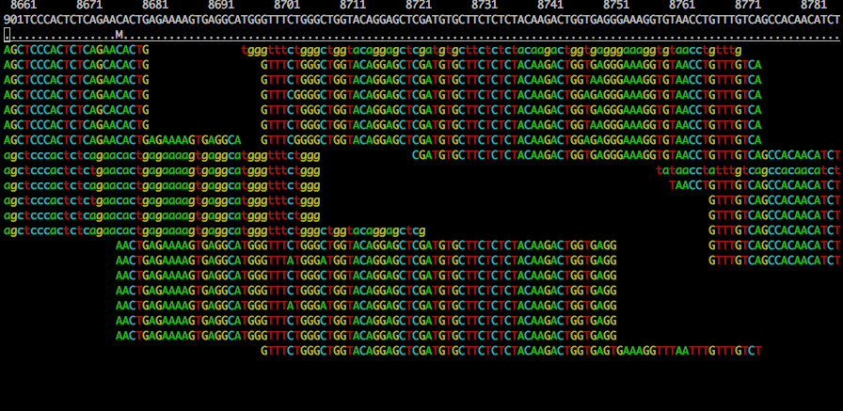
Duplicates and False SNPs
NA12005 - chr20:8660-8790

Slide 40
Software Tools
Alignment
BWA: http://bio-bwa.sourceforge.net/bwa.shtml
Smalt: http://www.sanger.ac.uk/science/tools/smalt-0
Stampy: http://www.well.ox.ac.uk/project-stampy
BAM Improvement
Realignment (GATK): https://software.broadinstitute.org/gatk/documentation/tooldocs/current/org_broadinstitute_gatk_tools_walkers_indels_IndelRealigner.php
Recalibration: https://software.broadinstitute.org/gatk/documentation/tooldocs/current/org_broadinstitute_gatk_tools_walkers_variantrecalibration_VariantRecalibrator.php
Library Merging
BAM Merging (Picard): http://broadinstitute.github.io/picard/command-line-overview.html#MergeSamFiles
Duplicate Marking/removal (Picard): http://broadinstitute.github.io/picard/command-line-overview.html#MarkDuplicates

Slide 41
Resequencing and Variant Calling
Sequence Alignment
Lab Exercises: Mapping
Alignment Post-processing
SNP/indel Calling
Lab Exercises: Calling

Slide 42
SNP Calling
SNP – single nucleotide polymorphisms
Examine the bases aligned to position and look for differences
SNP discovery
Finding new variant sites
SNP genotyping
Determining the genotype at a set of already known sites
Homozygous vs heterozygous SNPs
Factors to consider when calling SNPs
Base call qualities of each supporting base
Proximity to
Small indel
Homopolymer run (>4-5bp for 454 and >10bp for illumina)
Mapping qualities of the reads supporting the SNP
Low mapping qualities indicates repetitive sequence
Read length
Possible to align reads with high confidence to larger portion of the genome with longer reads
Paired reads
Sequencing depth
Few individuals/strains at high coverage vs. low coverage many individuals/strains
1000 genomes is low coverage sequencing across many individuals
Population based SNP calling methods

Slide 43
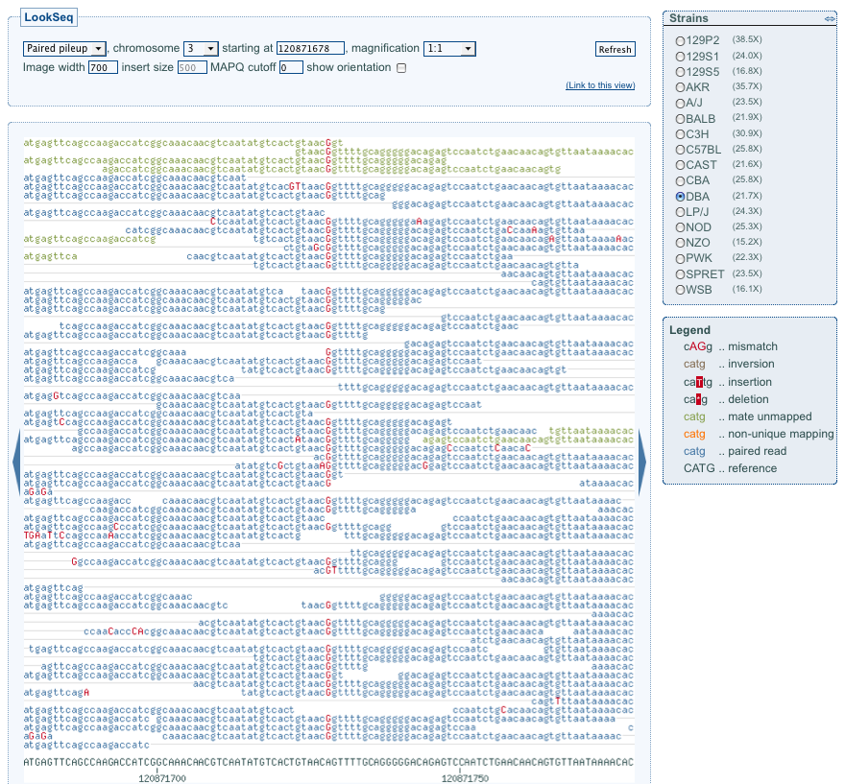
Mouse SNP

Slide 44
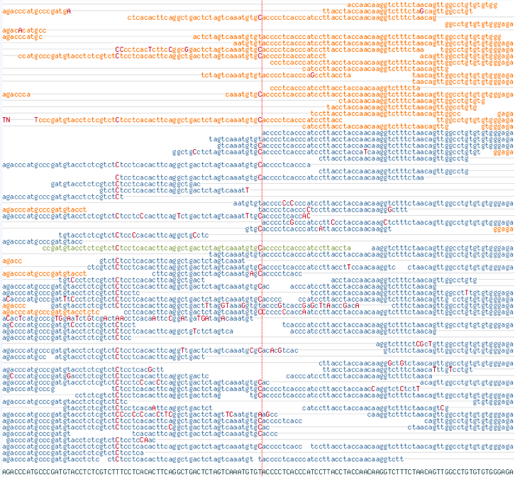
Is this a SNP?

Slide 45
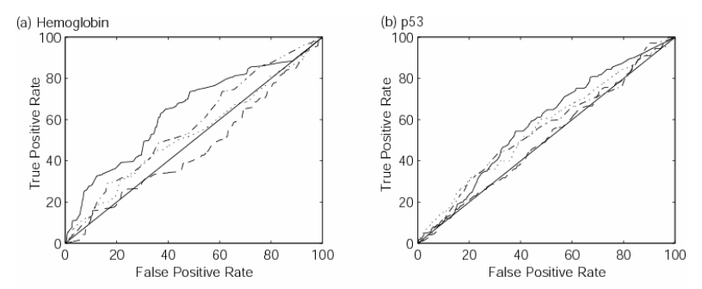
Evaluating SNPs
Specificity vs sensitivity
False positives vs. false negatives
Desirable to have high sensitivity and specificity
Sensitivity
External sources of validation
Specificity
Test a random selection of snps by another technology
e.g. Sequenom, Sanger sequencing…
Receiver operator curves to investigate effects of varying parameters

Slide 46
Known Systematic Biases
Many biases can be introduced in either sample preparation, sequencing process, computational alignment steps etc.
Can generate false positive SNPs/indels
Potential biases
Strand bias
End distance bias
Consistency across replicates/libraries
Variant distance bias
VCF Tools (vcf-annotate)
Soft filter variants file for these biases
Variants kept in the file – just annotated with potential bias affecting the variant

Slide 47
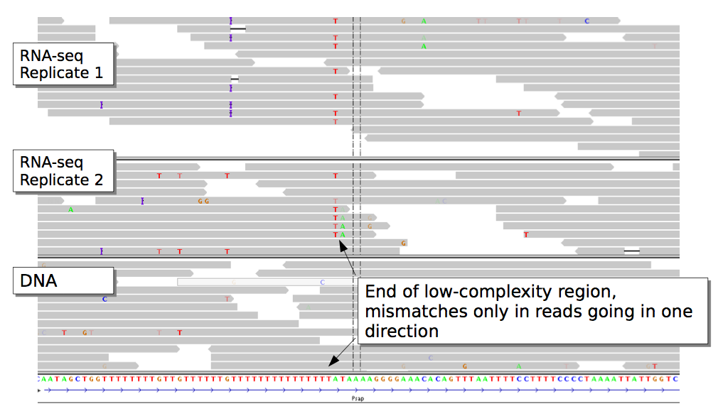
Strand Bias

Slide 48
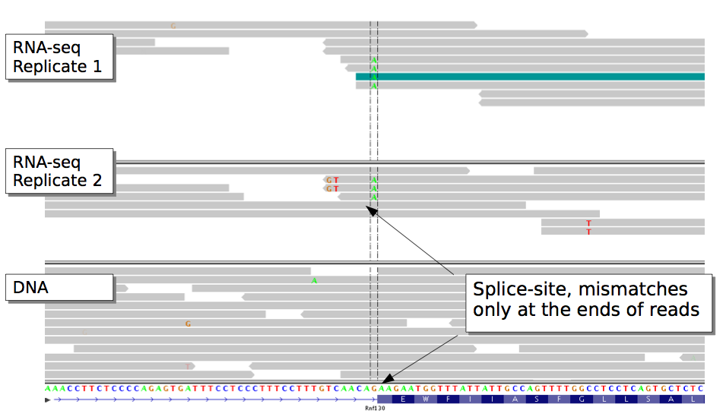
End Distance Bias

Slide 49
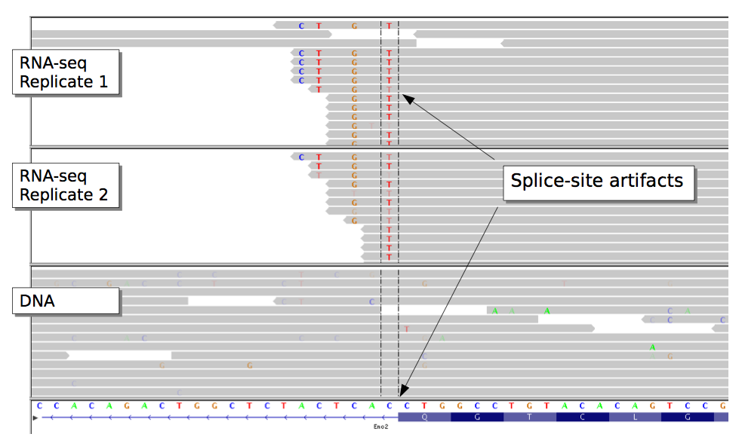
Variant Distance Bias
Notes:
VDB (variant distance bias) checks if variant bases occur at random positions in the aligned portion of the reads.

Slide 50
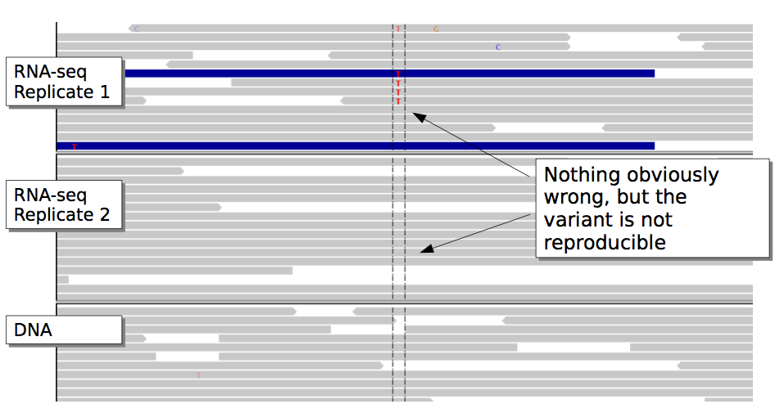
Reproducibility

Slide 51
Resequencing and Variant Calling
Sequence Alignment
Lab Exercises: Mapping
Alignment Post-processing
SNP/indel Calling
Lab Exercises: Calling

