Slide 1

Play with AI Agent
Fangjiang Wu

Slide 2
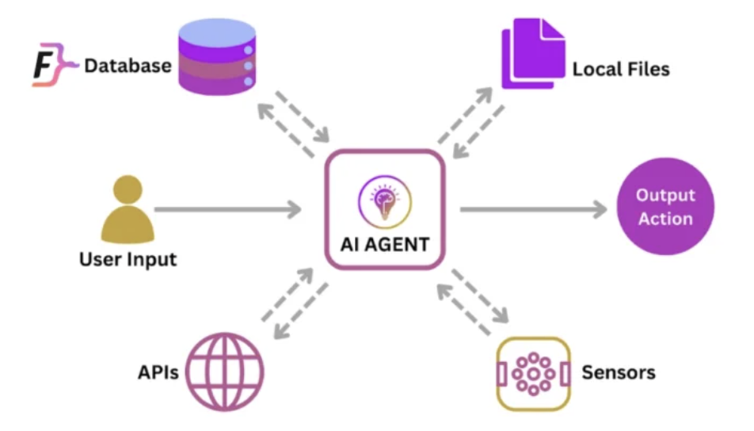

Slide 3
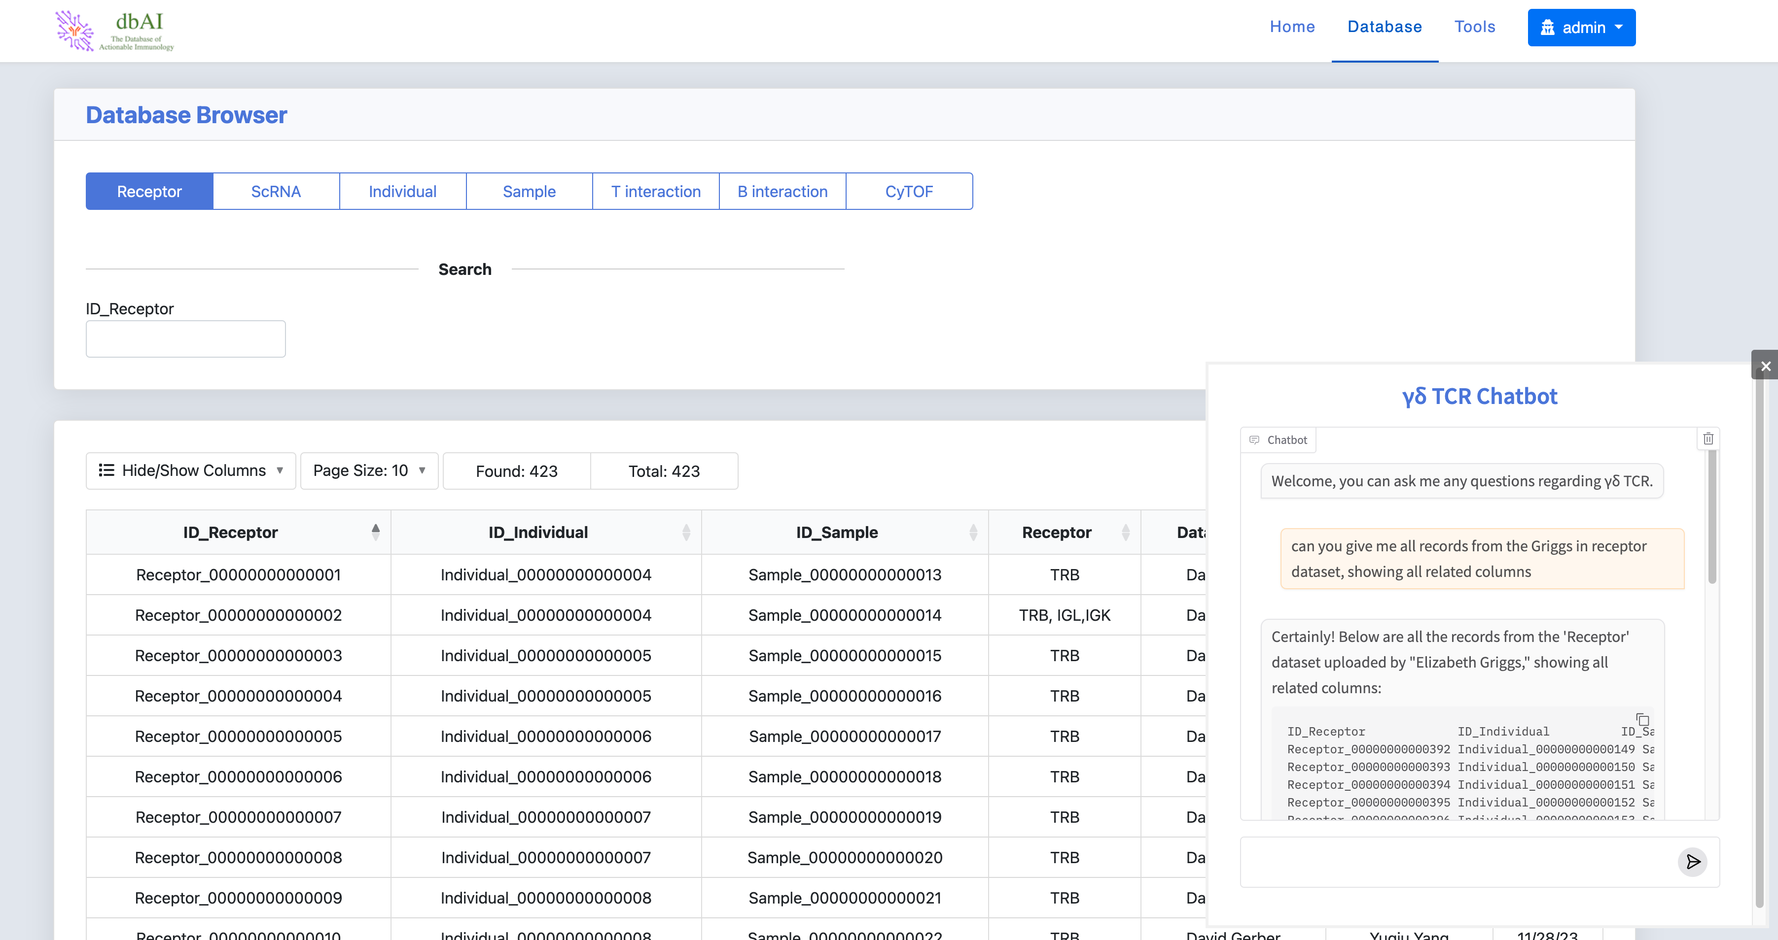

Slide 4
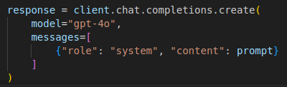
1. Store Preloaded Information in the Chatbot's Context
Directly append data to the system prompt via OpenAI API
Pros:
For small, static datasets; Easy to use
Cons:
limited by token constraints (128k tokens/ input for gpt-4); Higher token costs; low efficiency

Slide 5

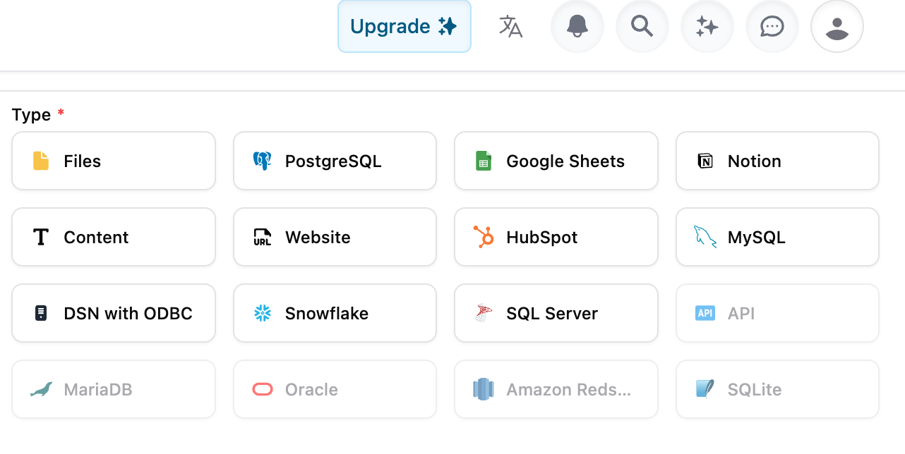
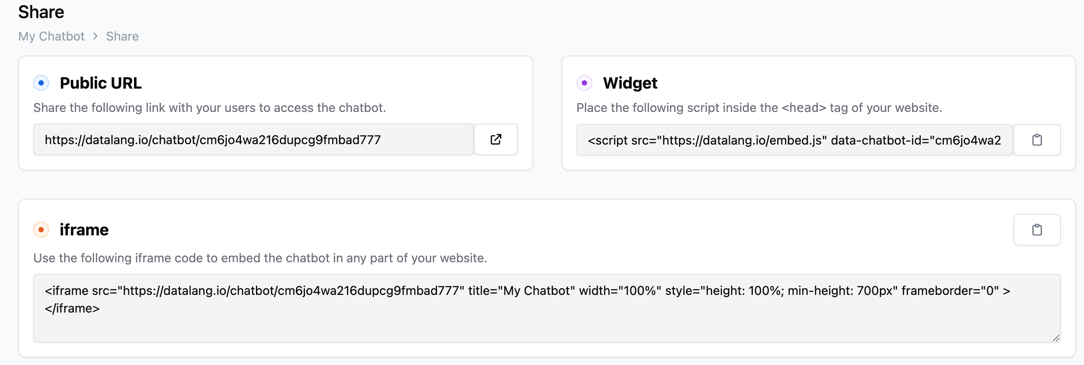
2. Use DATALANG
Connect multiple sources (SQL, Files, HTML, Notion, Google Sheets...), configure the chatbot, and share it with a public URL, embed it in your website

Slide 6
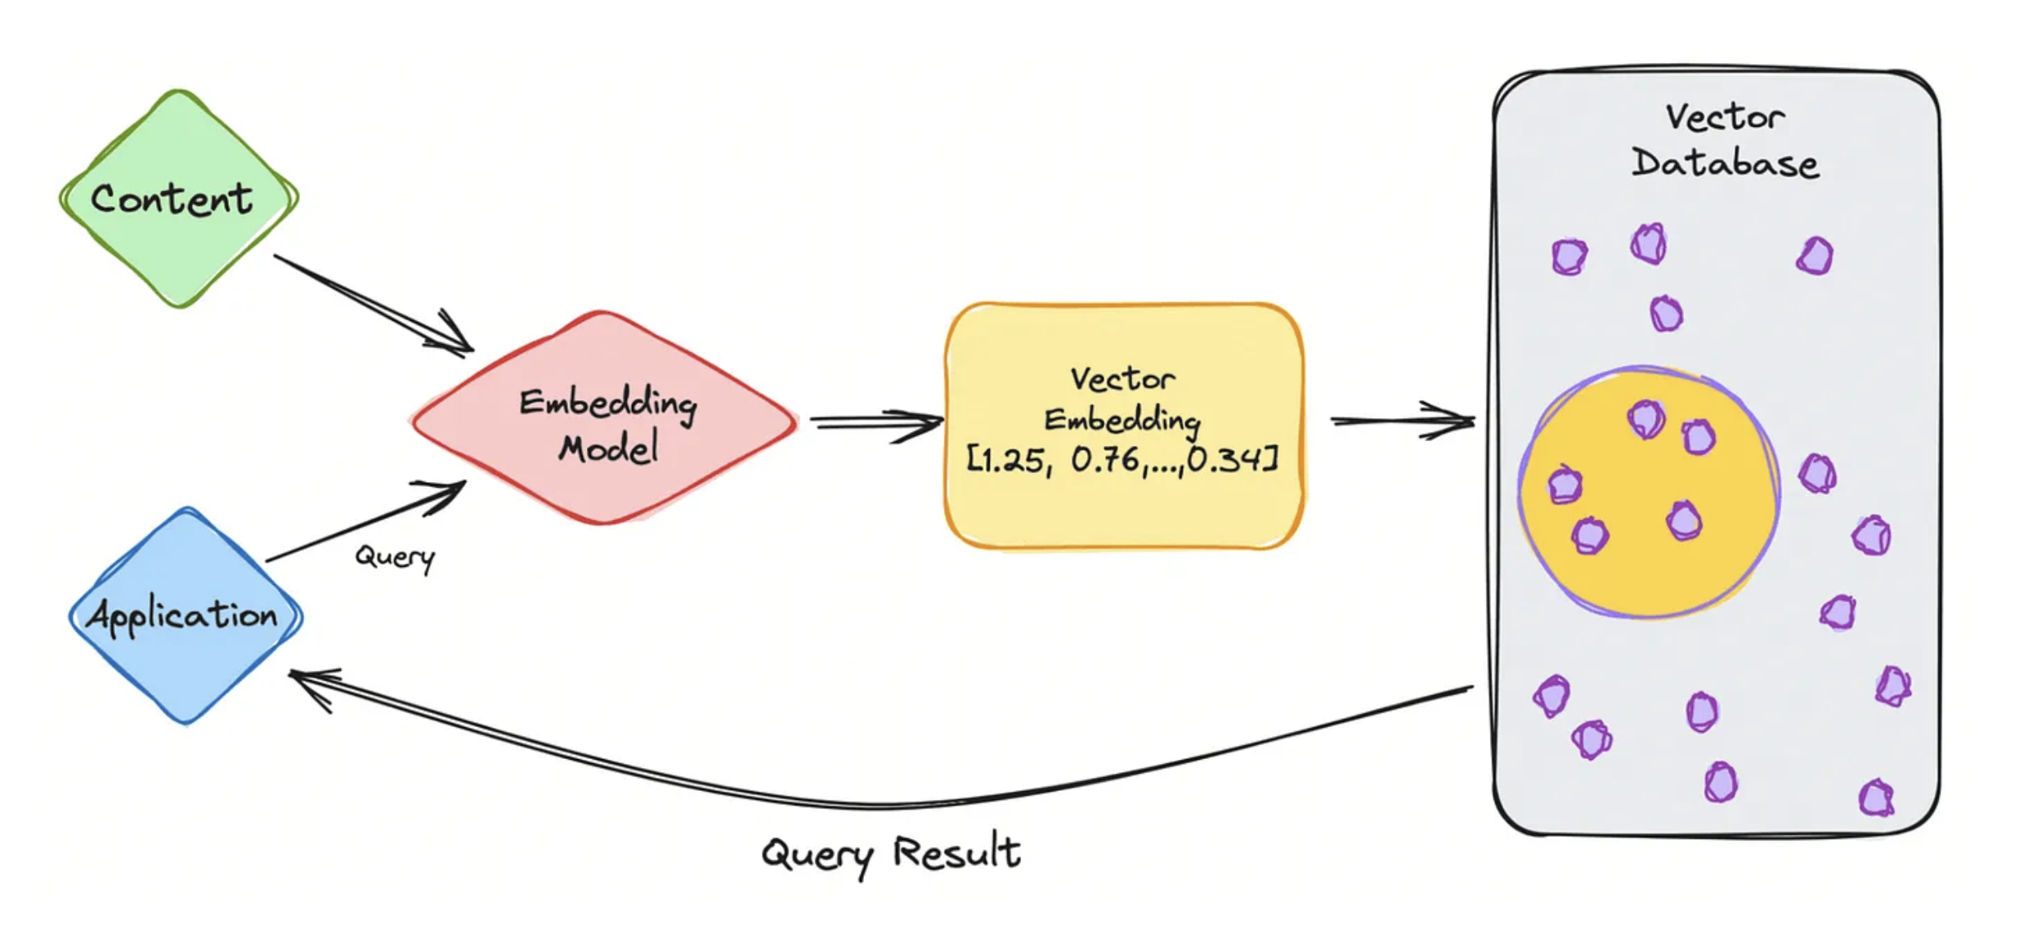
3. Store Preloaded Information in a vector database
(vector database like Chroma, FAISS, Pinecone, or a simple local retriever)

Slide 7

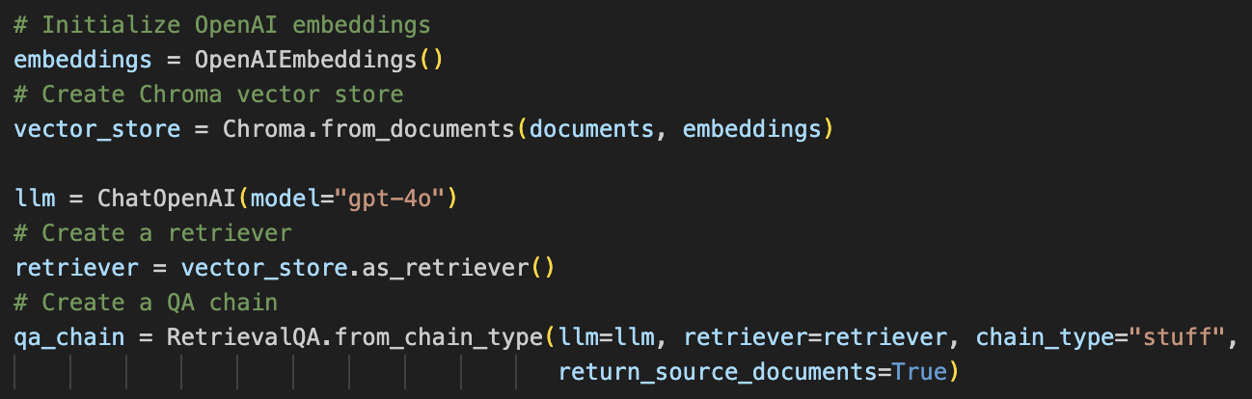
3.1 Build and implement vector DB with LangChain
Pros:
Handles large datasets; Retrieves only relevant data (semantic search); Lower token costs
Cons:
Additional setup; infrastructure cost

Slide 8
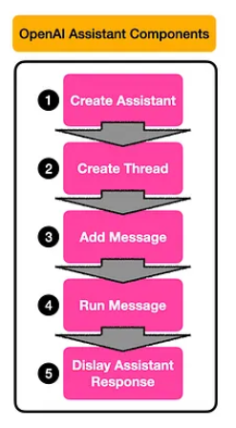
3.2 Build and implement vector DB with OpenAI Assistant

Slide 9
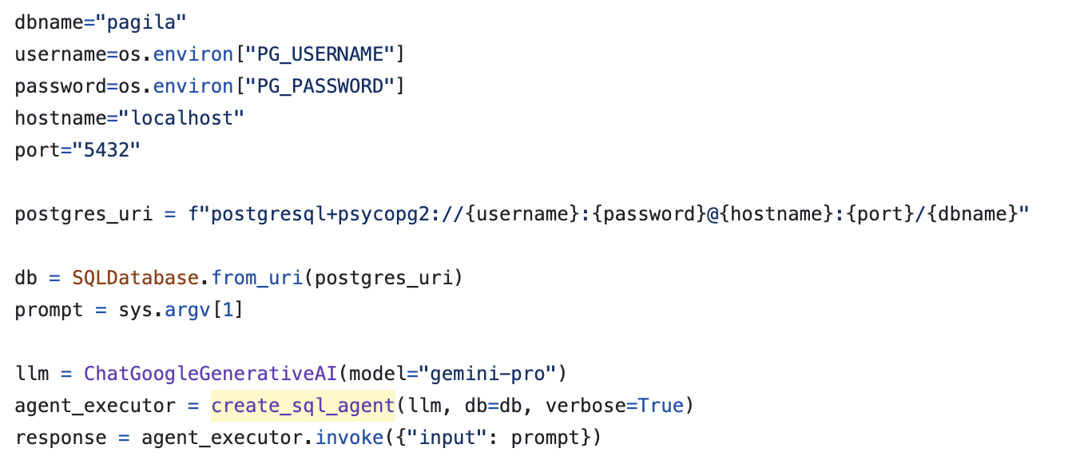
4. Build sql agent with LangChain

