Slide 1


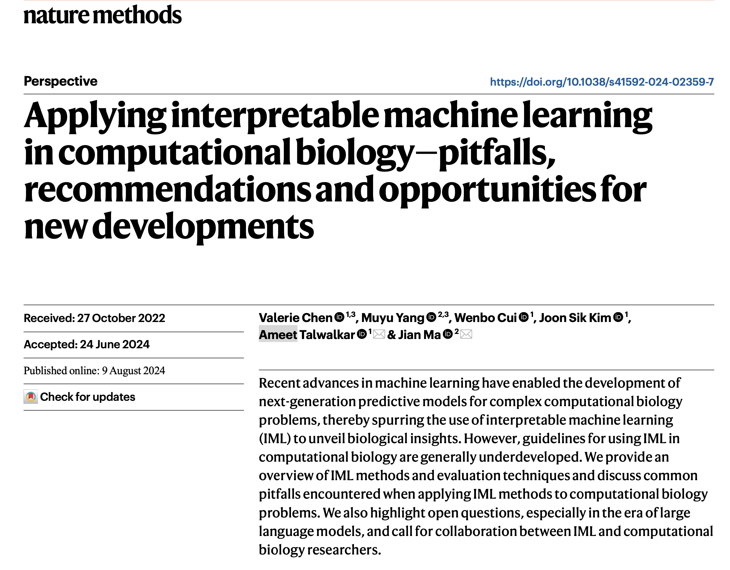
Jia Yao
09/06/2024

Slide 2
Related Article
P-Net: Biologically informed deep neural network for prostate cancer discovery. Nature 598, 348–352 (2021).
Dcell: Ma, J., Yu, M., Fong, S. et al. Using deep learning to model the hierarchical structure and function of a cell. Nat Methods 15, 290–298 (2018)
PAUSE: principled feature attribution for unsupervised gene expression analysis. Genome Biol 24, 81 (2023).
Geneformer: Transfer learning enables predictions in network biology. Nature 618, 616–624 (2023).

Slide 3
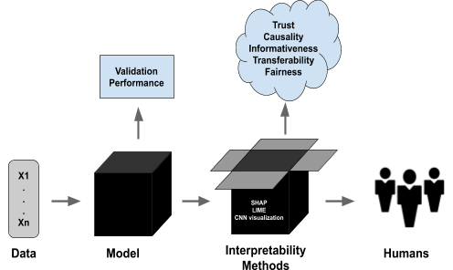
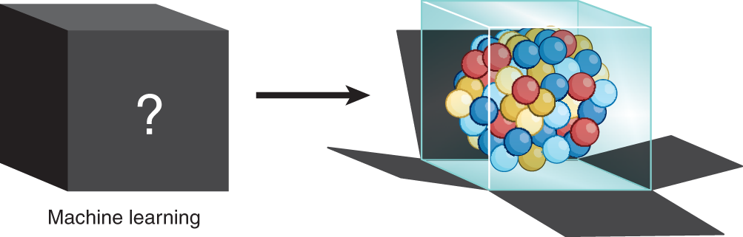
Introduction
Overview and objective of the paper
Advances in machine learning (ML) have transformed computational biology.
Need for interpretability in ML models for understanding biological processes.
Discuss common pitfalls, recommendations, and new opportunities in applying interpretable machine learning (IML).
What is IML?
creating models whose decisions can be understood by humans.
make machine learning more transparent and trustworthy by explaining how and why models make specific predictions.
Why IML?
Ensures models reflect biological mechanisms.
Helps build trust and reliability in predictive models.
Reference: Esterhuizen,. et al. Interpretable machine learning for knowledge generation in heterogeneous catalysis. Nat Catal 5, 175–184 (2022). https://doi.org/10.1038/s41929-022-00744-z

Slide 4
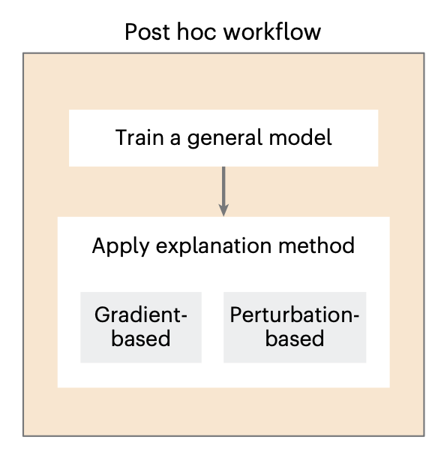
Post-Hoc Methods
Definition: Methods applied after model training to interpret the behavior of complex models.
Gradient-based: Calculate the importance of input features by leveraging the gradients of the model's output with respect to the input features.
Key methods:
DeepLIFT
Integrated Gradients
Grad-CAM
Perturbation-Based : systematically modifying (perturbing) each input feature and observing how much this alters the model’s output.
Key methods:
SHapley Additive exPlanations(SHAP)
In silico mutagenesis

Slide 5
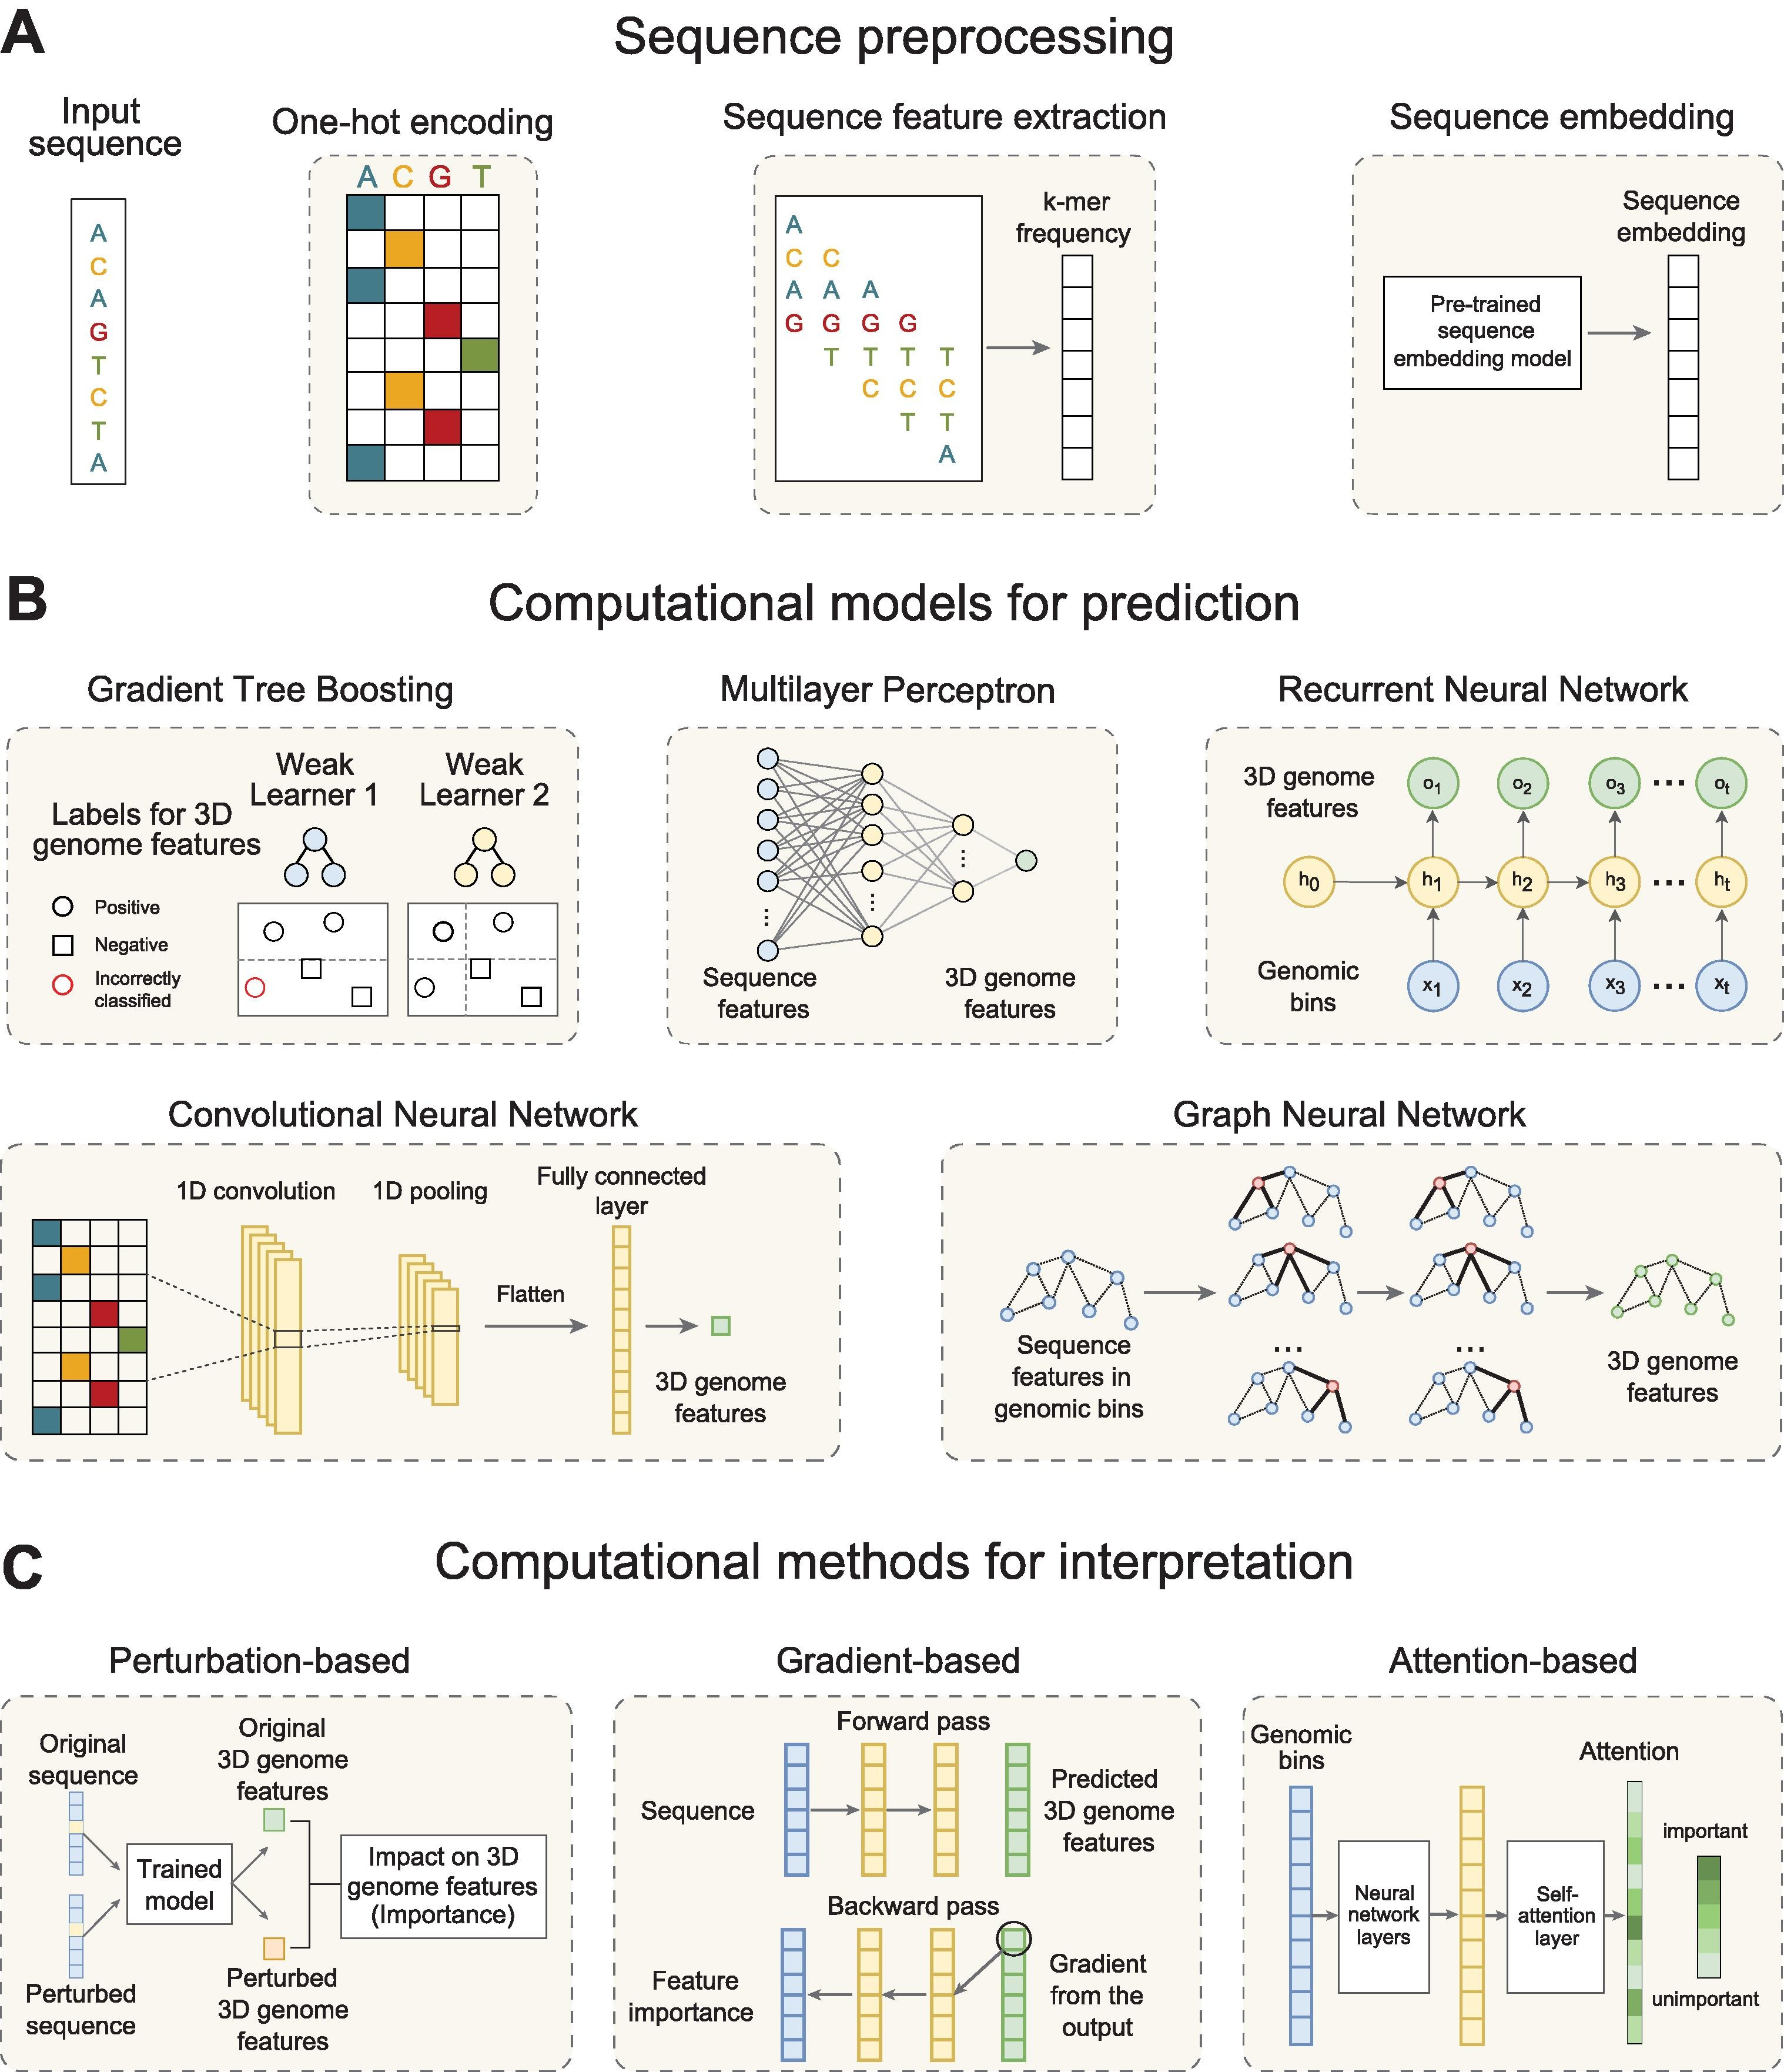
Post-Hoc Example
Yang, M. & Ma, J. Machine learning methods for exploring sequence determinants of 3D genome organization. J. Mol. Biol. 434, 167666 (2022).

Slide 6
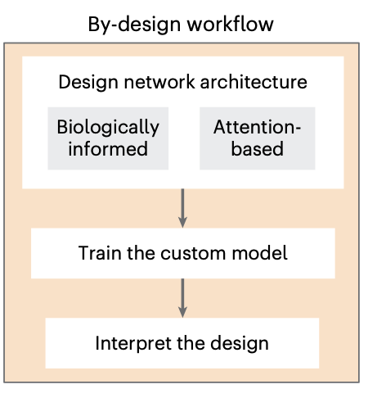
By-design methods
Definition: Methods applied after model training to interpret the behavior of complex models.
Biologically informed networks model architectures that encode domain knowledge. The process of architecture design is application specific and constitutes an open problem that is beyond the scope of this work.
Attention : a technique that has become a popular addition to neural networks that handle sequence-based inputs, where the network incorporates and learns a set of weights indicating the amount of attention the model is assigning to specific parts of the input.

Slide 7
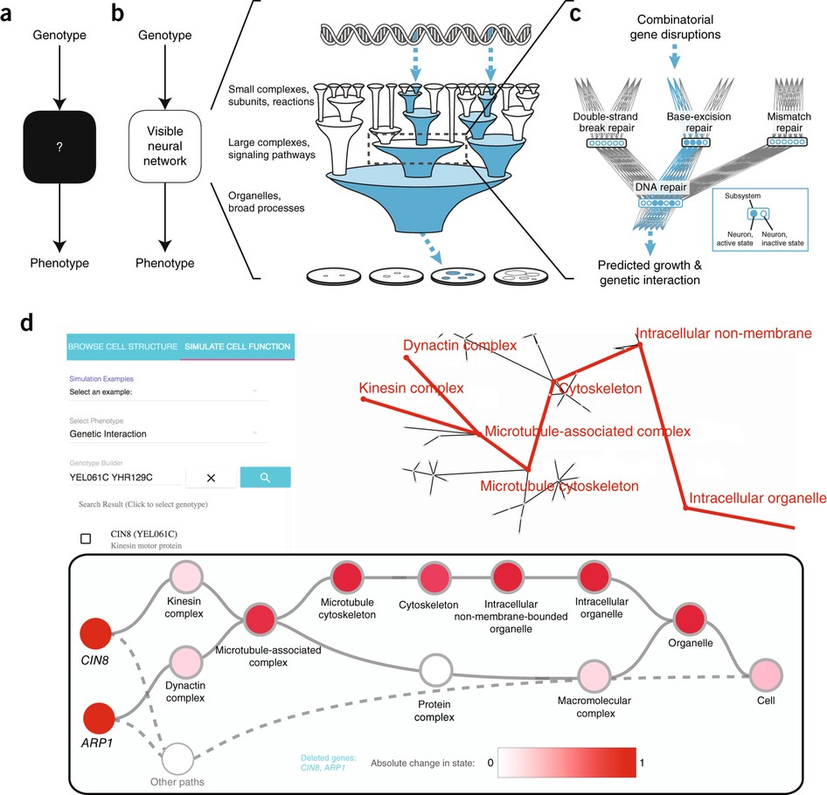
By design Example - Dcell
Biological Hierarchy Representation: DCell is designed using the hierarchical structure of 2,526 subsystems of a cell, drawn from the Gene Ontology (GO) and an alternative ontology called Clique-eXtracted Ontology (CliXO). These subsystems include cellular components, processes, and functions that form a natural hierarchical bridge from genes to phenotypes.
Visible Neural Network: DCell's architecture mirrors the biological hierarchy. Each hidden layer in the network corresponds to biological subsystems. Connectivity within the model follows parent-child relationships, where child nodes represent smaller components (e.g., genes) and parent nodes represent larger biological processes (e.g., pathways).
Ma, J.et al. Using deep learning to model the hierarchical structure and function of a cell. Nat Methods 15, 290–298 (2018). https://doi.org/10.1038/nmeth.4627

Slide 8
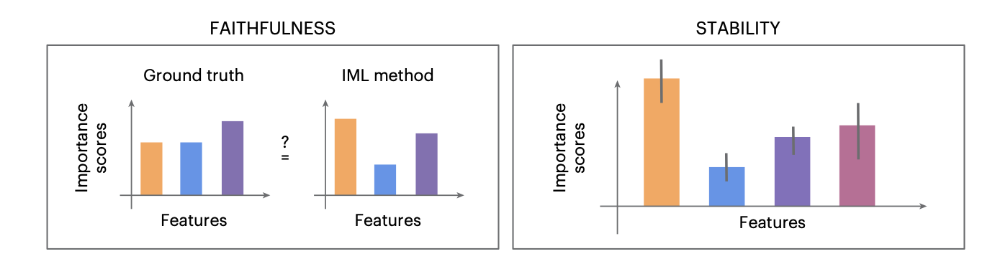
Evaluation techniques
Faithfulness:
measures how well the explanation aligns with the true reasoning process or "ground truth" of the underlying machine learning model.
ensure that the explanation method can produce feature importance scores that are as close as possible to the actual importance that the model assigns to each feature.
This is typically tested by comparing the IML method’s output to a known ground truth.
Stability:
Stability refers to the consistency of feature importance scores when small variations (or perturbations) are made to the input.
ensures that explanations are not overly sensitive to minor changes in the input data
introducing small perturbations to the input data and observing how much the importance scores change.
Many popular explanation methods, such as SHAP and LIME, have been shown to be unstable in certain scenarios.

Slide 9
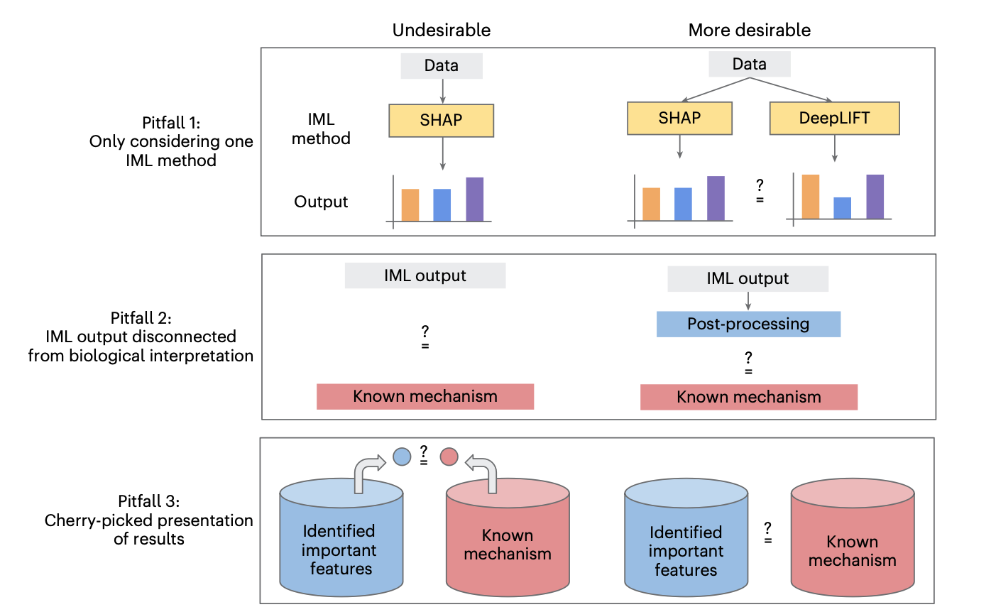
Pitfalls of IML usage in computational biology
Notes:
In this section, we’ll discuss three common pitfalls when using Interpretable Machine Learning (IML) in computational biology and how to avoid them for more reliable model interpretations.
Pitfall 1: Relying on a Single IML Method
One common pitfall is relying on just one IML method. This is problematic because different IML methods—such as SHAP, DeepLIFT, or Grad-CAM—often produce different explanations due to their underlying assumptions and algorithms. As a result, you may only capture one aspect of the model’s behavior, leading to biased or incomplete interpretations.
Solution: To overcome this, it’s important to use multiple IML methods with varied hyperparameters to gain a more comprehensive view of the model. For example, using both SHAP and DeepLIFT could provide different perspectives on feature importance. If these methods produce conflicting results, it’s crucial to employ evaluation mechanisms that compare the explanations against real data or expert knowledge to determine which is more plausible or biologically meaningful.
Pitfall 2: IML Output Disconnected from Biological Interpretation
Another issue is that IML outputs are often disconnected from biological interpretation. While IML methods can identify predictive features or regions of importance, they do not directly explain the biological significance of those features. Without bridging this gap, the raw importance scores produced by the IML methods can be challenging to interpret meaningfully in a biological context.
Solution: Post-processing steps are required to translate raw IML outputs into biologically meaningful insights. For instance, in sequence-based tasks, tools like TF-MoDISco can summarize nucleotide importance scores to highlight sequence motifs. For gene expression data, GO enrichment analysis can map gene importance scores to known biological functions. In cellular imaging tasks, areas highlighted by IML methods should be transformed into human-interpretable features that describe cellular structures or phenotypic traits. These post-processing techniques are highly domain-specific and depend on the data type and model architecture.
Pitfall 3: Cherry-Picking Presentation of Results
A final pitfall is the cherry-picking of results—selecting only examples where the IML output aligns with known biological mechanisms, while ignoring cases that show different or unexpected behaviors. This selective reporting can lead to biased interpretations of the model’s underlying mechanisms. Cherry-picking also limits the opportunity for discovering new insights, as deep learning models might reveal important but unexpected patterns that diverge from prior biological knowledge.
Solution: To avoid cherry-picking, researchers should conduct a quantitative evaluation of the faithfulness of IML importance scores across the entire dataset, rather than relying on selective examples. It’s essential to report both consistent and inconsistent feature importance scores with respect to prior knowledge. Additionally, using stability metrics—such as evaluating feature importance across different subsets of data, hyperparameters, or independent datasets—ensures that the model's interpretations are robust and reliable. By doing this, you foster a more comprehensive understanding of the model and allow room for discovering novel biological insights that might otherwise be overlooked.

Slide 10
Opportunities for IML developments in the age of LLMs
What is the right choice of tokenization for biological applications?
How can LLM-specific IML methods be adapted to biological contexts?
How do we develop IML techniques to handle multimodal applications?
What types of novel visualization tools can best facilitate interpretation?

Slide 11
Inspiration
Biologically informed network for our own project.
Use the evaluations to verify my model can be properly interpreted.
How can we improve the connection between IML outputs and biological insights

Slide 12
Thanks for listening!

