Slide 1

Project presentation
TianYi Wang, Linhao Liu, ZhongYuan Yu
Chen Wang, JiYuan Liao
T01

Slide 2
Project Abstract
Nowadays, many users will encounter the problem of wrong buying and irrational consumption.
In order to solve this problem, we designed a shopping assistance system to allow users to communicate to realize the communication of information between users.

Slide 3
Project Activities
Our project development is roughly divided into two stages:
Preliminary research and data collection
Product realization
After the implementation of the project is completed, we still have a trial run time.

Slide 4
Team Member
王天一
Developer and project manager, responsible for website architecture design, project team management, front-end, back-end design, management of the database MySQL and the configuration of Nginx
刘林昊
Back-end developer. Responsible for the writing of Django-related code
禹中元
Back-end developer. Responsible for the writing of Django-related code and the
王琛
Front-end developer
Art designer
廖冀远
Front-end developer
Business planner

Slide 5
Technologies
For back end:
Django(Basic)(刘林昊，禹中元，王天一)（此条为重点，因为网站大部分内容都由后端各类函数实现，按贡献排名）
Mysql (Database) (王天一)
HTTPS(Encrypt) (王天一)
Neural Network(Recommender system) (王天一)（仍存在一些问题）
Nginx (Load balancing)(王天一)

Slide 6
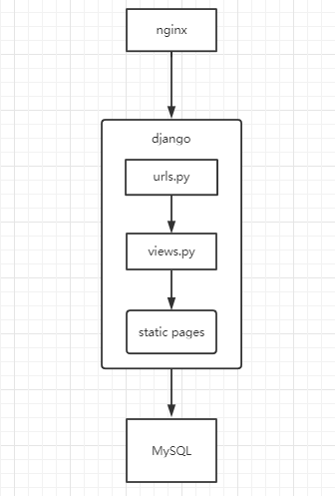
Web Architecture
Implementing high clustering and low coupling within the apps.
Load balancing can be achieved later by increasing the number of virtual machines easily.

Slide 7
Technologies
For front end:
HTML5 CSS (Basic)(王琛,廖冀远)
JS-Vue.js(Function)(王琛)（未完善）
Ajax(Updating)(王琛)

Slide 8
Webpage design
Main page
Logging in and searching link to all the pages
The introduction of the product
Advertisement
Navigation page
Classify all the forums and show them in the page
Guide users to the proper forum
Forum
Users share their opinions and take others’ ideas
Advertisement

Slide 9
Thanks for your attention!

