Slide 1
Introduction
面向对象设计.
统一建模语言Unified Modeling Language (UML).

Slide 2
系统建模
需要语言来描述系统：
在几个抽象层次上都很有用；
可以在组织内部和组织之间理解。
框图是一个开始，但不能涵盖所有内容。

Slide 3
面向对象设计
面向对象（OO）设计：面向对象编程的概括。
对象=状态+方法。
状态为每个对象提供了自己的身份。
方法为对象提供了一个抽象接口。

Slide 4
对象和类
类：对象类型。
类定义对象的状态元素，但状态值可能会随时间变化。
类定义了用于与该类型的所有对象交互的方法。
每个对象都有自己的状态。

Slide 5
OO design principles
Some objects will closely correspond to real-world objects.
  Some objects may be useful only for description or implementation.
Objects provide interfaces to read/write state, hiding the object’s implementation from the rest of the system.

Slide 6
UML
Developed by Booch et al.
Goals:
  object-oriented;
  visual;
  useful at many levels of abstraction;
  usable for all aspects of design.

Slide 7
UML object
object name
class name
d1: Display
pixels is a
2-D array
pixels: array[] of pixels
elements
menu_items
comment
attributes

Slide 8
UML class
Display
class name
pixels
elements
menu_items
mouse_click()
draw_box
operations

Slide 9
The class interface
The operations provide the abstract interface between the class’s implementation and other classes.
Operations may have arguments, return values.
An operation can examine and/or modify the object’s state.

Slide 10
Choose your interface properly
If the interface is too small/specialized:
  object is hard to use for even one application;
  even harder to reuse.
If the interface is too large:
  class becomes too cumbersome for designers to understand;
  implementation may be too slow;
  spec and implementation are probably buggy.

Slide 11
Relationships between objects and classes
Association: objects communicate but one does not own the other.
Aggregation: a complex object is made of several smaller objects.
Composition: aggregation in which owner does not allow access to its components.
Generalization: define one class in terms of another.

Slide 12
Class derivation
May want to define one class in terms of another.
  Derived class inherits attributes, operations of base class.
Derived_class
UML
generalization
Base_class

Slide 13
Class derivation example
Display
base
class
pixels
elements
menu_items
pixel()
set_pixel()
mouse_click()
draw_box
derived class
BW_display
Color_map_display

Slide 14
Multiple inheritance
base classes
Speaker
Display
Multimedia_display
derived class

Slide 15
Links and associations
Link: describes relationships between objects.
Association: describes relationship between classes.

Slide 16
Link example
Link defines the contains relationship:
message
msg = msg1
length = 1102
message set
count = 2
message
msg = msg2
length = 2114

Slide 17
Association example
# contained messages
# containing message sets
message
message set
0..*
1
msg: ADPCM_stream
length : integer
count : integer
contains

Slide 18
Stereotypes
Stereotype: recurring combination of elements in an object or class.
Example:
  <<foo>>

Slide 19
Behavioral description
Several ways to describe behavior:
  internal view;
  external view.

Slide 20
State machines
transition
a
b
state
state name

Slide 21
Event-driven state machines
Behavioral descriptions are written as event-driven state machines.
  Machine changes state when receiving an input.
An event may come from inside or outside of the system.

Slide 22
Types of events
Signal: asynchronous event.
Call: synchronized communication.
Timer: activated by time.

Slide 23
Signal event
<<signal>>
mouse_click
a
leftorright: button
x, y: position
mouse_click(x,y,button)
b
declaration
event description

Slide 24
Call event
draw_box(10,5,3,2,blue)
c
d

Slide 25
Time-out event
e
tm(time-value)
f
Often this can be implemented with a timer.

Slide 26
Example state machine
start
input/output
mouse_click(x,y,button)/
find_region(region)
region = menu/
which_menu(i)
call_menu(I)
region
found
got menu
item
called
menu item
region = drawing/
find_object(objid)
object
highlighted
found
object
highlight(objid)
finish

Slide 27
Sequence diagram
Shows sequence of operations over time.
Relates behaviors of multiple objects.

Slide 28
Sequence diagram example
m: Mouse
d1: Display
u: Menu
mouse_click(x,y,button)
which_menu(x,y,i)
time
call_menu(i)

Slide 29
Summary
Object-oriented design helps us organize a design.
UML is a transportable system design language.
  Provides structural and behavioral description primitives.

Slide 30
Example
Example: model train controller.

Slide 31
Purposes of example
Follow a design through several levels of abstraction.
Gain experience with UML.
Computers as Components 4e © 2016 Marilyn Wolf

Slide 32
Model train setup
rcvr
motor
power
supply
console
ECC
command
address
header

Slide 33
Requirements
Console can control 8 trains on 1 track.
Throttle has at least 63 levels.
Inertia control adjusts responsiveness with at least 8 levels.
Emergency stop button.
Error detection scheme on messages.

Slide 34
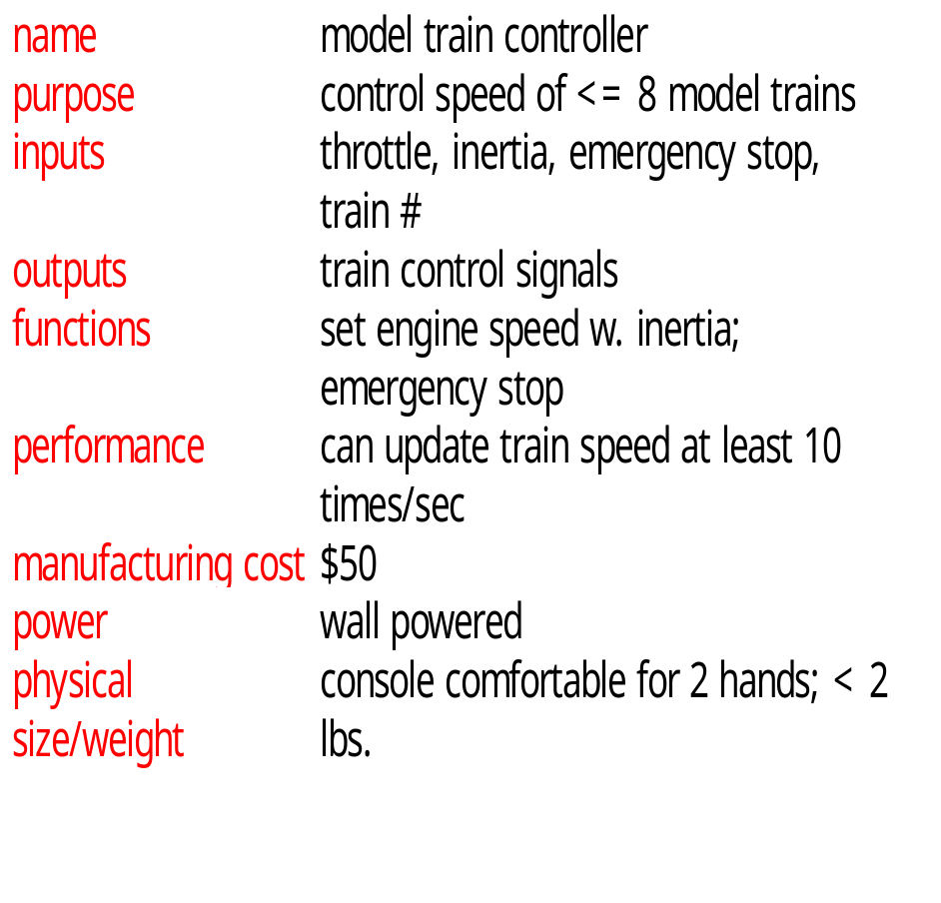
Requirements form

Slide 35
Use case
console
train 1
train 2
Select train 1
Set train 1 speed
Select train 1
Set train 1 speed

Slide 36
Digital Command Control
DCC created by model railroad hobbyists, picked up by industry.
Defines way in which model trains, controllers communicate.
  Leaves many system design aspects open, allowing competition.
This is a simple example of a big trend:
  Cell phones, digital TV rely on standards.

Slide 37
DCC documents
Standard S-9.1, DCC Electrical Standard.
  Defines how bits are encoded on the rails.
Standard S-9.2, DCC Communication Standard.
  Defines packet format and semantics.

Slide 38
DCC electrical standard
Voltage moves around the power supply voltage; adds no DC component.
1 is 58 μs, 0 is at least 100 μs.
logic 1
logic 0
time
58 μs
>= 100 μs

Slide 39
DCC communication standard
Basic packet format: PSA(sD)+E.
P: preamble = 1111111111.
S: packet start bit = 0.
A: address data byte.
s: data byte start bit.
D: data byte (data payload).
E: packet end bit = 1.

Slide 40
DCC packet types
Baseline packet: minimum packet that must be accepted by all DCC implementations.
  Address data byte gives receiver address.
  Instruction data byte gives basic instruction.
  Error correction data byte gives ECC.

Slide 41
Conceptual specification
Before we create a detailed specification, we will make an initial, simplified specification.
  Gives us practice in specification and UML.
  Good idea in general to identify potential problems before investing too much effort in detail.

Slide 42
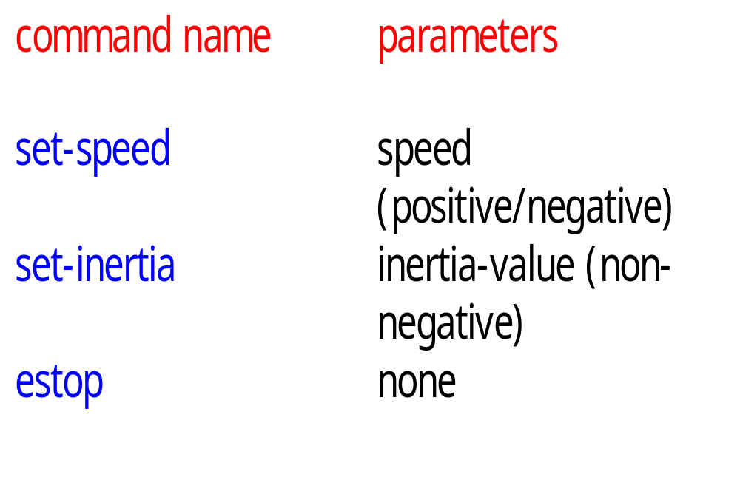
Basic system commands

Slide 43
Typical control sequence
:console
:train_rcvr
set-inertia
set-speed
set-speed
estop
set-speed

Slide 44
Message classes
command
set-speed
set-inertia
estop
value: integer
value: unsigned-
integer

Slide 45
Roles of message classes
Implemented message classes derived from message class.
  Attributes and operations will be filled in for detailed specification.
Implemented message classes specify message type by their class.
  May have to add type as parameter to data structure in implementation.

Slide 46
Subsystem collaboration diagram
Shows relationship between console and receiver (ignores role of track):
1..n: command
:console
:receiver

Slide 47
System structure modeling
Some classes define non-computer components.
  Denote by *name.
Choose important systems at this point to show basic relationships.

Slide 48
Major subsystem roles
Console:
  read state of front panel;
  format messages;
  transmit messages.
Train:
  receive message;
  interpret message;
  control the train.

Slide 49
Console system classes
console
1
1
1
1
1
1
panel
formatter
transmitter
1
1
1
1
receiver*
sender*

Slide 50
Console class roles
panel: describes analog knobs and interface hardware.
formatter: turns knob settings into bit streams.
transmitter: sends data on track.

Slide 51
Train system classes
train set
1
1..t
1
1
train
1
1
motor
interface
receiver
1
1
1
controller
1
1
1
detector*
pulser*

Slide 52
Train class roles
receiver: digitizes signal from track.
controller: interprets received commands and makes control decisions.
motor interface: generates signals required by motor.

Slide 53
Detailed specification
We can now fill in the details of the conceptual specification:
  more classes;
  behaviors.
Sketching out the spec first helps us understand the basic relationships in the system.

Slide 54
Train speed control
Motor controlled by pulse width modulation:
duty
cycle
+
V
-

Slide 55
Console physical object classes
knobs*
pulser*
train-knob: integer
speed-knob: integer
inertia-knob: unsigned-
integer
emergency-stop: boolean
pulse-width: unsigned-
integer
direction: boolean
sender*
detector*
send-bit()
read-bit() : integer

Slide 56
Panel and motor interface classes
panel
motor-interface
speed: integer
train-number() : integer
speed() : integer
inertia() : integer
estop() : boolean
new-settings()

Slide 57
Class descriptions
panel class defines the controls.
  new-settings() behavior reads the controls.
motor-interface class defines the motor speed held as state.

Slide 58
Transmitter and receiver classes
transmitter
receiver
current: command
new: boolean
send-speed(adrs: integer,
speed: integer)
send-inertia(adrs: integer,
val: integer)
set-estop(adrs: integer)
read-cmd()
new-cmd() : boolean
rcv-type(msg-type:
command)
rcv-speed(val: integer)
rcv-inertia(val:integer)

Slide 59
Class descriptions
transmitter class has one behavior for each type of message sent.
receiver function provides methods to:
  detect a new message;
  determine its type;
  read its parameters (estop has no parameters).

Slide 60
Formatter class
formatter
current-train: integer
current-speed[ntrains]: integer
current-inertia[ntrains]:
unsigned-integer
current-estop[ntrains]: boolean
send-command()
panel-active() : boolean
operate()

Slide 61
Formatter class description
Formatter class holds state for each train, setting for current train.
The operate() operation performs the basic formatting task.

Slide 62
Control input cases
Use a soft panel to show current panel settings for each train.
Changing train number:
  must change soft panel settings to reflect current train’s speed, etc.
Controlling throttle/inertia/estop:
  read panel, check for changes, perform command.

Slide 63
Control input sequence diagram
:knobs
:panel
:formatter
:transmitter
change in
control
settings
read panel
panel-active
panel settings
send-command
change in speed/
inertia/estop
read panel
send-speed,
send-inertia.
send-estop
panel settings
read panel
change in
train
number
panel settings
change in
train number
new-settings
set-knobs

Slide 64
Formatter operate behavior
update-panel()
panel-active()
new train number
idle
send-command()
other

Slide 65
Panel-active behavior
T
current-train = train-knob
update-screen
changed = true
panel*:read-train()
F
T
current-speed = throttle
changed = true
panel*:read-speed()
F
...
...

Slide 66
Controller class
controller
current-train: integer
current-speed: integer
current-direction: boolean
current-inertia: unsigned-integer
operate()
issue-command()

Slide 67
Setting the speed
Don’t want to change speed instantaneously.
Controller should change speed gradually by sending several commands.

Slide 68
Sequence diagram for set-speed command
:receiver
:controller
:motor-interface
:pulser*
new-cmd
cmd-type
rcv-speed
set-speed
set-pulse
set-pulse
set-pulse
set-pulse
set-pulse

Slide 69
控制器操作行为
wait for a
command
from receiver
receive-command()
issue-command()

Slide 70
Refined command classes
command
type: 3-bits
address: 3-bits
parity: 1-bit
set-speed
set-inertia
estop
type=010
value: 7-bits
type=001
value: 3-bits
type=000

Slide 71
Summary
单独的规范和编程。
在规范中，小错误更容易修复。
编程中的大错误花费了很多时间。
您不能完全分离规范和体系结构。
做一些有品位的假设。

