Slide 1
Instruction sets
Computer architecture taxonomy.
Assembly language.

Slide 2
von Neumann architecture
Memory holds data, instructions.
Central processing unit (CPU) fetches instructions from memory.
  Separate CPU and memory distinguishes programmable computer.
CPU registers help out: program counter (PC), instruction register (IR), general-purpose registers, etc.

Slide 3
CPU + memory
memory
address
CPU
PC
200
data
ADD r5,r1,r3
ADD r5,r1,r3
200
IR

Slide 4
Harvard architecture
address
CPU
data memory
data
PC
address
program memory
data

Slide 5
von Neumann vs. Harvard
Harvard can’t use self-modifying code.
Harvard allows two simultaneous memory fetches.
Most DSPs use Harvard architecture for streaming data:
  greater memory bandwidth;
  more predictable bandwidth.

Slide 6
RISC vs. CISC
Complex instruction set computer (CISC):
  many addressing modes;
  many operations.
Reduced instruction set computer (RISC):
  load/store;
  pipelinable instructions.

Slide 7
Instruction set characteristics
Fixed vs. variable length.
Addressing modes.
Number of operands.
Types of operands.

Slide 8
Programming model
Programming model: registers visible to the programmer.
Some registers are not visible (IR).

Slide 9
Multiple implementations
Successful architectures have several implementations:
  varying clock speeds;
  different bus widths;
  different cache sizes;
  etc.

Slide 10
Assembly language
One-to-one with instructions (more or less).
Basic features:
  One instruction per line.
  Labels provide names for addresses (usually in first column).
  Instructions often start in later columns.
  Columns run to end of line.

Slide 11
ARM assembly language example
label1 ADR r4,c
LDR r0,[r4] ; a comment
ADR r4,d
LDR r1,[r4]
SUB r0,r0,r1 ; comment

Slide 12
Pseudo-ops
Some assembler directives don’t correspond directly to instructions:
  Define current address.
  Reserve storage.
  Constants.

Slide 13
VLIW
VLIW: very long instruction word.
Performs several instructions simultaneously.
  Architecture usually restricts the combination of instructions that can be performed at once.
Superscalar vs. VLIW:
  Superscalar runs standard code, determines parallel operations at run time.
  VLIW determines parallelism at compile time.
Packet: a set of instructions to be executed in parallel.

Slide 14
VLIW and embedded computing
VLIW is more energy-efficient than superscalar.
VLIW is widely used in signal processing.
  Multimedia processing.
  Processing multiple channels of signals.

Slide 15
ARM instruction set
ARM versions.
ARM assembly language.
ARM programming model.
ARM memory organization.
ARM data operations.
ARM flow of control.

Slide 16
ARM versions
ARM architecture has been extended over several versions.
We will concentrate on ARM7.

Slide 17
ARM assembly language
Fairly standard assembly language:
LDR r0,[r8] ; a comment
label ADD r4,r0,r1

Slide 18
ARM programming model
r0
r8
r1
r9
31
0
r2
r10
r3
r11
CPSR
r4
r12
r5
r13
N Z C V
r6
r14
r7
r15 (PC)

Slide 19
Endianness
Relationship between bit and byte/word ordering defines endianness:
bit 31
bit 0
bit 31
bit 0
byte 3
byte 2
byte 1
byte 0
byte 0
byte 1
byte 2
byte 3
little-endian
big-endian

Slide 20
ARM data types
Word is 32 bits long.
Word can be divided into four 8-bit bytes.
ARM addresses cam be 32 bits long.
Address refers to byte.
  Address 4 starts at byte 4.
Can be configured at power-up as either little- or bit-endian mode.

Slide 21
ARM status bits
Every arithmetic, logical, or shifting operation sets CPSR bits:
  N (negative), Z (zero), C (carry), V (overflow).
Examples:
  -1 + 1 = 0: NZCV = 1001.
  0XFFFFFFFF+0X1=0X0
  2³¹-1+1 = -2³¹: NZCV = 0101.
  0X7FFFFFFF+0X1=0X800000

Slide 22
ARM data instructions
Basic format:
  ADD r0,r1,r2
  Computes r1+r2, stores in r0.
Immediate operand:
  ADD r0,r1,#2
  Computes r1+2, stores in r0.

Slide 23
ARM data instructions
ADD, ADC : add (w. carry)
SUB, SBC : subtract (w. carry)
RSB, RSC : reverse subtract (w. carry)
MUL, MLA : multiply (and accumulate)
AND, ORR, EOR
BIC : bit clear
LSL, LSR : logical shift left/right
ASL, ASR : arithmetic shift left/right
ROR : rotate right
RRX : rotate right extended with C

Slide 24
Data operation varieties
Logical shift:
  fills with zeroes.
Arithmetic shift:
  fills with ones.
RRX performs 33-bit rotate, including C bit from CPSR above sign bit.

Slide 25
ARM comparison instructions
CMP : compare
CMN : negated compare
TST : bit-wise test
TEQ : bit-wise negated test
These instructions set only the NZCV bits of CPSR.

Slide 26
ARM move instructions
MOV: move
MOV r0, r1 ; sets r0 to r1

Slide 27
ARM load/store instructions
LDR, LDRH, LDRB : load (half-word, byte)
STR, STRH, STRB : store (half-word, byte)
Addressing modes:
  register indirect : LDR r0,[r1]
  with second register : LDR r0,[r1,-r2]
  with constant : LDR r0,[r1,#4]

Slide 28
ARM ADR pseudo-op
Cannot refer to an address directly in an instruction.
Generate value by performing arithmetic on PC.
ADR pseudo-op generates instruction required to calculate address:
  ADR r1,FOO

Slide 29
Example: C assignments
C:
  x = (a + b) - c;
Assembler:
ADR r4,a ; get address for a
LDR r0,[r4] ; get value of a
ADR r4,b ; get address for b, reusing r4
LDR r1,[r4] ; get value of b
ADD r3,r0,r1 ; compute a+b
ADR r4,c ; get address for c
LDR r2[r4] ; get value of c

Slide 30
C assignment, cont’d.
SUB r3,r3,r2 ; complete computation of x
ADR r4,x ; get address for x
STR r3 [r4] ; store value of x

Slide 31
Example: C assignment
C:
  y = a*(b+c);
Assembler:
  ADR r4,b ; get address for b
  LDR r0,[r4] ; get value of b
  ADR r4,c ; get address for c
  LDR r1,[r4] ; get value of c
  ADD r2,r0,r1 ; compute partial result
  ADR r4,a ; get address for a
  LDR r0,[r4] ; get value of a

Slide 32
C assignment, cont’d.
  MUL r2,r2,r0 ; compute final value for y
  ADR r4,y ; get address for y
  STR r2,[r4] ; store y

Slide 33
Example: C assignment
C:
  z = (a << 2) | (b & 15);
Assembler:
ADR r4,a ; get address for a
LDR r0,[r4] ; get value of a
MOV r0,r0,LSL 2 ; perform shift
ADR r4,b ; get address for b
LDR r1,[r4] ; get value of b
AND r1,r1,#15 ; perform AND
ORR r1,r0,r1 ; perform OR

Slide 34
C assignment, cont’d.
ADR r4,z ; get address for z
STR r1,[r4] ; store value for z

Slide 35
Additional addressing modes
Base-plus-offset addressing:
  LDR r0,[r1,#16]
  Loads from location r1+16
Auto-indexing increments base register:
  LDR r0,[r1,#16]!
  r1 increase 16,then load r0 from r0
Post-indexing fetches, then does offset:
  LDR r0,[r1],#16
  Loads r0 from r1, then adds 16 to r1.

Slide 36
ARM flow of control
All operations can be performed conditionally, testing CPSR:
  EQ, NE, CS, CC, MI, PL, VS, VC, HI, LS, GE, LT, GT, LE
Branch operation:
  B #100
  Can be performed conditionally.

Slide 37
C:
  if (a > b) { x = 5; y = c + d; } else x = c – d;

Slide 38
Example: if statement
C:
  if (a > b) { x = 5; y = c + d; } else x = c - d;
Assembler:
; compute and test condition
ADR r4,a ; get address for a
LDR r0,[r4] ; get value of a
ADR r4,b ; get address for b
LDR r1,[r4] ; get value for b
CMP r0,r1 ; compare a < b
BGE fblock ; if a >= b, branch to false block

Slide 39
If statement, cont’d.
; true block
MOV r0,#5 ; generate value for x
ADR r4,x ; get address for x
STR r0,[r4] ; store x
ADR r4,c ; get address for c
LDR r0,[r4] ; get value of c
ADR r4,d ; get address for d
LDR r1,[r4] ; get value of d
ADD r0,r0,r1 ; compute y
ADR r4,y ; get address for y
STR r0,[r4] ; store y
B after ; branch around false block

Slide 40
If statement, cont’d.
; false block
fblock ADR r4,c ; get address for c
LDR r0,[r4] ; get value of c
ADR r4,d ; get address for d
LDR r1,[r4] ; get value for d
SUB r0,r0,r1 ; compute a-b
ADR r4,x ; get address for x
STR r0,[r4] ; store value of x
after ...

Slide 41
Example: switch statement
C:
  switch (test) { case 0: … break; case 1: … }
Assembler:
ADR r2,test ; get address for test
LDR r0,[r2] ; load value for test
ADR r1,switchtab ; load address for switch table
LDR r1,[r1,r0,LSL #2] ; index switch table
switchtab DCD case0
DCD case1
...

Slide 42
FIR filter
C:
  for (i=0, f=0; i<N; i++)
  f = f + c[i]*x[i];

Slide 43
Example: FIR filter
C:
  for (i=0, f=0; i<N; i++)
  f = f + c[i]*x[i];
Assembler
; loop initiation code
MOV r0,#0 ; use r0 for I
MOV r8,#0 ; use separate index for arrays
ADR r2,N ; get address for N
LDR r1,[r2] ; get value of N
MOV r2,#0 ; use r2 for f

Slide 44
FIR filter, cont’.d
ADR r3,c ; load r3 with base of c
ADR r5,x ; load r5 with base of x
; loop body
loop LDR r4,[r3,r8] ; get c[i]
LDR r6,[r5,r8] ; get x[i]
MUL r4,r4,r6 ; compute c[i]*x[i]
ADD r2,r2,r4 ; add into running sum
ADD r8,r8,#4 ; add one word offset to array index
ADD r0,r0,#1 ; add 1 to i
CMP r0,r1 ; exit?
BLT loop ; if i < N, continue

Slide 45
ARM subroutine linkage
Branch and link instruction:
  BL foo
  Copies current PC to r14.
To return from subroutine:
  MOV r15,r14

Slide 46
Nested subroutine calls
Nesting/recursion requires coding convention:
f1 LDR r0,[r13] ; load arg into r0 from stack
; call f2()
STR r13!,[r14] ; store f1’s return adrs
STR r13!,[r0] ; store arg to f2 on stack
BL f2 ; branch and link to f2
; return from f1()
SUB r13,#4 ; pop f2’s arg off stack
LDR r13!,r15 ; restore register and return

Slide 47
Summary
Load/store architecture
Most instructions are RISCy, operate in single cycle.
  Some multi-register operations take longer.
All instructions can be executed conditionally.

Slide 48

C55 instruction set

Slide 49
TI C55x instruction set
C55x programming model.
C55x assembly language.
C55x memory organization.
C55x data operations.
C55x flow of control.

Slide 50
TI C55x overview
Accumulator architecture:
  acc = operand op acc.
  Very useful in loops for DSP.
C55x assembly language:
  MPY *AR0, *CDP+, AC0
  Label: MOV #1, T0
C55x algebraic assembly language:
  AC1 = AR0 * coef(*CDP)

Slide 51
Intrinsic functions
Compiler support for assembly language.
Intrinsic function maps directly onto an instruction.
Example:
  int_sadd(arg1,arg2)
  Performs saturation arithmetic addition.

Slide 52
C55x data types
Data types:
  Word: 16 bits.
  Longword: 32 bits.
Instructions are byte-addressable.
Some instructions operate on register bits.

Slide 53
C55x registers
Terminology:
  Register: any type of register.
  Accumulator: acc = operand op ac.
Most registers are memory-mapped.

Slide 54
C55x program counter and control flow registers
PC is program counter.
XPC is program counter extension.
RETA is subroutine return address.

Slide 55
C55x accumulators and status registers
Four 40-bit accumulators: AC0, AC1, AC2, and AC3.
  Low-order bits 0-15 are AC0L, etc.
  High-order bits 16-31 are AC0H, etc.
  Guard bits 32-39 are AC0G, etc.
ST0, ST1, PMST, ST0_55, ST1_55, ST2_55, ST3_55 provide arithmetic/bit manipulation flags, etc.

Slide 56
C55x stack pointers
SP keeps track of user stack.
SSP holds system stack pointer.
SPH is extended data page pointer for both SP and SSP.

Slide 57
C55x auxiliary registers and circular buffer pointers
AR0-AR7 are auxiliary instructions.
CDP points to coefficients for polynomial evaluation instructions. CDPH is main data page pointer.
BK47 is used for circular buffer operations along with AR4-7.
BK03 addresses circular buffers.
BKC is size register for CDP.

Slide 58
C55x block repeat registers
BRC9 counts block repeat instructions.
RSA0L and REA0L keep track of start and end points of blocks.
BRC1 and BRS1 are used to repeat blocks of instructions.
RSA0 and RSA1 are the start address registers for block repeats.

Slide 59
C55x addressing mode and interrupt registers
DP and DPH set base address for data access.
PDP determines base address for I/O.
IER0 and IER1 are interrupt mask registers.
IFR0 and IFR1 keep track of currently pending registers.
DBIER0 and DBIER1 are for debugging.

Slide 60
C55x memory map
24-bit address space, 16 MB of memory.
Data, program, I/O all mapped to same physical memory.
Addressability:
  Program space address is 24 bits.
  Data space is 23 bits.
  I/O address is 16 bits.
main data page 0
memory mapped registers
main data page 1
main data page 2
…
main data page 127

Slide 61
C55x addressing modes
Three addressing modes:
  Absolute addressing supplies an address in an instruction.
  Direct addressing supplies an offset.
  Indirect addressing uses a register as a pointer.

Slide 62
C55x direct addressing
DP addressing accesses data pages:
  A_{DP} = DPH[22:15](DP+Doffset)
SP addressing accesses stack values:
  A_{SP} = SPH[22:15](SP+Soffset)
Register-bit direcdt addressing accesses bits in registers.
PDP addressing accesses data pages:
  A_{PDP} = PDP[15:6]PDPoffset

Slide 63
C55x indirect addressing
AR indirect addressing uses auxiliary register to point to data.
Dual AR indirect addressing allows two simultaneous accesses.
CDP indirect addressing uses CDP to access coefficients.
Coefficient indirect addressing is similar to CDP indirect but for instructions with 3 memory operands per cycle.

Slide 64
C55x stack operations
Two stacks: data and system.
Three different stack configurations:
  Dual 16-bit stack with fast return has independent data and system stacks.
  Dual 16-bit stack with slow return, independent data and system stacks but RETA and CFCT are not used for slow returns.
  32-bit stack with slow return, SP and SSP are both modified by the same amount.

Slide 65
C55x data operations
MOV moves data between registers and memory:
  MOV src, dst
Varieties of ADDs:
  ADD src,dst
  ADD dual(LMEM),ACx,ACy
Multiplication:
  MPY src,dst
  MAC AC,TX,ACy

Slide 66
C55x flow of control
Unconditional branch:
  B ACx
  B label
Conditional branch:
  BCC label, cond
Loops:
  Single-instruction repeat
  Block repeat

Slide 67
Efficient loops
General rules:
  Don’t use function calls.
  Keep loop body small to enable local repeat (only forward branches).
  Use unsigned integer for loop counter.
  Use <= to test loop counter.
  Make use of compiler---global optimization, software pipelining.

Slide 68
Single-instruction repeat loop example
STM #4000h,AR2
; load pointer to source
STM #100h,AR3
; load pointer to destination
RPT #(1024-1)
MVDD *AR2+,*AR3+
; move

Slide 69
C55x subroutines
Unconditional subroutine call:
  CALL target
Conditional subroutine call:
  CALLCC adrs,cond
Two types of return:
  Fast return gives return address and loop context in registers.
  Slow return puts return address/loop on stack.

Slide 70
C55x interrupts
Handled using subroutine mechanism.
Four step handling process:
  Receive interrupt.
  Acknowledge interrupt.
  Prepare for ISR by finishing current instruction, retrieving interrupt vector.
  Processing the interrupt service routine.
32 possible interrupt vectors, 27 priorities.

Slide 71
TI C64 instuction set

Slide 72
TI C64x
High-performance VLIW DSP.
  Up to eight instructions per cycle.
  Divided into two data paths A and B.
Floating-point and integer arithmetic
Harvard architecture.
Instruction grouping:
  Fetch packet is a group of instructions executed together.
  Execute packet instructions are executed together.

Slide 73
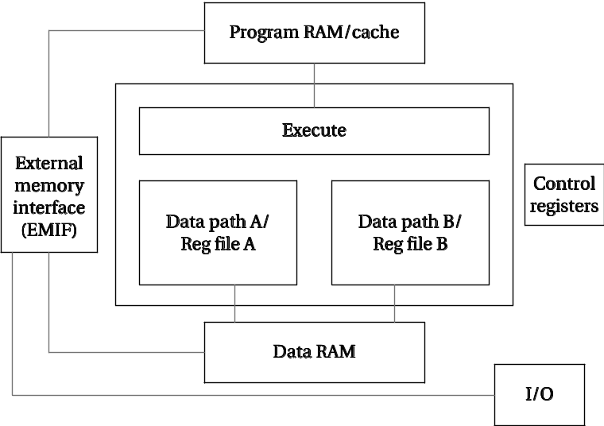
C64x block diagram
Exeuction divided between two data paths.
Each data path has its own register file.
Data must be explicitly copied from one register file to the other.

Slide 74
Function units
.L1 and .L2 perform 32/40-bit arithmetic, 32-bit logical, data packing/unpacking.
.S1 and .S2 perform 32-bit arithmetic, 32/40-bit shift and bit-field ops, 32-bit logical ops, branches, etc.
.M1 and .M2 perform multiplications, bit interleaving, rotation, Galois field multiplication, etc.
.D1 and .D2 perform address calculations, loads/stores, etc.

Slide 75
Constraints on execution packets
Each instruction must execute on a separate function unit.
Most .M write combinations are illegal.
Most cases of reading multiple values from opposite register file.
Delay cycle added for register read after update from cross-path.
Cannot execute two load/store usign dest/source from same reg file.
At most four reads of a register.
Can’t write to register twice.

Slide 76
Other features
Atomic operations for semaphores.
Circular addressing modes.
Delay slots to use instruction slots after a multi-cycle operation.
Interrupts mediated by registers IFR and IER.

Slide 77
PRACTICE
  USE TI CC implement the following algorithm in C55X AND C64X assembly language:
  for (i=0, f=0; i<N; i++)
  f = f + c[i]*x[i];
  COMPARE THE ASSEMLY PROGRAM FEATURES BETWEEN ARM,C55X AND C64X .

Slide 78
PIC 16F instruction set
DISCUSS THE FEATURES OF THE PIC16F MICRO CONTROLLERS,ACCORDING THE DATASHEET PROVIDED.
IN GROUP ,FOR 15 MINUTES.
THEN ADDRESS YOUR IDEAS.

Slide 79
PICmicro PIC16F
PIC16F processor and memory organization.
PIC16F data operations.
PIC16F flow of control.

Slide 80
Processor and memory organization
Exact features vary from model to model.
Harvard architecture.
Instruction flash memory up to 8192 words.
  Instructions are 14 bits long.
Data memory includes up to 368 words SRAM and 256 bytes EEPROM.
  Data is byte-addressable.

Slide 81
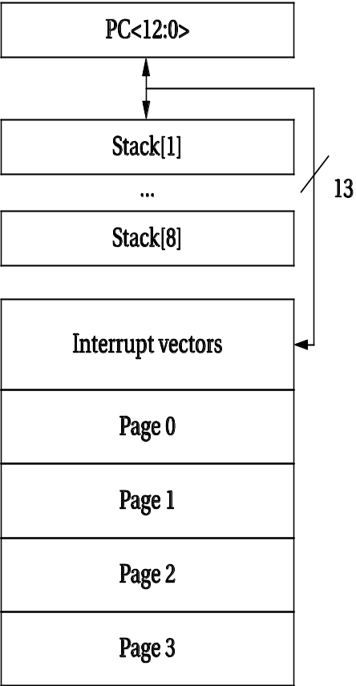
Addresses and instructinos
PC is 13 bits.
Shadowed by PCL and PCLATH.
Interrupt vectors in bottom of memory.
Memory divided into pages.

Slide 82
Program counter and status register
PC can be loaded from 8-level stack.
  Separate from program and data memory.
Stack operates as a circular buffer.
Used by CALL, RETURN/RETLW/RETFIE.
STATUS located in bank 0.
  ALU status, reset, bank select.

Slide 83
Data space
General purpose register: data memory location.
Special function register: I/O devices, etc.

Slide 84
Addressing modes
Terminology:
  f: general-purpose register.
  W: accumulator.
  b: bit address in register.
  k: constant, or label.
Indirect addressing controlled by INDF and FSR registers.
  Access to INDF causes indirect load through FSR.

Slide 85
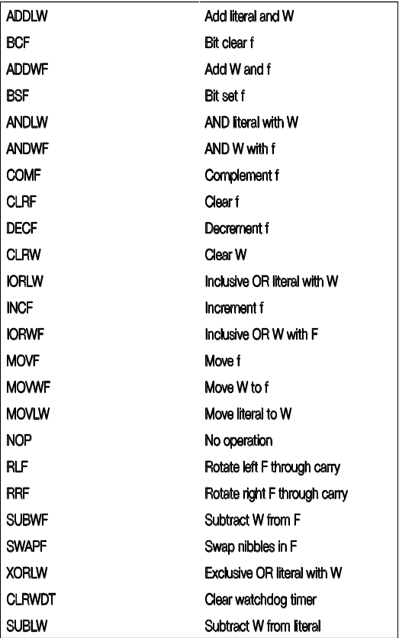
Data instructinos
Arithmetic.
Boolean.
Move.
Rotate.
Swap.
Watchdog timer.

Slide 86
FIR filter example
.L2:
lw $2,0($fp)
slt $2,$2,8
beq $2,$0,.L3 ; loop test---done?
nop ; fall through branch here
lw $
sll $2,$2,2 ; compute address of first array value
addu $3,$2,$fp
lw $2,0($fp) 2,0($fp)
sll $2,$2,2 ; second array adrs
addu $2,$2,$fp
lw $3,8($3) ; get first array value
lw $2,40($2) ; get second array
mul $3,$3,$2 ; multiply
lw $2,4($fp)
addu $2,$2,$3 ; running sum
sw $2,4($fp) ; store result
lw $2,0($fp)
addiu $2,$2,1 ; increment loop
sw $2,0($fp)
b .L2 ; go back to the loop test
nop

Slide 87
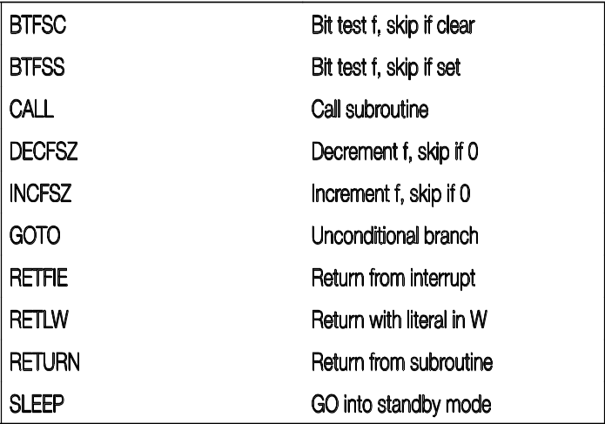
Flow of control
Unconditional branch.
Conditioanl branch.
Subroutine call/return.
Interrupt return.
Standby mode.

