Slide 1
CPUs
Input and output.
Supervisor mode, exceptions, traps.
Co-processors.

Slide 2
I/O devices
Usually includes some non-digital component.
Typical digital interface to CPU:
CPU
status
reg
mechanism
data
reg

Slide 3
Application: 8251 UART
Universal asynchronous receiver transmitter (UART) : provides serial communication.
8251 functions are integrated into standard PC interface chip.
Allows many communication parameters to be programmed.

Slide 4
Serial communication
Characters are transmitted separately:
no
char
bit 0
bit 1
...
bit n-1
start
stop
time

Slide 5
Serial communication parameters
Baud (bit) rate.
Number of bits per character.
Parity/no parity.
Even/odd parity.
Length of stop bit (1, 1.5, 2 bits).

Slide 6
8251 CPU interface
8251
CPU
status
(8 bit)
xmit/
rcv
data
(8 bit)
serial
port

Slide 7
Serial port mode bits
mode[1:0]: baud rate
  00: synchronous
  01: async, no clock prescaler
  10: async, 16x prescaler
  11: async, 64x prescaler
mode[3:2]: bits/char
  00: 5 bits
  01: 6 bits
  10: 7 bits
  11: 8 bits.
mode[5:4]: parity
  00, 10: no parity
  01: odd parity
  11: even parity
mode[7:6]: stop bit
  00: invalid
  01: 1 stop bit
  10: 1.5 stop bits
  11: 2 stop bits

Slide 8
Serial port command register
mode[0]: transmit enable
mode[1]: set nDTR output
mode[2]: enable receiver
mode[3]: send break
mode[4]: reset error flags
mode[5]: set nRTS
mode[6]: internal reset
mode[7]: hunt mode

Slide 9
Serial port status register
status[0]: transmitter ready
status[1]: receiver ready
status[2]: transmission complete
status[3]: parity
status[4]: overrun
status[5]: frame error
status[6]: sync char deleted
status[7]: nDSR value

Slide 10
Programming I/O
Two types of instructions can support I/O:
  special-purpose I/O instructions;
  memory-mapped load/store instructions.
Intel x86 provides in, out instructions. Most other CPUs use memory-mapped I/O.
I/O instructions do not preclude memory-mapped I/O.

Slide 11
ARM memory-mapped I/O
Define location for device:
DEV1 EQU 0x1000
Read/write code:
  LDR r1,#DEV1 ; set up device adrs
  LDR r0,[r1] ; read DEV1
  LDR r0,#8 ; set up value to write
  STR r0,[r1] ; write value to device

Slide 12
SHARC memory mapped I/O
Device must be in external memory space (above 0x400000).
Use DM to control access:
  I0 = 0x400000;
  M0 = 0;
  R1 = DM(I0,M0);

Slide 13
Peek and poke
Traditional HLL interfaces:
  int peek(char *location) {
  return *location; }
  void poke(char *location, char newval) {
  (*location) = newval; }

Slide 14
Busy/wait output
Simplest way to program device.
  Use instructions to test when device is ready.
current_char = mystring;
while (*current_char != ‘\0’) {
poke(OUT_CHAR,*current_char);
while (peek(OUT_STATUS) != 0);
current_char++;
}

Slide 15
Simultaneous busy/wait input and output
while (TRUE) {
/* read */
while (peek(IN_STATUS) == 0);
achar = (char)peek(IN_DATA);
/* write */
poke(OUT_DATA,achar);
poke(OUT_STATUS,1);
while (peek(OUT_STATUS) != 0);
}

Slide 16
Interrupt I/O
Busy/wait is very inefficient.
  CPU can’t do other work while testing device.
  Hard to do simultaneous I/O.
Interrupts allow a device to change the flow of control in the CPU.
  Causes subroutine call to handle device.

Slide 17
Interrupt interface
intr request
CPU
status
reg
intr ack
IR
PC
mechanism
data/address
data
reg

Slide 18
Interrupt behavior
Based on subroutine call mechanism.
Interrupt forces next instruction to be a subroutine call to a predetermined location.
  Return address is saved to resume executing foreground program.

Slide 19
Interrupt physical interface
CPU and device are connected by CPU bus.
CPU and device handshake:
  device asserts interrupt request;
  CPU asserts interrupt acknowledge when it can handle the interrupt.

Slide 20
Example: character I/O handlers
void input_handler() {
achar = peek(IN_DATA);
gotchar = TRUE;
poke(IN_STATUS,0);
}
void output_handler() {
}

Slide 21
Example: interrupt-driven main program
main() {
while (TRUE) {
if (gotchar) {
poke(OUT_DATA,achar);
poke(OUT_STATUS,1);
gotchar = FALSE;
}
}
}

Slide 22
Example: interrupt I/O with buffers
Queue for characters:
a
head
head
tail
tail

Slide 23
Buffer-based input handler
void input_handler() {
char achar;
if (full_buffer()) error = 1;
else { achar = peek(IN_DATA); add_char(achar); }
poke(IN_STATUS,0);
if (nchars == 1)
{ poke(OUT_DATA,remove_char(); poke(OUT_STATUS,1); }
}

Slide 24


Slide 25
I/O sequence diagram
:foreground
:input
:output
:queue
empty
a
empty
b
bc
c

Slide 26
Debugging interrupt code
What if you forget to change registers?
  Foreground program can exhibit mysterious bugs.
  Bugs will be hard to repeat---depend on interrupt timing.

Slide 27
Priorities and vectors
Two mechanisms allow us to make interrupts more specific:
  Priorities determine what interrupt gets CPU first.
  Vectors determine what code is called for each type of interrupt.
Mechanisms are orthogonal: most CPUs provide both.

Slide 28
Prioritized interrupts
device 1
device 2
device n
interrupt
acknowledge
CPU
L1 L2 .. Ln

Slide 29
Interrupt prioritization
Masking: interrupt with priority lower than current priority is not recognized until pending interrupt is complete.
Non-maskable interrupt (NMI): highest-priority, never masked.
  Often used for power-down.

Slide 30
Example: Prioritized I/O
:interrupts
:foreground
:A
:B
:C
B
C
A
A,B

Slide 31
Interrupt vectors
Allow different devices to be handled by different code.
Interrupt vector table:
Interrupt
vector
table head
handler 0
handler 1
handler 2
handler 3

Slide 32
Interrupt vector acquisition
:CPU
:device
receive
request
receive
ack
receive
vector

Slide 33
Generic interrupt mechanism
continue
execution
intr?
N
Assume priority selection is handled before this point.
Y
ignore
N
intr priority >
current priority?
Y
ack
Y
Y
bus error
N
timeout?
vector?
Y
call table[vector]

Slide 34
Interrupt sequence
CPU acknowledges request.
Device sends vector.
CPU calls handler.
Software processes request.
CPU restores state to foreground program.

Slide 35
Sources of interrupt overhead
Handler execution time.
Interrupt mechanism overhead.
Register save/restore.
Pipeline-related penalties.
Cache-related penalties.

Slide 36
ARM interrupts
ARM7 supports two types of interrupts:
  Fast interrupt requests (FIQs).
  Interrupt requests (IRQs).
Interrupt table starts at location 0.

Slide 37
ARM interrupt procedure
CPU actions:
  Save PC. Copy CPSR to SPSR.
  Force bits in CPSR to record interrupt.
  Force PC to vector.
Handler responsibilities:
  Restore proper PC.
  Restore CPSR from SPSR.
  Clear interrupt disable flags.

Slide 38
ARM interrupt latency
Worst-case latency to respond to interrupt is 27 cycles:
  Two cycles to synchronize external request.
  Up to 20 cycles to complete current instruction.
  Three cycles for data abort.
  Two cycles to enter interrupt handling state.

Slide 39
C55x interrupts
Latency is between 7 and 13 cycles.
Maskable interrupt sequence:
  Interrupt flag register is set.
  Interrupt enable register is checked.
  Interrupt mask register is checked.
  Interrupt flag register is cleared.
  Appropriate registers are saved.
  INTM set to 1, DBGM set to 1, EALLOW set to 0.
  Branch to ISR.
Two styles of return: fast and slow.

Slide 40
PIC16F interrupts
Synchronous interrupts come from inside CPU.
Asynchronous interrupts come from outside CPU.
INTCON register holds interrupt control bits.
  GIE allows unmasked interrupts.
  PIE allows peripheral interrupts.
  TMR0 enables timer 0.
  INT enables external interrupts.
  PIR1/PIR2 control peripheral interrupts.
RETFIE used to return from interrupts.
Latency:
  Synchronous: 3Tcy
  Asynchronous: 3 to 3.75 Tcy

Slide 41
Supervisor mode
May want to provide protective barriers between programs.
  Avoid memory corruption.
Need supervisor mode to manage the various programs.
SHARC does not have a supervisor mode.

Slide 42
ARM supervisor mode
Use SWI instruction to enter supervisor mode, similar to subroutine:
  SWI CODE_1
Sets PC.
Argument to SWI is passed to supervisor mode code.
Saves CPSR in SPSR.

Slide 43
Exception
Exception: internally detected error.
Exceptions are synchronous with instructions but unpredictable.
Build exception mechanism on top of interrupt mechanism.
Exceptions are usually prioritized and vectorized.

Slide 44
Trap
Trap (software interrupt): an exception generated by an instruction.
  Call supervisor mode.
ARM uses SWI instruction for traps.
SHARC offers three levels of software interrupts.
  Called by setting bits in IRPTL register.

Slide 45
Co-processor
Co-processor: added function unit that is called by instruction.
  Floating-point units are often structured as co-processors.
ARM allows up to 16 designer-selected co-processors.
  Floating-point co-processor uses units 1, 2.
C55x uses co-processors as well.

Slide 46
C55x image/video hardware extensions
Available in 5509 and 5510.
  Equivalent C-callable functions for other devices.
Available extensions:
  DCT/IDCT.
  Pixel interpolation
  Motion estimation.

Slide 47
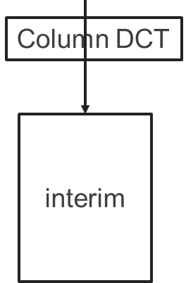
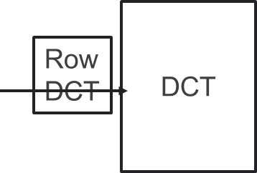
DCT/IDCT
2-D DCT/IDCT is computed from two 1-D DCT/IDCT.
  Put data in different banks to maximize throughput.
block

Slide 48
C55 DCT/IDCT coprocessor extensions
Load, compute, transfer to accumulators:
  ACy=copr(k8,ACx,Xmem,Ymem)
Compute, transfer, mem write:
  ACy=copr(k8,ACx,ACy), Lmem=ACz
Special:
  ACy=copr(k8,ACx,ACy)

Slide 49
Software pipelined load/compute/store for DCT
Iteration i-1
Iteration i
Iteration i+1
Dual_load
Dual_load
Dual_load
op_i(0), load_i+1(0,1)
4 empty
4 empty
4 empty
op_i(1), store_i-1(0,1)
op_i(2), store_i-1(2,3)
op_i(2), store_i-1(4,5)
3
Dual_load
3
Dual_load
3
Dual_load
op_i(2), store_i-1(6,7)
op_i(2), load_i+1(2,3)
…
8
compute
8
compute
8
compute
empty
empty
empty
4
Long_store
4
Long_store
4
Long_store

Slide 50
C55 motion estimation
Search strategy:
  Full vs. non-full.
Accuracy:
  Full-pixel vs. half-pixel.
Number of returned motion vectors:
  1 (one 16x16) vs. 4 (four 8x8).
Algorithms:
  3-step algorithm (distance 4,2,1).
  4-step algorithm (distance 8,4,2,1).
  4-step with half-pixel refinement.

Slide 51
Four-step motion estimation breakdown
d = {8,4,2,1};
for (i=0; i<4; i++) {
compute 3 upper differences for d[i];
compute 3 middle differences for d[i];
compute 3 lower differences for d[i];
compute minimum value;
move to next d;
}
X

Slide 52
C55 motion estimation accelerator
Includes 3 16-bit pixel data paths, 3 16-bit absolute differences (ADs).
Basic operation:
  [ACx,ACy] = copr(k8,ACx,ACy,Xmem,Ymem,Coeff)
  K8 = control bits (enable AD units, etc.)
  ACx, ACy = accumulated absolute differences
  Xmem, Ymem = pointers to odd, even lines of the search window
  Pointer to two adjacent pixels from reference window

Slide 53
C55 pixel interpolation
Given four pixels A, B, C, D, interpolate three half-pixels:
A
U
B
M
R
C
D

Slide 54
Pixel interpolation coprocessor operations
Load pixels and compute:
  ACy=copr(k8,AC,Lmem)
Load pixels, compute, and store:
  ACy=copr(k8,AACx,Lmem) || Lmem=ACz

Slide 55
Pixel interpolation coprocessor operations
Load pixels and compute:
  ACy=copr(k8,AC,Lmem)
Load pixels, compute, and store:
  ACy=copr(k8,AACx,Lmem) || Lmem=ACz

Slide 56
CPUs
Caches.
Memory management.

Slide 57
Caches and CPUs
address
data
cache
main
memory
CPU
cache
controller
address
data
data

Slide 58
Cache operation
Many main memory locations are mapped onto one cache entry.
May have caches for:
  instructions;
  data;
  data + instructions (unified).
Memory access time is no longer deterministic.

Slide 59
Terms
Cache hit: required location is in cache.
Cache miss: required location is not in cache.
Working set: set of locations used by program in a time interval.

Slide 60
Types of misses
Compulsory (cold): location has never been accessed.
Capacity: working set is too large.
Conflict: multiple locations in working set map to same cache entry.

Slide 61
Memory system performance
h = cache hit rate.
t_{cache} = cache access time, t_{main} = main memory access time.
Average memory access time:
  t_{av} = ht_{cache} + (1-h)t_{main}

Slide 62
Multiple levels of cache
L2 cache
CPU
L1 cache

Slide 63
Multi-level cache access time
h₁ = cache hit rate.
h₂ = rate for miss on L1, hit on L2.
Average memory access time:
  t_{av} = h₁t_{L1} + (h₂-h₁)t_{L2 +} (1- h₂-h₁)t_{main}

Slide 64
Replacement policies
Replacement policy: strategy for choosing which cache entry to throw out to make room for a new memory location.
Two popular strategies:
  Random.
  Least-recently used (LRU).

Slide 65
Cache organizations
Fully-associative: any memory location can be stored anywhere in the cache (almost never implemented).
Direct-mapped: each memory location maps onto exactly one cache entry.
N-way set-associative: each memory location can go into one of n sets.

Slide 66
Cache performance benefits
Keep frequently-accessed locations in fast cache.
Cache retrieves more than one word at a time.
  Sequential accesses are faster after first access.

Slide 67
Direct-mapped cache
valid
tag
data
1
0xabcd
byte byte byte ...
cache block
tag
index
offset
=
hit
value
byte

Slide 68
Write operations
Write-through: immediately copy write to main memory.
Write-back: write to main memory only when location is removed from cache.

Slide 69
Direct-mapped cache locations
Many locations map onto the same cache block.
Conflict misses are easy to generate:
  Array a[] uses locations 0, 1, 2, …
  Array b[] uses locations 1024, 1025, 1026, …
  Operation a[i] + b[i] generates conflict misses.

Slide 70
Set-associative cache
A set of direct-mapped caches:
Set 1
Set 2
Set n
...
hit
data

Slide 71
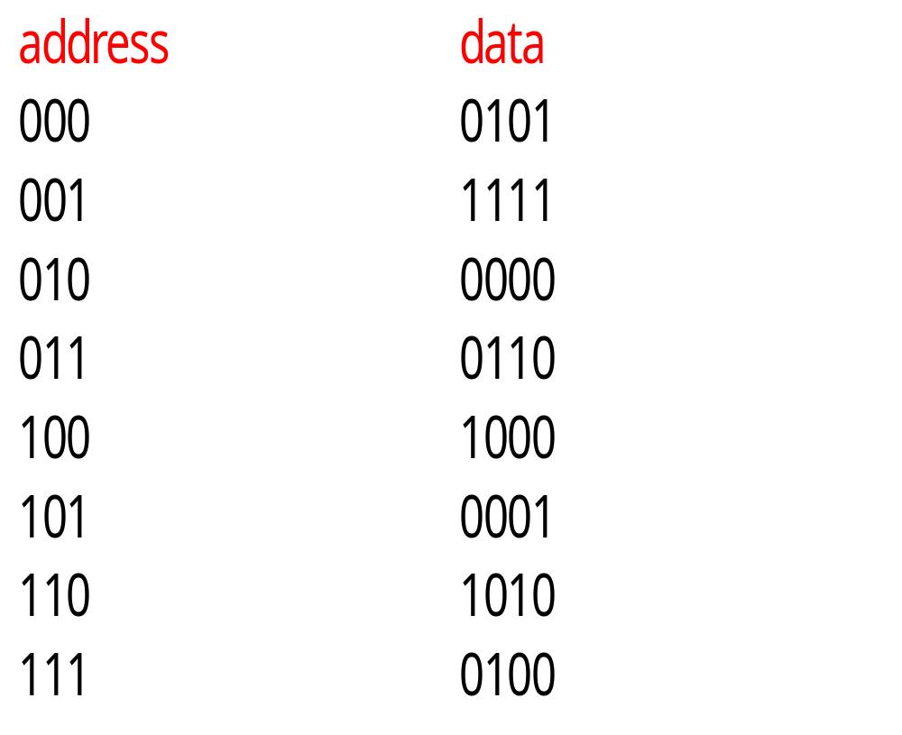
Example: direct-mapped vs. set-associative

Slide 72
Direct-mapped cache behavior
After 001 access:
  block tag data
  00 - -
  01 0 1111
  10 - -
  11 - -
After 010 access:
  block tag data
  00 - -
  01 0 1111
  10 0 0000
  11 - -

Slide 73
Direct-mapped cache behavior, cont’d.
After 011 access:
  block tag data
  00 - -
  01 0 1111
  10 0 0000
  11 0 0110
After 100 access:
  block tag data
  00 1 1000
  01 0 1111
  10 0 0000
  11 0 0110

Slide 74
Direct-mapped cache behavior, cont’d.
After 101 access:
  block tag data
  00 1 1000
  01 1 0001
  10 0 0000
  11 0 0110
After 111 access:
  block tag data
  00 1 1000
  01 1 0001
  10 0 0000
  11 1 0100

Slide 75
2-way set-associtive cache behavior
Final state of cache (twice as big as direct-mapped):
  set blk 0 tag blk 0 data blk 1 tag blk 1 data
  00 1 1000 - -
  01 0 1111 1 0001
  10 0 0000 - -
  11 0 0110 1 0100

Slide 76
2-way set-associative cache behavior
Final state of cache (same size as direct-mapped):
  set blk 0 tag blk 0 data blk 1 tag blk 1 data
  0 01 0000 10 1000
  1 10 0111 11 0100

Slide 77
Example caches
StrongARM:
  16 Kbyte, 32-way, 32-byte block instruction cache.
  16 Kbyte, 32-way, 32-byte block data cache (write-back).
SHARC:
  32-instruction, 2-way instruction cache.

Slide 78
Memory management units
Memory management unit (MMU) translates addresses:
main
memory
CPU
logical
address
memory
management
unit
physical
address

Slide 79
Memory management tasks
Allows programs to move in physical memory during execution.
Allows virtual memory:
  memory images kept in secondary storage;
  images returned to main memory on demand during execution.
Page fault: request for location not resident in memory.

Slide 80
Address translation
Requires some sort of register/table to allow arbitrary mappings of logical to physical addresses.
Two basic schemes:
  segmented;
  paged.
Segmentation and paging can be combined (x86).

Slide 81
Segments and pages
memory
segment 1
page 1
page 2
segment 2

Slide 82
Segment address translation
segment base address
logical address
+
segment lower bound
range
check
range
error
segment upper bound
physical address

Slide 83
Page address translation
page
offset
page i base
concatenate
page
offset

Slide 84



Page table organizations
page
descriptor
page descriptor
flat
tree

Slide 85
Caching address translations
Large translation tables require main memory access.
TLB: cache for address translation.
  Typically small.

Slide 86
ARM memory management
Memory region types:
  section: 1 Mbyte block;
  large page: 64 kbytes;
  small page: 4 kbytes.
An address is marked as section-mapped or page-mapped.
Two-level translation scheme.

Slide 87
ARM address translation
Translation table
base register
1st index
2nd index
offset
1st level table
descriptor
concatenate
concatenate
2nd level table
descriptor
physical address

Slide 88
CPUs
CPU performance.
CPU power consumption and power management.
Safety and security.

Slide 89
Elements of CPU performance
Cycle time.
CPU pipeline.
Memory system.

Slide 90
Pipelining
Several instructions are executed simultaneously at different stages of completion.
Various conditions can cause pipeline bubbles that reduce utilization:
  branches;
  memory system delays;
  etc.

Slide 91
Performance measures
Latency: time it takes for an instruction to get through the pipeline.
Throughput: number of instructions executed per time period.
Pipelining increases throughput without reducing latency.

Slide 92
ARM7 pipeline
ARM 7 has 3-stage pipe:
  fetch instruction from memory;
  decode opcode and operands;
  execute.

Slide 93
ARM pipeline execution
add r0,r1,#5
fetch
decode
execute
sub r2,r3,r6
fetch
decode
execute
cmp r2,#3
fetch
decode
execute
time
1
2
3

Slide 94
Pipeline stalls
If every step cannot be completed in the same amount of time, pipeline stalls.
Bubbles introduced by stall increase latency, reduce throughput.

Slide 95
ARM multi-cycle LDMIA instruction
ldmia
r0,{r2,r3}
fetch
decode
ex ld r2
ex ld r3
sub
r2,r3,r6
fetch
decode
ex sub
cmp
r2,#3
fetch
decode
ex cmp
time

Slide 96
Control stalls
Branches often introduce stalls (branch penalty).
  Stall time may depend on whether branch is taken.
May have to squash instructions that already started executing.
Don’t know what to fetch until condition is evaluated.

Slide 97
ARM pipelined branch
bne foo
fetch
decode
ex bne
ex bne
ex bne
sub r2,r3,r6
fetch
decode
foo add r0,r1,r2
fetch
decode
ex add
time

Slide 98
Delayed branch
To increase pipeline efficiency, delayed branch mechanism requires n instructions after branch always executed whether branch is executed or not.
SHARC supports delayed and non-delayed branches.
  Specified by bit in branch instruction.
  2 instruction branch delay slot.

Slide 99
Example: ARM execution time
Determine execution time of FIR filter:
  for (i=0, f=0; i<N; i++)
  f = f + c[i]*x[i];
Only branch in loop test may take more than one cycle.
  BLT loop takes 1 cycle best case, 3 worst case.

Slide 100
FIR filter ARM code
; loop initiation code
MOV r0,#0 ; use r0 for i, set to 0
MOV r8,#0 ; use a separate index for arrays
ADR r2,N ; get address for N
LDR r1,[r2] ; get value of N
MOV r2,#0 ; use r2 for f, set to 0
ADR r3,c ; load r3 with address of base of c
ADR r5,x ; load r5 with address of base of x
; test for exit
Loop CMP r0,r1
BGE loopend ; if I >= N, exit
; loop body
LDR r4,[r3,r8] ; get value of c[i]
LDR r6,[r5,r8] ; get value of x[i]
MUL r4,r4,r6 ; compute c[i]*x[i]
ADD r2,r2,r4 ; add into running sum
; update
ADD r8,r8,#4 ; add one to array index
ADD r0,r0,#1 ; add 1 to i
B loop
loopend ...

Slide 101
FIR filter block diagram
initiation
t_{init}
executed once
test
t_{test}
executed N+1 times
body
t_{body}
executed N times
update
t_{update}

Slide 102
FIR filter performance by block
Block | Variable | # instructions | # cycles
Initiation | t_{init} | 7 | 7
Test | t_{test} | 2 | [2,4]
Body | t_{body} | 4 | 4
Update | t_{update} | 3 | 3
t_{loop} = t_{init}+ N(t_{body} + t_{update} + t_{test,best}) + t_{test,worst}
Loop exit fails is best case
Loop exit succeeds is worst case

Slide 103
PIC16F execution time
Instruction divided into four Q cycles:
  Q1 decodes.
  Q2 reads operands.
  Q3 performs data operations.
  Q4 writes data.
One Q cycle per clock cycle.
Execution time for one instruction is Tcy.

Slide 104
PIC16F instruction timing
Most instructions execute in one cycle, except:
  CALL, GOTO, RETFIE, RETLW, RETURN require 2 cycles.
  Skip-if instructions require two cycles if skip is taken.

Slide 105
PIC16F loop execution timing
This program sets a bit on an I/O device for a data-dependent amount of time.
Computed goto determines number of bsfs executed.
  len=1 -> go to len3, etc.
movf len, w ; get ready for computed goto
addwf pcl, f ; computed goto (PCL is low byte of PC)
len3: bsf x, I ; set the bit at t-3
len2: bsf x,l ; set the bit at t-2
len1: bsf x,l ; set the bit at t-1
bcf x, l ; clear the bit at t

Slide 106
C55x pipeline
C55x has 7-stage pipe:
  fetch;
  decode;
  address: computes data/branch addresses;
  access 1: reads data;
  access 2: finishes data read;
  Read stage: puts operands on internal busses;
  execute.

Slide 107
C55x organization
B bus
C, D busses
3 data read busses
D bus
16
3 data read address busses
24
program address bus
24
program
read bus
Instruction
unit
Program
flow
unit
Address
unit
Data
unit
32
Dual operand
read
Dual-multiply
coefficient
Instruction
fetch
Writes
Data read
from memory
Single operand
read
2 data write busses
16
2 data write address busses
24

Slide 108
C55x pipeline hazards
Processor structure:
  Three computation units.
  14 operators.
Can perform two operations per instruction.
Some combinations of operators are not legal.

Slide 109
C55x hazards
A-unit ALU/A-unit ALU.
A-unit swap/A-unit swap.
D-unit ALU,shifter,MAC/D-unit ALU,shifter,MAC
D-unit shifter/D-unit shift, store
D-unit shift, store/D-unit shift, store
D-unit swap/D-unit swap
P-unit control/P-unit control

Slide 110
Memory system performance
Caches introduce indeterminacy in execution time.
  Depends on order of execution.
Cache miss penalty: added time due to a cache miss.

Slide 111
Types of cache misses
Compulsory miss: location has not been referenced before.
Conflict miss: two locations are fighting for the same block.
Capacity miss: working set is too large.

Slide 112
CPU power consumption
Most modern CPUs are designed with power consumption in mind to some degree.
Power vs. energy:
  heat depends on power consumption;
  battery life depends on energy consumption.

Slide 113
CMOS power consumption
Voltage drops: power consumption proportional to V².
Toggling: more activity means more power.
Leakage: basic circuit characteristics; can be eliminated by disconnecting power.

Slide 114
CPU power-saving strategies
Reduce power supply voltage.
Run at lower clock frequency.
Disable function units with control signals when not in use.
Disconnect parts from power supply when not in use.

Slide 115
C55x low power features
Parallel execution units---longer idle shutdown times.
Multiple data widths:
  16-bit ALU vs. 40-bit ALU.
Instruction caches minimizes main memory accesses.
Power management:
  Function unit idle detection.
  Memory idle detection.
  User-configurable IDLE domains allow programmer control of what hardware is shut down.

Slide 116
Power management styles
Static power management: does not depend on CPU activity.
  Example: user-activated power-down mode.
Dynamic power management: based on CPU activity.
  Example: disabling off function units.

Slide 117
Application: PowerPC 603 energy features
Provides doze, nap, sleep modes.
Dynamic power management features:
  Uses static logic.
  Can shut down unused execution units.
  Cache organized into subarrays to minimize amount of active circuitry.

Slide 118
PowerPC 603 activity
Percentage of time units are idle for SPEC integer/floating-point:
unit Specint92 Specfp92
D cache 29% 28%
I cache 29% 17%
load/store 35% 17%
fixed-point 38% 76%
floating-point 99% 30%
system register 89% 97%

Slide 119
Power-down costs
Going into a power-down mode costs:
  time;
  energy.
Must determine if going into mode is worthwhile.
Can model CPU power states with power state machine.

Slide 120
Application: NXP LPC 1311
Four power modes:
  Run: normal operation.
  Sleep: stops CPU clock, with CPU and peripheral logic still powered. Peripherals may initiate interrupts that wake up the CPU.
  Deep sleep: stops CPU clock, powers down most analog blocks, maintains CPU and peripheral registers and SRAM values.
  Deep power-down: power and clocks shut down to entire chip, registers and SRAM not maintained.

Slide 121
LPC1311 power state machine
P_{run} = 56 mW
run
2.9 μs
240 μs
23.6 μs
sleep
deep sleep
deep power-down
P_{sleep} = 6.6 mW
P_{deep} _{power-down} = 667 nA
P_{deep} _{sleep} = 89 μA

Slide 122
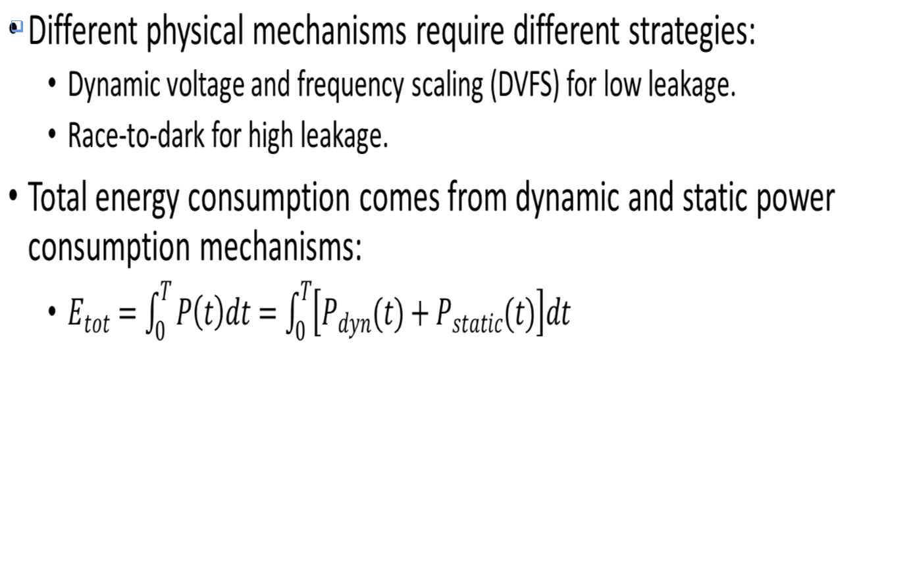
Power management

Slide 123
Two power management strategies
DVFS used for cases when power consumption is dominated by dynamic power.
Characteristics as a function of power supply voltage:
  Clock frequency proportional to power supply.
  Power consumption proportional to square of power supply.
Reducing power supply voltage reduces performance but reduces power consumption more.
Adjust power supply voltage to level just fast enough for current tasks.
Race-to-dark used when power consumption is dominated by static power.
Run as fast as possible, then remove power supply from logic to eliminate static power consumption.

Slide 124
Safety and security
Programs that perform important operations should run in trusted mode.
Supervisor mode, memory management provide some level of trust but does not ensure that the code comes from a trusted source.
Testing a digital signature for software before executing ensures that the software comes from a trusted source.

Slide 125
Trusted programs and root of trust
Checking a digital signature for code requires a public key.
  Public key must come from a trusted source.
A trusted program may rely on another trusted program, etc.
  New program’s level of trustworthiness depends on the previous program’s trustworthiness.
Trust must eventually be traced back to a root of trust that provides known trust.
Root of trust can be provided with a hardware key that cannot be altered.

Slide 126
Smart cards
Smart cards are used for financial, medical, other types of secure information.
  Must operate at very low energy levels and very low cost.
Runs from extneral power supply.
Some code held in ROM.
Permanent storage in non-volatile EEPROM.
Cryptography engine provides low power operation, trusted functions.
I/O
CPU
crypto
ROM
RAM
EEPROM

Slide 127
CPUs
Example: data compressor.

Slide 128
Goals
Compress data transmitted over serial line.
  Receives byte-size input symbols.
  Produces output symbols packed into bytes.
Will build software module only here.

Slide 129
Collaboration diagram for compressor
1..m: packed
output
symbols
1..n: input
symbols
:input
:data compressor
:output

Slide 130
Huffman coding
Early statistical text compression algorithm.
Select non-uniform size codes.
  Use shorter codes for more common symbols.
  Use longer codes for less common symbols.
To allow decoding, codes must have unique prefixes.
  No code can be a prefix of a longer valid code.

Slide 131
Huffman example
character P
a .45
b .24
c .11
d .08
e .07
f .05
P=1
P=.55
P=.31
P=.19
P=.12

Slide 132
Example Huffman code
Read code from root to leaves:
a 1
b 01
c 0000
d 0001
e 0010
f 0011

Slide 133
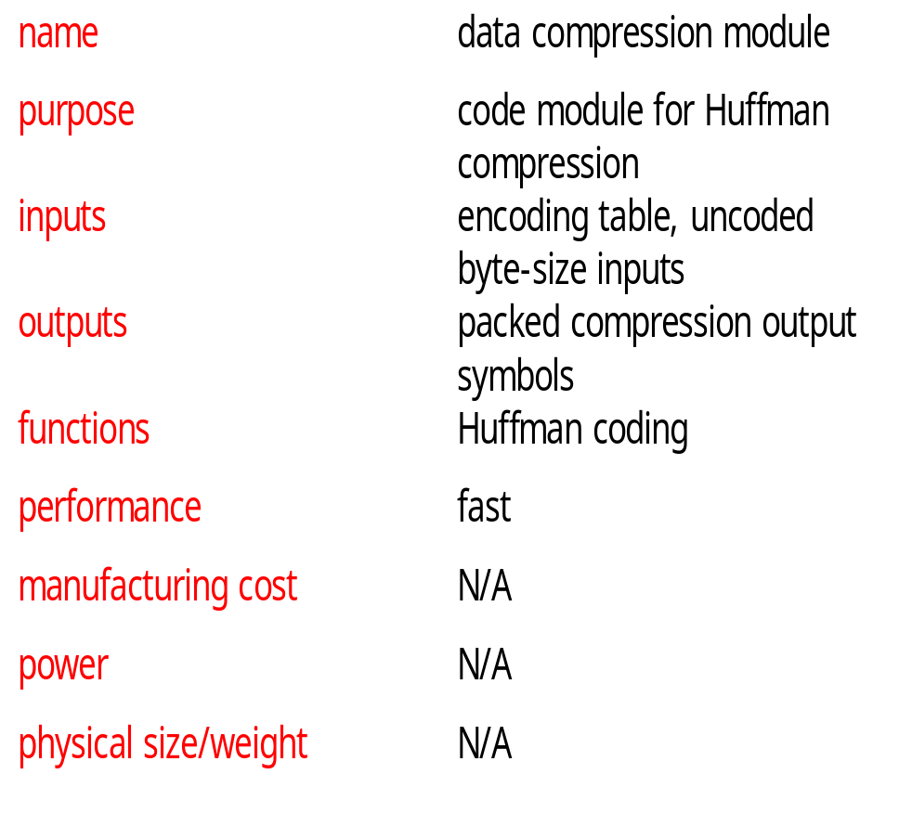
Huffman coder requirements table

Slide 134
Building a specification
Collaboration diagram shows only steady-state input/output.
A real system must:
  Accept an encoding table.
  Allow a system reset that flushes the compression buffer.

Slide 135
data-compressor class
data-compressor
buffer: data-buffer
table: symbol-table
current-bit: integer
encode(): boolean,
data-buffer
flush()
new-symbol-table()

Slide 136
data-compressor behaviors
encode: Takes one-byte input, generates packed encoded symbols and a Boolean indicating whether the buffer is full.
new-symbol-table: installs new symbol table in object, throws away old table.
flush: returns current state of buffer, including number of valid bits in buffer.

Slide 137
Auxiliary classes
data-buffer
symbol-table
databuf[databuflen] :
character
len : integer
symbols[nsymbols] :
data-buffer
len : integer
insert()
length() : integer
value() : symbol
load()

Slide 138
Auxiliary class roles
data-buffer holds both packed and unpacked symbols.
  Longest Huffman code for 8-bit inputs is 256 bits.
symbol-table indexes encoded verison of each symbol.
  load() puts data in a new symbol table.

Slide 139
Class relationships
data-compressor
1
1
1
1
data-buffer
symbol-table

Slide 140
Encode behavior
create new buffer
add to buffers
return true
T
input symbol
encode
buffer filled?
F
add to buffer
return false

Slide 141
Insert behavior
pack into
this buffer
input
symbol
T
update
length
fills buffer?
F
pack bottom bits
into this buffer,
top bits into
overflow buffer

Slide 142
Program design
In an object-oriented language, we can reflect the UML specification in the code more directly.
In a non-object-oriented language, we must either:
  add code to provide object-oriented features;
  diverge from the specification structure.

Slide 143
C++ classes
class data_buffer {
char databuf[databuflen];
int len;
int length_in_chars() { return len/bitsperbyte; }
public:
void insert(data_buffer,data_buffer&);
int length() { return len; }
int length_in_bytes() { return (int)ceil(len/8.0); }
int initialize();
...

Slide 144
C++ classes, cont’d.
class data_compressor {
data_buffer buffer;
int current_bit;
symbol_table table;
public:
boolean encode(char,data_buffer&);
void new_symbol_table(symbol_table);
int flush(data_buffer&);
data_compressor();
~data_compressor();
}

Slide 145
C code
struct data_compressor_struct {
data_buffer buffer;
int current_bit;
sym_table table;
}
typedef struct data_compressor_struct data_compressor,
*data_compressor_ptr;
boolean data_compressor_encode(data_compressor_ptr mycmptrs, char isymbol, data_buffer *fullbuf) ...

Slide 146
Testing
Test by encoding, then decoding:
symbol table
input symbols
encoder
decoder
result
compare

Slide 147
Code inspection tests
Look at the code for potential problems:
  Can we run past end of symbol table?
  What happens when the next symbol does not fill the buffer? Does fill it?
  Do very long encoded symbols work properly? Very short symbols?
  Does flush() work properly?

