Slide 1
Program design and analysis
Software components.
Representations of programs.
Assembly and linking.

Slide 2
Software state machine
State machine keeps internal state as a variable, changes state based on inputs.
Uses:
  control-dominated code;
  reactive systems.

Slide 3
State machine example
no seat/-
no seat/
buzzer off
idle
seat/timer on
no seat/-
no belt
and no
timer/-
buzzer
seated
Belt/buzzer on
belt/-
belt/
buzzer off
belted
no belt/timer on

Slide 4
C implementation
#define IDLE 0
#define SEATED 1
#define BELTED 2
#define BUZZER 3
switch (state) {
case IDLE: if (seat) { state = SEATED; timer_on = TRUE; }
break;
case SEATED: if (belt) state = BELTED;
else if (timer) state = BUZZER;
break;
…
}

Slide 5
Signal processing and circular buffer
Commonly used in signal processing:
  new data constantly arrives;
  each datum has a limited lifetime.
Use a circular buffer to hold the data stream.
time t
time t+1
d1
d2
d3
d4
d5
d6
d7

Slide 6
Circular buffer
x1
x2
x3
x4
x5
x6
t₁
t₂
t₃
Data stream
x1
x5
x2
x6
x3
x7
x4
Circular buffer

Slide 7
Circular buffers
Indexes locate currently used data, current input data:
d1
d5
input
use
d2
input
d2
d3
d3
d4
d4
use
time t1
time t1+1

Slide 8
Circular buffer in C
#define CMAX 6 /* filter order */
int circ[CMAX]; /* circular buffer */
int pos; /* position of current sample */
void circ_update(int xnew) {
/* compute the new head value with wraparound; the pos pointer moves from 0 to CMAX-1 */
pos = ((pos == CMAX-1) ? 0 : (pos+1));
/* insert the new value at the new head */
circ[pos] = xnew;
}

Slide 9
Circular buffer in C, cont’d.
void circ_init() {
int i;
for (i=0; i<CMAX; i++) /* set values to 0 */
circ[i] = 0; pos=CMAX-1; /* start at tail so first element will be at 0 */
}
int circ_get(int i) {
int ii;
/* compute the buffer position */
ii = (pos - i) % CMAX;
return circ[ii]; /* return the value */
}

Slide 10
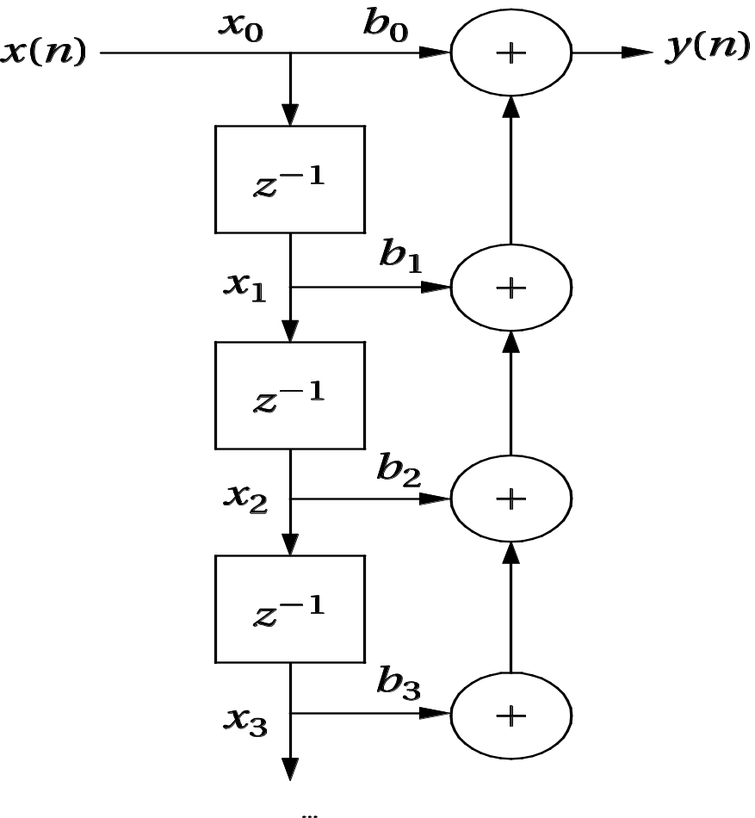
FIR filter

Slide 11
FIR filter update function
void circ_update(int xnew) {
/* add the new sample and push off the oldest one */
/* compute the new head value with wraparound; the pos pointer moves from CMAX-1 down to 0 */
pos = ((pos == 0) ? CMAX-1 : (pos-1));
/* insert the new value at the new head */
circ[pos] = xnew;
}

Slide 12
FIR filter using circular buffer
int fir(int xnew) {
/* given a new sample value, update the queue and compute the filter output */
int i;
int result; /* holds the filter output */
circ_update(xnew); /* put the new value in */
for (i=0, result=0; i<CMAX; i++)
result += b[i] * circ_get(i);
return result;
}

Slide 13
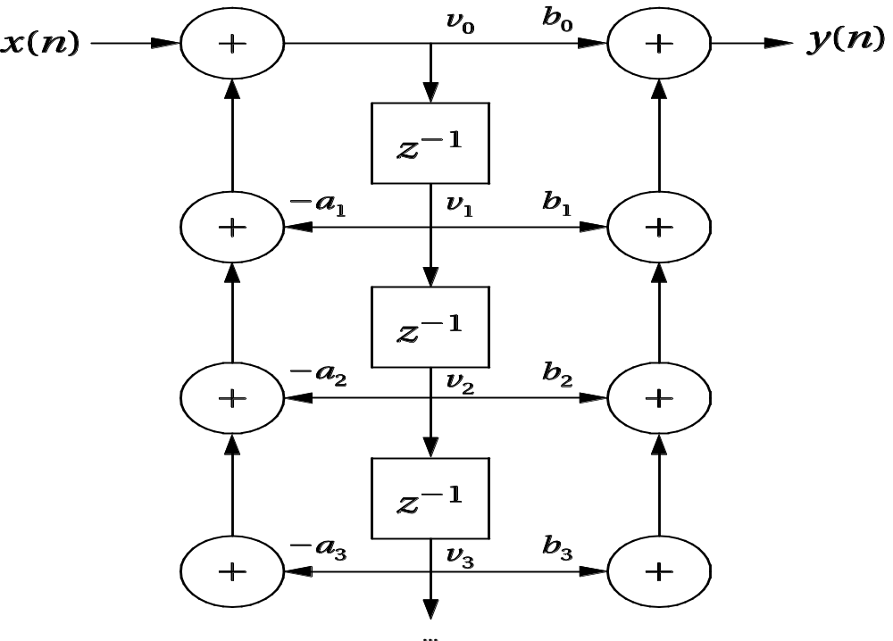
IIR direct form type II filter

Slide 14
IIR filter in C
int iir2(int xnew) {
int i, aside, bside, result;
for (i=0, aside=0; i<ZMAX; i++)
aside += -a[i+1] * circ_get(i);
for (i=0, bside=0; i<ZMAX; i++)
bside += b[i+1] * circ_get(i);
result = b[0] * (xnew + aside) + bside;
circ_update(xnew); /* put the new value in */
return result;
}

Slide 15
Array-based queue in C
#define Q_SIZE 5 /* your queue size may vary */
#define Q_MAX (Q_SIZE-1) /* this is the maximum index value into the array */
int q[Q_SIZE]; /* the array for our queue */
int head, tail; /* indexes for the current queue head and tail */
void queue_init() {
/* initialize the queue data structure */
head = 0;
tail = 0;
}

Slide 16
Array based queue, cont’d.
void enqueue(int val) {
if (((tail+1) % Q_SIZE) == head) error("enqueue onto full queue",tail);
q[tail] = val;
/* update the tail */
if (tail == Q_MAX)
tail = 0;
else
tail++;
}

Slide 17
Array based queue, cont’d.
int dequeue() {
int returnval;
if (head == tail) error("dequeue from empty queue",head);
returnval = q[head];
if (head == Q_MAX)
head = 0;
else
head++;
return returnval;
}

Slide 18
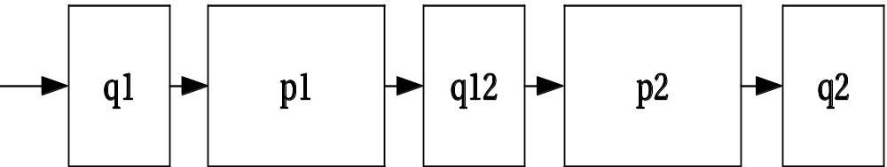
Producer-consumer system
Queues allow varying input and output rates.

Slide 19
Models of programs
Source code is not a good representation for programs:
  clumsy;
  leaves much information implicit.
Compilers derive intermediate representations to manipulate and optiize the program.

Slide 20
Data flow graph
DFG: data flow graph.
Does not represent control.
Models basic block: code with no entry or exit.
Describes the minimal ordering requirements on operations.

Slide 21
Single assignment form
x = a + b;
y = c - d;
z = x * y;
y = b + d;
original basic block
x = a + b;
y = c - d;
z = x * y;
y1 = b + d;
single assignment form

Slide 22
Data flow graph
x = a + b;
y = c - d;
z = x * y;
y1 = b + d;
single assignment form
a
b
c
d
+
-
y
x
*
+
z
y1
DFG

Slide 23
DFGs and partial orders
Partial order:
a+b, c-d; b+d x*y
Can do pairs of operations in any order.
a
b
c
d
+
-
y
x
*
+
z
y1

Slide 24
Control-data flow graph
CDFG: represents control and data.
Uses data flow graphs as components.
Two types of nodes:
  decision;
  data flow.

Slide 25
Data flow node
Encapsulates a data flow graph:
Write operations in basic block form for simplicity.
x = a + b;
y = c + d

Slide 26
Control
cond
T
v1
v4
value
v2
v3
F
Equivalent forms

Slide 27
CDFG example
if (cond1) bb1();
else bb2();
bb3();
switch (test1) {
case c1: bb4(); break;
case c2: bb5(); break;
case c3: bb6(); break;
}
T
cond1
bb1()
F
bb2()
bb3()
test1
c3
c1
c2
bb4()
bb5()
bb6()

Slide 28
for loop
for (i=0; i<N; i++)
loop_body();
for loop
i=0;
while (i<N) {
loop_body(); i++; }
equivalent
i=0
i<N
F
T
loop_body()

Slide 29
Assembly and linking
Last steps in compilation:
HLL
compile
assembly
HLL
assembly
assemble
HLL
assembly
assembly
assembly
object
load
executable
link

Slide 30
Multiple-module programs
Programs may be composed from several files.
Addresses become more specific during processing:
  relative addresses are measured relative to the start of a module;
  absolute addresses are measured relative to the start of the CPU address space.

Slide 31
Assemblers
Major tasks:
  generate binary for symbolic instructions;
  translate labels into addresses;
  handle pseudo-ops (data, etc.).
Generally one-to-one translation.
Assembly labels:
  ORG 100
  label1 ADR r4,c

Slide 32
Symbol table
ADD r0,r1,r2
xx ADD r3,r4,r5
CMP r0,r3
yy SUB r5,r6,r7
assembly code
xx 0x8
yy 0x10
symbol table

Slide 33
Symbol table generation
Use program location counter (PLC) to determine address of each location.
Scan program, keeping count of PLC.
Addresses are generated at assembly time, not execution time.

Slide 34
Symbol table example
ADD r0,r1,r2
xx ADD r3,r4,r5
CMP r0,r3
yy SUB r5,r6,r7
PLC=0x7
xx 0x8
PLC=0x8
yy 0x10
PLC=0x9
PLC=0x10

Slide 35
Two-pass assembly
Pass 1:
  generate symbol table
Pass 2:
  generate binary instructions

Slide 36
Relative address generation
Some label values may not be known at assembly time.
Labels within the module may be kept in relative form.
Must keep track of external labels---can’t generate full binary for instructions that use external labels.

Slide 37
Pseudo-operations
Pseudo-ops do not generate instructions:
  ORG sets program location.
  EQU generates symbol table entry without advancing PLC.
  Data statements define data blocks.

Slide 38
Linking
Combines several object modules into a single executable module.
Jobs:
  put modules in order;
  resolve labels across modules.

Slide 39
Externals and entry points
entry point
a ADR r4,yyy
ADD r3,r4,r5
xxx ADD r1,r2,r3
B a
yyy %1
external reference

Slide 40
Module ordering
Code modules must be placed in absolute positions in the memory space.
Load map or linker flags control the order of modules.
module1
module2
module3

Slide 41
Dynamic linking
Some operating systems link modules dynamically at run time:
  shares one copy of library among all executing programs;
  allows programs to be updated with new versions of libraries.

Slide 42
Reentrancy
Interrupting program with another call to the function does not change results.
  Changing global variables compromises reentrancy.
:
int foo = 1;
int task1() {
foo = foo + 1;
return foo;
}

Slide 43
Program design and analysis
Compilation flow.
Basic statement translation.
Basic optimizations.
Interpreters and just-in-time compilers.

Slide 44
Compilation
Compilation strategy :
  compilation = translation + optimization
Compiler determines quality of code:
  use of CPU resources;
  memory access scheduling;
  code size.

Slide 45
Basic compilation phases
HLL
parsing, symbol table
machine-independent
optimizations
machine-dependent
optimizations
assembly

Slide 46
Statement translation and optimization
Source code is translated into intermediate form such as CDFG.
CDFG is transformed/optimized.
CDFG is translated into instructions with optimization decisions.
Instructions are further optimized.

Slide 47
Arithmetic expressions
a*b + 5*(c-d)
a
b
c
d
*
-
expression
5
*
+
DFG

Slide 48
Arithmetic expressions, cont’d.
a
b
c
d
ADR r4,a
MOV r1,[r4]
ADR r4,b
MOV r2,[r4]
MUL r3,r1,r2
1
2
*
-
5
3
ADR r4,c
MOV r1,[r4]
ADR r4,d
MOV r5,[r4]
SUB r6,r4,r5
*
4
+
MUL r7,r6,#5
ADD r8,r7,r3
DFG
code

Slide 49
Compiled code for arithmetic expressions
ldr r2, [fp, #-16]
ldr r3, [fp, #-20]
mul r1, r3, r2 ; multiply
ldr r2, [fp, #-24]
ldr r3, [fp, #-28]
rsb r2, r3, r2 ; subtract
mov r3, r2
mov r3, r3, asl #2
add r3, r3, r2 ; add
add r3, r1, r3 ; add
str r3, [fp, #-32] ; assign

Slide 50
Control code generation
if (a+b > 0)
x = 5;
else
x = 7;
a+b>0
x=5
x=7

Slide 51
Control code generation, cont’d.
ADR r5,a
LDR r1,[r5]
ADR r5,b
LDR r2,b
ADD r3,r1,r2
BLE label3
1
2
a+b>0
x=5
3
x=7
LDR r3,#5
ADR r5,x
STR r3,[r5]
B stmtent
LDR r3,#7
ADR r5,x
STR r3,[r5]
stmtent ...

Slide 52
Compiled code for control
ldr r2, [fp, #-16]
ldr r3, [fp, #-20]
add r3, r2, r3
cmp r3, #0 ; test the branch condition
ble .L3 ; branch to false block if <=
mov r3, #5 ; true block
str r3, [fp, #-32]
b .L4 ; go to end of if statement
.L3: ; false block
mov r3, #7
str r3, [fp, #-32]
.L4:

Slide 53
Procedure linkage
Need code to:
  call and return;
  pass parameters and results.
Parameters and returns are passed on stack.
  Procedures with few parameters may use registers.
Local variables are stored in the stack.

Slide 54
Procedure stacks
growth
proc1
proc1(int a) {
proc2(5);
}
FP
frame pointer
proc2
5
accessed relative to SP or FP
SP
stack pointer

Slide 55
ARM procedure linkage
APCS (ARM Procedure Call Standard):
  r0-r3 pass parameters into procedure. Extra parameters are put on stack frame.
  r0 holds return value.
  r4-r7 hold register values.
  r11 is frame pointer, r13 is stack pointer.
  r10 holds limiting address on stack size to check for stack overflows.

Slide 56
Compiled procedure call code
ldr r3, [fp, #-32] ; get e
str r3, [sp, #0] ; put into p1()’s stack frame
ldr r0, [fp, #-16] ; put a into r0
ldr r1, [fp, #-20] ; put b into r1
ldr r2, [fp, #-24] ; put c into r2
ldr r3, [fp, #-28] ; put d into r3
bl p1 ; call p1()
mov r3, r0 ; move return value into r3
str r3, [fp, #-36] ; store into y in stack frame

Slide 57
Data structures
Different types of data structures use different data layouts.
Some offsets into data structure can be computed at compile time, others must be computed at run time.

Slide 58
One-dimensional arrays
C array name points to 0th element:
a
a[0]
a[1]
= *(a + 1)
a[2]

Slide 59
Two-dimensional arrays
Row-major layout:
a[0][0]
a[0][1]
M
...
N
...
a[1][0]
a[1][1]
= a[i*M+j]

Slide 60
Structures
Fields within structures are static offsets:
aptr
field1
struct {
int field1;
char field2;
} mystruct;
struct mystruct a, *aptr = &a;
4 bytes
field2
*(aptr+4)

Slide 61
Expression simplification
Constant folding:
  8+1 = 9
Algebraic:
  a*b + a*c = a*(b+c)
Strength reduction:
  a*2 = a<<1

Slide 62
Dead code elimination
Dead code:
#define DEBUG 0
if (DEBUG) dbg(p1);
Can be eliminated by analysis of control flow, constant folding.
0
0
1
dbg(p1);

Slide 63
Procedure inlining
Eliminates procedure linkage overhead:
int foo(a,b,c) { return a + b - c;}
z = foo(w,x,y);
⇨
z = w + x - y;

Slide 64
Loop transformations
Goals:
  reduce loop overhead;
  increase opportunities for pipelining;
  improve memory system performance.

Slide 65
Loop unrolling
Reduces loop overhead, enables some other optimizations.
for (i=0; i<4; i++)
a[i] = b[i] * c[i];
⇨
for (i=0; i<2; i++) {
a[i*2] = b[i*2] * c[i*2];
a[i*2+1] = b[i*2+1] * c[i*2+1];
}

Slide 66
Loop fusion and distribution
Fusion combines two loops into 1:
for (i=0; i<N; i++) a[i] = b[i] * 5;
for (j=0; j<N; j++) w[j] = c[j] * d[j];
⇨ for (i=0; i<N; i++) {
a[i] = b[i] * 5; w[i] = c[i] * d[i];
}
Distribution breaks one loop into two.
Changes optimizations within loop body.

Slide 67
Register allocation
Goals:
  choose register to hold each variable;
  determine lifespan of varible in the register.
Basic case: within basic block.

Slide 68
Register lifetime graph
w = a + b;
x = c + w;
y = c + d;
t=1
a
t=2
b
t=3
c
d
w
x
y
1
2
3
time

Slide 69
Instruction scheduling
Non-pipelined machines do not need instruction scheduling: any order of instructions that satisfies data dependencies runs equally fast.
In pipelined machines, execution time of one instruction depends on the nearby instructions: opcode, operands.

Slide 70
Reservation table
A reservation table relates instructions/time to CPU resources.
Time /instr A B
t+0/instr1 X
t+1/instr2 X X
t+2/instr3 X
t+3/instr4 X

Slide 71
Software pipelining
Schedules instructions across loop iterations.
Reduces instruction latency in iteration i by inserting instructions from iteration i+1.

Slide 72
Instruction selection
May be several ways to implement an operation or sequence of operations.
Represent operations as graphs, match possible instruction sequences onto graph.
+
+
*
+
*
MUL
ADD
*
MADD
expression
templates

Slide 73
Using your compiler
Understand various optimization levels (-O1, -O2, etc.)
Look at mixed compiler/assembler output.
Modifying compiler output requires care:
  correctness;
  loss of hand-tweaked code.

Slide 74
Interpreters and JIT compilers
Interpreter: translates and executes program statements on-the-fly.
JIT compiler: compiles small sections of code into instructions during program execution.
  Eliminates some translation overhead.
  Often requires more memory.

Slide 75
Program design and analysis
Program-level performance analysis.
Optimizing for:
  Execution time.
  Energy/power.
  Program size.
Program validation and testing.

Slide 76
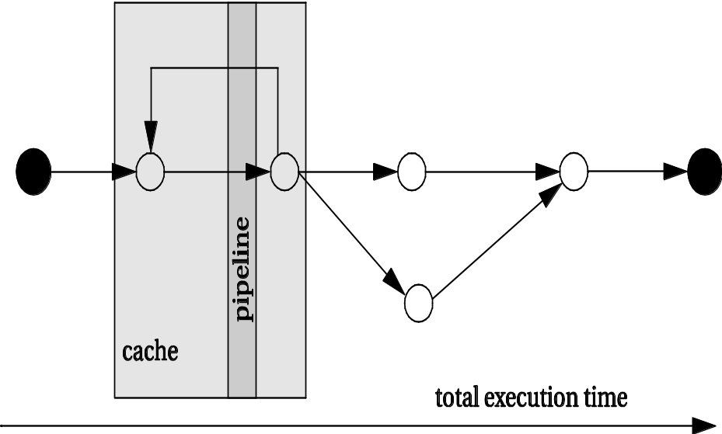
Program-level performance analysis
Need to understand performance in detail:
  Real-time behavior, not just typical.
  On complex platforms.
Program performance ≠ CPU performance:
  Pipeline, cache are windows into program.
  We must analyze the entire program.

Slide 77
Complexities of program performance
Varies with input data:
  Different-length paths.
Cache effects.
Instruction-level performance variations:
  Pipeline interlocks.
  Fetch times.

Slide 78
How to measure program performance
Simulate execution of the CPU.
  Makes CPU state visible.
Measure on real CPU using timer.
  Requires modifying the program to control the timer.
Measure on real CPU using logic analyzer.
  Requires events visible on the pins.

Slide 79
Program performance metrics
Average-case execution time.
  Typically used in application programming.
Worst-case execution time.
  A component in deadline satisfaction.
Best-case execution time.
  Task-level interactions can cause best-case program behavior to result in worst-case system behavior.

Slide 80
Elements of program performance
Basic program execution time formula:
  execution time = program path + instruction timing
Solving these problems independently helps simplify analysis.
  Easier to separate on simpler CPUs.
Accurate performance analysis requires:
  Assembly/binary code.
  Execution platform.

Slide 81
Data-dependent paths in an if statement
if (a || b) { /* T1 */
if ( c ) /* T2 */
x = r*s+t; /* A1 */
else y=r+s; /* A2 */
z = r+s+u; /* A3 */
}
else {
if ( c ) /* T3 */
y = r-t; /* A4 */
}
a | b | c | path
0 | 0 | 0 | T1=F, T3=F: no assignments
0 | 0 | 1 | T1=F, T3=T: A4
0 | 1 | 0 | T1=T, T2=F: A2, A3
0 | 1 | 1 | T1=T, T2=T: A1, A3
1 | 0 | 0 | T1=T, T2=F: A2, A3
1 | 0 | 1 | T1=T, T2=T: A1, A3
1 | 1 | 0 | T1=T, T2=F: A2, A3
1 | 1 | 1 | T1=T, T2=T: A1, A3

Slide 82
Paths in a loop
for (i=0, f=0; i<N; i++)
f = f + c[i] * x[i];
i=0
f=0
N
i=N
Y
f = f + c[i] * x[i]
i = i + 1

Slide 83

Paths in a loop with conditions
i=0;
f=0;
for (i=0, f=0; i<N; i++) {
if (x[i] > 0)
f = f + c[i] * x[i];
}
executed 1 time
i<N
T
executed N+1 times
F
x[i] > 0
F
executed N times
T
f =f + c[i] * x[i];
i++;
executed N times

Slide 84
Instruction timing
Not all instructions take the same amount of time.
  Multi-cycle instructions.
  Fetches.
Execution times of instructions are not independent.
  Pipeline interlocks.
  Cache effects.
Execution times may vary with operand value.
  Floating-point operations.
  Some multi-cycle integer operations.

Slide 85
Caching effects
for (i = 0, f = 0; i < N; i++)
f = f + c[i] * x[i];
line 0
Word 0
Word 1
Word 2
Word 3
line 1
Word 4
Word 5
Word 6
Word 7
First access to a cache line causes a miss and prefetch.
Later accesses to that line result in cache hits.

Slide 86
Mesaurement-driven performance analysis
Not so easy as it sounds:
  Must actually have access to the CPU.
  Must know data inputs that give worst/best case performance.
  Must make state visible.
Still an important method for performance analysis.

Slide 87
Feeding the program
Need to know the desired input values.
May need to write software scaffolding to generate the input values.
Software scaffolding may also need to examine outputs to generate feedback-driven inputs.

Slide 88
Trace-driven measurement
Trace-driven:
  Instrument the program.
  Save information about the path.
Requires modifying the program.
Trace files are large.
Widely used for cache analysis.

Slide 89
Physical measurement
In-circuit emulator allows tracing.
  Affects execution timing.
Logic analyzer can measure behavior at pins.
  Address bus can be analyzed to look for events.
  Code can be modified to make events visible.
Particularly important for real-world input streams.

Slide 90
CPU simulation
Some simulators are less accurate.
Cycle-accurate simulator provides accurate clock-cycle timing.
  Simulator models CPU internals.
  Simulator writer must know how CPU works.

Slide 91
SimpleScalar FIR filter simulation
int x[N] = {8, 17, … };
int c[N] = {1, 2, … };
main() {
int i, k, f;
for (k=0; k<COUNT; k++)
for (i=0; i<N; i++)
f += c[i]*x[i];
}
COUNT | total sim cycles | sim cycles per filter execution
100 | 25854 | 259
1,000 | 155759 | 156
1,0000 | 1451840 | 145

Slide 92
Performance optimization motivation
Embedded systems must often meet deadlines.
  Faster may not be fast enough.
Need to be able to analyze execution time.
  Worst-case, not typical.
Need techniques for reliably improving execution time.

Slide 93
Programs and performance analysis
Best results come from analyzing optimized instructions, not high-level language code:
  non-obvious translations of HLL statements into instructions;
  code may move;
  cache effects are hard to predict.

Slide 94
Loop optimizations
Loops are good targets for optimization.
Basic loop optimizations:
  code motion;
  induction-variable elimination;
  strength reduction (x*2 -> x<<1).

Slide 95
Code motion
for (i=0; i<N*M; i++)
z[i] = a[i] + b[i];
i=0; X = N*M
i=0;
i<N*M
N
i<X
Y
z[i] = a[i] + b[i];
i = i+1;

Slide 96
Induction variable elimination
Induction variable: loop index.
Consider loop:
  for (i=0; i<N; i++)
  for (j=0; j<M; j++)
  z[i,j] = b[i,j];
Rather than recompute i*M+j for each array in each iteration, share induction variable between arrays, increment at end of loop body.

Slide 97
Cache analysis
Loop nest: set of loops, one inside other.
Perfect loop nest: no conditionals in nest.
Because loops use large quantities of data, cache conflicts are common.

Slide 98
Array conflicts in cache
设M=256,N=3;
四路组相联CACHE,每一行块四个字
For(j=0;j<M;j++)
for(i=0;i<N;i++)
a[j][i]=b[j][i]*c;
a[0,0]
1024
1024
4099
b[0,0]
...
4099
main memory
cache

Slide 99
Array conflicts, cont’d.
Array elements conflict because they are in the same line, even if not mapped to same location.
Solutions:
  move one array;
  pad array to change alignment.

Slide 100

Array padding
Add array elements to change mapping into cache:
a[0,0]
a[0,1]
a[0,2]
a[0,0]
a[0,1]
a[0,2]
a[0,2]
a[1,0]
a[1,1]
a[1,2]
a[1,0]
a[1,1]
a[1,2]
a[1,2]
before
after

Slide 101
Loop tiling
Breaks one loop into a nest of loops.
Changes order of accesses within array.
  Changes cache behavior.

Slide 102
Loop tiling example
for (i=0; i<N; i++) {
for (j=0; j<N; j++) {
z[i][j] = x[i] * y[j];
}
}
for (j=0; j < N; j += TILE) {
for (i=0; i<N; i++) {
for (jj=0; j<TILE; jj++)
{
z[i][j + jj] = x[i] * y[j + jj];
}
}
}
x[]
x[0]
x[0]
x[]
x[1]
y[]
y[0]
y[1]
y[N-1]
y[0]
y[1]
y[]
y[0]
y[1]

Slide 103
Performance optimization hints
Use registers efficiently.
Use page mode memory accesses.
Analyze cache behavior:
  instruction conflicts can be handled by rewriting code, rescheudling;
  conflicting scalar data can easily be moved;
  conflicting array data can be moved, padded.

Slide 104
Energy/power optimization
Energy: ability to do work.
  Most important in battery-powered systems.
Power: energy per unit time.
  Important even in wall-plug systems---power becomes heat.

Slide 105
Measuring energy consumption
Execute a small loop, measure current:
I
while (TRUE)
a();

Slide 106
Sources of energy consumption
Relative energy per operation (Catthoor et al):
  memory transfer: 33
  external I/O: 10
  SRAM write: 9
  SRAM read: 4.4
  multiply: 3.6
  add: 1

Slide 107
Cache behavior is important
Energy consumption has a sweet spot as cache size changes:
  cache too small: program thrashes, burning energy on external memory accesses;
  cache too large: cache itself burns too much power.

Slide 108
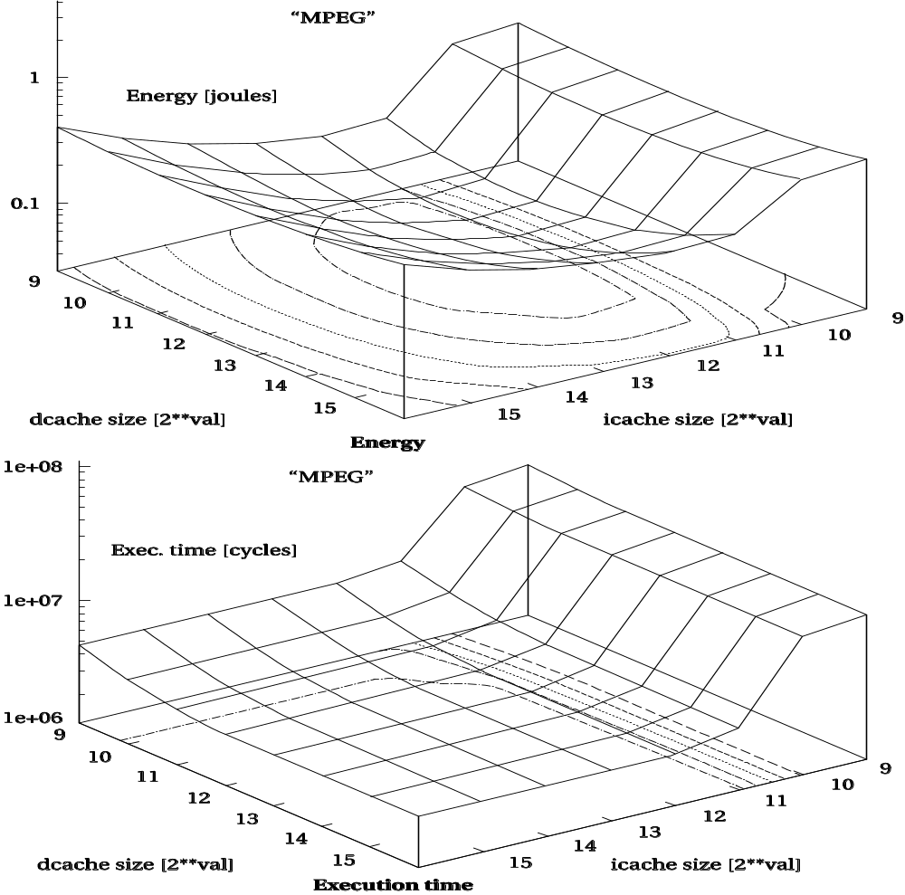
Cache sweet spot
[Li98] © 1998 IEEE

Slide 109
Optimizing for energy
First-order optimization:
  high performance = low energy.
Not many instructions trade speed for energy.

Slide 110
Optimizing for energy, cont’d.
Use registers efficiently.
Identify and eliminate cache conflicts.
Moderate loop unrolling eliminates some loop overhead instructions.
Eliminate pipeline stalls.
Inlining procedures may help: reduces linkage, but may increase cache thrashing.

Slide 111
Efficient loops
General rules:
  Don’t use function calls.
  Keep loop body small to enable local repeat (only forward branches).
  Use unsigned integer for loop counter.
  Use <= to test loop counter.
  Make use of compiler---global optimization, software pipelining.

Slide 112
Single-instruction repeat loop example
STM #4000h,AR2
; load pointer to source
STM #100h,AR3
; load pointer to destination
RPT #(1024-1)
MVDD *AR2+,*AR3+
; move

Slide 113
Optimizing for program size
Goal:
  reduce hardware cost of memory;
  reduce power consumption of memory units.
Two opportunities:
  data;
  instructions.

Slide 114
Data size minimization
Reuse constants, variables, data buffers in different parts of code.
  Requires careful verification of correctness.
Generate data using instructions.

Slide 115
Reducing code size
Avoid function inlining.
Choose CPU with compact instructions.
Use specialized instructions where possible.

Slide 116
Program validation and testing
But does it work?
Concentrate here on functional verification.
Major testing strategies:
  Black box doesn’t look at the source code.
  Clear box (white box) does look at the source code.

Slide 117
Clear-box testing
Examine the source code to determine whether it works:
  Can you actually exercise a path?
  Do you get the value you expect along a path?
Testing procedure:
  Controllability: provide program with inputs.
  Execute.
  Observability: examine outputs.

Slide 118
Controlling and observing programs
firout = 0.0;
for (j=curr, k=0; j<N; j++, k++)
firout += buff[j] * c[k];
for (j=0; j<curr; j++, k++)
firout += buff[j] * c[k];
if (firout > 100.0) firout = 100.0;
if (firout < -100.0) firout = -100.0;
Controllability:
  Must fill circular buffer with desired N values.
  Other code governs how we access the buffer.
Observability:
  Want to examine firout before limit testing.

Slide 119
Execution paths and testing
Paths are important in functional testing as well as performance analysis.
In general, an exponential number of paths through the program.
  Show that some paths dominate others.
  Heuristically limit paths.

Slide 120
Choosing the paths to test
Possible criteria:
  Execute every statement at least once.
  Execute every branch direction at least once.
Equivalent for structured programs.
Not true for gotos.
not covered

Slide 121
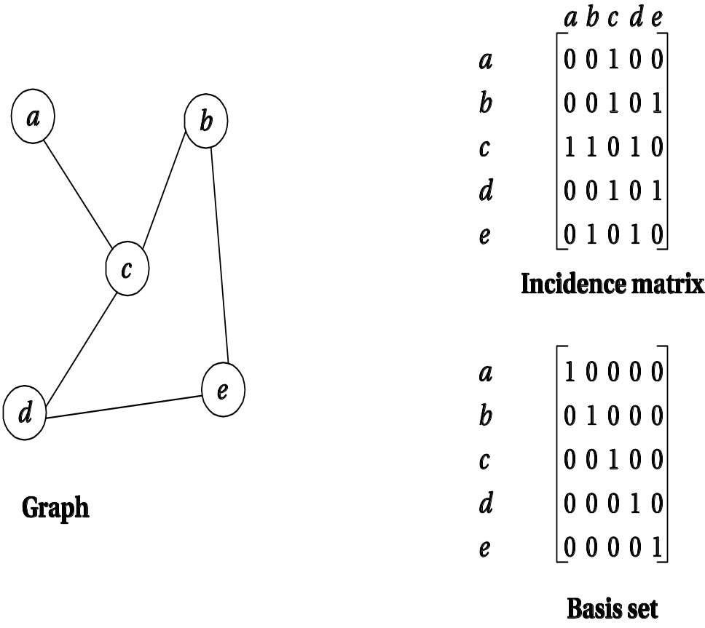
Basis paths
Approximate CDFG with undirected graph.
Undirected graphs have basis paths:
  All paths are linear combinations of basis paths.

Slide 122
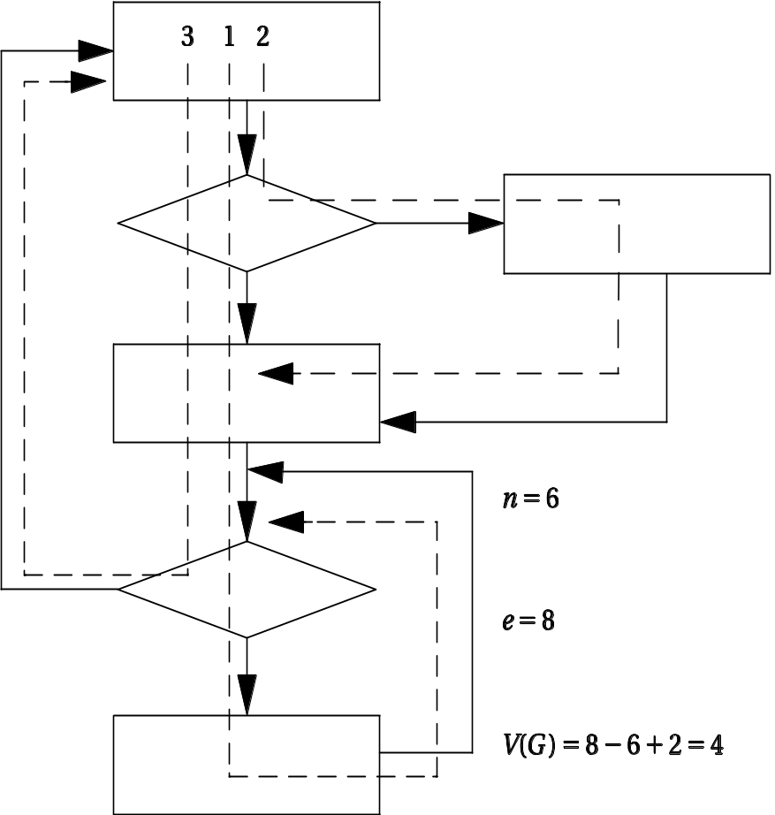
Cyclomatic complexity
Cyclomatic complexity is a bound on the size of basis sets:
  e = # edges
  n = # nodes
  p = number of graph components
  M = e – n + 2p.

Slide 123
Branch testing
Heuristic for testing branches.
  Exercise true and false branches of conditional.
  Exercise every simple condition at least once.

Slide 124
Branch testing example
Correct:
  if (a || (b >= c)) { printf(“OK\n”); }
Incorrect:
  if (a && (b >= c)) { printf(“OK\n”); }
Test:
  a = F
  (b >=c) = T
Example:
  Correct: [0 || (3 >= 2)] = T
  Incorrect: [0 && (3 >= 2)] = F

Slide 125
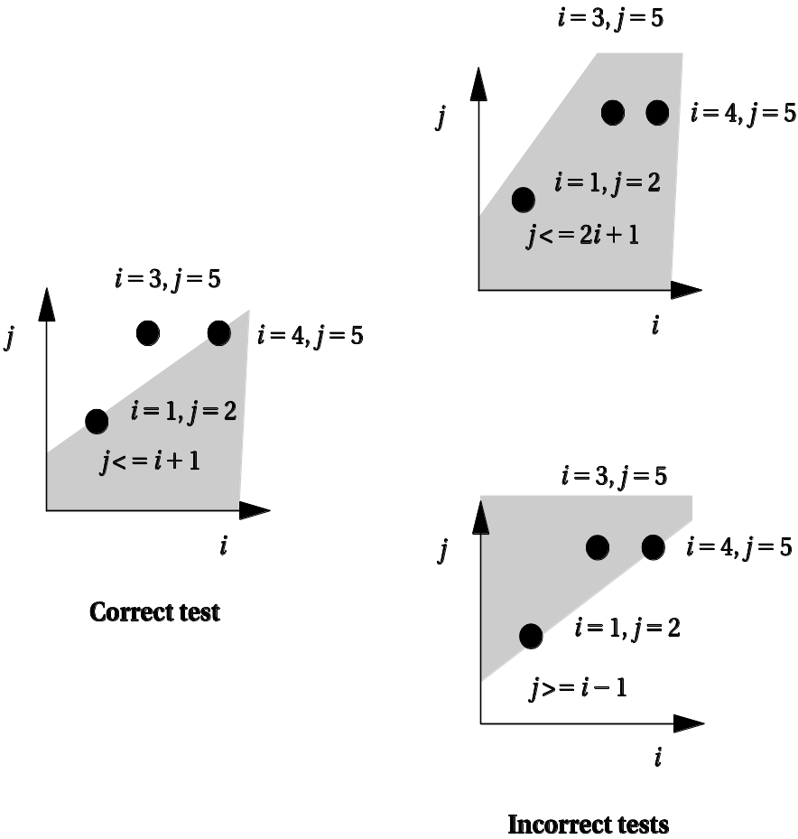
Domain testing
Heuristic test for linear inequalities.
Test on each side + boundary of inequality.

Slide 126
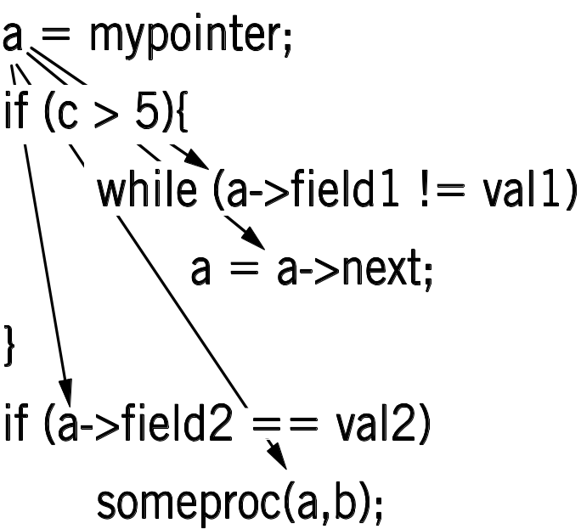
Def-use pairs
Variable def-use:
  Def when value is assigned (defined).
  Use when used on right-hand side.
Exercise each def-use pair.
  Requires testing correct path.

Slide 127
Loop testing
Loops need specialized tests to be tested efficiently.
Heuristic testing strategy:
  Skip loop entirely.
  One loop iteration.
  Two loop iterations.
  # iterations much below max.
  n-1, n, n+1 iterations where n is max.

Slide 128
Black-box testing
Complements clear-box testing.
  May require a large number of tests.
Tests software in different ways.

Slide 129
Black-box test vectors
Random tests.
  May weight distribution based on software specification.
Regression tests.
  Tests of previous versions, bugs, etc.
  May be clear-box tests of previous versions.

Slide 130
How much testing is enough?
Exhaustive testing is impractical.
One important measure of test quality---bugs escaping into field.
Good organizations can test software to give very low field bug report rates.
Error injection measures test quality:
  Add known bugs.
  Run your tests.
  Determine % injected bugs that are caught.

