Slide 1
Networks and Multiprocessors
Why networks and multiprocessors?
Categories of multiprocessors.
MPSoCs and shared memory multiprocessors.

Slide 2

Why multiprocessors?
Better cost/performance.
  Match each CPU to its tasks or use custom logic (smaller, cheaper).
  CPU cost is a non-linear function of performance.
cost
performance

Slide 3

Why multiprocessors? cont’d.
Better real-time performance.
  Put time-critical functions on less-loaded processing elements.
  Remember RMS utilization---extra CPU cycles must be reserved to meet deadlines.
cost
deadline w.
RMS overhead
deadline
performance

Slide 4
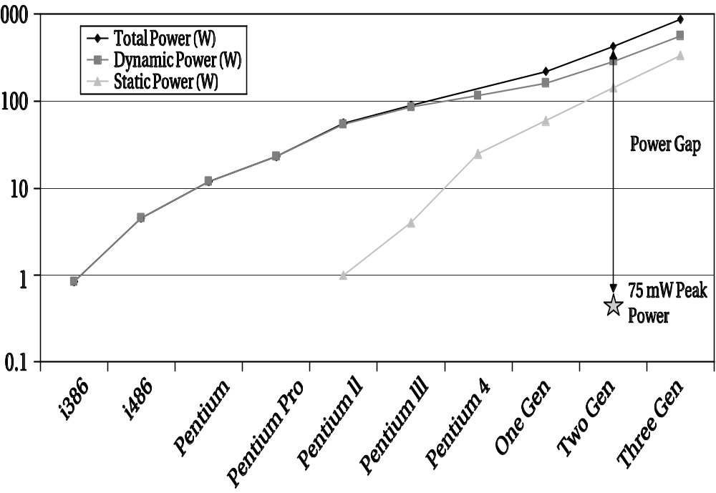
Why multiprocessors? cont’d.
Using specialized processors or custom logic saves power.
Desktop uniprocessors are not power-efficient enough for battery-powered applications.
[Aus04] © 2004 IEEE Computer Society

Slide 5
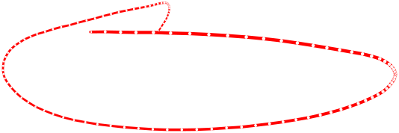
Why multiprocessors? cont’d.
Good for processing I/O in real-time.
May consume less energy.
May be better at streaming data.
May not be able to do all the work on even the largest single CPU.

Slide 6
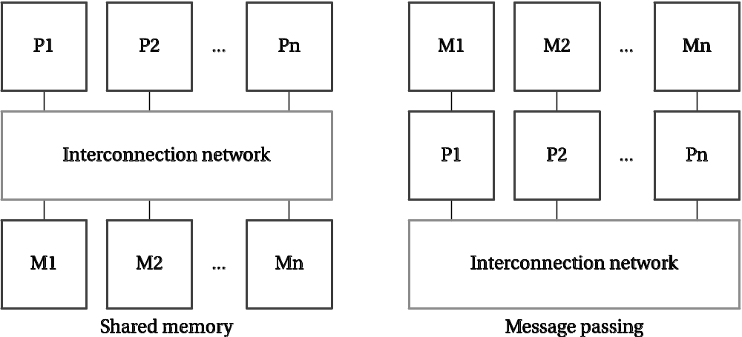
Categories of multiprocessors

Slide 7
Multiprocessor taxonomy
PE: processing element.
PEs and memory connected by interconnection network.
Shared memory: all PEs talk to a pool of memory.
Message passing: each PE has its own memory, communicates with messages.
Shared memory and message passing are equivalent.

Slide 8
Varieties of multiprocessor
System-on-chip is complete system, usually a multiprocessor, with I/O and memory.
A distributed system has multiple chips and significant communication delay.

Slide 9
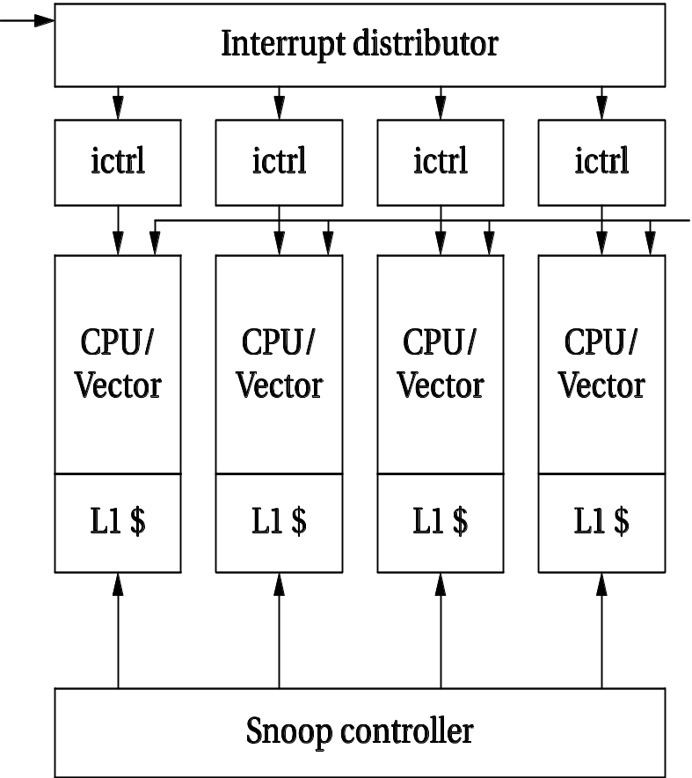
ARM MPCore
Up to four CPUs.
Distributed interrupt system.
Snooping cache controller.

Slide 10
Why distributed?
Higher performance at lower cost.
Physically distributed activities---time constants may not allow transmission to central site.
Improved debugging---use one CPU in network to debug others.
May buy subsystems that have embedded processors.

Slide 11
Shared memory multiprocessors
Multi-core systems are symmetric multiprocessors with identical PEs.
Many embedded multiprocessors are heterogeneous:
  Multiple programmable CPU types.
  Hardwired accelerators.
Heterogeneous multiprocessors use less energy, are less expensive.

Slide 12
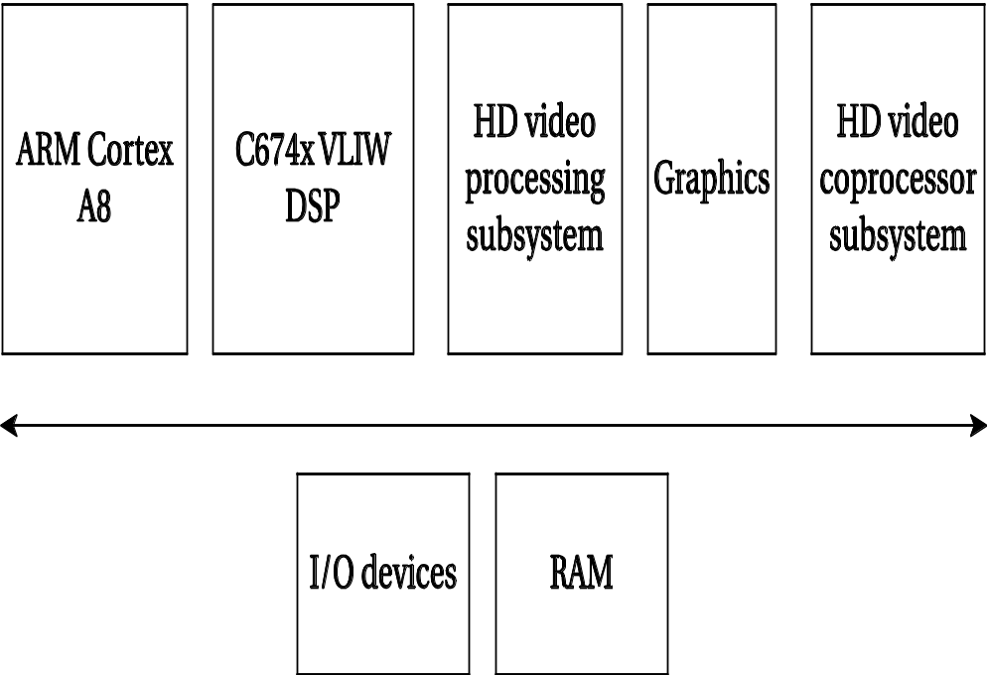
TI TMS320DM816x DaVinci
ARM Cortex A8 plus C674x VLIW DSP.
HD video coprocessor accelerates H.264, MPEG-4, etc.
HD video processing susystem provides additional video processing.
Graphics unit performs 3D graphics.

Slide 13
Accelerated systems
Use additional computational unit dedicated to some functions?
  Hardwired logic.
  Extra CPU.
Hardware/software co-design: joint design of hardware and software architectures.

Slide 14

Accelerated system architecture
accelerator
request
CPU
result
data
data
memory
I/O

Slide 15
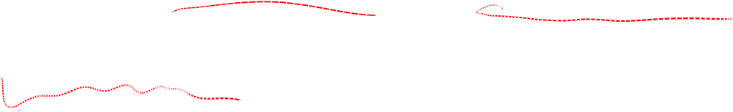
Accelerator vs. co-processor
A co-processor executes instructions.
  Instructions are dispatched by the CPU.
An accelerator appears as a device on the bus.
  The accelerator is controlled by registers.

Slide 16
Accelerator implementations
Application-specific integrated circuit.
Field-programmable gate array (FPGA).
Standard component.
  Example: graphics processor.

Slide 17
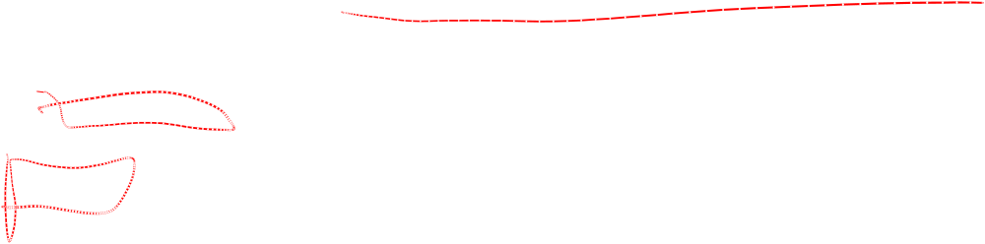
Xilinx Zynq UltraScale+
Quad-core ARM Cortex-A53 and dual-core ARM Cortex-R5.
Mali graphics unit.
FPGA fabric and block RAM.
PCI3, SATA, USB, CAN, SPI, GPIO.

Slide 18
System design tasks
Design a heterogeneous multiprocessor architecture.
  Processing element (PE): CPU, accelerator, etc.
Program the system.

Slide 19

Accelerated system design
First, determine that the system really needs to be accelerated.
  How much faster is the accelerator on the core function?
  How much data transfer overhead?
Design the accelerator itself.
Design CPU interface to accelerator.

Slide 20
Accelerated system platforms
Several off-the-shelf boards are available for acceleration in PCs:
  FPGA-based core;
  PC bus interface.

Slide 21
Accelerator/CPU interface
Accelerator registers provide control registers for CPU.
Data registers can be used for small data objects.
Accelerator may include special-purpose read/write logic.
  Especially valuable for large data transfers.

Slide 22
System integration and debugging
Try to debug the CPU/accelerator interface separately from the accelerator core.
Build scaffolding to test the accelerator.
Hardware/software co-simulation can be useful.

Slide 23
Caching problems
Main memory provides the primary data transfer mechanism to the accelerator.
Programs must ensure that caching does not invalidate main memory data.
  CPU reads location S.
  Accelerator writes location S.
  CPU reads location S.

Slide 24
Synchronization
As with cache, main memory writes to shared memory may cause invalidation:
  CPU reads S.
  Accelerator writes S.
  CPU reads S.

Slide 25
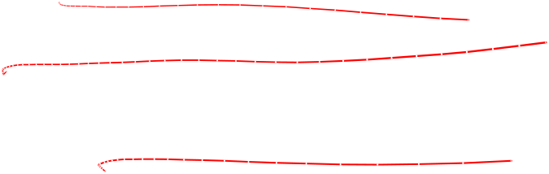
Multiprocessor performance analysis
Effects of parallelism (and lack of it):
  Processes.
  CPU and bus.
  Multiple processors.

Slide 26
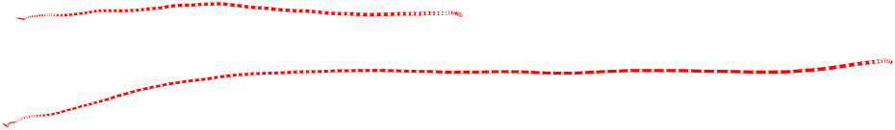
Accelerator speedup
Critical parameter is speedup: how much faster is the system with the accelerator?
Must take into account:
  Accelerator execution time.
  Data transfer time.
  Synchronization with the master CPU.

Slide 27
Accelerator execution time
Total accelerator execution time:
  t_{accel} = t_{in} + t_{x} + t_{out}
Data output
Data input
Accelerated
computation

Slide 28
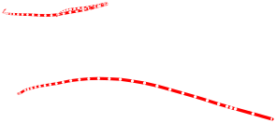
Accelerator speedup
Assume loop is executed n times.
Compare accelerated system to non-accelerated system:
  S = n(t_{CPU} - t_{accel})
  = n[t_{CPU} - (t_{in} + t_{x} + t_{out})]
Execution time on CPU

Slide 29
Single- vs. multi-threaded
One critical factor is available parallelism:
  single-threaded/blocking: CPU waits for accelerator;
  multithreaded/non-blocking: CPU continues to execute along with accelerator.
To multithread, CPU must have useful work to do.
  But software must also support multithreading.

Slide 30



Total execution time
Single-threaded:
Multi-threaded:
P1
split
P1
P2
A1
P2
A1
P3
P3
P4
join
P4

Slide 31
Execution time analysis
Single-threaded:
  Count execution time of all component processes.
Multi-threaded:
  Find longest path through execution.

Slide 32
Sources of parallelism
Overlap I/O and accelerator computation.
  Perform operations in batches, read in second batch of data while computing on first batch.
Find other work to do on the CPU.
  May reschedule operations to move work after accelerator initiation.

Slide 33
Data input/output times
Bus transactions include:
  flushing register/cache values to main memory;
  time required for CPU to set up transaction;
  overhead of data transfers by bus packets, handshaking, etc.

Slide 34
Scheduling and allocation
Must:
  schedule operations in time;
  allocate computations to processing elements.
Scheduling and allocation interact, but separating them helps.
  Alternatively allocate, then schedule.

Slide 35

Example: scheduling and allocation
P1
P2
M1
M2
d1
d2
P3
Task graph
Hardware platform

Slide 36

First design
Allocate P1, P2 -> M1; P3 -> M2.
M1
P1
P1C
P2
P2C
M2
P3
time

Slide 37
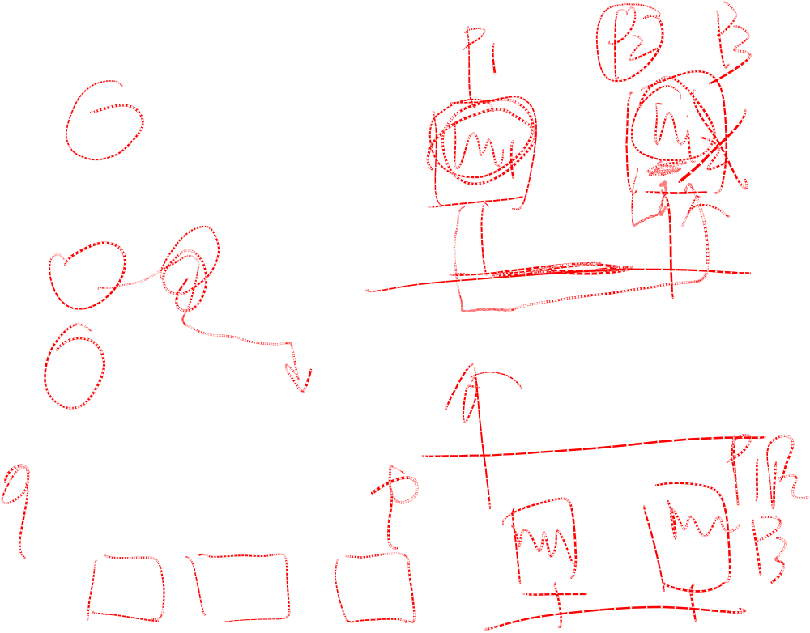
Second design
Allocate P1 -> M1; P2, P3 -> M2:
M1
P1
P1C
M2
P2
P3
time

Slide 38
Example: adjusting messages to reduce delay
Task graph:
Network:
execution time
3
3
allocation
P1
P2
M1
M2
M3
d1
d2
P3
4
Transmission time = 4

Slide 39
Initial schedule
M1
P1
M2
P2
M3
P3
network
d1
d2
Time = 15
0
5
10
15
20
time

Slide 40
New design
Modify P3:
  reads one packet of d1, one packet of d2
  computes partial result
  continues to next packet

Slide 41
New schedule
M1
P1
M2
P2
M3
P3
P3
P3
P3
network
d1
d2
d1
d2
d1
d2
d1
d2
Time = 12
0
5
10
15
20
time

Slide 42
Buffering and performance
Buffering may sequentialize operations.
  Next process must wait for data to enter buffer before it can continue.
Buffer policy (queue, RAM) affects available parallelism.

Slide 43
Buffers and latency
Three processes separated by buffers:
B1
A
B2
B
B3
C

Slide 44
Buffers and latency schedules
A[0]
B[0]
C[0]
A[1]
B[1]
C[1]
…
A[0]
A[1]
…
B[0]
B[1]
…
C[0]
C[1]
…
Must wait for
all of A before
getting any B

Slide 45
I²C bus
Designed for low-cost, medium data rate applications.
Characteristics:
  serial;
  multiple-master;
  fixed-priority arbitration.
Several microcontrollers come with built-in I²C controllers.

Slide 46
I²C physical layer
master 1
master 2
data line
SDL
clock line
SCL
slave 1
slave 2

Slide 47
I²C data format
SCL
...
...
SDL
...
start
MSB
ack

Slide 48
I²C electrical interface
Open collector interface:
+
SDL
+
SCL

Slide 49
I²C signaling
Sender pulls down bus for 0.
Sender listens to bus---if it tried to send a 1 and heard a 0, someone else is simultaneously transmitting.
Transmissions occur in 8-bit bytes.

Slide 50
I²C data link layer
Every device has an address (7 bits in standard, 10 bits in extension).
  Bit 8 of address signals read or write.
General call address allows broadcast.

Slide 51
I²C bus arbitration
Sender listens while sending address.
When sender hears a conflict, if its address is higher, it stops signaling.
Low-priority senders relinquish control early enough in clock cycle to allow bit to be transmitted reliably.

Slide 52
I²C transmissions
multi-byte write
S
adrs
0
data
data
P
read from slave
S
adrs
1
data
P
write, then read
S
adrs
0
data
S
adrs
1
data
P

Slide 53
Networks and multiprocessors
Example: video accelerator

Slide 54
Concept
Build accelerator for block motion estimation, one step in video compression.
Perform two-dimensional correlation:
Frame 1
f2
f2
f2
f2
f2
f2
f2
f2
f2
f2

Slide 55
Block motion estimation
MPEG divides frame into 16 x 16 macroblocks for motion estimation.
Search for best match within a search range.
Measure similarity with sum-of-absolute-differences (SAD):
  Σ | M(i,j) - S(i-o_{x}, j-o_{y}) |

Slide 56
Best match
Best match produces motion vector for motion block:

Slide 57
Full search algorithm
bestx = 0; besty = 0;
bestsad = MAXSAD;
for (ox = - SEARCHSIZE; ox < SEARCHSIZE; ox++) {
for (oy = -SEARCHSIZE; oy < SEARCHSIZE; oy++) {
int result = 0;
for (i=0; i<MBSIZE; i++) {
for (j=0; j<MBSIZE; j++) {
result += iabs(mb[i][j] - search[i-ox+XCENTER][j-oy-YCENTER]);

Slide 58
Full search algorithm, cont’d.
}
}
if (result <= bestsad) { bestsad = result; bestx = ox; besty = oy; }
}
}

Slide 59
Computational requirements
Let MBSIZE = 16, SEARCHSIZE = 8.
Search area is 8 + 8 + 1 in each dimension.
Must perform:
  n_{ops} = (16 x 16) x (17 x 17) = 73984 ops
CIF format has 352 x 288 pixels -> 22 x 18 macroblocks.

Slide 60
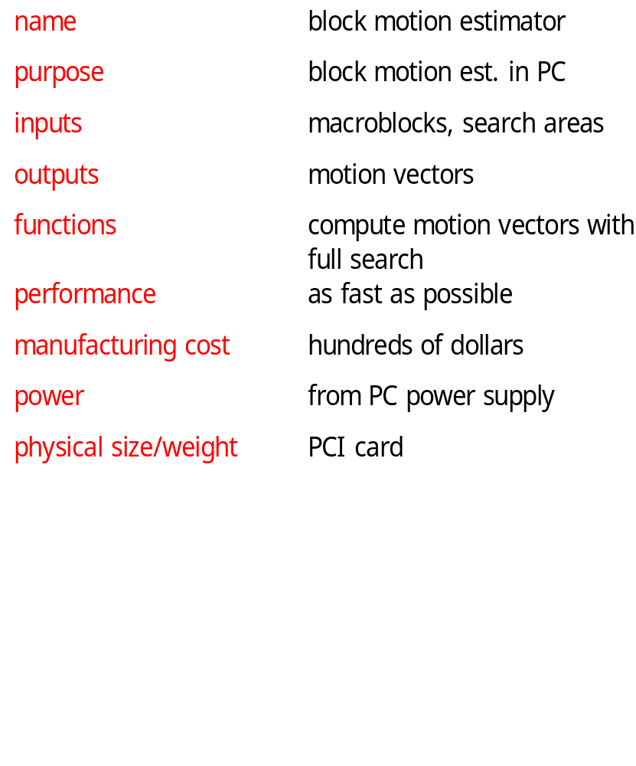
Accelerator requirements

Slide 61
Accelerator data types, basic classes
Motion-vector
Macroblock
Search-area
x, y : pos
pixels[] : pixelval
pixels[] : pixelval
PC
Motion-estimator
memory[]
compute-mv()

Slide 62
Sequence diagram
:PC
:Motion-estimator
compute-mv()
Search area
memory[]
memory[]
macroblocks
memory[]

Slide 63
Architectural considerations
Requires large amount of memory:
  macroblock has 256 pixels;
  search area has 1,089 pixels.
May need external memory (especially if buffering multiple macroblocks/search areas).

Slide 64
Motion estimator organization
PE 0
search area
network
PE 1
comparator
ctrl
...
Address
generator
Motion
vector
macroblock
network
PE 15

Slide 65
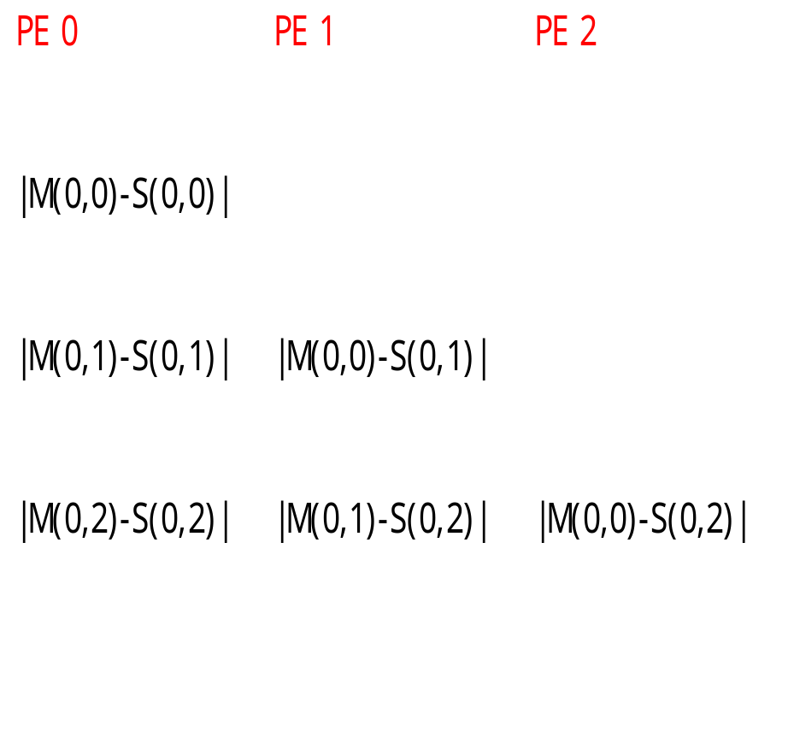
Pixel schedules
M(0,0)
S(0,2)

Slide 66
System testing
Testing requires a large amount of data.
Use simple patterns with obvious answers for initial tests.
Extract sample data from JPEG pictures for more realistic tests.

