Slide 1
Biological Databases and SQL
BioE 131/231
Fall 2018

Slide 2
Agenda for today
Overview of remote biological databases: Entrez, UCSC, Pfam, KEGG, Reactome
Storing data locally in SQLite
Using BioPython to query Entrez
Design a database, grab some data, and store it in your database
Done!

Slide 3
Online biological databases
Bioinformatics is largely concerned with finding the right data in online databases, reformatting it to suit your purposes, analyzing it, and plotting the results.
There are tons of databases out there, not all of which contain information of equal quality.
UCSC curates gene annotations of most sequenced mammalian genomes.
KEGG curates gene annotations and pathway information for nearly all sequenced prokaryotic genomes.
Pfam focuses on protein domains across all life.
Reactome focuses on pathways and gene interactions across all life.
Entrez lets you query largely uncurated databases of sequences uploaded by pretty much anyone.

Slide 4
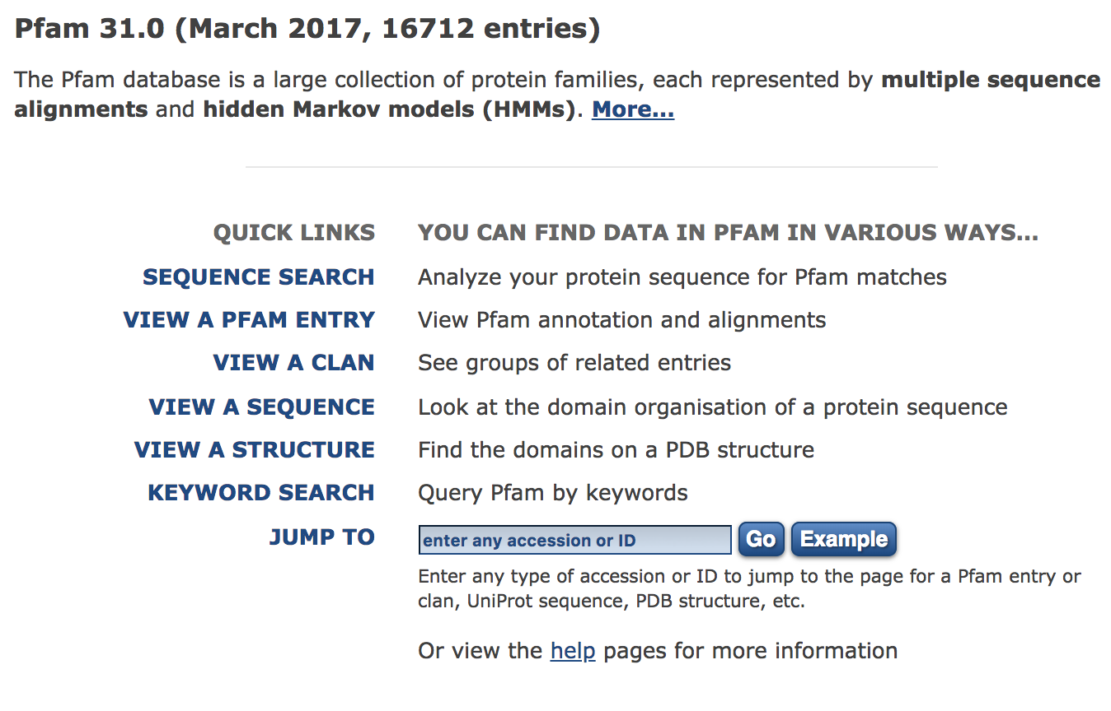
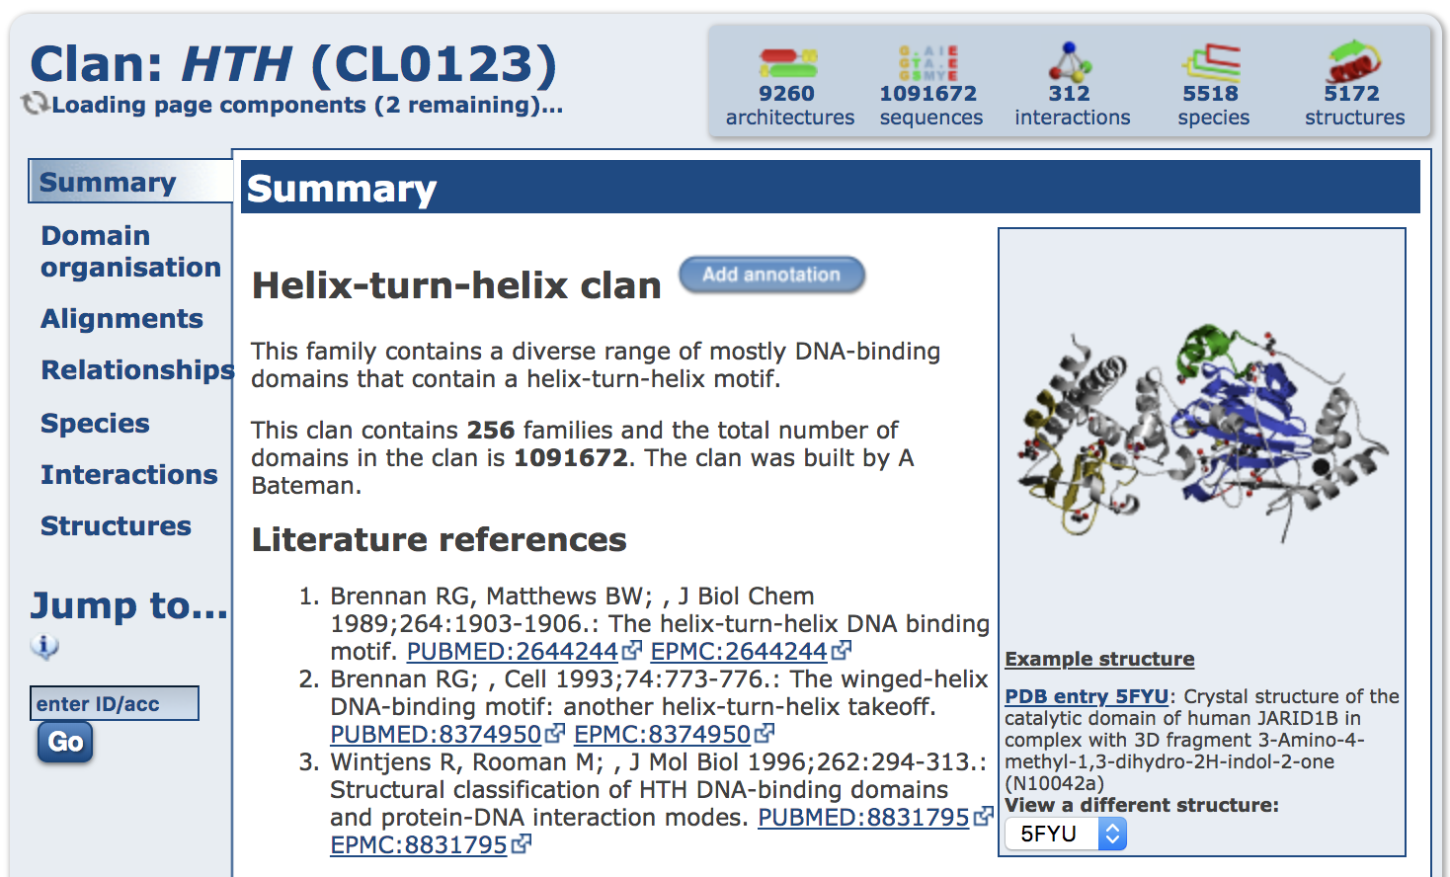
Online biological databases
Mostly, online biology databases are like Google. The better your search query is, the better your results will be, and it might take a few tries to get the query right. You will explore various databases in today’s lab.
LMGTFY (let me Google that for you) → LMBTFY (let me BLAST that for you)

Slide 5
Structured Query Language (SQL)
SQL is a widely-used language for creating, updating, and accessing relational databases. In SQL, a database is generally just a collection of tables. A table is a collection of rows. Each row is a collection of fields. Related information about a single entity (in this case, a gene or a group of genes) can be stored across multiple tables if there is some piece of information that connects them, like a name or ID number.
Rows in the ‘genes_in_groups’ table serve only to link entries in the ‘genes’ table to entries in the ‘groups’ table. Groups can contain many genes, and genes can appear in many groups.
Database: human_genome
Rows in the ‘genes’ table contain information (fields) about individual genes
Table: genes
Table: genes_in_groups
Table: groups
id | name | description | coordinates | strand
1 | BRCA1 | Breast cancer 1 | chr17 | -
...
45 | RORy | Th17 regulator | chr1 | +
group_id | gene_id
1 | 1
1 | 19
2 | 5
2 | 45
id | name | description
1 | Tumor Suppressors | Genes involved in oncogenesis
2 | Transcription Factors | Regulators of gene expression
Rows in the ‘groups’ table contain information about groups of genes

Slide 6
Relationships between tables
A one-to-one relationship is used to link a single row in one table to a single row in a second table.
A one-to-many relationship is used to link a single row in one table to multiple rows in a second table.
A many-to-many relationship is a bidirectional one-to-many relationship. A single row in the first table is linked to multiple rows in the second table, and a single row in the second table is also linked to multiple rows in the first table.

Slide 7
Our example is a many-to-many relationship
Database: human_genome
Table: genes
Table: genes_in_groups
Table: groups
id | name | description | coordinates | strand
1 | BRCA1 | Breast cancer 1 | chr17 | -
...
45 | RORy | Th17 regulator | chr1 | +
group_id | gene_id
1 | 1
1 | 19
2 | 5
2 | 45
id | name | description
1 | Tumor Suppressors | Genes involved in oncogenesis
2 | Transcription Factors | Regulators of gene expression
If we query ‘genes_in_groups’ for all rows with a given group_id number, what will the results be?
How can we use those results to get a list of genes in a particular group?
The id field in the ’genes’ and ‘groups’ tables is a primary key. Each row is guaranteed to have a unique primary key, generally because they are incremented by one as rows are added.
The ‘genes_in_groups’ table is called an associative table. Its only purpose is to describe the relationship between rows in ‘genes’ and ’groups’.
A gene can appear in multiple groups, and a group contains multiple genes. This is called a many-to-many relationship.

Slide 8
SQL implementation details
SQL commands are generally single lines beginning with a single command, like CREATE, UPDATE, or SELECT.
They are sent to an SQL server, which can be running locally on your machine (e.g., Postgres), handled by Python (e.g., SQLite), or on some remote server (e.g., UCSC’s public MySQL server).
After making changes to a database, they are committed to the database and written to disk. Some implementations of SQL keep the data in a single file, while some spread the data across multiple files (or even multiple machines for speed and redundancy).

Slide 9
Basic SQL command cheat sheet
Command | What it do
CREATE TABLE | Creates a new, empty table in the current database CREATE TABLE genes (id INT PRIMARY KEY ASC, name TEXT, description TEXT, chromosome TEXT, start INT, end INT, strand VARCHAR(1));
INSERT | Adds one or more new rows to a table INSERT INTO genes (name, description, chromosome, start, end, strand) VALUES ('BRCA1', 'Breast Cancer 1', 'chr17', 43044295, 43170245, '-');
SELECT | Retrieves data from one or more rows in a table SELECT * FROM genes WHERE name = 'BRCA1';
UPDATE | Modifies the contents of one or more rows in a table UPDATE genes SET description = 'Breast Cancer 1, a human tumor suppressor gene' WHERE name = 'BRCA1’;
DELETE FROM | Deletes some data inside a table, but not the entire table DELETE FROM genes WHERE name = 'BRCA1';
DROP TABLE | Deletes an entire table (https://xkcd.com/327/) DROP TABLE genes;

Slide 10
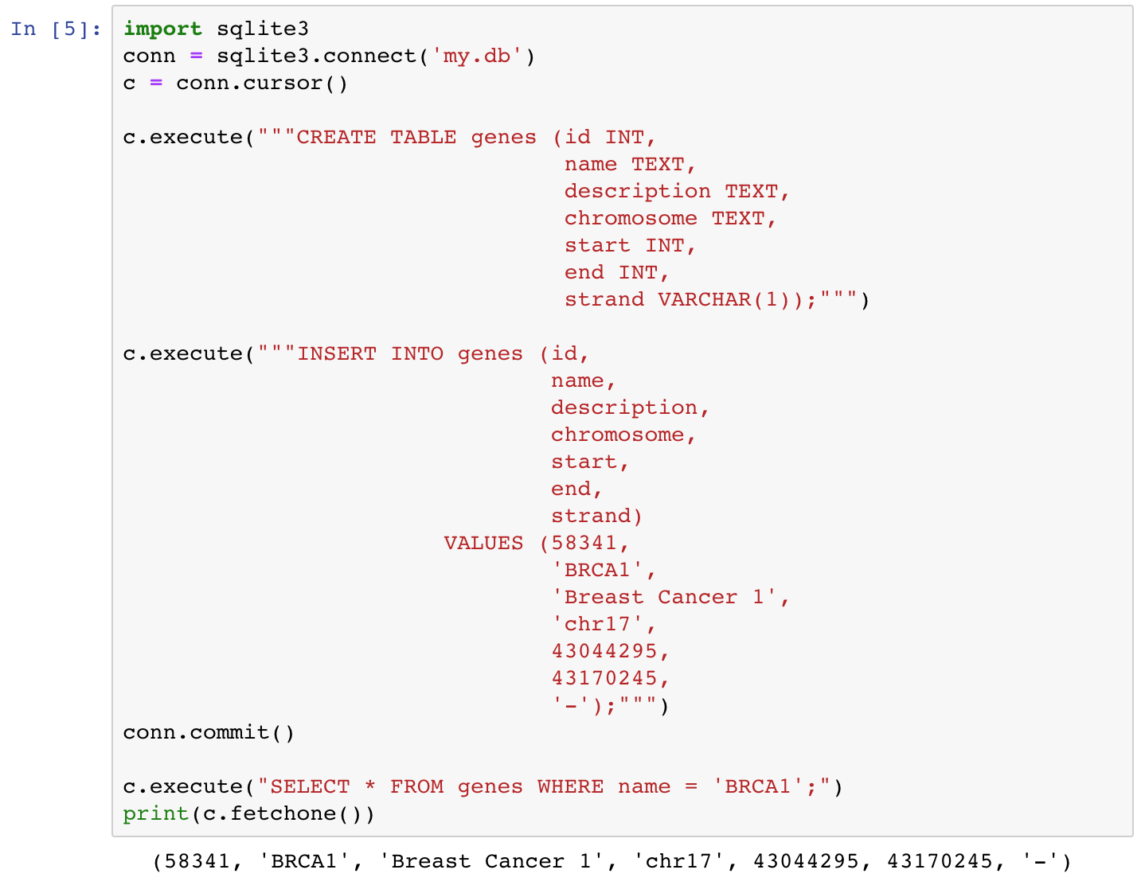
Create a table named ’genes’
INT – signed integer, 64 bits
TEXT – string, unlimited length
VARCHAR(n) – string, max length n
REAL – floating point, 64 bits BLOB – binary large object
Insert a new row into ‘genes’ specifying these fields (we could, for example, specify only a name and description if we didn’t yet know the chromosome, start, end, or strand)
Don’t forget to commit your changes
These are the values of the new row we’re inserting, in the same order that we specified above.
Now we can search our table for rows matching ‘BRCA1’ which are returned as tuples

Slide 11
Accessing Entrez using BioPython
BioPython includes a tool for fetching data (like GenBank files or PubMed records) from Entrez, NCBI’s data repository.
Import the module with:
from Bio import Entrez
Search one of the databases (db) for a given term, sorted as specified:
Entrez.esearch(db, term, sort) Fetch one or more records from a given database and return in a given format:
Entrez.efetch(db, id, rettype, retmode)

Slide 12
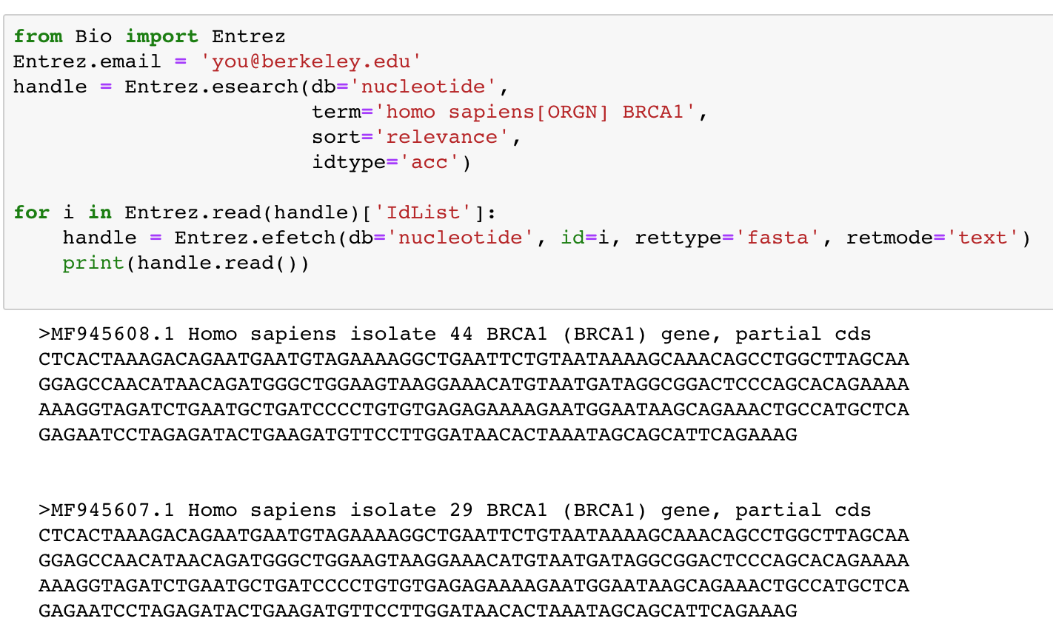
db can be anything on Entrez: nucleotide, gene, protein, genome term follows the same format for searching Entrez in your browser
sort by relevance is a good idea
idtype controls what types of record IDs are returned, ’acc’ means accession number
Once we have some IDs returned from our search, we can iterate over them and tell Entrez to send us back a bunch of FASTA sequences.
Here are the records simply printed to the screen. (1) How can we use BioPython to parse these FASTA sequences for us?
(2) How can we import them into an SQLite database?

Slide 13
Ok, now get started…
Download the Lab 4 PDF from bCourses and go through it together with your lab partner
You’ll have to query some databases in your web browser and using BioPython. Keep track of all your results in an iPython notebook.
Once you’ve curated the requested data, design a database to store it in that makes sense to you, then INSERT your data into it.
Turn in your iPython notebook and your SQLite database file when you’re finished.

