Slide 1
多益測驗練習說明
許耿誌WILLIAM
2019.9.13

Slide 2
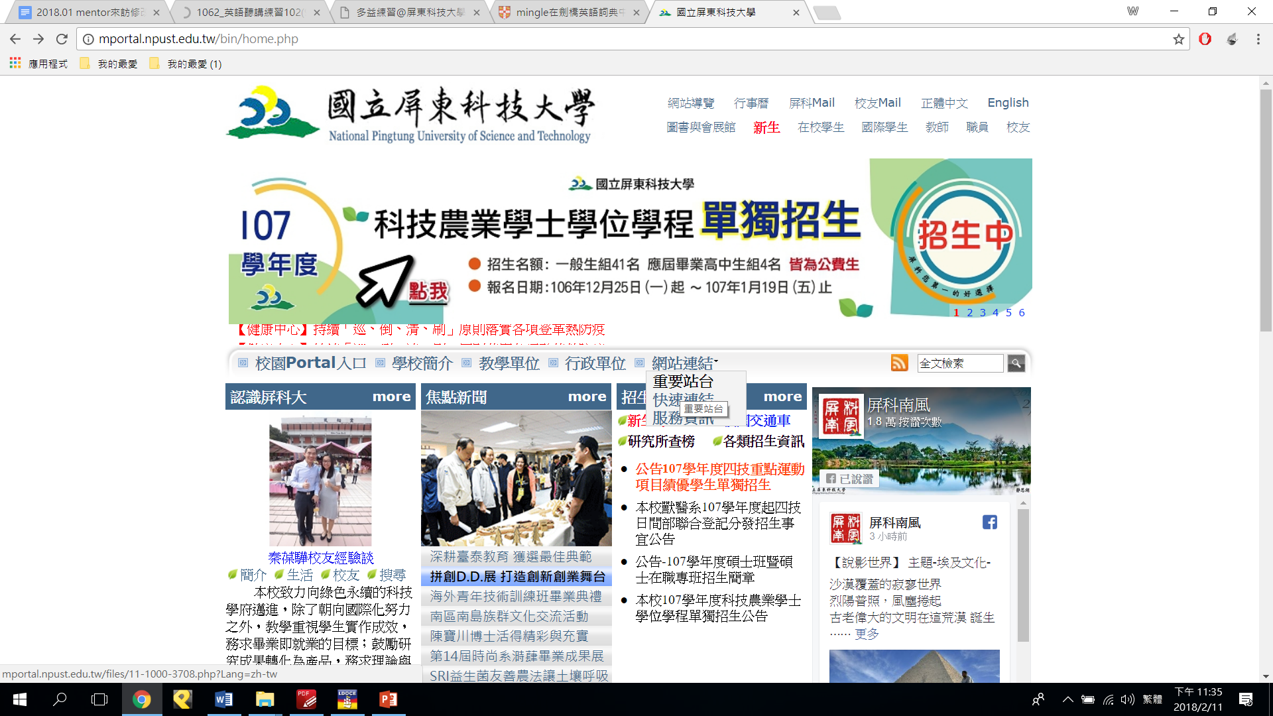

Slide 3
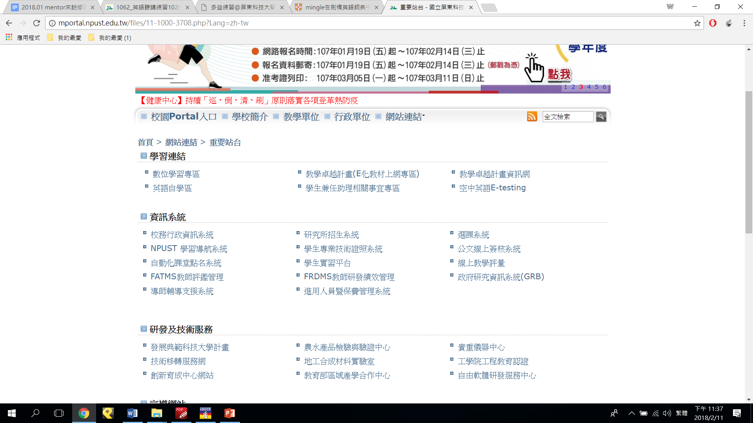

Slide 4
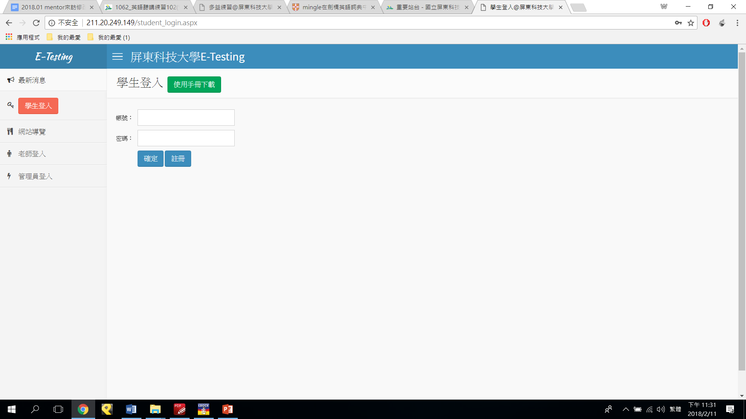
211.20.249.149
帳密皆為學號

Slide 5
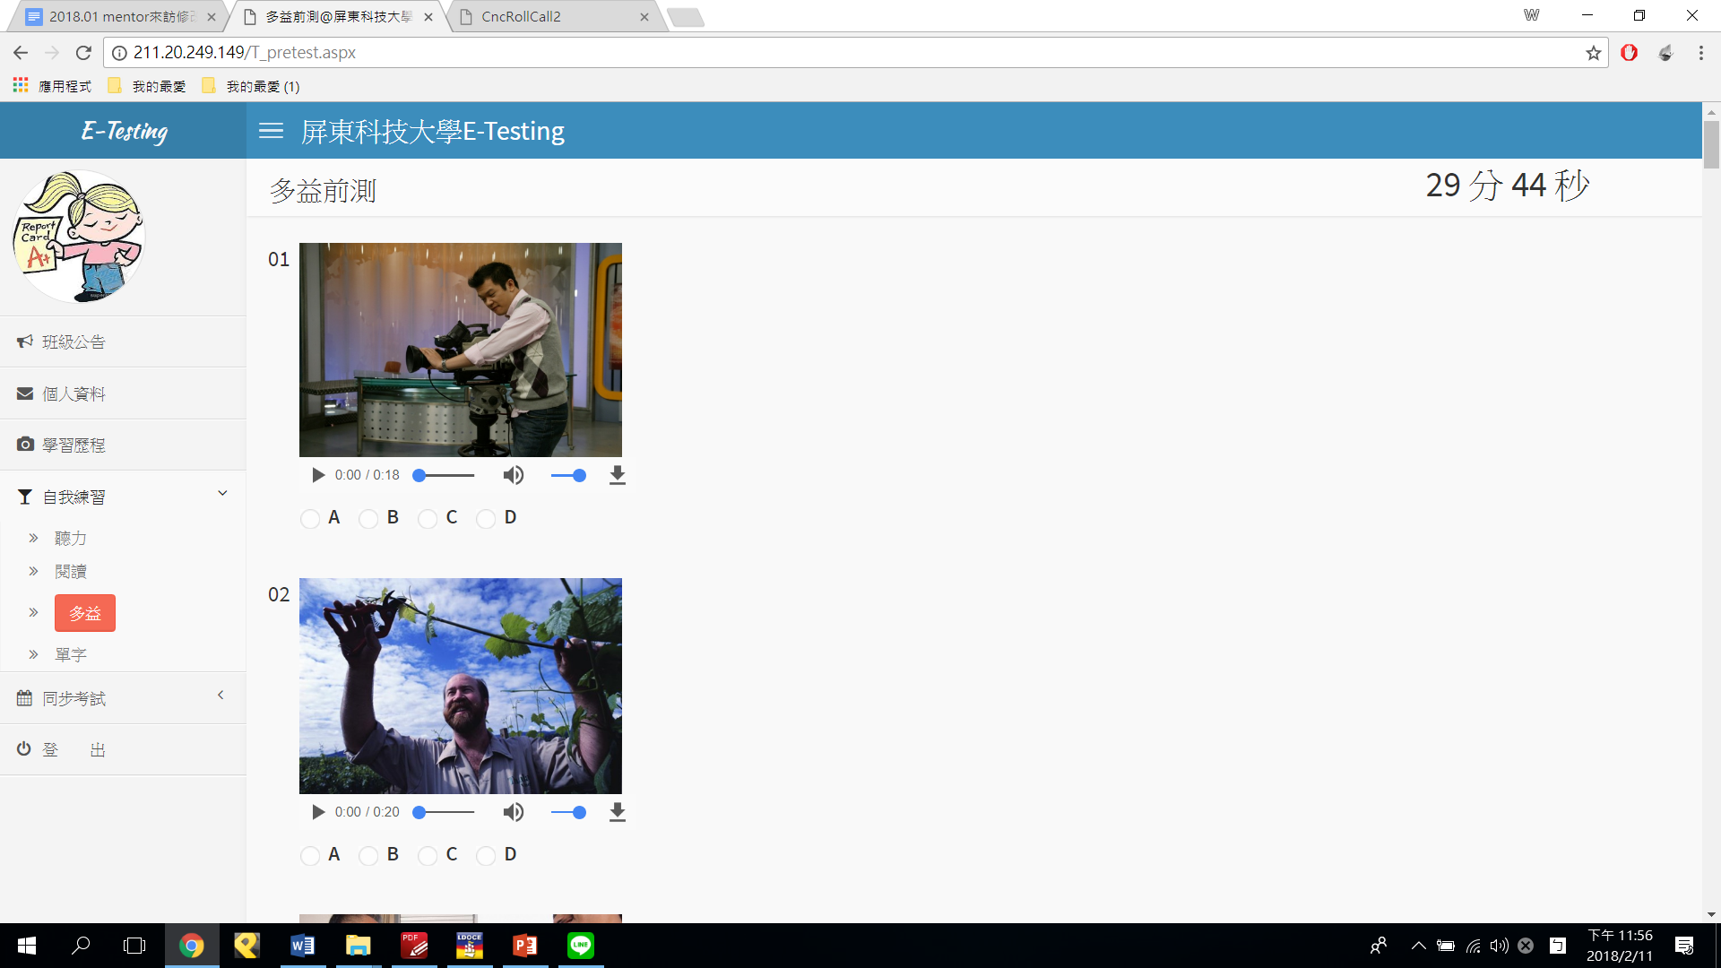

Slide 6
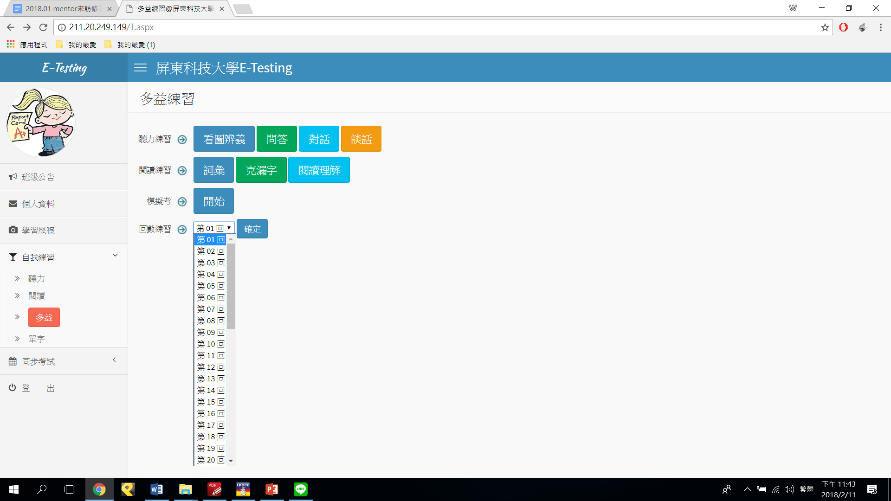
5,6,7,8回

Slide 7
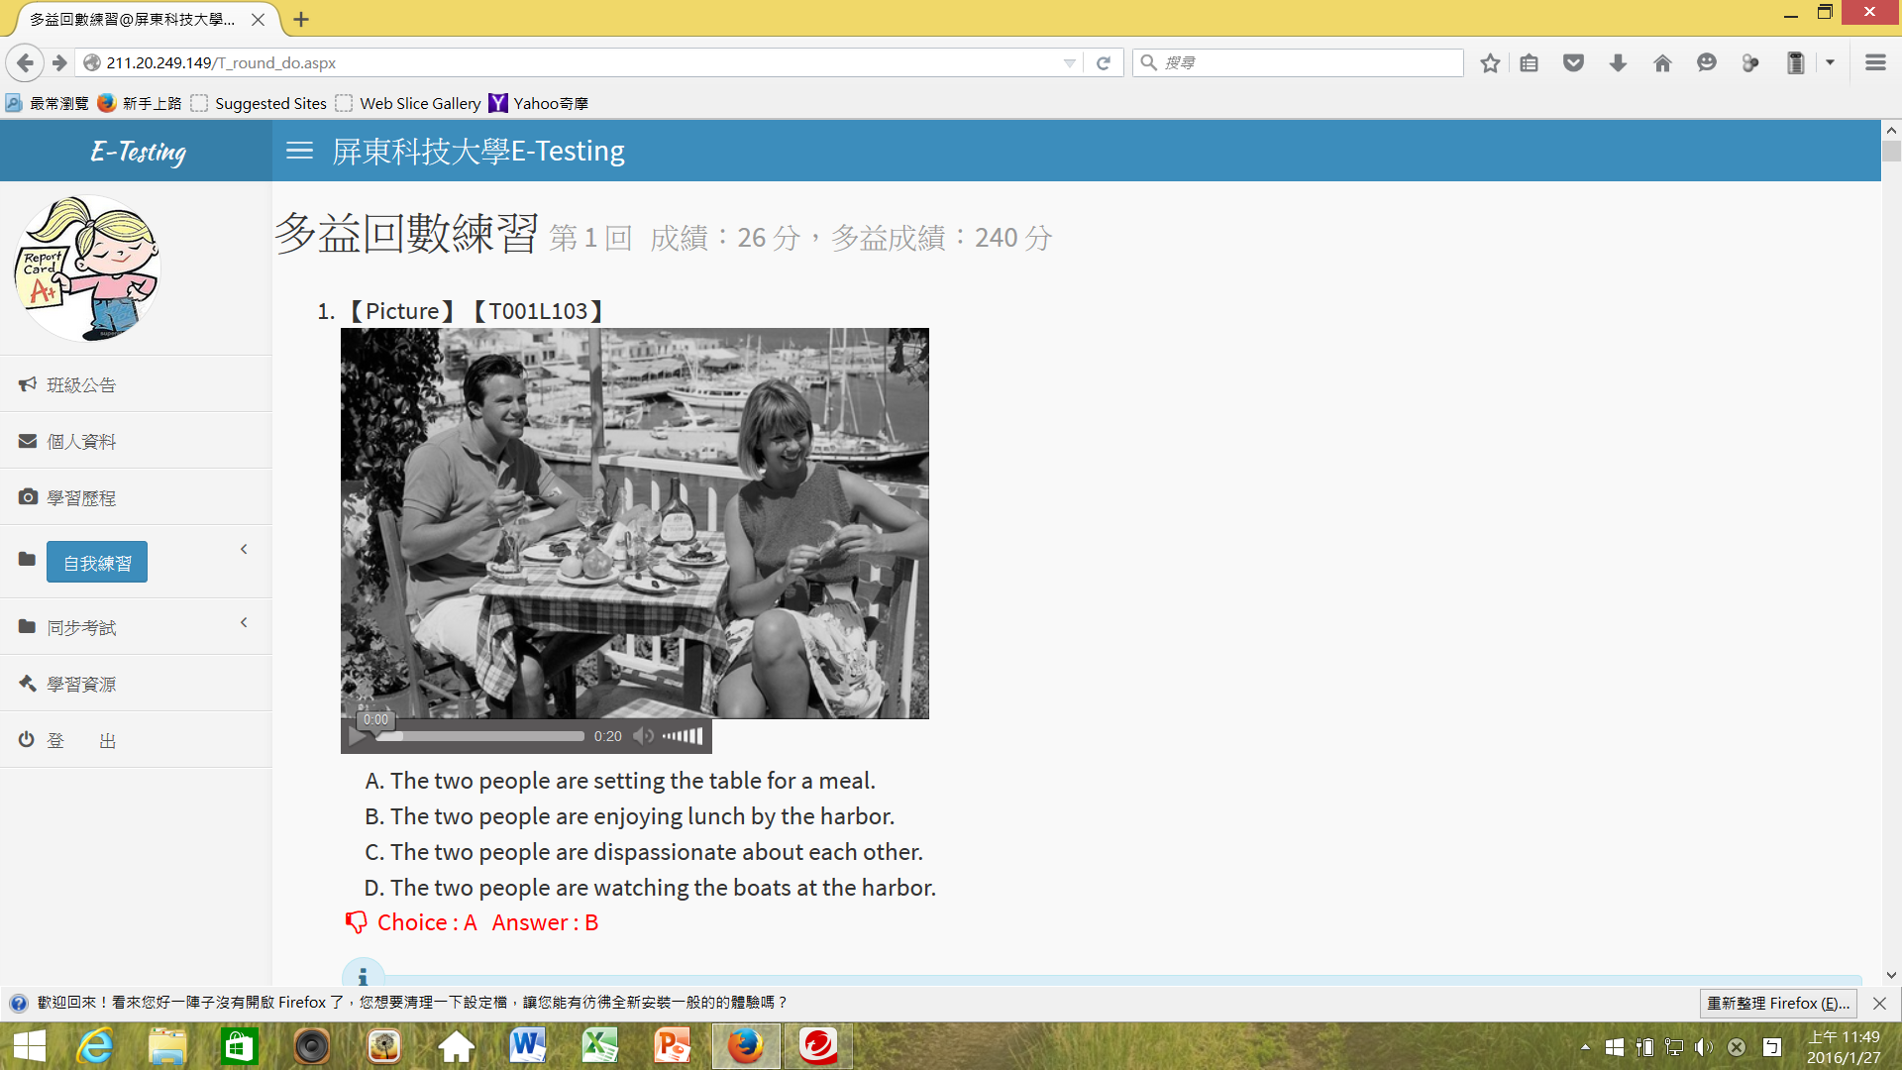
至少先做到500以上，再擷取分數交作業 (可重複練習)
注意:前次紀錄(錯的題目)不會保留

Slide 8

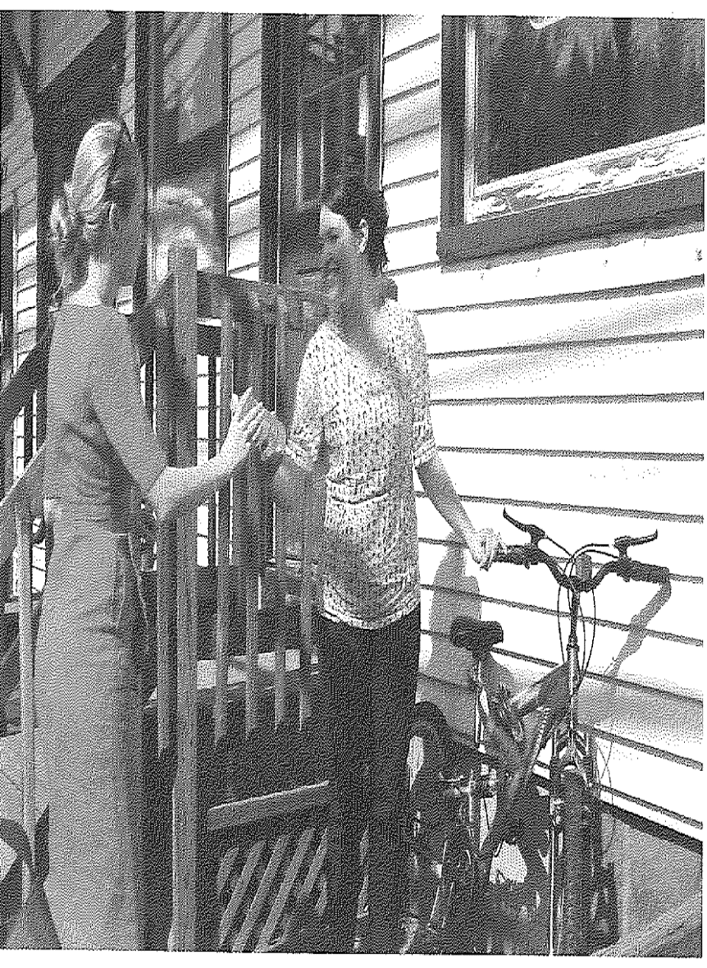
One of the women is adjusting (調整) a bicycle seat.
One of the women is drinking from a cup.
The women are standing by a wooden railing.欄杆
The women are climbing(攀爬) some stairs to a porch.

Slide 9
訂正報告
例如: 大題 題號 選項 聽力1 (3)
railing: a vertical post, usually metal or wooden, that is used together with other such posts to form a fence
(example):
Tourists pressed their faces against the palace railings.
I chained my bike to the park railings.
報告請包含成績+15個單字(含中英翻譯)+每單字2例句)

Slide 10
Time for handing in assignment
(hand in assignment practice 5.6 before mid-term exam (due day:10/27/2019),
assignment 7.8 before final exam(due day:12/29/2019)

