Slide 1
Chapter 7:
SQL
Modern Database Management
6th Edition
Jeffrey A. Hoffer, Mary B. Prescott, Fred R. McFadden

Slide 2
SQL Is:
Structured Query Language
The standard for relational database management systems (RDBMS)
SQL-92 Standard -- Purpose:
  Specify syntax/semantics for data definition and manipulation
  Define data structures
  Enable portability
  Specify minimal (level 1) and complete (level 2) standards
  Allow for later growth/enhancement to standard

Slide 3
Benefits of a Standardized Relational Language
Reduced training costs
Productivity
Application portability
Application longevity
Reduced dependence on a single vendor
Cross-system communication

Slide 4
SQL Environment
Catalog
  a set of schemas that constitute the description of a database
Schema
  The structure that contains descriptions of objects created by a user (base tables, views, constraints)
Data Definition Language (DDL):
  Commands that define a database, including creating, altering, and dropping tables and establishing constraints
Data Manipulation Language (DML)
  Commands that maintain and query a database
Data Control Language (DCL)
  Commands that control a database, including administering privileges and committing data

Slide 5
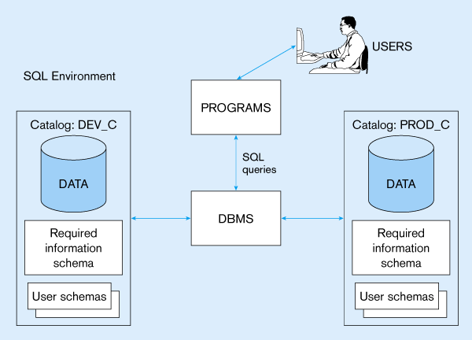
Figure 7-1:
A simplified schematic of a typical SQL environment, as described by the SQL-92 standard

Slide 6
SQL Data types (from Oracle8)
String types
  CHAR(n) – fixed-length character data, n characters long Maximum length = 2000 bytes
  VARCHAR2(n) – variable length character data, maximum 4000 bytes
  LONG – variable-length character data, up to 4GB. Maximum 1 per table
Numeric types
  NUMBER(p,q) – general purpose numeric data type
  INTEGER(p) – signed integer, p digits wide
  FLOAT(p) – floating point in scientific notation with p binary digits precision
Date/time type
  DATE – fixed-length date/time in dd-mm-yy form

Slide 7
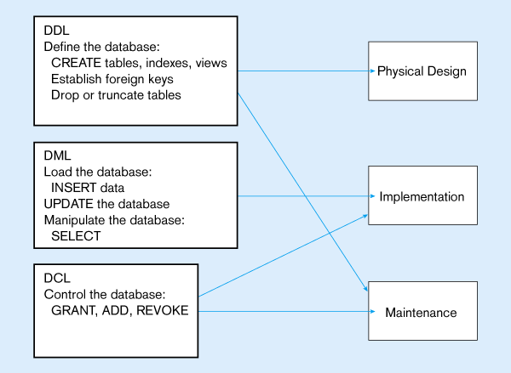
Figure 7-4:
DDL, DML, DCL, and the database development process

Slide 8
SQL Database Definition
Data Definition Language (DDL)
Major CREATE statements:
  CREATE SCHEMA – defines a portion of the database owned by a particular user
  CREATE TABLE – defines a table and its columns
  CREATE VIEW – defines a logical table from one or more views
Other CREATE statements: CHARACTER SET, COLLATION, TRANSLATION, ASSERTION, DOMAIN

Slide 9
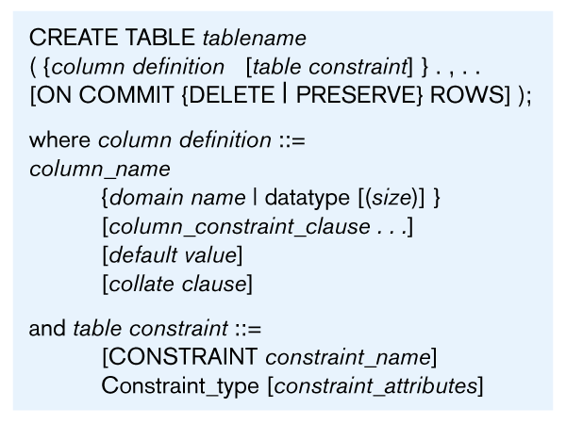
Table Creation
Steps in table creation:
Identify data types for attributes
Identify columns that can and cannot be null
Identify columns that must be unique (candidate keys)
Identify primary key-foreign key mates
Determine default values
Identify constraints on columns (domain specifications)
Create the table and associated indexes
Figure 7-5: General syntax for CREATE TABLE

Slide 10
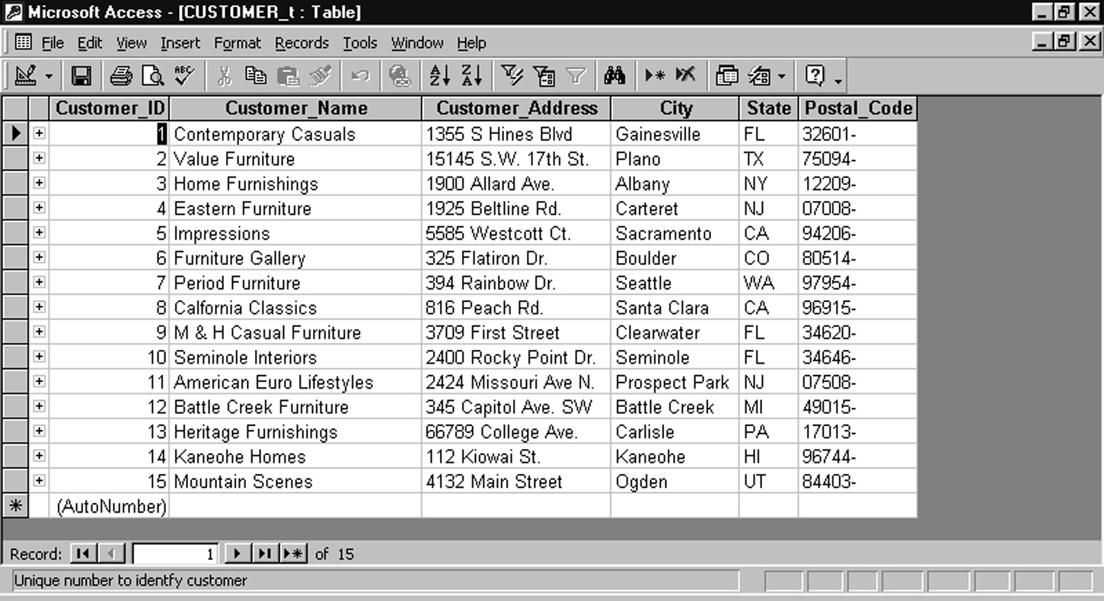
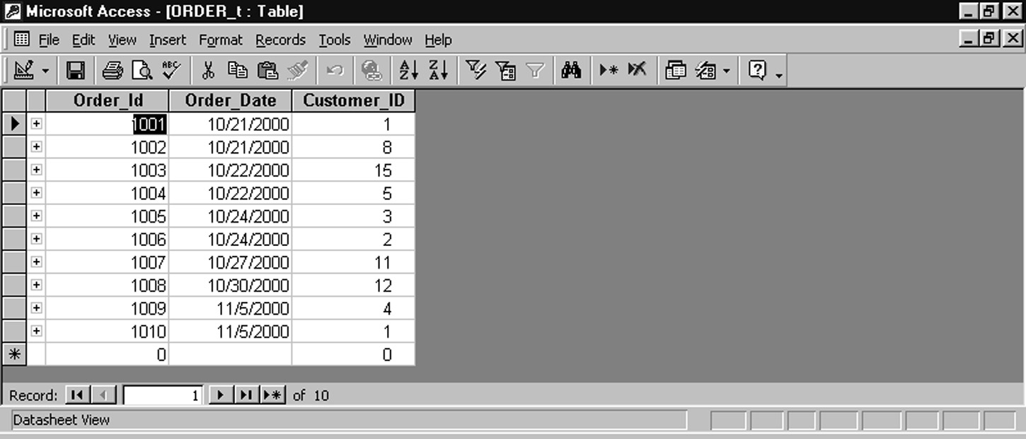
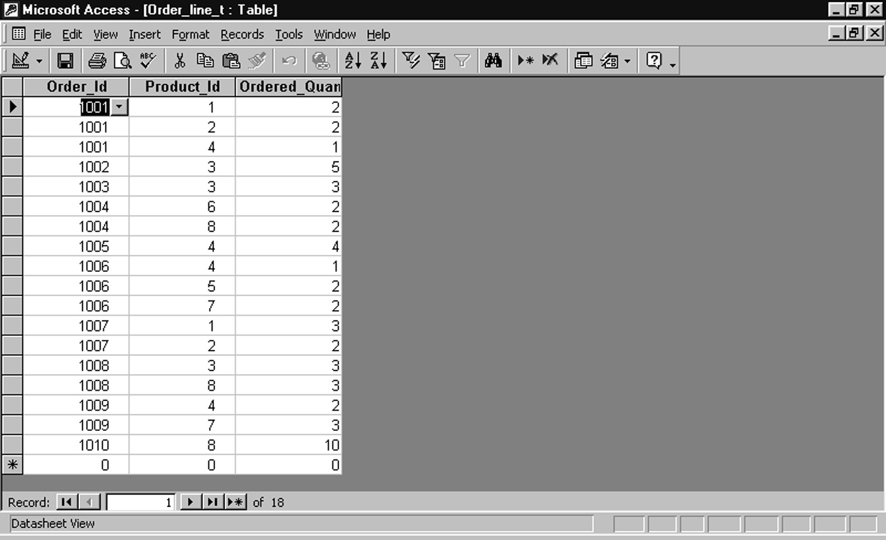
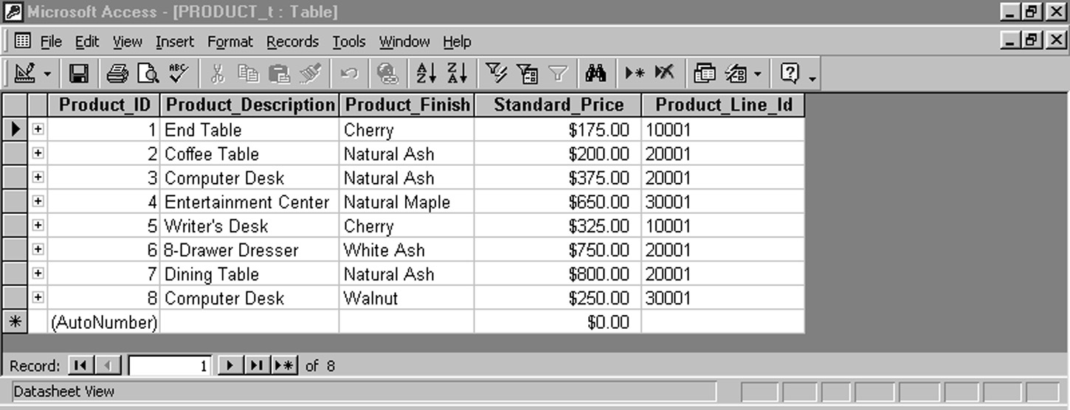
Figure 7-3: Sample Pine Valley Furniture data
customers
orders
order lines
products

Slide 11
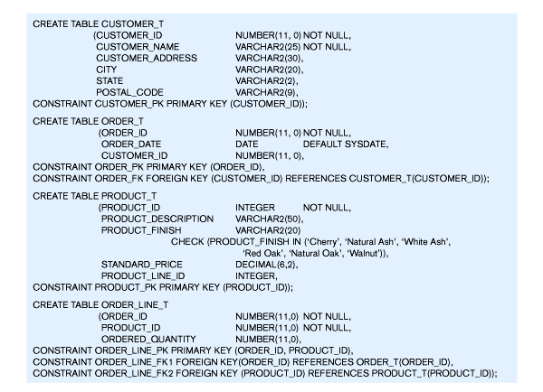
Figure 7-6: SQL database definition commands for Pine Valley Furniture

Slide 12
Figure 7-6: SQL database definition commands for Pine Valley Furniture
Defining attributes and their data types

Slide 13
Figure 7-6: SQL database definition commands for Pine Valley Furniture
Non-nullable specifications
Note: primary keys should not be null

Slide 14
Figure 7-6: SQL database definition commands for Pine Valley Furniture
Identifying primary keys
This is a composite primary key

Slide 15
Figure 7-6: SQL database definition commands for Pine Valley Furniture
Identifying foreign keys and establishing relationships

Slide 16
Figure 7-6: SQL database definition commands for Pine Valley Furniture
Default values and domain constraints

Slide 17
Figure 7-6: SQL database definition commands for Pine Valley Furniture
Overall table definitions

Slide 18
Using and Defining Views
Views provide users controlled access to tables
Advantages of views:
  Simplify query commands
  Provide data security
  Enhance programming productivity
CREATE VIEW command

Slide 19
View Terminology
Base Table
  A table containing the raw data
Dynamic View
  A “virtual table” created dynamically upon request by a user.
  No data actually stored; instead data from base table made available to user
  Based on SQL SELECT statement on base tables or other views
Materialized View
  Copy or replication of data
  Data actually stored
  Must be refreshed periodically to match the corresponding base tables

Slide 20
Sample CREATE VIEW
CREATE VIEW EXPENSIVE_STUFF_V AS
SELECT PRODUCT_ID, PRODUCT_NAME, UNIT_PRICE
FROM PRODUCT_T
WHERE UNIT_PRICE >300
WITH CHECK_OPTION;
View has a name
View is based on a SELECT statement
CHECK_OPTION works only for updateable views and prevents updates that would create rows not included in the view

Slide 21
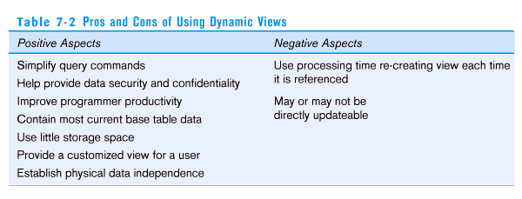
Table 7-2: Pros and Cons of Using Dynamic Views

Slide 22
Data Integrity Controls
Referential integrity – constraint that ensures that foreign key values of a table must match primary key values of a related table in 1:M relationships
Restricting:
  Deletes of primary records
  Updates of primary records
  Inserts of dependent records

Slide 23
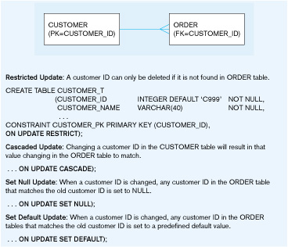
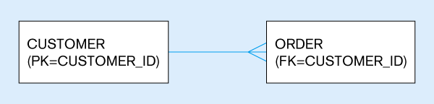
Figure 7-7: Ensuring data integrity through updates

Slide 24
Changing and Removing Tables
ALTER TABLE statement allows you to change column specifications:
  ALTER TABLE CUSTOMER_T ADD (TYPE VARCHAR(2))
DROP TABLE statement allows you to remove tables from your schema:
  DROP TABLE CUSTOMER_T

Slide 25
Schema Definition
Control processing/storage efficiency:
  Choice of indexes
  File organizations for base tables
  File organizations for indexes
  Data clustering
  Statistics maintenance
Creating indexes
  Speed up random/sequential access to base table data
  Example
    CREATE INDEX NAME_IDX ON CUSTOMER_T(CUSTOMER_NAME)
    This makes an index for the CUSTOMER_NAME field of the CUSTOMER_T table

Slide 26
Insert Statement
Adds data to a table
Inserting into a table
  INSERT INTO CUSTOMER_T VALUES (001, ‘CONTEMPORARY Casuals’, 1355 S. Himes Blvd.’, ‘Gainesville’, ‘FL’, 32601);
Inserting a record that has some null attributes requires identifying the fields that actually get data
  INSERT INTO PRODUCT_T (PRODUCT_ID, PRODUCT_DESCRIPTION,PRODUCT_FINISH, STANDARD_PRICE, PRODUCT_ON_HAND) VALUES (1, ‘End Table’, ‘Cherry’, 175, 8);
Inserting from another table
  INSERT INTO CA_CUSTOMER_T SELECT * FROM CUSTOMER_T WHERE STATE = ‘CA’;

Slide 27
Delete Statement
Removes rows from a table
Delete certain rows
  DELETE FROM CUSTOMER_T WHERE STATE = ‘HI’;
Delete all rows
  DELETE FROM CUSTOMER_T;

Slide 28
Update Statement
Modifies data in existing rows
UPDATE PRODUCT_T SET UNIT_PRICE = 775 WHERE PRODUCT_ID = 7;

Slide 29
The SELECT Statement
Used for queries on single or multiple tables
Clauses of the SELECT statement:
  SELECT
    List the columns (and expressions) that should be returned from the query
  FROM
    Indicate the table(s) or view(s) from which data will be obtained
  WHERE
    Indicate the conditions under which a row will be included in the result
  GROUP BY
    Indicate categorization of results
  HAVING
    Indicate the conditions under which a category (group) will be included
  ORDER BY
    Sorts the result according to specified criteria

Slide 30
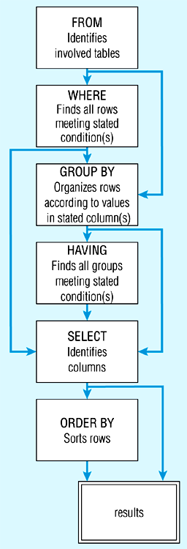
Figure 7-8: SQL statement processing order (adapted from van der Lans, p.100)

Slide 31
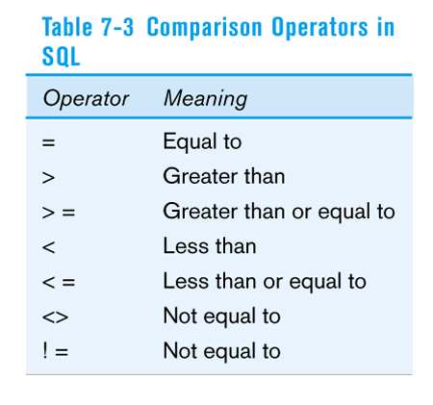
SELECT Example
Find products with standard price less than $275
SELECT PRODUCT_NAME, STANDARD_PRICE
FROM PRODUCT_V
WHERE STANDARD_PRICE < 275
Table 7-3: Comparison Operators in SQL

Slide 32
SELECT Example with ALIAS
Alias is an alternative column or table name
    SELECT CUST.CUSTOMER AS NAME, CUST.CUSTOMER_ADDRESS
    FROM CUSTOMER_V CUST
    WHERE NAME = ‘Home Furnishings’;

Slide 33
SELECT Example
Using a Function
Using the COUNT aggregate function to find totals
SELECT COUNT(*) FROM ORDER_LINE_V
WHERE ORDER_ID = 1004;
  Note: with aggregate functions you can’t have single-valued columns included in the SELECT clause

Slide 34
SELECT Example – Boolean Operators
AND, OR, and NOT Operators for customizing conditions in WHERE clause
SELECT PRODUCT_DESCRIPTION, PRODUCT_FINISH, STANDARD_PRICE
FROM PRODUCT_V
WHERE (PRODUCT_DESCRIPTION LIKE ‘%Desk’
OR PRODUCT_DESCRIPTION LIKE ‘%Table’)
AND UNIT_PRICE > 300;
Note: the LIKE operator allows you to compare strings using wildcards. For example, the % wildcard in ‘%Desk’ indicates that all strings that have any number of characters preceding the word “Desk” will be allowed

Slide 35
SELECT Example –
Sorting Results with the ORDER BY Clause
Sort the results first by STATE, and within a state by CUSTOMER_NAME
SELECT CUSTOMER_NAME, CITY, STATE
FROM CUSTOMER_V
WHERE STATE IN (‘FL’, ‘TX’, ‘CA’, ‘HI’)
ORDER BY STATE, CUSTOMER_NAME;
Note: the IN operator in this example allows you to include rows whose STATE value is either FL, TX, CA, or HI. It is more efficient than separate OR conditions

Slide 36
SELECT Example –
Categorizing Results Using the GROUP BY Clause
For use with aggregate functions
  Scalar aggregate: single value returned from SQL query with aggregate function
  Vector aggregate: multiple values returned from SQL query with aggregate function (via GROUP BY)
  SELECT STATE, COUNT(STATE)
  FROM CUSTOMER_V
  GROUP BY STATE;
  Note: you can use single-value fields with aggregate functions if they are included in the GROUP BY clause

Slide 37
SELECT Example –
Qualifying Results by Categories
Using the HAVING Clause
For use with GROUP BY
  SELECT STATE, COUNT(STATE)
  FROM CUSTOMER_V
  GROUP BY STATE
  HAVING COUNT(STATE) > 1;
  Like a WHERE clause, but it operates on groups (categories), not on individual rows. Here, only those groups with total numbers greater than 1 will be included in final result

