Slide 1
Chapter 8:
Advanced SQL
Modern Database Management
6th Edition
Jeffrey A. Hoffer, Mary B. Prescott, Fred R. McFadden

Slide 2
Processing Multiple Tables – Joins
Join – a relational operation that causes two or more tables with a common domain to be combined into a single table or view
Equi-join – a join in which the joining condition is based on equality between values in the common columns; common columns appear redundantly in the result table
Natural join – an equi-join in which one of the duplicate columns is eliminated in the result table
Outer join – a join in which rows that do not have matching values in common columns are nonetheless included in the result table (as opposed to inner join, in which rows must have matching values in order to appear in the result table)
Union join – includes all columns from each table in the join, and an instance for each row of each table
The common columns in joined tables are usually the primary key of the dominant table and the foreign key of the dependent table in 1:M relationships.

Slide 3
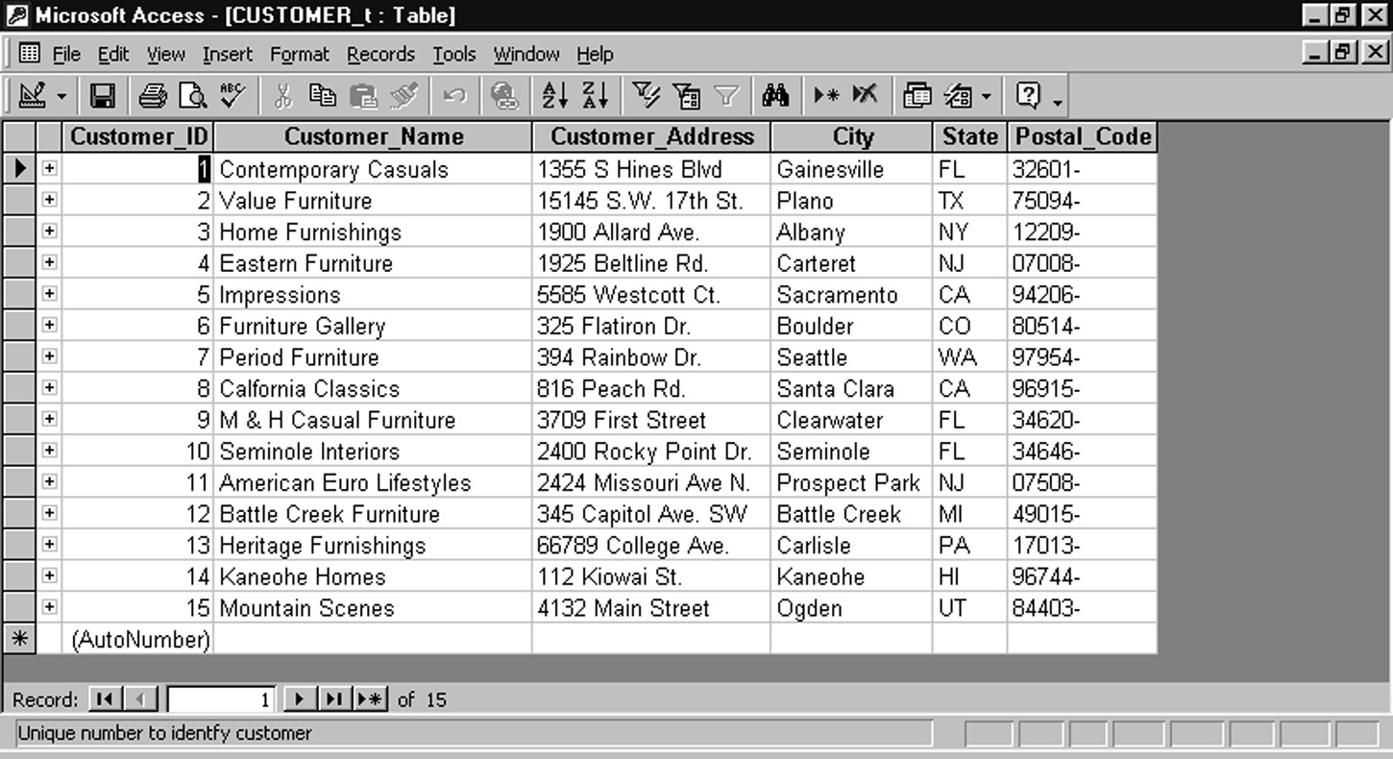
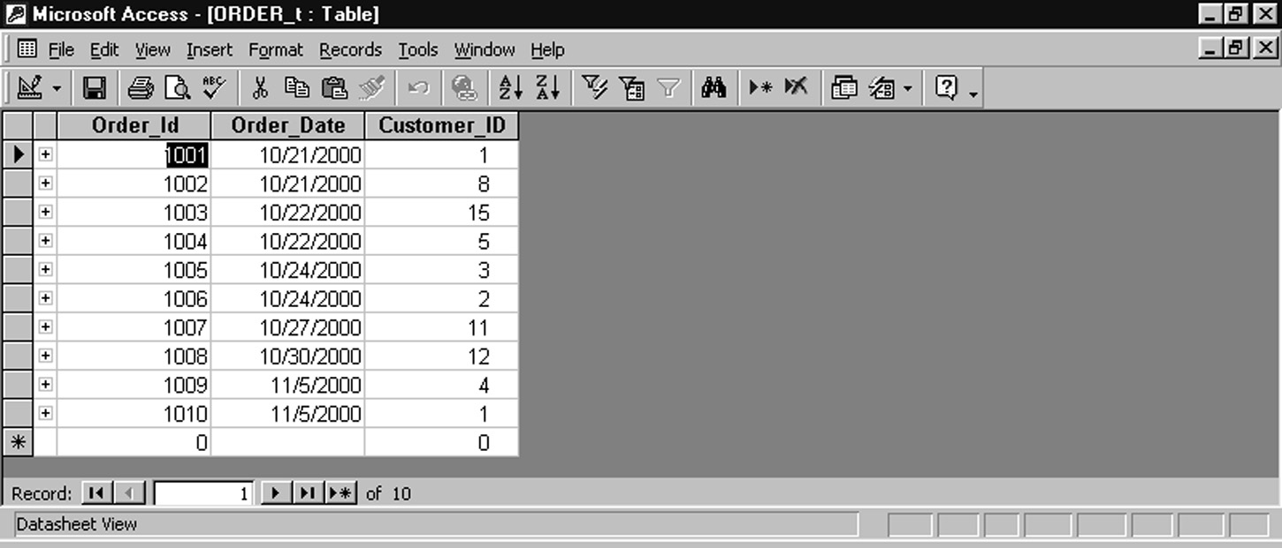
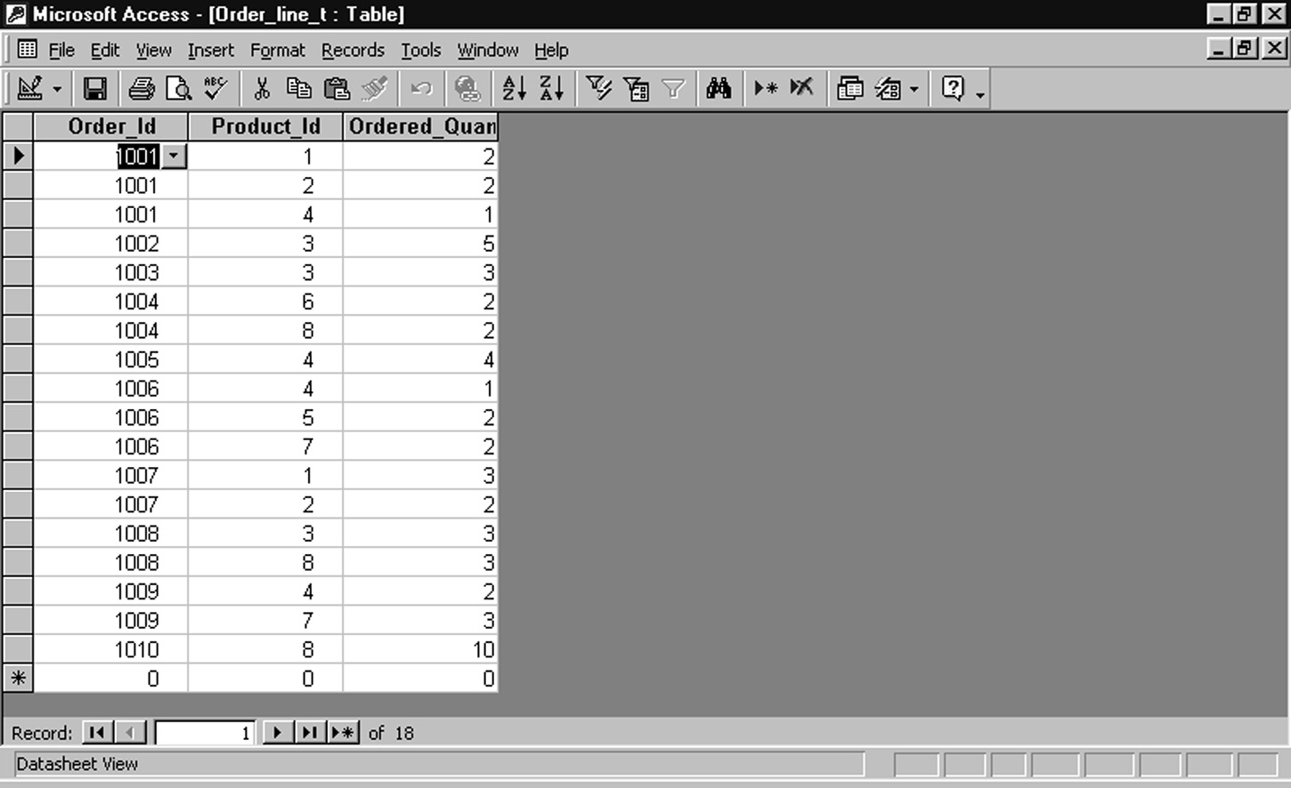
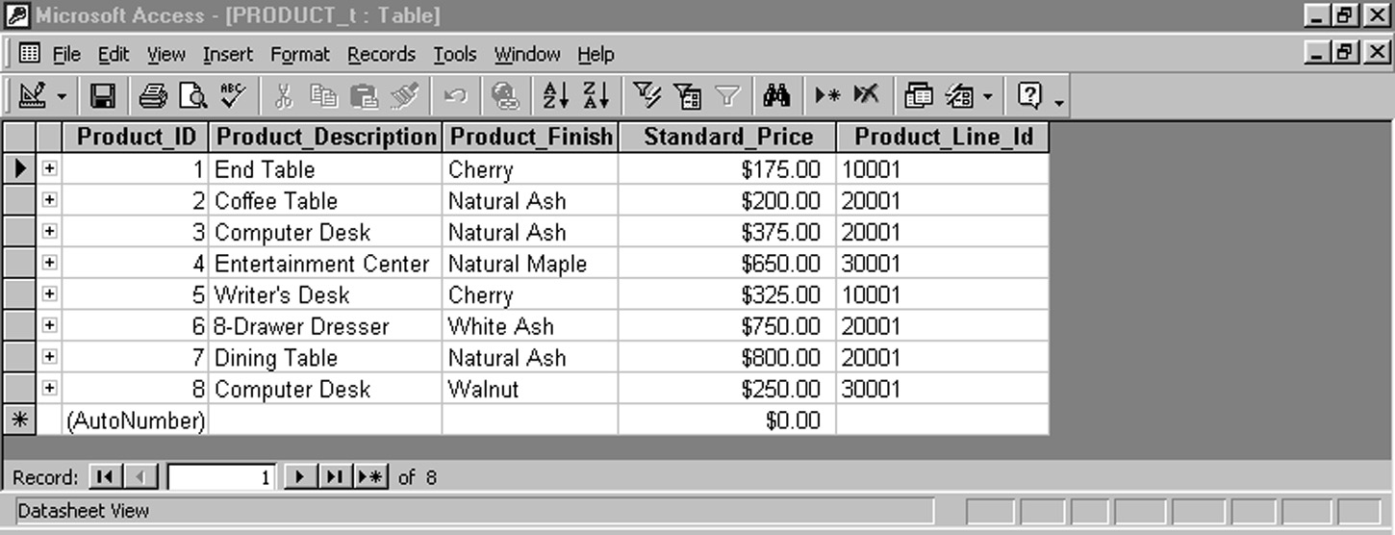
Figure 7-3 revisited: Sample Pine Valley Furniture data
customers
orders
order lines
products

Slide 4
Natural Join Example
For each customer who placed an order, what is the customer’s name and order number?
SELECT CUSTOMER_T.CUSTOMER_ID, CUSTOMER_NAME, ORDER_ID
FROM CUSTOMER_T, ORDER_T
WHERE CUSTOMER_T.CUSTOMER_ID = ORDER_T.CUSTOMER_ID
Join involves multiple tables in FROM clause
WHERE clause performs the equality check for common columns of the two tables

Slide 5
Outer Join Example
List the customer name, ID number, and order number for all customers. Include customer information even for customers that do have an order
SELECT CUSTOMER_T.CUSTOMER_ID, CUSTOMER_NAME, ORDER_ID
FROM CUSTOMER_T, LEFT OUTER JOIN ORDER_T
WHERE CUSTOMER_T.CUSTOMER_ID = ORDER_T.CUSTOMER_ID
LEFT OUTER JOIN syntax will cause customer data to appear even if there is no corresponding order data

Slide 6
Multiple Table Join Example
Assemble all information necessary to create an invoice for order number 1006
SELECT CUSTOMER_T.CUSTOMER_ID, CUSTOMER_NAME, CUSTOMER_ADDRESS, CITY, SATE, POSTAL_CODE, ORDER_T.ORDER_ID, ORDER_DATE, QUANTITY, PRODUCT_NAME, UNIT_PRICE, (QUANTITY * UNIT_PRICE)
FROM CUSTOMER_T, ORDER_T, ORDER_LINE_T, PRODUCT_T
WHERE CUSTOMER_T.CUSTOMER_ID = ORDER_LINE.CUSTOMER_ID AND ORDER_T.ORDER_ID = ORDER_LINE_T.ORDER_ID
  AND ORDER_LINE_T.PROEUCT_ID = PRODUCT_PRODUCT_ID
  AND ORDER_T.ORDER_ID = 1006;
Four tables involved in this join
Each pair of tables requires an equality-check condition in the WHERE clause, matching primary keys against foreign keys

Slide 7
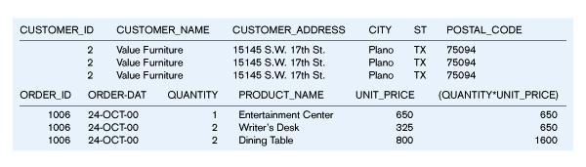
Figure 8-1 – Results from a four-table join
From CUSTOMER_T table
From ORDER_T table
From PRODUCT_T table

Slide 8
Processing Multiple Tables -- Subqueries
Subquery = placing an inner query (SELECT statement) inside an outer query
Options:
  In a condition of the WHERE clause
  As a “table” of the FROM clause
  Within the HAVING clause
Subqueries can be:
  Non correlated – execute once for the entire outer query
  Correlated – execute once for each row returned by the outer query

Slide 9
Subquery Example
Show all customers who have placed an order
SELECT CUSTOMER_NAME FROM CUSTOMER_T
WHERE CUSTOMER_ID IN
  (SELECT DISTINCT CUSTOMER_ID FROM ORDER_T);
The IN operator will test to see if the CUSTOMER_ID value of a row is included in the list returned from the subquery
Subquery is embedded in parentheses. In this case it returns a list that will be used in the WHERE clause of the outer query

Slide 10
Correlated vs. Noncorrelated Subqueries
Non-correlated subqueries:
  Do not depend on data from the outer query
  Executes once for the entire outer query
Correlated subqueries:
  Does make use of data from the outer query
  Executes once for each row of the outer query
  Can make use of the EXISTS operator

Slide 11
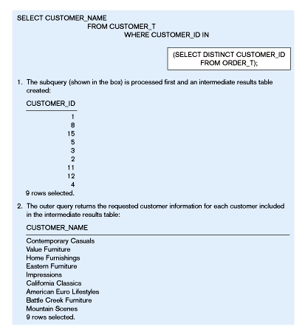
Figure 8-2(a) – Processing a noncorrelated subquery
No reference to data in outer query, so subquery executes once only

Slide 12
Correlated Subquery Example
Show all orders that include furniture finished in natural ash
SELECT DISTINCT ORDER_ID FROM ORDER_LINE_T
WHERE EXISTS
  (SELECT * FROM PRODUCT_T
  WHERE PRODUCT_ID = ORDER_LINE_T.PRODUCT_ID
  AND PRODUCT_FINISH = ‘Natural ash’);
The EXISTS operator will return a TRUE value if the subquery resulted in a non-empty set, otherwise it returns a FALSE
The subquery is testing for a value that comes from the outer query

Slide 13
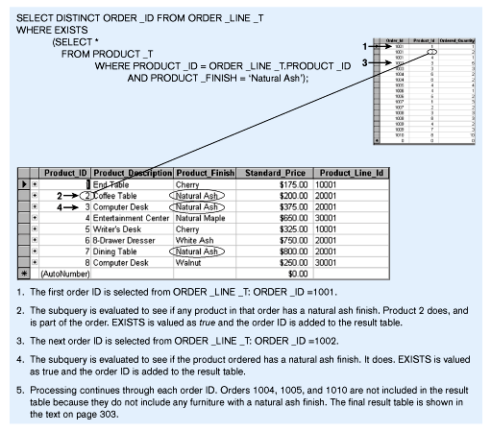
Figure 8-2(b) – Processing a correlated subquery
Subquery refers to outer-query data, so executes once for each row of outer query

Slide 14
Subquery Example – Using a Derived Table
Show all orders that include furniture finished in natural ash
SELECT PRODUCT_DESCRIPTION, STANDARD_PRICE, AVGPRICE
FROM
    (SELECT AVG(STANDARD_PRICE) AVGPRICE FROM PRODUCT_T),
    PRODUCT_T
    WHERE STANDARD_PRICE > AVG_PRICE;
One column of the subquery is an aggregate function that has an alias name. That alias can then be referred to in the outer query
Subquery forms the derived table used in the FROM clause of the outer query
The WHERE clause normally cannot include aggregate functions, but because the aggregate is performed in the subquery its result can be used in the outer query’s WHERE clause

Slide 15
Ensuring Transaction Integrity
Transaction = A discrete unit of work that must be completely processed or not processed at all
  May involve multiple updates
  If any update fails, then all other updates must be cancelled
SQL commands for transactions
  BEGIN TRANSACTION/END TRANSACTION
    Marks boundaries of a transaction
  COMMIT
    Makes all updates permanent
  ROLLBACK
    Cancels updates since the last COMMIT

Slide 16
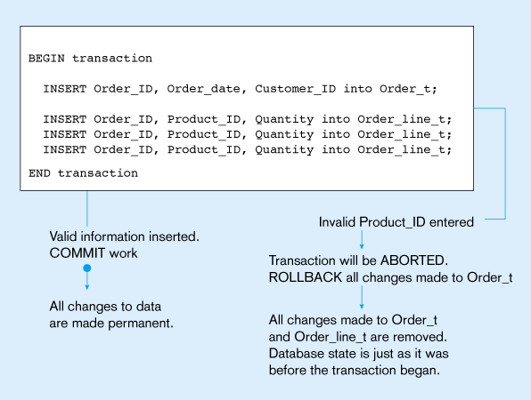
Figure 8-4: An SQL Transaction sequence (in pseudocode)

Slide 17
Data Dictionary Facilities
System tables that store metadata
Users usually can view some of these tables
Users are restricted from updating them
Examples in Oracle8i
  DBA_TABLES – descriptions of tables
  DBA_CONSTRAINTS – description of constraints
  DBA_USERS – information about the users of the system
  DBA_TAB_PRIVS – descriptions of grants on objects in the database

Slide 18
SQL-99 Enhancements/Extensions
User-defined data types (UDT)
  Subclasses of standard types or an object type
Analytical functions (for OLAP)
Persistent Stored Modules (SQL/PSM)
  Capability to create and drop code modules
  New statements:
    CASE, IF, LOOP, FOR, WHILE, etc.
    Makes SQL into a procedural language
SQL-99 Standard not widely adopted yet
Oracle has propriety version called PL/SQL

Slide 19
Routines and Triggers
Routines
  Program modules that execute on demand
  Functions – routines that return values and take input parameters
  Procedures – routines that do not return values and can take input or output parameters
Triggers
  Routines that execute in response to a database event (INSERT, UPDATE, or DELETE)

Slide 20
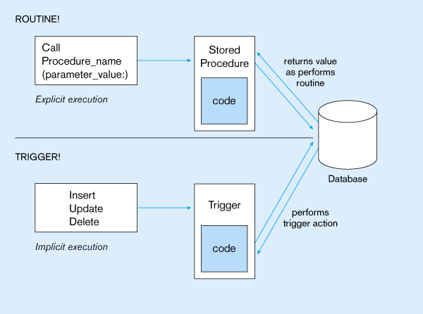
Figure 8-5: Triggers contrasted with stored procedures
Procedures are called explicitly
Triggers are event-driven
Source: adapted from Mullins, 1995.

Slide 21
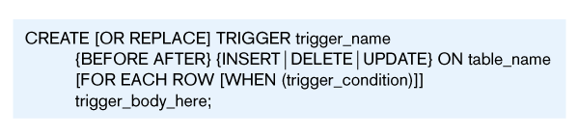
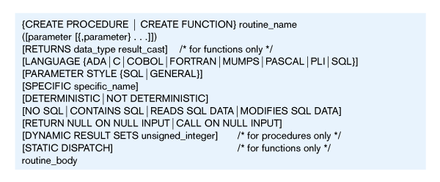
Figure 8-6: Oracle PL/SQL trigger syntax
Figure 8-7: SQL-99 Create routine syntax

Slide 22
Embedded and Dynamic SQL
Embedded SQL
  Including hard-coded SQL statements in a program written in another language such as C or Java
Dynamic SQL
  Ability for an application program to generate SQL code on the fly, as the application is running

