Slide 1
OFDM-based Cooperative Communications

Slide 2
Agenda
Basic Idea
Motivation
Classic relay channel
Single Path of Relays in Series
Multiple Paths of Relays in Parallel
OFDM in Cooperative Communications
Single Path Relay Network
Multiple Path Relay Network
References

Slide 3
Different Names
Different names stressing different aspects of the same idea.
  Cooperation
  Cooperative Communications
  Cooperative Relay Networks
  Cooperative Diversity

Slide 4
Basic Idea
Use a network of transceiver relay nodes to facilitate the transfer of information between the transmitter and receiver in a wireless system.
Increase end-to-end throughput of system, i.e. increase capacity.
Achieve spatial diversity without using a real physical antenna array. Instead, relay network forms a virtual array.
Therefore, it is still a form of diversity, i.e. cooperative diversity.

Slide 5
Basic Idea

Slide 6
Motivation
Radio propagation is omnidirectional, but traditionally, one transmitted signal is only intended for one receiver.
Other receivers receiving the same signal treat it as interference/noise when in fact it is valuable information.

Slide 7


Examples

Slide 8
Physical Layer Relaying
Relays need to follow some algorithm to transfer the information they receive to the next node.
3 steps in physical layer relaying.
1) A relay receives an information unit/packet/symbol from an upstream node.
2) The relay processes the information.
3) The relay transmits an information unit/packet/symbol to a downstream node.

Slide 9
Physical Layer Relaying
Relays follow some power constraint.
In one case, each relay has an individual transmit power constraint based on physical limitations (antenna, etc.).
In another case, groups of relays in the network have to satisfy some transmit power budget together.

Slide 10
Physical Layer Relaying
Fixed Relaying Protocols
  Amplify-and-forward (AF)
    Amplify whatever you receive and re-transmit.
    Benefit is low complexity.
  Decode-and-forward (DF)
    Fully decode, re-encode and re-transmit.
    Benefit is eliminating distortion at each relay.

Slide 11
Physical Layer Relaying
Selection Relaying
  Measure the channel quality, perform threshold tests and adaptively choose the best fixed relaying protocol.
Incremental Relaying
  Use feedback from destination node to determine a suitable protocol.

Slide 12
Network Information Theory
Graph theory is not sufficient to explain information transfer in a relay network.
We use information theory to investigate the fundamental limits of information transfer in a relay network.
But information transfer in a general network is a largely unsolved problem because complexity grows quickly as the network grows.
We consider specific relay networks to gain insight; so that one day we can achieve a general network information theory.

Slide 13
Classic Relay Channel
Ry
Tx
Rx

Slide 14
Outage Probability of CRC
Pout,dt has a 1/SNR relationship.
Pout,af has 1/SNR^2 relationship.
Pout,df also has 1/SNR relationship.

Slide 15
Single Path of Relays in Series
Relays
Tx
Rx

Slide 16
Multiple Paths of Relays in Parallel
Relays
Tx
Rx

Slide 17
OFDM in Cooperative Communications
Use OFDM signals in cooperative relay networks.
Intuition is that we can re-allocate power across the OFDM subcarriers.

Slide 18
OFDM in Cooperative Communications
Consider amplify-and-forward because of its low complexity.
Transmitter and every relay node has power constraint of Ptot.
Assume a uniform power distribution at the transmitter.

Slide 19
OFDM in Cooperative Communications
Three non-uniform power allocations at each relay corresponding to three mutual informations.
Constant gain allocation -> Constant gain capacity, Cct
Equal power allocation -> Equal power capacity, Ceq
Adaptive power allocation -> Adaptive allocation capacity, Caa

Slide 20
OFDM in Cooperative Communications
Two suboptimal power allocations at each relay.
Constant gain allocation
  Multiplying factor in amplify-and-forward constant across all subcarriers.
  Does not require any CSI.

Slide 21
OFDM in Cooperative Communications
Equal power allocation
  Choose multiplying factor such that every subcarrier has the same transmit power
  Requires upstream CSI.

Slide 22
OFDM in Cooperative Communications
Optimal power allocation (adaptive power allocation) at each relay to maximize the end-to-end mutual information.
  Requires CSI of entire network.
  Use average value of CSI of a channel if do not know it.

Slide 23
Single Path Relay Network
m relays
Tx
Rx
N=16, 32, 64, 128 subcarriers

Slide 24
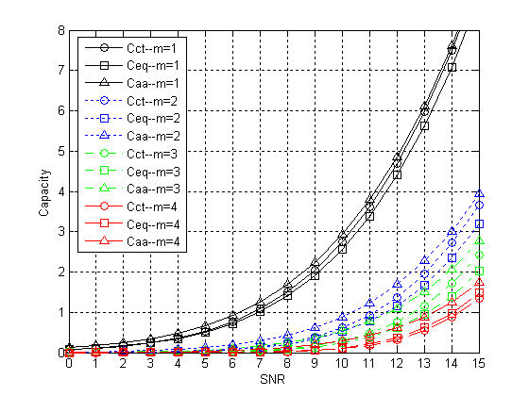
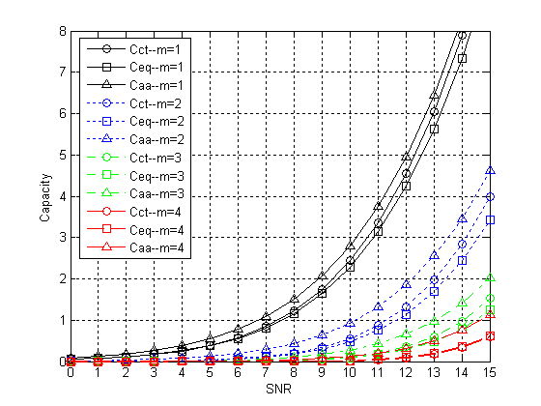
Single Path Relay Network
N=16
N=32

Slide 25
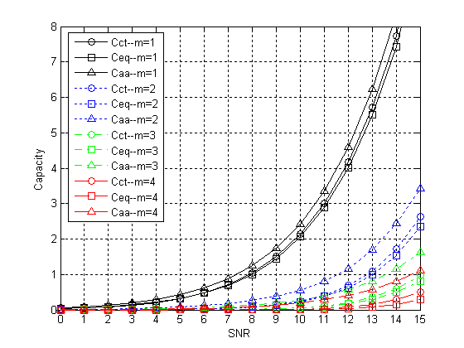
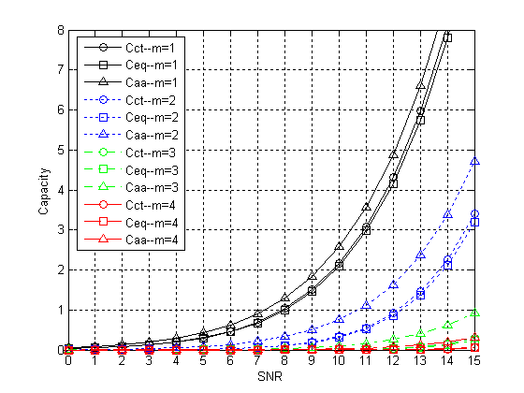
Single Path Relay Network
N=64
N=128

Slide 26
Single Path Relay Network
As we add more relays, more distortion enters system, capacity decreases.
As a result, as we add more relays, there is more room for improvement which adaptive power allocation provides.

Slide 27
Single Path Relay Network
For N=64 subcarriers, and m=4 relays there is 4 dB of SNR performance gain when Ceq is 15 dB. This is for low capacity values.
For 2 bits/s/Hz of capacity, there is approximately 1 dB of performance gain for m=2 relays.

Slide 28
Multiple Path Relay Network
m relays
Tx
Rx
N=16, 32, 64, 128 subcarriers

Slide 29
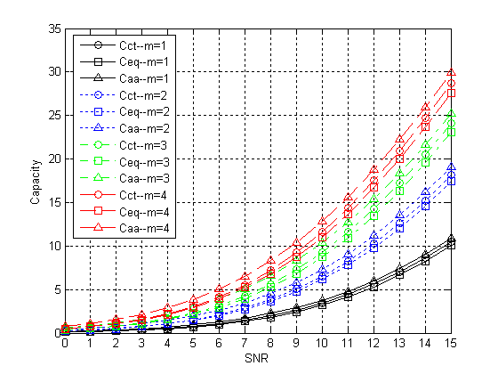
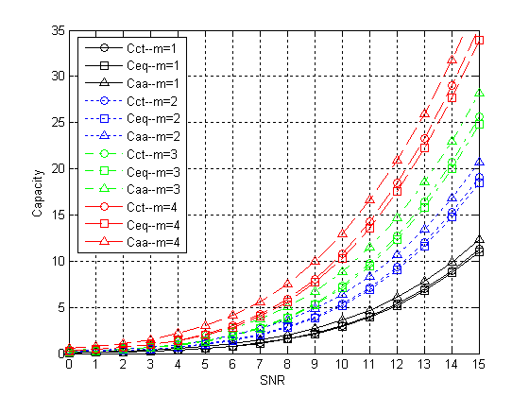
Multiple Path Relay Network
N=16
N=32

Slide 30
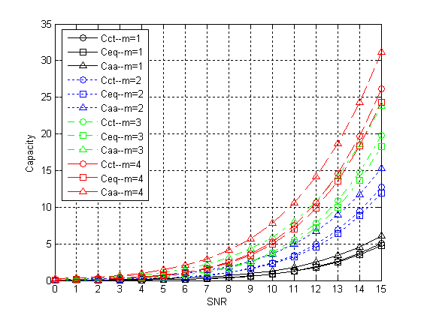
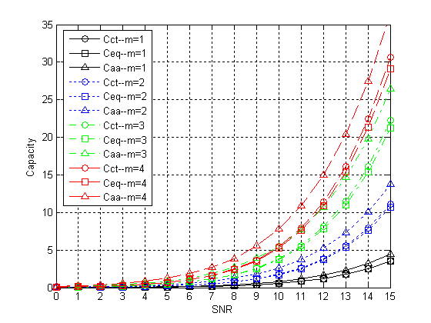
Multiple Path Relay Network
N=64
N=128

Slide 31
Multiple Path Relay Network
As we add more relays, the capacity increases. Having more paths in parallel gives a larger throughput between the transmitter and receiver.
The performance gain is approximately independent of number of relays we use.

Slide 32
Multiple Path Relay Network
For N=128, SNR gain is about 1 dB for m=2,3 and 4 relays at 10 bits/s/Hz of capacity.
This gives more flexibility in choosing appropriate transmit power range for given throughput requirement.

Slide 33
Multiple Path Relay Network
For N=64, the Caa curve for m=3 is approximately the same as the Cct and Ceq curves for m=4. This means by using adaptive power allocation, in addition to the power savings of about 1 dB in this case, can also save all the resources of one extra relay node.

Slide 34
References
A. Sendonaris, E. Erikip, and B. Aazhang, “User cooperation diversity – Part I: System description,” IEEE Trans. Commun., vol. 51, pp. 1927-1938, Nov. 2003.
--, “User cooperation diversity – Part II: Implementation aspects and performance analysis,” IEEE Trans. Commun., vol. 51, pp. 1939-1948, Nov. 2003.
J. N. Laneman, D. N. C. Tse and G. W. Wornell, “Cooperative diversity in wireless networks: Efficient protocols and outage behavior,” IEEE Trans. Inform. Theory, vol. 50, pp. 3062-3080, Dec. 2004.
J. N. Laneman, “Cooperative diversity in wireless networks: algorithms and architectures,” Ph.D. dissertation, MIT, Cambridge, MA, Sept. 2002.
J. N. Laneman, G. Wornell, and D. N. C. Tse, “An efficient protocol for realizing cooperative diversity in wireless networks,” in Proc. IEEE Int. Symp. Information Theory (ISIT), Washington D.C., June 2001, p. 294.
T. M. Cover and J. A. Thomas, Elements of Information Theory. New York, NY: John Wiley & Sons, Inc., 1991.
T. M. Cover and A. A. E. Gamal, “Capacity theorems for the relay channel,” IEEE Trans. Inform. Theory, vol. IT-25, pp. 572-584, Sept. 1979.
M. O. Hasna and M. Alouini, “Optimal power allocation for relayed transmissions over rayleigh-fading channels,” IEEE Trans. Wireless Commun., vol. 3, pp. 1999-2004, Nov. 2004.
--, “Performance analysis of two-hopped relayed transmission over rayleigh-fading channels,” in Proc. IEEE Vehicular Technology Conf., Vancouver, BC, Canada, Sept. 2002, pp. 1992-1996.
Y. Zhao, R. Adve, and T. J. Lim, “Improving amplify-and-forward relay networks: Optimal power allocation versus selection.”
I. E. Telatar, “Capacity of multi-antenna gaussian channels,” Eur. Trans. Telecom. ETT, vol. 10, pp. 585-596, Nov. 1999.

