Slide 1
Cooperative Communications
Applying OFDM to Cooperative Relay Networks

Slide 2
Agenda
Basic Idea
Motivation and examples
Classic relay channel
Single Path of Relays in Series
Multiple Paths of Relays in Parallel

Slide 3
Agenda
OFDM in Cooperative Communications
Single Path Relay Network
Multiple Path Relay Network
References

Slide 4
Different Names
Different names stressing different aspects of the same idea.
  Cooperation
  Cooperative Communications
  Cooperative Relay Networks
  Cooperative Diversity

Slide 5
Basic Idea
Use a network of transceiver relay nodes to facilitate the transfer of information between the transmitter and receiver in a wireless system.
Increase end-to-end throughput of system, i.e. increase capacity.

Slide 6
Basic Idea
Achieve spatial diversity without using a real physical antenna array. Instead, relay network forms a virtual array.
Therefore, it is still a form of diversity, i.e. cooperative diversity.

Slide 7
Basic Idea

Slide 8
Motivation
Radio propagation is omnidirectional, but traditionally, one transmitted signal is only intended for one receiver.
Other receivers receiving the same signal treat it as interference/noise when in fact it is valuable information.

Slide 9
Motivation
With wireless devices so prevalent today, cooperative diversity is very relevant.
Wireless ad hoc networks are becoming increasingly popular. Once network is formed, cooperative diversity can be applied.

Slide 10


Examples

Slide 11
Examples

Slide 12
Relay Algorithms
Relays need to follow some algorithm to transfer the information they receive to the next node.
Network layer relaying.
Physical layer relaying.

Slide 13
Network Layer Relaying
Physical layer communications researchers usually assume some sort of network layer routing algorithm a priori.
For example, a given relay always receives information from S specific sources and transmits information to D specific destinations.

Slide 14
Physical Layer Relaying
3 steps in physical layer relaying.
1) A relay receives an information unit/packet/symbol from an upstream node.
2) The relay processes the information.
3) The relay transmits an information unit/packet/symbol to a downstream node.

Slide 15
Physical Layer Relaying
Relays follow some power constraint.
In one case, each relay has an individual transmit power constraint based on physical limitations (antenna, etc.).
In another case, groups of relays in the network have to satisfy some transmit power budget together.

Slide 16
Physical Layer Relaying
Fixed Relaying Protocols
  Amplify-and-forward (AF)
    Amplify whatever you receive and re-transmit.
    Benefit is low complexity.
  Decode-and-forward (DF)
    Fully decode, re-encode and re-transmit.
    Benefit is eliminating distortion at each relay.

Slide 17
Physical Layer Relaying
Selection Relaying
  Measure the channel quality, perform threshold tests and adaptively choose the best fixed relaying protocol.
Incremental Relaying
  Use feedback from destination node to determine a suitable protocol.

Slide 18
Network Information Theory
Graph theory is not sufficient to explain information transfer in a relay network.
We use information theory to investigate the fundamental limits of information transfer in a relay network.

Slide 19
Network Information Theory
But information transfer in a general network is a largely unsolved problem because complexity grows quickly as the network grows.

Slide 20
Specific Relay Networks
We consider specific relay networks to gain insight; so that one day we can achieve a general network information theory.

Slide 21
Classic Relay Channel
One of the simplest networks is the classic relay channel (CRC).
The CRC was considered over 30 years ago by Thomas Cover
Back then, wireless devices were definitely not prevalent!

Slide 22
Classic Relay Channel
Ry
Tx
Rx

Slide 23
Time Division in CRC
Total transmission time of one packet is Ts.
From time = 0 to Ts/2, Tx transmits and Ry and Rx receive.
From time = Ts/2 to Ts, Ry transmits and Rx receives.
Rx estimates the original packet from its two received packets.

Slide 24
Mutual Information of CRC
Idt = mutual information of direct transmission (no relay, base case for comparison)
Iaf = mutual information using amplify-and-forward (AF)
Idf = mutual information using decode-and-forward (DF)

Slide 25
Mutual Information of CRC
hsd, hsr, hrd = channel gains of transmitter-receiver, transmitter-relay and receiver-relay links respectively.
Use zero-mean, circular symmetric complex Gaussian input symbols.

Slide 26
Mutual Information of CRC
Idf = log (1 + SNR|hsd|^2 )
Iaf = 0.5 log (1 + SNR|hsd|^2 +
f(SNR|hsr|^2, SNR|hrd|^2) )
where f(x,y) = xy / (x + y + 1)

Slide 27
Mutual Information of CRC
Use repetition coding for DF.
Idf = 0.5 min { log (1 + SNR|hsr|^2) , log (1 + SNR|hsd|^2 + SNR|hrd|^2) }

Slide 28
Outage Probability of CRC
I = Idt, Iaf, Idf
Outage probability = Pout = Prob[I < R] where R is the threshold throughput.
Assume hsd, hsr, hrd are complex Gaussian RVs with variances vsd, vsr, vrd respectivley.

Slide 29
Outage Probability of CRC
At high SNR,
Pout,dt ≈ (2^R-1) / (SNR vsd)
Pout,af ≈ [(2^(2R)-1) / SNR]^2 *
[(vsr + vrd) / (2 vsd vsr vrd)]
Pout,df ≈ (2^(2R)-1) / (SNR vsr)

Slide 30
Outage Probability of CRC
At high SNR and setting all variances = 1,
Pout,dt ≈ (2^R-1) / SNR
Pout,af ≈ [(2^(2R)-1) / SNR]^2
Pout,df ≈ (2^(2R)-1) / SNR

Slide 31
Outage Probability of CRC
Pout,dt has a 1/SNR relationship.
Pout,af has 1/SNR^2 relationship.
Pout,df also has 1/SNR relationship.

Slide 32
Outage Probability of CRC
So at large SNR, DF does not give any significant gains. In AF achieves “second-order diversity” because of the 1/SNR^2 relationship.
So in this situation, DF is more complex and gives worse performance.

Slide 33
Outage Probability of CRC
Using selection relaying with decode-and-forward, it can be shown that the outage probability is the same as amplify-and-forward at high SNR.

Slide 34
Single Path of Relays in Series
Relays
Tx
Rx

Slide 35
Single Path of Relays in Series
Motivation is that broader wireless coverage can be achieved while still maintaining a low power constraint at the transmitter.
Consider decode-and-forward relay algorithm.

Slide 36
Single Path of Relays in Series
There is a power constraint on the entire system, i.e. the net transmit power of the transmitter and each relay is constrained.
One power allocation method is just to distribute power uniformly.

Slide 37
Single Path of Relays in Series
Another is power allocation is to optimally allocate power so that outage probability is minimized.
Simulations show that 2 dB of total power (power used in entire network) can be saved for 5 relays by using optimal power allocation versus uniform power allocation.

Slide 38
Multiple Paths of Relays in Parallel
Relays
Tx
Rx

Slide 39
Multiple Paths of Relays in Parallel
In conventional scheme, all relays participate using amplify-and-forward (all-participate amplify-and-forward, AP-AF).
New algorithm, one relay chosen (selection amplify-and-forward, S-AF)

Slide 40
Multiple Paths of Relays in Parallel
S-AF selects the relay which results in maximum mutual information
Simulations of outage probability indicate that 5 dB of SNR can be saved for 3 relays by using S-AF instead of AP-AF.

Slide 41
OFDM in Cooperative Communications
Use OFDM signals in cooperative relay networks.
Intuition is that we can re-allocate power across the OFDM subcarriers.

Slide 42
OFDM in Cooperative Communications
Consider amplify-and-forward because of its low complexity.
Transmitter and every relay node has power constraint of Ptot.
Assume a uniform power distribution at the transmitter.

Slide 43
OFDM in Cooperative Communications
Three non-uniform power allocations at each relay corresponding to three mutual informations.
Constant gain allocation -> Constant gain capacity, Cct
Equal power allocation -> Equal power capacity, Ceq
Adaptive power allocation -> Adaptive allocation capacity, Caa

Slide 44
OFDM in Cooperative Communications
Two suboptimal power allocations at each relay.
Constant gain allocation
  Multiplying factor in amplify-and-forward constant across all subcarriers.
  Does not require any CSI.

Slide 45
OFDM in Cooperative Communications
Equal power allocation
  Choose multiplying factor such that every subcarrier has the same transmit power
  Requires upstream CSI.

Slide 46
OFDM in Cooperative Communications
Optimal power allocation (adaptive power allocation) at each relay to maximize the end-to-end mutual information.
  Requires CSI of entire network.
  Use average value of CSI of a channel if do not know it.

Slide 47
Single Path Relay Network
m relays
Tx
Rx
N=16, 32, 64, 128 subcarriers

Slide 48
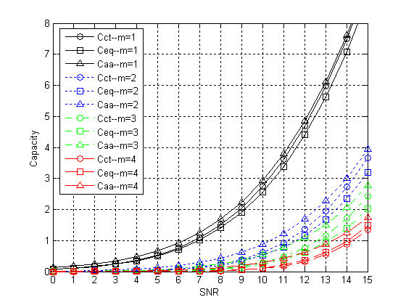
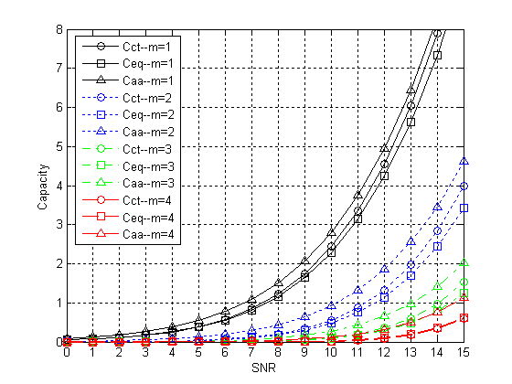
Single Path Relay Network
N=16
N=32

Slide 49
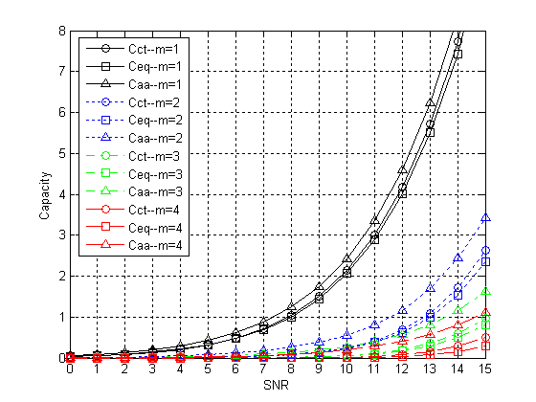
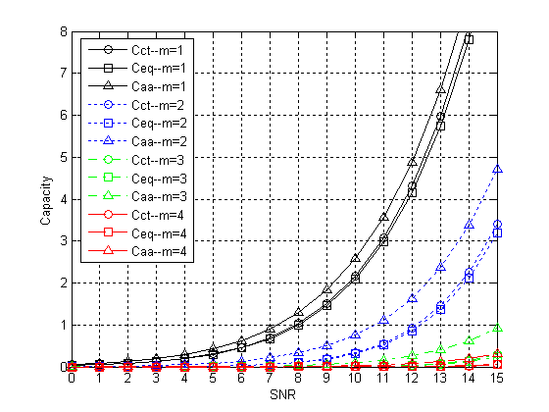
Single Path Relay Network
N=64
N=128

Slide 50
Single Path Relay Network
As we add more relays, more distortion enters system, capacity decreases.
As a result, as we add more relays, there is more room for improvement which adaptive power allocation provides.

Slide 51
Single Path Relay Network
For N=64 subcarriers, and m=4 relays there is 4 dB of SNR performance gain when Ceq is 15 dB. This is for low capacity values.
For 2 bits/s/Hz of capacity, there is approximately 1 dB of performance gain for m=2 relays.

Slide 52
Single Path Relay Network
Remember constant gain allocation does not require any CSI while equal power allocation does.
But plots show Cct > Ceq. This means knowing the CSI is not necessarily beneficial.

Slide 53
Multiple Path Relay Network
m relays
Tx
Rx
N=16, 32, 64, 128 subcarriers

Slide 54
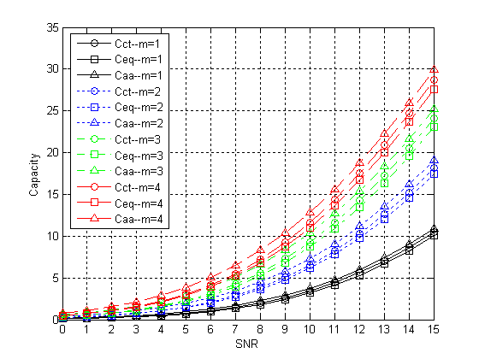
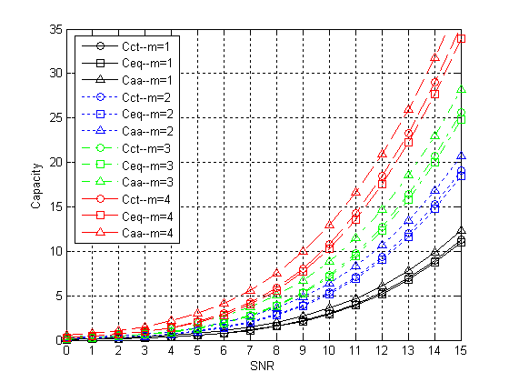
Multiple Path Relay Network
N=16
N=32

Slide 55
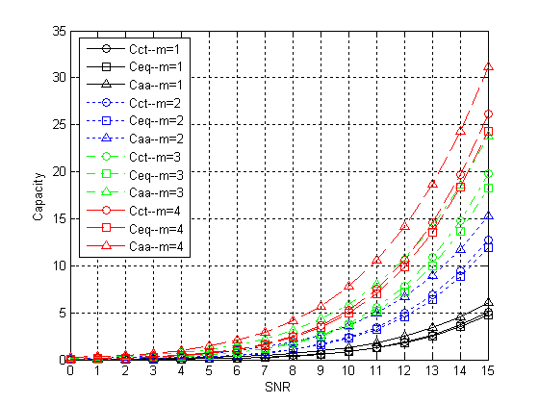
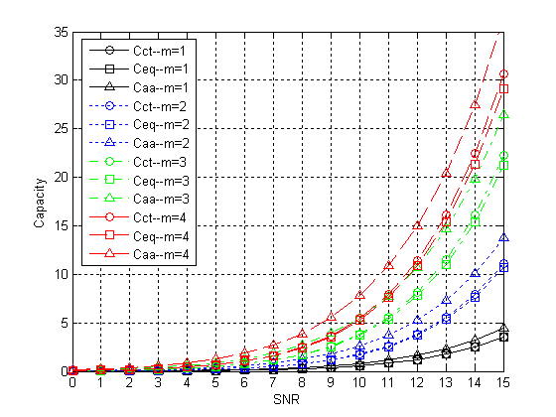
Multiple Path Relay Network
N=64
N=128

Slide 56
Multiple Path Relay Network
All plots have low capacities at low SNR values.
At high SNR values, the capacity curves merge together.
So, performance gain is achieved somewhere in the middle.

Slide 57
Multiple Path Relay Network
As we add more relays, the capacity increases. Having more paths in parallel gives a larger throughput between the transmitter and receiver.
The performance gain is approximately independent of number of relays we use.

Slide 58
Multiple Path Relay Network
For N=128, SNR gain is about 1 dB for m=2,3 and 4 relays at 10 bits/s/Hz of capacity.
This gives more flexibility in choosing appropriate transmit power range for given throughput requirement.

Slide 59
Multiple Path Relay Network
For N=64, the Caa curve for m=3 is approximately the same as the Cct and Ceq curves for m=4. This means by using adaptive power allocation, in addition to the power savings of about 1 dB in this case, can also save all the resources of one extra relay node.

Slide 60
References
A. Sendonaris, E. Erikip, and B. Aazhang, “User cooperation diversity – Part I: System description,” IEEE Trans. Commun., vol. 51, pp. 1927-1938, Nov. 2003.
--, “User cooperation diversity – Part II: Implementation aspects and performance analysis,” IEEE Trans. Commun., vol. 51, pp. 1939-1948, Nov. 2003.

Slide 61
References
J. N. Laneman, D. N. C. Tse and G. W. Wornell, “Cooperative diversity in wireless networks: Efficient protocols and outage behavior,” IEEE Trans. Inform. Theory, vol. 50, pp. 3062-3080, Dec. 2004.
J. N. Laneman, “Cooperative diversity in wireless networks: algorithms and architectures,” Ph.D. dissertation, MIT, Cambridge, MA, Sept. 2002.
J. N. Laneman, G. Wornell, and D. N. C. Tse, “An efficient protocol for realizing cooperative diversity in wireless networks,” in Proc. IEEE Int. Symp. Information Theory (ISIT), Washington D.C., June 2001, p. 294.

Slide 62
References
T. M. Cover and J. A. Thomas, Elements of Information Theory. New York, NY: John Wiley & Sons, Inc., 1991.
T. M. Cover and A. A. E. Gamal, “Capacity theorems for the relay channel,” IEEE Trans. Inform. Theory, vol. IT-25, pp. 572-584, Sept. 1979.

Slide 63
References
M. O. Hasna and M. Alouini, “Optimal power allocation for relayed transmissions over rayleigh-fading channels,” IEEE Trans. Wireless Commun., vol. 3, pp. 1999-2004, Nov. 2004.
--, “Performance analysis of two-hopped relayed transmission over rayleigh-fading channels,” in Proc. IEEE Vehicular Technology Conf., Vancouver, BC, Canada, Sept. 2002, pp. 1992-1996.

Slide 64
References
Y. Zhao, R. Adve, and T. J. Lim, “Improving amplify-and-forward relay networks: Optimal power allocation versus selection.”
I. E. Telatar, “Capacity of multi-antenna gaussian channels,” Eur. Trans. Telecom. ETT, vol. 10, pp. 585-596, Nov. 1999.

