Slide 1
Error Rate Performance in OFDM-based Cooperative Networks

Slide 2
Agenda
Cooperative Networks
Motivation
Relaying Schemes
OFDM Power Allocation
Single Path Relay Network
Multiple Path Relay Network
Simulations

Slide 3
Cooperative Networks
Relays are network of transceiver nodes between the transmitter and receiver.
Relays have no network demands.
Relays merely facilitate transfer of information, and thus improve performance.
This is known as cooperation/cooperative communications. Also known as meshed networking.

Slide 4
Motivation
Wireless point-to-point communications is very mature in both theory and technology.
Mature wireless networking theory is still far away. But wireless networks are already everywhere.
Wireless networks are slowly becoming very affordable.

Slide 5
Motivation
Example is One Laptop per Child (OPLC) project [1].
Aims to provide affordable laptops to children in developing world.

Slide 6
Motivation
These laptops equipped with meshed networking technology.
Cellular and Internet connectivity is sparse and sporadic in these regions. Networking would make best use of available bandwidth.

Slide 7
Relaying Schemes
How do relays transmit their received information (at the physical layer)?
Amplify-and-forward (AF) [2]: Relay amplifies its receive symbol, subject to power constraint, and retransmits.
This has low complexity.

Slide 8
Relaying Schemes
Decode-and-forward (DF) [2]: Fully decode, re-encode, and re-transmit. Eliminate channel distortion and noise.
Other hybrid schemes also.

Slide 9
OFDM Power Allocation
We consider applying OFDM (orthogonal frequency division multiplexing) cooperative networks.
Transmitters and relays have a maximum power constraint.
For DF, transmitter and relays divide transmit power uniformly across all subchannels.

Slide 10
OFDM Power Allocation
For AF, only transmitter divides transmit power uniformly across all subchannels.
Relays use one of two power allocation schemes. This introduces a new degree of freedom.

Slide 11
OFDM Power Allocation
Constant gain allocation (CT): Amplifying gain is the same for all subcarriers. Pick this gain so that total transmit power is maximized at its constraint. Don’t confuse subcarrier gain with subcarrier power.
Don’t need CSI (channel state information). Can calculate this gain from the power constraint and the received symbol.

Slide 12
OFDM Power Allocation
Equal power allocation (EQ): Choose subcarrier amplifying gain so that subcarrier transmit power constant for all subcarriers.
Requires CSI.

Slide 13
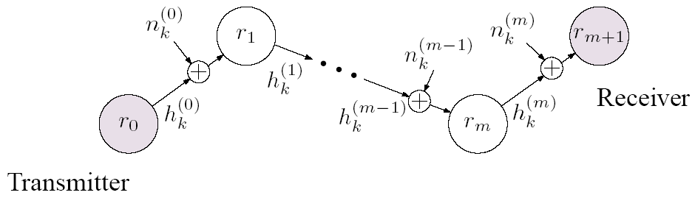
Single Path Relay Network

Slide 14
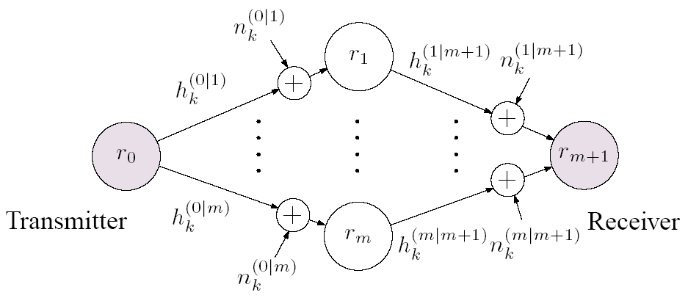
Multiple Path Relay Network

Slide 15
Simulations
Simulate WERs (word error rates) versus SNR (signal-to-noise ratio).
Consider both AF and DF cases.
Consider both networks.
Consider m=2 and 4 relays.
Use a convolutional encoder. Viterbi decoder with both hard and soft decisions.

Slide 16
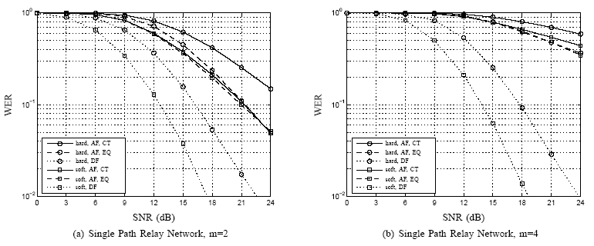
Simulations

Slide 17
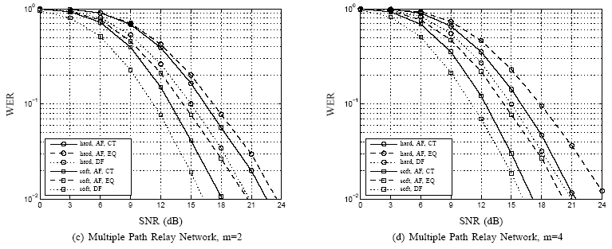
Simulations

Slide 18
Simulations
For single path relay network, DF is the better choice over AF. Improvement increases when more relays added.
This is expected because noise and channel distortion eliminated.
EQ slightly better performance over than CT, but at the cost of requiring CSI.

Slide 19
Simulations
For multiple path relay network, performance gains of using DF over AF diminish as more paths (and thus relays) added.
For 4 paths, system already noise and distortion resistant. Using DF does not help. AF may be better due to lower complexity.
Soft decisions better than hard, as expected.

