Slide 1

RFID Smart Posters:
Dynamic Digital Whiteboards for Efficient Ad-hoc Communications
Tuesday, February 16, 2010
Victor K.Y. Wu

Slide 2

Agenda
Purpose
Basic idea
Two motivating applications
Research problems

Slide 3
Purpose
Purpose of this talk
  Introduce a new usage of passive RFID tags.
  Solicit your criticism.
Please interrupt with questions, suggestions, etc.

Slide 4
Basic idea
Use passive UHF RFID tags with storage.
Cluster tags together in one location.
  Often a physical board or wall, hence “smart poster”.
With RFID interrogators (readers), read from and write to the poster. “Digital whiteboards”.
Multiple posters in a system.
Tags dynamically added and removed. Travel between posters.
Relies on mobile RFID interrogators.
  Dedicated devices and integrated solutions available.

Slide 5
Motivating applications
Large conference communications
Stage one communications in disaster relief

Slide 6
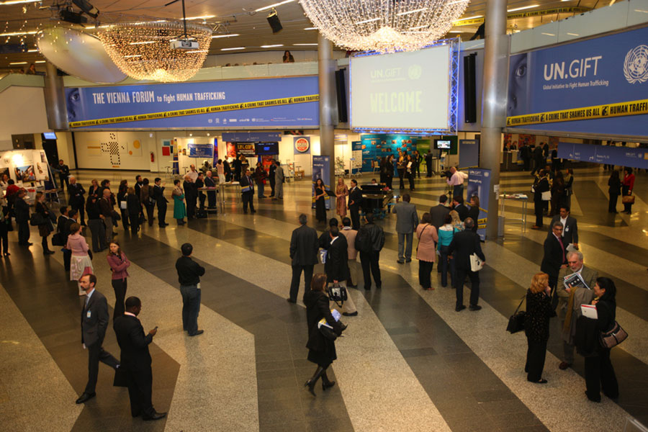
Conference communications

Slide 7
Conference communications
Large conference setting.
Real-time communications difficult between attendees and/or organizers.
Lack of Internet connectivity.
“Primitive” communications.
  Post-it notes, whiteboards.

Slide 8
Conference communications
Attendees provided with RFID tags.
Encouraged to stick tags at highly trafficked locations.
Tags removed, re-attached, shuffled, etc.
Clusters of tags serve as digital whiteboards.
Information physically disseminated in space.
Similar in concept to DTNs.

Slide 9
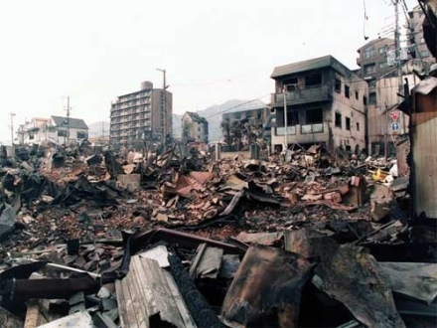
Disaster relief

Slide 10
Disaster relief
In case of disaster, lack of infrastructure (supply chains, housing, communications) in stage one.
Stage one is crucial for first responders to move in, access, and strategize.

Slide 11
Disaster relief
First responders distribute clusters of tags at disaster site.
Tags allow for communication and aggregation of information (during and afterward in stage two plus).
Tags are damaged, shuffled, lost, etc.
System should be robust to handle this uncertainty.
Many previous work with RFID and disaster relief. We focus on recovering information even when tags are scattered.

Slide 12
Research problems
Single poster dynamics
Multiple posters

Slide 13
Single poster dynamics
Poster
λ(t)
μ(t)
Reader
Reader

Slide 14
Single poster dynamics
Want to move beyond simple storage paradigm. (This has been done in other fields, such as harddrives, channel coding, etc.)
Focus on how users should scan (read/write) posters given these uncertain conditions.
  What are the algorithms?

Slide 15
Single poster dynamics
Some measureable quantities (statistically, probably as a moving average for example).
  “Arrival” and “departure” rates of tags.
  Amount and content of information in arriving and departing tags.
Writing to tags.
  Coding over multiple tags to combat tag failures and tags leaving.
  Tradeoff storage space. Replace old with new?
  Other schemes to determine priority.
Singulation process is uncertain.
  Cannot know which tags are being read/write. Random.

Slide 16


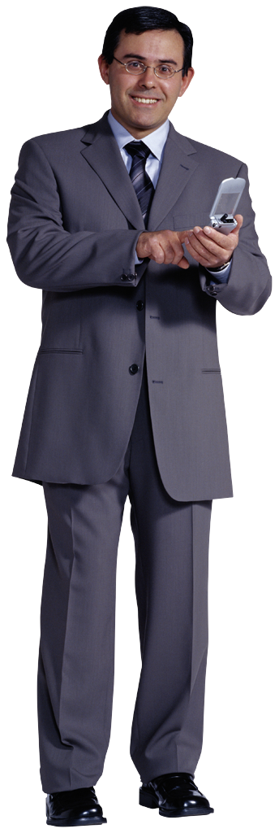
Multiple posters

Slide 17
Multiple posters
Network of posters together.
Posters created and destroyed, due to tag lifecycles and tag dynamics.
Flows of tags in network.
  Difficult to measure, since tags are passive.
  Can measure locally, and store locally on a poster.
Users themselves can carry information when travelling between posters.

Slide 18
Multiple posters
Coding over multiple tags.
  Not just for single poster robustness.
  Tags shuffled and rearranged when travelling. Want to recover messages.
  Borrow ideas from DTNs and network coding theory.

