Slide 1

Efficient Access Protocols for High Storage RFID
Wednesday, June 30, 2010
Victor K.Y. Wu

Slide 2
High storage passive RFID tags
Chip manufacturers beginning to make high storage tags
Tego chip has 32 kilobytes
Industries using increased storage
  Manufacturing (consumer products), supply chain management, smart parts manufacturing (aircraft, automobile), healthcare

Slide 3
Research direction
Design systems to read from and write to a group of tags
Initially focus on algorithm design
  Essentially MAC protocols
Future work is investigating more specific application domains

Slide 4
Design goals
Large set of tags, move in and out of system, prone to failures
  Don’t want to keep track of tags individually
Interrogators cannot communicate with each other
  State information should be saved only (if at all) inline (within tags)

Slide 5
Design goals
Read newest (newer) information from system of tags
  Freshest information often most relevant
Write to empty space if available
Replace oldest (older) data if necessary
Secondary considerations
  Best effort design
  Offering user-defined priorities (QoS)

Slide 6
Tag access protocols
Protocols to read from and write to a system of tags
One interrogator at a time
Read and write one message at a time
Each message occupies all the space in a tag

Slide 7
Protocols
Regular aloha
Aloha-max
Aloha-half
Regular query tree
Query tree-max
Timeslots-query tree

Slide 8
1. Regular aloha
Singulate all tags using aloha
Estimate tag population in each round
Tags respond with timestamps
Interrogator knows which tags are new

Slide 9
1. Regular aloha
IDs are 96 bits each
Timestamps 17 bits each
3 bits for number of slots (N) ∈ {16, 32, 64, 128, 256}
In each round
  Interrogator sends 3 bits
  Tags respond with N x 113 bits

Slide 10
2. Aloha-max
Model interrogator arrivals as Poisson arrivals
Each time interrogator writes a geometric random variable number of messages

Slide 11
2. Aloha-max
In aloha-max, in each round, take largest timestamp
In next round, tell only tags with larger timestamps to respond
Estimate population using interrogator statistics

Slide 12
2. Aloha-max
In each round
  Interrogator sends 17 + 3 = 20 bits
  Tags respond with N x 113 bits

Slide 13
3. Aloha-half
Do not know interrogator statistics
Instead of taking largest timestamp, use average of timestamps from previous round
In each round
  Interrogator sends 17 + 3 = 20 bits
  Tags respond with N x 113 bits

Slide 14
4. Regular query tree
Singulate all tags using query tree
In each round
  Interrogator sends <prefix length> bits
  Tags respond with 113 bits

Slide 15
5. Query tree-max
Continually collect largest timestamp
Segment tree accordingly
In each round
  Interrogator sends <prefix length> + 96 bits
  Tags respond with 113 bits

Slide 16
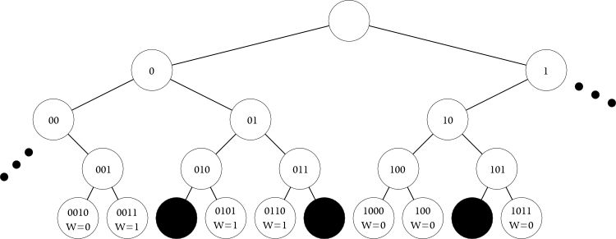
6. Timeslots-query tree

Slide 17
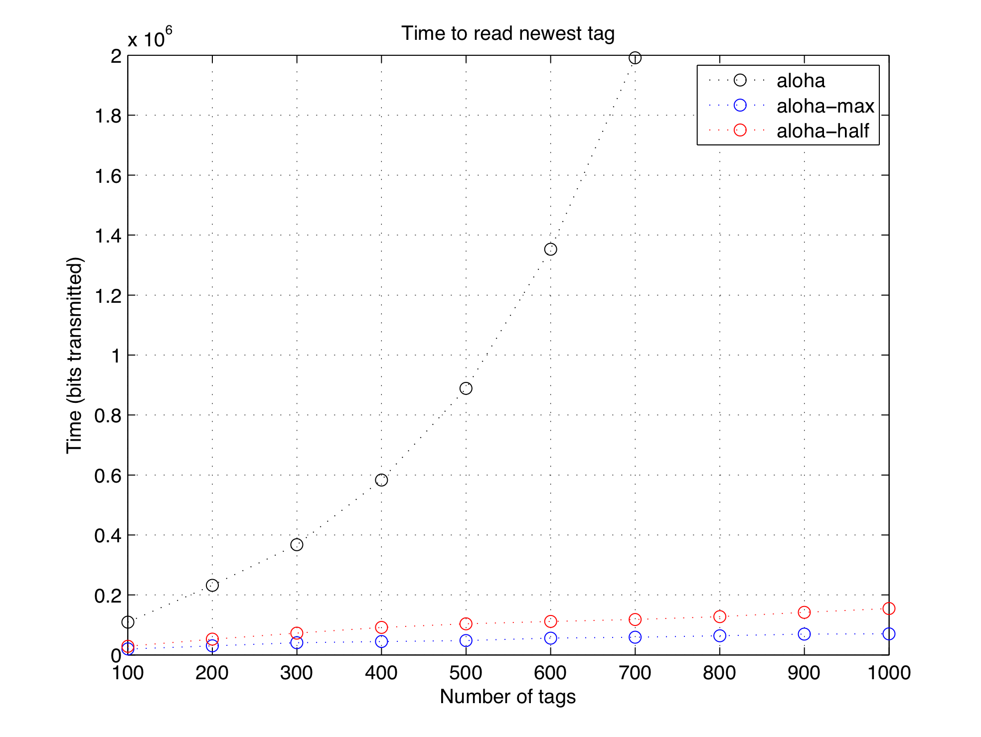
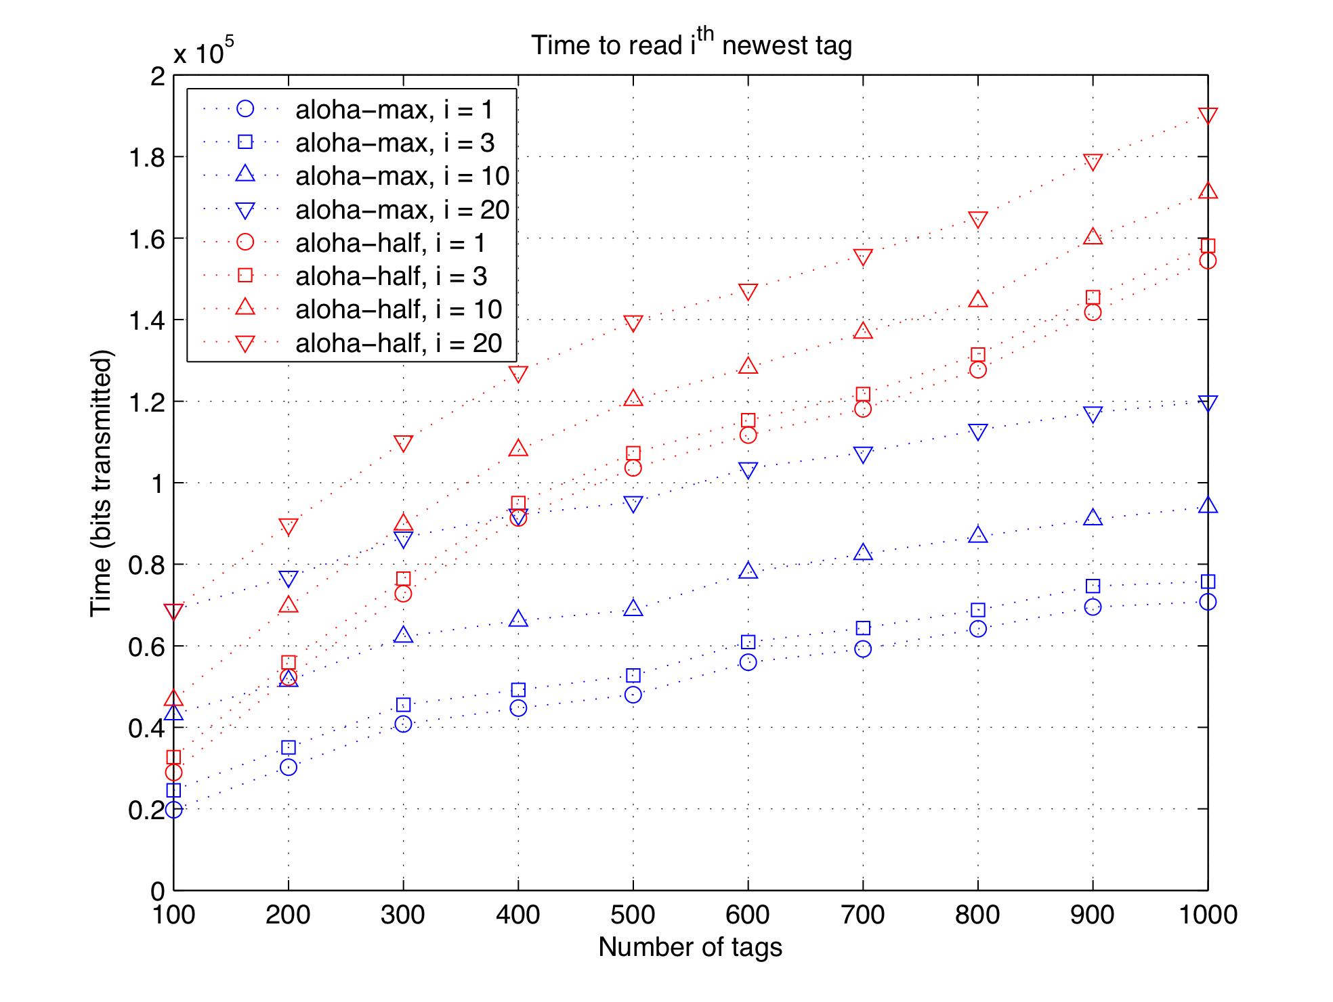
Performance

Slide 18
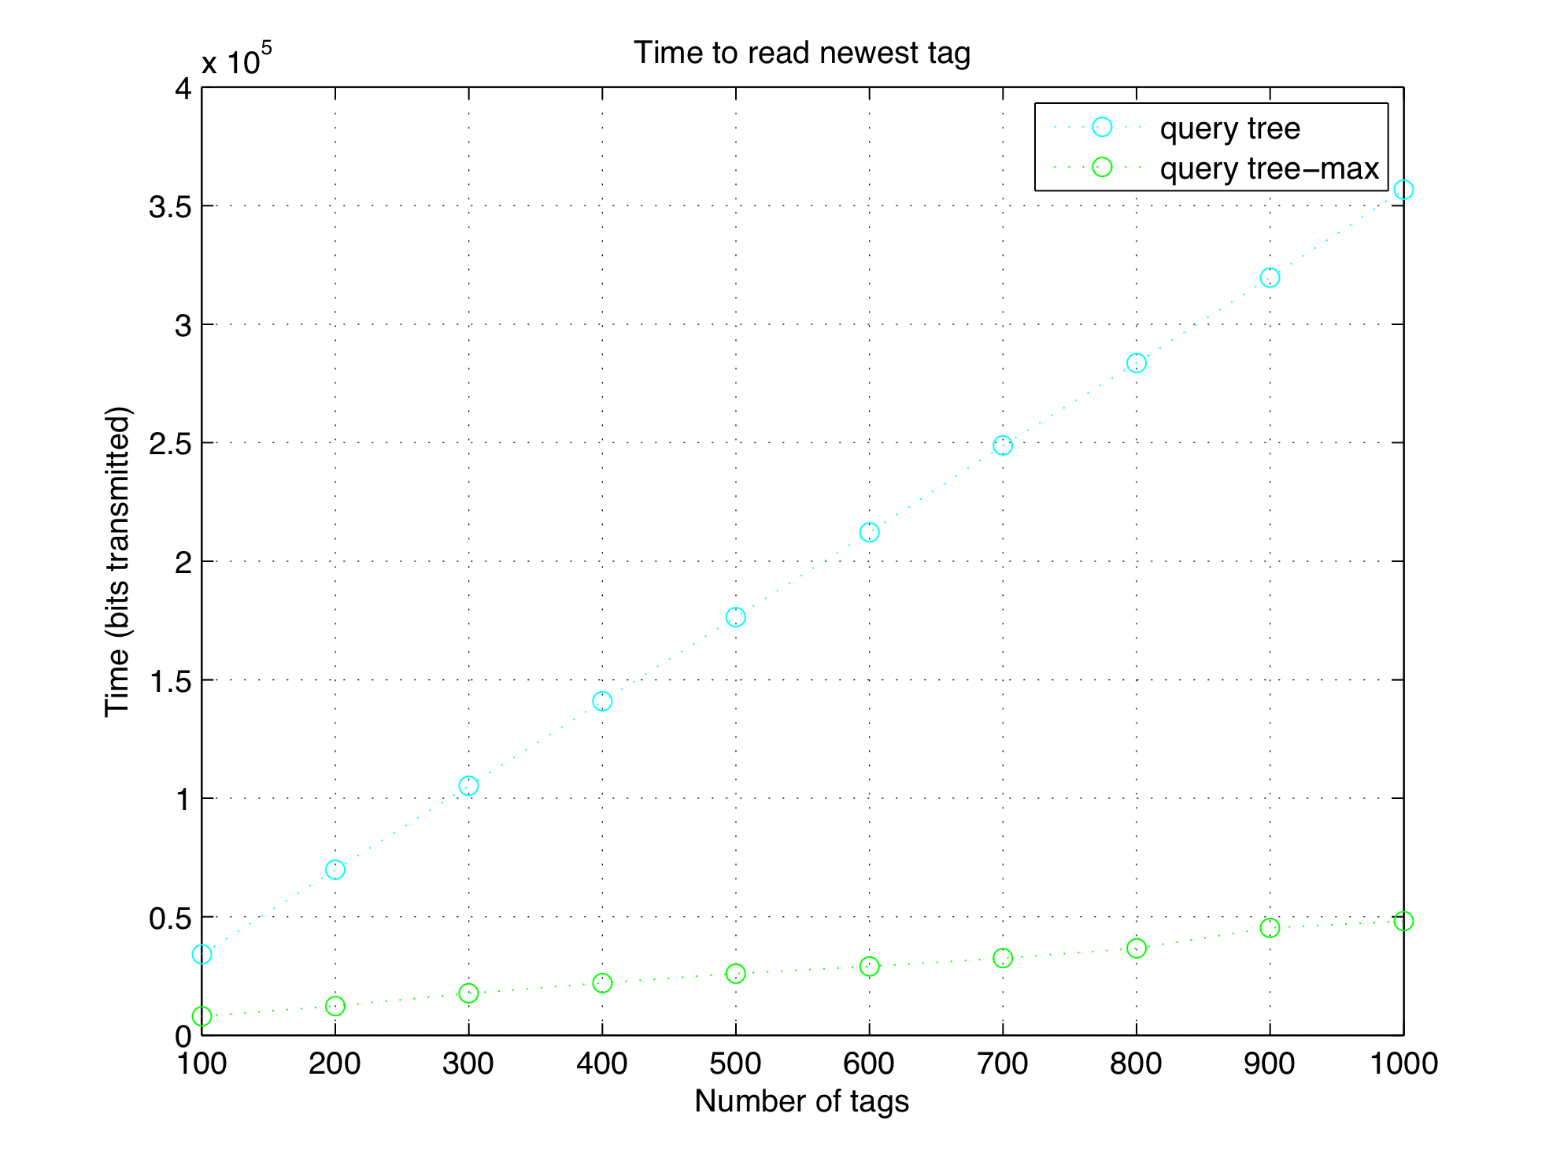
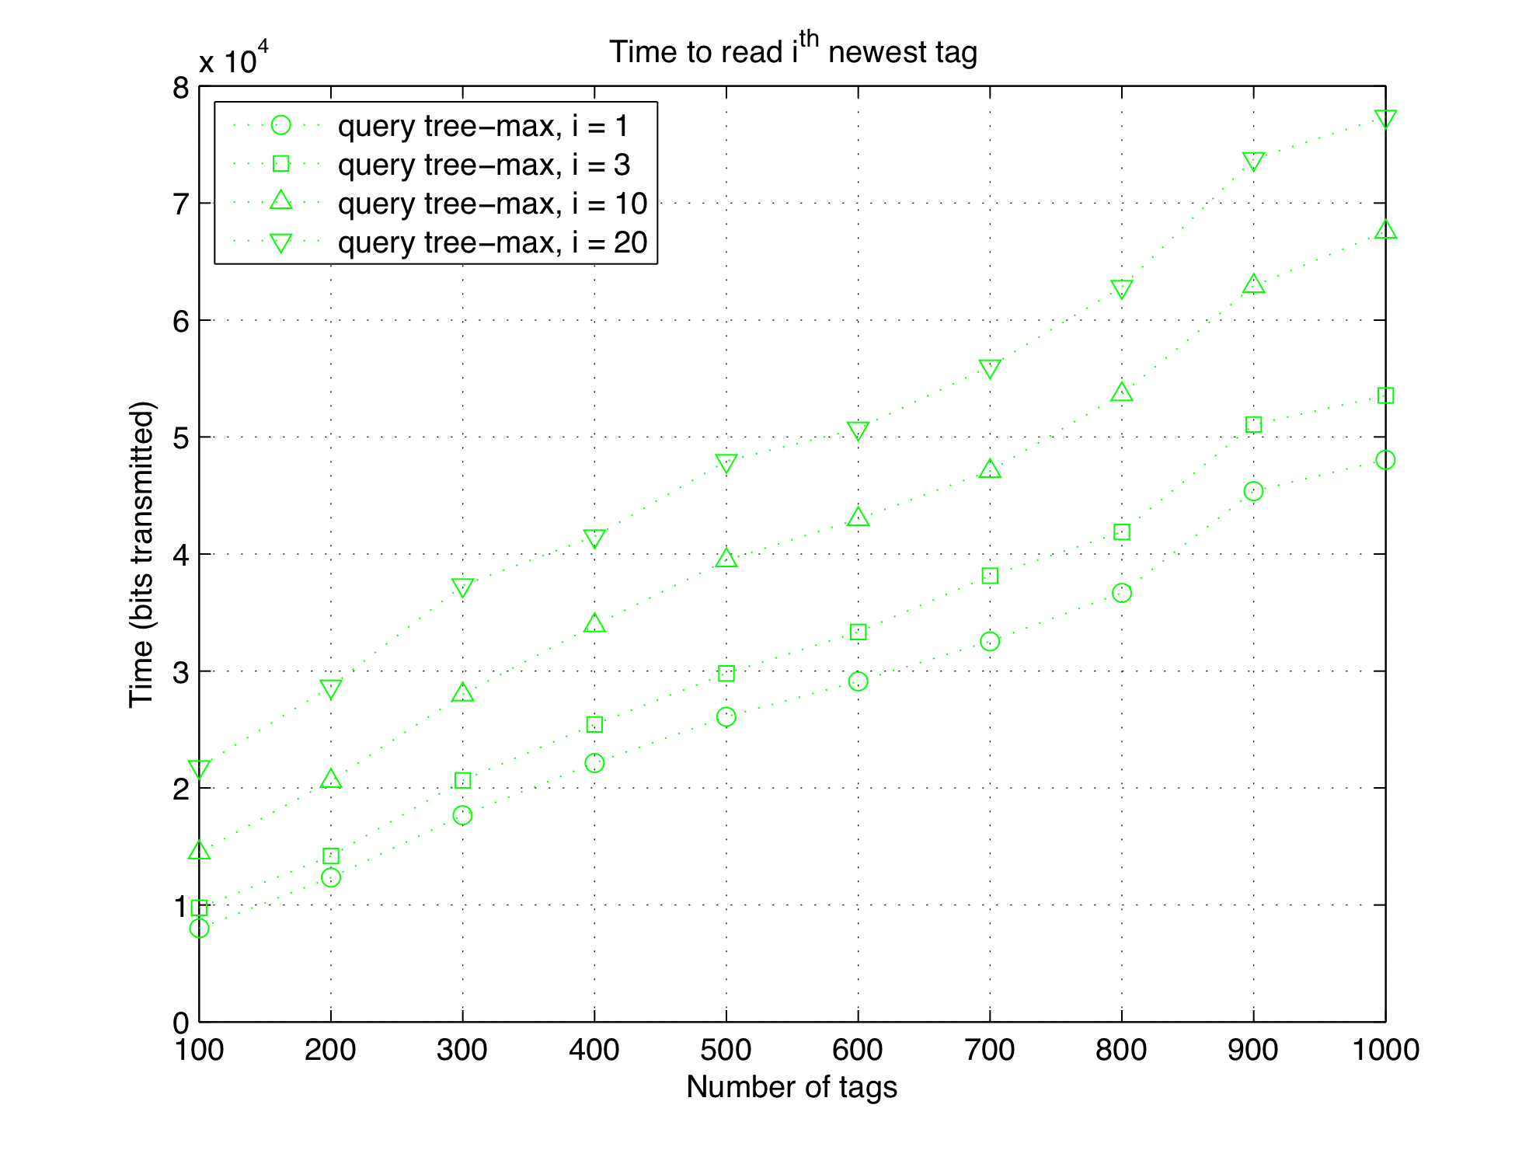
Performance

Slide 19
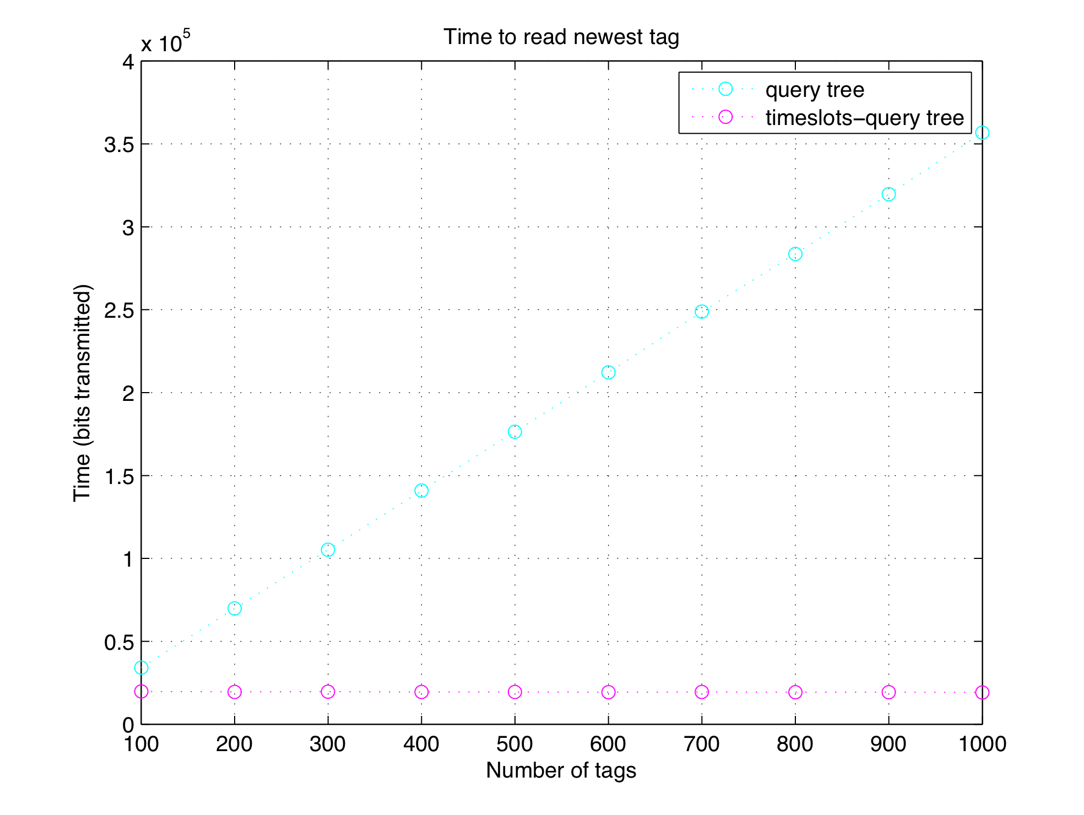
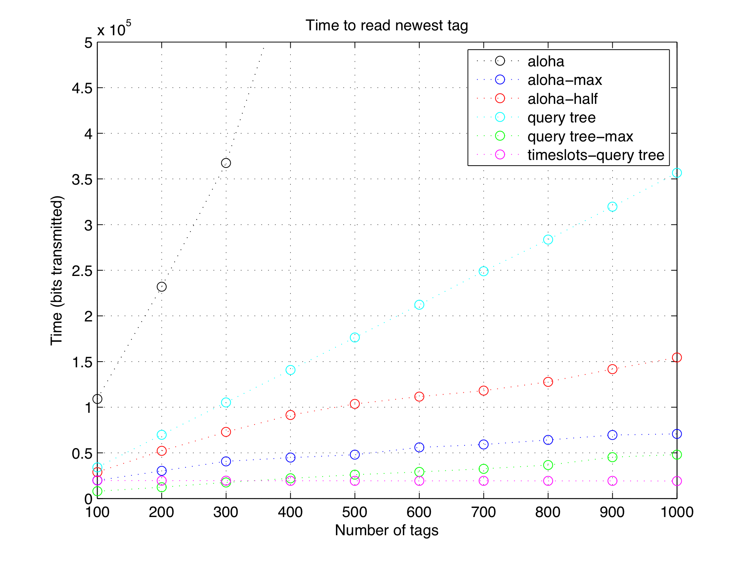
Performance

Slide 20
Other considerations
Timestamps and clocks
  Clocks, synchronization
  Sequence numbers
Interrogator dynamics
  Aloha-max needs interrogator statistics
Tag dynamics
  Tags moving in and out

Slide 21
(Immediate) future work
Model tag dynamics and failures, model scan failures
Make newer messages more safe with a “coding cushion” (RS codes)
As messages become older, remove redundancy
Resource allocation of messages and/or users

