Slide 1
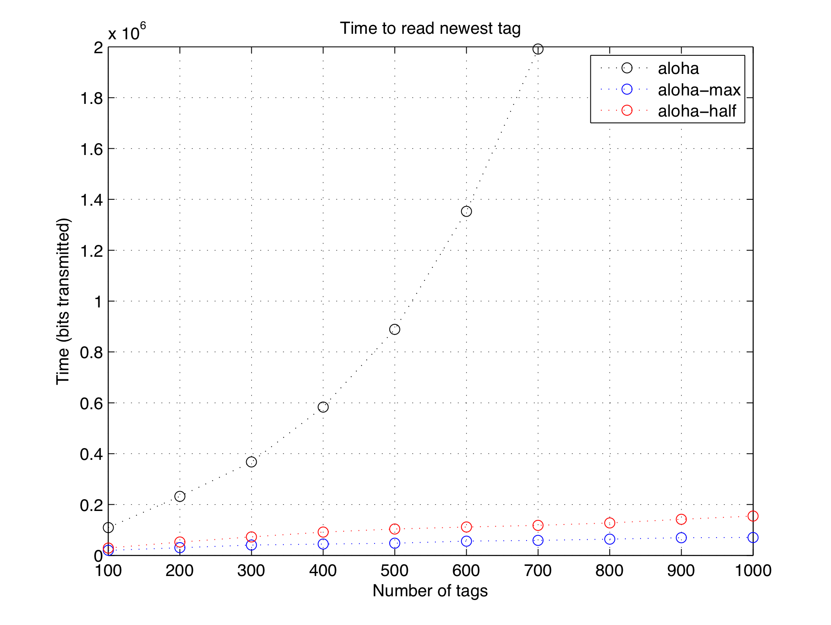
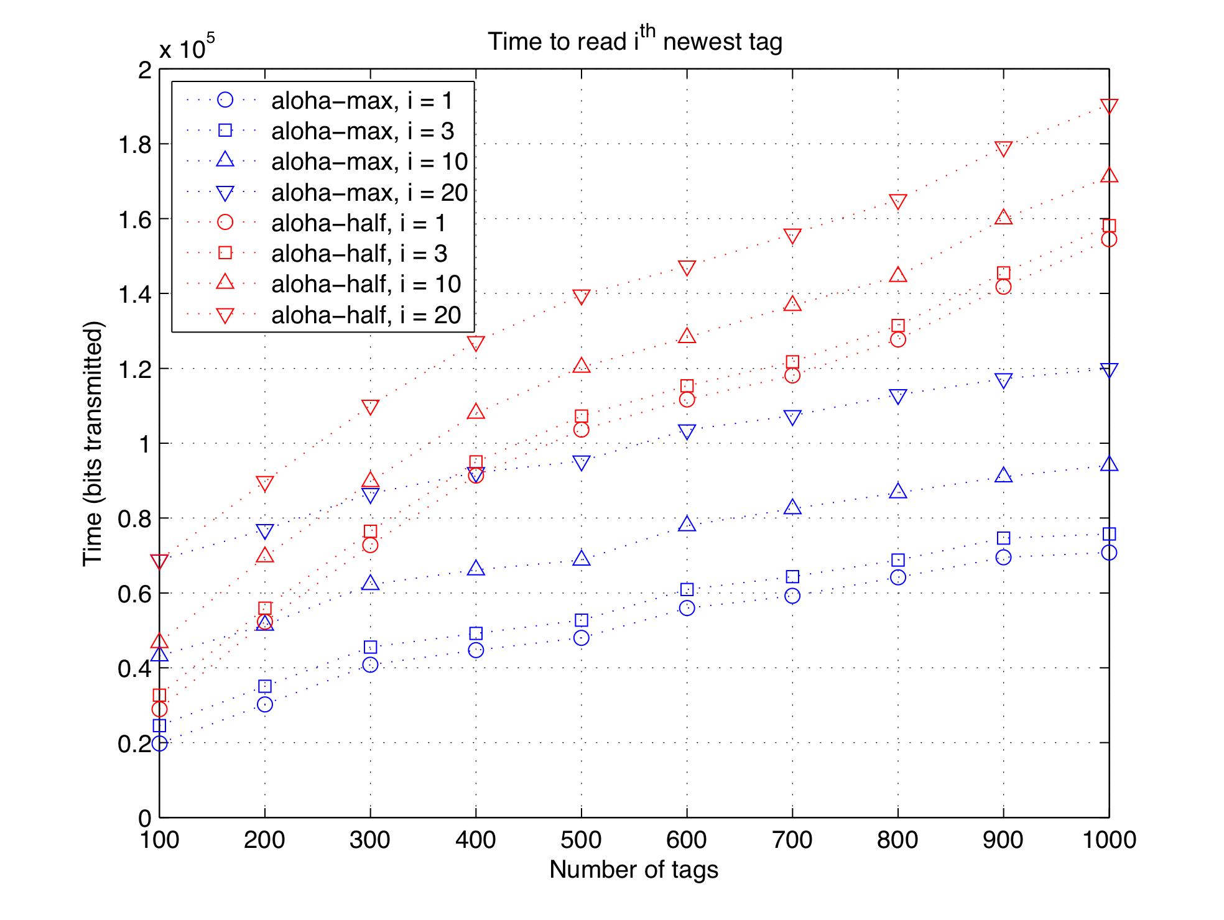
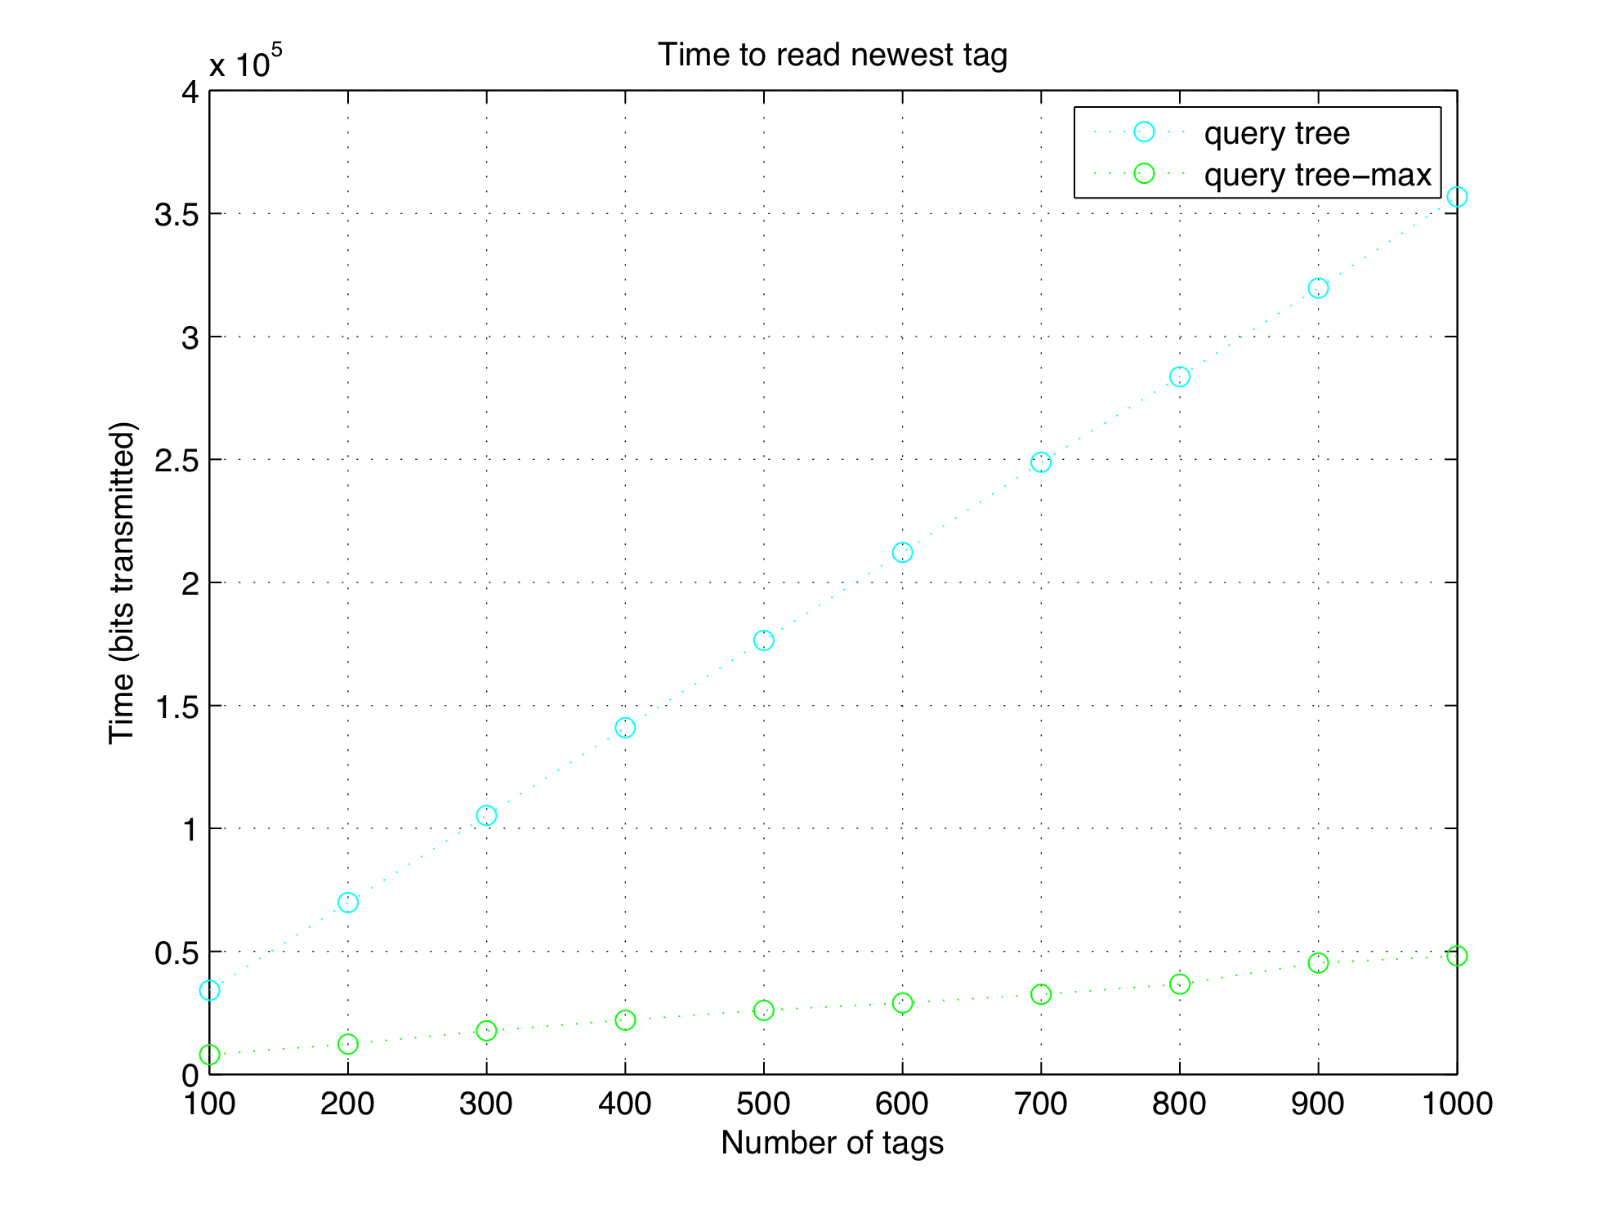
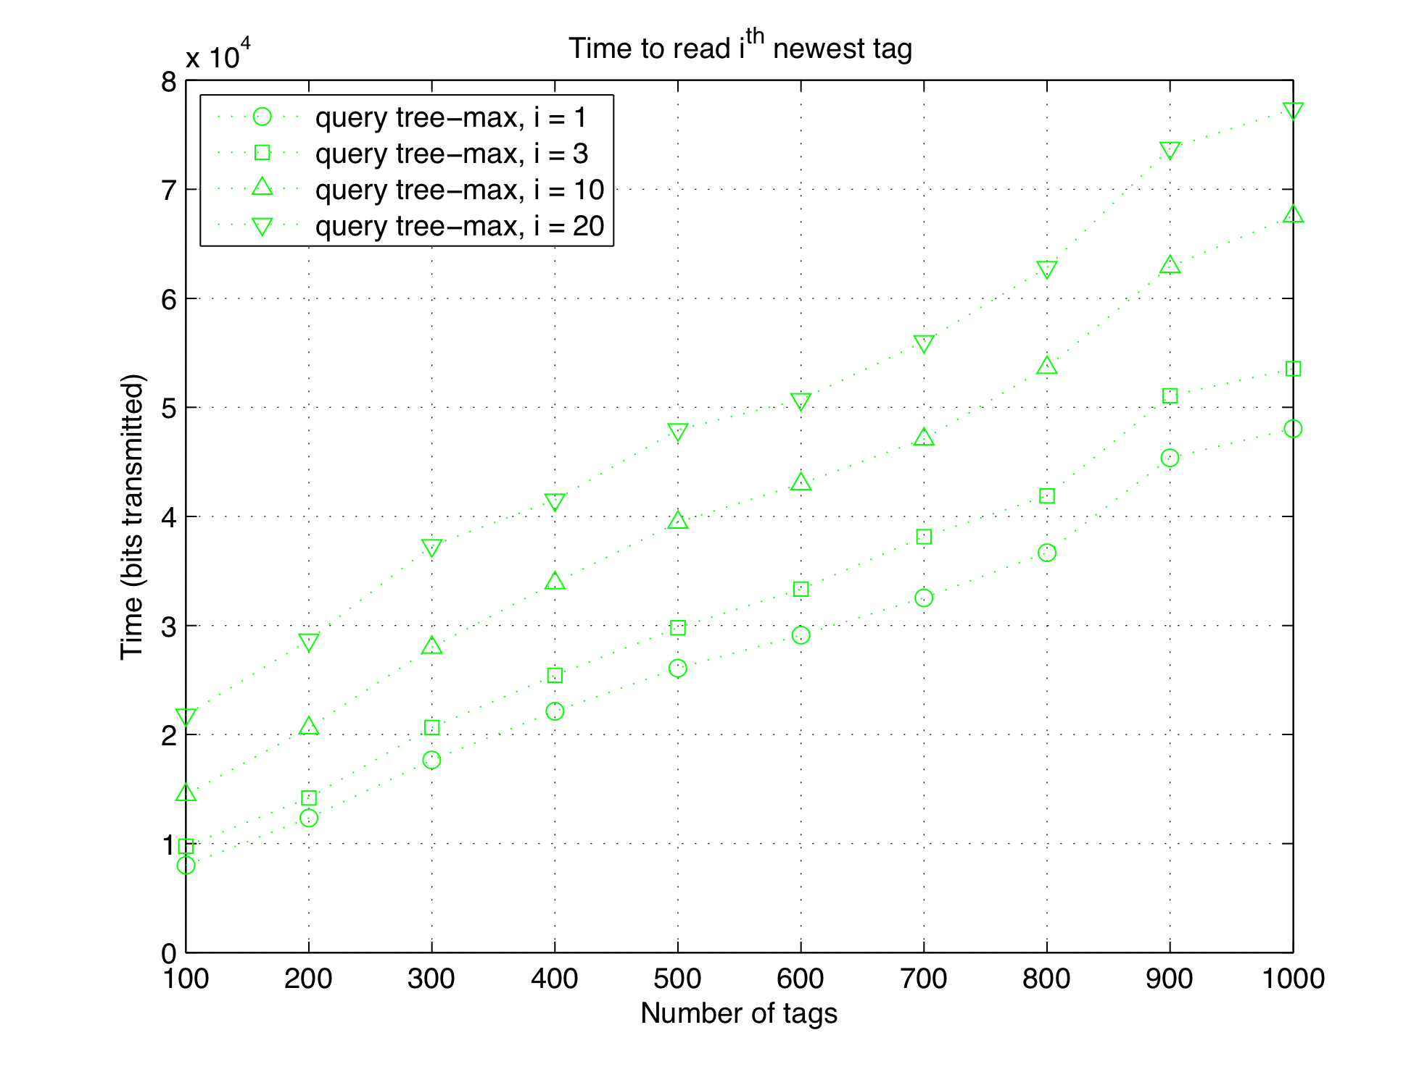
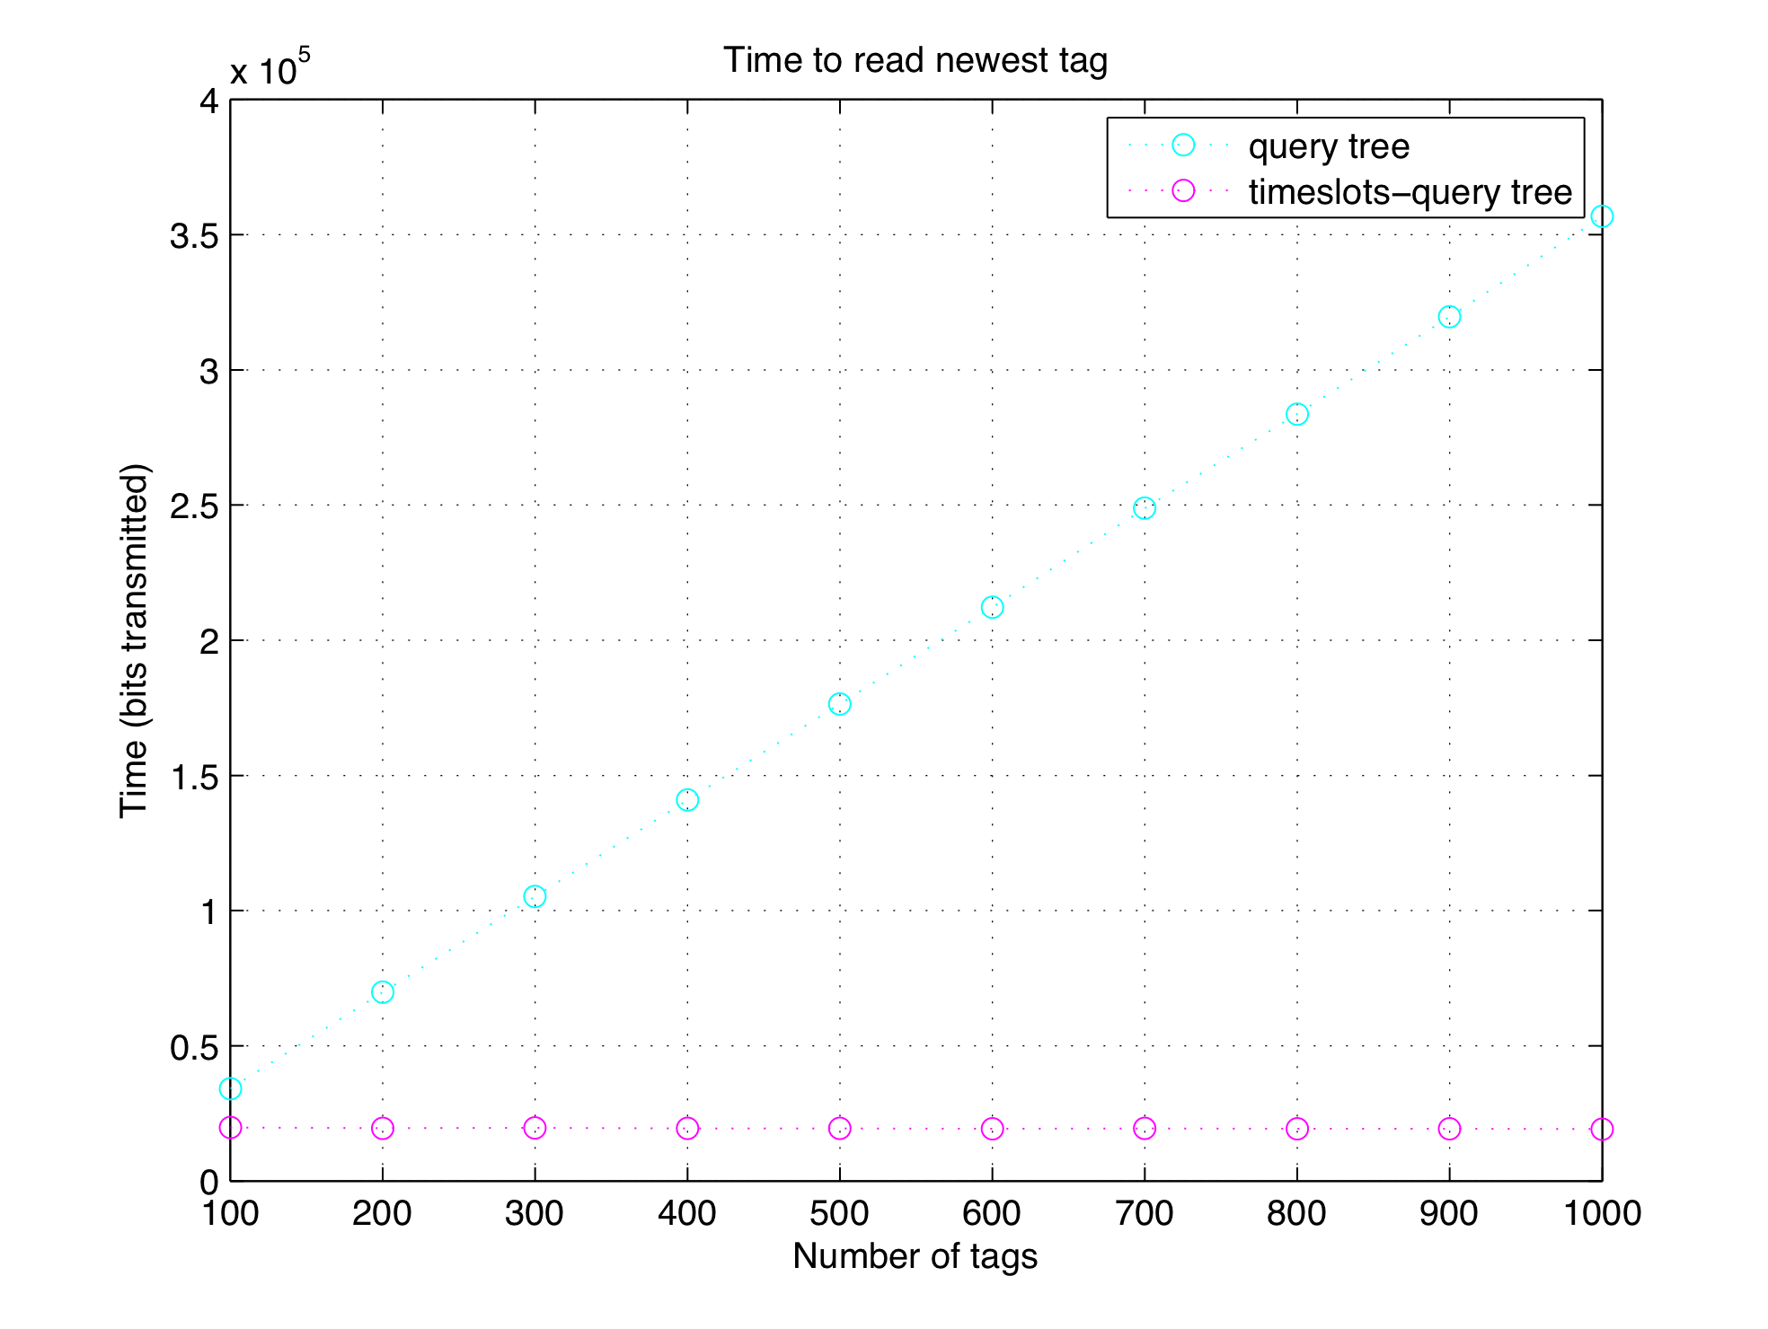
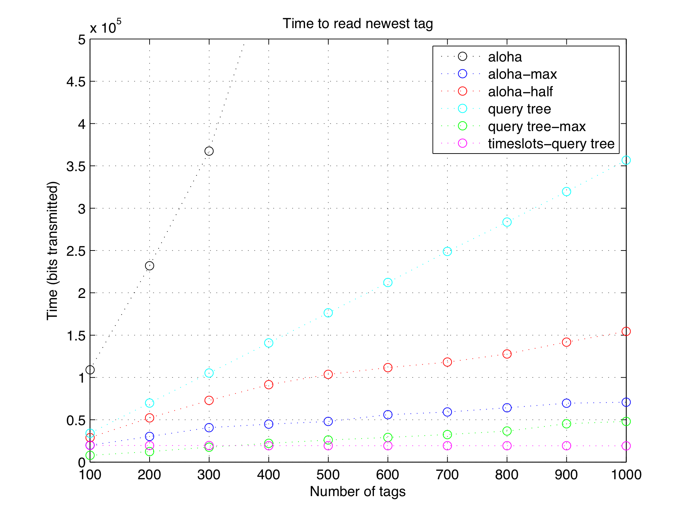
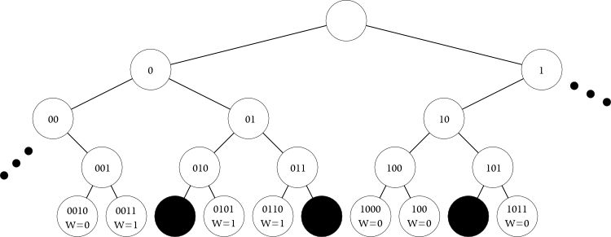




Efficient Access Protocols for High Storage RFID
Victor K.Y. Wu and Nitin H. Vaidya
Department of Electrical and Computer Engineering, University of Illinois at Urbana-Champaign
Introduction/motivations
Passive RFID tags are starting to contain increasingly more storage space.
RFID is not only useful for identification, but distributed storage.
Need robust protocols to read from and write to these high storage tags, because of tag uncertainties (dynamics, failures).
Do not keep track of individual tags.
Want stateless protocols.
Read newest information.
Write to empty space or replace oldest information.
Simulations
Bit times
96 bits for RFID unique ID (EPC).
17 bits for timestamp. Finer than second precision for 24 hours.
3 bits to store number of timeslots in aloha (16, 32, 64, 128, or 256).
Variable bit lengths for prefix in query tree.
Results
Algorithms
Regular aloha
Do aloha singulation. Read timestamps.
Aloha-max
Do aloha singulation. Segment out fraction of tags in each round. Requires knowing reader dynamics.
Aloha-half
Similar to aloha-max. Segment out approximately half of tags in each round. Does not require knowing reader dynamics.
Regular query tree
Do query tree singulation. Read timestamps.
Query tree-max
Do query tree singulation. Segment out fraction of tags in each round.
Timeslots-query tree
All possible tag IDs each mapped to a timeslot. Find the root of a subtree containing the target tag. Do query tree on the subtree.
References
C. Law, K. Lee, and K.-Y. Siu, “Efficient Memoryless Protocol for Tag Identification,” in Proc. ACM International Workshop on Discrete Algorithms and Methods for Mobile Computing and Communications, Boston, MA, Aug. 2000, pp. 75-84.
H. Vogt, “Multiple Object Identification with Passive RFID Tags,” in Proc. IEEE Conference on Systems, Man, and Cybernetics (SMC), Hammamet, Tunisia, Oct. 2002.

