Slide 1
Efficient Access Protocols for
High Storage RFID
Victor K.Y. Wu and Nitin H. Vaidya
Department of Electrical and Computer Engineering
University of Illinois at Urbana-Champaign
Slide 1 of 3

Slide 2
Passive RFID tags have increasingly more storage.
Need protocols to read from and write to a set of tags.
Want stateless protocols.
Don’t want to track individual tags.
Read newest information.
Write to empty space or replace oldest information.
Adapt singulation protocols to do this. Aloha and query tree.
Slide 2 of 3

Slide 3
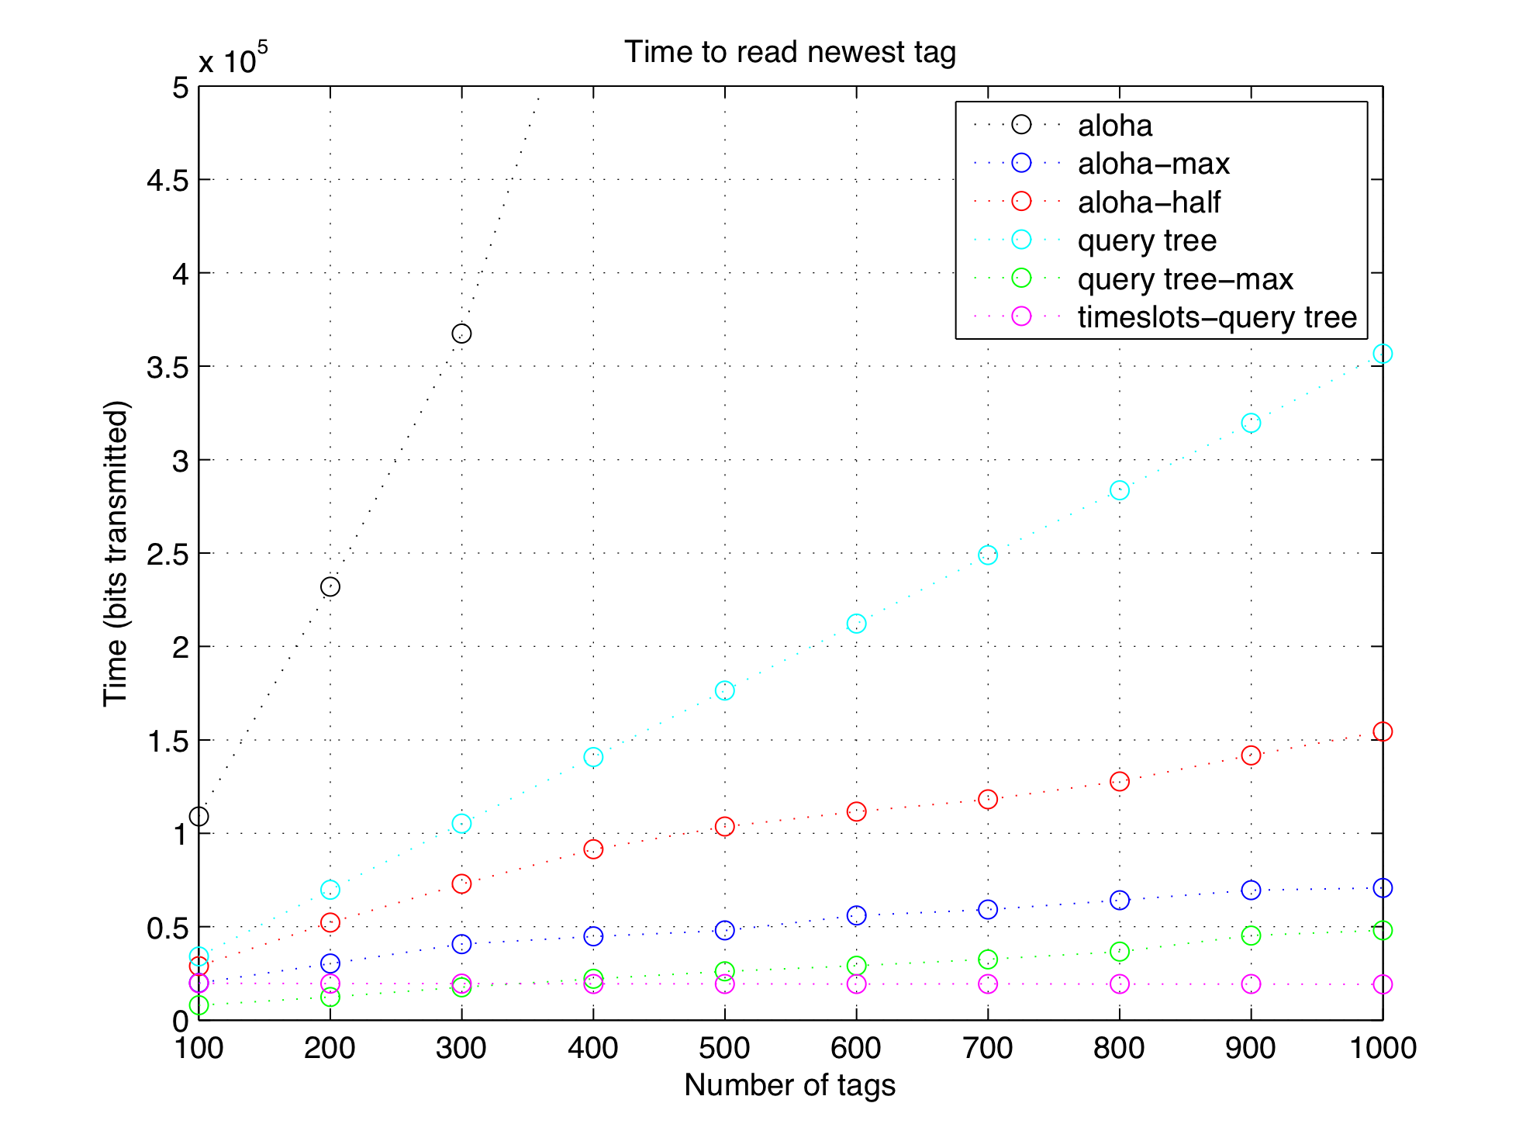
Slide 3 of 3

