Slide 1

RFID

Slide 2

NFC
NFC (Near field communications) / Contactless
Smart cards
Octopus card
Train ticket
Public transportation
Credit cards, mobile payments, micro (and macro!) payments
Consumer customizable: tikitags

Slide 3
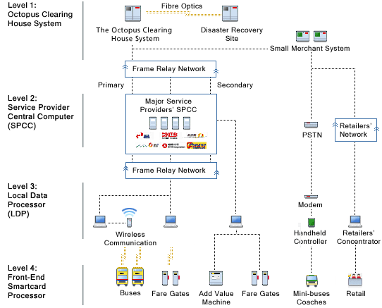

Slide 4
RFID
Active
  I-294: transponder is active tag
  Asset tracking
  Search and rescue: active RFID wristbands
Passive
  Driver’s license
  Manufacturing, supply chain
  Walmart
  When people say “RFID”, they mean this

Slide 5
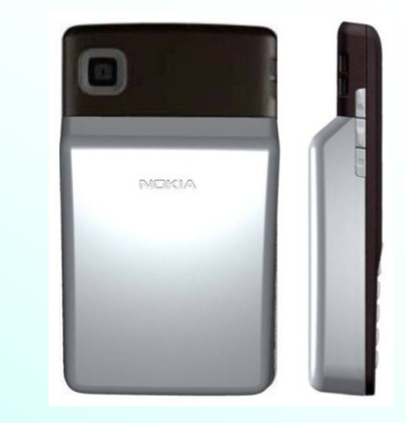

Slide 6
RFID
RF identification
Traditional paradigm
  Each tag has a unique ID
  Scan for presence of tags at physical layer
  Offer services at higher layers
  Lower layers are dumb, higher layers are smart
Shifting paradigm
  Smarter lower layers allows for more novel/efficient services
  Do more things “inline” or “in place”
  One way to “create” this intelligence is to use the rewriteable memory in tags

Slide 7
Tagging Trees for Search and Rescue
A (hopefully) novel idea
Tag trees (not entirely new idea) densely in a forest (this is new)
Hikers leave digital paths
Searchers follow path to find lost hikers
Constraint: Tags are limited in memory
How to share this memory?

Slide 8
Digital Paths
In tags, store unique hiker ID, and increasing sequence numbers (SNs): ID-SN pair
Searchers can follow the path by looking for larger SNs
If ID-SN pairs deleted, hard to follow
Try to prevent big gaps
Draw a picture

Slide 9
Replacement Algorithms
Oldest Selection (OS)
Random Selection (RS)
Highest Frequency Selection (HFS)
  Most frequently seen ID so far
Lowest Delete Frequency Selection (LDFS)
  Least deleted ID so far
Draw a picture

Slide 10
Simulation Model
Tags distributed uniformly in a disk
Hikers start in one of three locations
Move according to a simple mobility model
Stop when outside the disk
Along the way, leave ID-SN pairs
Use replacement algorithms
Draw a picture

