Slide 1
Leaf Classification
0310120 陳家煒
0310139 曾敏原
0410117 吳沛璇

Slide 2
Outline
Dataset descriptions
Model evaluation – Machine Learning
Model evaluation – Deep Learning
Feature Engineering
Discussion
Future Plan

Slide 3
Dataset descriptions
id - an anonymous id unique to an image
margin_1, margin_2, margin_3, ..., margin_64 - each of the 64 attribute vectors for the margin feature
→ edge
shape_1, shape_2, shape_3, ..., shape_64 - each of the 64 attribute vectors for the shape feature → main structure
texture_1, texture_2, texture_3, ..., texture_64 - each of the 64 attribute vectors for the texture feature

Slide 4
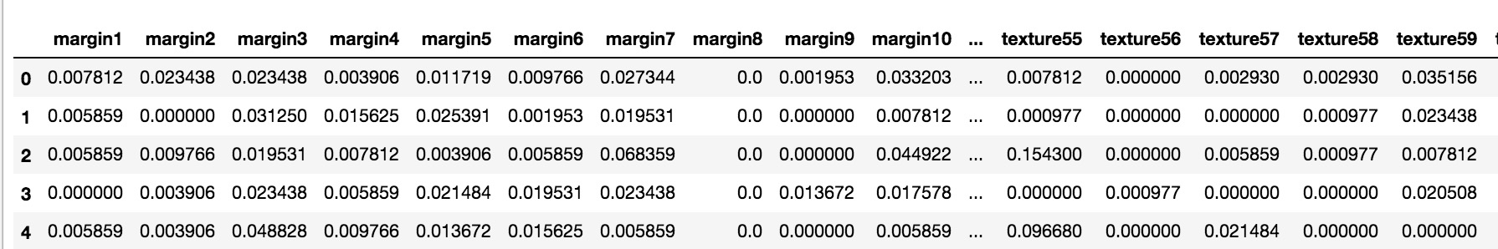

Slide 5

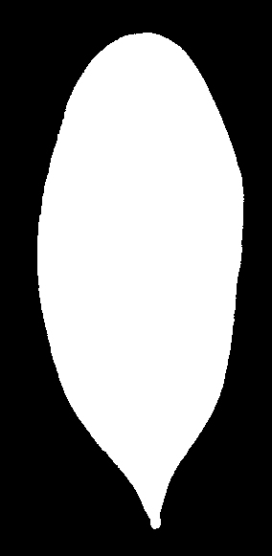

Dataset Descriptions
1,584 images of leaf specimens (16 samples each of 99 species) which have been converted to binary black leaves against white backgrounds.

Slide 6
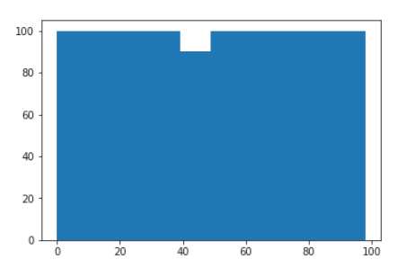
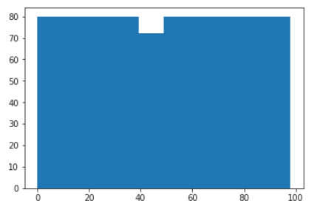
Model Evaluation
StratifiedShuffleSplit(labels, test_size=0.2)
plt.hist(labels) | plt.hist(y_train)

Slide 7
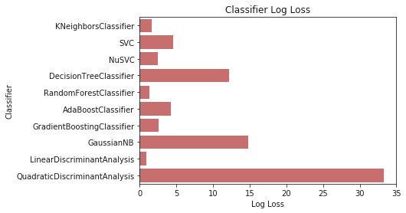
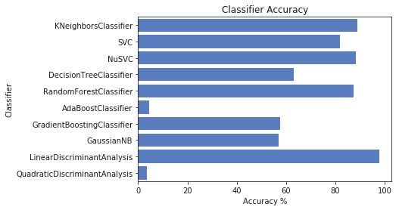
Model Evaluation

Slide 8
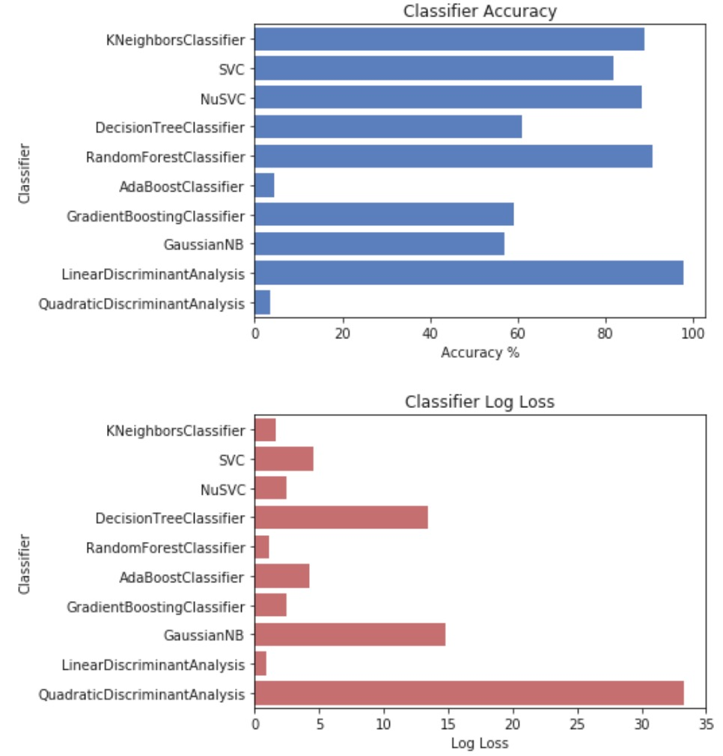
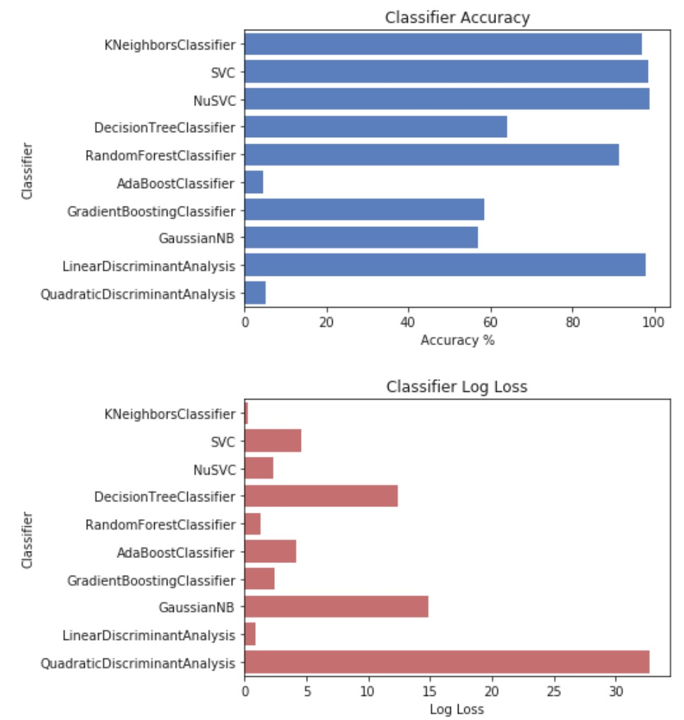
Feature Normalize - StandardScaler()

Slide 9
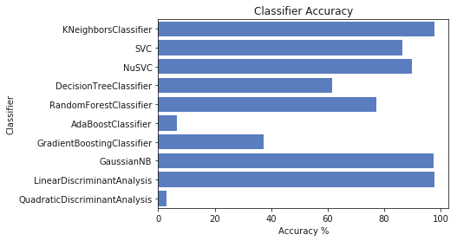
Reduce Dimension (LDA) 192 -> 92

Slide 10
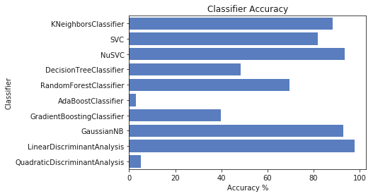
Reduce Dimension (PCA) 192 -> 92

Slide 11
LDA | PCA

Slide 12
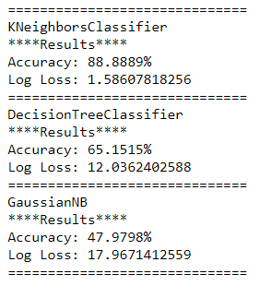
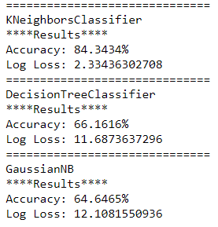
Reduce Dimension (Tree-based)
Use DecisionTreeClassifier() feature_importances_
Extract top 128 features
Result:
Original features
New features

Slide 13
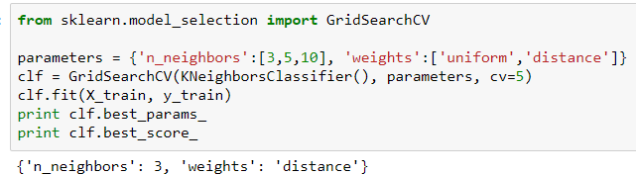
KNN fine-tuning
KNN – parameter n_neighbors=3, weights=’distance’
default accuracy: 88.8889% after fine-tuning accuracy: 90.909%

Slide 14
Deep Learning Approach
MLP
MLP + CNN
CNN
CNN with Pre-trained Model

Slide 15
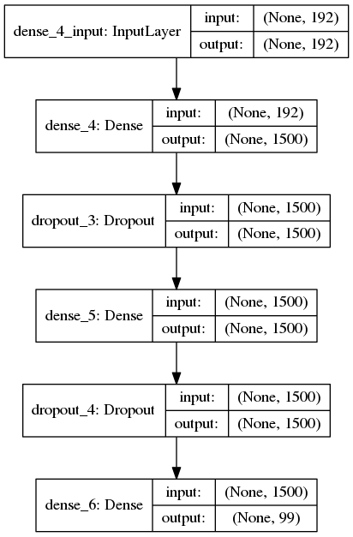
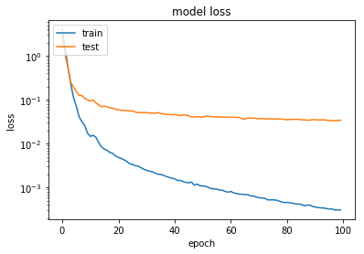
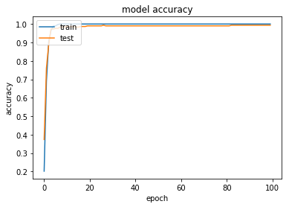
MLP
Epochs : 100
Batch Size : 30
Optimizer : Adam
Loss Func. : Cross Entropy
Train Acc : 1.0
Val Acc : 0.99
Test Loss : 0.02954

Slide 16
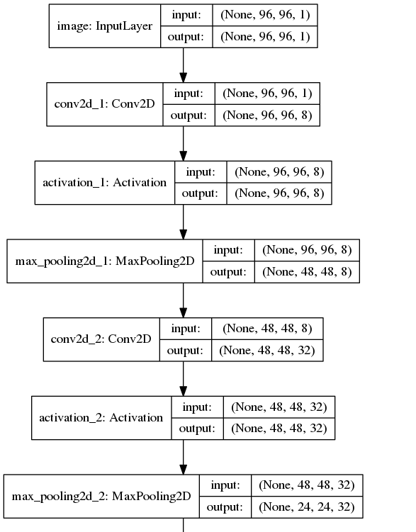
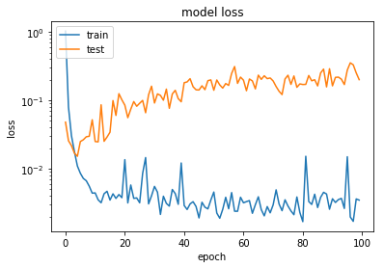
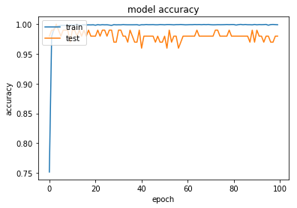
MLP + CNN
Epochs : 100
Batch Size : 30
Optimizer : Adam
Loss Func. : Cross Entropy
Train Acc : 0.999541788856
Val Acc : 1.0
Test Loss : 0.01778

Slide 17
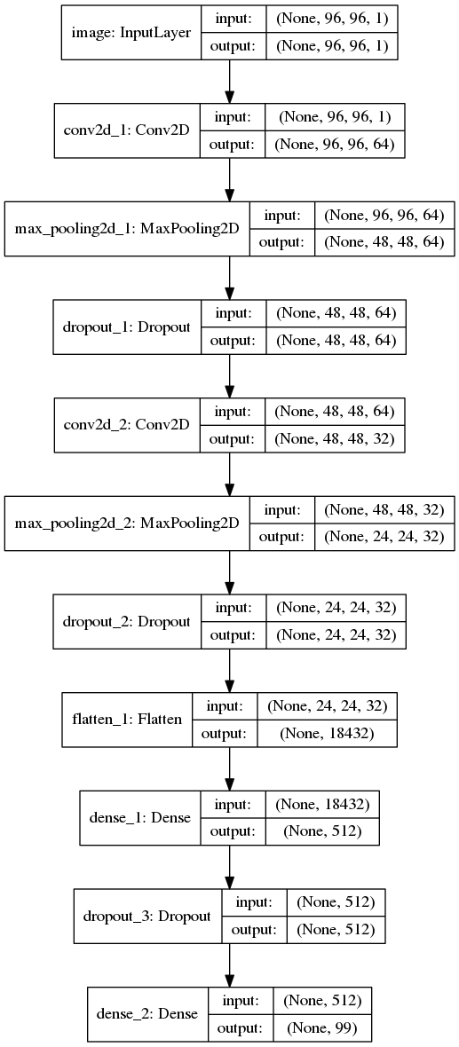
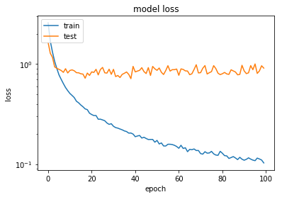
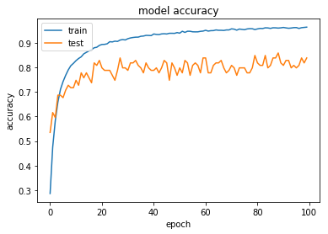
CNN
Epochs : 100
Batch Size : 30
Optimizer : Adam
Loss Func. : Cross Entropy
Train Acc : 0.96
Val Acc : 0.86
Test Loss : 0.89944

Slide 18
Discussion – Deep Learning
Data Augmentation
Pure CNN not work well
Overfitting
Pre-trained Model not work well
VGG 16
Similar problem with pure CNN

Slide 19
Feature Engineering
Target : Reconstruct shape & blade
Preprocessing
Feature Adding

Slide 20
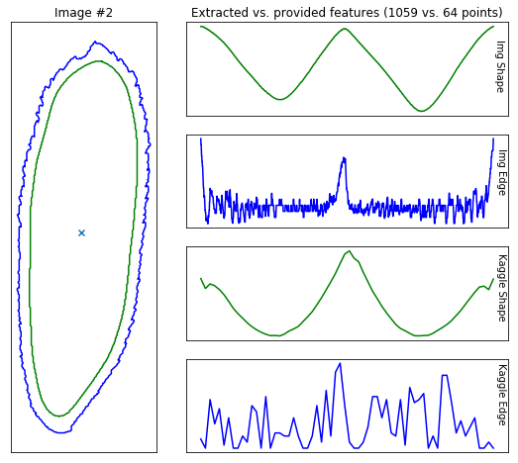
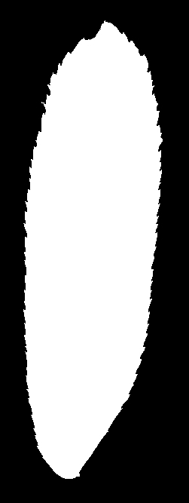
Motivation

Slide 21
Preprocessing
1. threshold --> leaf image not simply 0 or 255, is 0 ~ 255
2. portrait --> make every leaf stand up
3. resample --> resize image to a same size

Slide 22
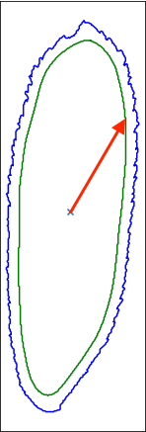
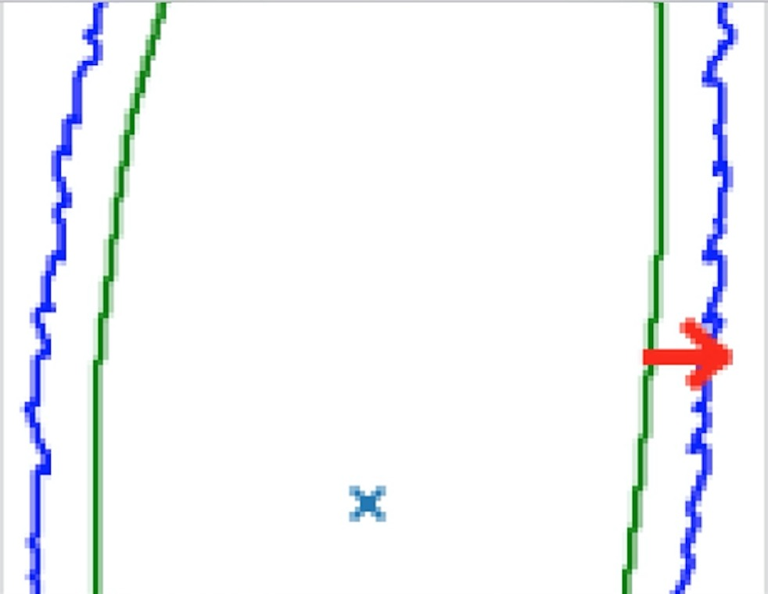
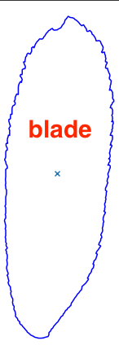
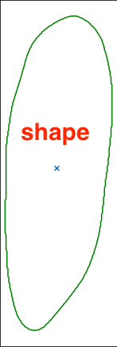
Feature Adding
Screen Shot 2017-12-30 at 8.46.00 PM
blade
distance
1. Make a gaussian blur image for shape
2. Get contours from original / blur image
3. Compute shape distance (line to center)
4. Compute blade distance (line to line)
5. Combine 3. 4. into original feature
shape
distance

Slide 23
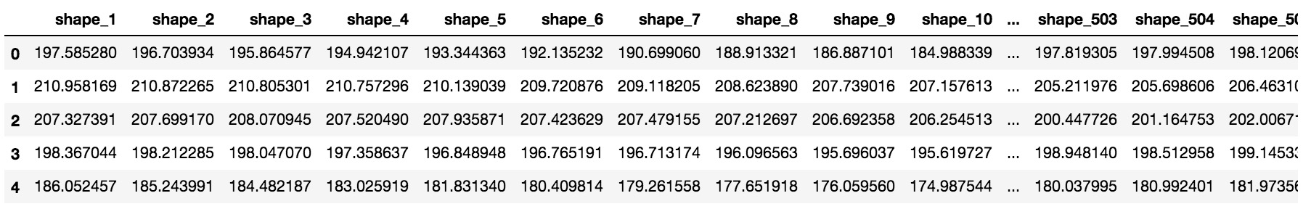
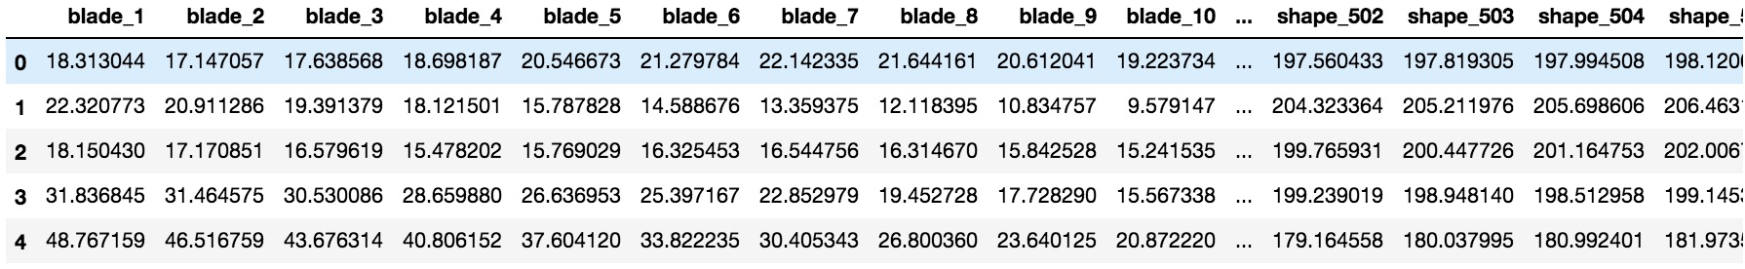
Original dataset with 192 features
New dataset with 1214 features

Slide 24
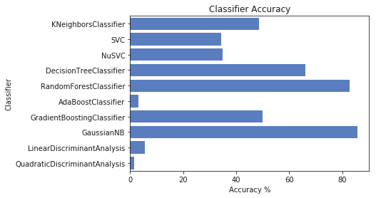
Default with new features

Slide 25
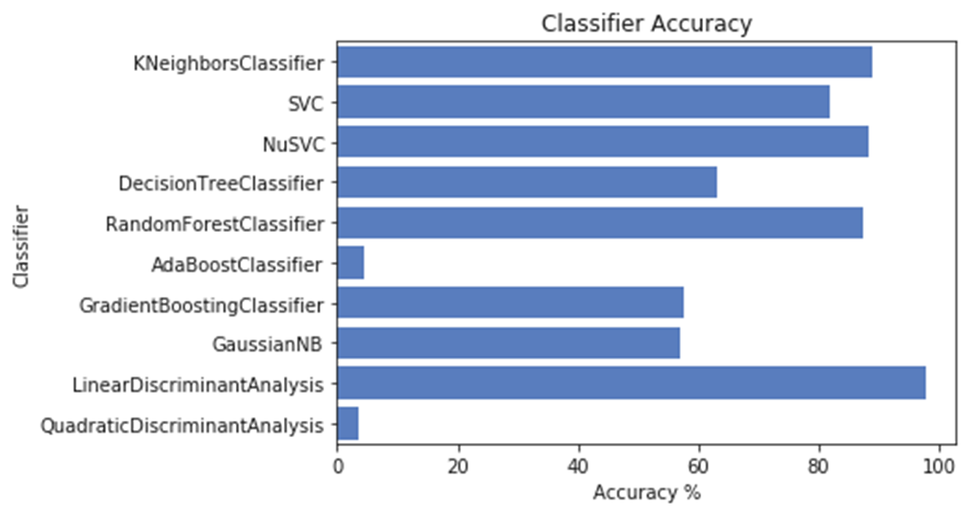
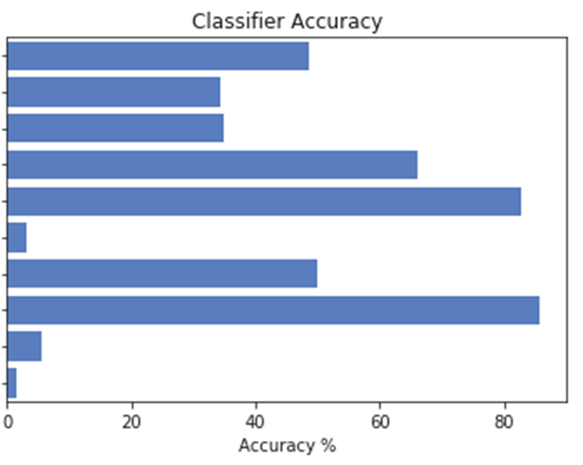
Default(192) | New features(1214)
Only GaussianNB improves…

Slide 26
Discussion – Feature Engineering
Not meaningful feature enough
Need to transform to further information
→ comparing aspect ratios, smoothness
describing the shape "in general"

Slide 27
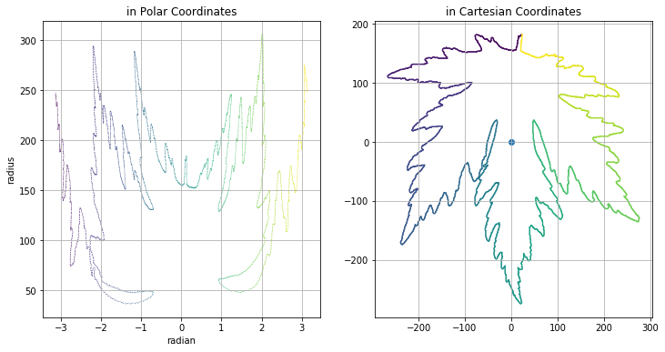
Future Plan

Slide 28
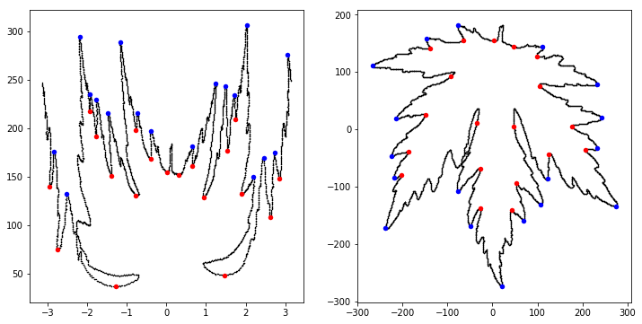

Slide 29
