Slide 1
Music Genre and Popularity Analysis
0316303 卓柏霖 0316223 尤靖允
0316020 李陳洋 0316214 洪偉傑

Slide 2
Outline
Introduction/motivation
-dataset
Problem statement
Proposed solution
Evaluation
-for popularity
-for music genres

Slide 3



Introduction/motivation
More and more people like listening to streaming music with free apps and websites.

Slide 4
Dataset -- Free music archive
Contain 106,574 songs from 16,341 artists and 14,854 albums.
Most of the data were caught from Spotify and Echonest web API.
Free Music Archive
metadata
features
echonest
7 more
album
artist
track
mfcc
…
spectral
centroid
metadata
audio
features
social
features
ranks
…
track
id
Bit
rate
comments
interest
genre top
composer
Total 14 attributes

Slide 5
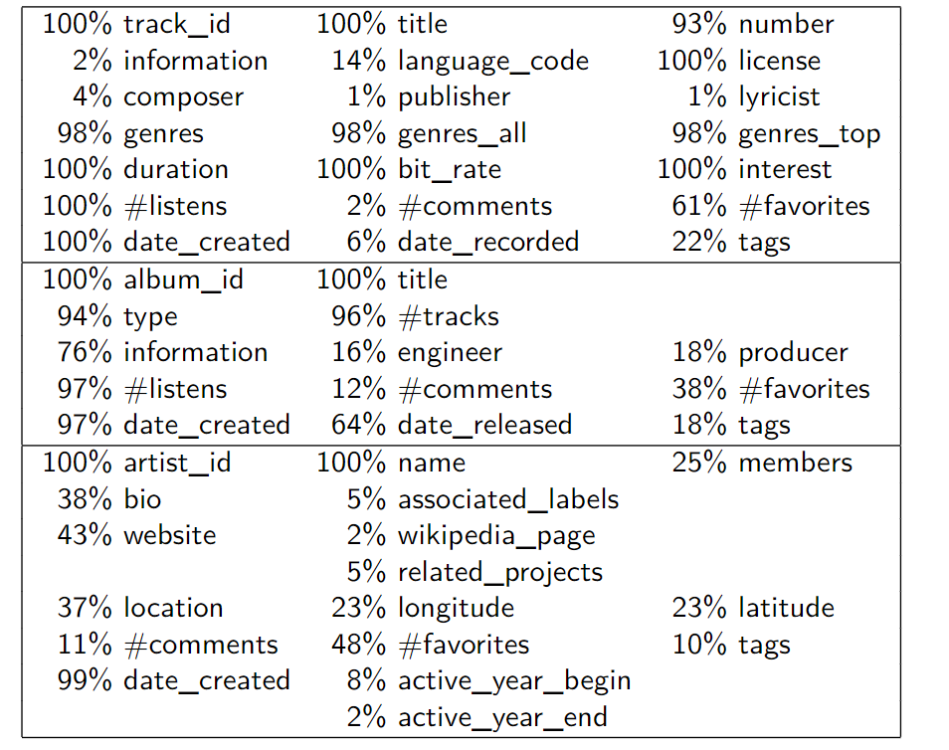
track
album
artist

Slide 6

Problem statement
Predict music genres and popularity
1. Which features should we pick?
2. How to define popularity scale?
3. Which data models fit better?

Slide 7
Proposed solution
Decision Tree
Random Forest
KNN
Naïve Bayes
SVM
PCA and LDA

Slide 8
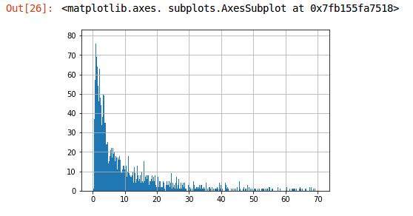
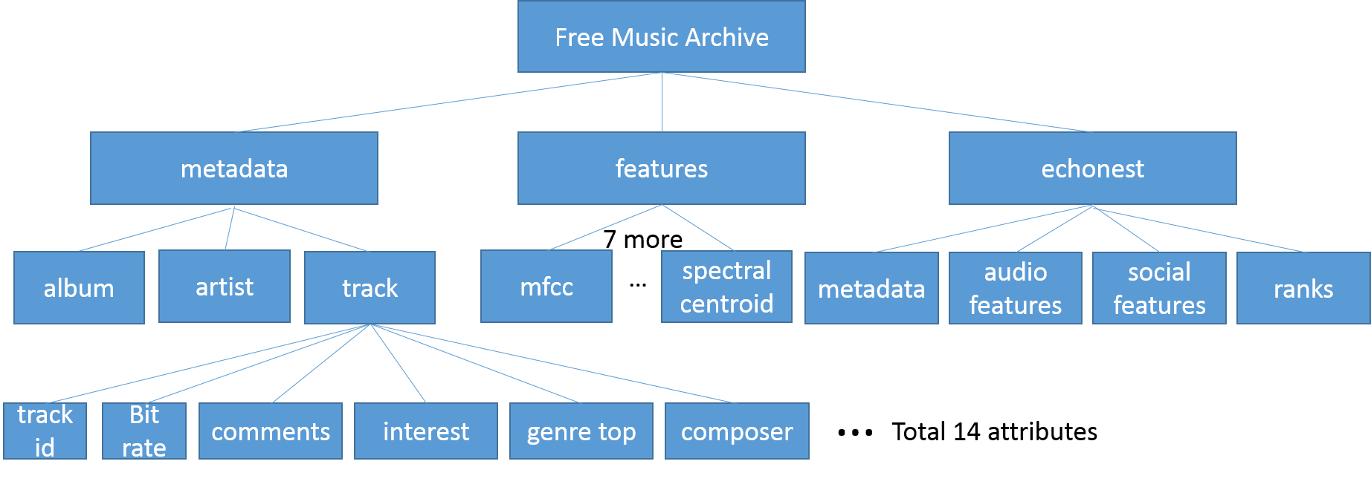
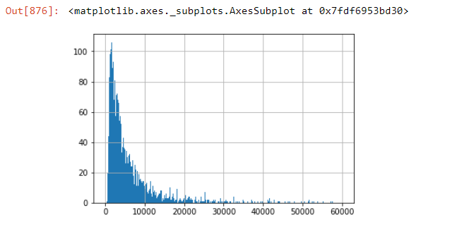
Define labels
We divide 5 classes (scale 0 to 4).
1. Listen+interest / DeletaDays
2. Listen / DeletaDays + interest

Slide 9
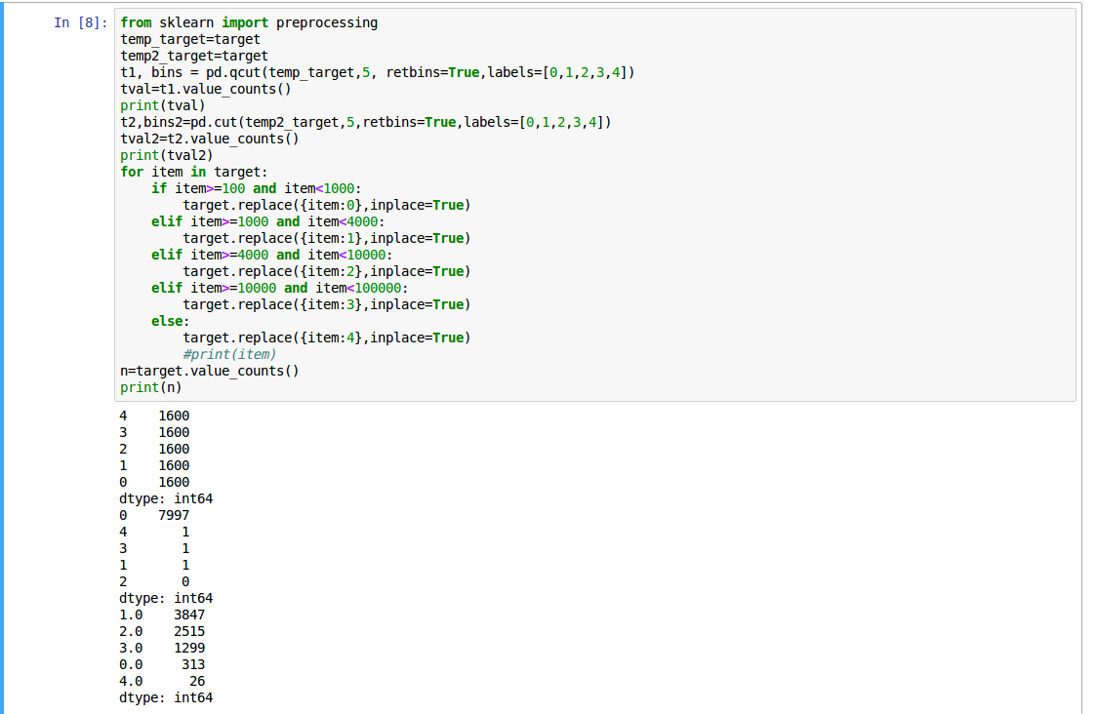
Define labels
Cut target into 5 labels :[0,1,2,3,4]
Qcut:
Cut:
Cut by our own definition

Slide 10
Select features
social_features: artist_discovery, artist_familiarity, artist_hotttnesss
audio_features: energy
Track: bit_rate, genre_top

Slide 11
Evaluation for popularity
Using 7200 tracks
Train data: 6400 tracks
Test data: 800 tracks

Slide 12
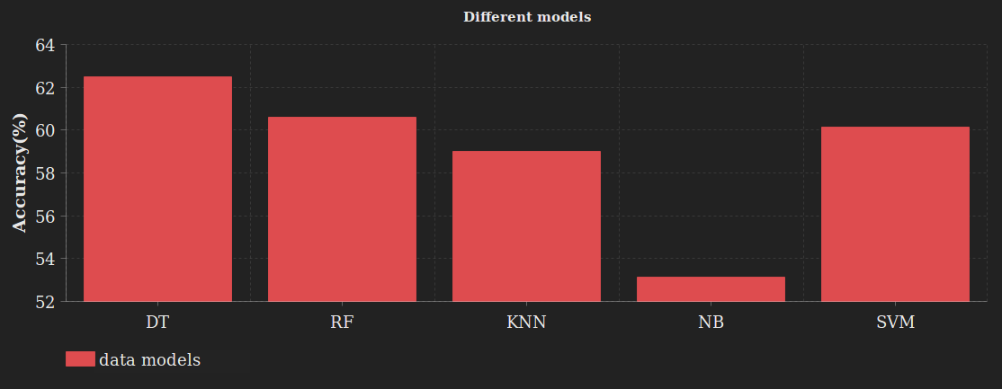
Different models

Slide 13
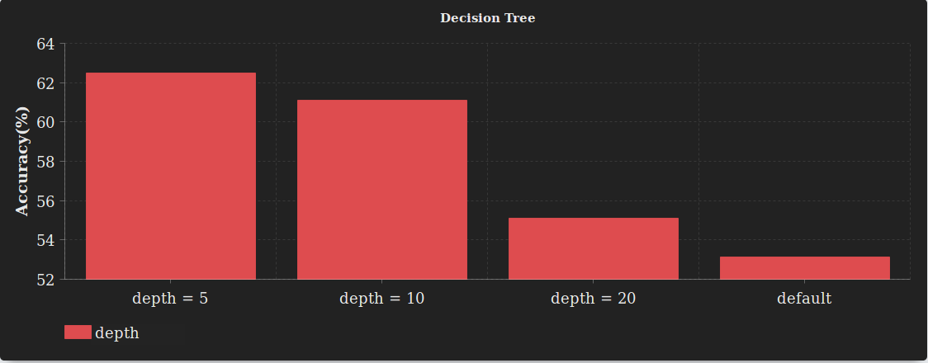
Decision Tree

Slide 14
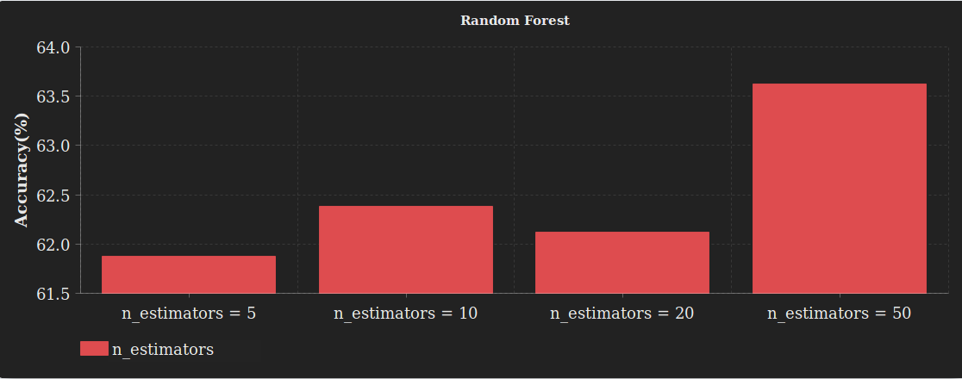
Random Forest

Slide 15
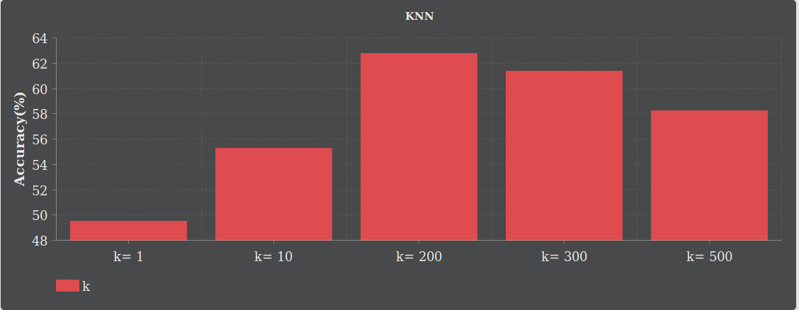
KNN

Slide 16
Evaluation for music genres

Slide 17
Evaluation for music genres
audio features provided by Echonest (now Spotify) for a subset of 13,129 tracks.
Discrete:
Metadata
ranks
Continue:
audio_features
social_features
temporal_features

Slide 18
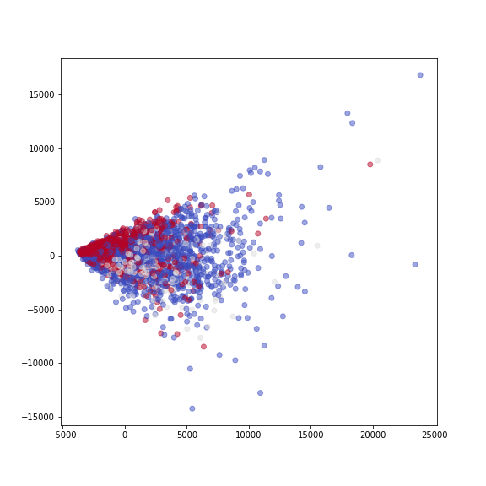
Analyze using PCA ( D = 237 >> D = 2)
Rock
Electronic
Hip-Hop

Slide 19
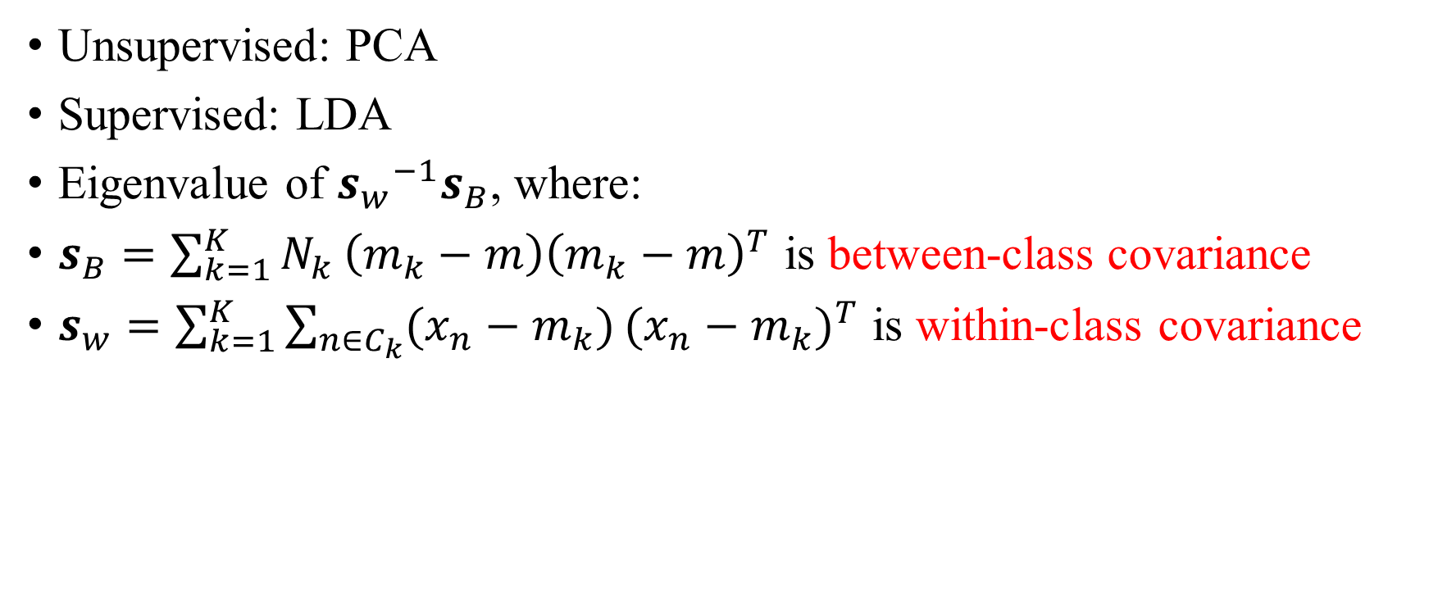
Linear Discriminant Analyze (LDA)
Unsupervised: PCA
Supervised: LDA
Eigenvalue of ${s_{w}}^{−1}s_{B}$, where:
$s_{B}=\sum_{k=1}^{K}{N_{k}}\left(m_{k}−m\right){\left(m_{k}−m\right)}^{T}$ is between-class covariance
$s_{w}=\sum_{k=1}^{K}{\sum_{n∈C_{k}}{(x_{n}−m_{k})}}{(x_{n}−m_{k})}^{T}$ is within-class covariance

Slide 20
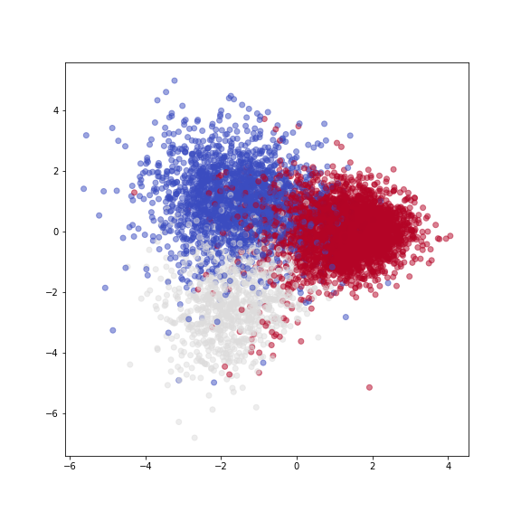

Slide 21
Evaluation
 | dim | NB | kNN | DT | RF | linSVC | SVCpoly2
echonest_social | 5 | 19.20% | 32.98% | 28.50% | 24.15% | 37.81% | 37.81%
echonest_all | 237 | 23.67% | 60.07% | 54.65% | 58.42% | 65.25% | 63.49%
echonest_audio | 8 | 49.47% | 53.83% | 46.88% | 54.65% | 52.89% | 52.41%
echonest_temporal | 224 | 22.61% | 58.42% | 49.71% | 61.25% | 64.31% | 61.60%
echonest_audio/social | 13 | 39.46% | 54.89% | 46.64% | 58.78% | 54.53% | 52.30%

Slide 22
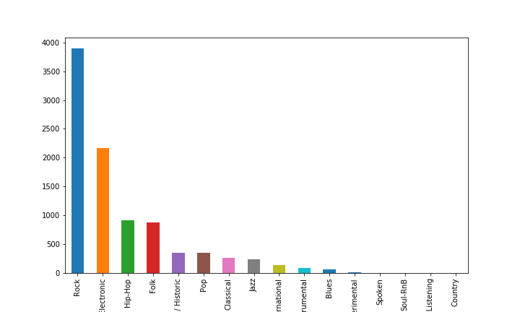
Class are not balanced

Slide 23
Evaluation (weighted)
 | dim | NB | kNN | DT | RF | linSVC | SVCpoly2
echonest_social | 5 | 14.23% | 10.05% | 10.67% | 15.37% | 19.46% | 8.59%
echonest_all | 237 | 22.14% | 32.15% | 28.54% | 29.22% | 43.41% | 34.75%
echonest_audio | 8 | 26.09% | 25.54% | 27.19% | 29.75% | 30.57% | 25.33%
echonest_temporal | 224 | 21.48% | 31.26% | 24.88% | 28.57% | 34.34% | 34.24%
echonest_audio/social | 13 | 22.48% | 26.86% | 23.55% | 27.66% | 26.79% | 25.11%

Slide 24
Reference
[1] fma https://github.com/mdeff/fma
[2] fma_paper https://arxiv.org/pdf/1612.01840.pdf

Slide 25
Thanks for listening

