Slide 1
前端自动化测试的 一些尝试 邬明鸣 2018-9-24

Slide 2
目录
1.思路篇
2.架构篇
3.原理篇

Slide 3



传统前端自动化测试
思路篇
自动化
脚本
浏览器
渲染DOM
对比DOM
内容

Slide 4
痛点在哪？
思路篇
费时费力，
需要MOCK数据
大量延时，等待DOM渲染
频繁查找selector

Slide 5




可能优化？
思路篇
用户访问网站
前端通过ajax发送请求
站点向接口发发请求
接口访问DB

Slide 6
用户角度
思路篇
用户访问网站
前端通过ajax发送请求
站点向接口发发请求
接口访问DB

Slide 7














架构篇-client
change
key down
resize
dom mutation
key up
mouse up
mouse down
navigate
ats client
blur
focus
network
scroll
mouse over

Slide 8
架构篇-client
change
key down
1) 浏览器
初始化事件
resize
dom mutation
key up
mouse up
mouse down
navigate
ats client
blur
focus
network
scroll
mouse over

Slide 9
架构篇-client
change
key down
2) 用户
行为事件
resize
dom mutation
key up
mouse up
mouse down
navigate
ats client
blur
focus
network
scroll
mouse over

Slide 10
架构篇-client
change
key down
3) 浏览器
渲染
resize
dom mutation
key up
mouse up
mouse down
navigate
ats client
blur
focus
network
scroll
mouse over

Slide 11

架构篇-client
change
key down
4) 输出包含
所有事件
的json文件
resize
dom mutation
key up
mouse up
ats data.json
mouse down
navigate
ats client
blur
focus
network
scroll
mouse over

Slide 12




架构篇-server
ats client
compare
images
ats data.json
ats server
puppeteer
screen shot

Slide 13
架构篇-小结
ats client
ats server
录制页面跳转、网络请求
监听浏览器内的用户行为事件
监听DOM改变
还原浏览器内发生的整个事情
录制expect、测试actual
将dom截图并对比，生成差异

Slide 14


总结
ats client
ats server
录制过程速度快、成本低
不用了解业务、不用写代码
业务可能影响验证结果，不能自行判断是否通过测试
只适用于前端测试

Slide 15
总结
特点：
录制成本低:不用了解业务、不用写代码
只能作为辅助工具，不能自行判断是否通过测试
只适用于前端测试
…
“

Slide 16
谢谢大家

Slide 17
架构篇
ats_client录制浏览器内的用户行为、网络请求、DOM改变
ats_server还原浏览器内发生的整个事情，可录制expect、测试actual，将dom截图并对比，生成差异

Slide 18
原理篇 ats_client
chrome扩展程序
注入javascript监听
用户行为： change, focus, blur, keydown, keyup, mousedown, mouseup, mouse_over, scroll
浏览器行为：network, navigate, mutation, resize
输出：包含上述所有信息的一个ats_data.json文件

Slide 19
原理篇 ats_server
客户端electron程序
Puppeteer（ headless chrome ）还原整个ats_data.json文件，将 dom mutation截图保存
pixelmatch实现截图对比，发现差异

Slide 20
INSTRUCTIONS FOR USE
EDIT IN GOOGLE SLIDES
Click on the button under the presentation preview that says "Use as Google Slides Theme". You will get a copy of this document on your Google Drive and will be able to edit, add or delete slides. You have to be signed in to your Google account.
EDIT IN POWERPOINT®
Click on the button under the presentation preview that says "Download as PowerPoint template". You will get a .pptx file that you can edit in PowerPoint.
Remember to download and install the fonts used in this presentation (you’ll find the links to the font files needed in the Presentation design slide)
More info on how to use this template at www.slidescarnival.com/help-use-presentation-template
This template is free to use under Creative Commons Attribution license. You can keep the Credits slide or mention SlidesCarnival and other resources used in a slide footer.

Slide 21
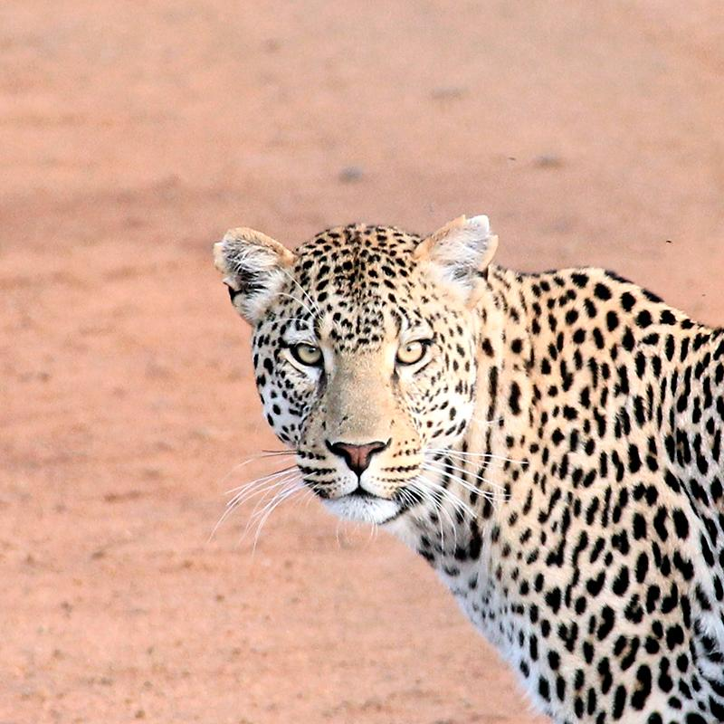
Hello world!
I AM JAYDEN SMITH
I am here because I love to give presentations.
You can find me at:
@username

Slide 22
1
TRANSITION HEADLINE
Let’s start with the first set of slides

Slide 23
Quotations are commonly printed as a means of inspiration and to invoke philosophical thoughts from the reader.

Slide 24
THIS IS A SLIDE TITLE
Here you have a list of items
And some text
But remember not to overload your slides with content
Your audience will listen to you or read the content, but won’t do both.

Slide 25
BIG CONCEPT
Bring the attention of your audience over a key concept using icons or illustrations

Slide 26
YOU CAN ALSO SPLIT YOUR CONTENT
White
Is the color of milk and fresh snow, the color produced by the combination of all the colors of the visible spectrum.
Black
Is the color of coal, ebony, and of outer space. It is the darkest color, the result of the absence of or complete absorption of light.

Slide 27
IN TWO OR THREE COLUMNS
Yellow
Is the color of gold, butter and ripe lemons. In the spectrum of visible light, yellow is found between green and orange.
Blue
Is the colour of the clear sky and the deep sea. It is located between violet and green on the optical spectrum.
Red
Is the color of blood, and because of this it has historically been associated with sacrifice, danger and courage.

Slide 28
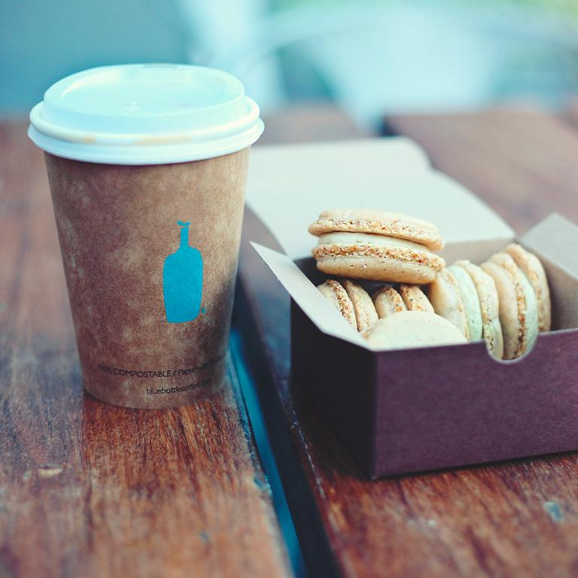
A PICTURE IS WORTH A THOUSAND WORDS
A complex idea can be conveyed with just a single still image, namely making it possible to absorb large amounts of data quickly.

Slide 29
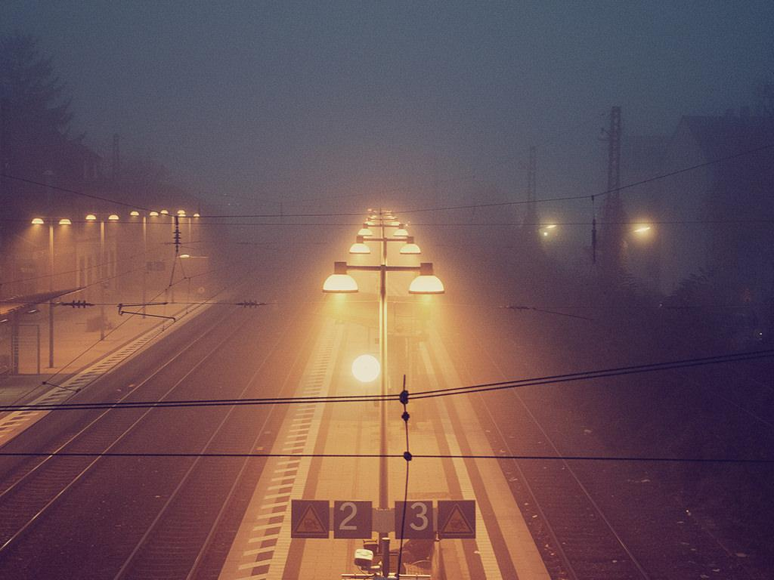
Want big impact?
USE BIG IMAGE

Slide 30
USE CHARTS TO EXPLAIN YOUR IDEAS
White
Gray
Black

Slide 31
AND TABLES TO COMPARE DATA
 | A | B | C
Yellow | 10 | 20 | 7
Blue | 30 | 15 | 10
Orange | 5 | 24 | 16

Slide 32

MAPS
our office

Slide 33
89,526,124
Whoa! That’s a big number, aren’t you proud?

Slide 34
89,526,124$
185,244 users
100%
That’s a lot of money
And a lot of users
Total success!

Slide 35
OUR PROCESS IS EASY
first
second
last

Slide 36
LET’S REVIEW SOME CONCEPTS
Yellow
Is the color of gold, butter and ripe lemons. In the spectrum of visible light, yellow is found between green and orange.
Blue
Is the colour of the clear sky and the deep sea. It is located between violet and green on the optical spectrum.
Red
Is the color of blood, and because of this it has historically been associated with sacrifice, danger and courage.
Yellow
Is the color of gold, butter and ripe lemons. In the spectrum of visible light, yellow is found between green and orange.
Blue
Is the colour of the clear sky and the deep sea. It is located between violet and green on the optical spectrum.
Red
Is the color of blood, and because of this it has historically been associated with sacrifice, danger and courage.

Slide 37
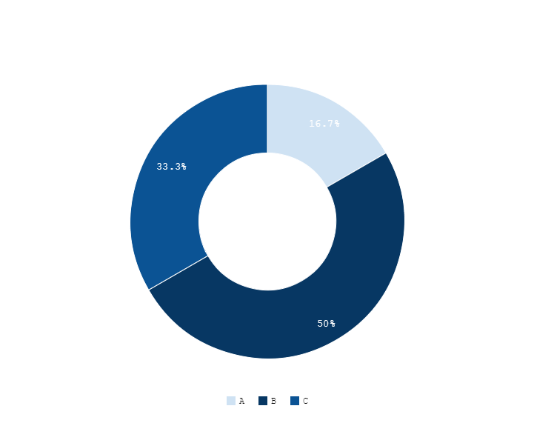
You can copy&paste graphs from Google Sheets

Slide 38
ANDROID PROJECT
Show and explain your web, app or software projects using these gadget templates.
Place your screenshot here

Slide 39
iPHONE PROJECT
Show and explain your web, app or software projects using these gadget templates.
Place your screenshot here

Slide 40
TABLET PROJECT
Show and explain your web, app or software projects using these gadget templates.
Place your screenshot here

Slide 41
DESKTOP PROJECT
Show and explain your web, app or software projects using these gadget templates.
Place your screenshot here

Slide 42
Thanks!
ANY QUESTIONS?
You can find me at:
@username user@mail.me

Slide 43
CREDITS
Special thanks to all the people who made and released these awesome resources for free:
Presentation template by SlidesCarnival
Photographs by Unsplash

Slide 44
Presentation design
This presentations uses the following typographies:
Titles & Body copy: Cousine
You can download the fonts on this page:
https://www.fontsquirrel.com/fonts/cousine
You don’t need to keep this slide in your presentation. It’s only here to serve you as a design guide if you need to create new slides or download the fonts to edit the presentation in PowerPoint®

Slide 45
SlidesCarnival icons are editable shapes.
This means that you can:
Resize them without losing quality.
Change fill color and opacity.
Isn’t that nice? :)
Examples:

Slide 46
😉
Now you can use any emoji as an icon!
And of course it resizes without losing quality and you can change the color.
How? Follow Google instructions https://twitter.com/googledocs/status/730087240156643328
✋👆👉👍👤👦👧👨👩👪💃🏃💑❤😂😉😋😒😭👶😸🐟🍒🍔💣📌📖🔨🎃🎈🎨🏈🏰🌏🔌🔑 and many more...

