Slide 1
Crypto Race: Teams of 6
Sit at a table with a lockbox
Turn on computers
https://crypto.cyberpdx.org

Slide 2
Race
Rules
3 teams, 5 challenges to solve
Decode a challenge to reveal a riddle
QR code, Columnar, Caesar, Steganography, Barcode, Hexadecimal, Enigma, Navajo Code, Vigenere, ASCII, Scytale
For each riddle revealed, hunt for its answer within or immediately outside of the NASCC (e.g. sidewalk, courtyard, rooftop)
First four challenges given initially
Teams submitting correct answers to me for all 4 initial challenges will receive the final challenge whose answer unlocks the box in front of you
Use anything you want to decode puzzles (Helpful links provided at https://crypto.cyberpdx.org)
Will trickle out solutions as race goes on
Hints
Smaller challenges simpler (allocate your team accordingly)

Slide 3
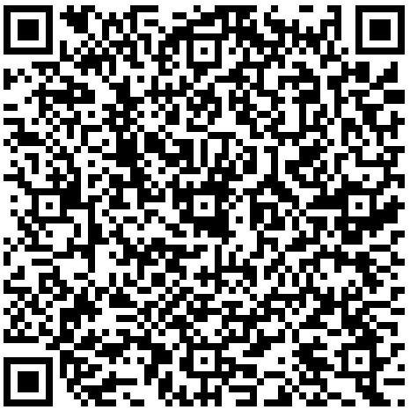
Challenge #1
H T D U C
t n f i d
m n h e a
h f e o t
m o e r o
e e w h r
i o s t r
e a e s r
. l t o d
D U T C H
f i n d t
h e n a m
e o f t h
e r o o m
w h e r e
s t o r i
e s a r e
t o l d .
find the name of the room where stories are told.

Slide 4
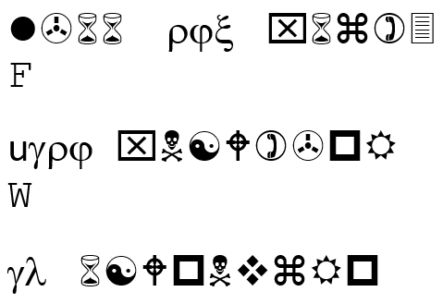
Challenge #2
ILL THE BLANK
ITH BROWNIES
IN LOWERCASE
https://crypto.cyberpdx.org/static/________.jpg

Slide 5

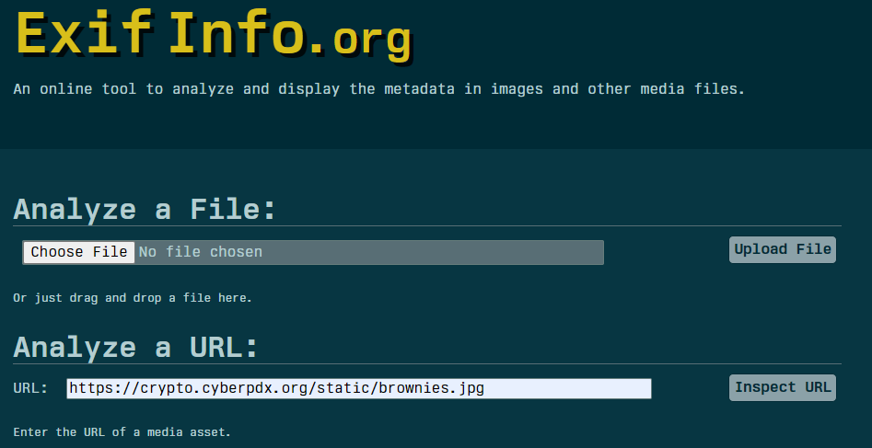
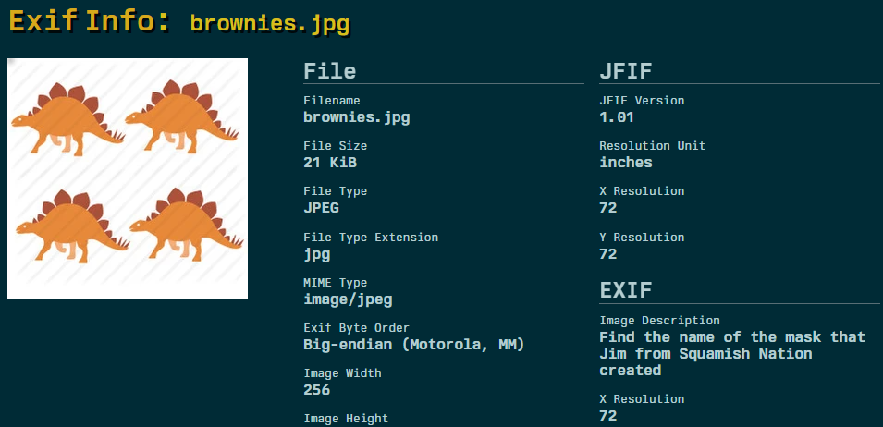

Slide 6

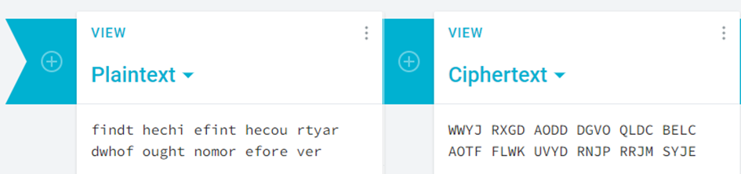
Challenge #3
Today is 0x22
=> 34
find the chief in the courtyard who fought no more forever

Slide 7
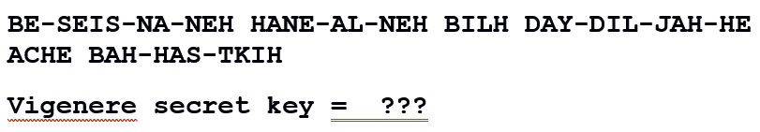
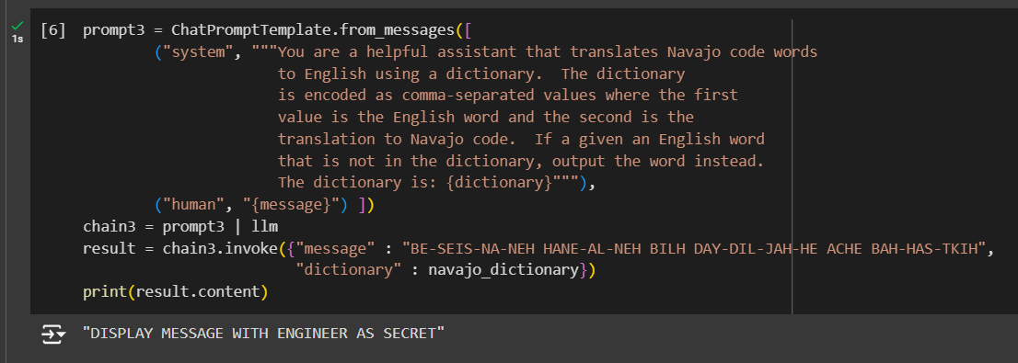
Challenge #4

Slide 8
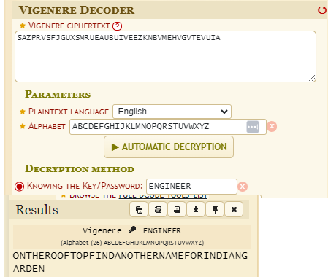
ENGINEERENGINEERENGINEERENGINEERENGINEEREN
SAZPRVSFJGUXSMRUEAUBUIVEEZKNBVMEHVGVTEVUIA
on the rooftop find another name for indian garden

Slide 9
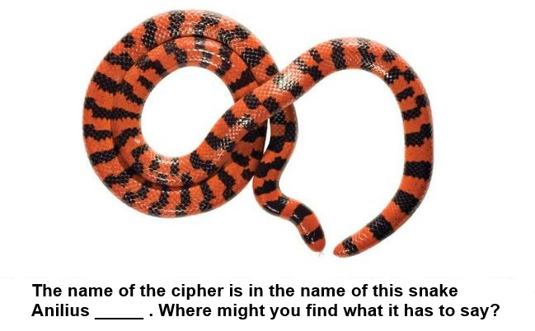
Challenge #5
68 74 74 70 73 3a 2f 2f 67 6f 6f 2e 67 6c 2f 69 67 4a 79 6c 30
https://goo.gl/igJyl0
https://crypto.cyberpdx.org/static/snake.jpg
(Scytale snake)

Slide 10
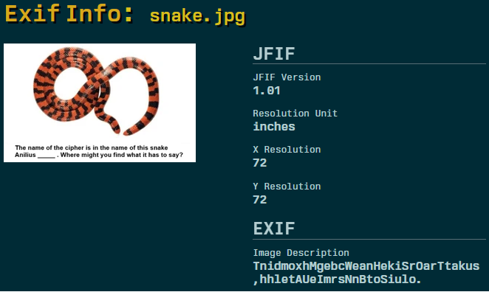
Tnidmox
hMgebcW
eanHeki
SrOarTt
akus,hh
letAUeI
mrsNnBt
oSiulo.
The Salmon Marker Sign Outside Has A Number,
Unlock The Box With It.

