Slide 1
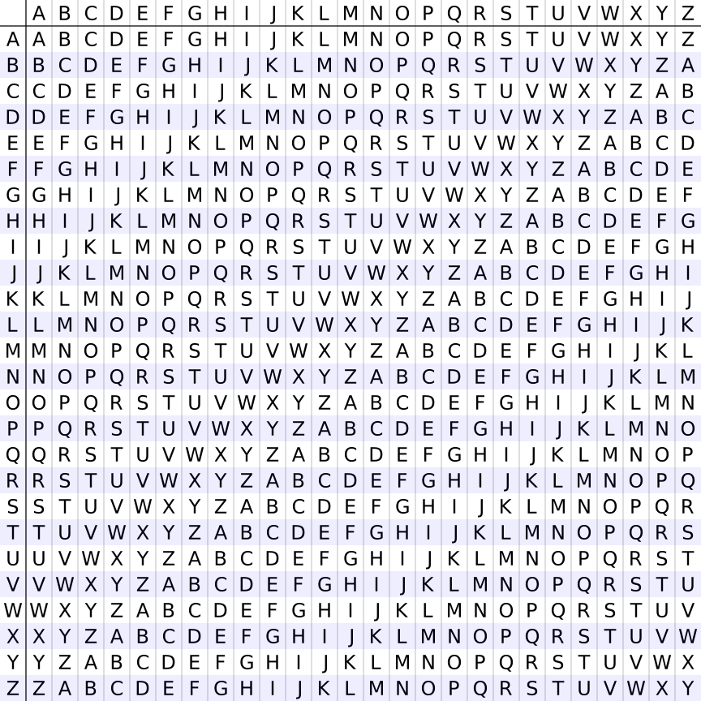
Key character
Key character
Plaintext character
Plaintext character
Ciphertext table
Ciphertext table

