Slide 1
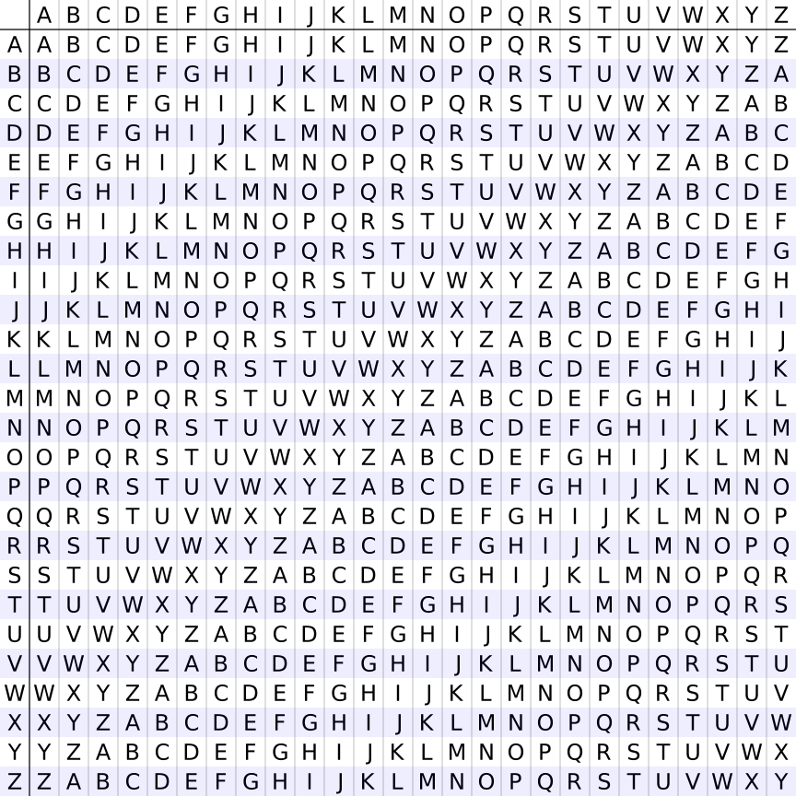
Plaintext character
Plaintext character
Key character
Key character
Ciphertext table
Ciphertext table

