Slide 1
Cryptology in an Algebra 2 Classroom

Slide 2
Nicole Barker CyberPDX 2016 Lesson Plan
LESSON OBJECTIVES:
-link coding to exponential growth functions and geometric sequences
-compute decimal values of hexadecimal characters
-decrypt a message given in hexadecimal
-use simple substation cipher
-decode the punchline to a joke using the Vigenere cipher

Slide 3
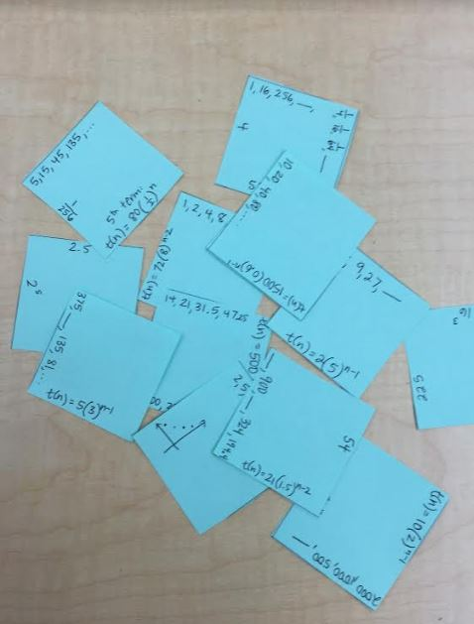
LESSON:
Warm up puzzle (see attached)
Students will be given a baggie of puzzle pieces that complete missing terms in sequences, or match explicit formulas to given sequences.

Slide 4
When completed, it will look something like this:

Slide 5
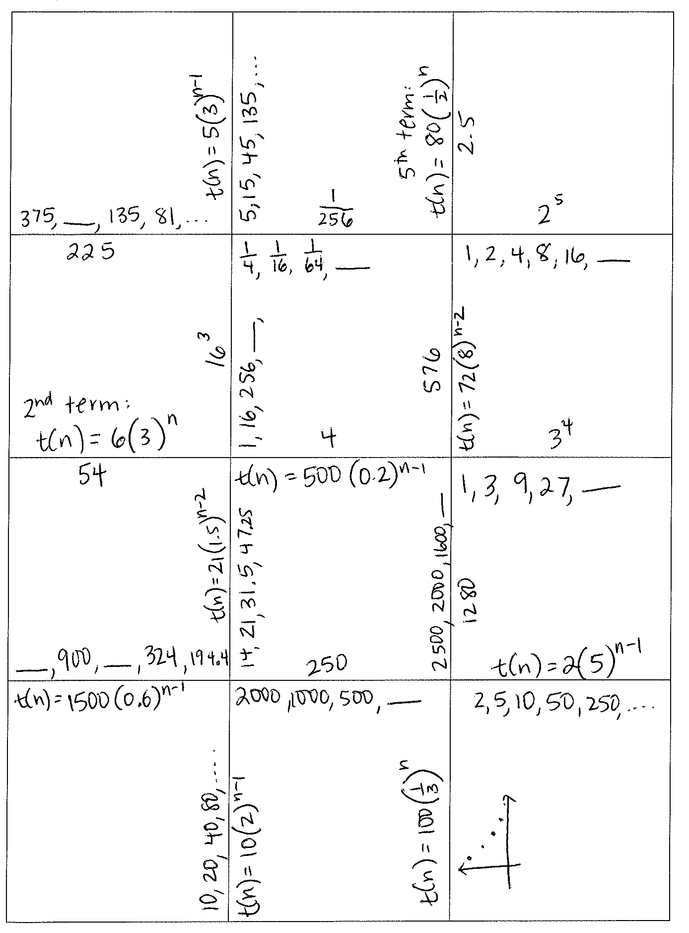

Slide 6
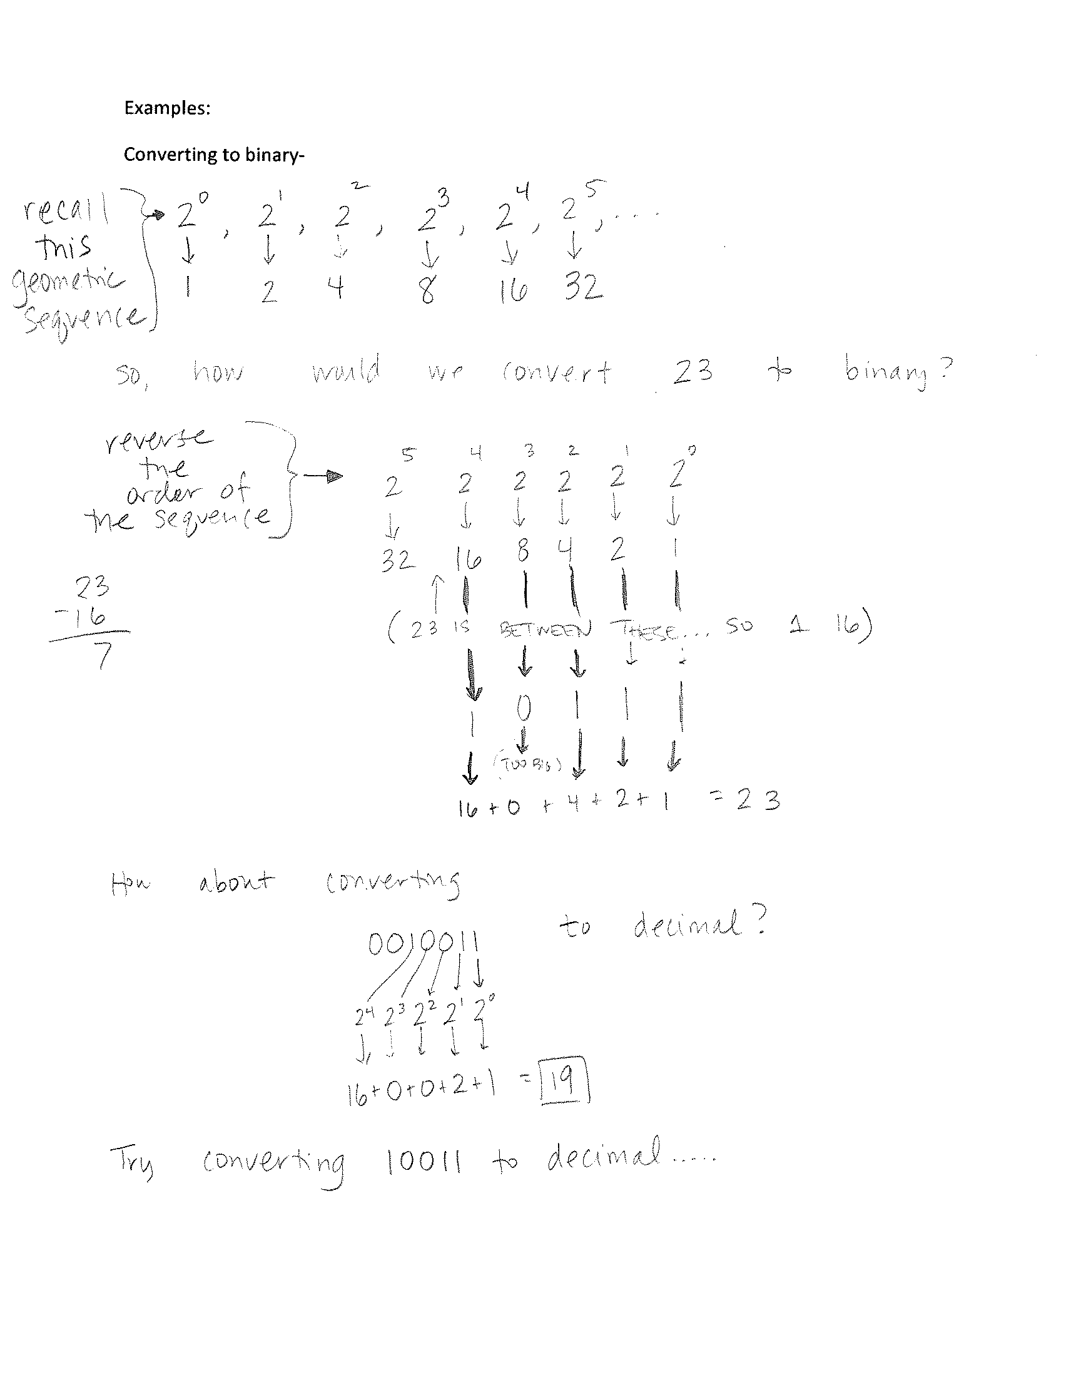
Introduce binary system comparing it to a simple geometric sequence (1, 2, 4, 8, 16, …)

Slide 7
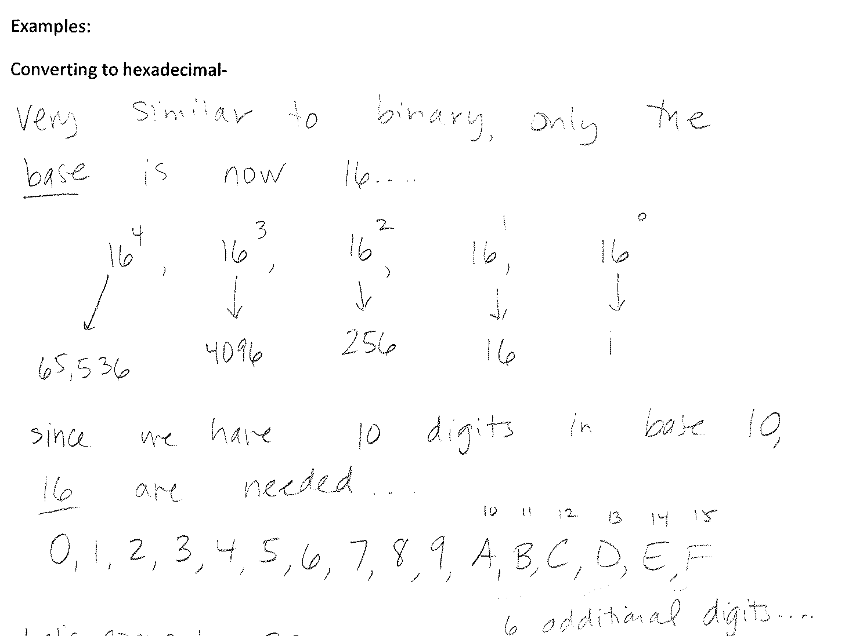
Continue the talk of exponential growth, and introduce the hexadecimal system.

Slide 8
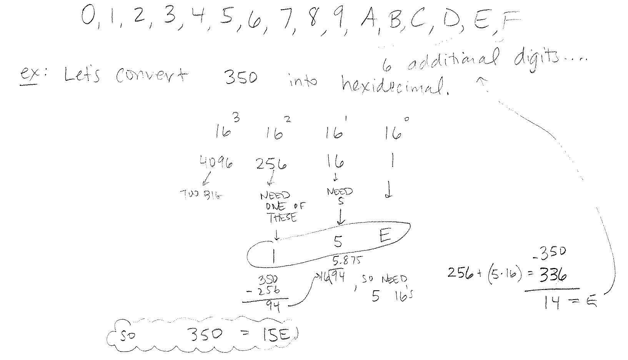
Show examples of how to convert to hexadecimal.

Slide 9
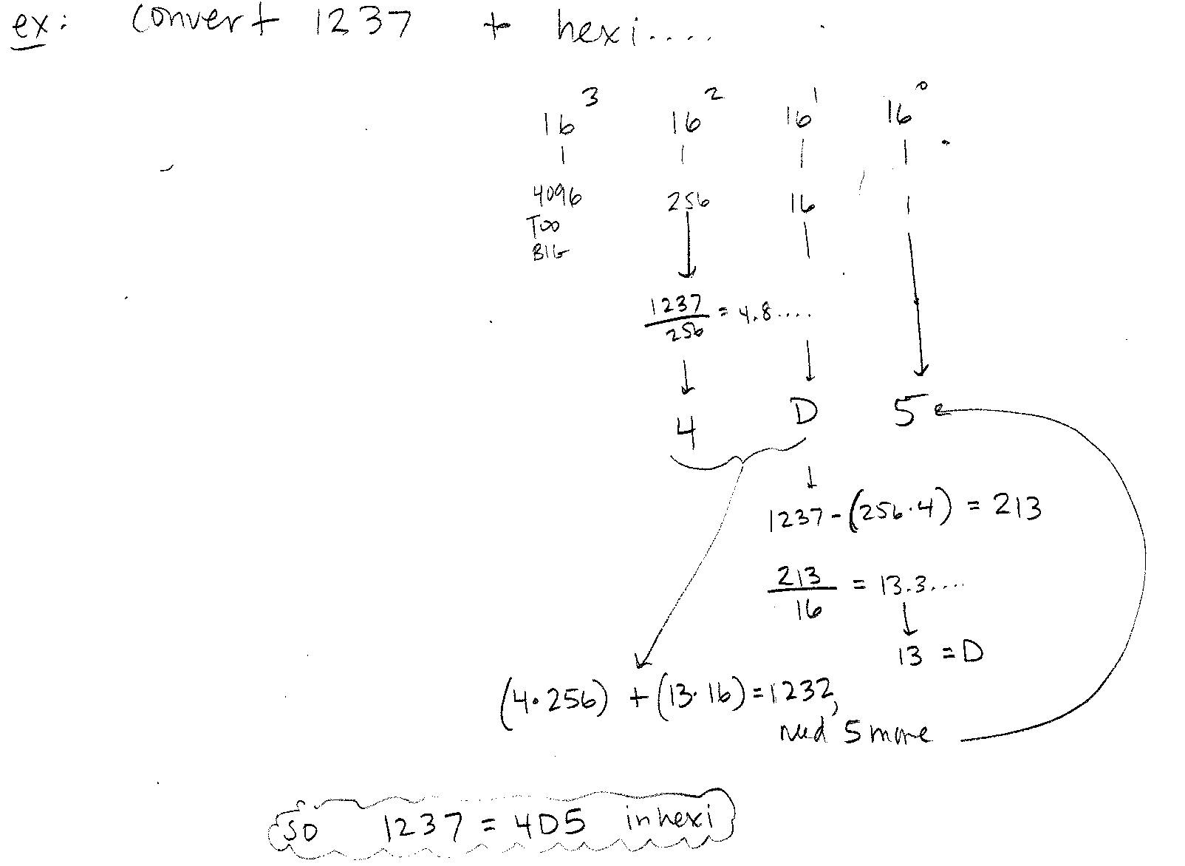

Slide 10
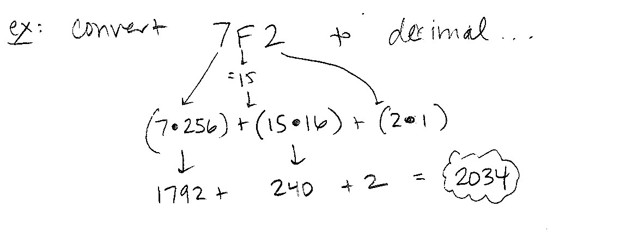

Slide 11
Students will now write a short message to be decoded by a partner using either binary or hexadecimal.

Slide 12
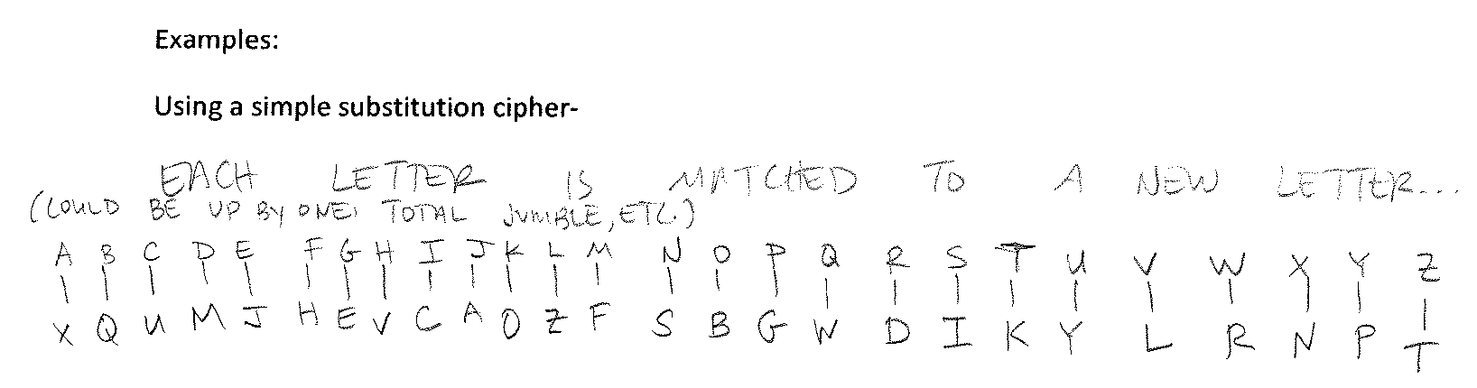

Introduce substitution cipher and provide examples.

Slide 13
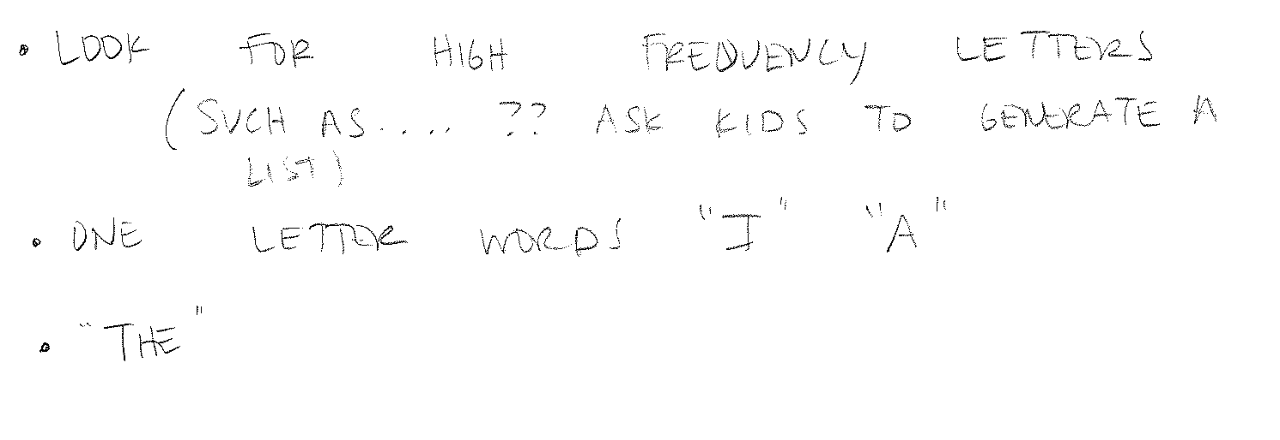

Slide 14
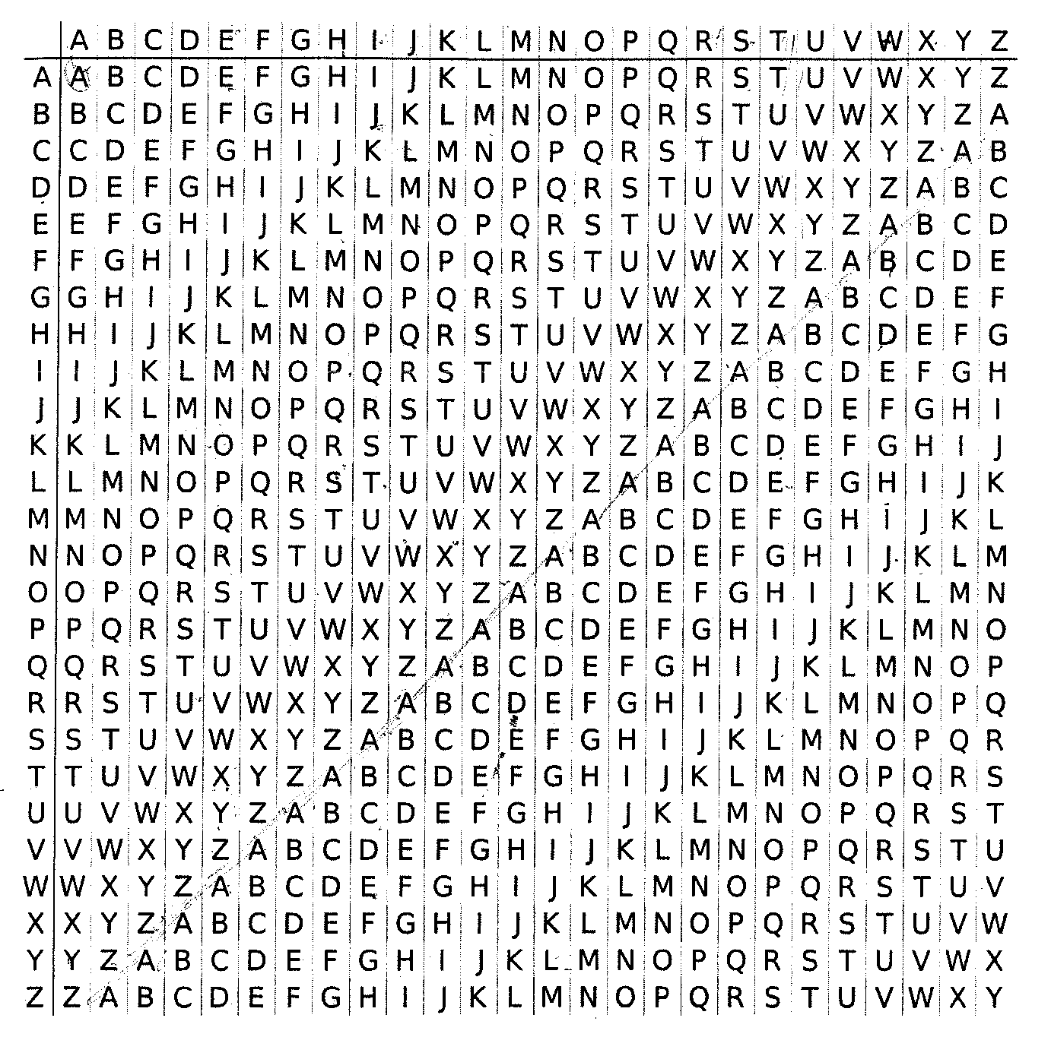
Show students how to use a key to decrypt a message given using the Vigenere cipher.

Slide 15
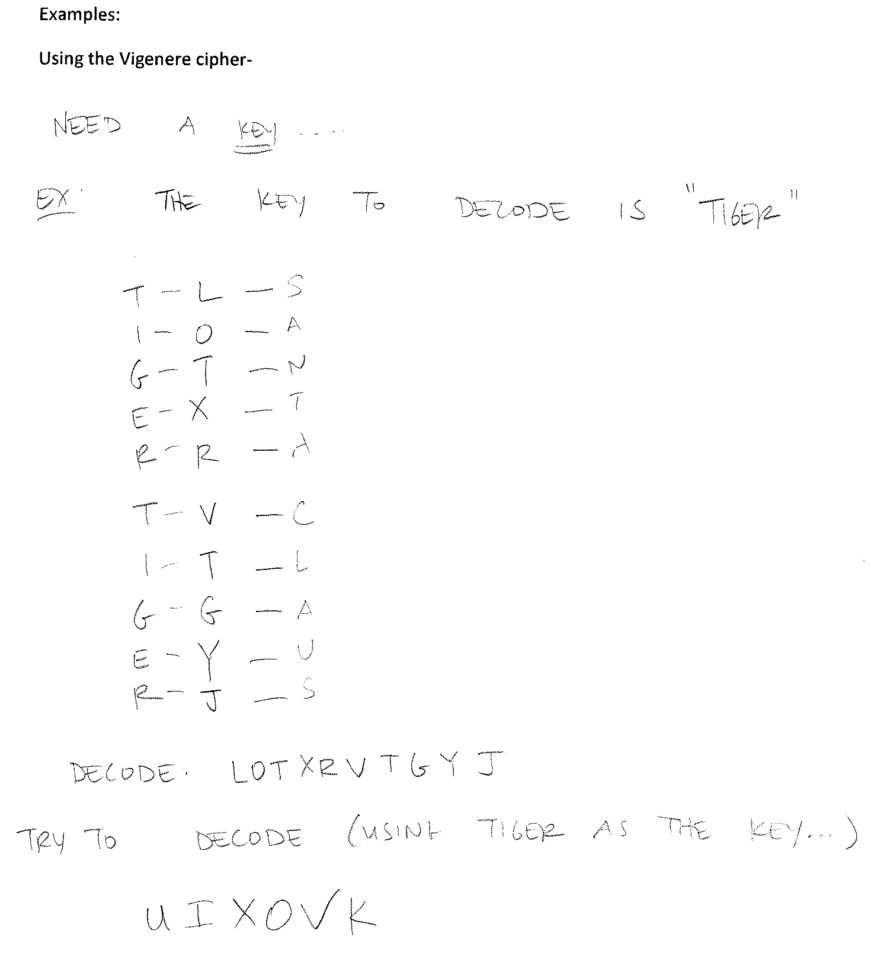

Slide 16
Exit ticket: To find the punchline to this joke, “What is a chicken’s least favorite day?”
Decrypt using a simple substitution cipher:
cyp tpd cf hpufhp gw wgutf
(the key to decode is sicko)
Using the Vigonere cipher, and the key ‘sicko’ the punchline is:
XZKNOQ (Friday)

