Slide 1
Camp Structure/Schedule
By Lois Delcambre

Slide 2
Four threads
Cyprtography
CS/Programming
Policy
Filmmaking

Slide 3
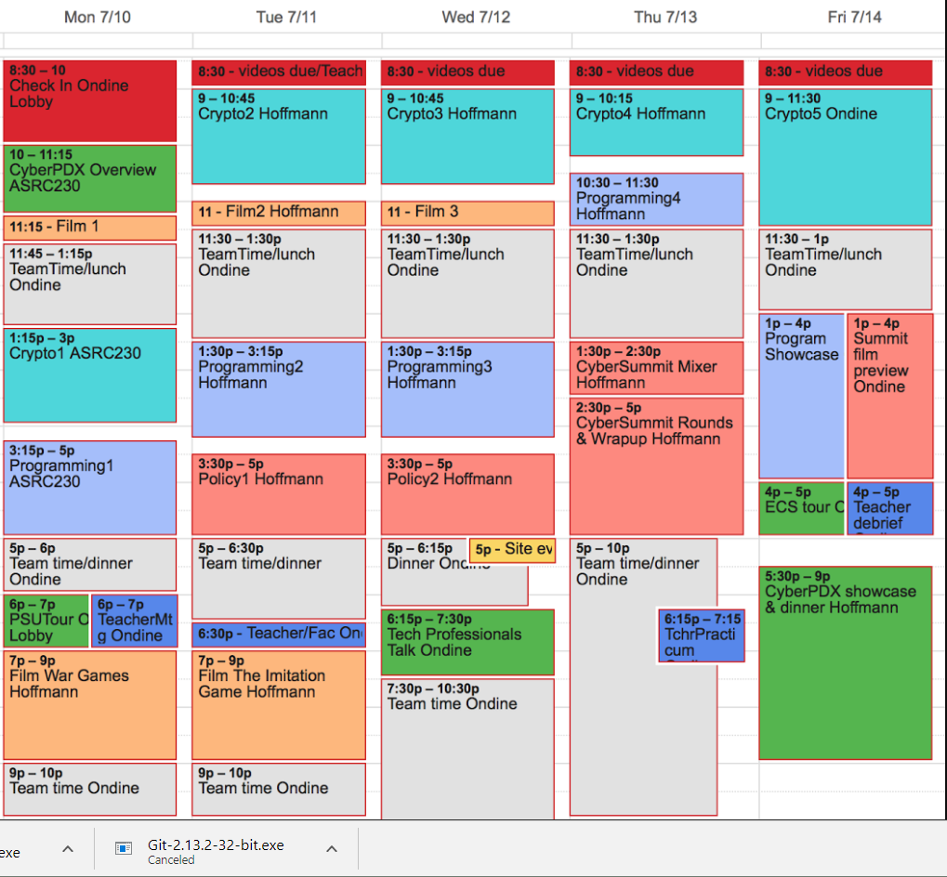
Crypto

Slide 4
CS/Programming

Slide 5
Policy

Slide 6
Filmmaking

Slide 7
Camp-wide events

Slide 8
Video deadlines (to upload your video)

Slide 9
All-camp activities

