Slide 1
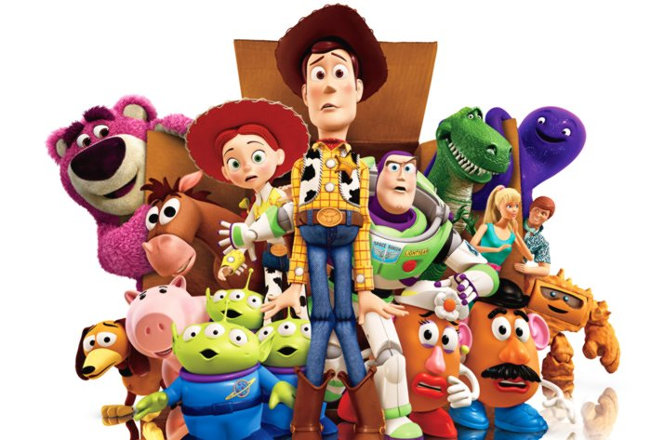
Toy Story
Toy Story

Slide 2
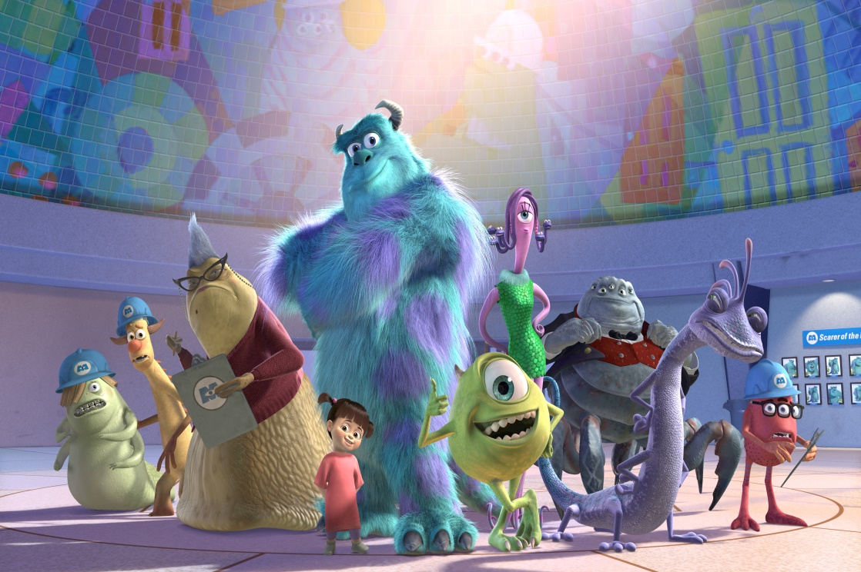
Monsters Inc.
Monsters Inc.

Slide 3
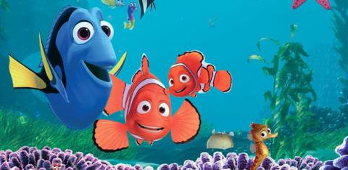
Finding Nemo
Finding Nemo

Slide 4
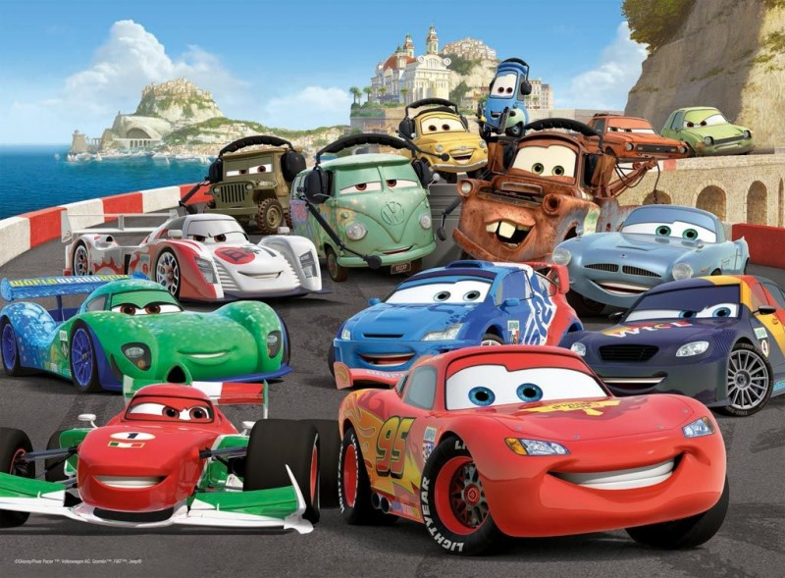
Cars
Cars

Slide 5
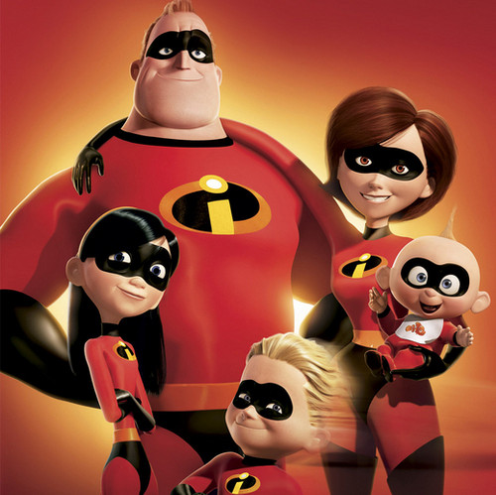
The Incredibles
The Incredibles

Slide 6
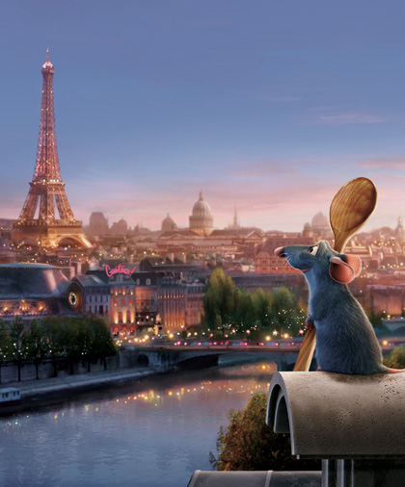
Ratatouille
Ratatouille

Slide 7

Wall-E
Wall-E

Slide 8
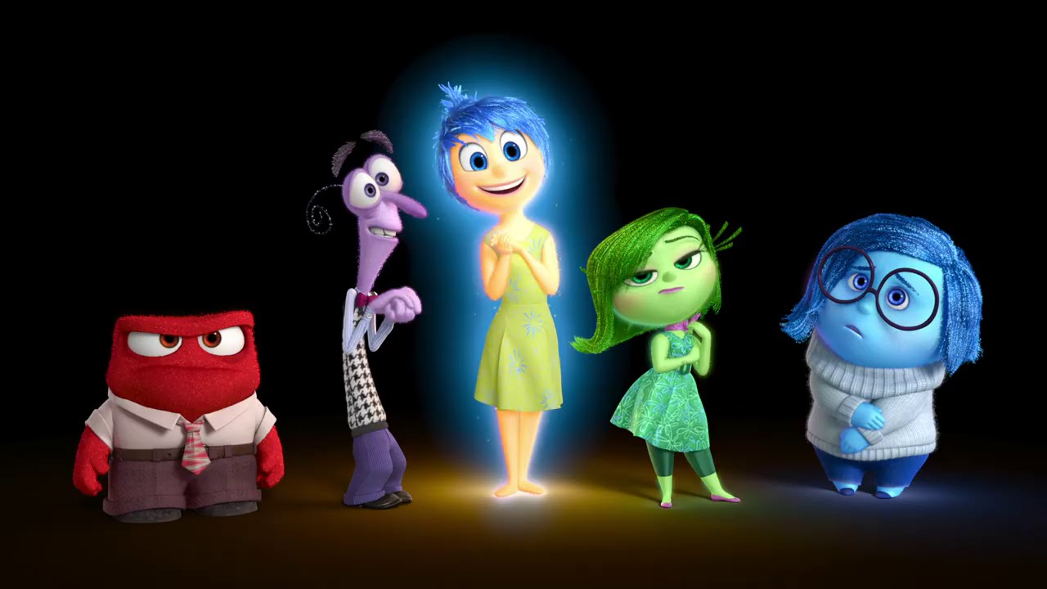
Inside Out
Inside Out

Slide 9
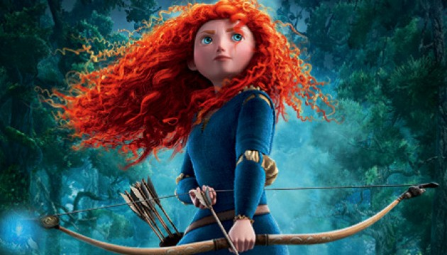
Brave
Brave

Slide 10
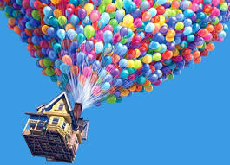
Up
Up

Slide 11
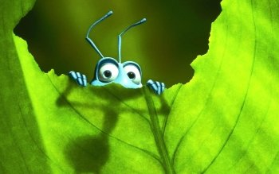
A Bug’s Life
A Bug’s Life

Slide 12
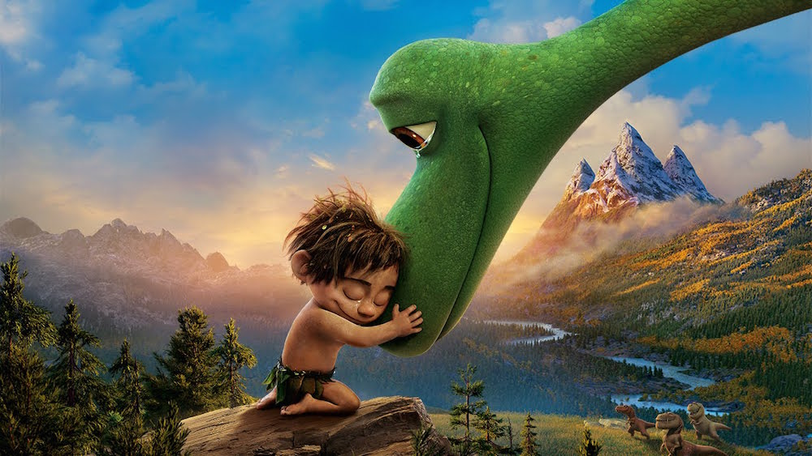
The Good
Dinosaur
The Good
Dinosaur

