Slide 1
Fitbit Analysis
Vivian Wu

Slide 2
Problem
Consumers use Fitbit to track physical activity and sleep
Data is stored and accessible
Users can export their own data on Fitbit’s website
How is the tracked information used, if at all?
Numbers on a spreadsheet are meaningless without interpretation

Slide 3
SOLUTION
Tracy
Fitbit consumer
Group exercise instructor
Home health aide
Provide stats and visualizations of the data
Provides insight on Tracy’s fitness & sleeping habits
Helps gauge what habits should be maintained or changed

Slide 4
The data
Extract up to 31 days of data at a time
Body, activity, sleep, food data
CSV or XLSX file option
Each category of data is saved in a separate sheet (within the same Excel file)

Slide 5
The Data
Each XLSX file ‘2018-10.xls’
“Foods”
Date
Calories In
“Activities”
Dates
Calories Burned
Steps
Distance
Floors
Minutes Sedentary
Minutes Lightly Active
Minutes Fairly Active
Minutes Very Active
Activity Calories
“Sleep”
Start Time
End Time
Minutes Asleep
Minutes Awake
Number of Awakenings
Time in Bed
Minutes REM Sleep
Minutes Light Sleep
Minutes Deep Sleep
“Food Log 20181001”
One for each day

Slide 6
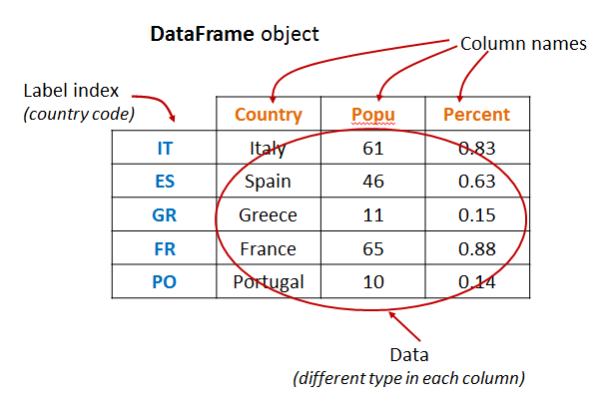
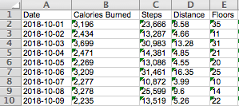
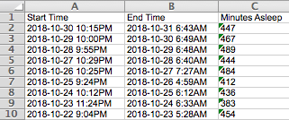
The data
The ideal dataset:
Fitbit’s activity & sleep data:

Slide 7
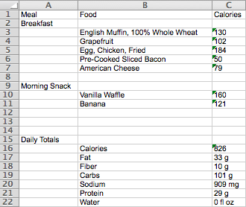
The data (problem)
Fitbit displays food data in a “labeled” table format:
Also includes random table with nutrition info at bottom of file

Slide 8
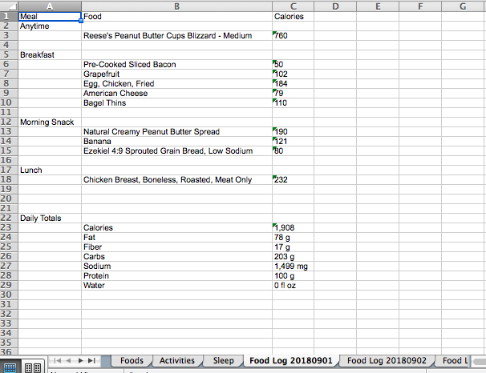
The data (problem)
Food data unusable in the given format
Need to transform
One sheet for each day’s food log
Each XLSX file contains
30+ sheets
Not all sheets contain the
same kind of data
Need to determine how to
to correctly extract data to
the appropriate dataframe

Slide 9
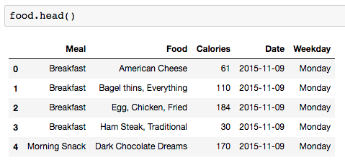
DATA WRANGLING
Food dataframe
Matched food to meal
Added ‘Date’
‘Food Log 20151109’
Added ‘Weekday’

Slide 10
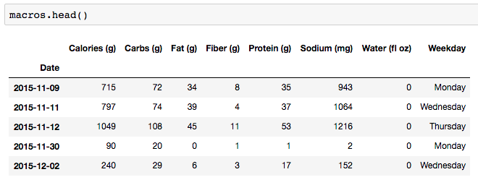
DATA WRANGLING
Macros dataframe
Pivoted original table
Added ‘Date’ as index
‘Food Log 20151109’
Added ‘Weekday’

Slide 11
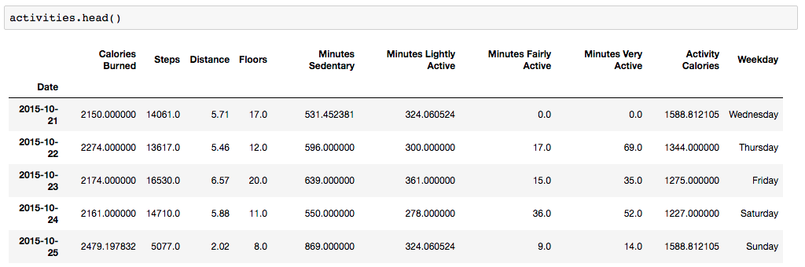
Data wrangling
Replaced outliers with mean value of respective column
Converted string to numeric value
Remove missing values
When ‘Steps’ is 0

Slide 12
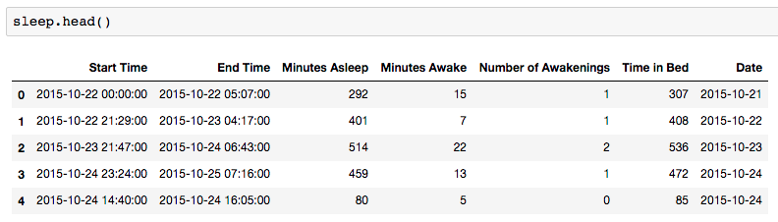
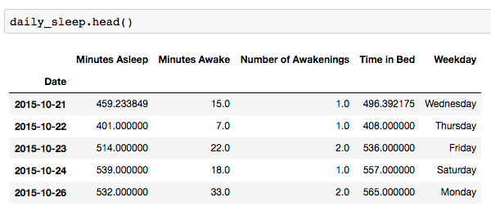
Data wrangling
Sleep dataframe includes nap as well
Derived a ‘Daily Sleep’ dataframe from original ‘Sleep’ dataframe

Slide 13
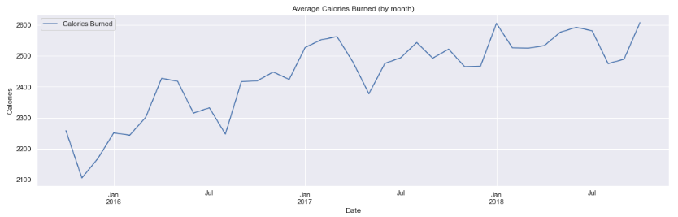
Data storytelling
Overall average calories burned (aggregated by month)
A general upward trend in amount of calories Tracy burns from October 2015 until November 2018
Age is not stopping Tracy from staying active

Slide 14
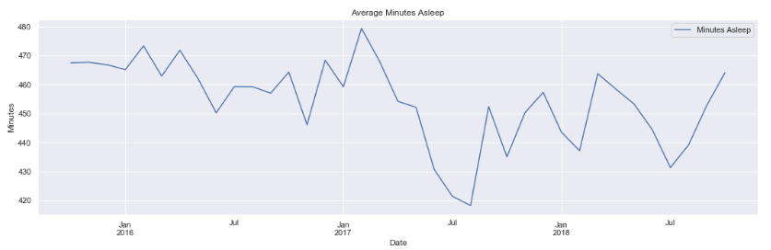
Data storytelling
Overall average amount of sleep Tracy gets
Unsteady trend
Huge drop from May 2017 to August 2017
A general upward trend afterwards – recovery of sleep time

Slide 15
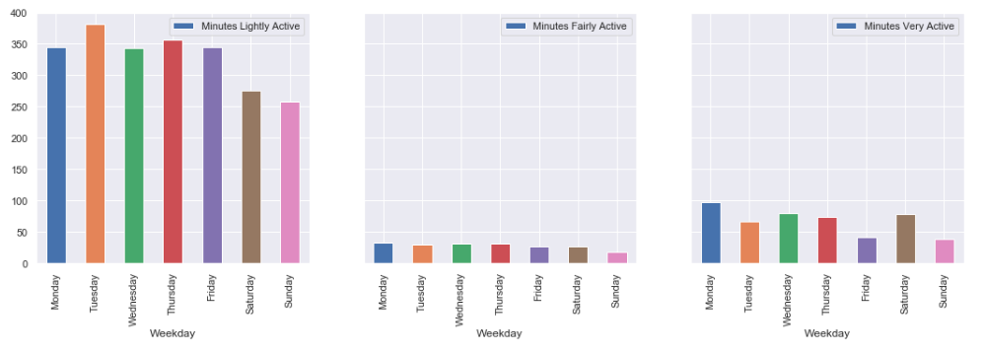
Data storytelling
Comparing average minutes per activity level (by week)
Most physically active during the weekdays, with exception of Saturday

Slide 16
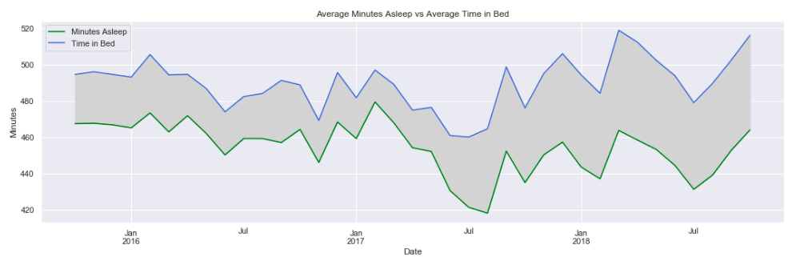
DATA STORYTELLING
Tracy’s restlessness
Space between represents Minutes Awake
Since 2017, having more trouble staying asleep

Slide 17
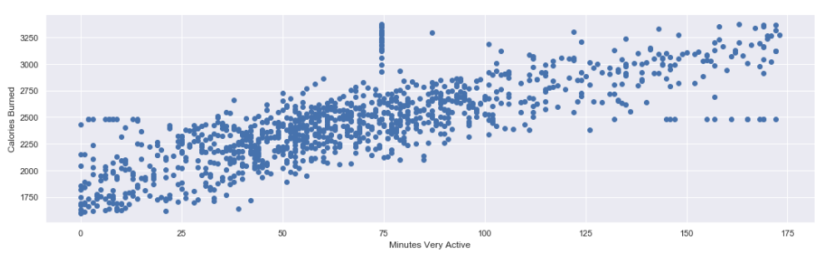
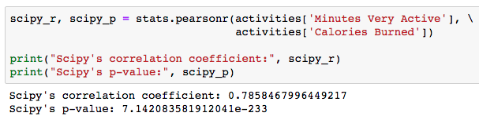
INFERENTIAL STATS
Minutes Very Active vs Calories Burned
Relatively strong, positive correlation
Null hypothesis:
There is no correlation between duration of workout and amount of calories burned

Slide 18
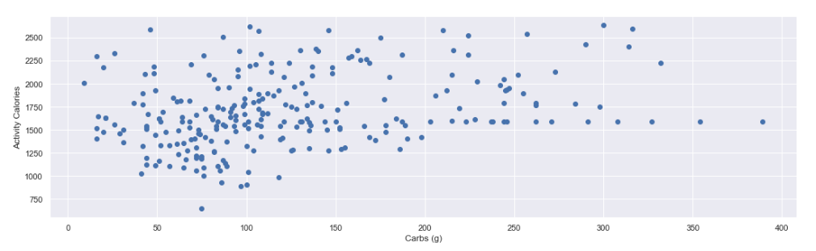
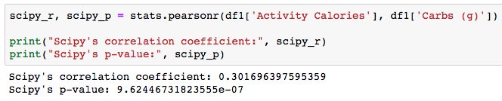
Inferential stats
Does Tracy load up on carbs on her workout intensive days?
Weak, but nonetheless positive correlation
p-value suggests rejection of null hypothesis
Null hypothesis:
There is no correlation between Tracy’s activity level and carb intake

Slide 19
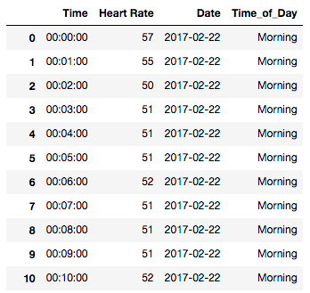
Machine learning
Through an outside source, heart rate data was also retrieved
‘Date’ and ‘Time_of_Day’ were added via data wrangling

Slide 20
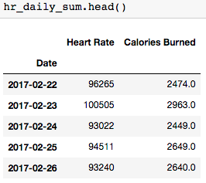
Machine learning
Supervised learning: Predicting calories burned by taking sum of heart rates per day
Chose Linear Regression & Random Forest Regressor models
70% of data used to train model – remaining 30% left to test model’s performance

Slide 21
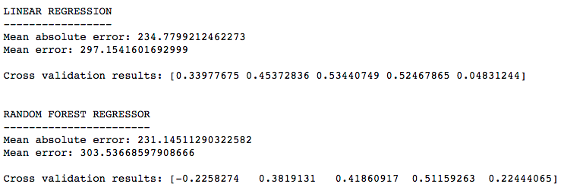
Predicting calories burned by taking sum of heart rates per day
Results:
Linear Regression model yields an average prediction error of 234-297 calories
Random Forest Regressor model yields an average prediction error of 231-303 calories

Slide 22
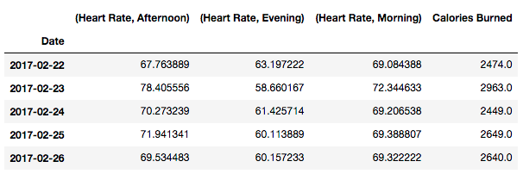
Machine learning
Include time of day (morning, afternoon, evening) and take average heart rate

Slide 23
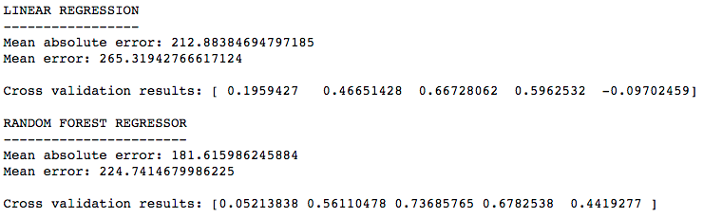
Predicting calories burned by average heart rates by time of day
Can we create a model with better predictive performance?
Both models produce smaller predictive errors, especially the Random Forest Regressor model

Slide 24
Machine learning
Unsupervised Learning
No labeled data
Uncover patterns in data
Chosen method: K-Means Clustering
Group similar data points together an discover underlying patterns

Slide 25
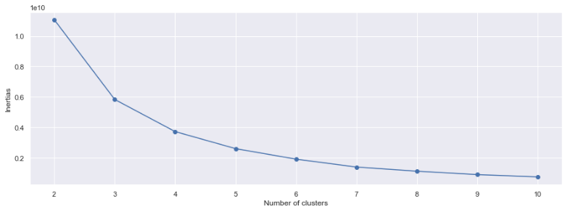
K-means clustering
Choosing K (number of clusters/groups) to optimize clustering results
Select k where an “elbow” forms in the line chart → 3

Slide 26
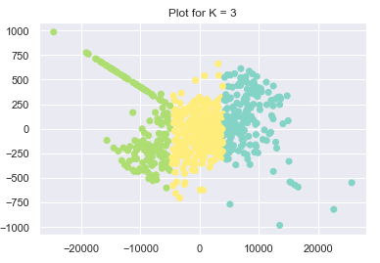
Unsupervised learning
Cluster 2
How are these clusters formed?
By activities? Sleep? Heart rate?
Analyze data to find patterns
Cluster 0
Cluster 1

Slide 27
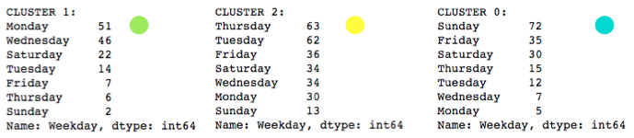
Unsupervised learning
Through investigation, ‘Weekday’ seems to be most deterministic of how clusters are formed
Cluster 0: Sunday’s
Cluster 1: Monday’s and Wednesday’s
Cluster 2: Tuesday’s and Thursday’s
…something comes to mind

Slide 28
The top two days of week of each cluster seem to have something in common

Slide 29
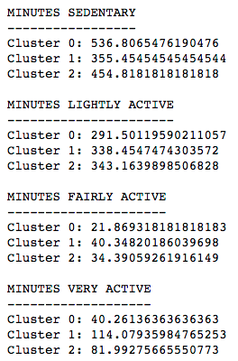
Cluster 0 has highest mean under Minutes Sedentary category
Cluster 1 has highest mean under Minutes Very Active category
Cluster 2 has a slightly higher mean under Minutes Lightly Active category
So it seems the clusters are formed by the days of the week, which in turn says a lot about how active Tracy is on those days

Slide 30
conclusion
Recommendations
With evidence of increasing restless nights, Tracy should seek ways to obtain better, uninterrupted sleep
There is some evidence of a positive correlation between carb intake and activeness. Tracy should consider fueling her body with carbs to have a more productive workout session.
Next steps
Using heart rate data to perform predictions on sleep patterns
Can heart rate be used to predict sleep stage?
Creating more features based on existing data to detect more patterns in activities and/or sleep
Split data by season

