Slide 1
Fitbit Analysis
Vivian Wu

Slide 2
Problem
Consumers use Fitbit to track physical activity and sleep
Data is stored and accessible
Users can export their own data on Fitbit’s website
How is the tracked information used, if at all?
Numbers on a spreadsheet are meaningless without interpretation

Slide 3
SOLUTION
Tracy
Fitbit consumer
Group exercise instructor
Home health aide
Provide stats and visualizations of the data
Provides insight on Tracy’s fitness & sleeping habits
Helps gauge what habits should be maintained or changed

Slide 4
The data
Extract up to 31 days of data at a time
Body, activity, sleep, food data
CSV or XLSX file option
Each category of data is saved in a separate sheet (within the same Excel file)

Slide 5
The Data
Each XLSX file ‘2018-10.xls’
“Foods”
Date
Calories In
“Activities”
Dates
Calories Burned
Steps
Distance
Floors
Minutes Sedentary
Minutes Lightly Active
Minutes Fairly Active
Minutes Very Active
Activity Calories
“Sleep”
Start Time
End Time
Minutes Asleep
Minutes Awake
Number of Awakenings
Time in Bed
Minutes REM Sleep
Minutes Light Sleep
Minutes Deep Sleep
“Food Log 20181001”
One for each day

Slide 6
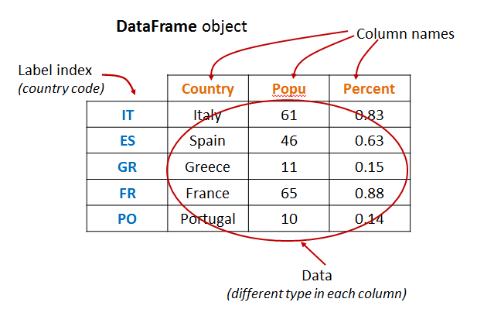
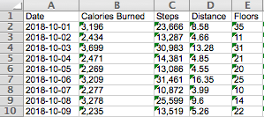
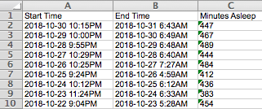
The data
The ideal dataset:
Fitbit’s activity & sleep data:

Slide 7
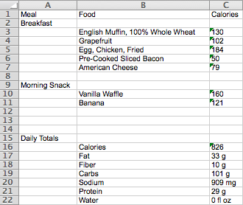
The data (problem)
Fitbit displays food data in a “labeled” table format:
Also includes random table with nutrition info at bottom of file

Slide 8
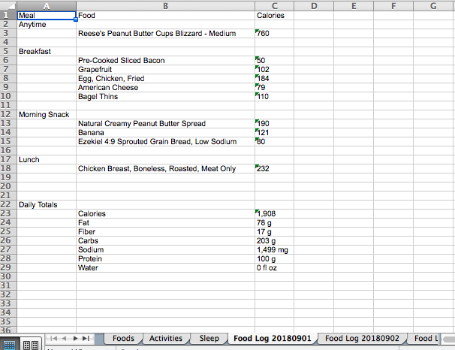
The data (problem)
Food data unusable in the given format
Need to transform
One sheet for each day’s food log
Each XLSX file contains
30+ sheets
Not all sheets contain the
same kind of data
Need to determine how to
to correctly extract data to
the appropriate dataframe

Slide 9
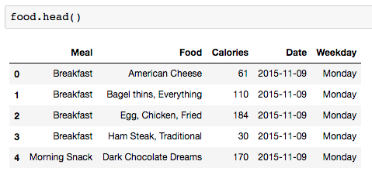
DATA WRANGLING
Food dataframe
Matched food to meal
Added ‘Date’
‘Food Log 20151109’
Added ‘Weekday’

Slide 10
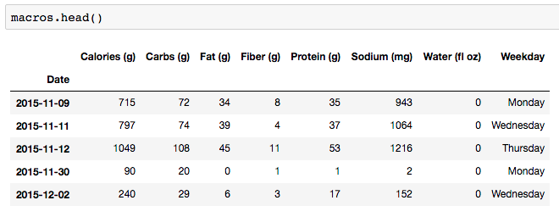
DATA WRANGLING
Macros dataframe
Pivoted original table
Added ‘Date’ as index
‘Food Log 20151109’
Added ‘Weekday’

Slide 11
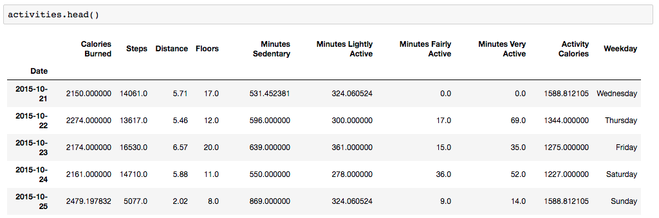
Data wrangling
Replaced outliers with mean value of respective column
Converted string to numeric value
Remove missing values
When ‘Steps’ is 0

Slide 12
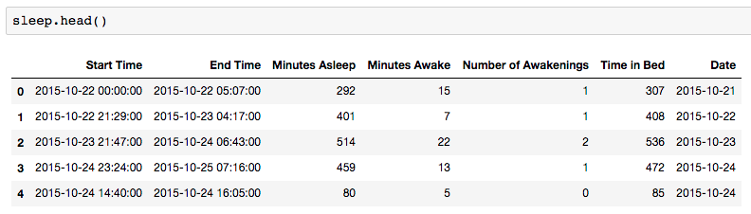
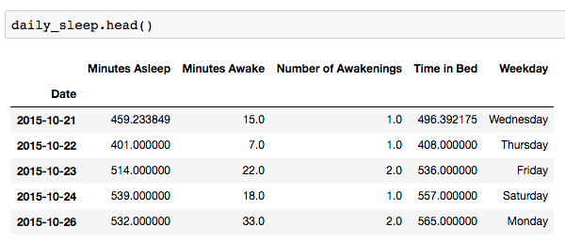
Data wrangling
Sleep dataframe includes nap as well
Derived a ‘Daily Sleep’ dataframe from original ‘Sleep’ dataframe

Slide 13
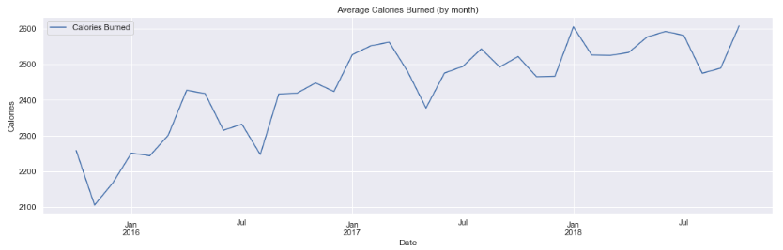
Data storytelling
Overall average calories burned (aggregated by month)
A general upward trend in amount of calories Tracy burns from October 2015 until November 2018
Age is not stopping Tracy from staying active

Slide 14
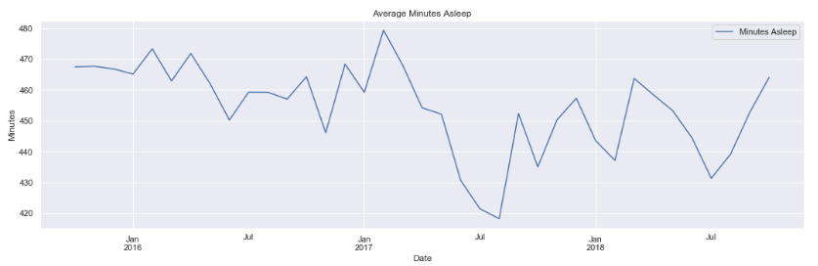
Data storytelling
Overall average amount of sleep Tracy gets
Unsteady trend
Huge drop from May 2017 to August 2017
A general upward trend afterwards – recovery of sleep time

Slide 15
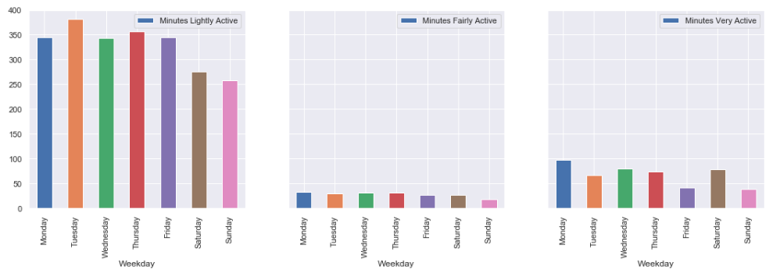
Data storytelling
Comparing average minutes per activity level (by week)
Most physically active during the weekdays, with exception of Saturday

Slide 16
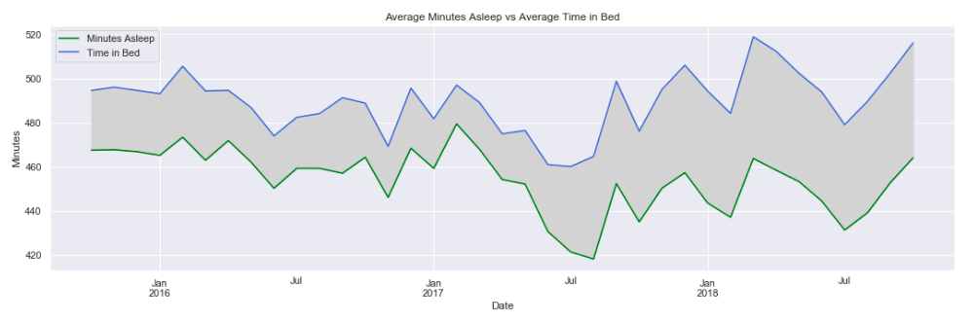
DATA STORYTELLING
Tracy’s restlessness
Space between represents Minutes Awake
Since 2017, having more trouble staying asleep

Slide 17
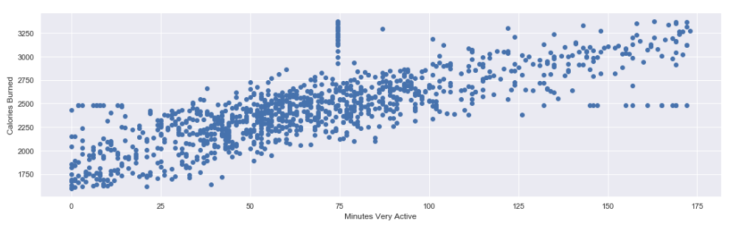
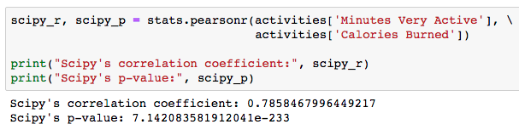
INFERENTIAL STATS
Minutes Very Active vs Calories Burned
Relatively strong, positive correlation
Null hypothesis:
There is no correlation between duration of workout and amount of calories burned

Slide 18
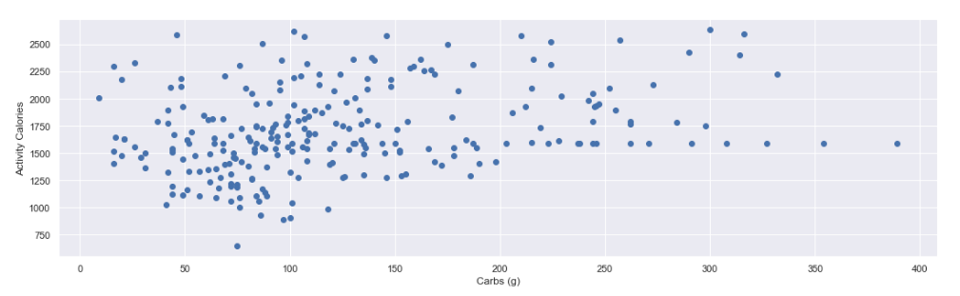
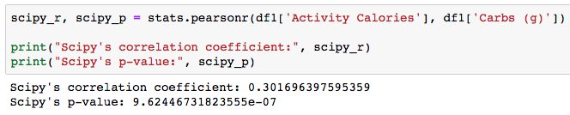
Inferential stats
Does Tracy load up on carbs on her workout intensive days?
Weak, but nonetheless positive correlation
p-value suggests rejection of null hypothesis
Null hypothesis:
There is no correlation between Tracy’s activity level and carb intake

