Slide 1


Click Modular
Router
Bandwidth Limitation
Module
HAS Server:
sliverlight
bw
HAS client
A video clip:
10mins,
299 segments
Microsoft Smooth Streaming
t
Server Log
Client Log

Slide 2
S3
T3
Training Set:
Video sessions
S2
Test Set:
Video sessions
T2
S1
T1
Feature extraction
Feature extraction
S1: x₁=[f₁₁, f₁₂, f₁₃, f₁₄…]: (0 0 0)
S2: x₂=[f₂₁, f₂₂, f₂₃, f₂₄…]: (1 0 1)
S3: x₃=[f₃₁, f₃₂, f₃₃, f₃₄…]: (1 1 1)
T1: x₁ =[f₁₁, f₁₂, f₁₃, f₁₄…]
T2: x₂ =[f₂₁, f₂₂, f₂₃, f₂₄…]
T3: x₃ =[f₃₁, f₃₂, f₃₃, f₃₄…]
Feature evaluation
and selection
x₁ =[f₁₃, f₁₅, …]
x₂ =[f₂₃, f₂₅, …]
x₃ =[f₃₃, f₃₅, …]
x₁ =[f₁₃, f₁₈ ,…]
x₂ =[f₂₃, f₂₈, …]
x₃ =[f₃₃, f₃₈, …]
x₁ =[f₁₄, f₁₇, …]
x₂ =[f₂₄, f₂₇, …]
x₃ =[f₃₄, f₂₇, …]
Task 1
Task 2
Task 3
x₁=[f₁₃, f₁₅, …]: 0
x₂=[f₂₃, f₂₅, …]: 1
x₃=[f₃₃, f₃₅, …]: 1
x₁ =[f₁₃, f₁₈ …]: 0
x₂ =[f₂₃, f₂₈…]: 0
x₃ =[f₃₃, f₃₈…]: 1
x₁ =[f₁₄, f₁₇ …]: 0
x₂ =[f₂₄, f₂₇…]: 1
x₃ =[f₃₄, f₂₇…]: 1
Classify
Classify
Classify
Task 1
Task 2
Task 3
Modeling
Modeling
Modeling
T1: no freeze (0 0 0)
T2: freeze, long freeze (1 1 0)
T3: freeze, multiple freezes (1 0 1)
Classifiers
Off-line training
On-line test

Slide 3
Client Buffer Filling Level
20s
14s
6s New segment
8s
6s
6s New
segment
2s
Play-out time
0s
12s
24s
36s
4s freeze

Slide 4
[SmoothStream-heuristic] received 58916 bytes
[2014/4/3 6:8:32 heuristic] request segment [1/0] at time 0
/QualityLevels( 300000 )/Fragments(video= 0 )
[SmoothStream-heuristic] perceived BW = 666.055 Kbps
[heuristic] new ql = 1 buffer = 2 tot-freezetime = 0.885
/QualityLevels( 300000 )/Fragments(video= 20000000 )
[SmoothStream-heuristic] perceived BW = 416.221 Kbps
[heuristic] new ql = 1 buffer = 2.684 tot-freezetime = 0.885
/QualityLevels( 300000 )/Fragments(video= 40000000 )
[SmoothStream-heuristic] perceived BW = 444.774 Kbps
[heuristic] new ql = 1 buffer = 3.162 tot-freezetime = 0.885
/QualityLevels( 300000 )/Fragments(video= 60000000 )
[SmoothStream-heuristic] perceived BW = 376.266 Kbps
[heuristic] new ql = 1 buffer = 3.437 tot-freezetime = 0.885
/QualityLevels( 300000 )/Fragments(video= 80000000 )
[SmoothStream-heuristic] perceived BW = 359.053 Kbps
…
192.168.3.102 - - [03/Apr/2014:07:08:42 +0200] "GET /Big_Buck_Bunny/Big Buck Bunny.ism?Manifest HTTP/1.1" 200 58916
192.168.3.102 - - [03/Apr/2014:07:08:43 +0200] "GET /Big_Buck_Bunny/Big Buck Bunny.ism?QualityLevels(300000)&Fragments(video=0) HTTP/1.1" 200 73266
192.168.3.102 - - [03/Apr/2014:07:08:45 +0200] "GET /Big_Buck_Bunny/Big Buck Bunny.ism?QualityLevels(300000)&Fragments(video=20000000) HTTP/1.1" 200 67896
192.168.3.102 - - [03/Apr/2014:07:08:46 +0200] "GET /Big_Buck_Bunny/Big Buck Bunny.ism?QualityLevels(300000)&Fragments(video=40000000) HTTP/1.1" 200 83951
192.168.3.102 - - [03/Apr/2014:07:08:48 +0200] "GET /Big_Buck_Bunny/Big Buck Bunny.ism?QualityLevels(300000)&Fragments(video=60000000) HTTP/1.1" 200 80568
…
Server log
Client log

Slide 5
b_{1,1}
<=-3
>-3
1(26543/255)
b_{1,5}
<=-24
>-24
b_{1,2}
b_{1,2}
<=-9
>-9
<=-9
>-9
1(1281/188)
b_{1,2}
1(144/10)
0(56123/484)
<=-21
>-21
1(1163/19)
0(2855/628)

Slide 6
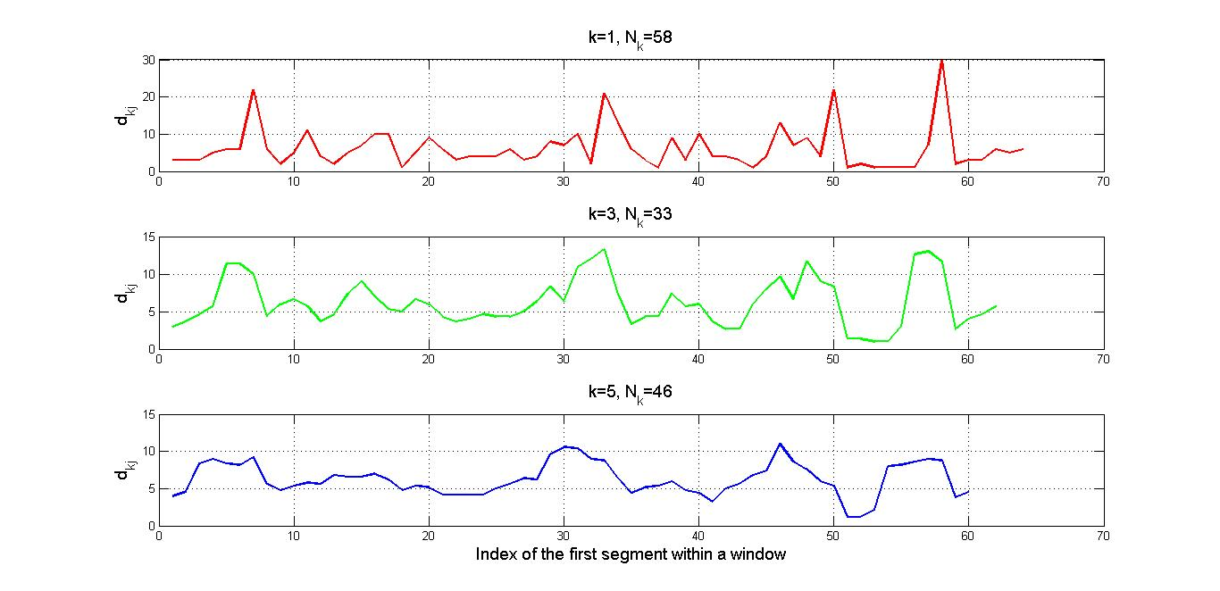
N_{k}=58
N_{k}=33
N_{k}=46

Slide 7
Detection
Classifiers
Prediction
Classifier
Training
Training
Offline
detection
Online
prediction
Session-level freeze detection
Segment-level
freeze prediction
With/without freeze
Feature extraction
QoE metric &
users events
Close to freeze?
Global QoE rating for the complete session
Session tracking
No
CDN
logfile
Yes
end
CDN node
Origin HAS server
Priority controller
HAS client

