Slide 2


Click Modular
Router
Bandwidth Limitation
Module
HAS Server:
sliverlight
bw
HAS client
A video clip:
10mins,
299 segments
Microsoft Smooth Streaming
t
Server Log
Client Log

Slide 3
S3
T3
Training Set:
Video sessions
S2
Test Set:
Video sessions
T2
S1
T1
Feature extraction
Feature extraction
S1: x₁=[f₁₁, f₁₂, f₁₃, f₁₄…]: (0 0 0)
S2: x₂=[f₂₁, f₂₂, f₂₃, f₂₄…]: (1 0 1)
S3: x₃=[f₃₁, f₃₂, f₃₃, f₃₄…]: (1 1 1)
T1: x₁ =[f₁₁, f₁₂, f₁₃, f₁₄…]
T2: x₂ =[f₂₁, f₂₂, f₂₃, f₂₄…]
T3: x₃ =[f₃₁, f₃₂, f₃₃, f₃₄…]
Feature evaluation
and selection
x₁ =[f₁₃, f₁₅, …]
x₂ =[f₂₃, f₂₅, …]
x₃ =[f₃₃, f₃₅, …]
x₁ =[f₁₃, f₁₈ ,…]
x₂ =[f₂₃, f₂₈, …]
x₃ =[f₃₃, f₃₈, …]
x₁ =[f₁₄, f₁₇, …]
x₂ =[f₂₄, f₂₇, …]
x₃ =[f₃₄, f₂₇, …]
Task 1
Task 2
Task 3
x₁=[f₁₃, f₁₅, …]: 0
x₂=[f₂₃, f₂₅, …]: 1
x₃=[f₃₃, f₃₅, …]: 1
x₁ =[f₁₃, f₁₈ …]: 0
x₂ =[f₂₃, f₂₈…]: 0
x₃ =[f₃₃, f₃₈…]: 1
x₁ =[f₁₄, f₁₇ …]: 0
x₂ =[f₂₄, f₂₇…]: 1
x₃ =[f₃₄, f₂₇…]: 1
Classify
Classify
Classify
Task 1
Task 2
Task 3
Modeling
Modeling
Modeling
T1: no freeze (0 0 0)
T2: freeze, long freeze (1 1 0)
T3: freeze, multiple freezes (1 0 1)
Classifiers
Off-line training
On-line test

Slide 4
t₁
I1
t₂
I2
t₃
I3
t₄
I4
t₅

Slide 5
Client Buffer Filling Level
20s
14s
6s New segment
8s
6s
6s New
segment
2s
Play-out time
0s
12s
24s
36s
4s freeze

Slide 6
T=0 second
T=12 second, received s1
20 sec
8 sec
6 sec
Client
buffer
Client
buffer
A. Buffer = 20 sec
B. Buffer =14 sec
T=24 second, received s2
T=36 second, received s3
4 sec
6 sec
2 sec
6 sec
Client
buffer
Client
buffer
C. Buffer = 8 sec
D. Buffer = 6 sec, freeze = 4 sec

Slide 8
[SmoothStream-heuristic] received 58916 bytes
[2014/4/3 6:8:32 heuristic] request segment [1/0] at time 0
/QualityLevels( 300000 )/Fragments(video= 0 )
[SmoothStream-heuristic] perceived BW = 666.055 Kbps
[heuristic] new ql = 1 buffer = 2 tot-freezetime = 0.885
/QualityLevels( 300000 )/Fragments(video= 20000000 )
[SmoothStream-heuristic] perceived BW = 416.221 Kbps
[heuristic] new ql = 1 buffer = 2.684 tot-freezetime = 0.885
/QualityLevels( 300000 )/Fragments(video= 40000000 )
[SmoothStream-heuristic] perceived BW = 444.774 Kbps
[heuristic] new ql = 1 buffer = 3.162 tot-freezetime = 0.885
/QualityLevels( 300000 )/Fragments(video= 60000000 )
[SmoothStream-heuristic] perceived BW = 376.266 Kbps
[heuristic] new ql = 1 buffer = 3.437 tot-freezetime = 0.885
/QualityLevels( 300000 )/Fragments(video= 80000000 )
[SmoothStream-heuristic] perceived BW = 359.053 Kbps
…
192.168.3.102 - - [03/Apr/2014:07:08:42 +0200] "GET /Big_Buck_Bunny/Big Buck Bunny.ism?Manifest HTTP/1.1" 200 58916
192.168.3.102 - - [03/Apr/2014:07:08:43 +0200] "GET /Big_Buck_Bunny/Big Buck Bunny.ism?QualityLevels(300000)&Fragments(video=0) HTTP/1.1" 200 73266
192.168.3.102 - - [03/Apr/2014:07:08:45 +0200] "GET /Big_Buck_Bunny/Big Buck Bunny.ism?QualityLevels(300000)&Fragments(video=20000000) HTTP/1.1" 200 67896
192.168.3.102 - - [03/Apr/2014:07:08:46 +0200] "GET /Big_Buck_Bunny/Big Buck Bunny.ism?QualityLevels(300000)&Fragments(video=40000000) HTTP/1.1" 200 83951
192.168.3.102 - - [03/Apr/2014:07:08:48 +0200] "GET /Big_Buck_Bunny/Big Buck Bunny.ism?QualityLevels(300000)&Fragments(video=60000000) HTTP/1.1" 200 80568
…
Server log
Client log

Slide 9
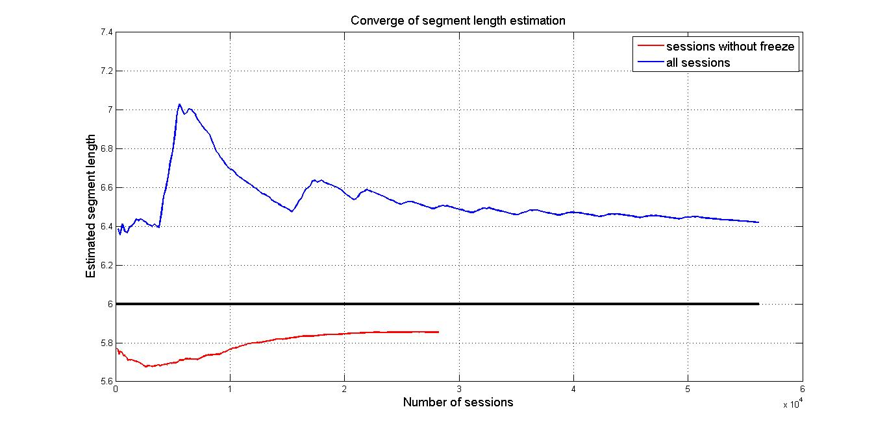

Slide 10
b_{1,1}
<=-3
>-3
1(26543/255)
b_{1,5}
<=-24
>-24
b_{1,2}
b_{1,2}
<=-9
>-9
<=-9
>-9
1(1281/188)
b_{1,2}
1(144/10)
0(56123/484)
<=-21
>-21
1(1163/19)
0(2855/628)

Slide 11
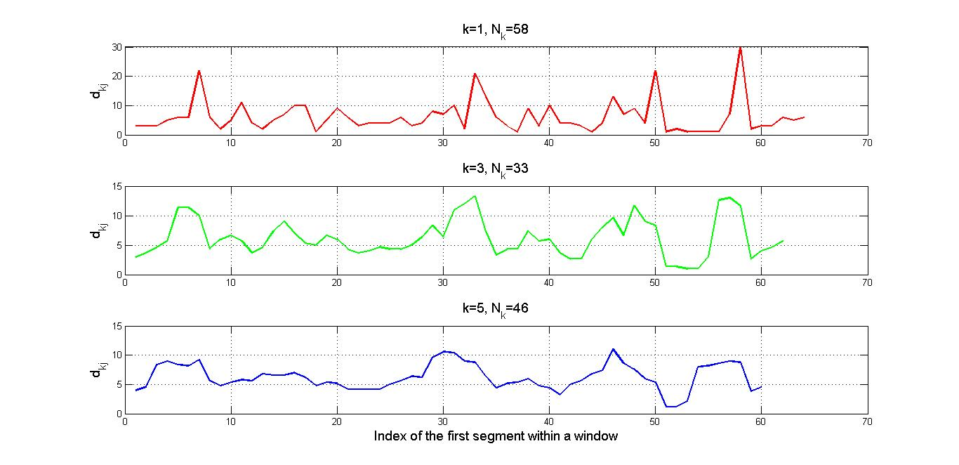
N_{k}=58
N_{k}=33
N_{k}=46

Slide 12
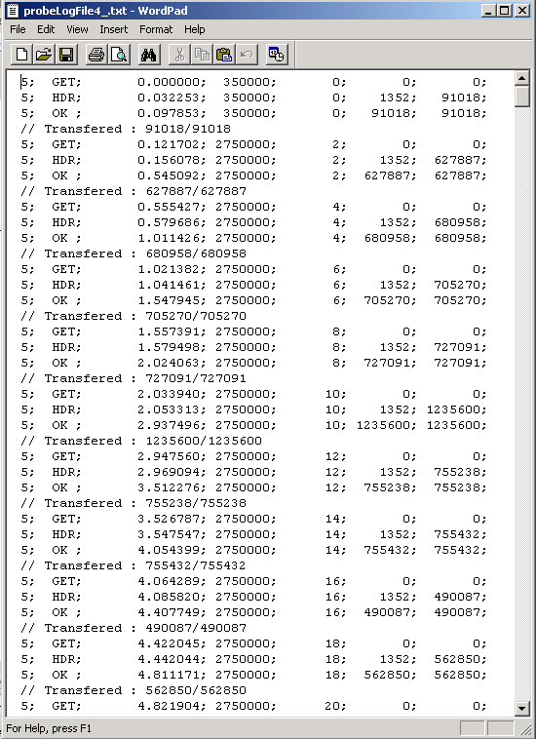

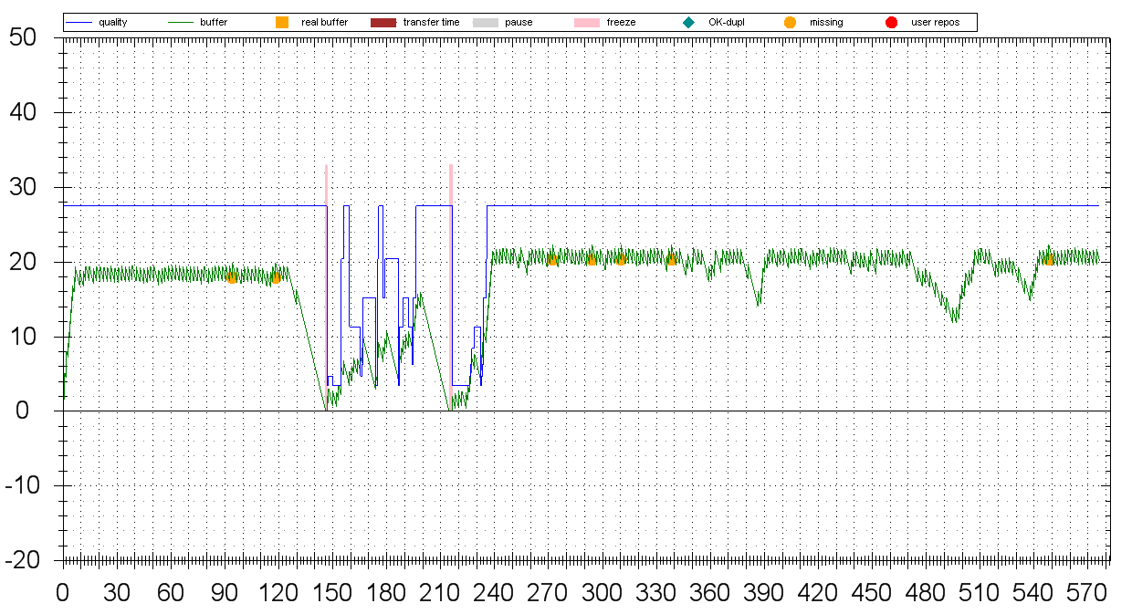
Training
Models
Training Step
HAS scalable video-freeze detection
without freeze
Evaluation Step
with freeze
Session log
parsing
HAS session reconstruction
CDN
logfile
Client requires no modification
QoE parameter estimation
Client
CDN node
Origin server
Global QoE rating for the complete session

