Slide 1
SplitFS: Reducing Software Overhead in File Systems for Persistent Memory
Rohan Kadekodi University of Texas at Austin
SOSP, 2019 吳彬睿, R08942087

Slide 2
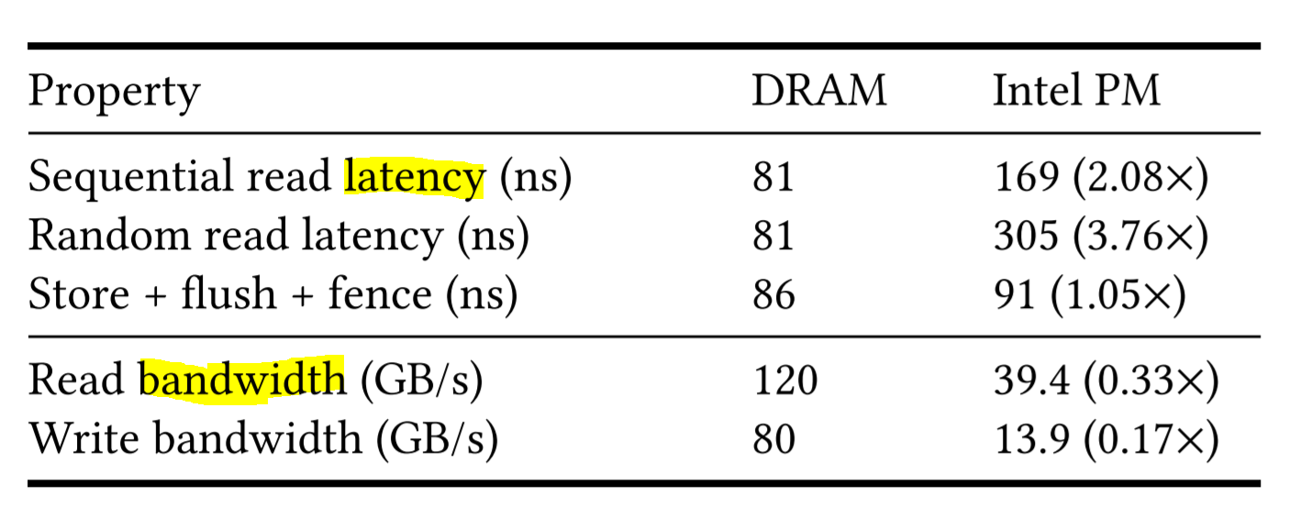
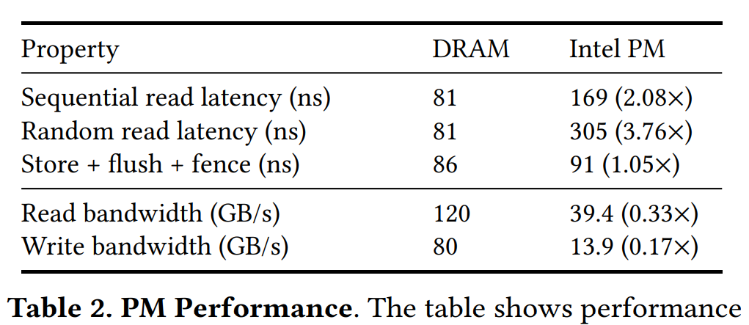
Introduction - Background
First PM product: Intel DC Persistent Memory [April 2019]
PM file system: SCMFS, BPFS, Aerie, PMFS, NOVA, Strata, ext4 DAX
(# publicly available and support Linux 4.x kernels)
Notes:
Intel optane pm

Slide 3
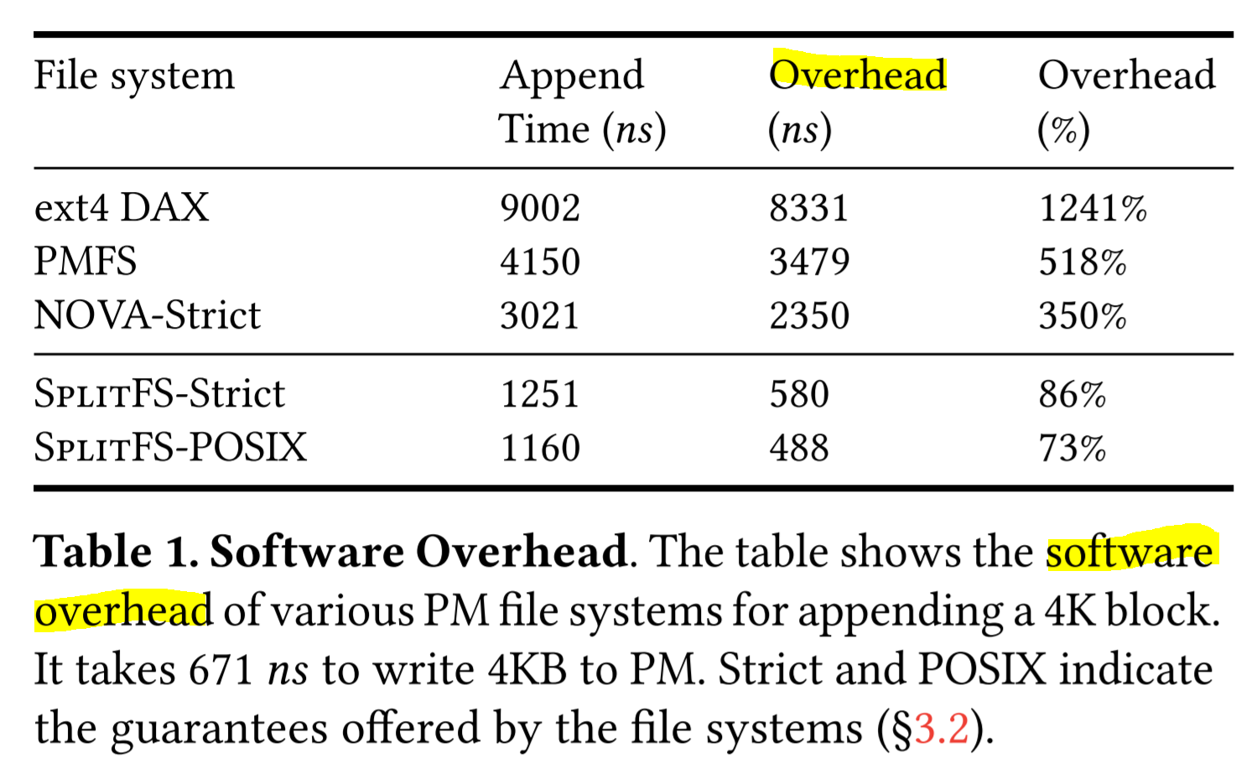
Introduction - Motivation
Goals
Low software overhead
Transparency
Minimal data copying and write IO
Low implementation complexity
Flexible guarantees (crash-consistency)
Notes:
Low software overhead
減少data operatio的overhead
Transparency
application 不用更改，就可以在splitfs裡面做到low latency，可移植性
Minimal data copying and write IO
reduce # of writes
Low implementation complexity
re-use ext4 DAX 的 code
Flexible guarantees
choice of crash-consistency guarantee

Slide 4
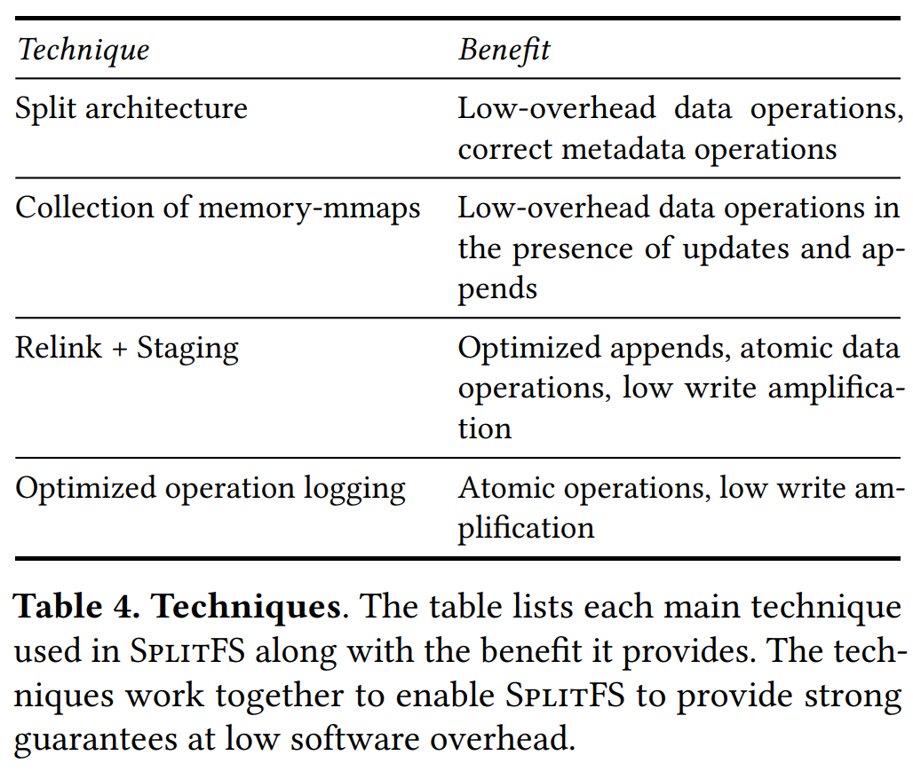
Introduction - Solution
SplitFS based on Linux ext4 DAX
Notes:
* 有一些切user有一些切kernel，減少overhead
* 一個檔案是很多個mmap
* 開好buffer

Slide 5
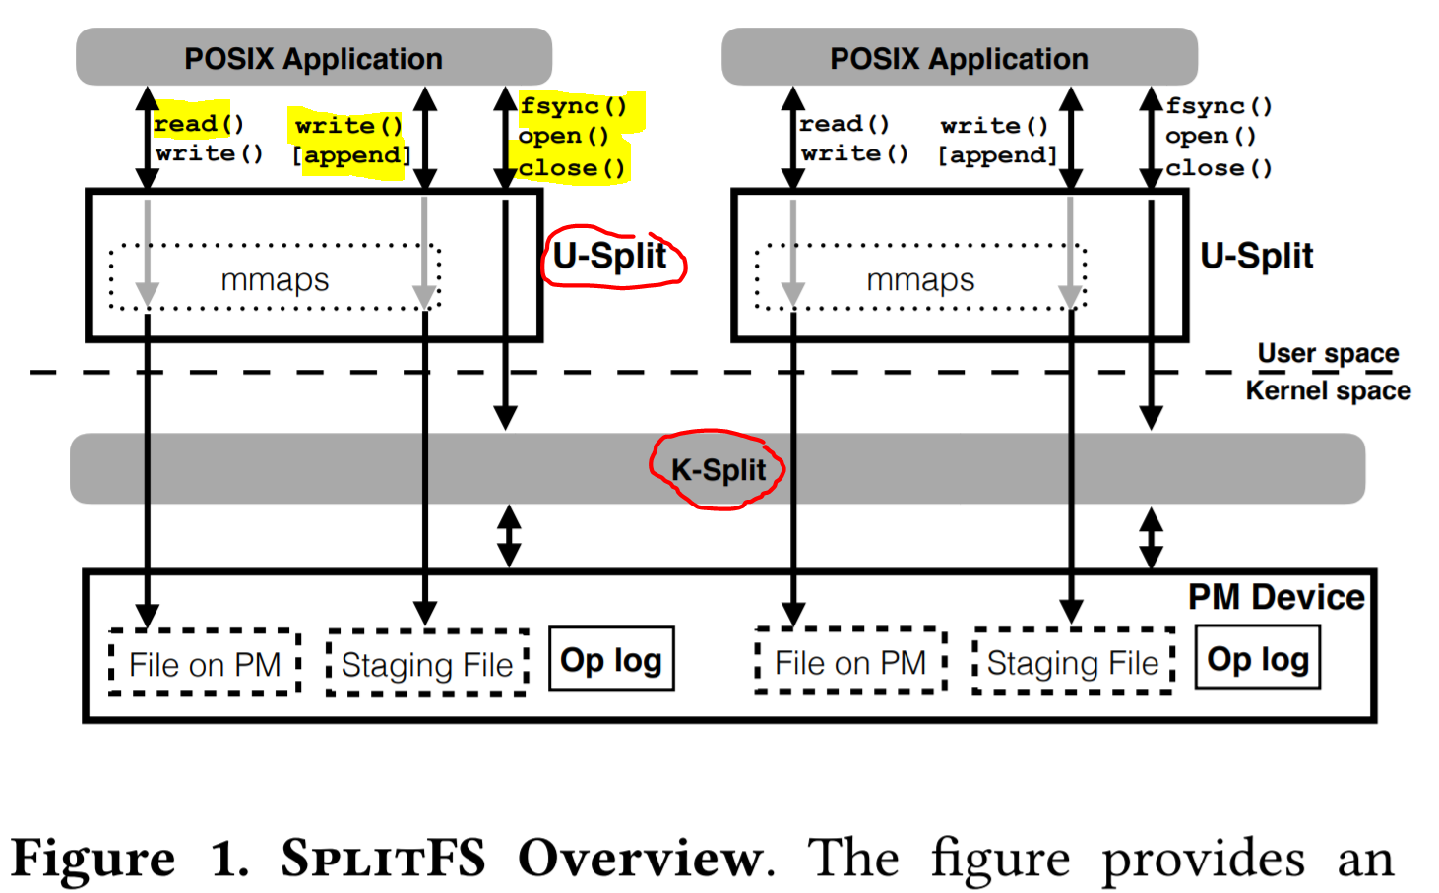
Introduction - Solution

Slide 6
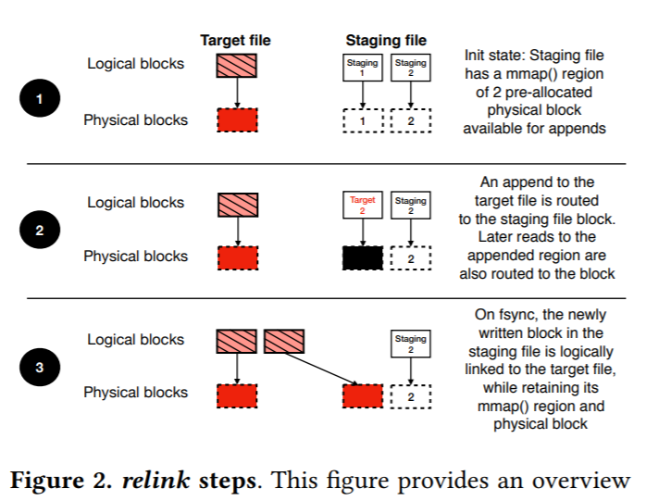
Introduction - Solution

Slide 7
Running Example
Handling Reads, Overwrites, and Appends
Reads, adf
Overwrites,
Appends,
Providing Atomic Operations
synchronous
Atomic operations

Slide 8
Running Example
Security
SplitFS does not expose any new security vulnerabilities as compared to an in-kernel file system.
All metadata operations are passed through to kernel.(Open Close Fsync)
U-Split instance isolated from each processes.
Avoiding work in critical path
SplitFS using a background thread to pre-allocate staging.
W/O staging writes in DRAM
DRAM buffering is less useful in PM systems because PM and DRAM performance similar.

Slide 9
Solution
Rigorously define the problem.
Define the solution formally.
Argue for the correctness or performance of the solution.

Slide 10
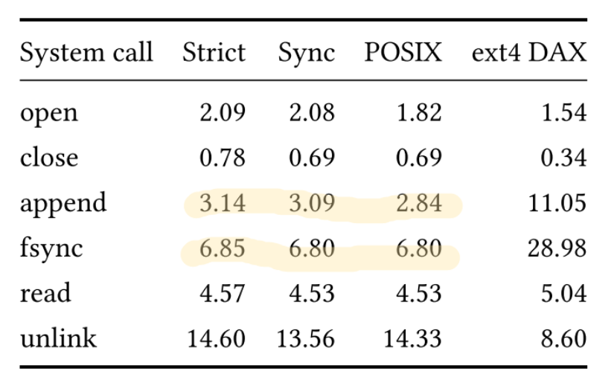
Experiment

Slide 11
Experiment
Platform: Intel Optane DC Persistent Memory Module (PMM).
Workload: key-value store(Redis,LevelDB), embedded
database(SQLite), utilites(tar, git, rsync).

Slide 12
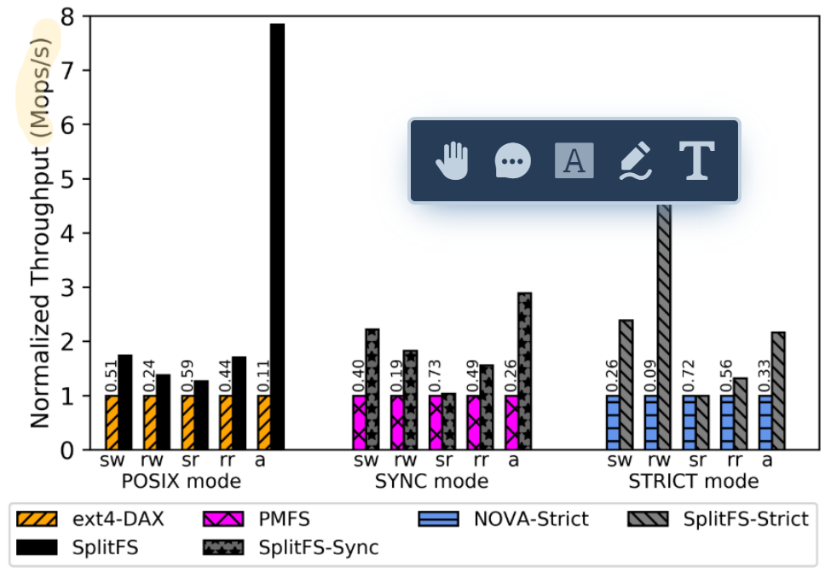
Experiment

Slide 13
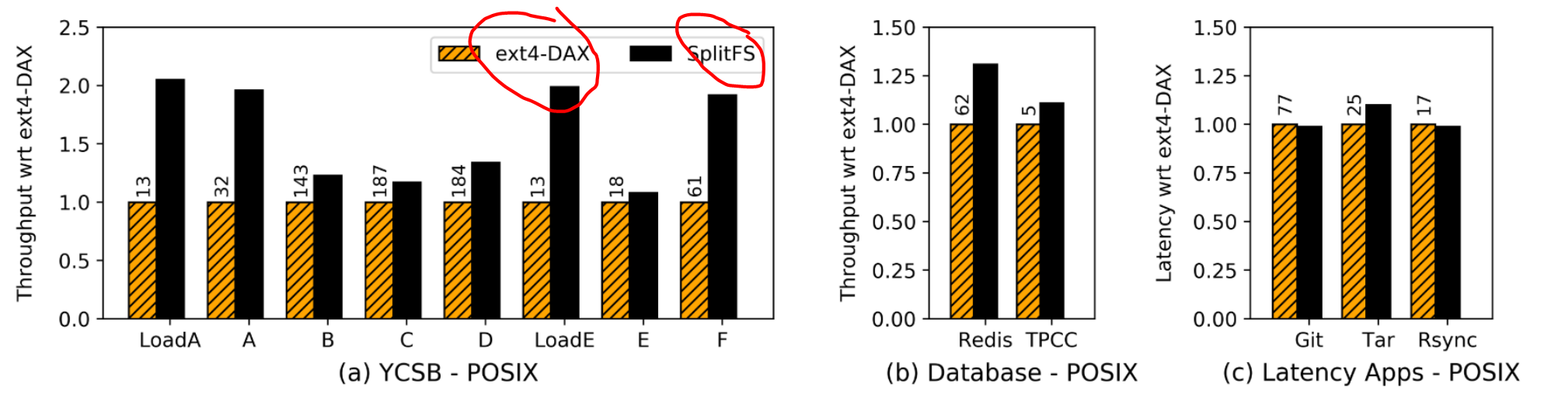
Experiment

Slide 14
Conclusion
SplitFS: a PM file system with split architecture
Handle data operations: User-space
Routes metadata operations: Kernel-space
Outperform state-of-the-art PM file system.

Slide 15
Related work
System Software for Persistent Memory [EUROSYS 2014]
Basic Performance Measurements of the Intel Optane DC Persistent Memory Module [2019]

Slide 16
Solution
Related work
What has people already done ? What is the contribution of the work comparing to related work ?
Motivating example
A small example from practical world to explain the motivation, the challenges, the solution, the correctness of the solution, and the efficiency of the solution.
Solution
Rigorously define the problem. Define the solution formally. Argue for the correctness or performance of the solution.
5. Experiment
The benchmarks, the experiment platform, the experiment data, the analysis (why it solves the problem), threats to validity.
Conclusion

