Slide 1
Lecture 1
Introduction to Computer Operating Systems and Programming
Instructor: Wubin Bai

Slide 2
Course Description
This course will introduce students to the basics of Operating Systems, the use of Linux/Unix operating system and the Bash shell. This course will also expose students to the programming language python. Most of the content taught in this course will be done at the command line on a Linux computer. The command line is harder to use than the graphical user interfaces we are used to. But the command line is more powerful and gives us full access to all the features of the operating system. Students will also be exposed to the basics of the programming language in python.

Slide 3
Course Goal:
Upon completion, students should be able to:
- install and apply basic practical operations on the operating system Linux
- manage the file system on the operating system Linux
- write basic shell scripts on Linux to automate command line
- use the vi/vim text editor
- install common applications in Linux
- make use the powerful command line in Linux to bring production in daily life, such as interacting with pdf, docx and common files
- write basic programming language codes in python

Slide 4
Textbooks and Resources:
Linux Command Line: Beginners Guide to Learn Linux Commands and Shell Scripting by David A. Williams
The Linux Command Line by William E. Shotts, Jr. (https://wiki.lib.sun.ac.za/images/c/ca/TLCL-13.07.pdf)
The Python Tutorial (https://docs.python.org/3/tutorial/index.html)

Slide 5
Grades
Attendance 30% Quizzes 30% Final 40%

Slide 6
Before we begin:
One of the important rules of learning concepts, skills and knowledge in computer science is:
Check the I/O (Input/Output)

Slide 7
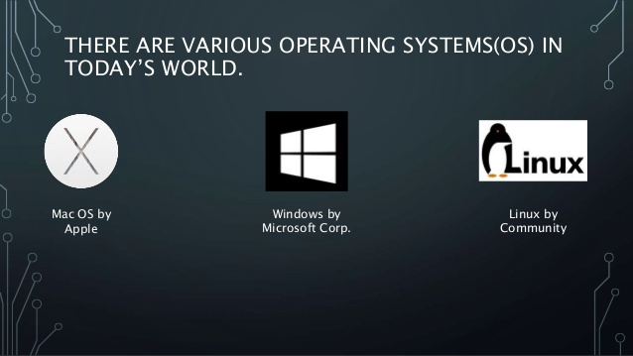
Introduction to Operating Systems

Slide 8
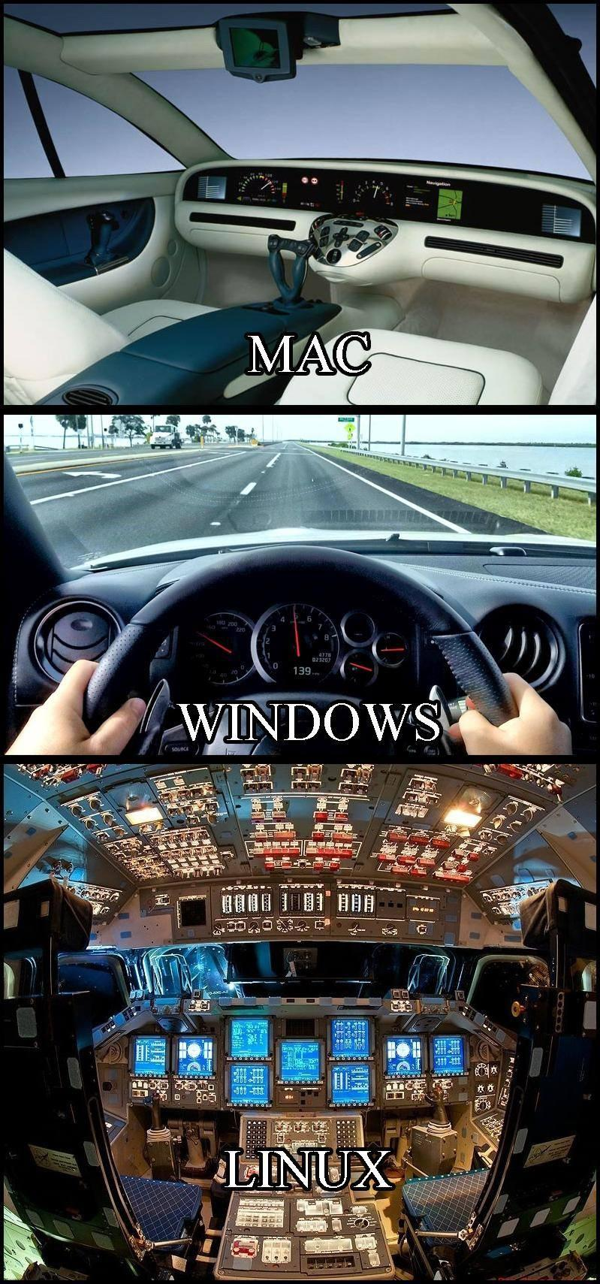

Comparisons

Slide 9
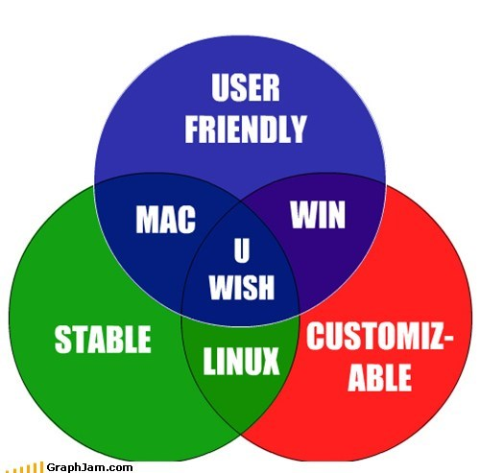

Slide 10
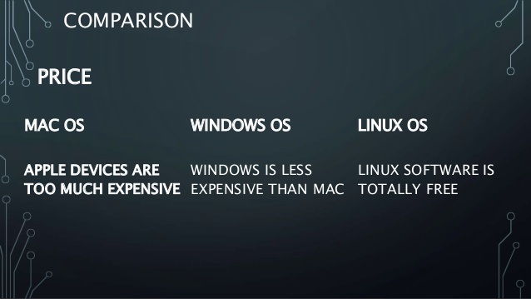

Slide 11
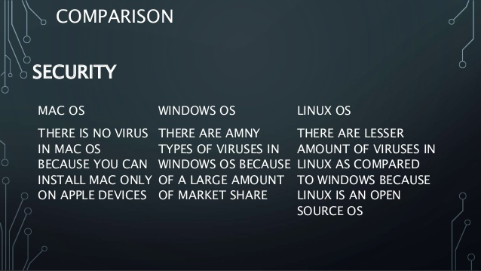

Slide 12
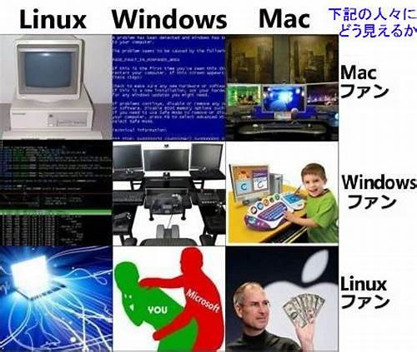

Slide 13
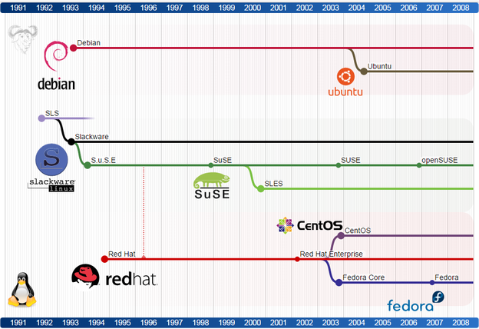
Linux Distributions

Slide 14
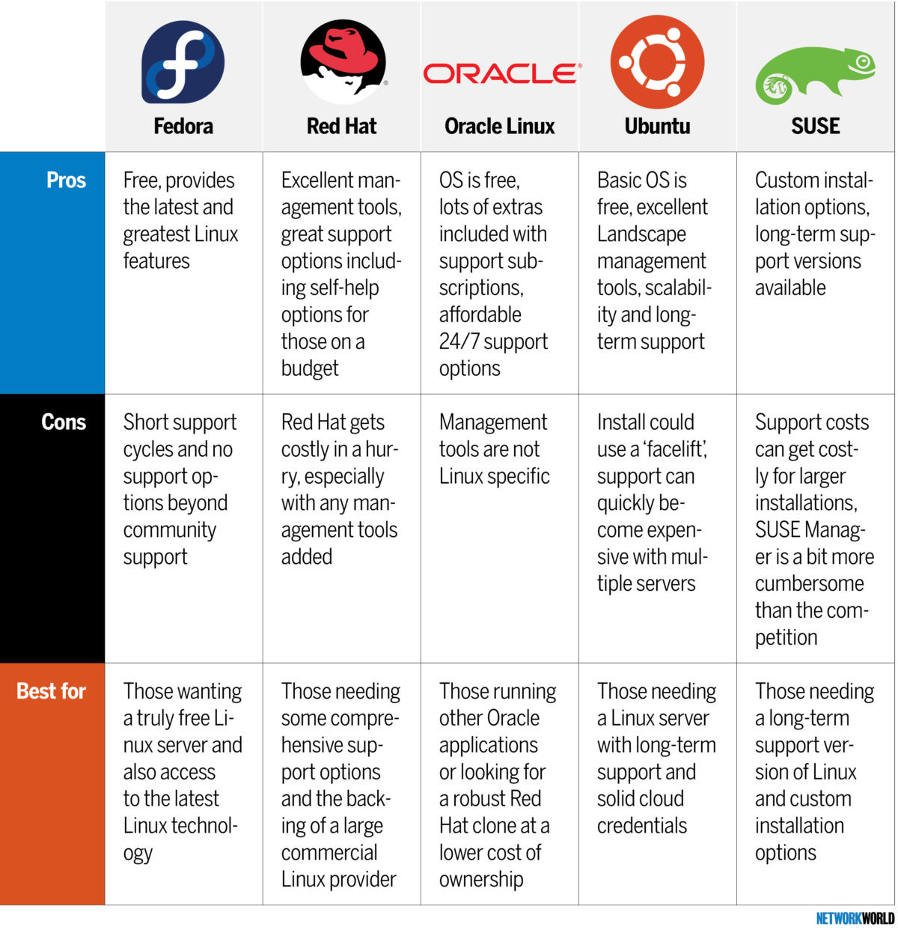

Slide 15
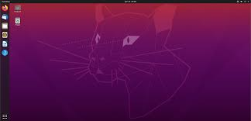
Ubuntu https://ubuntu.com/

Slide 16
Installation/SystemRequirements
2 GHz dual core processor
4 GiB RAM (system memory)
25 GB of hard-drive space (or USB stick, memory card or external drive but see LiveCD for an alternative approach)
VGA capable of 1024x768 screen resolution
Either a CD/DVD drive or a USB port for the installer media
Internet access is helpful
https://help.ubuntu.com/community/Installation/SystemRequirements

Slide 17
You need a computer first...
- taobao.com
- jd.com
- apple.com
- shop
Specification:
CPU, GPU, SSD, Motherboard, Power supply, Fan, Monitor, etc.

Slide 18
1.1. What is Ubuntu?
Ubuntu is a complete Linux operating system, freely available with both community and professional support. The Ubuntu community is built on the ideas enshrined in the Ubuntu Manifesto: that software should be available free of charge, that software tools should be usable by people in their local language and despite any disabilities, and that people should have the freedom to customize and alter their software in whatever way they see fit.
https://help.ubuntu.com/lts/installation-guide/s390x/ch01s01.html

Slide 19
1.1. What is Ubuntu?
Ubuntu will always be free of charge, and there is no extra fee for the “enterprise edition”, we make our very best work available to everyone on the same Free terms.
Ubuntu includes the very best in translations and accessibility infrastructure that the Free Software community has to offer, to make Ubuntu usable by as many people as possible.

Slide 20
1.1. What is Ubuntu?
Ubuntu is shipped in stable and regular release cycles; a new release will be shipped every six months. Every two even years an Ubuntu long term support (LTS) release will become available, that is supported for 5 years. The Ubuntu releases in between (known as development or non-LTS releases) are supported for 9 month each.
Ubuntu is entirely committed to the principles of open source software development; we encourage people to use open source software, improve it and pass it on.

Slide 21
1.1. What is Ubuntu?
Ubuntu is suitable for both desktop and server use. The current Ubuntu release supports Intel x86 (IBM-compatible PC), AMD64 (x86-64), ARMv7, ARMv8 (ARM64), IBM POWER8/POWER9 (ppc64el), IBM Z zEC12/zEC13/z14 and IBM LinuxONE Rockhopper I+II/Emporer I+II (s390x)
Ubuntu includes thousands of pieces of software, starting with the Linux kernel version 5.4 and GNOME 3.28, and covering every standard desktop application from word processing and spreadsheet applications to internet access applications, web server software, email software, programming languages and tools and of course several games.

Slide 22
Activities:
- Explore ubuntu official website https://ubuntu.com/
- Explore ubuntu download: https://ubuntu.com/#download
- Basic Installation Steps:
1. Download
2. Burn a USB/DVD
3. Install

Slide 23
Post Installation
Explore Ubuntu Help
GNOME: GNu Object Model Environment
GNU: GNU's Not Unix, GNU ( pronounced g'noo) is a free software project to provide a distributable replacement for Unix.

Slide 24
Some Pracitacal Pros about Lniux
Fast Boot
Donwload videos: e.g. you-get
Combine pdf: pdfunite
Convert filetype: convert
Internet Speed: Speedtest
Disk Drive Speed: hdparm
Etc.

Slide 25
Textbooks
The Linux Command Line: https://wiki.lib.sun.ac.za/images/c/ca/TLCL-13.07.pdf
Part 1 Shell
Part 2 Config and Environment
Part 3 Common tasks
Part 4 Scripts

Slide 26
Textbooks
Linux Audio Book

Slide 27
Python Documentation
Www.python.org

Slide 28
What if..
You want to play around linux in Windows 7: install virtualbox
You want to play around linux with Cloud:

Slide 29
More resources...
Www.bing.com
“Linux Cheatsheet”

Slide 30
Getting started with keyboard keys:
Get familiar with all keys in the keyboard

Slide 31
Basics of Commands
All commands are case-sensitive.
To shutdown computer: shutdown
Ctrl + Alt + t to open a new terminal in a new window
Ctrl + Shift + t to open a new terminal in a new tab
Alt + Numbers to switch between terminals(different tab)

Slide 32
More shortcuts
Ctrl + c "interrupt" or "exit"
Ctrl + d “logs out of the interface” or “end of file”

