Slide 1
Lecture 4
More basic commands:
To exit terminal: exit
To get help: man

Slide 2
Summary of ls
What does the command “ls -t -h -l Music” mean?
It means: List directory content of Music, with option long, human-readable and sort by time, newest first.

Slide 3
Summary of cd
To go back to the last(upper) directory: cd ..
To go back to the last directory of the last directory: cd ../../
To go back to the previous directory: cd -
To go to the default directory: cd

Slide 4
Following:
Root Directory
Miscellaneous commands: date, cal, df, free
Organize files and directories: cp, mv, mkdir, rm.

Slide 5
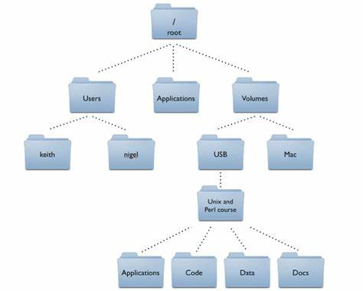
Root Directory
Root directory: /
Default directory: ~

Slide 6
date
print or set the system date and time

Slide 7
cal
displays a calendar and the date of Easter
Display 202008: cal 8 2020
Display both 202008 and 202009: cal 8 2020 & cal 9 2020

Slide 8
df
df - report file system disk space usage
Usage: df -h

Slide 9
free
Display amount of free and used memory in the system
Usage: free -h

Slide 10
du
estimate file space usage
Usage: du -h

