Slide 1
Implementation of Decentralized Coded Caching in Erroneous Networks using KODO
Wu, Binyi
Wu, Beibei
Gong, Kaixuan

Slide 2
Content
Motivation
Decentralized Coded Caching
Multicast Data
KODO and RLNC
Implementation
Simulation

Slide 3
Content
Motivation
Decentralized Coded Caching
Multicast Data
KODO and RLNC
Implementation
Simulation

Slide 4
Problem
Traffic in networks exhibits strong temporal variability:
1. congestion during peak hours
2. resource underutilization during off-peak hours.

Slide 5
How to solve?
“shift” some of the traffic from peak to off-peak hours
Solution:
Caching

Slide 6
Centralized Caching
Central coordination in placement phase
Why use decentralized ?
More realistic – Number of clients and their identity is usually unknown.

Slide 7
Content
Motivation
Decentralized Coded Caching
Multicast Data
KODO and RLNC
Implementation
Simulation

Slide 8







XOR operation
A
$$⨂$$
B
A
$$=$$
B
$$⨂$$
encoding
A
$$⨂$$
B
decoding
A
$$⨂$$
B
B
A
$$⨂$$
$$=$$

Slide 9
Basic model
A
Server
N files
File size: F
B
Share link
Client 1
Client 2
Cache size: M

Slide 10
Placement phase

Slide 11
Placement phase
0
1
2
12
2 files
File size: F
0
1
2
12
Server
Share link
Client 1
Client 2
1
12
2
12
1
12
2
12
Cache size: 1

Slide 12
Request

Slide 13
0
1
2
12
2 files
File size: F
Server
0
1
2
12
Share link
Client 1
Client 2
1
12
2
12
1
12
2
12
A
B

Slide 14
Delivery phase

Slide 15

0
1
2
12
2 files
File size: F
Server
0
1
2
12
Send data useful for both clients
2
$$⨂$$
1
Share link
Client 1
Client 2
1
12
2
12
1
12
2
12
A
B

Slide 16
0
1
2
12
2 files
File size: F
Server
0
1
2
12
Decode
Share link
Client 1
Client 2
1
12
2
2
12
1
12
2
12
1
A
B

Slide 17
0
1
2
12
2 files
File size: F
Server
0
1
2
12
Decode
Share link
Client 1
Client 2
1
12
2
2
12
12
1
12
2
12
1
A
B

Slide 18
0
1
2
12
2 files
File size: F
Server
0
1
2
12
Send the remaining data
Share link
0
0
Client 1
Client 2
1
12
2
2
12
12
1
12
2
12
1
A
B

Slide 19
0
1
2
12
2 files
File size: F
Server
0
1
2
12
Send the remaining data
Share link
Client 1
Client 2
1
12
2
0
2
12
12
1
12
2
12
1
0
A
B

Slide 20
Transmission finish

Slide 21
Content
Motivation
Decentralized Coded Caching
Multicast Data
KODO and RLNC
Implementation
Results

Slide 22
Delivery with multicast
XORed data (Delivery phase I)
original data (Delivery phase II)
------- No XOR

Slide 23
How to creat xored data: Step 1
Search the all the clients which ask for the same files (important)
If every two clients of them has different parts of the requested file, then exchange these parts of file between themselves.

Slide 24
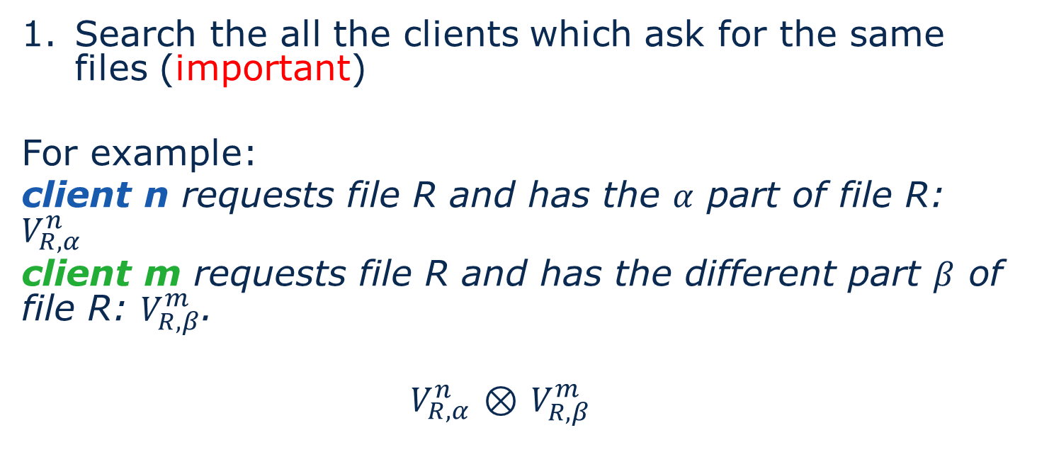
How to create XORed data: Step 1
Search the all the clients which ask for the same files (important)
For example:
client n requests file R and has the $α$ part of file R: $V_{R,α}^{n}$
client m requests file R and has the different part $β$ of file R: $V_{R,β}^{m}$.
$V_{R,α}^{n}$ $⊗$ $V_{R,β}^{m}$

Slide 25
How to creat xored data: Step 2
2. Search the all the clients which ask for the different files
If every two clients have files which is needed by each other, then exchange these files between themselves

Slide 26
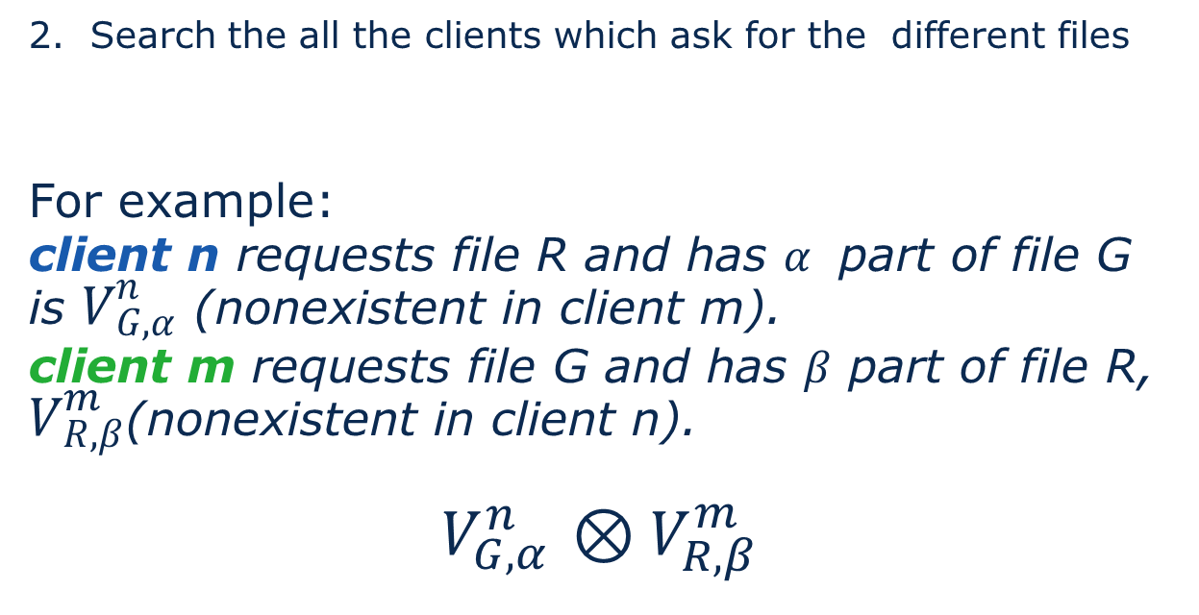
How to creat xored data: Step 2
2. Search the all the clients which ask for the different files
For example:
client n requests file R and has $α$ part of file G is $V_{G,α}^{n}$ (nonexistent in client m).
client m requests file G and has $β$ part of file R, $V_{R,β}^{m}$(nonexistent in client n).
$V_{G,α}^{n}$ $⊗V_{R,β}^{m}$

Slide 27
Content
Motivation
Decentralized Coded Caching
Multicast Data
KODO and RLNC
Implementation
Results

Slide 28
Why use KODO?
Multicast bases on UDP
UDP is not reliable

Slide 29
KODO
Kodo implements a number of different erasure correcting codes.
In our project, The Full RLNC (Random Linear Network Coding) is used.

Slide 30
KODO: key parameters
The number of symbol: symbols
The symbol size: symbolsize
Notes:
when configuring an erasure correcting code

Slide 31
KODO: symbols
symbols denotes the number of symbols in a block.
Increasing this number will have the following effects:
computational complexity will increase
decoding delay will become larger
……

Slide 32
KODO: symbolsize
symbolsize denotes the size of each symbol in bytes.
MTU (Maximum Transfer Unit)
around 1300-1400 bytes

Slide 33
KODO
Blocksize = symbols * symbolsize
Block 1
Block 2
……..
Block N
File
symbol 1
symbol 2
……..
symbol M
M = symbols

Slide 34
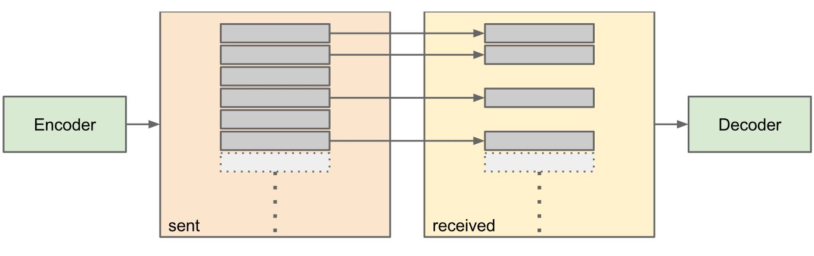
KODO: graphical representation
http://docs.steinwurf.com

Slide 35
Content
Motivation
Decentralized Coded Caching
Multicast Data
KODO and RLNC
Implementation
Simulation
Results

Slide 36
Program flow chart Server
begin
initial
Wait connection
from client
Placement
Phase
Cache data in client
Placement finish
Request from clients
Delivery Phase
Creat multicast data
Transmit xored data with kodo
Transmit original data with kodo
end

Slide 37
Program flow chart – Client
begin
Connect server
Placement
Phase
Receive cached data from server
Request file from server
Need?
No
Wait until next file
Delivery Phase
Yes
decode?
Still receive data
No
Yes
ACK to server
Placement finish
end

Slide 38
Program flow chart
begin
begin
initial
server
Placement
TCP
Placement
client
delivery,
UDP
delivery,
end
end

Slide 39
Content
Motivation
Decentralized Coded Caching
Multicast Data
KODO and RLNC
Implementation
Simulation

Slide 40
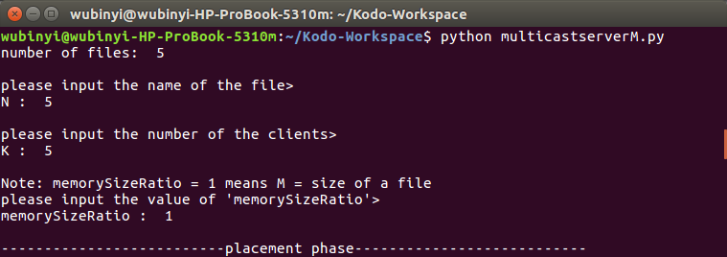
Results

Slide 41
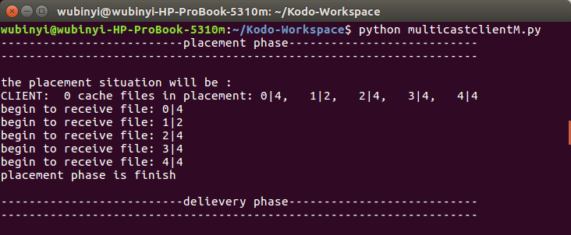
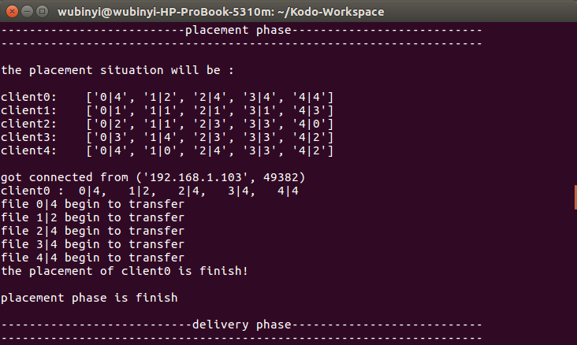
Results
Client
Server
Cached files

Slide 42
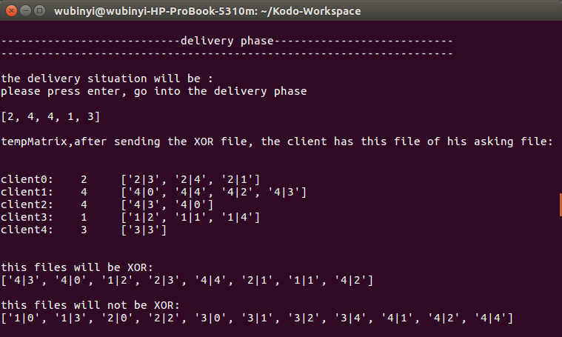
Results
Server
Request files
Multicast data

Slide 43
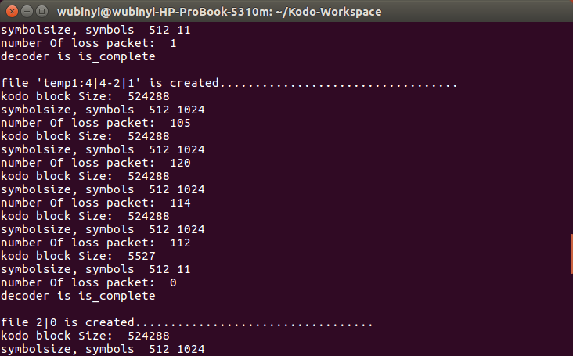
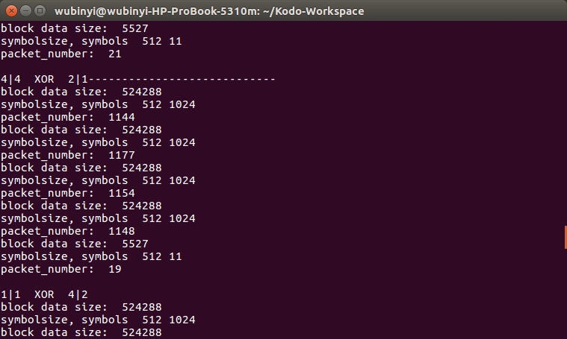
Results
Client
Server
v
1136
1148

Slide 44
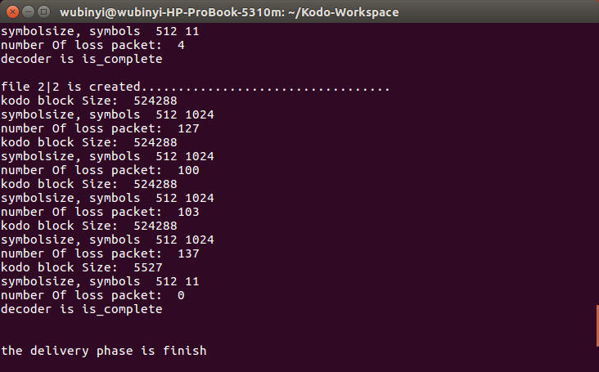
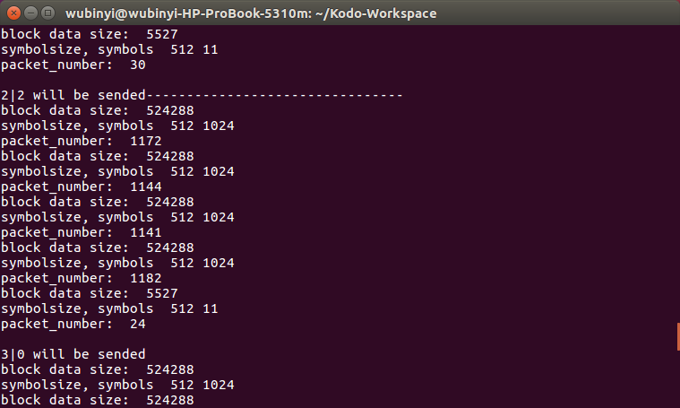
Results
Client
Server
v
1161
1182

Slide 45
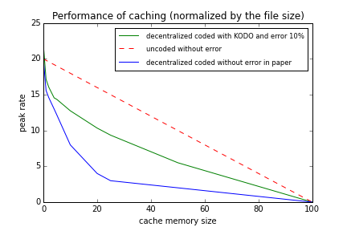
Results
100 files in server
20 clients

Slide 46
Conclusion
Decentralized caching was proposed in the paper but without errors
We used KODO with errors and received the complete video files at the clients.

Slide 47
What have we done?
Wu, Binyi : the main programmer
Wu, Beibei : responsible for paper work and document
Guo, Kaixuan : understanding KODO in cooperation with Wu, Binyi and in charge of the Poster

Slide 48
References
Mohammad Ali Maddah-Ali and Urs Niesen, “Fundamental Limits of Caching”
Mohammad Ali Maddah-Ali and Urs Niesen, “Decentralized Coded Caching Attains Order-Optimal Memory-Rate Tradeoff”
Kodo document in steinwurf, http://docs.steinwurf.com/overview.html
Raymond W. Yeung, Shuo-Yen Robert Li, Ning Cai and Zhen Zhang, “ Network Coding Theory ”, 2006
Linear network coding, https://en.wikipedia.org/wiki/Linear_network_coding

Slide 49
Thank you for your attention!

