Slide 1
SpiNNaker2 MAC Array (16x2)
Performance Report

Slide 2
Note: this performance report is based on VGG-19 model with the best mapping strategy.
Mapping strategy:
Convolution layer: operator fusion + data reuse
Fully-connected layer: operator fusion
Operator fusion will decrease the size of output activation
Data reuse will reduce bandwidth problem of dram
(Next slide has details information for the mapping strategy)
Splitting scheme difference between MAC array (16*4) and MAC array (16*2)
No different
Simulator difference between MAC array (16*4) and MAC array (16*2)
MAC array size is different 16*4 → 16 *2;
The prefetching of filter for CONV is different.
For 16*4_MAC_array, each 4 clocks send a fetching request.
For 16*2_MAC_array, each 8 clocks send a fetching request.

Slide 3
Mapping strategy Convolution layer: operator fusion + data reuse
Operator Fusion
Data reuse
Begin
Input-activation into SRAM
Load weight into SpiNNaker2
(DRAM->SRAM)
Decrease size of input activation
padding
Weight clocks
convolution
activation
Load input-acti into SpiNNaker2
(DRAM/SRAM->SRAM)
inActi clocks
Decrease size of output activation
pooling
Decrease size of output activation
quantization
Accelerate with data reuse in QPE and write output activation to storage QPE
computation clocks
output-activation to SRAM
finish
yes
Note that padding, activation, pooling and quantization is not simulated. It is assume to be done immediately (0 clock).
End
no
Weight Migration
migration clocks

Slide 4
Mapping strategy Fully-connected layer: operator fusion
For fully-connected layer, operator fusion and data reuse cannot coexist. As for the convolution, its result (the output activation of CONV will be the input activation of FC) will be stored in QPE. Therefore, data reuse in FC has no meaning, because only input-activation could be reused and due to NoC bandwidth is larger than DRAM bandwidth, reuse input-activation will not increase the system performance. The whole system performance of FC wil be limited by DRAM bandwidth.
Due to the DRAM bandwidth, most the Pes in SpiNNaker2 will be idle. Theoretically, 8 PEs can fully utilize 4 DRAM.
However, because FC is splitted, some computation (element-wise addition) muss be done ARM core. In order to eliminate this part, some idle PEs (not the PE used for FC) will be used to accelerate the element-wise addition. Moreover, these PEs will also be used to accelerate non-linearity and quantization.
Input-activation and weight into SRAM
Matrix Multiplication
element-wise addition
neighbor PE
activation
quantization
output-activation to SRAM

Slide 5
Result for VGG-19
MAC array Row = 4， Column = 16
"VGG-CONV_1" : 37982
weight_clock: 497
inActi_clock: 8374
weight_migration: 0
computation: 29111 (including write outActi from SRAM to SRAM)
"VGG-CONV_6" : 214575
weight_clock: 9611
inActi_clock: 23344
weight_migration: 2432*4=9728
computation: 171892 (including write outActi from SRAM to SRAM)
"VGG-CONV_8": 413733
weight_clock: 19114
inActi_clock: 49389
weight_migration: 4736*4=18944
computation: 326286 (including write outActi from SRAM to SRAM)
"VGG-FC_19" : 132044

Slide 6
Result for VGG-19
MAC array Row = 2， Column = 16
"VGG-CONV_1" : 49153
weight_clock: 495
inActi_clock: 8374
weight_migration: 0
computation: 40284 (including write outActi from SRAM to SRAM)
"VGG-CONV_6" : 327914
weight_clock: 9611
inActi_clock: 23342
weight_migration: 2432*4=9728
computation: 285233 (including write outActi from SRAM to SRAM)
"VGG-CONV_8": 639999
weight_clock: 19115
inActi_clock: 49386
weight_migration: 4736*4=18944
computation: 552554 (including write outActi from SRAM to SRAM)
"VGG-FC_19" : 131864

Slide 7
Result for VGG-19
MAC array Row = 4， Column = 8
"VGG-CONV_1" : 52504
weight_clock: 493
inActi_clock: 8373
weight_migration: 0
computation: 43638 (including write outActi from SRAM to SRAM)
"VGG-CONV_6" : 376141
weight_clock: 9611
inActi_clock: 23342
weight_migration: 2433*4=9732
computation: 333456 (including write outActi from SRAM to SRAM)
"VGG-CONV_8": 736468
weight_clock: 19115
inActi_clock: 49388
weight_migration: 4736*4=18944
computation: 649021 (including write outActi from SRAM to SRAM)
"VGG-FC_19" : 132816

Slide 8
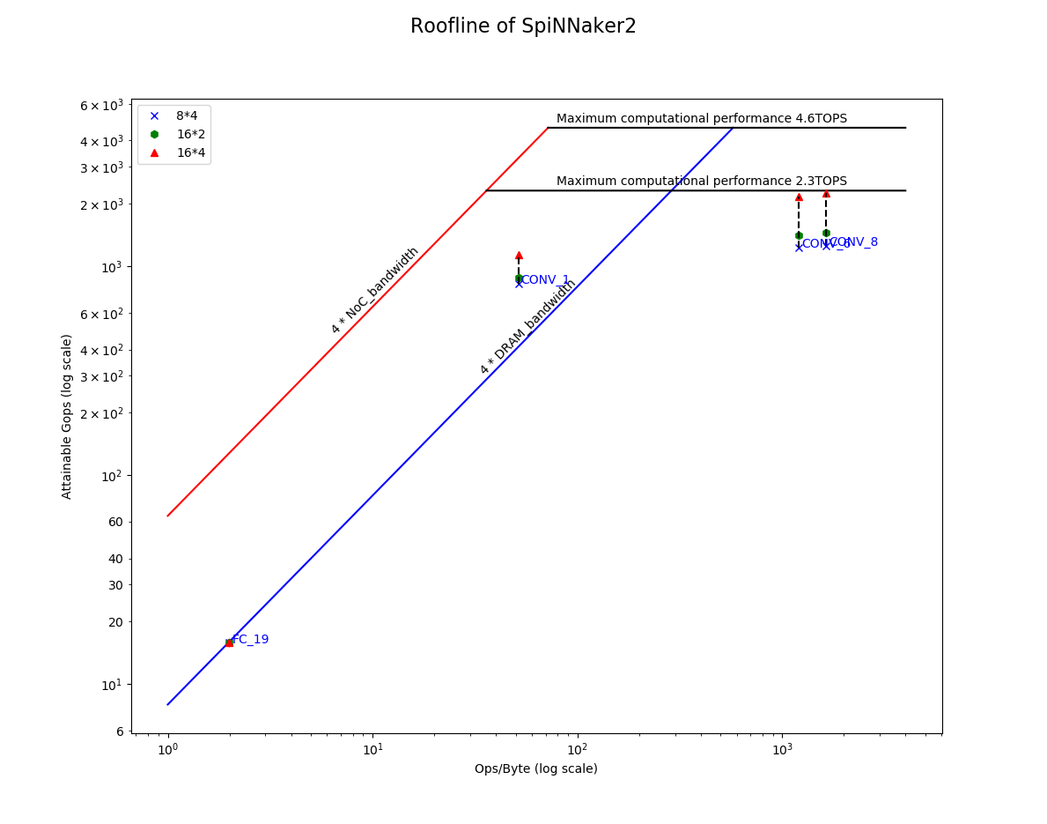
Result for VGG-19
‘layer’: (operation/bytes, attainable Gops)
8*4
'CONV_1': (51.51423733445824, 825.6906902331251)
'CONV_6': (1210.275376884422, 1229.3847679460628)
'CONV_8': (1641.3775556565197, 1255.783050994748)
'FC_19': (1.9975615703486955, 15.789904830743284)
16*2
'CONV_1': (51.51423733445824, 881.9820560291334)
'CONV_6': (1210.275376884422, 1410.192965228688)
'CONV_8': (1641.3775556565197, 1445.0710579235279)
'FC_19': (1.9975615703486955, 15.903900988897652)
16*4
'CONV_1': (51.51423733445824, 1141.3844452635458)
'CONV_6': (1210.275376884422, 2155.0600768961904)
'CONV_8': (1641.3775556565197, 2235.3644306835567)
'FC_19': (1.9975615703486955, 15.882221077822544)

Slide 9
Result for ResNet-50
MAC array Row = 4， Column = 16
"RES-CONV_1": 99623
weight_clock: 971
inActi_clock: 11061
weight_migration: 0
computation: 87591 (including write outActi from SRAM to SRAM)
"CONV_SC_14": 115207
weight_clock: 6926
inActi_clock: 18284
weight_migration: 634 (half) * 2 = 1268
computation: 89363 (including write outActi from SRAM to SRAM)
"CONV_19": 44987
weight_clock: 7735
inActi_clock: 15453
weight_migration: 0
computation: 21799 (including write outActi from SRAM to SRAM)
"CONV_42": 47116
weight_clock: 25364
inActi_clock: 11049
weight_migration: 0
computation: 10703 (including write outActi from SRAM to SRAM)

Slide 10
Result for ResNet-50
MAC array Row = 2, ， Column = 16
"RES-CONV_1": 168451
weight_clock: 968
inActi_clock: 11061
weight_migration: 0
computation: 156422 (including write outActi from SRAM to SRAM)
"CONV_SC_14": 180906
weight_clock: 6936
inActi_clock: 18290
weight_migration: 634 (half) * 2 = 1268
computation: 154412 (including write outActi from SRAM to SRAM)
"CONV_19": 59216
weight_clock: 7736
inActi_clock: 15455
weight_migration: 0
computation: 36025 (including write outActi from SRAM to SRAM)
"CONV_42": 55317
weight_clock: 25365
inActi_clock: 11051
weight_migration: 0
computation: 18901 (including write outActi from SRAM to SRAM)

Slide 11
Result for ResNet-50
MAC array Row = 4， Column = 8
"RES-CONV_1": 170628
weight_clock: 969
inActi_clock: 11060
weight_migration: 0
computation: 158599 (including write outActi from SRAM to SRAM)
"CONV_SC_14": 176935
weight_clock: 6898
inActi_clock: 18295
weight_migration: 634 (half) * 2 = 1268
computation: 150474 (including write outActi from SRAM to SRAM)
"CONV_19": 65233
weight_clock: 7739
inActi_clock: 15454
weight_migration: 0
computation: 42040 (including write outActi from SRAM to SRAM)
"CONV_42": 57366
weight_clock: 25366
inActi_clock: 11050
weight_migration: 0
computation: 20950 (including write outActi from SRAM to SRAM)

Slide 12
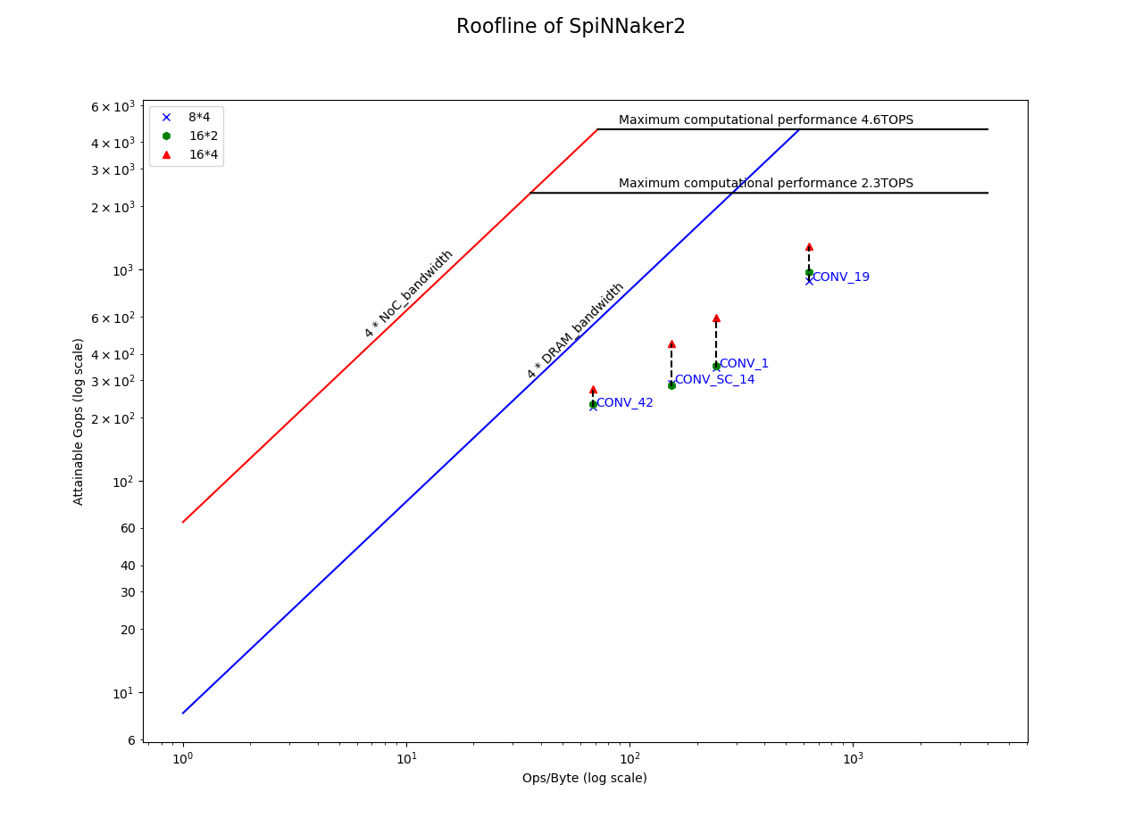
Result for ResNet-50
‘layer’: (operation/bytes, attainable Gops)
8*4
'CONV_1': (243.44142573799928, 345.8223503762571) 'CONV_SC_14': (153.91411042944785, 290.3903919518467)
'CONV_19': (636.9308885754584, 886.0967915012341) 'CONV_42': (68.49965870307167, 223.91409545723948)
16*2
'CONV_1': (243.44142573799928, 350.2916337688705
'CONV_SC_14': (153.91411042944785, 284.0161409792931)
'CONV_19': (636.9308885754584, 976.1340178330182
'CONV_42': (68.49965870307167, 232.20810962271992)
16*4
'CONV_1': (243.44142573799928, 592.3027413348323)
'CONV_SC_14': (153.91411042944785, 445.9817893009973)
'CONV_19': (636.9308885754584, 1284.8767866272476)
'CONV_42': (68.49965870307167, 272.6261991680108)}

Slide 13
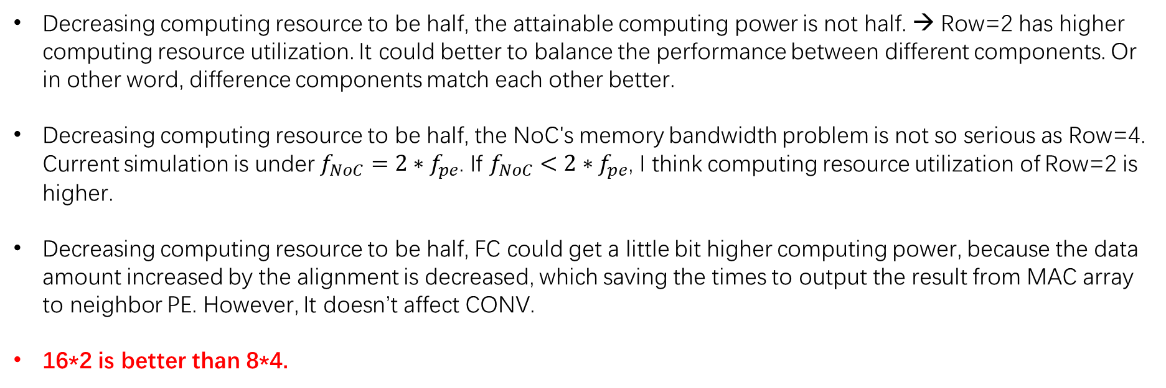
Conclusion
Decreasing computing resource to be half, the attainable computing power is not half. → Row=2 has higher computing resource utilization. It could better to balance the performance between different components. Or in other word, difference components match each other better.
Decreasing computing resource to be half, the NoC's memory bandwidth problem is not so serious as Row=4. Current simulation is under $f_{NoC}=2∗f_{pe}$. If $f_{NoC}<2∗f_{pe}$, I think computing resource utilization of Row=2 is higher.
Decreasing computing resource to be half, FC could get a little bit higher computing power, because the data amount increased by the alignment is decreased, which saving the times to output the result from MAC array to neighbor PE. However, It doesn’t affect CONV.
16*2 is better than 8*4.

