Slide 1
Fully-Connected Layer

Slide 2




FC: Fully-Connected Layer
(Using MAC Array to accelerate)
A
B
C
1
1
$$∗$$
 |  |  | …
$$=$$
C_0 | C_1 | C_2 | … | C_(w-1)
H
W
W
$ceil\left(x, y\right)=math.ceil\left(\frac{x}{y}\right)∗y$
Need memory size in SRAM:
$SRAM_{need}=H∗4+H∗ceil\left(W, 16\right)+ceil\left(W, 16\right)∗4$
Note that if one PE’s SRAM is not large enough to hold B and C, B need to be splitted.

Slide 3





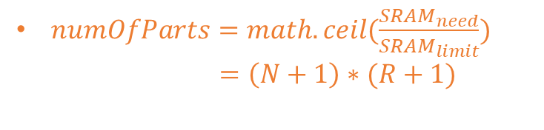
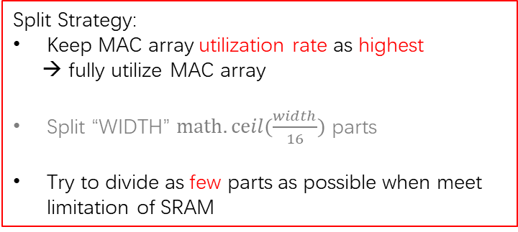
FC: Fully-Connected Layer
(Using MAC Array to accelerate)
A
B
$$C^{′}$$
x
x
 |  |  | …
$$∗$$
PE_0_0 | PE_0_1 | PE_0_2 | … | PE_0_N
PE_1_0 | PE_1_1 | PE_1_2 | … | PE_1_N
PE_2_0 | PE_2_1 | PE_2_2 | … | PE_2_N
… | … | … | … | …
PE_R_0 | PE_R_1 | PE_R_2 | … | PE_R_N
$$=$$
PE_0_0 | PE_0_1 | PE_0_2 | … | PE_0_N
PE_1_0 | PE_1_1 | PE_1_2 | … | PE_1_N
PE_2_0 | PE_2_1 | PE_2_2 | … | PE_2_N
… | … | … | … | …
PE_R_0 | PE_R_1 | PE_R_2 | … | PE_R_N
1
M
M
M
…
M
M+1
M+1
M+1
…
M
M
M
M
…
M’
1
$numOfParts=math.ceil(\frac{SRAM_{need}}{SRAM_{limit}})$
$=\left(N+1\right)∗(R+1)$
MAC array utilization rate
$\frac{C}{ceil(C, 16)}$
N*C
Split Strategy:
Keep MAC array utilization rate as highest
→ fully utilize MAC array
Split “WIDTH” $math.ceil(\frac{width}{16})$ parts
Try to divide as few parts as possible when meet limitation of SRAM
C
C
C
…
C
$\frac{L∗\left(C+1\right)+\left(N−L\right)∗C}{L∗ceil\left(C+1, 16\right)+(N−L)ceil(C,16)}$
L*(C+1) + (N-L)*C
C+1
C+1
C+1
…
C
$\frac{\left(N−1\right)∗16∗C+X}{\left(N−1\right)∗16∗C+ceil(X, 16)}$
(N-1)*(16*C) + X
16*C
16*C
16*C
…
C’

Slide 4
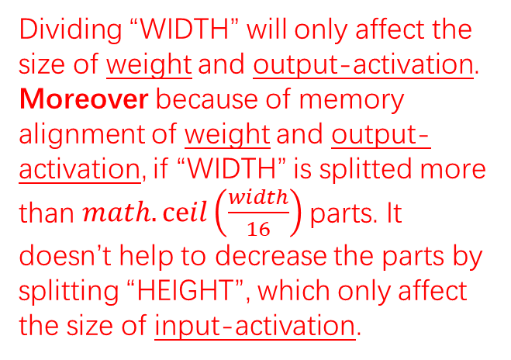
FC: Fully-Connected Layer
(Using MAC Array to accelerate)
A
B
$$C^{′}$$
x
x
 |  |  | …
$$∗$$
PE_0_0 | PE_0_1 | PE_0_2 | … | PE_0_N
PE_1_0 | PE_1_1 | PE_1_2 | … | PE_1_N
PE_2_0 | PE_2_1 | PE_2_2 | … | PE_2_N
… | … | … | … | …
PE_R_0 | PE_R_1 | PE_R_2 | … | PE_R_N
$$=$$
PE_0_0 | PE_0_1 | PE_0_2 | … | PE_0_N
PE_1_0 | PE_1_1 | PE_1_2 | … | PE_1_N
PE_2_0 | PE_2_1 | PE_2_2 | … | PE_2_N
… | … | … | … | …
PE_R_0 | PE_R_1 | PE_R_2 | … | PE_R_N
1
M
M
M
…
M
M+1
M+1
M+1
…
M
M
M
M
…
M’
1
Preferred (If not equally divisible).
→Balance the computation clocks of each PE.
Dividing “WIDTH” will only affect the size of weight and output-activation. Moreover because of memory alignment of weight and output-activation, if “WIDTH” is splitted more than $math.ceil\left(\frac{width}{16}\right)$parts. It doesn’t help to decrease the parts by splitting “HEIGHT”, which only affect the size of input-activation.
C
C
C
…
C
Because the computation time of each PE is decided by each part’s length. Their lengths are almost the same, so the cost of time will also almost be the same.
…
C+1
C+1
C+1
C
16*C
16*C
16*C
…
C’

Slide 5
FC: Fully-Connected Layer
(Using MAC Array to accelerate)
Split Result:
PE_0_0 | PE_0_1 | PE_0_2 | … | PE_0_N
PE_1_0 | PE_1_1 | PE_1_2 | … | PE_1_N
PE_2_0 | PE_2_1 | PE_2_2 | … | PE_2_N
… | … | … | … | …
PE_R_0 | PE_R_1 | PE_R_2 | … | PE_R_N
PE_0_0 | PE_0_1 | PE_0_2 | … | PE_0_N
PE_1_0 | PE_1_1 | PE_1_2 | … | PE_1_N
PE_2_0 | PE_2_1 | PE_2_2 | … | PE_2_N
… | … | … | … | …
PE_R_0 | PE_R_1 | PE_R_2 | … | PE_R_N
M
M
M
…
M
M+1
M+1
M+1
…
M
C
C
C
…
C
C+1
C+1
C+1
…
C

Slide 6
FC: Fully-Connected Layer
(Using MAC Array to accelerate)
Split Result:
PE_0_0 | PE_0_1 | PE_0_2 | … | PE_0_N
PE_1_0 | PE_1_1 | PE_1_2 | … | PE_1_N
PE_2_0 | PE_2_1 | PE_2_2 | … | PE_2_N
… | … | … | … | …
PE_R_0 | PE_R_1 | PE_R_2 | … | PE_R_N
PE_0_0 | PE_0_1 | PE_0_2 | … | PE_0_N
PE_1_0 | PE_1_1 | PE_1_2 | … | PE_1_N
PE_2_0 | PE_2_1 | PE_2_2 | … | PE_2_N
… | … | … | … | …
PE_R_0 | PE_R_1 | PE_R_2 | … | PE_R_N
M+1
M+1
M+1
…
M
M
M
M
…
M
C
C
C
…
C
C+1
C+1
C+1
…
C

Slide 7


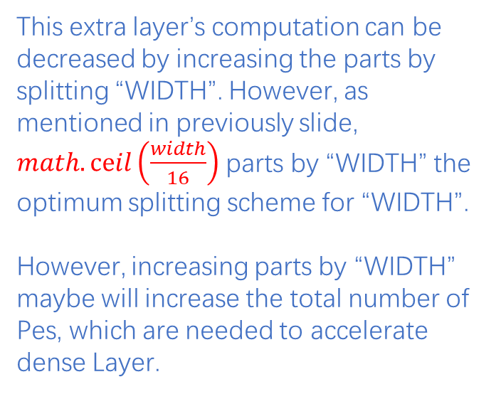





FCE: Extra Layer for FC
(Using ARM Core to accelerate)
$$C$$
This extra layer’s computation can be decreased by increasing the parts by splitting “WIDTH”. However, as mentioned in previously slide, $math.ceil\left(\frac{width}{16}\right)$ parts by “WIDTH” the optimum splitting scheme for “WIDTH”.
However, increasing parts by “WIDTH” maybe will increase the total number of Pes, which are needed to accelerate dense Layer.
1
C_0 | C_1 | C_2 | … | C_w
$$=$$
$$=$$
$$=$$
$$=$$
$$=$$
PE_0_0 | PE_0_1 | PE_0_2 | … | PE_0_N
PE_1_0 | PE_1_1 | PE_1_2 | … | PE_1_N
PE_2_0 | PE_2_1 | PE_2_2 | … | PE_2_N
… | … | … | … | …
PE_R_0 | PE_R_1 | PE_R_2 | … | PE_R_N
$$C^{′}$$
1
…
C
C
C
C
C+1
C+1
C+1
…
C
…
16*C
16*C
16*C
X

Slide 8
Trade-off between Splitting Scheme
Splitting as few parts as possible along “width”
Increase data reuse of input-activation by column of weight
Increase parts by “height”
Reduce bandwidth requirements
Increase computation amount of FCE (ARM)

Slide 9
CONV Layer

Slide 10
CONV
PADD
CONV’
+
Convolutional layer:
Padding = valid/same
Padding layer:
Execute in ARM Core
Only exist when padding=same
Convolutional layer:
Execute in MAC Array
Padding = valid

Slide 11
CONV:
Splitting Strategy
Lead some calculations to be accelerated by ARM Core→ STEP 4
$$Activation_{input}:\left[width_{in}, height_{in},channel_{in}\right]$$
$$filter:\left[width_{filter}, height_{filter},channel_{in}, channel_{out}\right]$$
$$Activation_{output}:\left[width_{out}, height_{out},channel_{out}\right]$$
Width need to align to MAC_ARRAY_COLUMN (16)
→ STEP 3
Alignment with
MAC_ARRAY_ROW (4)
→ STEP 2
STEP 1: No splitting

Slide 12
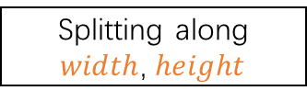


CONV:
Splitting Step
Begin
No splitting
yes
SRAM enough?
no
Splitting along $channel_{out}$
yes
SRAM enough?
no
Splitting along $width$, $height$
yes
SRAM enough?
no
Splitting along $channel_{in}$
End

Slide 13
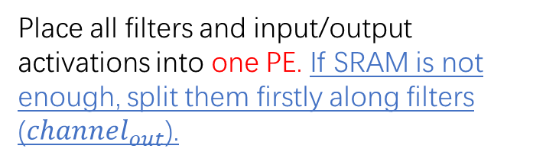
CONV:
STEP 1: No splitting
Place all filters and input/output activations into one PE. If SRAM is not enough, split them firstly along filters ($channel_{out}$).
Filters_1
Filters_2
Filters_3
Input Activation
MAC Array
Filters_4
Filters_5
Filters_6
…
PE

Slide 14

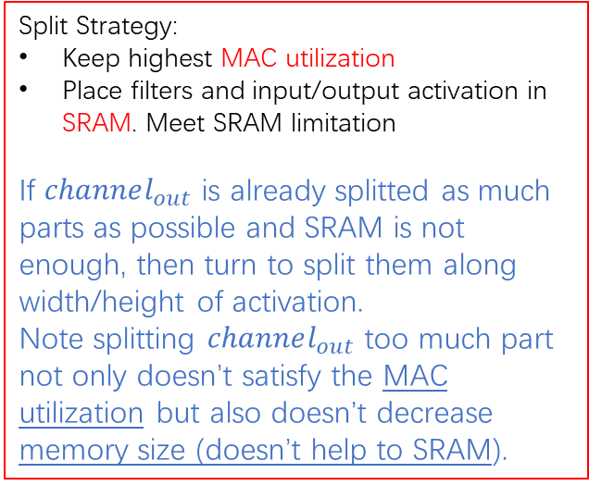
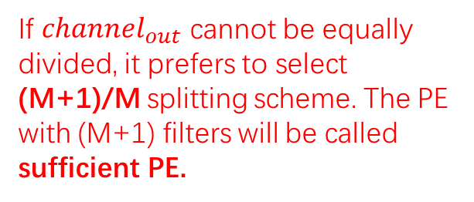
CONV:
STEP 2: Splitting along $channel_{out}$
Split Strategy:
Keep highest MAC utilization
Place filters and input/output activation in SRAM. Meet SRAM limitation
If $channel_{out}$ is already splitted as much parts as possible and SRAM is not enough, then turn to split them along width/height of activation.
Note splitting $channel_{out}$ too much part not only doesn’t satisfy the MAC utilization but also doesn’t decrease memory size (doesn’t help to SRAM).
Input Activation
MAC Array
…
PE
Input Activation
If $channel_{out}$ cannot be equally divided, it prefers to select (M+1)/M splitting scheme. The PE with (M+1) filters will be called sufficient PE.
MAC Array
…
PE
…

Slide 15







CONV:
STEP 3: Splitting along $width/height$
$$\frac{in{CubeA}_{width}−filter_{width}}{stride}+1=out{SquareA}_{width}$$
$$\frac{inCubeA_{height}−filter_{height}}{stride}+1=outSquareA_{height}$$
PE_0_0 | PE_0_1 | PE_0_2 | … | PE_0_N
PE_1_0 | PE_1_1 | PE_1_2 | … | PE_1_N
PE_2_0 | PE_2_1 | PE_2_2 | … | PE_2_N
… | … | … | … | …
PE_R_0 | PE_R_1 | PE_R_2 | … | PE_R_N
Filters
$$inCubeA_{height}$$
$$outSquareA_{height}$$
$out{SquareA}_{width}$
$$in{CubeA}_{width}$$
Each cube overlaps with adjacent cubes.
Splitting too much parts will increase the demand for memory bandwidth!!!
Splitting width/height on output-activation is easier!!!
Because no overlap.

Slide 16


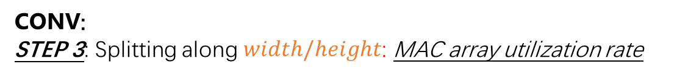

CONV:
STEP 3: Splitting along $width/height$: MAC array utilization rate
Split Strategy:
Keep MAC array utilization rate as high as possible
→ fully utilize MAC array
Satisfy the input-activation utilization, which means the memory bandwidth problem caused by splitting activation
Split as few parts as possible when SRAM limitation are met. Otherwise, split as more parts as possible (when SRAM limitation are not met)
B
PE_0_0 | PE_0_1 | PE_0_2 | … | PE_0_N
PE_1_0 | PE_1_1 | PE_1_2 | … | PE_1_N
PE_2_0 | PE_2_1 | PE_2_2 | … | PE_2_N
… | … | … | … | …
PE_R_0 | PE_R_1 | PE_R_2 | … | PE_R_N
M
M
M
…
M
M+1
M+1
M+1
…
M
M
M
M
…
X
MAC array utilization rate
$\frac{C}{ceil(C, 16)}$
N*C
C
C
C
…
C
$\frac{L∗\left(C+1\right)+\left(N−L\right)∗C}{L∗ceil\left(C+1, 16\right)+(N−L)ceil(C,16)}$
L*(C+1) + (N-L)*C
Preferred (If not equally divisible).
→Balance the computation clocks of each PE.
C+1
C+1
C+1
…
C
$\frac{\left(N−1\right)∗16∗C+X}{\left(N−1\right)∗16∗C+ceil(X, 16)}$
(N-1)*(16*C) + X
16*C
16*C
16*C
…
X

Slide 17
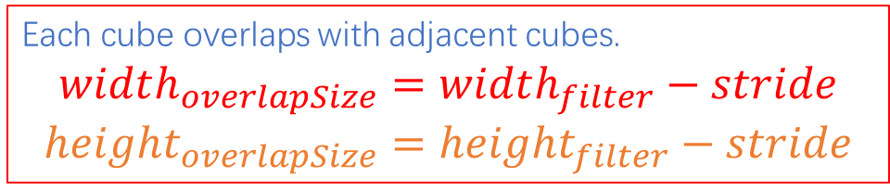



CONV:
STEP 3: Splitting along $width/height$: Memory Bandwidth
Split Strategy:
output activation’s height in each PE should not be too small. (There is no hardware limitation for this.) Try to divide as few parts as possible. If there are too many parts, the input activation parts overlap with each other, which lower the memory utilization.
For above point, we set a input-activation utilization, e.g. 80%.
A
Note that when input-activation’s width and height is small, the overlap size will taking a larger part.
$$Utilization_{memory}=\frac{width_{in}∗height_{in}∗channel_{in}}{width_{in_{overlap}}∗height_{in_{overlap}}∗channel_{in}}$$
Non-overlap
$$width_{overlapSize}$$
Each cube overlaps with adjacent cubes.
$$width_{overlapSize}=width_{filter}−stride$$
$$height_{overlapSize}=height_{filter}−stride$$
$$height_{overlapSize}$$

Slide 18
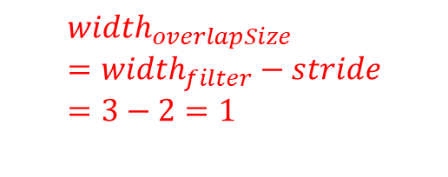



CONV:
STEP 3: Splitting along $width/height$: Memory Bandwidth-Overlap Size
$$width_{overlapSize}=width_{filter}−stride=3−1=2$$
$$width_{overlapSize}=width_{filter}−stride=3−2=1$$
$$stride=1$$
$$stride=2$$

Slide 19


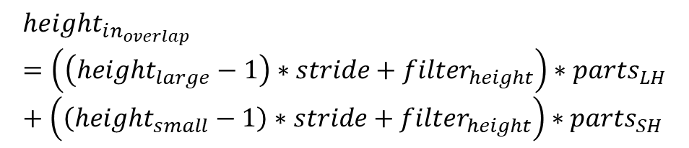






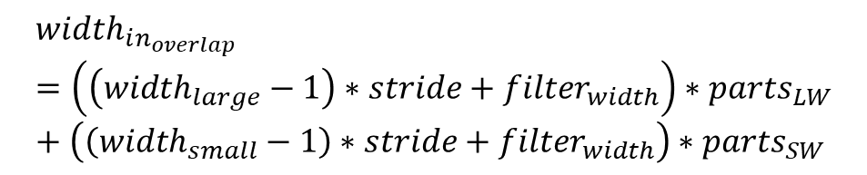





CONV:
STEP 3: Splitting along $width/height$: Memory Bandwidth
$parts_{LW}$
$parts_{SW}$
C+1
C+1
C+1
…
C
PE_0_0 | PE_0_1 | PE_0_2 | … | PE_0_N
PE_1_0 | PE_1_1 | PE_1_2 | … | PE_1_N
PE_2_0 | PE_2_1 | PE_2_2 | … | PE_2_N
… | … | … | … | …
PE_R_0 | PE_R_1 | PE_R_2 | … | PE_R_N
$$width_{large}=C+1$$
$$width_{small}=C$$
$$height_{large}=M+1$$
$parts_{LH}$
$$height_{samll}=M$$
M+1
M+1
M+1
…
M
Filters
$parts_{SH}$
$$inCubeA_{height}$$
$$outSquareA_{height}$$
$out{SquareA}_{width}$
$$width_{in_{overlap}}=\left(\left(width_{large}−1\right)∗stride+filter_{width}\right)∗parts_{LW}+\left(\left(width_{small}−1\right)∗stride+filter_{width}\right)∗parts_{SW}$$
$$in{CubeA}_{width}$$
$$\frac{in{CubeA}_{width}−filter_{width}}{stride}+1=out{SquareA}_{width}$$
$$height_{in_{overlap}}=\left(\left(height_{large}−1\right)∗stride+filter_{height}\right)∗parts_{LH}+\left(\left(height_{small}−1\right)∗stride+filter_{height}\right)∗parts_{SH}$$
$$\frac{inCubeA_{height}−filter_{height}}{stride}+1=outSquareA_{height}$$

Slide 20


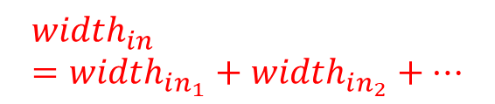


CONV:
STEP 4: Splitting along $channel_{in}$
$$width_{in_{1}}$$
$$width_{in}$$
$$width_{in_{2}}$$
$$width_{in}=width_{in_{1}}+width_{in_{2}}+…$$
…

Slide 21




…
…
…
…
…
…
$1$ PE
…
…
…
…
…
…
…
…
…
$N∗W∗H$PEs
…
…
…
During splitting, there is a minimum requirement for SRAM utilization.
Currently, it is 0.9.
e.g. if available SRAM = 96KB,
After splitting, it uses at least 86.4KB.
…
…
…
…
$N∗W∗H∗I$PEs
$N$ PEs

Slide 22
Trade-off between Splitting Scheme
Splitting as few parts as possible along “width/height” of activation
Decrease data overlap
Increase parts by input channel
Reduce bandwidth requirements
Increase computation amount of CONVEE (ARM)

Slide 23
POOL Layer
(MAX POOL)

Slide 24
MAX POOL:
Accelerate by ARM, splitting channel, width and height together
Split Strategy:
Select as few parts as possible
PE_0_0 | PE_0_1 | PE_0_2 | … | PE_0_N
PE_1_0 | PE_1_1 | PE_1_2 | … | PE_1_N
PE_2_0 | PE_2_1 | PE_2_2 | … | PE_2_N
… | … | … | … | …
PE_R_0 | PE_R_1 | PE_R_2 | … | PE_R_N
M
M
M
…
M
M+1
M+1
M+1
…
M
M
M
M
…
X
Keep splitted-channel align to MAC_ARRAY_COLUMN
C
C
C
…
C
Preferred (If not equally divisible).
→Balance the computation clocks of each PE.
C+1
C+1
C+1
…
C
16*C
16*C
16*C
…
X

Slide 25
Task Level Pipeline Parallelism
(TLPP)

Slide 26
How TLPP works?
Purpose: hidden memory latency → keeping PE as busy as possible
Method: splitting available SRAM into N blocks (Non-physical). Each block contains different task. N is recommended to be at least 3.
Available SRAM
Block 1
Block 2
…
Block N

Slide 27
Advantages of TLPP
Use all available SRAM
Without TLPP:
DRAM →
SRAM
Task 1 Execution
SRAM → DRAM
DRAM →
SRAM
Task 2 Execution
SRAM → DRAM
DRAM →
SRAM
Task 3 Execution
SRAM → DRAM
Task 1(9 clocks)
Task 2(9 clocks)
Task 3(9 clocks)
With TLPP:
Problem:
SRAM operation at same time!!!
Maybe data hazards
Task 1
Each task is splitted into 3 sub-tasks, as well as the SRAM. Moreover, it is assumed that the needed SRAM and execution time can also be divided into N parts
Task 2
Task 3
11 clocks

Slide 28
Operator Fusion

Slide 29
ARM Core
MAC Array
Padding operation + Convolutional operation
MAC Array
ARM Core
ARM Core(MAX) / MAC Array(Average)
Last Convolutional operation + Quantization operation + Pooling operation
Output-activation splitting data need to align to pooling filter size
ARM Core
ARM Core(MAX) / MAC Array(Average)
Quantization operation + Pooling operation
MAC Array
ARM Core(MAX) / MAC Array(Average)
Last Vector-matrix multiplication operation + Quantization operation

Slide 30
ARM Core
MAC Array
ARM Core(MAX) / MAC Array(Average)
Padding operation + Convolutional operation + Pooling operation
ARM Core
ARM Core
MAC Array
ARM Core(MAX) / MAC Array(Average)
CNN Quantization operation + Padding operation + Convolutional operation + Pooling operation
ARM Core
MAC Array
CNN Quantization operation + Vector-matrix multiplication operation
ARM Core
MAC Array
FC Quantization operation + Vector-matrix multiplication operation

Slide 31
Data Reuse
(SRAM Reuse)

Slide 32
CONV layer: possible input/filter reuse:
For SpiNNaker2, it only possible to reuse one of them: input-activation or filter
We select the one with smaller BW requirement.
36-288 parts
18.188 MB
4-32 parts
0.066 MB
1024 filter: 4.5 MB
144 parts
2.087 MB
FC layer: possible input reuse
achieved by splitting as few parts as possible along “width”
→ however it increases computation amount of FCE (accelerated with ARM) [trade-off of splitting scheme of FC]

Slide 33
Roofline Model

Slide 34
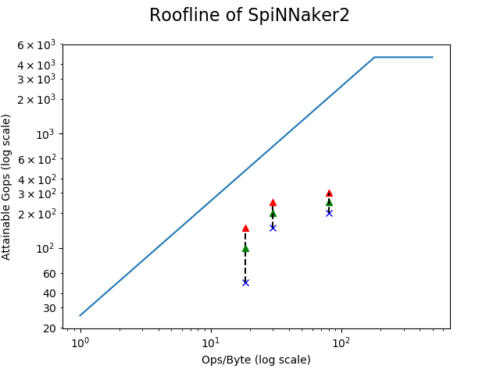
1. Determine the gap between parallel algorithms and optimal values
2. Intuitively get the degree of improvement of the parallel algorithm

Slide 35
Dynamic SRAM Allocation

Slide 36
What is Dynamic SRAM Allocation?
The size of each block is not necessarily equal. → The block size depends on each Task.
The block memory space occupied by each task must be continuous, and it must be guaranteed that there are at least 2 tasks/blocks (however, only 2 tasks are not guaranteed to hidden memory latency). → This is to ensure that no memory fragmentation occurs and that the parallelism of the task is maintained.
Available SRAM
Block 1
Block 2
…
Block N

Slide 37
Why we need Dynamic SRAM Allocation?
Splitting schemes of different layers of are different. The optimum splitting scheme for each layer may need different size of SRAM. Dynamic SRAM allocation is fit for this situation.
Dynamic SRAM allocation is fit for operator fusion.
Flexible allocation of memory → Improve SRAM utilization

Slide 38
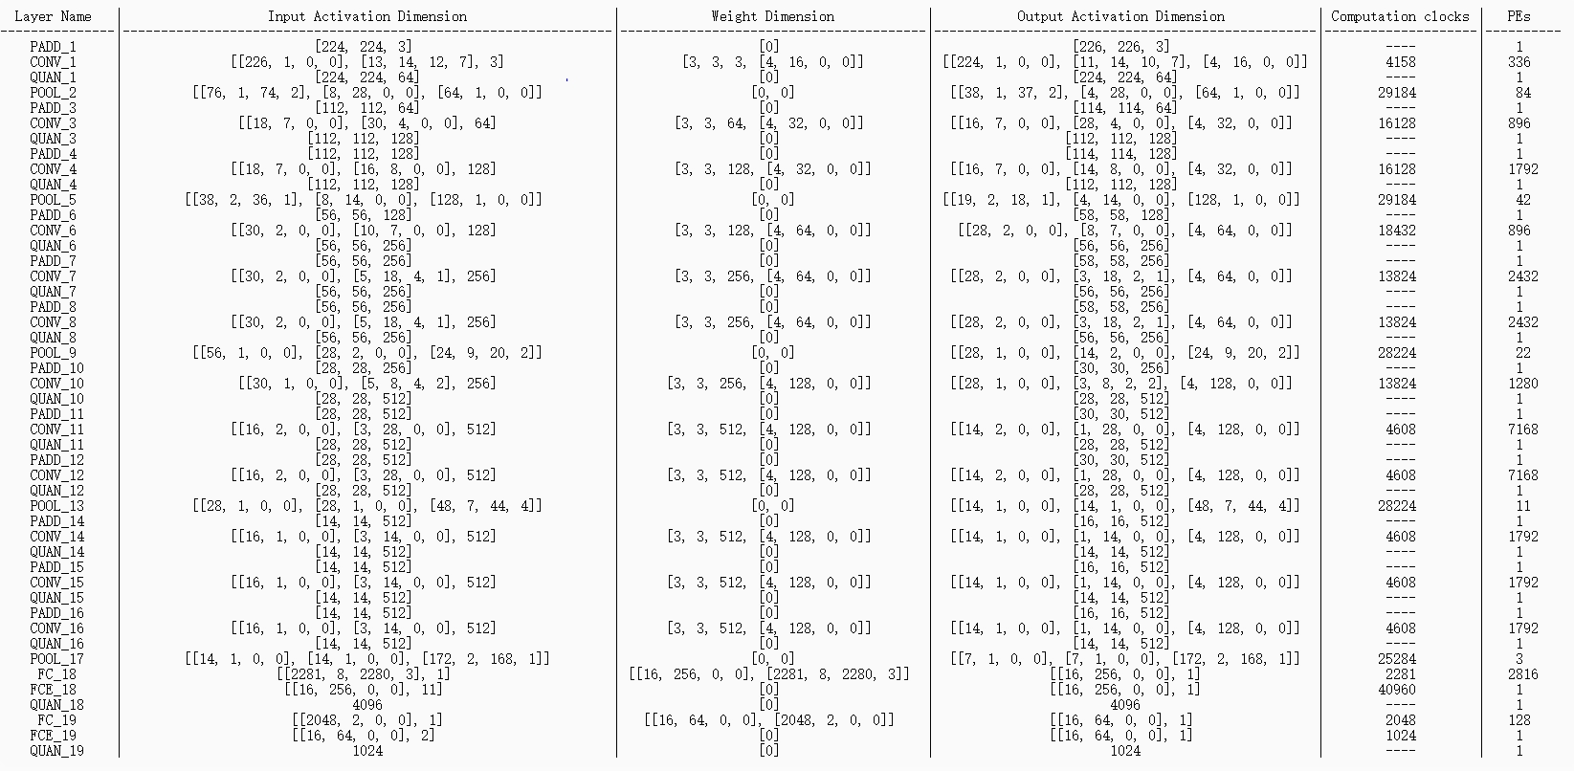

Slide 39
CNN Parallelism Solution

Slide 40
(1,6)
(2,6)
(3,6)
(4,6)
(5,6)
(6,6)
DRAM(1,2)
DRAM(2,2)
(1,5)
(2,5)
(3,5)
(4,5)
(5,5)
(6,5)
(1,4)
(2,4)
(3,4)
(4,4)
(5,4)
(6,4)
(1,3)
(2,3)
(3,3)
(4,3)
(5,3)
(6,3)
DRAM(1,1)
DRAM(2,1)
(1,2)
(2,2)
(3,2)
(4,2)
(5,2)
(6,2)
(1,1)
(2,1)
(3,1)
(4,1)
(5,1)
(6,1)

Slide 41
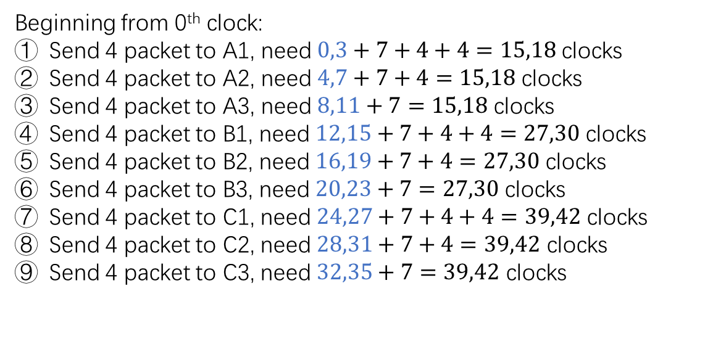
Beginning from 0th clock:
Send 4 packet to A1, need $0,3+7+4+4=15,18$ clocks
Send 4 packet to A2, need $4,7+7+4=15,18$ clocks
Send 4 packet to A3, need $8,11+7=15,18$ clocks
Send 4 packet to B1, need $12,15+7+4+4=27,30$ clocks
Send 4 packet to B2, need $16,19+7+4=27,30$ clocks
Send 4 packet to B3, need $20,23+7=27,30$ clocks
Send 4 packet to C1, need $24,27+7+4+4=39,42$ clocks
Send 4 packet to C2, need $28,31+7+4=39,42$ clocks
Send 4 packet to C3, need $32,35+7=39,42$ clocks
(4,6)
A1
(5,6)
A2
(6,6)
A3
DRAM(2,2)
(4,5)
(5,5)
(6,5)
B1
B2
B3
C1
C2
C3
(4,4)
(5,4)
(6,4)

Slide 42
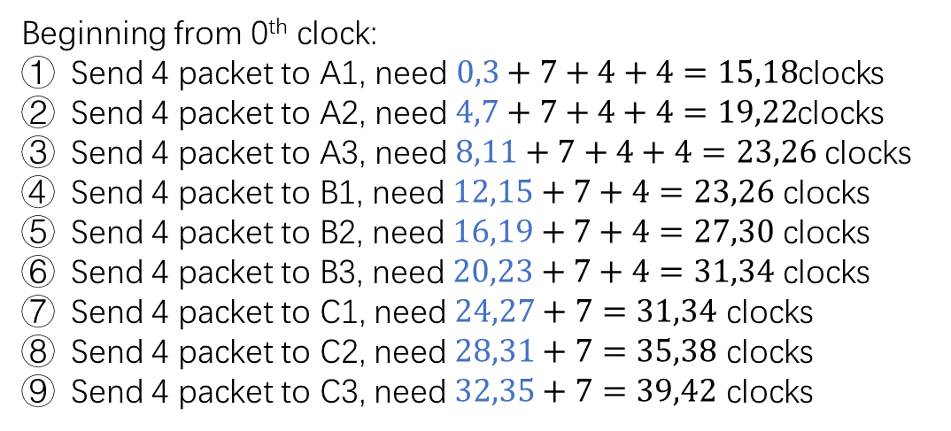
Beginning from 0th clock:
Send 4 packet to A1, need$0,3+7+4+4=15,18$clocks
Send 4 packet to A2, need $4,7+7+4+4=19,22$clocks
Send 4 packet to A3, need $8,11+7+4+4=23,26$ clocks
Send 4 packet to B1, need $12,15+7+4=23,26$ clocks
Send 4 packet to B2, need $16,19+7+4=27,30$ clocks
Send 4 packet to B3, need $20,23+7+4=31,34$ clocks
Send 4 packet to C1, need $24,27+7=31,34$ clocks
Send 4 packet to C2, need $28,31+7=35,38$ clocks
Send 4 packet to C3, need $32,35+7=39,42$ clocks
(4,6)
A1
(5,6)
B1
(6,6)
C1
DRAM(2,2)
(4,5)
(5,5)
(6,5)
A2
B2
C2
A3
B3
C3
(4,4)
(5,4)
(6,4)

Slide 43
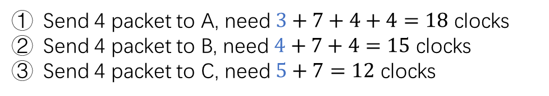
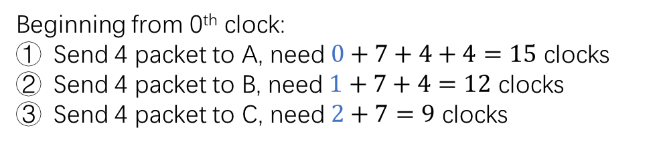
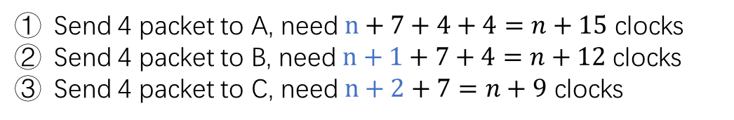
Beginning from 0th clock:
Send 4 packet to A, need $0+7+4+4=15$ clocks
Send 4 packet to B, need $1+7+4=12$ clocks
Send 4 packet to C, need $2+7=9$ clocks
(4,6)
Send 4 packet to A, need $3+7+4+4=18$ clocks
Send 4 packet to B, need $4+7+4=15$ clocks
Send 4 packet to C, need $5+7=12$ clocks
C
(5,6)
D
QPE
(4,5)
(5,5)
A
B
…
Send 4 packet to A, need $n+7+4+4=n+15$ clocks
Send 4 packet to B, need $n+1+7+4=n+12$ clocks
Send 4 packet to C, need $n+2+7=n+9$ clocks

Slide 44
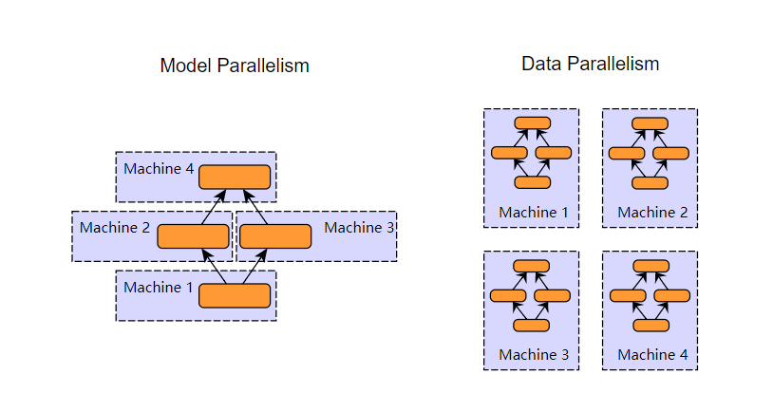

Slide 45
QPE Simulator

Slide 46
4 ML-Accelerators and SRAM<->NoC, both of them need NoC.
There are totally 5 operations: FC, CONV, NoC->SRAM, SRAM->NoC.
These 5 operation cannot be executed at the same time, as they all need NoC.
During FC and CONV, only 4 PEs in QPE are under running, the NoC in QPE is always busy, otherwise every 4 clocks, there are 4-Pes clocks, which are free for other operations.
NoC<->DRAM bandwidth inconsistent problem is not considered here.

Slide 47
Begin
NoC->SRAM: write 4 PE SRAM
CONV/FC: ML Accelerator
Yes
SRAM->NoC: write free PE SRAM
When writing SRAM from NoC, CONV/FC is stop.
Data to Write?
NoC->SRAM: read PE SRAM
When reading SRAM from NoC, CONV/FC is stop.
No
Yes
Finish?
End
No
CONV/FC: ML Accelerator
CONV/FC is running on 4 PEs except the last iteration.

Slide 48
QPE CONV Simulation

Slide 49
CONV Parallelism Scheme 1

Slide 50
Parallelism Scheme 1:
QPE_DISTRI_NO_DATA_REUSED
QPE
IO
IO
IO
IO
No data reuse
4 Pes run parallelly
2 Pes as a group (A from NoC, B from AHB )
Data in/out BW 128bit * 250MB
F
F
F
F
PE-1
PE-1
PE-1
PE-1
+: simple distribution algorithm
-: no data reuse -> bandwidth problem is serious

Slide 51



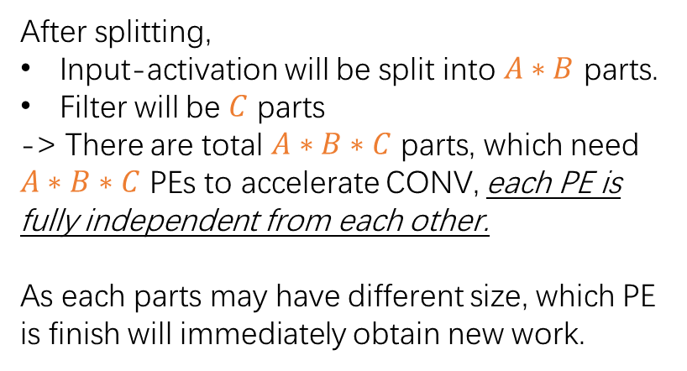

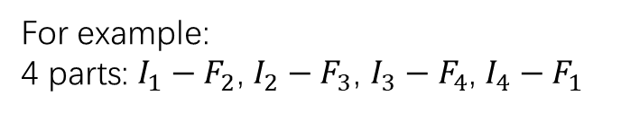




Parallelism Scheme 1:
QPE_DISTRI_NO_DATA_REUSED
After splitting,
Input-activation will be split into $A∗B$ parts.
Filter will be $C$ parts
-> There are total $A∗B∗C$ parts, which need $A∗B∗C$ PEs to accelerate CONV, each PE is fully independent from each other.
As each parts may have different size, which PE is finish will immediately obtain new work.
QPE
$$IO_{1}$$
$$IO_{2}$$
$$IO_{3}$$
$$IO_{4}$$
$$F_{1}$$
$$F_{2}$$
$$F_{3}$$
$$F_{4}$$
PE-1
PE-2
PE-3
PE-4
For example:
4 parts: $I_{1}−F_{2}$, $I_{2}−F_{3}$, $I_{3}−F_{4}$, $I_{4}−F_{1}$

Slide 52
CONV Parallelism Scheme 2

Slide 53
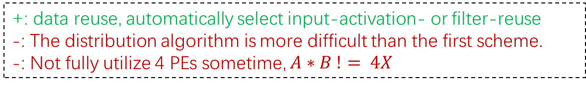
Parallelism Scheme 2:
QPE_DISTRI_DATA_REUSED_DYNAMIC
QPE
IO
IO
IO
IO
input-activation/filter reuse
4 Pes run parallelly
2 Pes as a group (A from NoC, B from AHB )
Data in/out BW 128bit * 250MB
F
F
F
F
PE-1
PE-1
PE-1
PE-1
+: data reuse, automatically select input-activation- or filter-reuse
-: The distribution algorithm is more difficult than the first scheme.
-: Not fully utilize 4 PEs sometime, $A∗B != 4X$

Slide 54
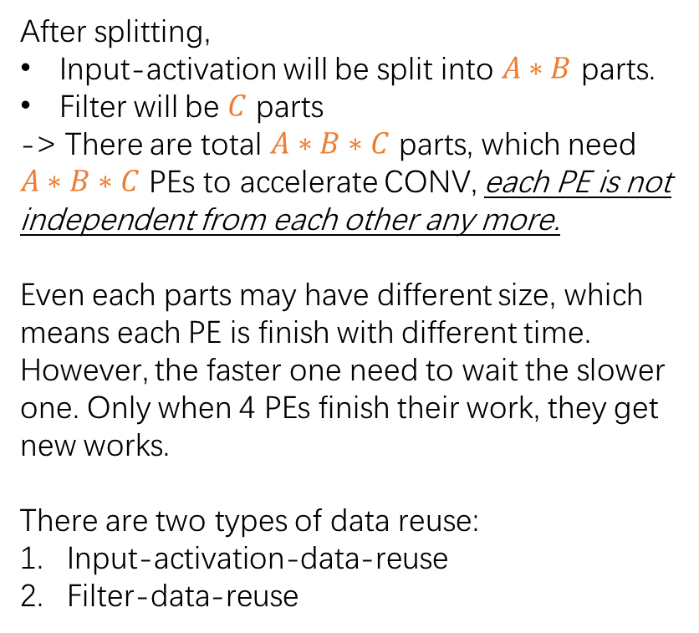
Parallelism Scheme 2:
QPE_DISTRI_DATA_REUSED_DYNAMIC
After splitting,
Input-activation will be split into $A∗B$ parts.
Filter will be $C$ parts
-> There are total $A∗B∗C$ parts, which need $A∗B∗C$ PEs to accelerate CONV, each PE is not independent from each other any more.
Even each parts may have different size, which means each PE is finish with different time. However, the faster one need to wait the slower one. Only when 4 PEs finish their work, they get new works.
There are two types of data reuse:
Input-activation-data-reuse
Filter-data-reuse
QPE
$$IO_{1}$$
$$IO_{2}$$
$$IO_{3}$$
$$IO_{4}$$
$$F_{1}$$
$$F_{2}$$
$$F_{3}$$
$$F_{4}$$
PE-1
PE-2
PE-3
PE-4
For example:
4 parts: $I_{1}−F_{2}$, $I_{2}−F_{3}$, $I_{3}−F_{4}$, $I_{4}−F_{1}$

Slide 55



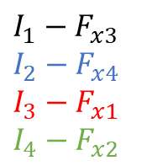







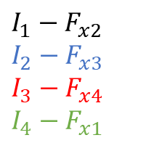









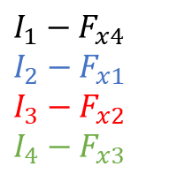









Parallelism Scheme 2:
QPE_DISTRI_DATA_REUSED_DYNAMIC
Fully-input-activation-reuse
Partial-filter-reuse
QPE
QPE
$$I_{1}−F_{x2}$$
$$I_{2}−F_{x3}$$
$$I_{3}−F_{x4}$$
$$I_{4}−F_{x1}$$
$$IO_{1}$$
$$IO_{2}$$
$$IO_{3}$$
$$IO_{4}$$
$$IO_{1}$$
$$IO_{2}$$
$$IO_{3}$$
$$IO_{4}$$
$$I_{1}−F_{x3}$$
$$I_{2}−F_{x4}$$
$$I_{3}−F_{x1}$$
$$I_{4}−F_{x2}$$
$$F_{x1}$$
$$F_{x2}$$
$$F_{x3}$$
$$F_{x4}$$
$$F_{x1}$$
$$F_{x2}$$
$$F_{x3}$$
$$F_{x4}$$
PE-1
PE-2
PE-3
PE-4
PE-1
PE-2
PE-3
PE-4
QPE
QPE
$$I_{1}−F_{x1}$$
$$I_{2}−F_{x2}$$
$$I_{3}−F_{x3}$$
$$I_{4}−F_{x4}$$
$$IO_{1}$$
$$IO_{2}$$
$$IO_{3}$$
$$IO_{4}$$
$$IO_{1}$$
$$IO_{2}$$
$$IO_{3}$$
$$IO_{4}$$
$$I_{1}−F_{x4}$$
$$I_{2}−F_{x1}$$
$$I_{3}−F_{x2}$$
$$I_{4}−F_{x3}$$
$$F_{x1}$$
$$F_{x2}$$
$$F_{x3}$$
$$F_{x4}$$
$$F_{x1}$$
$$F_{x2}$$
$$F_{x3}$$
$$F_{x4}$$
PE-1
PE-2
PE-3
PE-4
PE-1
PE-2
PE-3
PE-4

Slide 56




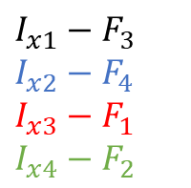




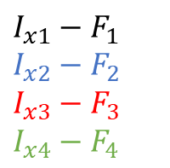
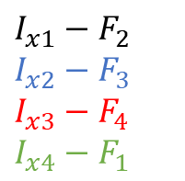















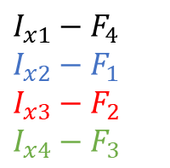

Parallelism Scheme 2:
QPE_DISTRI_DATA_REUSED_DYNAMIC
Fully-filter-reuse
Partial-input-activation-reuse
QPE
QPE
$$I_{x1}−F_{2}$$
$$I_{x2}−F_{3}$$
$$I_{x3}−F_{4}$$
$$I_{x4}−F_{1}$$
$$IO_{x1}$$
$$IO_{x2}$$
$$IO_{x3}$$
$$IO_{x4}$$
$$IO_{x1}$$
$$IO_{x2}$$
$$IO_{x3}$$
$$IO_{x4}$$
$$I_{x1}−F_{3}$$
$$I_{x2}−F_{4}$$
$$I_{x3}−F_{1}$$
$$I_{x4}−F_{2}$$
$$F_{1}$$
$$F_{2}$$
$$F_{3}$$
$$F_{4}$$
$$F_{1}$$
$$F_{2}$$
$$F_{3}$$
$$F_{4}$$
PE-1
PE-2
PE-3
PE-4
PE-1
PE-2
PE-3
PE-4
QPE
QPE
$$I_{x1}−F_{1}$$
$$I_{x2}−F_{2}$$
$$I_{x3}−F_{3}$$
$$I_{x4}−F_{4}$$
$$IO_{x1}$$
$$IO_{x2}$$
$$IO_{x3}$$
$$IO_{x4}$$
$$IO_{x1}$$
$$IO_{x2}$$
$$IO_{x3}$$
$$IO_{x4}$$
$$I_{x1}−F_{4}$$
$$I_{x2}−F_{1}$$
$$I_{x3}−F_{2}$$
$$I_{x4}−F_{3}$$
$$F_{1}$$
$$F_{2}$$
$$F_{3}$$
$$F_{4}$$
$$F_{1}$$
$$F_{2}$$
$$F_{3}$$
$$F_{4}$$
PE-1
PE-2
PE-3
PE-4
PE-1
PE-2
PE-3
PE-4

Slide 57
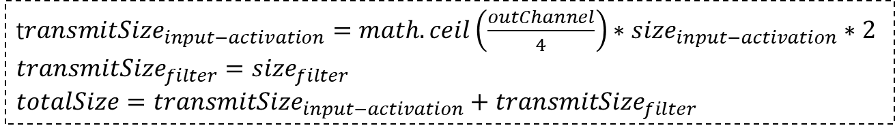
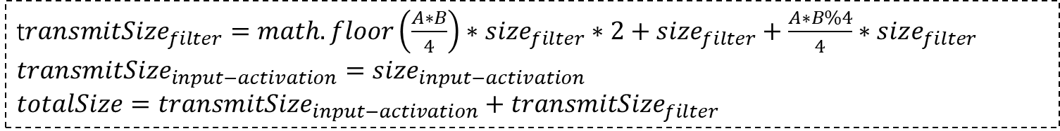
Parallelism Scheme 2:
QPE_DISTRI_DATA_REUSED_DYNAMIC
Fully-input-activation-reuse
Partial-filter-reuse
OR
Fully-filter-reuse
Partial-input-activation-reuse
?
t$ransmitSize_{filter}=math.floor\left(\frac{A∗B}{4}\right)∗size_{filter}∗2+size_{filter}+\frac{A∗B\%4}{4}∗size_{filter}$
$$transmitSize_{input−activation}=size_{input−activation}$$
$$totalSize=transmitSize_{input−activation}+transmitSize_{filter}$$
t$ransmitSize_{input−activation}=math.ceil\left(\frac{outChannel}{4}\right)∗size_{input−activation}∗2$
$$transmitSize_{filter}=size_{filter}$$
$$totalSize=transmitSize_{input−activation}+transmitSize_{filter}$$

Slide 58
CONV Parallelism Scheme 3

Slide 59
Parallelism Scheme 3:
QPE_DISTRI_DATA_REUSED_DYNAMIC_FULL
QPE
IO
IO
IO
IO
input-activation/filter reuse
Consider the case, in which all PEs are used
2 Pes as a group (A from NoC, B from AHB )
Data in/out BW 128bit * 250MB
F
F
F
F
PE-1
PE-1
PE-1
PE-1
+: data reuse, automatically select input-activation- or filter-reuse
+: Considering fully utilize 4 Pes
-: most complicate distribution algorithm

Slide 60
Fully-input-activation-reuse
Partial-filter-reuse

Slide 61













Parallelism Scheme 3:
QPE_DISTRI_DATA_REUSED_DYNAMIC_FULL
Special Case: 4 filters and 1 input-activation!!!
Fully-input-activation-reuse
Partial-filter-reuse
QPE
QPE
$$I_{1}−F_{x2}$$
$$IO_{1}$$
$$IO_{1}$$
$$I_{1}−F_{x3}$$
$$F_{x1}$$
$$F_{x2}$$
$$F_{x3}$$
$$F_{x4}$$
$$F_{x1}$$
$$F_{x2}$$
$$F_{x3}$$
$$F_{x4}$$
PE-1
PE-2
PE-3
PE-4
PE-1
PE-2
PE-3
PE-4
QPE
QPE
$$I_{1}−F_{x1}$$
$$IO_{1}$$
$$IO_{1}$$
$$I_{1}−F_{x4}$$
$$F_{x1}$$
$$F_{x1}$$
$$F_{x2}$$
$$F_{x3}$$
$$F_{x4}$$
PE-1
PE-2
PE-3
PE-4
PE-1
PE-2
PE-3
PE-4
$$Clocks_{total} = wfc∗4+cc∗4$$

Slide 62

Parallelism Scheme 3:
QPE_DISTRI_DATA_REUSED_DYNAMIC_FULL
Special Case: 4 filters and 1 input-activation!!!
Fully-input-activation-reuse
Partial-filter-reuse
QPE
$$I_{1}−F_{x1}$$
$$I_{1}−F_{x2}$$
$$I_{1}−F_{x3}$$
$$I_{1}−F_{x4}$$
$$IO_{1}$$
$$IO_{1}$$
$$IO_{1}$$
$$IO_{1}$$
$$F_{x1}$$
$$F_{x2}$$
$$F_{x3}$$
$$F_{x4}$$
PE-1
PE-2
PE-3
PE-4
$$Clocks_{total} = wfc∗4 + \frac{wic∗3}{filter_{iter}} + cc$$

Slide 63
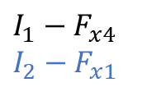

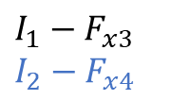

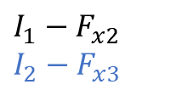


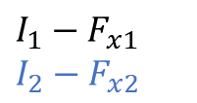
Parallelism Scheme 3:
QPE_DISTRI_DATA_REUSED_DYNAMIC_FULL
Special Case: 4 filters and 2 input-activation!!!
Fully-input-activation-reuse
Partial-filter-reuse
QPE
QPE
$$I_{1}−F_{x3}$$
$$I_{2}−F_{x4}$$
$$I_{1}−F_{x2}$$
$$I_{2}−F_{x3}$$
$$IO_{1}$$
$$IO_{2}$$
$$IO_{1}$$
$$IO_{2}$$
$$F_{x1}$$
$$F_{x2}$$
$$F_{x3}$$
$$F_{x4}$$
$$F_{x1}$$
$$F_{x2}$$
$$F_{x3}$$
$$F_{x4}$$
PE-1
PE-2
PE-3
PE-4
PE-1
PE-2
PE-3
PE-4
QPE
QPE
$$I_{1}−F_{x1}$$
$$I_{2}−F_{x2}$$
$$IO_{1}$$
$$IO_{2}$$
$$IO_{1}$$
$$IO_{2}$$
$$I_{1}−F_{x4}$$
$$I_{2}−F_{x1}$$
$$F_{x1}$$
$$F_{x2}$$
$$F_{x1}$$
$$F_{x2}$$
$$F_{x3}$$
$$F_{x4}$$
PE-1
PE-2
PE-3
PE-4
PE-1
PE-2
PE-3
PE-4
$$Clocks_{total} = wfc∗4+cc∗4$$

Slide 64


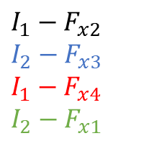


Parallelism Scheme 3:
QPE_DISTRI_DATA_REUSED_DYNAMIC_FULL
Special Case: 4 filters and 2 input-activation!!!
Fully-input-activation-reuse
Partial-filter-reuse
QPE
$$I_{1}−F_{x2}$$
$$I_{2}−F_{x3}$$
$$I_{1}−F_{x4}$$
$$I_{2}−F_{x1}$$
$$IO_{1}$$
$$IO_{2}$$
$$IO_{1}$$
$$IO_{2}$$
$$F_{x1}$$
$$F_{x2}$$
$$F_{x3}$$
$$F_{x4}$$
PE-1
PE-2
PE-3
PE-4
QPE
$$I_{1}−F_{x1}$$
$$I_{2}−F_{x2}$$
$$I_{1}−F_{x3}$$
$$I_{2}−F_{x4}$$
$$IO_{1}$$
$$IO_{2}$$
$$IO_{1}$$
$$IO_{2}$$
$$F_{x1}$$
$$F_{x2}$$
$$F_{x3}$$
$$F_{x4}$$
PE-1
PE-2
PE-3
PE-4
$$Clocks_{total} = wfc∗4 + \frac{wic∗2}{filter_{iter}} + cc∗2$$

Slide 65
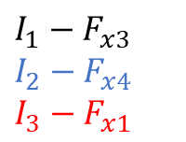
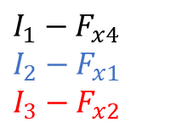
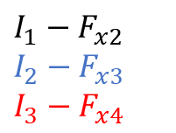

Parallelism Scheme 3:
QPE_DISTRI_DATA_REUSED_DYNAMIC_FULL
Special Case: 4 filters and 3 input-activation!!!
Fully-input-activation-reuse
Partial-filter-reuse
QPE
QPE
$$I_{1}−F_{x2}$$
$$I_{2}−F_{x3}$$
$$I_{3}−F_{x4}$$
$$IO_{1}$$
$$IO_{2}$$
$$IO_{3}$$
$$IO_{1}$$
$$IO_{2}$$
$$IO_{3}$$
$$I_{1}−F_{x3}$$
$$I_{2}−F_{x4}$$
$$I_{3}−F_{x1}$$
$$F_{x1}$$
$$F_{x2}$$
$$F_{x3}$$
$$F_{x4}$$
$$F_{x1}$$
$$F_{x2}$$
$$F_{x3}$$
$$F_{x4}$$
PE-1
PE-2
PE-3
PE-4
PE-1
PE-2
PE-3
PE-4
QPE
QPE
$$I_{1}−F_{x1}$$
$$I_{2}−F_{x2}$$
$$I_{3}−F_{x3}$$
$$IO_{1}$$
$$IO_{2}$$
$$IO_{3}$$
$$IO_{1}$$
$$IO_{2}$$
$$IO_{3}$$
$$I_{1}−F_{x4}$$
$$I_{2}−F_{x1}$$
$$I_{3}−F_{x2}$$
$$F_{x1}$$
$$F_{x2}$$
$$F_{x3}$$
$$F_{x4}$$
$$F_{x1}$$
$$F_{x2}$$
$$F_{x3}$$
$$F_{x4}$$
PE-1
PE-2
PE-3
PE-4
PE-1
PE-2
PE-3
PE-4
$$Clocks_{total} = wfc∗4+cc∗4$$

Slide 66

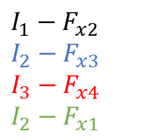






Parallelism Scheme 3:
QPE_DISTRI_DATA_REUSED_DYNAMIC_FULL
Special Case: 4 filters and 3 input-activation!!!
Fully-input-activation-reuse
Partial-filter-reuse
QPE
QPE
$$I_{1}−F_{x2}$$
$$I_{2}−F_{x3}$$
$$I_{3}−F_{x4}$$
$$I_{2}−F_{x1}$$
$$IO_{1}$$
$$IO_{2}$$
$$IO_{3}$$
$$IO_{2}$$
$$IO_{1}$$
$$IO_{2}$$
$$IO_{3}$$
$$IO_{3}$$
$$I_{1}−F_{x3}$$
$$I_{2}−F_{x4}$$
$$I_{3}−F_{x1}$$
$$I_{3}−F_{x2}$$
$$F_{x1}$$
$$F_{x2}$$
$$F_{x3}$$
$$F_{x4}$$
$$F_{x1}$$
$$F_{x2}$$
$$F_{x3}$$
$$F_{x4}$$
PE-1
PE-2
PE-3
PE-4
PE-1
PE-2
PE-3
PE-4
QPE
$$I_{1}−F_{x1}$$
$$I_{2}−F_{x2}$$
$$I_{3}−F_{x3}$$
$$I_{1}−F_{x4}$$
$$IO_{1}$$
$$IO_{2}$$
$$IO_{3}$$
$$IO_{1}$$
$$F_{x1}$$
$$F_{x2}$$
$$F_{x3}$$
$$F_{x4}$$
PE-1
PE-2
PE-3
PE-4
$$Clocks_{total} = wfc∗4 +wic∗3+ cc∗3$$

Slide 67
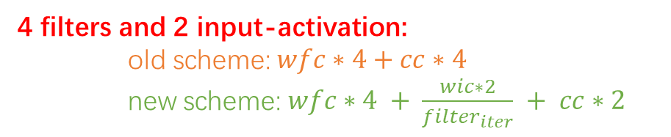
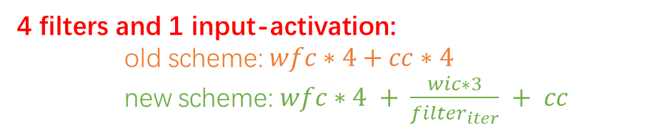
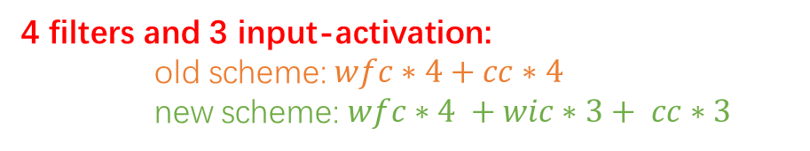
Fully-input-activation-reuse
Partial-filter-reuse
Summary
4 filters and 1 input-activation:
old scheme: $wfc∗4+cc∗4$
new scheme: $wfc∗4 + \frac{wic∗3}{filter_{iter}} + cc$
→ Select scheme with fewer clocks
4 filters and 2 input-activation:
old scheme: $wfc∗4+cc∗4$
new scheme: $wfc∗4 + \frac{wic∗2}{filter_{iter}} + cc∗2$
→ Select scheme with fewer clocks
4 filters and 3 input-activation:
old scheme: $wfc∗4+cc∗4$
new scheme: $wfc∗4 +wic∗3+ cc∗3$
→ Select scheme with fewer clocks

Slide 68
Fully-filter-reuse
Partial-input-activation-reuse

Slide 69




Parallelism Scheme 3:
QPE_DISTRI_DATA_REUSED_DYNAMIC_FULL
Special Case: 4 filters and 1 input-activation!!!
Fully-filter-reuse
Partial-input-activation-reuse
QPE
QPE
$$I_{x1}−F_{2}$$
$$IO_{x1}$$
$$IO_{x1}$$
$$I_{x1}−F_{3}$$
$$F_{1}$$
$$F_{2}$$
$$F_{3}$$
$$F_{4}$$
$$F_{1}$$
$$F_{2}$$
$$F_{3}$$
$$F_{4}$$
PE-1
PE-2
PE-3
PE-4
PE-1
PE-2
PE-3
PE-4
QPE
QPE
$$I_{x1}−F_{1}$$
$$−$$
$$−$$
$$−$$
$$IO_{x1}$$
$$IO_{x1}$$
$$I_{x1}−F_{4}$$
$$F_{1}$$
$$F_{2}$$
$$F_{3}$$
$$F_{4}$$
$$F_{1}$$
$$F_{2}$$
$$F_{3}$$
$$F_{4}$$
PE-1
PE-2
PE-3
PE-4
PE-1
PE-2
PE-3
PE-4
$$Clocks_{total} = wic+cc∗4$$

Slide 70


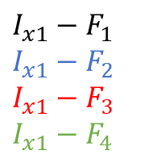
Parallelism Scheme 3:
QPE_DISTRI_DATA_REUSED_DYNAMIC_FULL
Special Case: 4 filters and 1 input-activation!!!
Fully-filter-reuse
Partial-input-activation-reuse
QPE
$$I_{x1}−F_{1}$$
$$I_{x1}−F_{2}$$
$$I_{x1}−F_{3}$$
$$I_{x1}−F_{4}$$
$$IO_{x1}$$
$$IO_{x1}$$
$$IO_{x1}$$
$$IO_{x1}$$
$$F_{1}$$
$$F_{2}$$
$$F_{3}$$
$$F_{4}$$
PE-1
PE-2
PE-3
PE-4
$$Clocks_{total} = wic∗4+cc$$

Slide 71
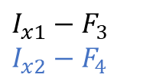




Parallelism Scheme 3:
QPE_DISTRI_DATA_REUSED_DYNAMIC_FULL
Special Case: 4 filters and 2 input-activation!!!
Fully-filter-reuse
Partial-input-activation-reuse
QPE
QPE
$$I_{x1}−F_{2}$$
$$I_{x2}−F_{3}$$
$$IO_{x1}$$
$$IO_{x2}$$
$$IO_{x1}$$
$$IO_{x2}$$
$$I_{x1}−F_{3}$$
$$I_{x2}−F_{4}$$
$$F_{1}$$
$$F_{2}$$
$$F_{3}$$
$$F_{4}$$
$$F_{1}$$
$$F_{2}$$
$$F_{3}$$
$$F_{4}$$
PE-1
PE-2
PE-3
PE-4
PE-1
PE-2
PE-3
PE-4
QPE
QPE
$$I_{x1}−F_{1}$$
$$I_{x2}−F_{2}$$
$$−$$
$$−$$
$$IO_{x1}$$
$${IO}_{x2}$$
$$IO_{x1}$$
$$IO_{x2}$$
$$I_{x1}−F_{4}$$
$$I_{x2}−F_{1}$$
$$F_{1}$$
$$F_{2}$$
$$F_{3}$$
$$F_{4}$$
$$F_{1}$$
$$F_{2}$$
$$F_{3}$$
$$F_{4}$$
PE-1
PE-2
PE-3
PE-4
PE-1
PE-2
PE-3
PE-4
$$Clocks_{total} = wic∗2+cc∗4$$

Slide 72







Parallelism Scheme 3:
QPE_DISTRI_DATA_REUSED_DYNAMIC_FULL
Special Case: 4 filters and 2 input-activation!!!
Fully-filter-reuse
Partial-input-activation-reuse
QPE
$$I_{x1}−F_{2}$$
$$I_{x2}−F_{3}$$
$$I_{x1}−F_{4}$$
$$I_{x2}−F_{1}$$
$$IO_{x1}$$
$$IO_{x2}$$
$$IO_{x1}$$
$$IO_{x2}$$
$$F_{1}$$
$$F_{2}$$
$$F_{3}$$
$$F_{4}$$
PE-1
PE-2
PE-3
PE-4
QPE
$$I_{x1}−F_{1}$$
$$I_{x2}−F_{2}$$
$$I_{x1}−F_{3}$$
$$I_{x2}−F_{4}$$
$$IO_{x1}$$
$$IO_{x2}$$
$$IO_{x1}$$
$$IO_{x2}$$
$$F_{1}$$
$$F_{2}$$
$$F_{3}$$
$$F_{4}$$
PE-1
PE-2
PE-3
PE-4
$$Clocks_{total} = wic∗4+cc∗2$$

Slide 73




Parallelism Scheme 3:
QPE_DISTRI_DATA_REUSED_DYNAMIC_FULL
Special Case: 4 filters and 3 input-activation!!!
Fully-filter-reuse
Partial-input-activation-reuse
QPE
QPE
$$I_{x1}−F_{2}$$
$$I_{x2}−F_{3}$$
$$I_{x3}−F_{4}$$
$$IO_{x1}$$
$$IO_{x2}$$
$$IO_{x3}$$
$$IO_{x1}$$
$$IO_{x2}$$
$$IO_{x3}$$
$$I_{x1}−F_{3}$$
$$I_{x2}−F_{4}$$
$$I_{x3}−F_{1}$$
$$F_{1}$$
$$F_{2}$$
$$F_{3}$$
$$F_{4}$$
$$F_{1}$$
$$F_{2}$$
$$F_{3}$$
$$F_{4}$$
PE-1
PE-2
PE-3
PE-4
PE-1
PE-2
PE-3
PE-4
QPE
QPE
$$I_{x1}−F_{1}$$
$$I_{x2}−F_{2}$$
$$I_{x3}−F_{3}$$
$$I_{x1}−F_{1}$$
$$IO_{x1}$$
$$IO_{x2}$$
$$IO_{x3}$$
$$IO_{x1}$$
$$IO_{x2}$$
$$IO_{x3}$$
$$I_{x1}−F_{4}$$
$$I_{x2}−F_{1}$$
$$I_{x3}−F_{2}$$
$$F_{1}$$
$$F_{2}$$
$$F_{3}$$
$$F_{4}$$
$$F_{1}$$
$$F_{2}$$
$$F_{3}$$
$$F_{4}$$
PE-1
PE-2
PE-3
PE-4
PE-1
PE-2
PE-3
PE-4
$$Clocks_{total} = wic∗4+cc∗4$$

Slide 74




Parallelism Scheme 3:
QPE_DISTRI_DATA_REUSED_DYNAMIC_FULL
Special Case: 4 filters and 3 input-activation!!!
Fully-filter-reuse
Partial-input-activation-reuse
QPE
QPE
$$I_{x1}−F_{2}$$
$$I_{x2}−F_{3}$$
$$I_{x3}−F_{4}$$
$$I_{x1}−F_{1}$$
$$IO_{x1}$$
$$IO_{x2}$$
$$IO_{x3}$$
$$IO_{x1}$$
$$IO_{x1}$$
$$IO_{x2}$$
$$IO_{x3}$$
$$IO_{x2}$$
$$I_{x1}−F_{3}$$
$$I_{x2}−F_{4}$$
$$I_{x3}−F_{1}$$
$$I_{x2}−F_{2}$$
$$F_{1}$$
$$F_{2}$$
$$F_{3}$$
$$F_{4}$$
$$F_{1}$$
$$F_{2}$$
$$F_{3}$$
$$F_{4}$$
PE-1
PE-2
PE-3
PE-4
PE-1
PE-2
PE-3
PE-4
QPE
$$I_{x1}−F_{1}$$
$$I_{x2}−F_{2}$$
$$I_{x3}−F_{3}$$
$$I_{x3}−F_{4}$$
$$IO_{x1}$$
$$IO_{x2}$$
$$IO_{x3}$$
$$IO_{x3}$$
$$F_{1}$$
$$F_{2}$$
$$F_{3}$$
$$F_{4}$$
PE-1
PE-2
PE-3
PE-4
$$Clocks_{total} = wic∗6+cc∗3$$

Slide 75



Fully-input-activation-reuse
Partial-filter-reuse
Summary
4 filters and 1 input-activation:
old scheme:$wic+cc∗4$
new scheme:$wic∗4+cc$
→ Select scheme with fewer clocks
4 filters and 2 input-activation:
old scheme:$wic∗2+cc∗4$
new scheme:$wic∗4+cc∗2$
→ Select new scheme
4 filters and 3 input-activation:
old scheme:$wic∗3+cc∗4$
new scheme:$wic∗6+cc∗3$
→ Select new scheme

Slide 76
QPE FC Simulation

Slide 77






Parallelism Scheme: No data reuse
$A$ parts
$B$ parts
$A$ parts
$B$ parts
input
output
weight
Only “input” can be reuse and can be reused $A$ times
Reuse “input”
+: decrease BW problem caused by “input” $A$ times
-: increase BW problem caused by “output” $B$ times
-: can not hidden computation clocks by ARM core
Not reuse “input”
+: hidden computation clocks by ARM core
  -: increase BW problem caused by “input” $A$ times
As the splitting scheme will choose $A$ as small as possible, which decrease BW problem caused by “input”
Under most situation: $A < B$
No reuse “input” takes extra benefit: hidden ARM computation clocks
Choose no “input” reuse

