Slide 1
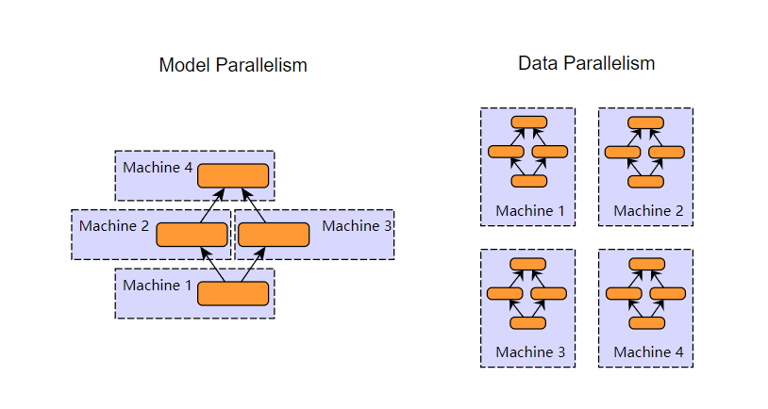

Slide 2

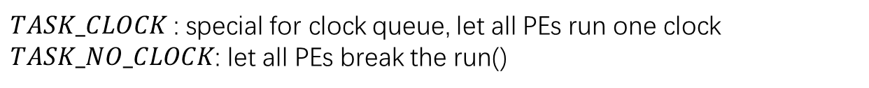

Task Description:
$TASK_CLOCK$: special for clock queue, let all PEs run one clock
$TASK_NO_CLOCK$: let all PEs break the run()
Thread.start()
Start
QPE Thread
Wait clockQueue
(block)
$$TASK_CLOCK$$
Run one clock
$$TASK_NO_CLOCK$$
Break
while loop
Thread.join()
End
QPE Thread

Slide 3
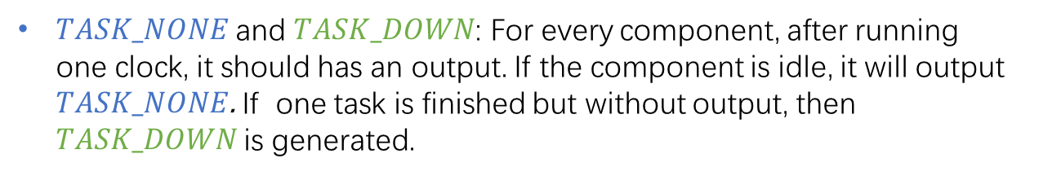
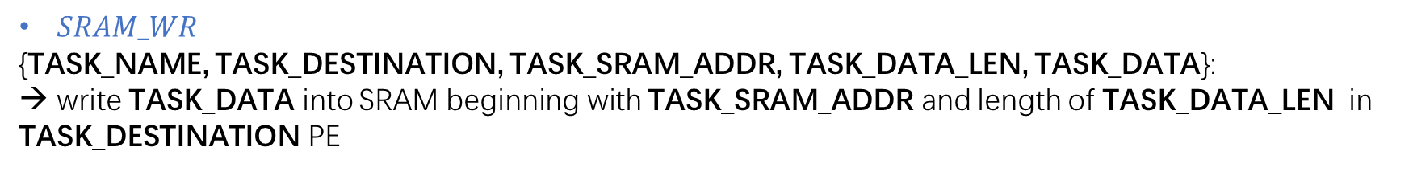
Task Description:
$TASK_NONE$and $TASK_DOWN$: For every component, after running one clock, it should has an output. If the component is idle, it will output $TASK_NONE$. If one task is finished but without output, then $TASK_DOWN$ is generated.
$SRAM_WR$
{TASK_NAME, TASK_DESTINATION, TASK_SRAM_ADDR, TASK_DATA_LEN, TASK_DATA}:
→ write TASK_DATA into SRAM beginning with TASK_SRAM_ADDR and length of TASK_DATA_LEN in TASK_DESTINATION PE

Slide 4
12.02.2019

Slide 5
Qpe
ARM
ARM
MLA
MLA
Every block is a class (Except NoC Interface)
Each object has run()/process()/accelerate()/transfer() function, calling once is equivalent to running the hardware one clock.
Each object has a task FIFO with different size, which stores the tasks from itself or other object.
Each clock will fetch only one task from task FIFO.
DMA
SRAM
DMA
SRAM
NoC Interface
NoC Interface
NoC (4 clocks delay)
ARM
ARM
MLA
MLA
DMA
SRAM
DMA
SRAM
NoC Interface
NoC Interface

Slide 6
Qpe
ARM
ARM
MLA
MLA
DMA
SRAM
DMA
SRAM
NoC Interface
NoC Interface
Task from PE and other QPE can be add into NoC at the same time.
→Adding into Queue doesn’t mean being processing.
NoC (4 clocks delay)
ARM
ARM
MLA
MLA
DMA
SRAM
DMA
SRAM
NoC Interface
NoC Interface

Slide 7
Qpe
ARM
ARM
MLA
MLA
DMA
SRAM
DMA
SRAM
NoC Interface
NoC Interface
Every clock, there is only one output
→simulating that NoC processing one packet per clock
NoC (4 clocks delay)
ARM
ARM
MLA
MLA
DMA
SRAM
DMA
SRAM
NoC Interface
NoC Interface

Slide 8
DRAM Controller:
Every clock, there is only one task being output from Queue.
→ simulating that one packet per clock
Task from QPE and DRAM can be add into DRAM interface at the same time.
→ Adding into Queue doesn’t mean being processing.
DRAM Interface
(7 clock delay)
DRAM

Slide 9
Host Interface:
Every clock, there is only one task being output from Queue.
→ simulating that one packet per clock
Task from HOST_QPE and HOST can be add into Host interface at the same time.
→ Adding into Queue doesn’t mean being processing.
4 HOST_QPE
Host Interface
(10 clock delay)
HOST

Slide 10
SpiNNaker2:
DRAM Controller
QPE
QPE
QPE
QPE
QPE
QPE
DRAM Controller
QPE
QPE
QPE
QPE
QPE
QPE
QPE
QPE
QPE
QPE
QPE
QPE
DRAM Controller
QPE
QPE
QPE
QPE
QPE
QPE
DRAM Controller
QPE
QPE
QPE
QPE
QPE
QPE
QPE
QPE
QPE
QPE
QPE
QPE
HOST Interface

Slide 11
Qpe Block Process
PE
PE
PE
PE
PE
PE
DRAM Controller
NoC
NoC
NoC
PE
PE
PE
PE
PE
PE
Thread is slow for CPU intensive task (GIL). →Processes are more suitable for CPU intensive tasks
Each QPE-process is much slower because the task of a qpe process is too small, so much time is wasted for process switching. →Every process contains 9 QPEs.
PE
PE
PE
PE
PE
PE
NoC
NoC
NoC
PE
PE
PE
PE
PE
PE
PE
PE
PE
PE
PE
PE
NoC
NoC
NoC
PE
PE
PE
PE
PE
PE

Slide 12
Splitter
Data Generator
Distributor
SpiNNaker2
Main Process (Distributor+Splitter+SpiNNaker2+DRAMs)
Main Process
QPE-Block Process (9 QPEs+DRAM)
QPE-Block Process (9 QPEs+DRAM)
QPE-Block Process (9 QPEs+DRAM)
QPE-Block Process (9 QPEs+DRAM)

Slide 13
SpiNNaker2:
DRAM Controller
QPE
QPE
QPE
QPE
QPE
QPE
DRAM Controller
QPE
QPE
QPE
QPE
QPE
QPE
QPE
QPE
QPE
QPE
QPE
QPE
DRAM Controller
QPE
QPE
QPE
QPE
QPE
QPE
DRAM Controller
Host QPEs:
Responsible for managing a tri-block
QPE
QPE
QPE
QPE
QPE
QPE
QPE
QPE
QPE
QPE
QPE
QPE
HOST Interface

Slide 14
SpiNNaker2:
DRAM Controller
QPE
QPE
QPE
QPE
QPE
QPE
DRAM Controller
QPE
QPE
QPE
QPE
QPE
QPE
QPE
QPE
QPE
QPE
QPE
QPE
DRAM Controller
QPE
QPE
QPE
QPE
QPE
QPE
DRAM Controller
Host QPEs:
Responsible for managing a tri-block
QPE
QPE
QPE
QPE
QPE
QPE
triple-block :
A 3 x 3 QPE array
QPE
QPE
QPE
QPE
QPE
QPE
HOST Interface

Slide 15
SpiNNaker2:
DRAM Controller
QPE
QPE
QPE
QPE
QPE
QPE
DRAM Controller
QPE
QPE
QPE
QPE
QPE
QPE
QPE
QPE
QPE
QPE
QPE
QPE
DRAM Controller
QPE
QPE
QPE
QPE
QPE
QPE
DRAM Controller
Storage QPEs:
Responsible for storing in/out-activation;
Data Rearrangement
QPE
QPE
QPE
QPE
QPE
QPE
QPE
QPE
QPE
QPE
QPE
QPE
HOST Interface

Slide 16
SpiNNaker2:
DRAM Controller
QPE
QPE
QPE
QPE
QPE
QPE
DRAM Controller
QPE
QPE
QPE
QPE
QPE
QPE
QPE
QPE
QPE
QPE
QPE
QPE
DRAM Controller
QPE
QPE
QPE
QPE
QPE
QPE
DRAM Controller
Storage QPEs:
Responsible for storing in/out-activation;
Data Rearrangement
QPE
QPE
QPE
QPE
QPE
QPE
basic-block :
A 2 x 2 QPE array
QPE
QPE
QPE
QPE
QPE
QPE
HOST Interface

Slide 17
SpiNNaker2:
DRAM Controller
QPE
QPE
QPE
QPE
QPE
QPE
DRAM Controller
QPE
QPE
QPE
QPE
QPE
QPE
double-block :
2 basic-blocks
QPE
QPE
QPE
QPE
QPE
QPE
DRAM Controller
QPE
QPE
QPE
QPE
QPE
QPE
DRAM Controller
Storage QPEs:
Responsible for storing in/out-activation;
Data Rearrangement
QPE
QPE
QPE
QPE
QPE
QPE
basic-block :
A 2 x 2 QPE array
QPE
QPE
QPE
QPE
QPE
QPE
HOST Interface

Slide 18
SpiNNaker2:
DRAM Controller
QPE
QPE
QPE
QPE
QPE
QPE
DRAM Controller
double-block :
2 basic-blocks
QPE
QPE
QPE
QPE
QPE
QPE
QPE
QPE
QPE
QPE
QPE
QPE
Weight migration direction
DRAM Controller
QPE
QPE
QPE
QPE
QPE
QPE
DRAM Controller
Storage QPEs:
Responsible for storing in/out-activation;
Data Rearrangement
QPE
QPE
QPE
QPE
QPE
QPE
basic-block :
A 2 x 2 QPE array
QPE
QPE
QPE
QPE
QPE
QPE
HOST Interface

Slide 19
CONV: Weight(16)

Slide 20
SpiNNaker2: CONV_3: Weight(16)
Step 1
DRAM Controller
F12-15
F12-15
F12-15
DRAM Controller
F8-11
F8-11
F8-11
QPE
QPE
DRAM Controller
QPE
QPE
DRAM Controller
F4-7
F4-7
F4-7
F0-3
F0-3
F0-3
HOST Interface

Slide 21
CONV: Weight(32)

Slide 22
SpiNNaker2: CONV_3: Weight(32)
2
Step 1
DRAM Controller
F3’
F1’
F3’
F1’
F3’
F1’
DRAM Controller
Filter block 1
1
F5’
F7’
F5’
F7’
F5’
F7’
F3’
F1’
QPE
QPE
F3’
F1’
DRAM Controller
F5’
F7’
QPE
QPE
F5’
F7’
DRAM Controller
F3’
F1’
F3’
F1’
F3’
F1’
F5’
F7’
F5’
F7’
F5’
F7’
HOST Interface

Slide 23
SpiNNaker2: CONV_3: Weight(32)
Step 1
DRAM Controller
F3’
F1’
F3’
F1’
F3’
F1’
DRAM Controller
Filter block 1
F5’
F7’
F5’
F7’
F5’
F7’
F3’
F1’
QPE
QPE
F3’
F1’
DRAM Controller
F5’
F7’
QPE
QPE
F5’
F7’
DRAM Controller
F3’
F1’
F3’
F1’
F3’
F1’
F5’
F7’
F5’
F7’
F5’
F7’
HOST Interface

Slide 24
SpiNNaker2: CONV_3: Weight(32)
Step 2
DRAM Controller
F3’
F8’
F1’
F6’
F3’
F8’
F1’
F6’
F3’
F8’
F1’
F6’
DRAM Controller
Filter block 2
F5’
F2’
F7’
F4’
F5’
F2’
F7’
F4’
F5’
F2’
F7’
F4’
F3’
F8’
F1’
F6’
QPE
QPE
F3’
F8’
F1’
F6’
DRAM Controller
F5’
F2’
F7’
F4’
QPE
QPE
F5’
F2’
F7’
F4’
DRAM Controller
F3’
F8’
F1’
F6’
F3’
F8’
F1’
F6’
F3’
F8’
F1’
F6’
F5’
F2’
F7’
F4’
F5’
F2’
F7’
F4’
F5’
F2’
F7’
F4’
HOST Interface

Slide 25
SpiNNaker2: CONV_3: Weight(32)
Step 2
DRAM Controller
F3’
F8’
F1’
F6’
F3’
F8’
F1’
F6’
F3’
F8’
F1’
F6’
DRAM Controller
Filter block 2
F5’
F2’
F7’
F4’
F5’
F2’
F7’
F4’
F5’
F2’
F7’
F4’
F3’
F8’
F1’
F6’
QPE
QPE
F3’
F8’
F1’
F6’
DRAM Controller
F5’
F2’
F7’
F4’
QPE
QPE
F5’
F2’
F7’
F4’
DRAM Controller
F3’
F8’
F1’
F6’
F3’
F8’
F1’
F6’
F3’
F8’
F1’
F6’
F5’
F2’
F7’
F4’
F5’
F2’
F7’
F4’
F5’
F2’
F7’
F4’
HOST Interface

Slide 26
CONV: Weight(64)

Slide 27
SpiNNaker2: CONV_3: Weight(64)
2
3
Step 1
DRAM Controller
DRAM Controller
4
1
F13’
F9’
F9’
QPE
QPE
F5’
DRAM Controller
F13’
QPE
QPE
DRAM Controller
F1’
F1’
F5’
HOST Interface

Slide 28
SpiNNaker2: CONV_3: Weight(64)
2
3
Step 2
DRAM Controller
F14’
F10’
F10’
DRAM Controller
4
1
F13’
F9’
F9’
F14’
QPE
QPE
F5’
DRAM Controller
F13’
QPE
QPE
F6’
DRAM Controller
F1’
F1’
F5’
F2’
F2’
F6’
HOST Interface

Slide 29
SpiNNaker2: CONV_3: Weight(64)
2
3
Step 3
DRAM Controller
F14’
F15’
F10’
F10’
DRAM Controller
4
1
F13’
F9’
F11’
F9’
F11’
F14’
F15’
QPE
QPE
F5’
DRAM Controller
F13’
QPE
QPE
F7’
F6’
DRAM Controller
F3’
F1’
F3’
F1’
F5’
F2’
F2’
F7’
F6’
HOST Interface

Slide 30
SpiNNaker2: CONV_3: Weight(64)
2
3
Step 4
DRAM Controller
F14’
F15’
F12’
F10’
F12’
F10’
DRAM Controller
4
1
F16’
F13’
F9’
F11’
F9’
F11’
F14’
F15’
QPE
QPE
F5’
F8’
DRAM Controller
F16’
F13’
QPE
QPE
F7’
F6’
DRAM Controller
F3’
F1’
F3’
F1’
F5’
F8’
F2’
F4’
F2’
F4’
F7’
F6’
HOST Interface

Slide 31
CONV: Weight(128)

Slide 32
SpiNNaker2: CONV_3: Weight(128)
Step 1
DRAM Controller
8
6
4
2
DRAM Controller
7
5
3
1
3
5
7
1
2
1
QPE
QPE
4
8
2
6
DRAM Controller
4
3
QPE
QPE
DRAM Controller
6
5
1
3
5
7
8
7
2
4
6
8
HOST Interface

Slide 33
CONV: InActi(8)

Slide 34
SpiNNaker2: CONV_3: InActi(8)
Step 1
DRAM Controller
I12
I8
DRAM Controller
Time: 2x
Copy to self when inActi arrives
QPE
QPE
DRAM Controller
QPE
QPE
DRAM Controller
I0
I4
HOST Interface

Slide 35
SpiNNaker2: CONV_3: InActi(8)
Step 2
DRAM Controller
I12,
I13
I12
I8
I8,I9
DRAM Controller
Time: 2x
I12
I12
Copy to self when inActi arrives
QPE
QPE
I8
I8
DRAM Controller
I0
I0
QPE
QPE
DRAM Controller
I4
I4
I0,I1
I0
I4
I4,I5
HOST Interface

Slide 36
SpiNNaker2: CONV_3: InActi(8)
Step 3
DRAM Controller
I12,
I13
I12
I12
I12
I8
I8,I9
DRAM Controller
Time: 1x
I12, I13
I12
I12
I12
Copy to self when inActi arrives
I0
I0
QPE
QPE
I8
I8
DRAM Controller
I0
I0
QPE
QPE
DRAM Controller
I0
I0
I4
I4
I0,I1
I0,I1
I4
I4,I5
HOST Interface

Slide 37
SpiNNaker2: CONV_3: InActi(8)
Step 4
DRAM Controller
I12,
I13
I12
I12,
I13
I12
I8
I8,I9
DRAM Controller
Time: 1x
I12, I13
I12
I12,
I13
I12
Copy to self when inActi arrives
I0
I0
QPE
QPE
I8
I8
DRAM Controller
I0,I1
I0,I1
QPE
QPE
DRAM Controller
I0
I0
I4
I4
I0,I1
I0,I1
I4
I4,I5
HOST Interface

Slide 38
SpiNNaker2: CONV_3: InActi(8)
Step 5
DRAM Controller
I12,
I13
I12, I13
I12,
I13
I12, I13
I8
I8,I9
DRAM Controller
Time: 1x
I12, I13
I12, I13
I12,
I13
I12,
I13
Copy to self when inActi arrives
I0,I1
I0,I1
QPE
QPE
I8
I8
DRAM Controller
I0,I1
I0,I1
QPE
QPE
DRAM Controller
I0,I1
I0,I1
I4
I4
I0,I1
I0,I1
I4
I4,I5
HOST Interface

Slide 39
CONV: InActi(16)

Slide 40
SpiNNaker2: CONV_3: InActi(16)
Step 1
DRAM Controller
I12
DRAM Controller
Time: 2x
QPE
QPE
DRAM Controller
QPE
QPE
DRAM Controller
I0
HOST Interface

Slide 41
SpiNNaker2: CONV_3: InActi(16)
Step 2
DRAM Controller
I12,
I13
I12
DRAM Controller
Time: 2x
I12
I12
QPE
QPE
DRAM Controller
I0
I0
QPE
QPE
DRAM Controller
I0,I1
I0
HOST Interface

Slide 42
SpiNNaker2: CONV_3: InActi(16)
Step 3
DRAM Controller
I12,
I13,
I14
I12,
I13
I12
I12
DRAM Controller
Time: 2x
I12,
I13
I12,
I13
I12
I12
I0
I0
QPE
QPE
DRAM Controller
I0
I0
QPE
QPE
DRAM Controller
I0,I1
I0,I1
I0,I1,I2
I0,I1
HOST Interface

Slide 43
SpiNNaker2: CONV_3: InActi(16)
Step 4
DRAM Controller
I12,
I13,
I14,
I15
I12,
I13,
I14
I12,
I13
I12,
I13
DRAM Controller
Time: 2x
I12,
I13,
I14
I12,
I13
I14
I12,
I13
I12,
I13
I0
I0
QPE
QPE
DRAM Controller
I0
I0
QPE
QPE
DRAM Controller
I0,I1
I0,I1
I0,I1,I2
I0,I1
HOST Interface

Slide 44
SpiNNaker2: CONV_3: InActi(16)
Step 5
DRAM Controller
I12,
I13,
I14,
I15
I12,
I13,
I14
I12,
I13,
I14
I12,
I13
DRAM Controller
Time: 1x
I12,
I13,
I14,
I15
I12,
I13
I14
I12,
I13,
I14
I12,
I13
I0
I0
QPE
QPE
DRAM Controller
I0
I0
QPE
QPE
DRAM Controller
I0,I1
I0,I1
I0,I1,I2
I0,I1
HOST Interface

Slide 45
SpiNNaker2: CONV_3: InActi(16)
Step 6
DRAM Controller
I12,
I13,
I14,
I15
I12,
I13,
I14
I12,
I13,
I14,
I15
I12,
I13,
I14
DRAM Controller
Time: 1x
I12,
I13,
I14,
I15
I12,
I13
I14
I12,
I13,
I14,
I15
I12,
I13,
I14
I0
I0
QPE
QPE
DRAM Controller
I0
I0
QPE
QPE
DRAM Controller
I0,I1
I0,I1
I0,I1,I2
I0,I1
HOST Interface

Slide 46
SpiNNaker2: CONV_3: InActi(16)
Step 7
DRAM Controller
I12,
I13,
I14,
I15
I12,
I13,
I14,
I15
I12,
I13,
I14,
I15
I12,
I13,
I14,
I15
DRAM Controller
Time: 1x
I12,
I13,
I14,
I15
I12,
I13
I14,
I15
I12,
I13,
I14,
I15
I12,
I13,
I14,
I15
I0
I0
QPE
QPE
DRAM Controller
I0
I0
QPE
QPE
DRAM Controller
I0,I1
I0,I1
I0,I1,I2
I0,I1
HOST Interface

Slide 47
CONV: InActi(64)

Slide 48
SpiNNaker2: CONV_3: Weight(64)
4
2
Step 1
DRAM Controller
3
4
DRAM Controller
3
1
1
2
F13’
F13’
F9’
F1’
QPE
QPE
DRAM Controller
QPE
QPE
F9’
DRAM Controller
2
F1’
F5’
F5’
3
1
1
4
3
2
4
HOST Interface

Slide 49
SpiNNaker2: CONV_3: Weight(64)
4
2
Step 2
DRAM Controller
DRAM Controller
3
1
F13’
F13’
F9’
1
F1’
QPE
QPE
DRAM Controller
QPE
QPE
F9’
DRAM Controller
1
F1’
F5’
F5’
1
HOST Interface

Slide 50
CONV: InActi(4)

Slide 51
SpiNNaker2: CONV_3: InActi(4)
Step 1
DRAM Controller
I12
I8
DRAM Controller
Time: 2x
QPE
QPE
DRAM Controller
QPE
QPE
DRAM Controller
I0
I4
HOST Interface

Slide 52
SpiNNaker2: CONV_3: InActi(4)
Step 2
DRAM Controller
I12
I8
I8
DRAM Controller
Time: 1x
I12
QPE
QPE
DRAM Controller
QPE
QPE
DRAM Controller
I4
I0
I0
I4
HOST Interface

Slide 53
SpiNNaker2: CONV_3: InActi(4)
Step 3
DRAM Controller
I12
I12
I8
I8
DRAM Controller
Time: 1x
I12
I12
QPE
QPE
I8
I8
DRAM Controller
I0
I0
QPE
QPE
DRAM Controller
I4
I4
I0
I0
I4
I4
HOST Interface

Slide 54
SpiNNaker2: CONV_3: InActi(4)
Step 4
DRAM Controller
I12
I12
I12
I12
I8
I8
DRAM Controller
Time: 1x
I12
I12
I12
I12
I8
I8
I0
I0
QPE
QPE
I8
I8
DRAM Controller
I0
I0
QPE
QPE
I8
I8
DRAM Controller
I0
I0
I4
I4
I4
I4
I0
I0
I4
I4
I4
I4
HOST Interface

Slide 55
-----------------------------------

Slide 56
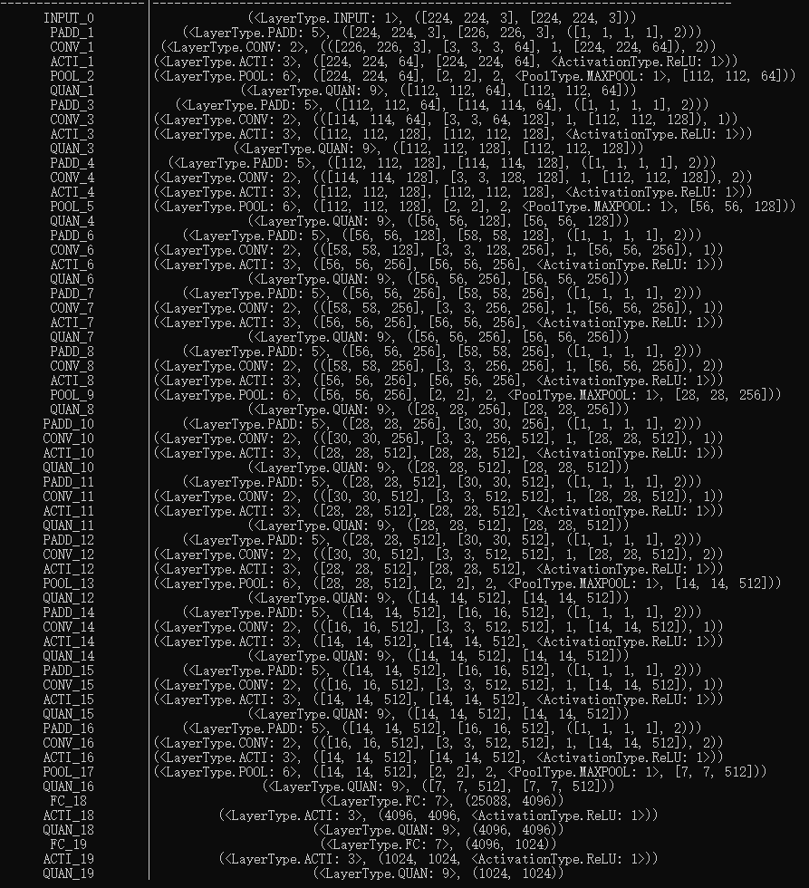

Slide 57
RAM
input
DRAM
weight
RAM
input
DRAM
weight
MLA:CONV
MLA:CONV
ARM:QUAN
ARM:QUAN
ARM:ACTI
ARM:POOL
ARM:POOL
ARM:ACTI
RAM
output
SRAM
output

Slide 58
-----------------------------------

Slide 59
CONV: InActi(12)

Slide 60
SpiNNaker2: CONV_3: InActi(12)
Step 1
DRAM Controller
I12
DRAM Controller
Time: 2x
QPE
QPE
DRAM Controller
QPE
QPE
DRAM Controller
I0
HOST Interface

Slide 61
SpiNNaker2: CONV_3: InActi(12)
Step 2
DRAM Controller
I12,
I13
I12
DRAM Controller
Time: 2x
I12
I12
QPE
QPE
DRAM Controller
I0
I0
QPE
QPE
DRAM Controller
I0,I1
I0
HOST Interface

Slide 62
SpiNNaker2: CONV_3: InActi(12)
Step 3
DRAM Controller
I12,
I13,
I14
I12,
I13
I12
I12
DRAM Controller
Time: 2x
I12,
I13
I12,
I13
I12
I12
I0
I0
QPE
QPE
DRAM Controller
I0
I0
QPE
QPE
DRAM Controller
I0,I1
I0,I1
I0,I1,I2
I0,I1
HOST Interface

Slide 63
SpiNNaker2: CONV_3: InActi(12)
Step 4
DRAM Controller
I12,
I13,
I14
I12,
I13
I12,
I13
I12
DRAM Controller
Time: 1x
I12,
I13,
I14
I12,
I13
I12,
I13
I12
I0
I0
QPE
QPE
DRAM Controller
I0,I1
I0,I1
QPE
QPE
DRAM Controller
I0,I1
I0,I1
I0,I1,I2
I0,I1,I2
HOST Interface

Slide 64
SpiNNaker2: CONV_3: InActi(12)
Step 5
DRAM Controller
I12,
I13,
I14
I12,
I13
I12,
I13,
I14
I12,
I13,
DRAM Controller
Time: 1x
I12,
I13,
I14
I12,
I13
I12,
I13, I14
I12,
I13,
I0,I1
I0,I1
QPE
QPE
DRAM Controller
I0,I1,
I2
I0,I1,
I2
QPE
QPE
DRAM Controller
I0,I1
I0,I1
I0,I1,I2
I0,I1,I2
HOST Interface

Slide 65
SpiNNaker2: CONV_3: InActi(12)
Step 6
DRAM Controller
I12,
I13,
I14
I12,
I13,
I14
I12,
I13,
I14
I12,
I13,
I14
DRAM Controller
Time: 1x
I12,
I13,
I14
I12,
I13, I14
I12,
I13, I14
I12,
I13,
I14
I0,I1,
I2
I0,I1,
I2
QPE
QPE
DRAM Controller
I0,I1,
I2
I0,I1,
I2
QPE
QPE
DRAM Controller
I0,I1,
I2
I0,I1, I2
I0,I1,I2
I0,I1,I2
HOST Interface

Slide 66
CONV: InActi(32)

Slide 67
SpiNNaker2: CONV_3: InActi(32)
Step 1
DRAM Controller
I4‘
I4‘
I4‘
I4‘
I3‘
DRAM Controller
Time: 8x
I3‘
I1‘
QPE
QPE
I3‘
DRAM Controller
I1‘
QPE
QPE
I3‘
DRAM Controller
I1‘
I1‘
I2‘
I2‘
I2‘
I2‘
HOST Interface

Slide 68
SpiNNaker2: CONV_3: InActi(32)
Step 2
DRAM Controller
I4‘
I4‘
I4‘
I4‘
I3‘
I7’
DRAM Controller
Time: 8x
I8’
I8’
I8’
I8’
I3‘
I7’
I5’
I1‘
QPE
QPE
I3‘
I7’
DRAM Controller
I5’
I1‘
QPE
QPE
I3‘
I7’
DRAM Controller
I5’
I1‘
I6’
I6’
I6’
I6’
I5’
I1‘
I2‘
I2‘
I2‘
I2‘
HOST Interface

