Slide 1
OpenDaylight
Integration
Robot Hands-On

Slide 2
Robot Framework
Robot Framework is a Keyword Driven automation framework using Python or Java as it's backend.
Test cases are automated by writing steps using Robot framework keywords.
Provides a simple library API for creating customized test libraries.
Provides a command line interface and XML based outputs for integration into existing build infrastructure (continuous integration systems).
Report files created as a result of every pybot execution: report.html, log.html, output.xml.
Implemented with Python
– Runs also on Jython (JVM) and IronPython (.NET)
– Can be extended natively using Python or Java
– Other languages supported via a remote interface
Open source
– Apache 2.0 license
– Active development and growing community

Slide 3
Robot Framework Test Cases
Collections of test cases are called test suites
Test suites are made of files and directories
Plain text format
The plain text format you can use either two or more spaces or a pipe character surrounded with spaces ( | ) to separate test data.
The test data tables must have one or more asterisk before their names. Otherwise asterisks and possible spaces in the table
header are ignored so, for example, *** Settings *** and *Settings work the same way. Everything before the first table is ignored.
Robot Framework test file hierarchy:
http://robotframework.googlecode.com/hg/doc/userguide/RobotFrameworkUserGuide.html?r=2.8.4#test-data-syntax
How to wirite good test cases:
https://code.google.com/p/robotframework/wiki/HowToWriteGoodTestCases
Test Execution:
pybot <file.txt or dir>
Usage: pybot|jybot|ipybot [options] data_sources
When pybot’s destination is a directory, every .txt file in the directory will be
executed as a test suite file.

Slide 4
Test Case Format
*** Setup ***
All Configuration details, Environment and topology, libraries to use… etc.
*** Settings ***
Documentation
Describe the test case scenario and what’s being tested …
Example:
This test has a workflow that is created using keywords in ...
the imported resource file.
Resource
resource.txt
*** Variables ***
Variables –optional but recommended
Encapsulate long and/or complicated values
Pass information from command line
Pass information between keywords
*** Test Cases ***
Contains Test steps. All steps should be related to each other
Specify test case name and step details here
Example: Start Base Controller with OF1.3
. Input Password mode
[Teardown]
This section is used to shutdown systems, close connections, and cleanup configurations.
A test case file, for our purposes, contains the following default sections:
Setup, Settings, Test Cases, and Teardown.

Slide 5
Test Case Format
A test case file can contain other configuration information to ease the processing and speed results such as specifying variables, path to external keywords or python functions. Or flat files configuration data.
Pybot can traverse directories of files creating a testsuite report and log file.
Tagging
● Free metadata to categorize test cases
● Statistics by tags collected automatically
● Select test cases to be executed
● Specify which test cases are considered critical

Slide 6
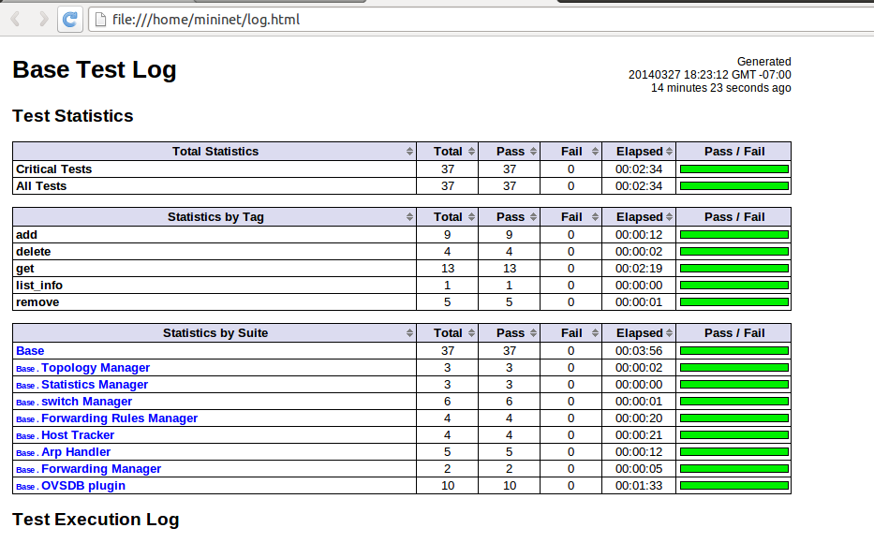
Test Suite Log File
Example Test Suite Report

Slide 7
Test Case Execution
pybot|jybot|ipybot [options] data_sources python|jython|ipy -m robot.run [options] data_sources python|jython|ipy path/to/robot/run.py [options] data_sources java -jar robotframework.jar [options] data_sources
Test execution is normally started using pybot, jybot or ipybot runner script. These scripts are otherwise identical, but the first one executes tests using Python, the second using Jython, and the last one using IronPython.
Alternatively it is possible to use robot.run entry point either as a module or a script using any interpreter, or use the standalone JAR distribution.
Regardless of execution approach, the path (or paths) to the test data to be executed is given as an argument after the command.
Additionally, different command line options can be used to alter the test execution or generated outputs in some way.
Specifying test data to be executed
Robot Framework test cases are created in files and directories, and they are executed by giving the path to the file or directory in question to the selected runner script. The path can be absolute or, more commonly, relative to the directory where tests are executed from.
The given file or directory creates the top-level test suite, which gets its name, unless overridden with the --name option, from the file or directory name. Different execution possibilities are illustrated in the examples below.
Note that in these examples, as well as in other examples in this section, only the pybot script is used, but other execution approaches could be used similarly.
pybot test_cases.html pybot path/to/my_tests/ pybot c:\robot\tests.txt
It is also possible to give paths to several test case files or directories at once, separated with spaces. In this case, Robot Framework creates the top-level test suite automatically, and the specified files and directories become its child test suites.
The name of the created test suite is got from child suite names by catenating them together with an ampersand (&) and spaces. For example, the name of the top-level suite in the first example below is My Tests & Your Tests.
These automatically created names are often quite long and complicated. In most cases, it is thus better to use the --name option for overriding it, as in the second example below:
pybot my_tests.html your_tests.html pybot --name Example path/to/tests/pattern_*.html
3.1.2 Using command line options
Robot Framework provides a number of command line options that can be used to control how test cases are executed and what outputs are generated. This section explains the option syntax, and what options actually exist. How they can be used is discussed elsewhere in this chapter.
Using options
When options are used, they must always be given between the runner script and the data sources. For example:
pybot -L debug my_tests.txt pybot --include smoke --variable HOST:10.0.0.42 path/to/tests/

Slide 8
Test Case Execution
Short and long options
Options always have a long name, such as --name, and the most frequently needed options also have a short name, such as -N. In addition to that, long options can be shortened as long as they are unique. For example, --logle DEBUG works, while --lo log.html does not, because the former matches only --loglevel, but the latter matches several options. Short and shortened options are practical when executing test cases manually, but long options are recommended in start-up scripts, because they are easier to understand.
The long option format is case-insensitive, which facilitates writing option names in an easy-to-read format. For example, --SuiteStatLevel is equivalent to, but easier to read than --suitestatlevel.
Setting option values
Most of the options require a value, which is given after the option name. Both short and long options accept the value separated from the option name with a space, as in --include tag or -i tag. With long options, the separator can also be the equals sign, for example --include=tag, and with short options the separator can be omitted, as in -itag.
Some options can be specified several times. For example, --variable VAR1:value --variable VAR2:another sets two variables. If the options that take only one value are used several times, the value given last is effective.
Simple patterns
Many command line options take arguments as simple patterns. These glob-like patterns are matched according to the following rules:
* is a wildcard matching any string, even an empty string.
? is a wildcard matching any single character.
Unless noted otherwise, pattern matching is case, space, and underscore insensitive.
Examples:
--test Example* # Matches tests with name starting 'Example', case insensitively. --include f?? # Matches tests with a tag that starts with 'f' or 'F' and is three characters long.
Tag patterns
Most tag related options accept arguments as tag patterns. They have all the same characteristics as simple patterns, but they also support AND, OR and NOT operators explained below. These operators can be used for combining two or more individual tags or patterns together.
AND or &
  The whole pattern matches if all individual patterns match. AND and & are equivalent.
  --include fooANDbar # Matches tests containing tags 'foo' and 'bar'. --exclude xx&yy&zz # Matches tests containing tags 'xx', 'yy', and 'zz'.
OR
  The whole pattern matches if any individual pattern matches.
  --include fooORbar # Matches tests containing either tag 'foo' or tag 'bar'. --exclude xxORyyORzz # Matches tests containing any of tags 'xx', 'yy', or 'zz'.
NOT
  The whole pattern matches if the pattern on the left side matches but the one on the right side does not. If used multiple times, none of the patterns after the first NOT must not match.
  --include fooNOTbar # Matches tests containing tag 'foo' but not tag 'bar'. --exclude xxNOTyyNOTzz # Matches tests containing tag 'xx' but not tag 'yy' or tag 'zz'.
Mixed
  The above operators can also be used together. The operator precedence, from highest to lowest, is AND, OR and NOT.
  --include xANDyORz # Matches tests that contain either tags 'x' and 'y', or tag 'z'. --include xORyNOTz # Matches tests that contain either tag 'x' or 'y', but not tag 'z'. --include xNOTyANDz # Matches tests that contain tag 'x', but not tags 'y' and 'z'.
Note
All operators are case-sensitive and must be written with capital letters.
Note
OR operator is new in Robot Framework 2.8.4.

Slide 9
Example test case for controller
Setup part:
*** Settings ***
Documentation Test suite for the forwarding rule manager module.
Suite Setup Create Session session http://${CONTROLLER}:8080 auth=${AUTH} headers=${HEADERS}
Suite Teardown Delete All Sessions
Library Collections
Library ../../libraries/RequestsLibrary.py
Library ../../libraries/Common.py
Variables ../../variables/Variables.py
*** Variables ***
${name} flow1
${key} flowConfig
${node_id} 00:00:00:00:00:00:00:02
${REST_CONTEXT} /controller/nb/v2/flowprogrammer
${REST_CONTEXT_ST} /controller/nb/v2/statistics
${FLOW} "10.0.0.1"

Slide 10
Example test case for controller
Test Case part:
*** Test Cases ***
Add a flow
[Documentation] Add a flow, list to validate the result.
[Tags] add
${node} Create Dictionary type OF id ${node_id}
${actions} Create List OUTPUT=1
${body} Create Dictionary name ${name} installInHw true node
... ${node} priority 1 etherType 0x800 nwDst
... 10.0.0.1/32 actions ${actions}
${resp} Put session ${REST_CONTEXT}/${CONTAINER}/node/OF/${node_id}/staticFlow/${name} data=${body}
Should Be Equal As Strings ${resp.status_code} 201
${resp} Get session ${REST_CONTEXT}/${CONTAINER}
Should Be Equal As Strings ${resp.status_code} 200
${result} To JSON ${resp.content}
${content} Get From Dictionary ${result} ${key}
List Should Contain Value ${content} ${body}

Slide 11
Example test case for controller
Test Case part continuation:
Check flow in flow stats
[Documentation] Show flow stats and validate result
[Tags] get
Sleep 10
${resp} Get session ${REST_CONTEXT_ST}/${CONTAINER}/flow
Should Be Equal As Strings ${resp.status_code} 200
Log ${resp.content}
Should Contain ${resp.content} ${FLOW}

Slide 12
Example test case for controller
Test Case part continuation:
Remove a flow
[Documentation] Remove a flow, list to validate the result.
[Tags] remove
${node} Create Dictionary type OF id ${node_id}
${actions} Create List OUTPUT=1
${body} Create Dictionary name ${name} installInHw true node
... ${node} priority 1 etherType 0x800 nwDst
... 10.0.0.1/32 actions ${actions}
${resp} Delete session ${REST_CONTEXT}/${CONTAINER}/node/OF/${node_id}/staticFlow/${name}
Should Be Equal As Strings ${resp.status_code} 204
${resp} Get session ${REST_CONTEXT}/${CONTAINER}
Should Be Equal As Strings ${resp.status_code} 200
${result} To JSON ${resp.content}
${content} Get From Dictionary ${result} ${key}
List Should Not Contain Value ${content} ${body}

Slide 13
Example test case for controller
Test Case part continuation:
Check flow is not in flow stats
[Documentation] Show flow stats and validate result
[Tags] get
Sleep 10
${resp} Get session ${REST_CONTEXT_ST}/${CONTAINER}/flow
Should Be Equal As Strings ${resp.status_code} 200
Log ${resp.content}
Should Not Contain ${resp.content} ${FLOW}

Slide 14
Robot Reporting
Open Robot log file in browser:

Slide 15
Demo
Copy USB test VM to your laptop
Follow test VM installation in: https://wiki.opendaylight.org/view/CrossProject:Integration_Group:Test_VMs
Try existing Base edition suite:
run: ~/integration/vm/scripts/run_test_base_self.sh

Slide 16
Write your own test!
Start controller base edition:
cd ~/controller-base/opendaylight
./run.sh -start
Try to write a test file
Run your test suite: pybot <file.txt>

Slide 17
References
Robot Guides
http://robotframework.org/
https://code.google.com/p/robotframework/
http://robotframework.googlecode.com/hg/doc/userguide/RobotFrameworkUserGuide.html?r=2.8.4#executing-test-cases
Extending Robot
http://robotframework.googlecode.com/hg/doc/userguide/RobotFrameworkUserGuide.html?r=2.8.4#extending-robot-framework

