Slide 1
Input Multivariate Time Series
N Senors
•
•
•

Slide 2
Anomaly Scoring
Output Layer
Thresholding
Anomaly Detection
Anomaly Detection Module

Slide 3
Input Multivariate Time Series
Channel Independence
•
•
Subsequence Division
•
Time2vec Encoding
Temporal Features
Transformer Backbone
Temporal Features Exactor Module

Slide 4
Input Multivariate Time Series
N Embeddings
•
•
•
•
•
•
Graph Structure Learning
Graph Attention-Based Features

Slide 5
Spatial Features
Graph Structure Learning
Graph Attention Network
Learned Relations
Graph Attention-Based Features
•
•
element-wise multiply
•
•
•
•
Learned Embeddings
Spatial Features
N Embeddings
Spatial Features Exactor Module

Slide 6
Spatial Features
Graph Structure Learning
Graph Attention Network
Learned Relations
Graph Attention-Based Features
•
•
element-wise multiply
•
•
•
•
Learned Embeddings
Spatial Features
N Embeddings
Spatial Features Exactor Module

Slide 7
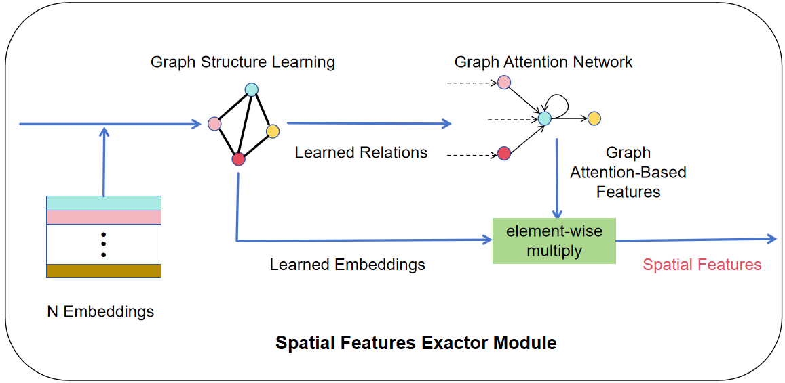
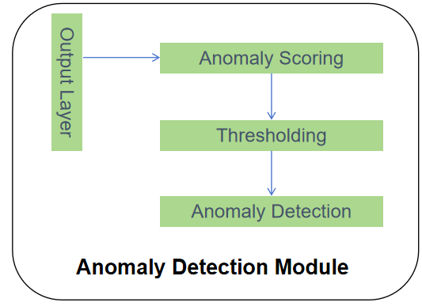
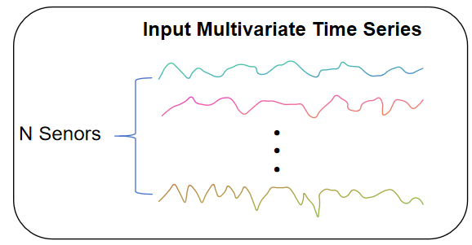
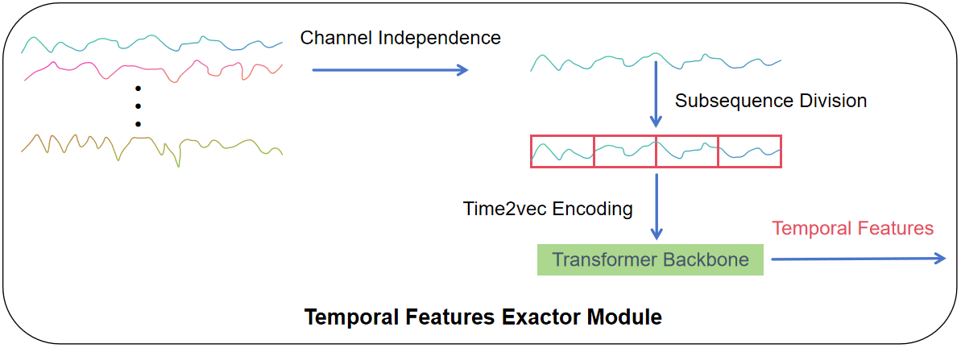
Concat Features
⨁

Slide 8
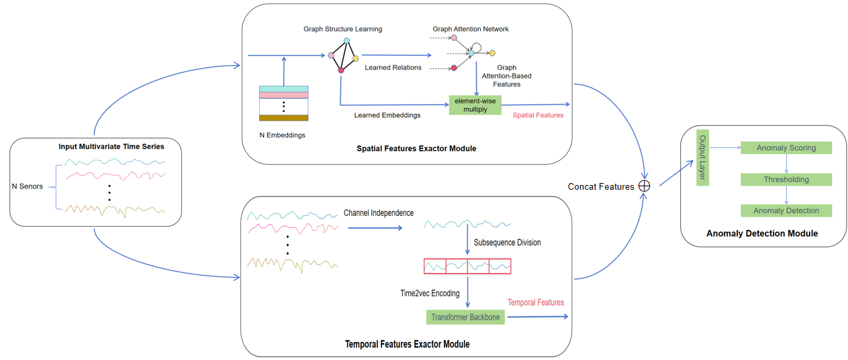

Slide 9
MLP-based Reconstruction
Concat Multi-Scale Features
Euclidean Distance Between Multi-Scale Features
Multi-Scale Encoder
Embedding
Multi-Scale Patching
Mask Dominant Period
FTT
Channel Independence

Slide 10
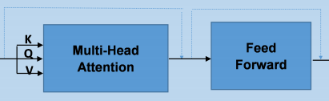
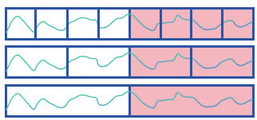


Anomaly Prediction
Reconstruction Error
Euclidean Distance
MLP-based Reconstruction
Similarities Between Multi-Scale Features
Multi-Scale Encoder
Multi-Scale Subsequence Division
Embedding
Mask Dominant Period
Nx
TopK Frequencies
FTT
Channel Independence
Input MTS

Slide 11
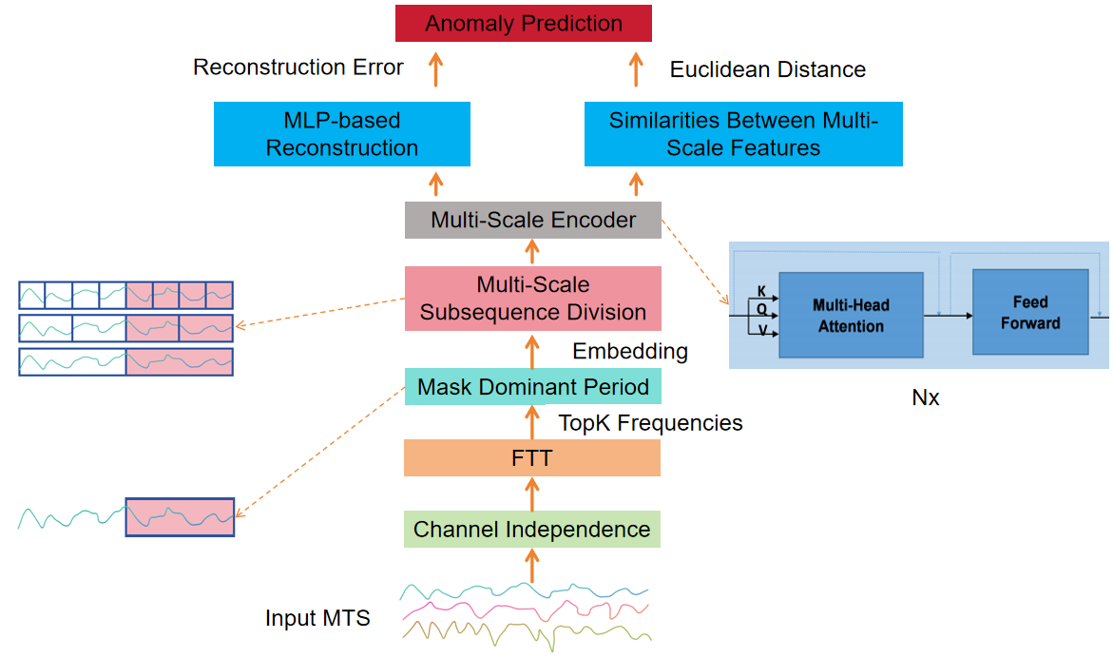

Slide 12

研究背景
（1）目前多维时间序列异常检测方法主要侧重于对时间序列时间维度进行信息挖掘（AE、GAN、RNN、LSTM、 Transformer等），忽略了维度之间的联系，缺少对时间序列空间维度的信息挖掘
（2）Transformer模型能够有效处理长时间序列问题，但存在计算时间复杂度高、无法有效提取局部数据信息、无法学习不同维度的特定序列模式等问题
（3）目前大部分研究侧重于对异常检测方法性能的提升，缺少对异常发生原因以及异常在不同维度之间传播情况的研究

