Slide 1
Input Multivariate Time Series
N Senors
•
•
•

Slide 2
Anomaly Scoring
Output Layer
Thresholding
Anomaly Detection
Anomaly Detection Module

Slide 3
Input Multivariate Time Series
•
Channel Indenpendence
•
•
•
•
•
Time2vec Encoding
Temporal Features
Transformer Backbone
Temporal Features Exactor Module

Slide 4
Input Multivariate Time Series
N Embeddings
•
•
•
•
•
•
Graph Structure Learning
Graph Attention-Based Features

Slide 5
Spatial Features
Graph Structure Learning
Graph Attention Network
Learned Relations
Graph Attention-Based Features
•
•
element-wise multiply
•
•
•
•
Learned Embeddings
Spatial Features
N Embeddings
Spatial Features Exactor Module

Slide 6
Spatial Features
Graph Structure Learning
Graph Attention Network
Learned Relations
Graph Attention-Based Features
•
•
element-wise multiply
•
•
•
•
Learned Embeddings
Spatial Features
N Embeddings
Spatial Features Exactor Module

Slide 7
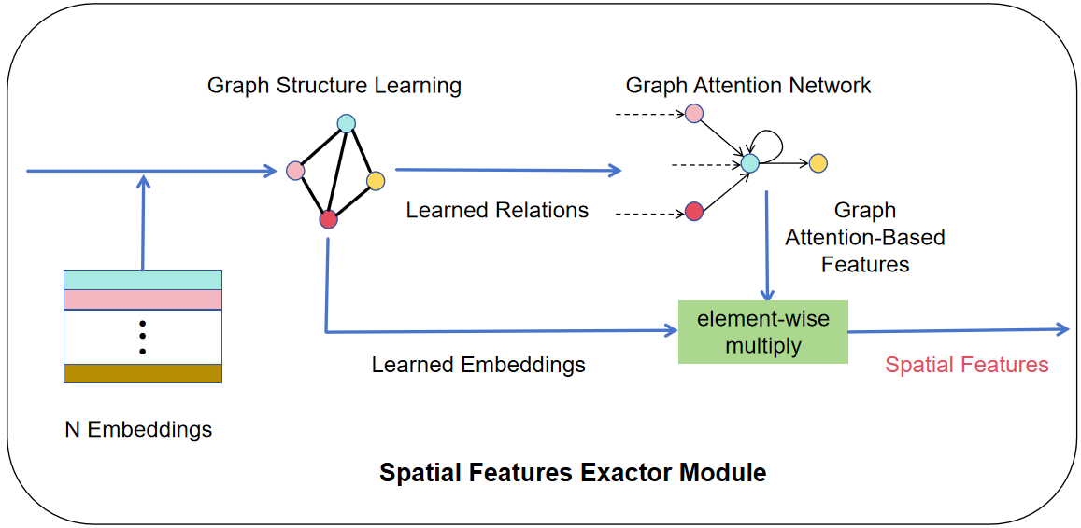
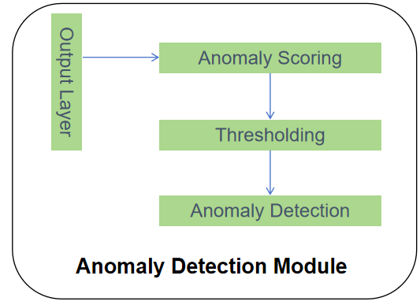
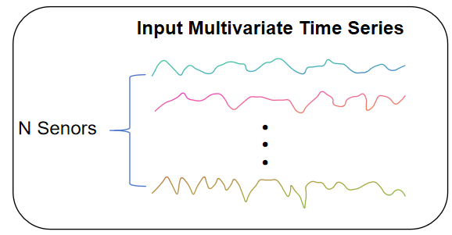
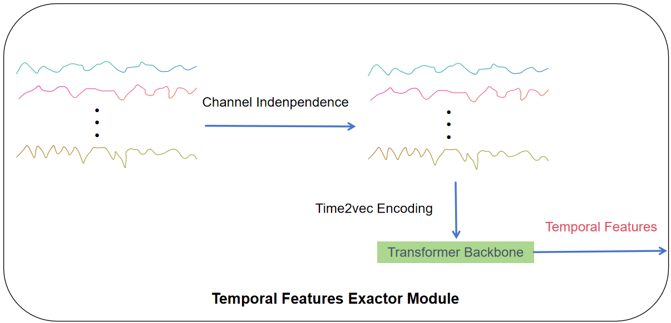
Concat Features
⨁

Slide 8
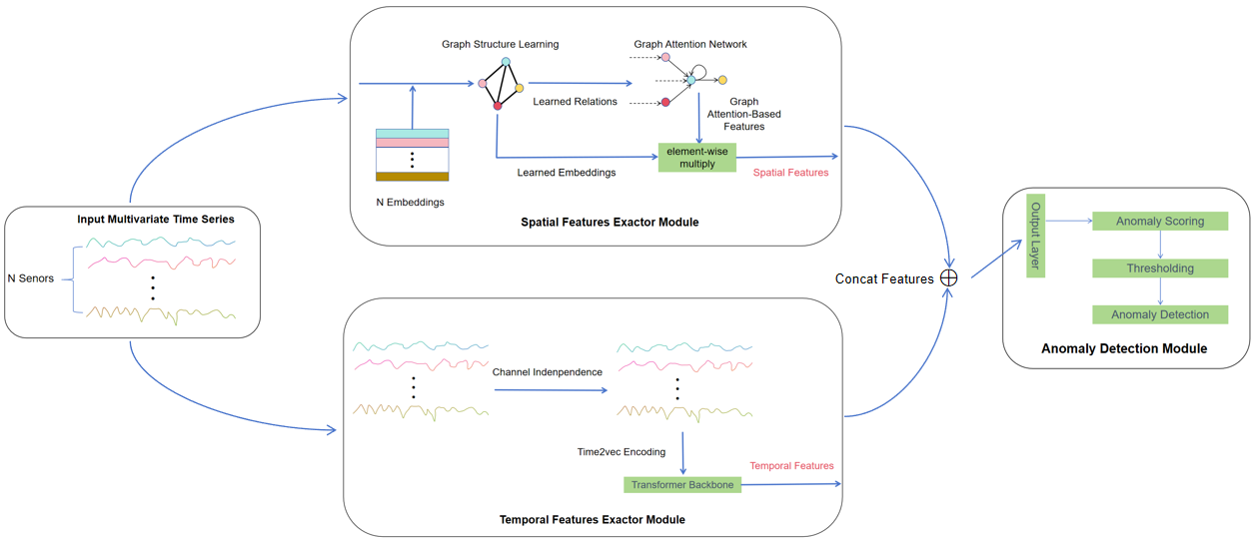

Slide 9
MLP-based Reconstruction
Concat Multi-Scale Features
Euclidean Distance Between Multi-Scale Features
Multi-Scale Encoder
Embedding
Multi-Scale Patching
Mask Dominant Period
FTT
Channel Independence

Slide 10
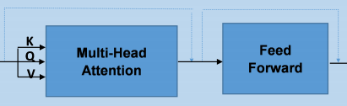
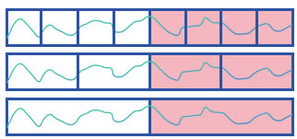


Anomaly Prediction
Reconstruction Error
Euclidean Distance
MLP-based Reconstruction
Similarities Between Multi-Scale Features
Multi-Scale Encoder
Multi-Scale Patching
Embedding
Mask Dominant Period
Nx
TopK Frequencies
FTT
Channel Independence
Input MTS

Slide 11
