Slide 1
About AI
Biomedicine
Workshop
23/11/21

Slide 2
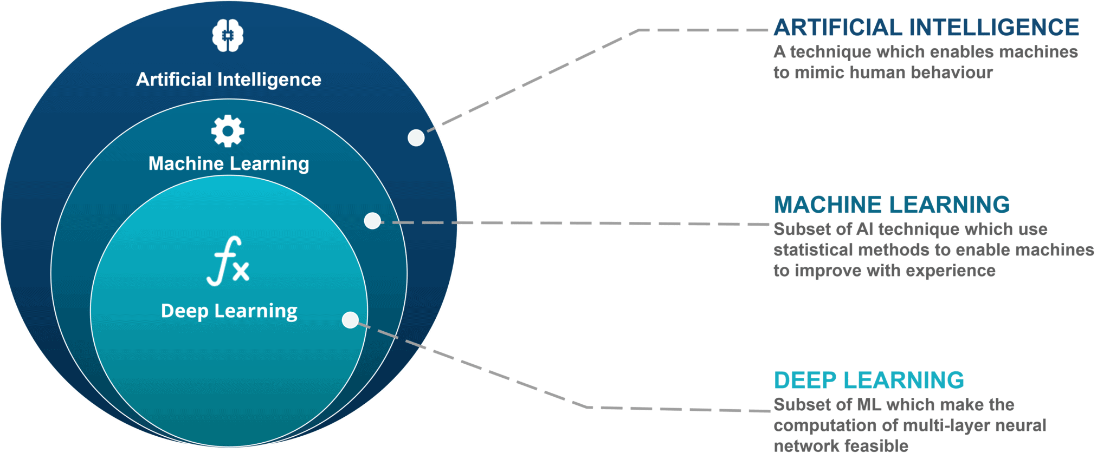
What’s AI meaning?
K21Academy.com

Slide 3
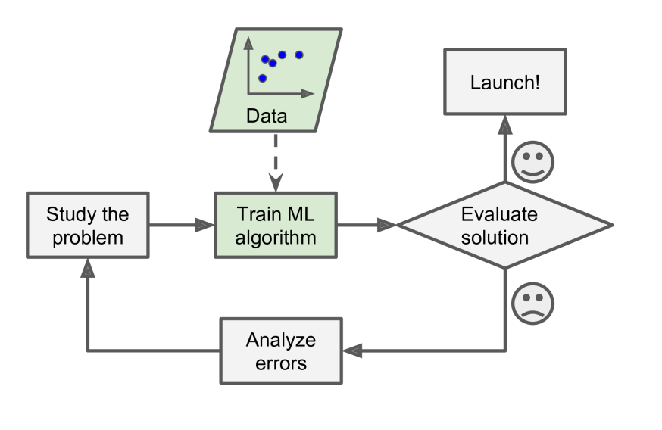
Machine learning algorithms
A machine learning algorithm:
Input: Training data
“Learns” from the training data
Output: A prediction function that produces output 𝑦 given
Slide from ShanghaiTech SI364 2023

Slide 4
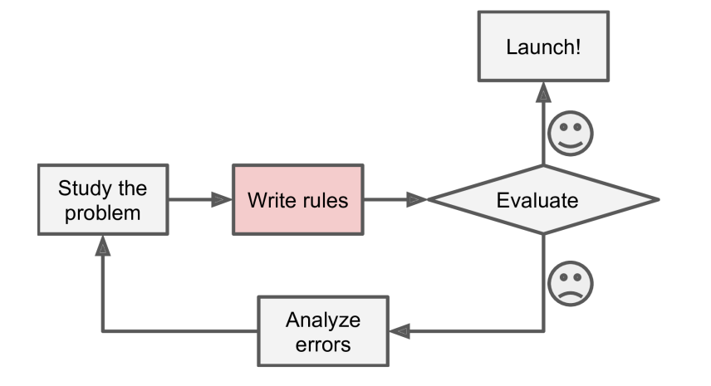
Traditional rule-based approaches
A traditional method for spam filtering:
Study what spam typically looks like
A spam email usually contains some special key words in the subject,e.g. “4U”, “credit card”…
Write and test a spam detection algorithm
Slide from ShanghaiTech SI364 2023

Slide 5
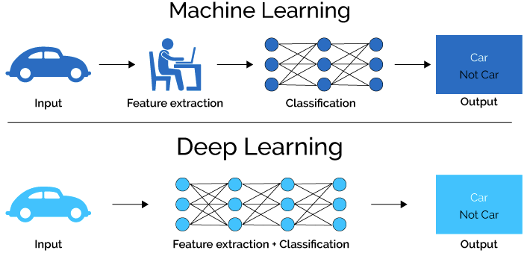
The difference between ML & DL
https://lamiae-hana.medium.com/

Slide 6
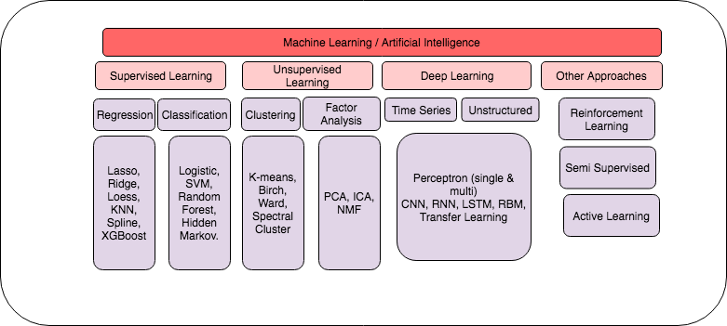
Models
https://medium.com/@amit_karm

Slide 7
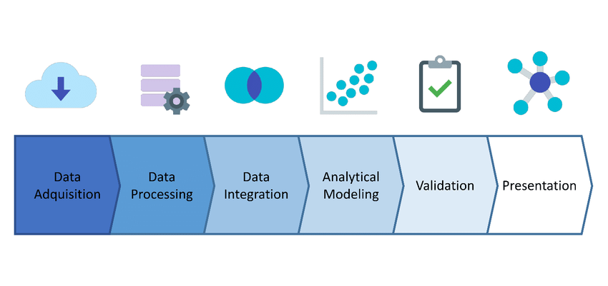
Pipeline
researchgate.net/

Slide 8
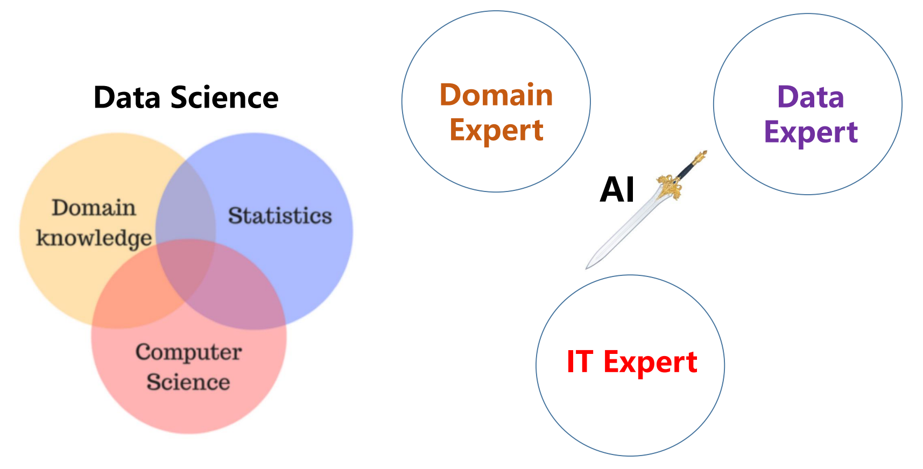
Biomedical Data Science

Slide 9
Thanks

