Slide 1
NASA/Africa
SPRINT-1
Wu Di
Litao Chen
Anindya Paul
Archana Bajaj
10/12/2016

Slide 2



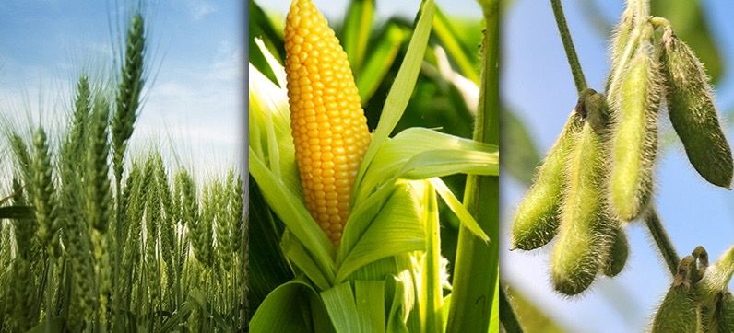
What’s our Project about?
10/10/16
Model Soil
Samples
Develop
application
Predict crops suited for location

Slide 3
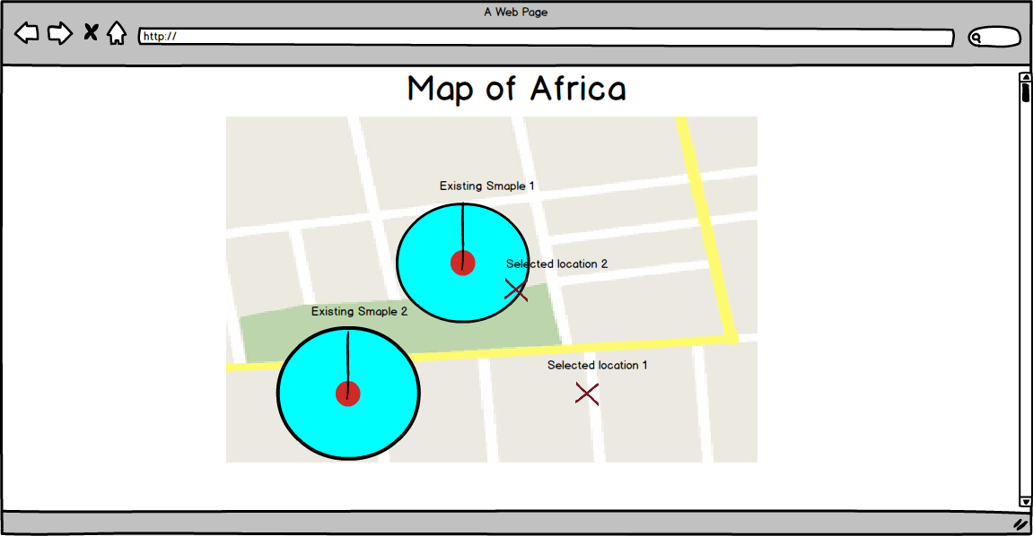
Website Prototype

Slide 4
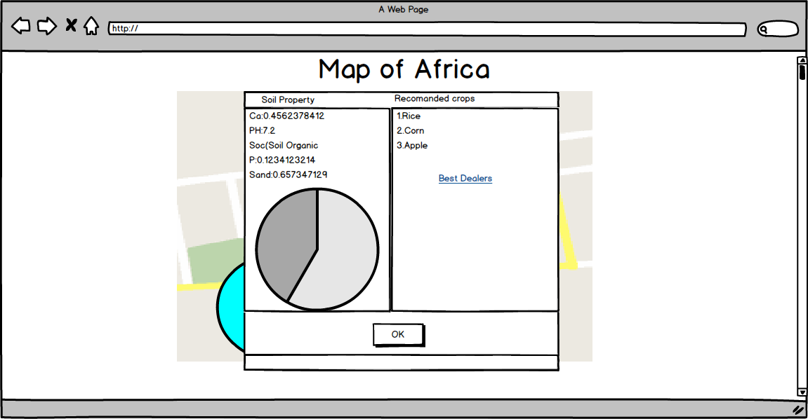
Website Prototype

Slide 5


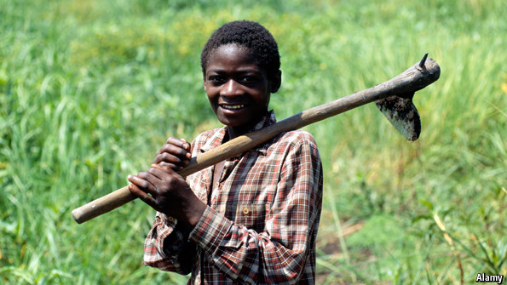
Targeted users
10/10/16
African Farmers
Agricultural Companies
Agricultural scientists and research areas

Slide 6



Target customers
10/10/16
African governments
Agricultural companies
Agriculture scientists
Agriculture research labs
Amazon

Slide 7
Phases of the project
10/10/16
Data set of soil samples and their “absorption values” w.r.t Wavelengths
Implement a model using machine learning and get property values such as Ca, P, pH, SOC and Soil
Make a table that relates each property value to one or more specific crop such as wheat, rice, barley & corn
A user interface is constructed. When user clicks a location it displays crops for the soil on that location
FUTURE:
Get values for other location of world and use it in our model. Amazon connectivity

Slide 8
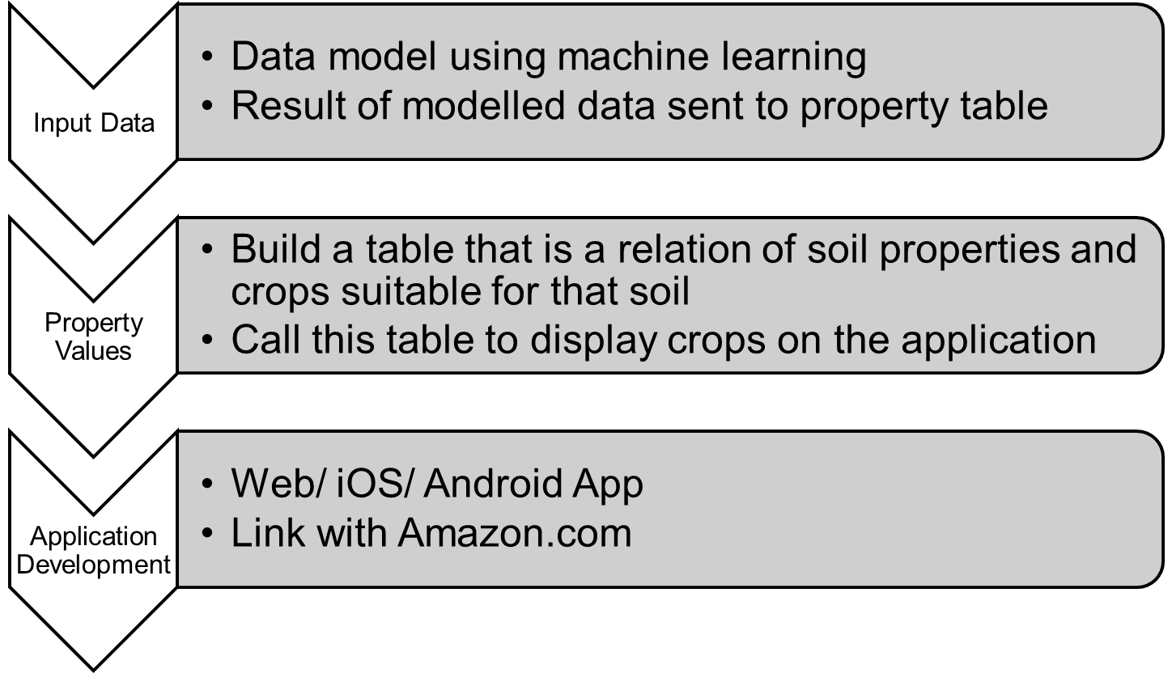
NASA/Africa
10/10/16
Challenges of our Project

Slide 9
Research on soil data processing
10/10/16
Machine leaning
Supervised learning
Regression problem
Decide on Pre-processing Methods
Regression Models:
Neural Networks
Support Vector Machine (SVM)
Parameter and feature Choosing

Slide 10
Further Research and Implementation
10/10/16
Google map API
Web / Android/ iOS Development
MySQL as the Database Management system
Research on chemical property values of soil to the crops that can be grown on that soil
www.fda.gov

Slide 11
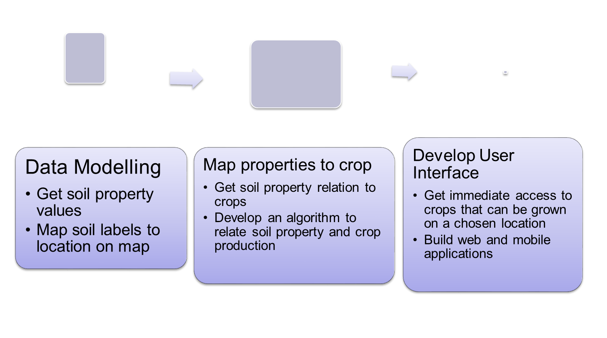
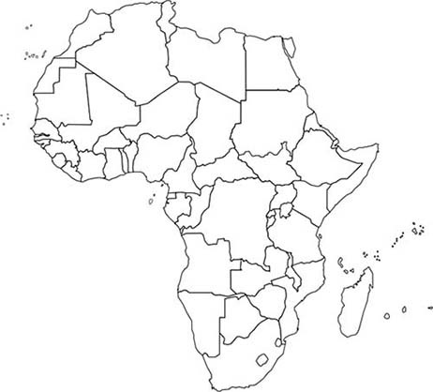
10/10/16
Modular Diagram

Slide 12
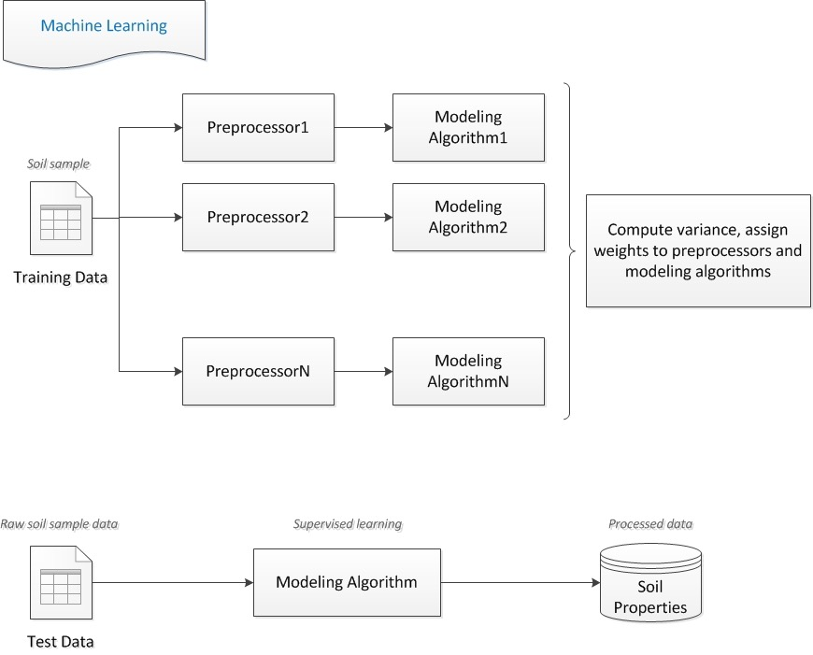
Workflow diagram
10/10/16

Slide 13
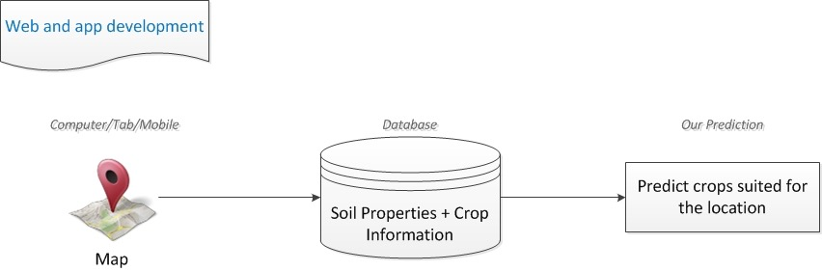
Workflow diagram
10/10/16

Slide 14
Next Sprint Board
10/10/16
Start working on Machine Learning models.
Implement a matrix input by taking in data from excel sheet to start pre-processing.
Plot a continuous form of the input discrete data.
Run various combinations of pre-processing and training models and decide on the best model for our application.

Slide 15
THANK YOU
10/10/16
Questions or Suggestions?

