Slide 1
Boosting Dynamic Programming with Neural Networks for Solving NP-hard Problems
Feidiao Yang yangfeidiao@ict.ac.cn
Joint work with Tiancheng Jin, Tie-Yan Liu, Xiaoming Sun, and Jialin Zhang
Institute of Computing Technology, Chinese Academy of Sciences Microsoft Research Asia
Asian Conference on Machine Learning (ACML) November 15th, 2018
Notes:
Good afternoon!
My name is Feidiao Yang and I am a PhD candidate from Institute of Computing Technology, Chinese Academy of Sciences.
It is my great pleasure to introduce our recent work on “boosting dynamic programming with neural networks for solving NP-hard problems”.

Slide 2
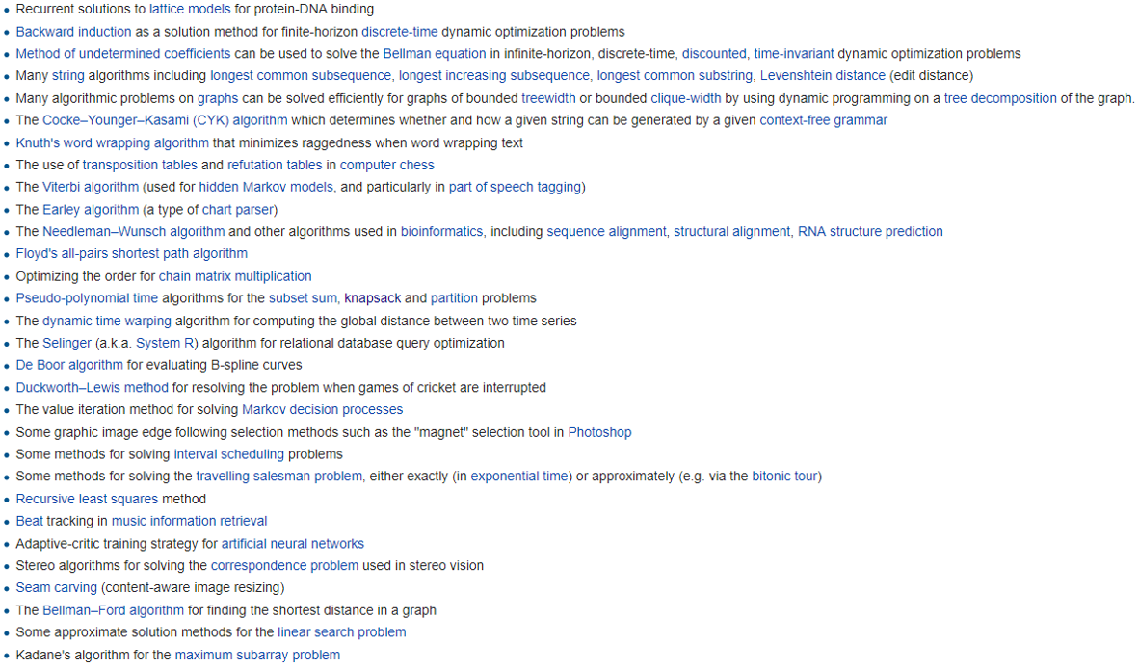
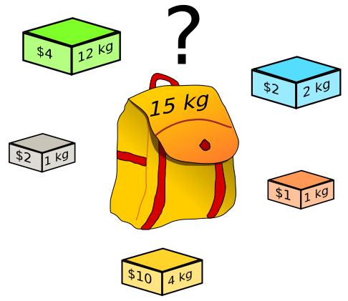
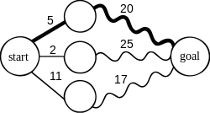
Dynamic Programming is Powerful and Widely Used
A lot of algorithms use dynamic programming (DP).
DP can find the shortest path in a graph efficiently.
DP can even solve some NP-hard problems (e.g. Knapsack) much faster than the brute-force methods.
Note: The snapshot and figures in this page are from Wikipedia.
Notes:
As we all know, dynamic programming is a powerful and widely used method for solving combinatorial optimization problems. A lot of algorithms use the idea of dynamic programming. For example, the dynamic programming can find the shortest path in a graph very quickly. And the dynamic programming can even solve some NP-hard problem efficiently. For example, it can solve the famous Knapsack problem with pseudo-polynomial time.

Slide 3
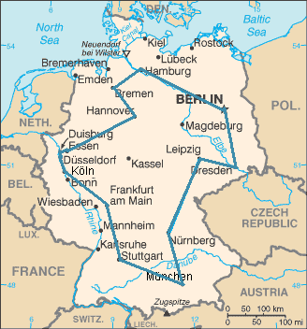
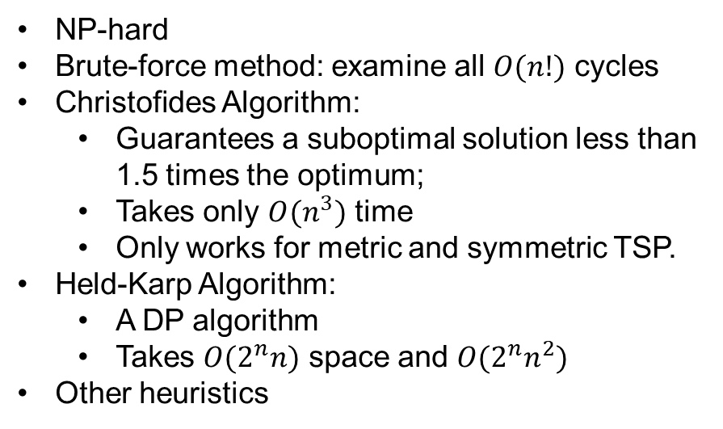
The Travelling Salesman Problem (TSP)
NP-hard
Brute-force method: examine all $O(n!)$ cycles
Christofides Algorithm:
Guarantees a suboptimal solution less than 1.5 times the optimum;
Takes only $O(n^{3})$ time
Only works for metric and symmetric TSP.
Held-Karp Algorithm:
A DP algorithm
Takes $O(2^{n}n)$ space and $O(2^{n}n^{2})$
Other heuristics
TSP is to find a minimum cost cycle in a (complete) graph, visiting every vertex exactly once.
Notes:
However, dynamic programming does not always work well. For example, the Held-Karp algorithm, a dynamic programming algorithm for solving the travelling salesman problem, that is, the TSP problem, requires exponential space and time.
Before deeply discussing the Held-Karp algorithm, let’s recap the TSP problem. The TSP problem is to find a minimum cost cycle in a complete graph, visiting every vertex exactly once. TSP is very important and useful in both theory or practice. However, TSP is NP-hard and there is no efficient algorithm known. The most direct solution is to examine all vertex permutations and that will take O n factorial time. If we allow an approximation solution, we have the Christofides algorithm. It can provide a theoretical guarantee that the solution is not greater than 1.5 times the optimal solution and it requreis only O n cube running time.
If we have to find the optimal solution, a dynamic programming algorithm, proposed by Held and Karp, can find the optimal solution much faster than the brute-force method.

Slide 4
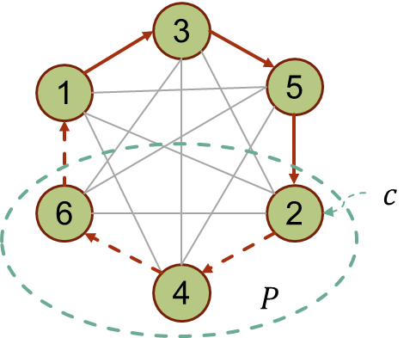
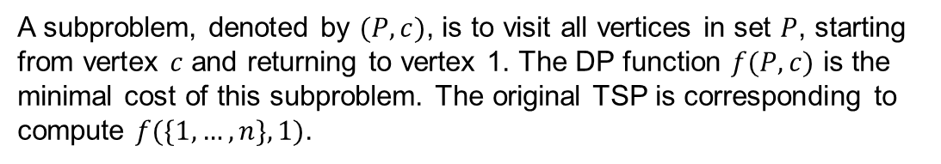
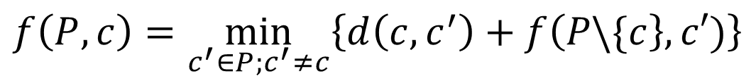

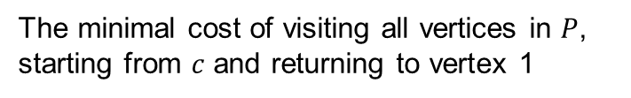


A DP Algorithm (Held-Karp) to Solve TSP
A subproblem, denoted by $(P,c)$, is to visit all vertices in set $P$, starting from vertex $c$ and returning to vertex 1. The DP function $f(P, c)$ is the minimal cost of this subproblem. The original TSP is corresponding to compute $f(\{1, …,n\}, 1)$.
The minimal cost of visiting all vertices in $P$, starting from $c$ and returning to vertex 1
The cost of travelling from $c$ to $c′$ directly
$$f\left(P,c\right)=\min_{c^{′}∈P;c^{′}≠c}\left\{d\left(c,c^{′}\right)+f\left(P\backslash \{c\right\},c′)\right\}$$
$c∈P$: the starting vertex of the remining visit
$P∈\{1, …,n\}$: vertices to be visited
The DP function of the Held-Karp Algorithm for solving the Travelling Salesman Problem (TSP)
Notes:
In this page, I will introduce the dynamic programming method of solving TSP. As usual DP does, we present a subproblem by a pair (P, c), meaning to visit all vertices in vertex set P, starting from vertex c, and returning to vertex 1. the DP function f(P, c) is the minimal cost of the subproblem. In this example, P is the set of 2, 4, 6 and the starting point c is 2.
We will have the dynamic programming equation as follows. To find a path in P, we will first find the next vertex c’. If c’ is selected, we can recursively find the optimal path of the left nodes.

Slide 5



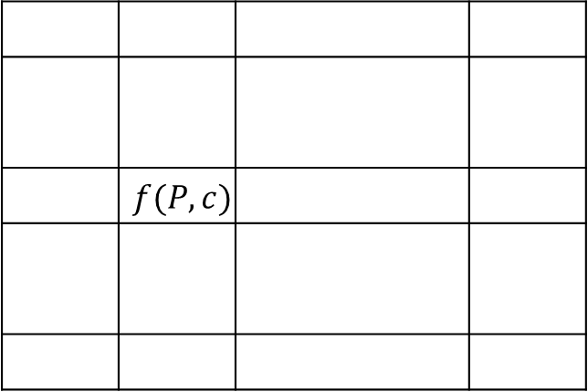
The Tabular Method Takes Exponential Space and Time
$$c$$
1
2
……
$$n$$
000000
 | $$f(P,c)$$
……
$$P$$
010101
……
111111
The conventional tabular method costs exponential space and time. Specifically, it requires $O(2^{n}n)$ space to store the DP function and $O(2^{n}n^{2})$ time to fill the table.
Notes:
However, although the dynamic programming method runs faster than the brute-force method. It still requires exponential space and time. Specifically, in dynamic programming, we usually use a table to store the results of each subproblems so that they can be reused. However, in the Held-Karp algorithm, there are exponential number of possible subproblems so that we have to use an exponentially large table.

Slide 6
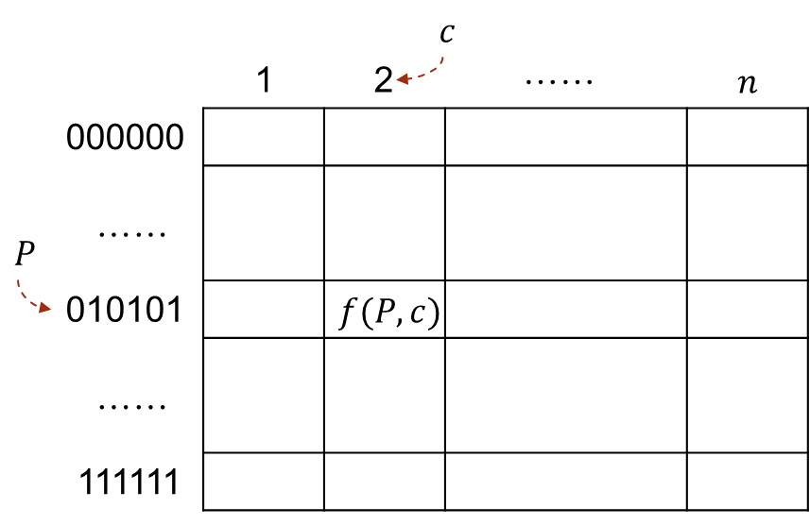
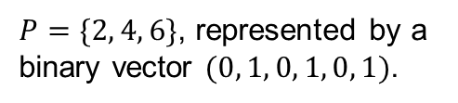
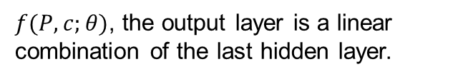
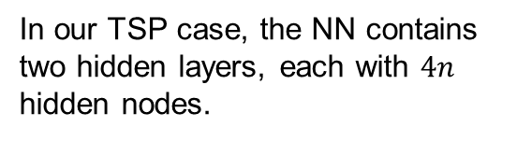
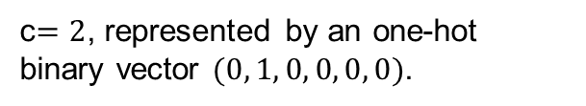
Idea: Representing the DP function with a Neural Network
$f(P, c;θ)$, the output layer is a linear combination of the last hidden layer.
……
……
……
In our TSP case, the NN contains two hidden layers, each with $4n$ hidden nodes.
$P=\{2, 4, 6\}$, represented by a binary vector $(0, 1, 0, 1, 0, 1)$.
c$=2$, represented by an one-hot binary vector $(0, 1, 0, 0, 0, 0)$.
Our basic idea is to replace the conventional tabular method for representing the DP function with a neural network of much less space. We will learn the model parameter $θ$.
Notes:
The purpose of a table in dynamic programming is to store the values of the DP function. As we know, in addition to the rigid tabular method, there are different methods to present a function. Inspired by the recent advancement of deep learning and deep reinforcement learning, we think neural network is a good alternative to the tabular method. The basic idea of our approach is to replace the conventional tabular method for representing the DP function with a neural network of much less size and we learn the parameter of the network to represent the DP function.
In our TSP case, our network structure is as follows. The input layer has two part. The blue part corresponds to P and the green part corresponds to c. The network has two hidden layers, with size linear to the problem size. And the output layer is a linear combinatorial to the last hidden layer.

Slide 7
Why is a Neural Network Good for DP?
An NN with enough size can approximate arbitrary function (with mild assumption);
A DP function is not necessary to be absolutely precise, since it is utilized to construct a solution (the actual value can be computed from the solution);
Not all states are equally important and it is not necessary to store all states precisely;
A suboptimal solution is good in practice and an approximated DP function represented by an NN may produce good or even optimal solutions;
NN is much more flexible in controlling the model size than the tabular method, which can reduce the space complexity significantly.
Notes:
Neural network has some advantages for DP over tabular method. We summarize some key points as follows. …

Slide 8


How to Train the Neural Network Efficiently?
a collection of $(\left(P,c\right),f(P,c))$ pairs
BP
$$θ^{∗}$$
Traditional supervising learning with a lot of labeled data is impractical, since even computing a single $(\left(P,c\right),f(P,c))$ label may take exponential time.
Notes:
After we resolve the space issue. A following problem is that how shall we train the network. The traditional method of supervising learning by collecting a lot of labeled data is impractical in our case, since computing even a single label data may requires exponential time.

Slide 9
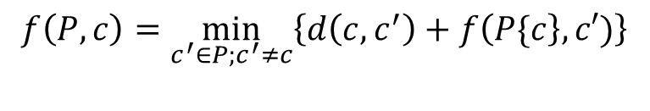
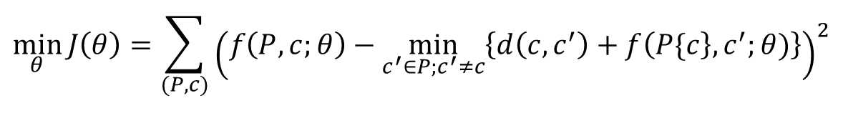
How to Train the Neural Network Efficiently?
DP equation
$$f\left(P,c\right)=\min_{c^{′}∈P;c^{′}≠c}\left\{d\left(c,c^{′}\right)+f\left(P\{c\right\},c′)\right\}$$
$$\min_{θ}{J\left(θ\right)=\sum_{(P,c)}{{\left(f\left(P,c;θ\right)−\min_{c^{′}∈P;c^{′}≠c}\left\{d\left(c,c^{′}\right)+f\left(P\{c\right\},c^{′};θ)\right\}\right)}^{2}}}$$
Training objective
The training objective is to find a parameter $θ$ that makes the neural network look like a DP function as much as possible. Stochastic mini-batch gradient can be adopted to optimize the objective function.
Notes:
So our idea turn to find a parameter that make the neural network look like a DP function as much as possible. Specifically, we try to close the gap between the function value with the value of the recursive definition and gradient method can be utilized to optimize the loss function. For saving time of estimating the gradient, we use the stochastic mini-bath gradient method.

Slide 10
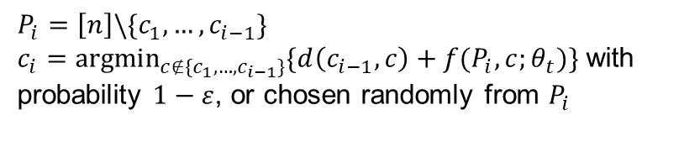


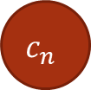


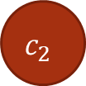
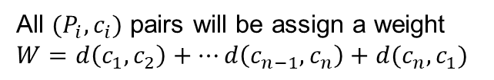
Generating the Training Data
$$P_{i}=\left[n\right]\backslash \{c_{1},…,c_{i−1}\}$$
$c_{i}=\underset{c∉\{c_{1},…,c_{i−1}\}}{argmin}{\{d\left(c_{i−1},c\right)+f(P_{i},c;θ_{t})\}}$ with probability $1−ε$, or chosen randomly from $P_{i}$
$$P_{i}=[n] \\ c_{1}=1$$
$$c_{1}$$
$$c_{2}$$
……
$$c_{i}$$
……
$$c_{n}$$
$$(P_{i},c_{i},W)$$
All $(P_{i},c_{i})$ pairs will be assign a weight $W=d\left(c_{1},c_{2}\right)+…d\left(c_{n−1},c_{n}\right)+d(c_{n},c_{1})$
data pool
weighted random sample
Training data
The process of generating the training data based on parameter $θ_{t}$. It supposes $f(P,c;θ_{t})$ is good and constructs the “optimal” path, by adding some random exploration.
Notes:
We generate the training data by constructing a good path based on current model as if it is the actual DP function and the subproblems along the path are regarded as the training data. For avoiding going into local optimum too early, we add some random perturbation into the path constructing process. Finally, we push the data into a data pool with a weight, which is the actual cost of the path. The training data are randomly sampled from the data pool.

Slide 11













The Main Process
Start
$$P_{1}=\left[n\right], c_{1}=1$$
Generating data based on $θ_{t}$ and push into the data pool
$$P_{i}=\left[n\right]\backslash \{c_{1},…,c_{i−1}\}$$
$$Pr=1−ε$$
$$Pr=ε$$
Random sampling from the data pool
$$c_{i}=\underset{c∉\{c_{1},…,c_{i−1}\}}{argmin}{\{d\left(c_{i−1},c\right)+f(P_{i},c;θ_{t})\}}$$
$c_{i}∈P_{i}$ randomly
Update the parameter by $$θ_{t+1}=θ_{t}−η_{t}\tilde{∇}J(θ_{t})$$
$$i≤n$$
$$t<T$$
$$W=d\left(c_{1},c_{2}\right)+d\left(c_{2},c_{3}\right)+⋯+d(c_{n},c_{1})$$
Output the solution based on parameter $θ_{T}$
Push all $(P_{i},c_{i},W)$ into the data pool
End
Notes:
This is the main process of our method. Like usual machine learning process, it is an iterative process of updating the model parameters. In each iteration, it first generate data based on current parameter, and then samples some data for estimating the gradient of the objective function, and finally update the parameter with gradient descent method. In the end, it will construct the final solution based on the last model parameter.

Slide 12
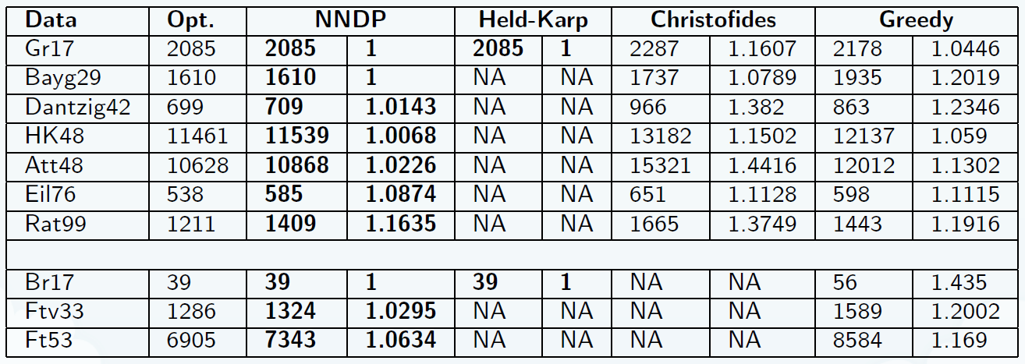
Experimental Results in TSPLIB
Our method can solve larger problems that are intractable for the conventional DP algorithm (the Held-Karp) and our approach outperforms the well-known approximation algorithms such as Christofides and Greedy.
Note: The number in the data name is the size of the instance. The first 7 cases are symmetric TSP instances and the last 3 cases are asymmetric TSP instances. In each experiment instance, the first value is the length of the output solution and the second value is the ratio comparing with the optimal solution.
Notes:
This is our experimental results in the data set TSPLIB, which is a standard benchmark for TSP problem. The number in each instance’s name is the size of the problem instance. The first 7 cases are symmetric TSP instance and the last 3 cases are asymmetric TSP instance. In each experiment instance, the first value is the actual cost of the output solution and the second value is the ratio comparing with the optimal solution. We compare our method, named NNDP, with the conventional Held-Karp algorithm, and two famous approximation algorithms, the Christofides algorithm and the Greedy algorithm. Seeing from the table, our method can solve larger problems that are intractable for the conventional DP algorithm. Our approach also performs well. The relative errors are almost within 10%, better than the well-known approximation algorithms such as the Christofides and Greedy.

Slide 13
Summary
Replace the rigid tabular method in DP with a flexible neural network for representing a DP function. And the network is trained with objective of making it close to the DP function with training data generated from a replay process;
Our method combines the approximating ability and flexibility of neural networks and the advantage of dynamic programming in utilizing intrinsic properties of a problem. Our method can significantly reduce the space complexity and it is flexible in balancing space, running time, and accuracy;
Experimental results show that our method can solve larger problems that are intractable for the conventional DP and our method outperforms the well-known approximation algorithms.
Take away: If you meet a hard problem and you can work out a DP solution but it takes exponential space and time, try our idea of employing a neural network.
Notes:
Finally, I would like to summarize our work.
Our basic idea is to replace the rigid tabular method in DP with a flexible neural network for representing a DP function;
We train the neural network by making it close to the DP function;
We propose a replay process for generating the training data;
The experimental results show that our method can solve larger problems that are intractable for the conventional DP and our method performs better than the well-known approximation algorithms.
At last, the most value of our work is to give you a hint that if you meet a hard problem and you can work out a dynamic programming solution but it takes exponential space and time, you may try our idea of employing a neural network.

Slide 14
Thank You! Q & A
Notes:
That is all for my report. Thank you very much!

Slide 15
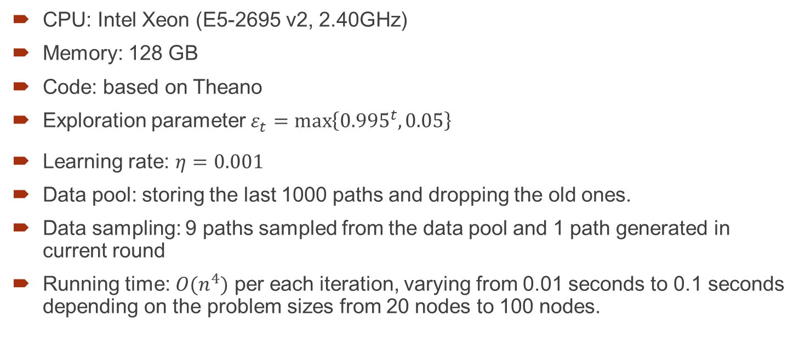
Backup Pages: More experimental Details
CPU: Intel Xeon (E5-2695 v2, 2.40GHz)
Memory: 128 GB
Code: based on Theano
Exploration parameter $ε_{t}=\max_{}\left\{{0.995}^{t}, 0.05\right\}$
Learning rate: $η=0.001$
Data pool: storing the last 1000 paths and dropping the old ones.
Data sampling: 9 paths sampled from the data pool and 1 path generated in current round
Running time: $O(n^{4})$ per each iteration, varying from 0.01 seconds to 0.1 seconds depending on the problem sizes from 20 nodes to 100 nodes.

Slide 16
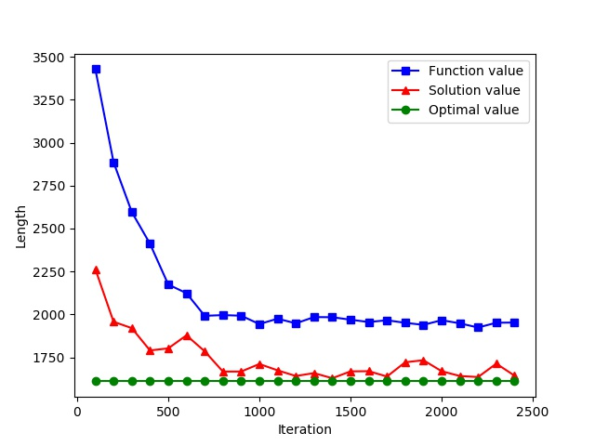
Backup Page: Convergence
Illustration of convergence of case Bayg29. It shows that our approach can reach a nearly optimal solution with about 500 iterations.

Slide 17
Backup Page: Different from DRL
Our work is partially inspired by the DRL and the ideas are similar;
Difference between MDP and combinatorial optimization:
MDP is non-deterministic vs. CO is usually deterministic;
One state can only jump to another single state with one simulation step vs. one step may go to multiple sub-states in CO.
Difference in training objective.

Slide 18
Backup Page: Drawback of Our Method
Our method do not generalize to unseen cases;
It still take considerable time to solve much larger problem instance, say, those with more than 1000 nodes.

Slide 19
More Experimental Details

Slide 20
Compare with DRL

Slide 21
Following are backup pages

Slide 22







The Main Process
Start
$$c_{1}=1$$
$$P_{i}=\left[n\right]\backslash \{c_{1},…,c_{i−1}\}$$
$$Pr=1−ε$$
$$Pr=ε$$
$$c_{i}=\underset{c∉\{c_{1},…,c_{i−1}\}}{argmin}{\{d\left(c_{i−1},c\right)+f(P_{i},c;θ_{t})\}}$$
$c_{i}∈P_{i}$ randomly
computing $W$ and put $(P_{i},c_{i},W)$ into the data pool
Weighted sampling from the data pool and update the parameter $θ_{t}→θ_{t+1}$ with mini-batch gradient descent
Construct the final solution based on the last model $θ_{T}$

Slide 23
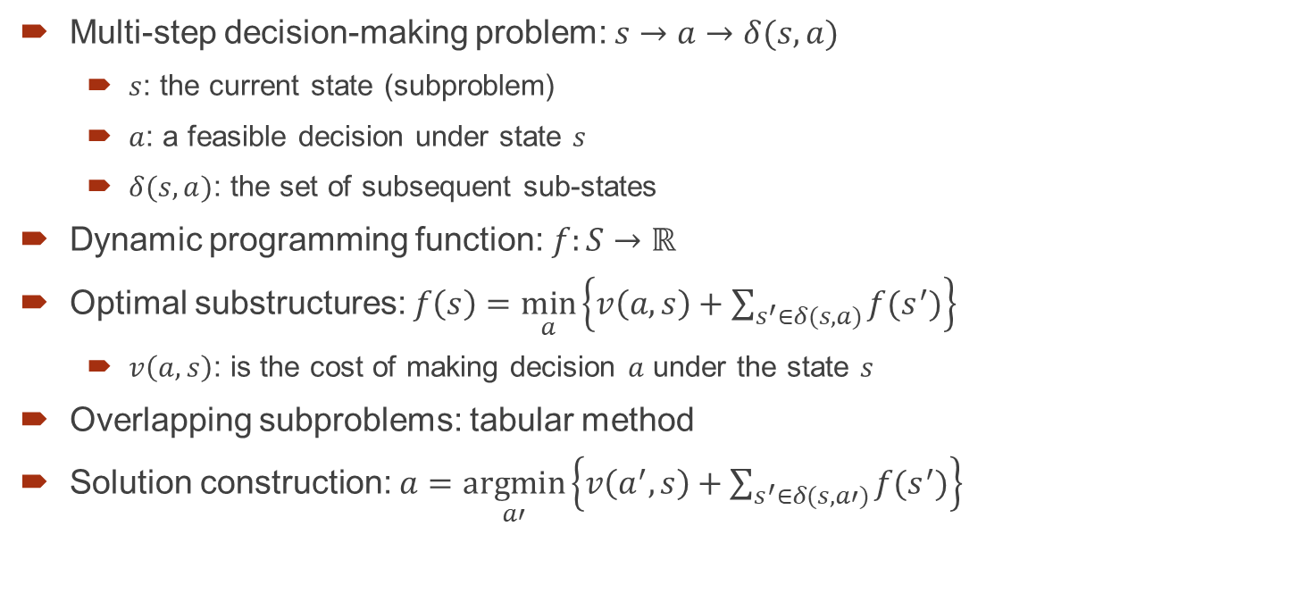
Revisiting Dynamic Programming
Multi-step decision-making problem: $s→a→δ(s, a)$
$s$: the current state (subproblem)
$a$: a feasible decision under state $s$
$δ(s, a)$: the set of subsequent sub-states
Dynamic programming function: $f:S→ℝ$
Optimal substructures: $f\left(s\right)=\min_{a}\left\{v\left(a,s\right)+\sum_{s^{′}∈δ(s, a)}{f(s^{′})}\right\}$
$v\left(a,s\right)$: is the cost of making decision $a$ under the state $s$
Overlapping subproblems: tabular method
Solution construction: $a=\underset{a′}{argmin}\left\{v\left(a^{′},s\right)+\sum_{s^{′}∈δ(s, a′)}{f(s^{′})}\right\}$
Notes:
Let’s briefly revisit this powerful method in this page. If a problem can be seem as a multi-step decision making problem and it has some specific properties. It may be solved with DP. One of the required property is the optimal substructures property. That is, the optimal solution to a problem can be constructed by the optimal solutions to its subproblems.

Slide 24





3
1
$$c_{2}$$
$$c_{3}$$
……
$$c_{n}$$
1
5
6
2
$$c$$
4
$$P$$

Slide 25
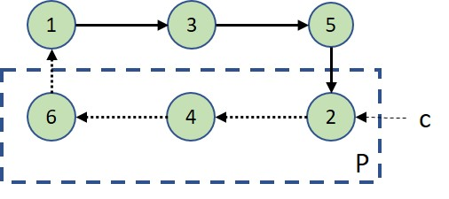
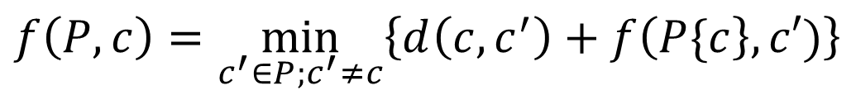



An Example of Combinatorial Explosion in DP
The minimal of visiting all vertices in $P$, starting from $c$ and returning to vertex 1
The cost of travelling from $c$ to $c′$ directly
$$f\left(P,c\right)=\min_{c^{′}∈P;c^{′}≠c}\left\{d\left(c,c^{′}\right)+f\left(P\{c\right\},c′)\right\}$$
$c∈P$: the starting vertex of the remining visit
$P∈\{1, …,n\}$: vertices to be visited
The DP function of the Held-Karp Algorithm for solving the Travelling Salesman Problem (TSP)
An illustration to the Held-Karp Algorithm, where $P=\{2,4,6\}$ and $c=2$
Notes:
这个图换成完全图

Slide 26

$$P$$

Slide 27
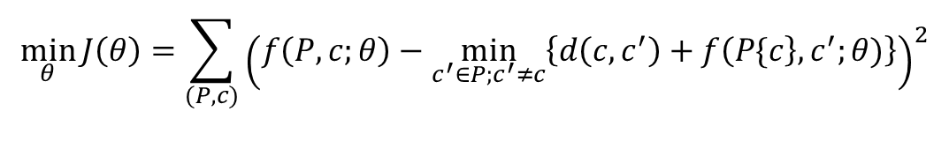
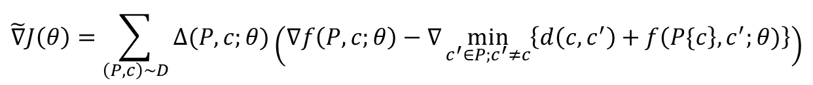
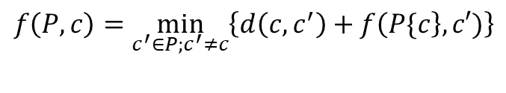
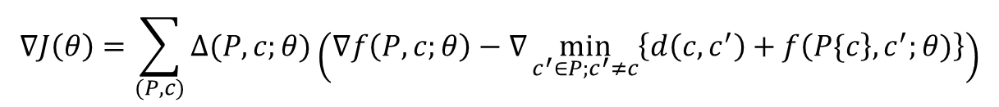

How to Train the Neural Network Efficiently?
DP equation
$$f\left(P,c\right)=\min_{c^{′}∈P;c^{′}≠c}\left\{d\left(c,c^{′}\right)+f\left(P\{c\right\},c′)\right\}$$
$$\min_{θ}{J\left(θ\right)=\sum_{(P,c)}{{\left(f\left(P,c;θ\right)−\min_{c^{′}∈P;c^{′}≠c}\left\{d\left(c,c^{′}\right)+f\left(P\{c\right\},c^{′};θ)\right\}\right)}^{2}}}$$
Training objective
Gradient descent
$$θ_{t+1}=θ_{t}−η_{t}∇J(θ_{t})$$
$$∇J\left(θ\right)=\sum_{(P,c)}{Δ(P,c;θ)\left(∇f\left(P,c;θ\right)−∇\min_{c^{′}∈P;c^{′}≠c}\left\{d\left(c,c^{′}\right)+f\left(P\{c\right\},c^{′};θ)\right\}\right)}$$
Gradient
$$\tilde{∇}J\left(θ\right)=\sum_{\left(P,c\right)∼D}{Δ(P,c;θ)\left(∇f\left(P,c;θ\right)−∇\min_{c^{′}∈P;c^{′}≠c}\left\{d\left(c,c^{′}\right)+f\left(P\{c\right\},c^{′};θ)\right\}\right)}$$
Mini-batch
The training objective is to make the neural network look like a DP function as much as possible.
Note: $Δ(P,c;θ)=2\left(f\left(P,c;θ\right)−\min_{c^{′}∈P;c^{′}≠c}\left\{d\left(c,c^{′}\right)+f\left(P\{c\right\},c^{′};θ)\right\}\right)$

Slide 28

The Tabular Method Takes Exponential Space and Time
1
2
……
$$n$$
00…0
00…1
……
11…1
The conventional tabular method costs exponential space and time. Specifically, it requires $O(2^{n}n)$ space to store the DP function and $O(2^{n}n^{2})$ time to fill the table.

