Slide 1

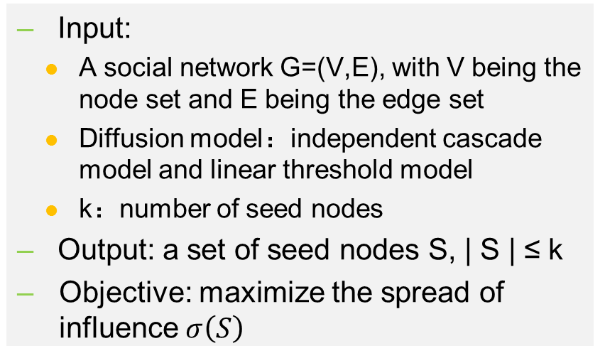
Influence maximization
Problem definition
Given a social network, influence maximization aims to find a size-fixed set of seed nodes, maximizing the spread of influence.
Input:
A social network G=(V,E), with V being the node set and E being the edge set
Diffusion model：independent cascade model and linear threshold model
k：number of seed nodes
Output: a set of seed nodes S, | S | ≤ k
Objective: maximize the spread of influence $σ\left(S\right)$
0.1
0.2
0.1
0.3
0.1
0.5
0.5
0.2
0.1
0.4
0.3
0.4
0.2
0.4
0.1
Spread of influence
Cheng et al., CIKM 2013

Slide 2
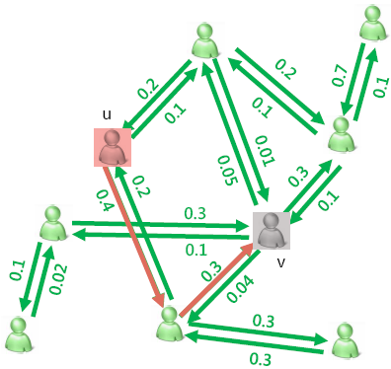

Influence maximization
Two key Problems:
How to determine the interpersonal influence, i.e., the propagation probability among nodes?
Sparsity problem
Over represented
How to design efficient and accurate algorithm for influence maximization?
NP-hard problem
Cheng et al., CIKM 2013

Slide 3
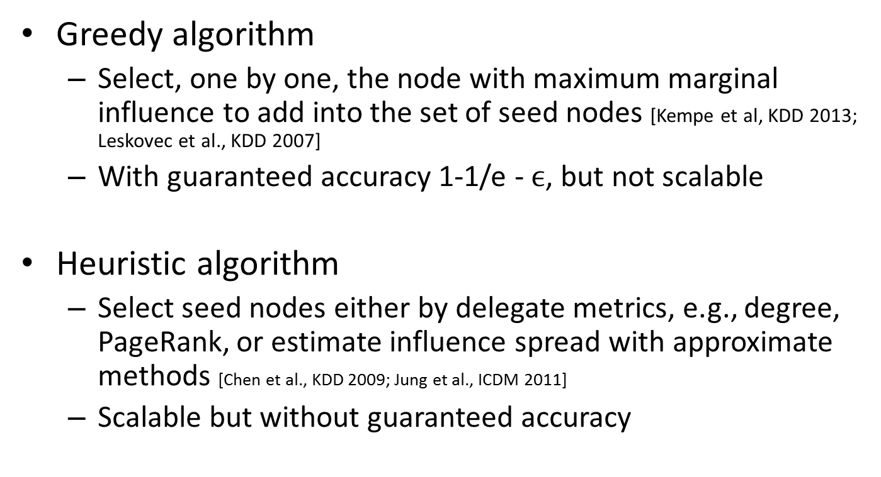
Influence maximization
Existing methods:
Greedy algorithm
Select, one by one, the node with maximum marginal influence to add into the set of seed nodes [Kempe et al, KDD 2013; Leskovec et al., KDD 2007]
With guaranteed accuracy 1-1/e - $ϵ$, but not scalable
Heuristic algorithm
Select seed nodes either by delegate metrics, e.g., degree, PageRank, or estimate influence spread with approximate methods [Chen et al., KDD 2009; Jung et al., ICDM 2011]
Scalable but without guaranteed accuracy
We lack an accurate and scalable algorithm to solve the problem of influence maximization.

Slide 4
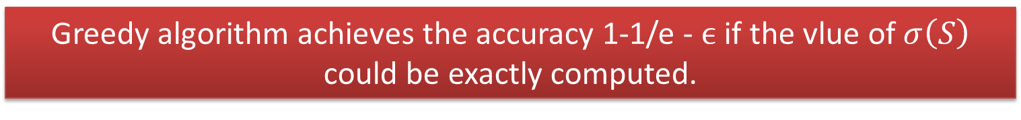



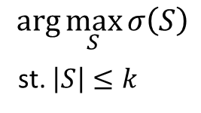
Influence maximization
Properties of IM
Influence maximization (IM)
Properties of $σ\left(S\right)$
Non-negative
Monotone
Submodular
$$arg\max_{S}{σ\left(S\right)}$$
st. $\left|S\right|≤k$
$$σ\left(S\right)≥0, for any S$$
$$σ\left(S\right)≤σ\left(T\right), if S⊆T$$
$$σ\left(S∪\{v\}\right)−σ\left(S\right)≥σ\left(T∪\left\{v\right\}\right)−σ\left(T\right), if S⊆T$$
Greedy algorithm achieves the accuracy 1-1/e - $ϵ$ if the vlue of $σ\left(S\right)$ could be exactly computed.

Slide 5
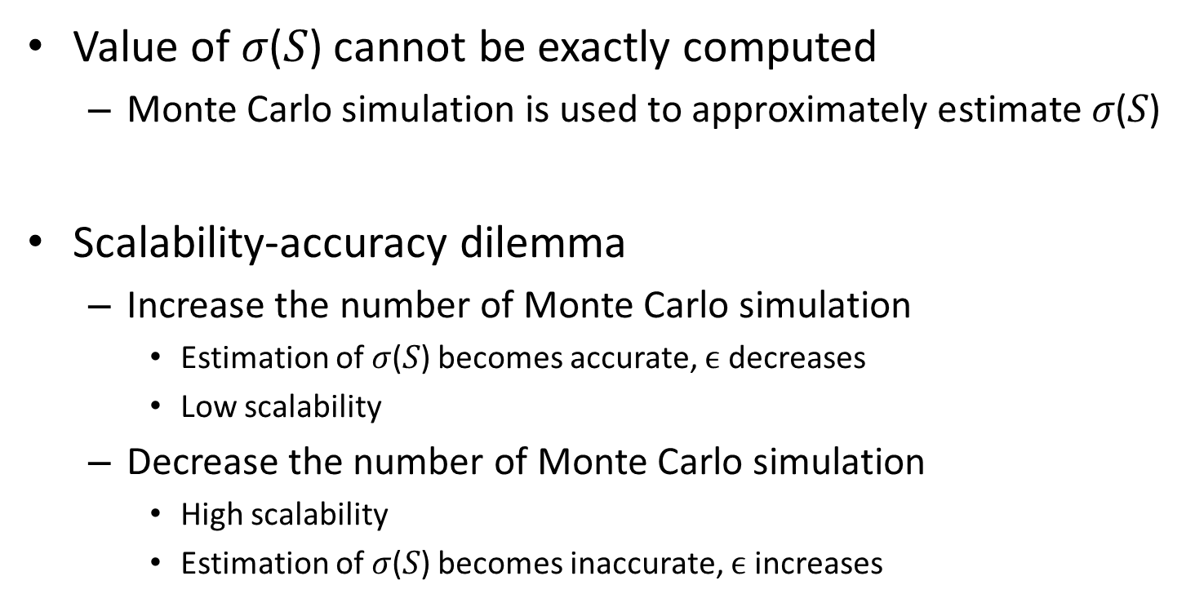
Influence maximization
Scalability-accuracy dilemma
Value of 𝜎(𝑆) cannot be exactly computed
Monte Carlo simulation is used to approximately estimate 𝜎(𝑆)
Scalability-accuracy dilemma
Increase the number of Monte Carlo simulation
Estimation of 𝜎(𝑆) becomes accurate, $ϵ$ decreases
Low scalability
Decrease the number of Monte Carlo simulation
High scalability
Estimation of 𝜎(𝑆) becomes inaccurate, $ϵ$ increases
Cheng et al., CIKM 2013

Slide 6
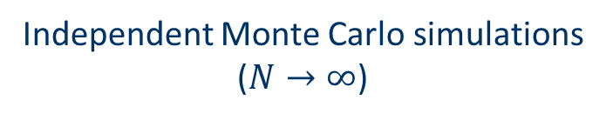
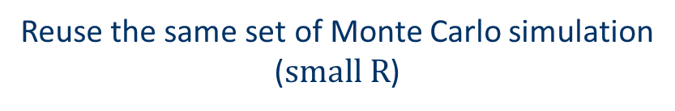
Influence maximization
Our solution: StaticGreedy
Idea: reuse the same set of Monte Caro simulation
1…N
1…N
1…R
1…R
…
vs.
…
vs.
…
…
𝜎(𝑆)
𝜎(T)
𝜎(𝑆)
𝜎(T)
Independent Monte Carlo simulations
($N→∞$)
Reuse the same set of Monte Carlo simulation
($small R$)
Monotonicity and submodularity are strictly satisfied. Scalability-accuracy dilemma is solved.

Slide 7
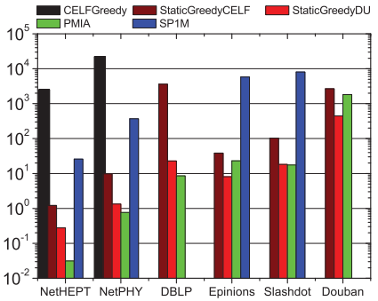
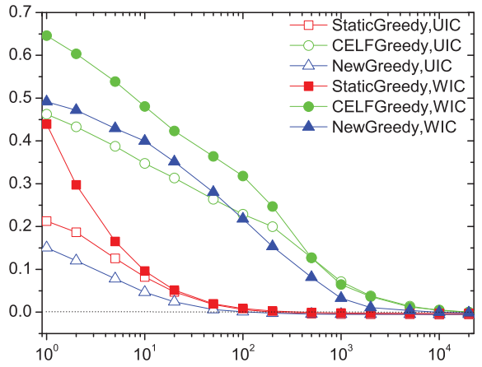


Influence maximization
StaticGreedy: Results
Number of Mone Carlo simulations decreases by 2-3 orders of magnitudes
Running time decreases by 3-4 orders of magnitudes
Our method
Running time
$$d_{R,k}$$
$$\log{R}$$
Datasets
Our method
Cheng et al., CIKM 2013

Slide 8
Influence maximization
IMRank: Idea
Can we further improve the greedy algorithm?
We find that greedy algorithm is indeed finding a self-consistent ranking.
Self-consistent ranking: nodes are ranked by their marginal spread of influence
s₁
M_{r}(s₁) = I(s₁)
s₂
M_{r} (s₂) = I({s₂ } | {s₁})
s₃
M_{r} (s₃) = I({s₃} | {s₁, s₂})
s₄
M_{r} (s₄) =I({s₄} | {s₁, s₂, s₃})
……
……
Self-consistent ranking r

Slide 9
Influence maximization
IMRank: Implementation
We propose to directly find self-consistent ranking from scratch, i.e., from any ranking of nodes by adjusting it into a self-consistent ranking
Initial Ranking
IMRank
Current ranking
1
2
Compute ranking-based
marginal influence
Rank-based marginal influence
Re-ranking by rank-based marginal influence
Self-consistent ranking
Cheng et al., CIKM 2013
Running time is further decreased by 1-2 orders of magnitudes.

Slide 10
Influence maximization
Summary
Previous research focuses on designing scalable and accurate algorithm for influence maximization
Limited by influence spread model
Limited by unknown interpersonal influence [Wang et al., AAAI 2015]
For further research on influence maximization
Fully data-driven
e.g., select seed nodes from historical cascades
Without requiring influence spread model
End-to-end without caring the spread path of influence

