Slide 1
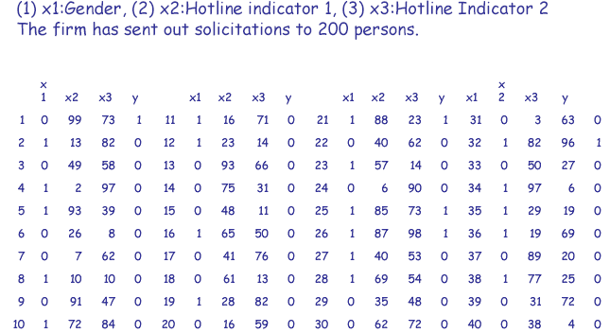
Measure responses of customers

Slide 2
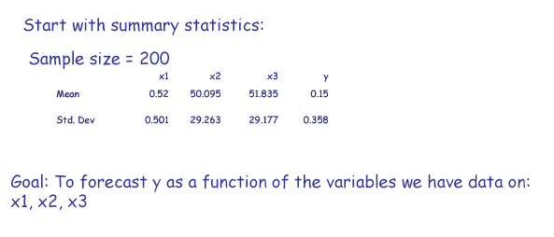
Characteristic

Slide 3
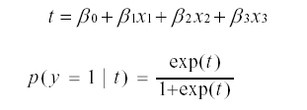
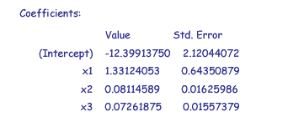
Logistic Regression
Logistic regression: y only takes value 0 and 1
Run logistic regression on the training data

Slide 4
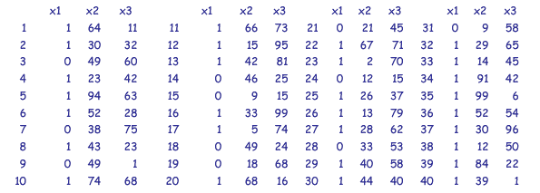
Prediction
Suppose the firm has 300 further addresses that you are considering for customer acquisition. Who should the firm contact?

Slide 5


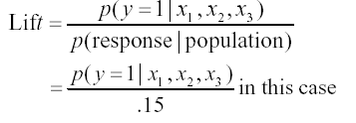
List Scoring
Compute the following for each person in the list
  The value of t
  Predicted response probability
  Predicted lift
  The firm ought to more interested in persons with the higher values of above measures

Slide 6
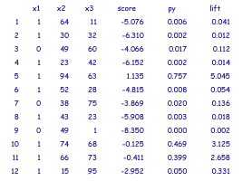
List Scoring
The three measures turn out to be the following:
Over all 300 persons, average “py” is 0.126, average “lift” is 0.8408

Slide 7
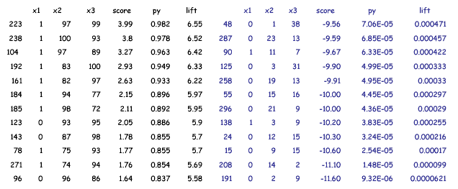
List Scoring
Sort the prospects in descending order

Slide 8
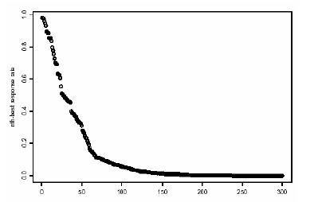
Curve for Marginal Response Rate vs Number of Solicitations Made
Consider n solicitations are made to the n “best” prospects. Plot each value of n against the n^{th} highest predicted response rate

Slide 9
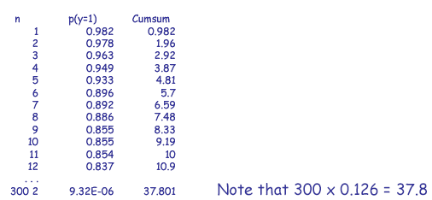
Curve for Number of Positive Responses vs Number of Solicitations Made
If n solicitations are made to the n “best” prospects, the expected number of positive responses (sales) is the cumulative sum of the n highest values of p(y=1)

Slide 10
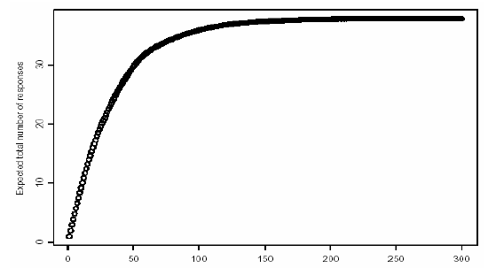
Curve for Number of Positive Responses vs
Number of Solicitations Made

Slide 11
Rollout run on best prospects
Whom should the rollout run be deployed on? How many in rollout?
  Limited supply rule: Suppose firm has only k items. Then firm should choose n such that the sum of n highest predicted response rate (cumsum()) is just under k.
  Example, for k=20, cumsum(25)=19.57 and cumsum(26)=20.07. Therefore, the firm should mail to the 25 highest prospects.

Slide 12
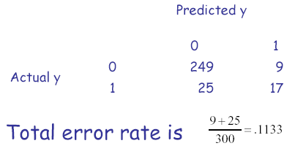
Model Assessment via Holdout Data
Assume that the firm had actual response data for the second list of 300 persons.
Examine the “confusion” matrix, which is the cross-tab of predicted response against actual response.
Note: Predicted response is 0 if response rate is less than 0.5 and 1 otherwise

Slide 13
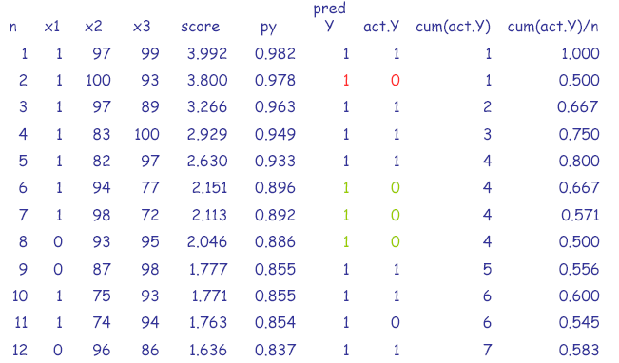
Holdout Data Analysis

Slide 14
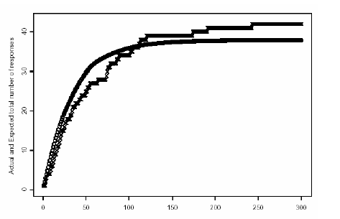
Holdout Data Analysis

Slide 15
Example
Marketing Problem: catalog company wants to acquire new customers
Method: use a rented list, e.g., from another catalog company
Predict: will a customer on this list respond if we send an offer?
One approach
– Perform a test mailing on the list
– Build data-mining model linking response to other information in the database
– Apply model to entire database

Slide 16

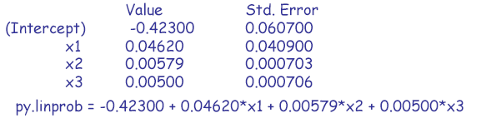
Linear Regression Model
Linear regression model:

Slide 17
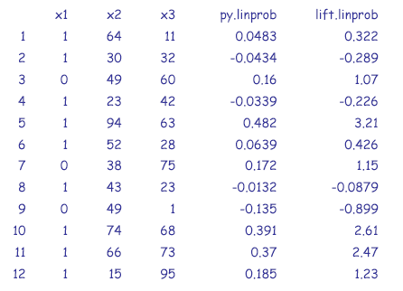
List Scoring with the Linear Regression
Model

Slide 18
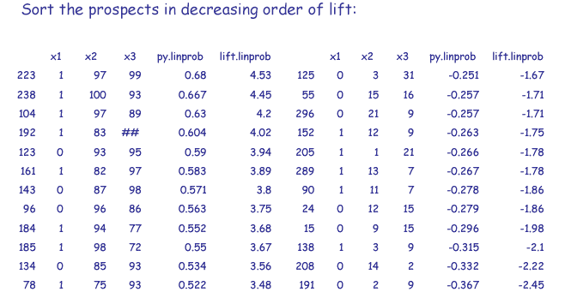
List Scoring with the Linear Regression
Model

Slide 19
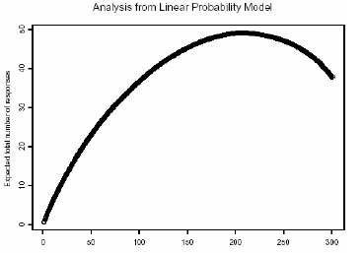
Curve for Marginal Response Rate vs Number of Solicitations Made
Consider n solicitations are made to the n “best” prospects. Plot each value of n against the n^{th} highest predicted response rate

