Slide 1
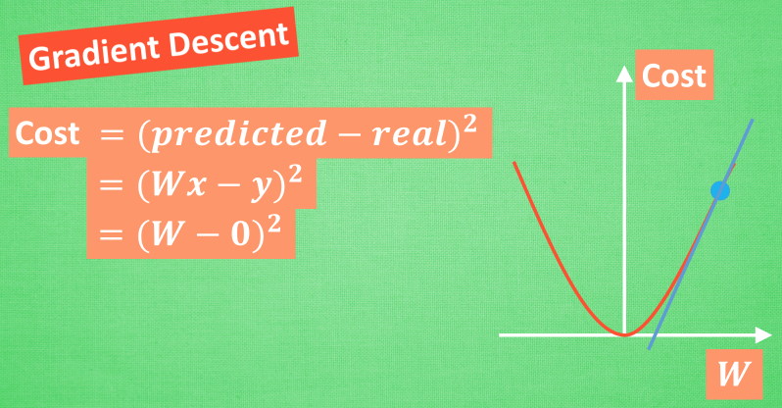
Cost >= 0, how to move W?

Slide 2
Cost >= 0, how to move W?
Cost誤差最小的時候正是這條cost曲線最低的地方,不過在藍點的W卻不知道這件事情,他目前所知道的就是梯度線為自己在這個位置指出的一個下降方向,我們就要朝著這個藍色梯度的方向下降一點點.
再做一條切線,發現還能下降,那就朝著梯度的方向繼續下降,這時,再展示出現在的梯度,因為梯度線已經躺平了,我們已經指不出哪邊是下降的方向了,所以這時就找到了W參數的最理想值.簡而言之,就是找到梯度線躺平的點.可是神經網路的梯度下降可沒這麼簡單.

Slide 3
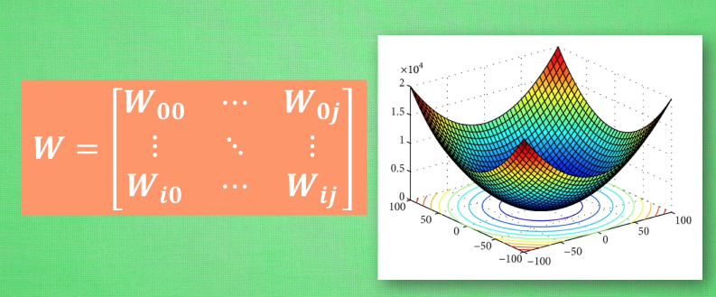
Cost >= 0, how to move W?

Slide 4
Cost >= 0, how to move W?
神經網路中的W可不止一個,如果只有一個W,我們就能畫出之前那樣的誤差曲線,如果有兩個W也簡單,我們可以用一個3D圖來展示,可是超過3個W,我們可就沒辦法很好的視覺化出來啦.這可不是最要命的.在通常的神經網路中,誤差曲線可沒這麼優雅.

Slide 5
Gradient Descent
Theory

Slide 6


Question
When solving:
Each time we update the parameters, we obtain $θ$ that makes $L\left(θ\right)$ smaller.
$$θ^{∗}=arg\min_{θ}{L\left(θ\right)}$$
by gradient descent
$$L\left(θ^{0}\right)>L\left(θ^{1}\right)>L\left(θ^{2}\right)>…$$
Is this statement correct?
Notes:
Demo minecraft

Slide 7
Warning of Math

Slide 8
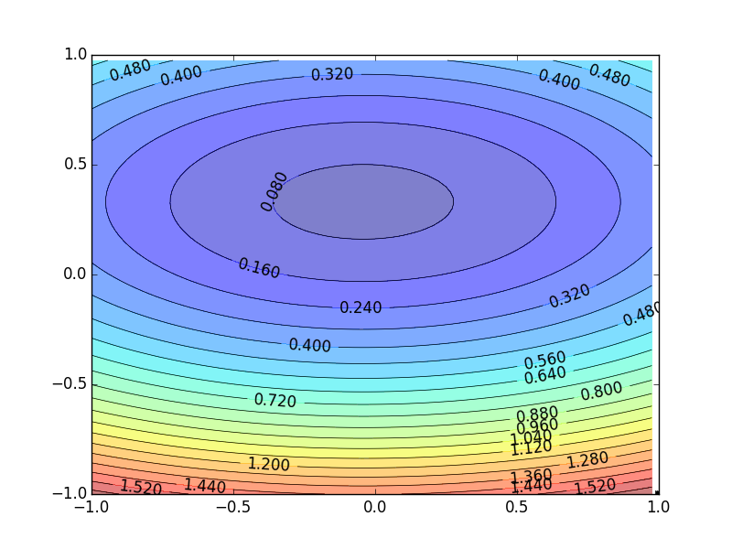
Formal Derivation
Suppose that θ has two variables {θ₁, θ₂}
L(θ)
Given a point, we can easily find the point with the smallest value nearby.
How?
Notes:
You cannot know C(θ) outside the red circle!

Slide 9
Taylor Series
Taylor series: Let h(x) be any function infinitely differentiable around x = x₀.
When x is close to x₀

Slide 10
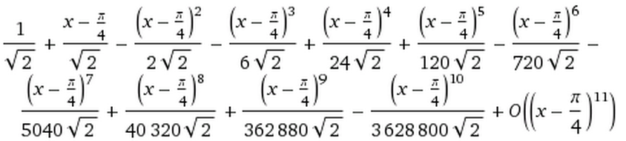
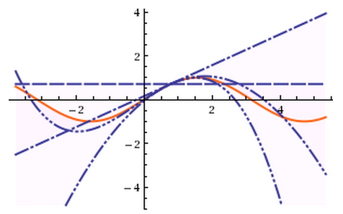
E.g. Taylor series for h(x)=sin(x) around x₀=π/4
sin(x)=
……
The approximation is good around π/4.

Slide 11
Multivariable Taylor Series
+ something related to (x-x₀)² and (y-y₀)² + ……
When x and y is close to x₀ and y₀

Slide 12
Back to Formal Derivation
Based on Taylor Series:
If the red circle is small enough, in the red circle
L(θ)

Slide 13
Back to Formal Derivation
Based on Taylor Series:
constant
If the red circle is small enough, in the red circle
Find θ₁ and θ₂ in the red circle minimizing L(θ)
L(θ)
Simple, right?
d

Slide 14
Gradient descent – two variables
Red Circle:
(If the radius is small)
Cost function is positive, it implies s is positive. We need find a negative value from the last two terms to reduce cost function value.
Find θ₁ and θ₂ in the red circle minimizing L(θ)
To minimize L(θ)
Notes:
Eta
Cost function is positive, it implies s is positive. We need find a negative value from the last two terms to reduce cost function value.

Slide 15
Back to Formal Derivation
Based on Taylor Series:
constant
If the red circle is small enough, in the red circle
Find $θ_{1}$ and $θ_{2}$ yielding the smallest value of $L\left(θ\right)$ in the circle
This is gradient descent.
Not satisfied if the red circle (learning rate) is not small enough
You can consider the second order term, e.g. Newton’s method.
Notes:
Simple, right?

Slide 16
End of Warning

Slide 17
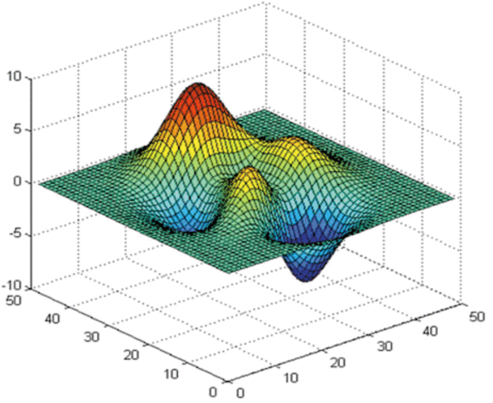






More Limitation of Gradient Descent
Loss
Very slow at the plateau
$$L$$
Stuck at saddle point
$$w_{1}$$
$$w_{2}$$
Stuck at local minima
$$∂L∕∂w$$
$$≈0$$
$$∂L∕∂w$$
$$=0$$
$$∂L∕∂w$$
$$=0$$
The value of the parameter w
Notes:
Demo: Why all the problmes/

